Slide 1
Sarcasm Target Identification
CS-529 : Topics & tools in social media data mining
Team Name : Data Transformers
Bhaskar Sharma – 204101018
Kunal Wanikar - 204101070
Kaushal Dewangan - 204101071
Harshwardhan Dubey - 204101026

Slide 2
Introduction
All the major functionality of the program are implemented into a one file (sarcasm.py).
Some of the important concepts which we have implemented are - Encoder ,Decoder etc.
We have taken book snippet as input and generating the sarcastic target.

Slide 3
Overview

Slide 4
Basic Building Blocks-
Input
Preparing &Training Data
Encoding
Decoding
Evaluate

Slide 5
Preparing & Training Data

Slide 6
Preparing & Training Data -
Read text file and split into lines, split lines into pairs.
Normalize text, filter by length and content.
Make word lists from sentences in pairs.
To train we run the input sentence through the encoder, and keep track of every output and the latest hidden state. Then the decoder is given the <SOS> token as its first input, and the last hidden state of the encoder as its first hidden state.

Slide 7
Encoder

Slide 8
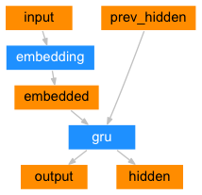
Encoder
For every input word the encoder outputs a vector and a hidden state, and uses the hidden state for the next input word.

Slide 9
Decoder

Slide 10
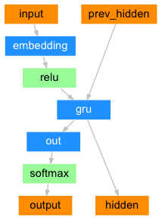
Decoder
The decoder is another RNN that takes the encoder output vector(s) and outputs a target words.

Slide 11
Attention Model

Slide 12
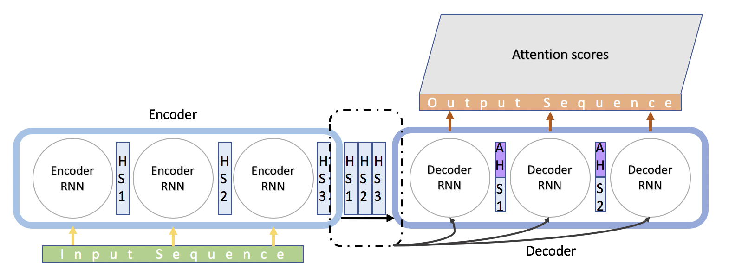
Attention
Attention allows the decoder network to “focus” on a different part of the encoder’s outputs for every step of the decoder’s own outputs.

Slide 13
Evaluation

Slide 14
Evaluate output
Evaluation is mostly the same as training, but there are no targets so we simply feed the decoder’s predictions back to itself for each step.

Slide 15
Improvement

Slide 16
Improvement
We have used attention model to improve the accuracy of our model.
Before implementing attention, it was able to detect 239 out of 999 sentences and now it is able to detect 574 sentences correctly.

Slide 17
Thank You

