Slide 1

Project Title: Credit Risk Prediction for Indian FinTech Lending Apps
PROJECT REVIEW -1
Using Data Mining to build accurate, explainable, and practical risk scoring for
India's digital lending ecosystem
NAME: KUNAL KUMAR DAPPU
ROLL NO: 2320030167

Slide 2
Introduction & Motivation
Instant Decisions
Thin-File Users
Approve/reject, set limits, and price loans in seconds — traditional underwriting can't keep up
Millions of Indians are new-to-credit, lacking bureau history that conventional models depend on
Compounding Risk
The Need
Digital lenders face default risk, fraud, and rapidly shifting borrower behavior simultaneously
A scoring system that is accurate, explainable, and deployment-ready for real FinTech stacks

Slide 3
Problem Statement
Model Inputs
Model Output
Applicant demographics and loan details
Limited or no bureau credit signals
Device and KYC flags (optional)
Probability of Default (PD)
Good–Bad classification
Risk band: Low / Medium / High
Prediction Horizon
Real-World Use Cases
DPD30+ within 90 days — a standard short-term delinquency window aligned with NBFC reporting norms
NBFCs and digital-first lenders
BNPL and Buy-Now-Pay-Later platforms
Salary advance and embedded finance apps
Partner bank co-lending programs

Slide 4
Project Objectives
1
2
Baseline Model
Advanced Model
Build a Logistic Regression scorecard using WOE/IV encoding as a transparent, auditable benchmark
Train XGBoost / LightGBM to capture non-linear feature interactions and outperform the baseline on PR-AUC
3
4
Robust Engineering
Explainability
Address class imbalance and eliminate data leakage through time-based train/test splits
Deliver per-user SHAP reason codes and global feature importance for compliance and trust

Slide 5

Literature Landscape
Traditional Scoring
ML-Based Scoring
Scorecards and Logistic Regression with WOE/IV remain industry standards for regulatory interpretability
Random Forest, XGBoost, and LightGBM consistently outperform on tabular credit datasets
Thin-File Solutions
Explainability & Monitoring
Alternative data (behavioral, device, psychometric) bridges the gap for new-to-credit borrowers
SHAP/LIME for decisions; concept drift tracking essential in rapidly evolving lending markets

Slide 6
RESEARCH GAP & NOVELTY
Where Existing Approaches Fall Short
Accuracy Is Not Enough
Leakage & Temporal Integrity
Standard accuracy is misleading on imbalanced default datasets. This project focuses on PR-AUC, Recall, and KS statistic — metrics that reflect real lending economics
Most academic benchmarks use random splits. Production models require time-based splits to reflect genuine out-of-time performance
Business-Aware Thresholding
Explainable Decisions
Optimal cut-off selection must balance default capture rate against rejection volume — a tradeoff rarely addressed in published work
Regulators and borrowers need clear reason codes. SHAP-driven explanations make model outputs actionable and compliant with RBI digital lending guidelines

Slide 7
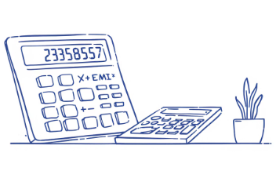

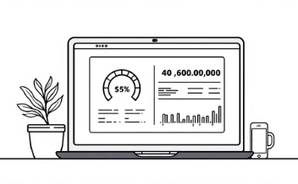
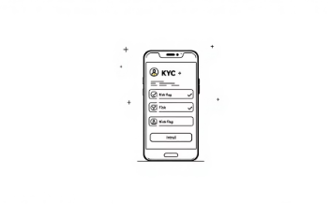
Data & Feature Groups
Affordability
Stability
Credit Behavior
Digital Risk Flags
Monthly income vs. loan amount
EMI-to-income ratio
Loan purpose category
Job tenure and employer type
Residential stability
Age band
Score band (if available)
Active loan count
Past delinquency signals
New device indicator
KYC mismatch signals
Only ethical, permitted signals used

Slide 8
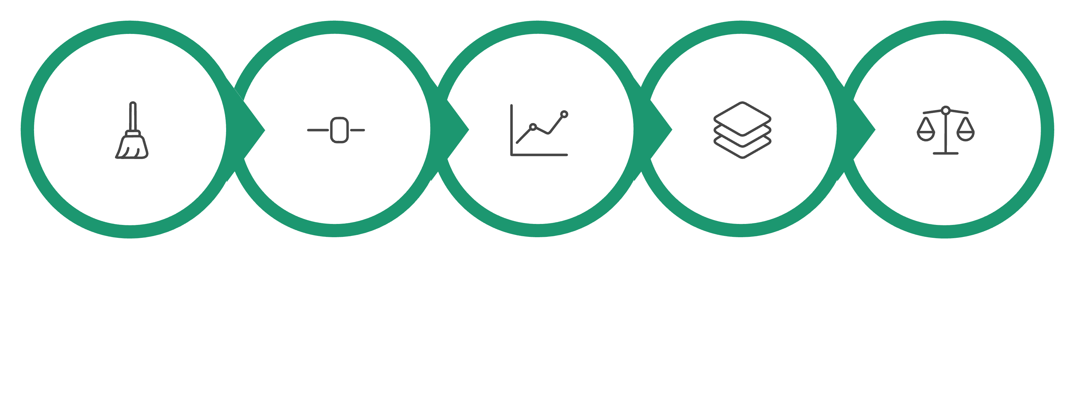





Proposed Methodology Pipeline
Data Cleaning
Baseline Model
Advanced Models
Imbalance Handling
Feature Eng.
The pipeline mirrors production underwriting: a clean, auditable sequence from raw data to explainable credit decisions — with no shortcuts that would compromise model integrity.

Slide 9
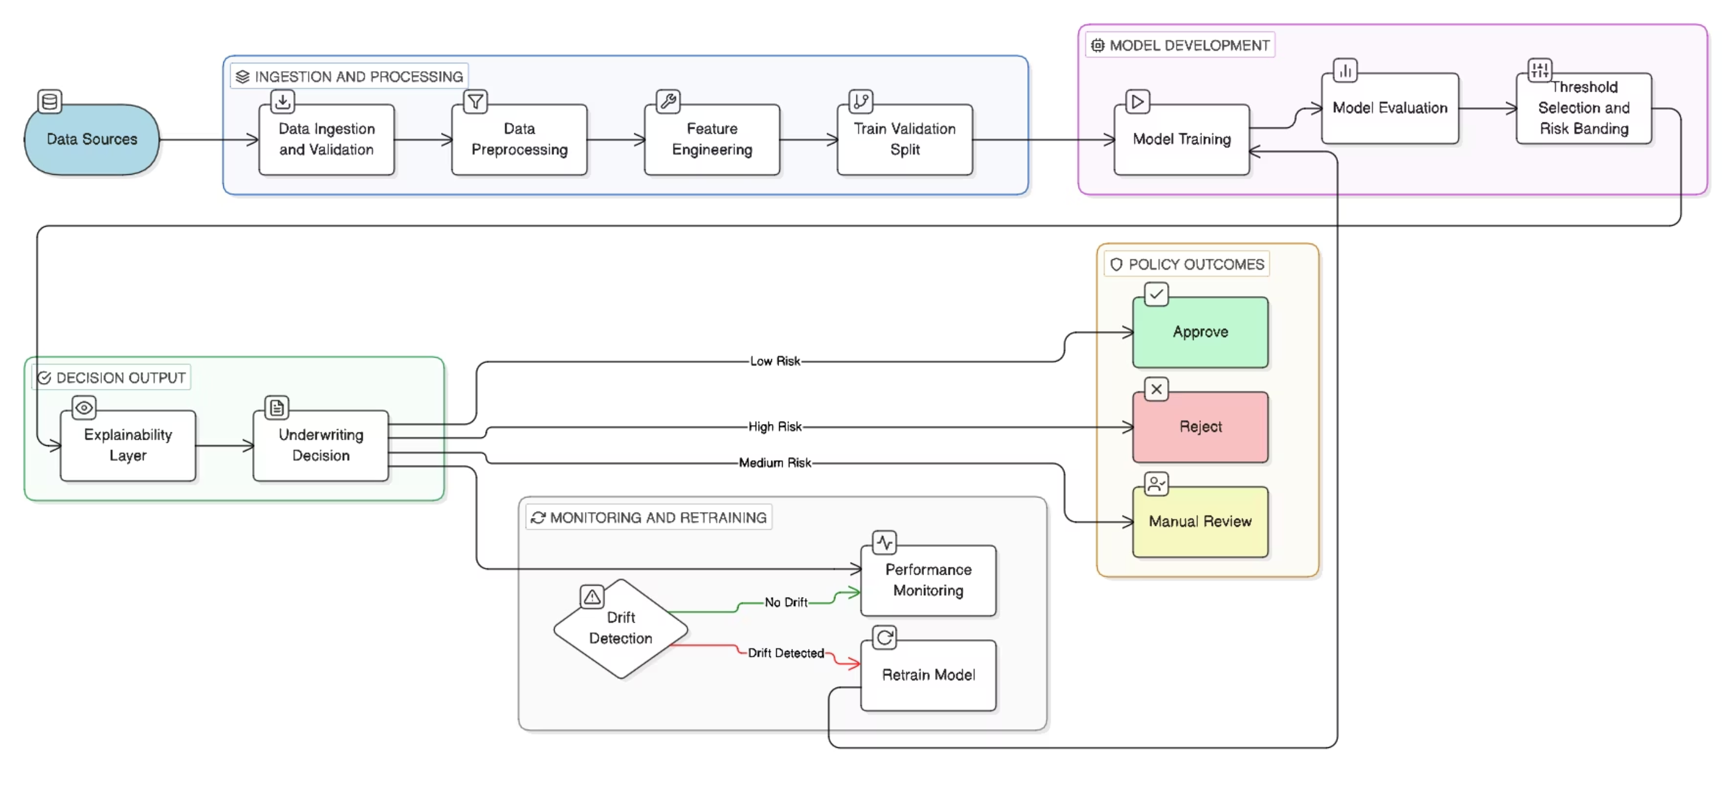
System Architecture & Workflow
The diagram shows the complete end-to-end system flow including data sources, model development, decision outputs (Approve/Reject/Manual Review), and monitoring loops.

Slide 10
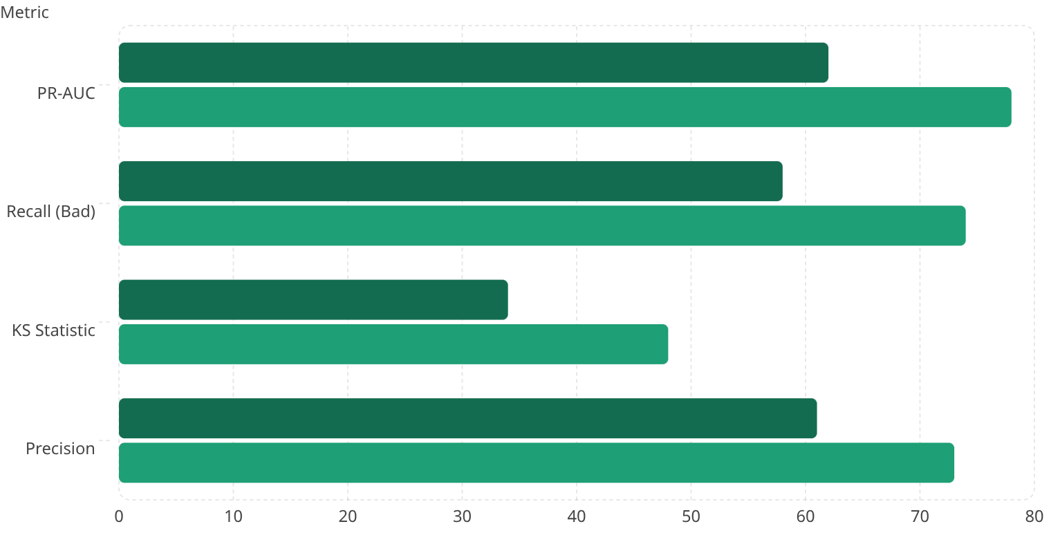

Evaluation Plan
Logistic Regression
XGBoost / LightGBM
Why These Metrics?
PR-AUC — Best measure for imbalanced default datasets
Recall — Captures true default cases; minimizes missed bad loans
KS Statistic — Industry standard for credit scorecard separation
Threshold tuning — Balances loss minimization vs. rejection rate
Expected loss concept: PD × LGD × EAD ties model output to portfolio economics

Slide 11

Expected Results & Deliverables
Expected Results
Deliverables
PD/risk score + risk bands (Low/Med/High)
Better PR-AUC than baseline
Top drivers (e.g., EMI/income, stability, delinquency signals)
SHAP-based "Top 5 reasons" for decision
Clean dataset + data dictionary
Model + evaluation report
Explainability report
PPT + final documentation

Slide 12
Real-World Example: UPI-First FinTech Lending Scenario
1
2
3
Use Case:
Sample Applicant Input:
Model Output:
Instant loan / BNPL approval for a user on a FinTech app (NBFC partner)
Age: 26, City tier: 2, Employment: Salaried
Monthly income: ₹32,000, Existing EMI: ₹6,500
Requested loan: ₹18,000 for 3 months
Account age: 8 months, Bureau history: thin-file
UPI behavior (summary features): high P2P volume, many new payees recently
Predicted PD = 0.23 → Medium Risk
Decision: Approve with lower limit + higher rate / or Manual Review
4
5
Top Reasons (SHAP / Reason Codes):
Action Taken:
Reduce limit to ₹10,000
Add step-up verification (KYC/device check)
Set tighter repayment reminders / autopay suggestion
High EMI-to-income ratio
Multiple new beneficiaries in last 7 days
Short credit history / thin-file
Recent increase in transaction velocity

Slide 13
THANK YOU

