Slide 1

Real-Time Payments Ops Monitoring on Microsoft Azure
Harness the power of Microsoft Azure to gain unparalleled insights and control
over your payment ecosystem.
PROJECT REVIEW - 1
TEAM – 12
KUNAL KUMAR DAPPU – 2320030167
SASIDHAR . G – 2320030275
VAISHNAVI. A – 2320030450

Slide 2
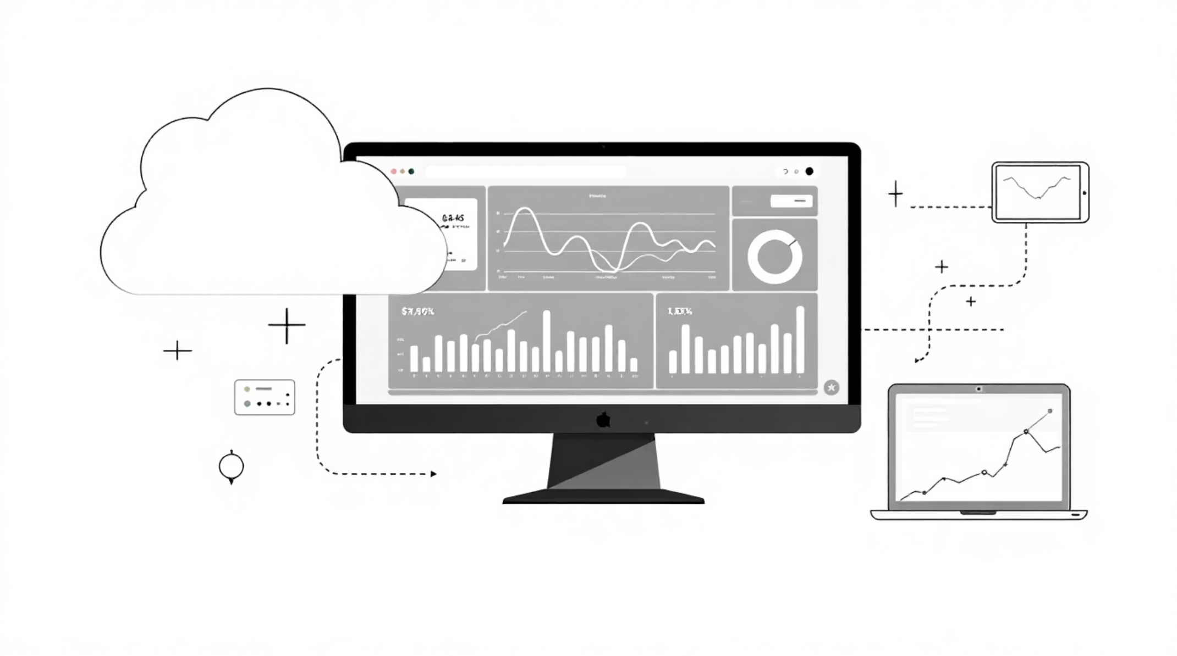
Driving Real-Time Payment Oversight
We developed a cloud-native observability and operations monitoring platform for UPI-like digital payment transactions on Microsoft Azure. This system actively ingests real-time transaction events, calculates critical operational KPIs, detects incidents through intelligent, rule-based alerting, and delivers actionable insights via dynamic Power BI dashboards.
Monitor Real-Time KPIs
Automate Incident Detection
Store Historical Data
Track success rates, transactions per second (TPS), and latency percentiles.
Identify anomalies promptly with rule-based alerting mechanisms.
Preserve raw events and aggregates for in-depth business intelligence.

Slide 3
Unlocking Peak Performance: The UPI Operations Challenge
As UPI handles billions of transactions annually, operations teams critically need real-time visibility, rapid incident detection, and swift blast-radius isolation to maintain demanding reliability Service Level Objectives (SLOs).
What is each bank's/PSP's current transaction success rate?
Are we seeing a failure spike in a specific region?
Is p95/p99 latency meeting our SLOs?
Which failure reasons dominate: timeout, bank down, or validation?

Slide 4

Project Scope: Goals & Exclusions
In Scope
Out of Scope
Ingest real-time transaction event streams.
Calculate windowed KPIs (1-min / 5-min aggregations).
Store raw events for replay/auditing and aggregate data for Business Intelligence.
Develop an operational dashboard with drill-down views.
Implement alerting and incident detection using configurable thresholds.
Illustrate Service Level Indicators (SLI), Service Level Objectives (SLO), availability, and latency percentile concepts.
Avoid direct integration with NPCI or Bank networks.
Exclude production-grade PCI-DSS security/compliance (provide best-practice notes only).
Omit advanced ML-based anomaly detection (consider as an optional extension).
This platform directly addresses real-world payments operations challenges, including managing peak-hour loads, handling PSP degradation, mitigating timeout spikes, and continuously monitoring Service Level Objectives (SLOs) for availability.

Slide 5
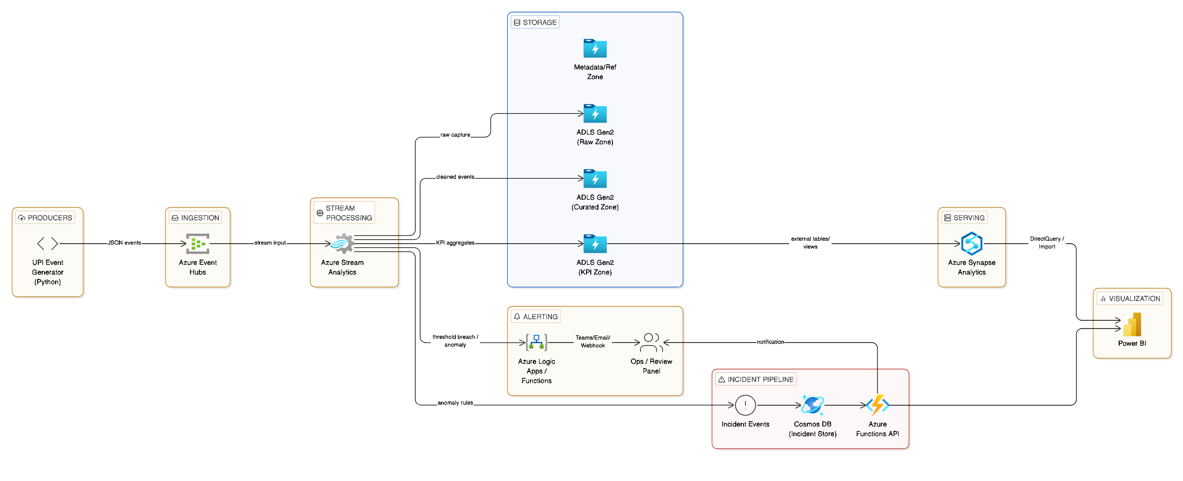
Accelerating Insights: Our Real-time Data Architecture
Each architectural layer scales independently. Event Hubs serves as the high-throughput entry point, while Stream Analytics delivers sub-minute KPI computation. ADLS Gen2 and Synapse provide durable, queryable storage for both real-time and historical workloads.

Slide 6
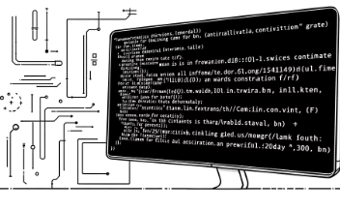
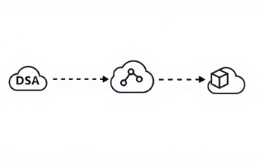
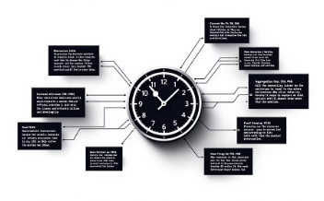
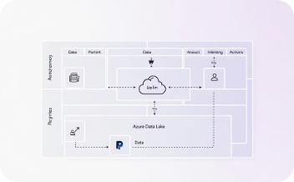
Core Platform Components
Generate Realistic Traffic Scenarios
Ingest High-Volume Streaming Data
Compute Real-time Performance Metrics
Enable Scalable Data Storage & Analysis
The Transaction Producer simulates real-world UPI traffic, including peak surges (8–10 PM), bank outages, latency degradation, and regional disruptions, creating a robust testing environment.
Azure Event Hubs serves as a high-throughput ingestion layer, supporting consumer groups and replay via retention, capable of scaling to millions of events per second.
Stream Analytics rapidly computes tumbling window KPIs (1-min, 5-min), grouping metrics by bank, PSP, channel, region, and specific failure reasons for immediate insights.
ADLS Gen2 ensures immutable raw event storage, partitioned by date and hour. Synapse Serverless SQL then exposes these views for Power BI dashboards and ad-hoc investigation queries.

Slide 7
Define Transaction Events and Track Key Performance
Transaction Event Schema (JSON)
Key Performance Indicator (KPI) Aggregation
Field
Description
1
txn_id
Unique transaction identifier
Overall Minute KPIs
event_time
ISO timestamp of the event
Captures transaction count, success rate, average latency, and approximate P95/P99 latency per minute window.
payer_bank / payee_bank
Identifiers for participating banks
psp
Payment Service Provider (e.g., PhonePe, GPay, Paytm, BankApp)
2
status
Transaction outcome (SUCCESS, FAIL, PENDING)
Bank/PSP Specific KPIs
failure_reason
Specific reason for failure (e.g., timeout, bank_unavailable, invalid_vpa, limit_exceeded)
Provides metrics per bank and PSP: success rate, total failure count, timeout failure count, and average latency.
latency_ms
End-to-end transaction processing time in milliseconds
3
region
Geographic region (optional; state or city)
Failure Reason Breakdown
Details failure reasons, including individual failure counts and their percentage share of total failures per minute.

Slide 8

Achieving Reliability: SLI/SLO Framework & Automated Incident Detection
Our Reliability Framework: Defining SLIs and SLOs
Automated Incident Detection: Our Rule-Based Triggers
Availability
Latency
Detect Overall Success Drop
Maintain a Success Rate of ≥ 97% over any rolling 5-minute period.
Achieve p95 latency ≤ 800 ms; monitor p99 to proactively identify SLO breaches.
If the 5-minute success rate falls below 97%, flag an incident candidate for review.
Identify Bank-Specific Outage
When a bank's 5-minute success rate drops below 90% (with sufficient transaction volume), trigger a bank-specific incident.
Throughput
Monitor Transactions Per Second (TPS) for peak load detection and effective capacity planning.
Pinpoint Latency Spikes
A 5-minute p95 latency exceeding 800 ms triggers a performance incident (SEV2).
Monitor for Timeout Surges
If timeout failures constitute over 40% of all failures in a 5-minute window, investigate potential network or connectivity issues.

Slide 9



Power BI Ops Control Tower
Monitor Live Operational Performance
Track critical key performance indicators (TPM, success rate, p95/p99 latency) with dynamic trend lines. Quickly identify top failing banks and core failure reasons over the last two hours.
Pinpoint Bank and PSP Performance Issues
Utilize flexible slicers to filter data by bank, PSP, channel, and region. Examine 1-minute success rate trends, analyze failure breakdowns by reason, and visualize performance using hour-vs-success-rate heatmaps.
Track and Manage Incident Timelines
View a detailed incident list table including start time, type, severity, and top contributor. Overlay incident windows on live KPI trends to understand impact and response times.

Slide 10
Accelerating Impact: Key Takeaways & Action Plan
1
Maximize Cloud-Native Scalability
Action Plan: Immediate Steps
Fully managed Azure services deliver elastic scaling, effortlessly handling UPI-level transaction volumes and eliminating infrastructure overhead.
01
Deploy Synthetic Producers
2
Configure peak-hour and bank-outage simulation scenarios.
Gain Real-time Operational Insight
Real-time KPIs, rule-based incident detection, and Power BI drill-downs empower teams to detect and isolate failures within minutes.
02
Validate Stream Analytics Jobs
Verify 1-minute and 5-minute windowed KPI outputs against expected values.
3
Design for Future Extensibility
The architecture supports optional ML anomaly detection, production-grade security hardening, and direct integration with NPCI/bank networks, facilitating future growth.
03
Connect Power BI to Synapse
Publish Ops Overview and Incident Timeline pages for stakeholder review.
04
Tune Alert Thresholds
Calibrate incident rules based on baseline traffic patterns from simulation results.

