Slide 1
Financial Agent
Angela Kunanbaeva

Slide 2
Problem statement
solution
Financial analysts spend hours manually reviewing quarterly reports, annual filings, and financial statements to extract key metrics and insights. This is time-consuming, error-prone, and doesn't scale
An AI agent that can analyze financial documents, extract data from charts and tables, compute metrics, and answer questions with full source attribution.

Slide 3
PROBLEM
Manual process
Financial analysts spend hours manually reviewing quarterly reports, annual filings, and financial statements to extract key metrics and insights
Errors
Time-consuming, error-prone, and doesn't scale.
costs
Time-consuming and loss of productivity results in thousands of dollars

Slide 4
SOLUTION
TECHNOLOGY
COST SAVINGS
An AI agent that can analyze financial documents, extract data from charts and tables, compute metrics, and answer questions with full source attribution.
Reduction in time to find relevant information and insights
TARGET USERS
EASY TO USE
Financial analysts
Investment researchers
CFO offices
Compliance teams
Simple design that gives customers the targeted information they need

Slide 5
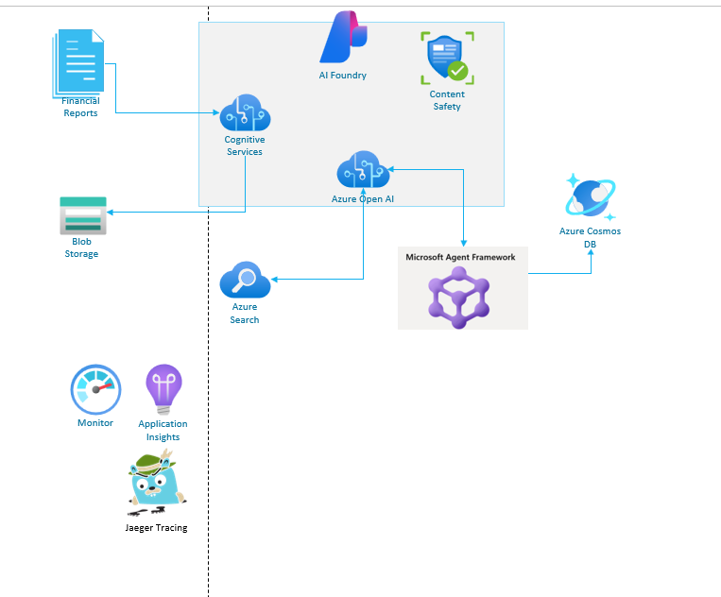
architecture

Slide 6
PRODUCT BENEFITS
Hybrid retrieval = keyword + semantic, fused for better relevance (RRF)
Structure-aware ingestion: chunks align to sections / headers / tables (better for financial docs)
Full attribution by design: every answer returns document + page + section sources
Multi-modal analysis: handles text + tables + chart images in one workflow
Purpose-built financial tools: deterministic financial calculators, not generic chat tools

Slide 7
KEY design CONSIDERATIONS
Azure AI Search vs. Local Vector Store
Hybrid Search Built-in: Combines keyword (BM25) + semantic vectors in single query
Production-Ready: Handles millions of documents with automatic scaling
Reciprocal Rank Fusion (RRF): Native result merging for hybrid search
No Infrastructure Management: Fully managed service
Security Features: Built-in authentication, encryption, compliance
Trade-off:
  Cost: ~$75-300/month vs free local vector stores
  Cloud Dependency: Requires Azure connectivity
Worth it because: Financial data needs production-grade reliability, security, and hybrid search quality

Slide 8
KEY CONSIDERATIONS
Document Processing vs. Content Understanding API
Control Over Chunking: Structure-aware chunking preserves tables, sections, financial data
Cost Efficiency: One-time processing vs per-call API costs
Metadata Extraction: Custom logic to extract document type, fiscal period, company info
Flexibility: Can add specialized parsers for 10-K forms, earnings reports
When Content Understanding API Makes Sense:
  Complex layouts with tables/forms
  Multi-language documents
  Quick prototyping without custom code
Reasoning
  Financial reports have predictable structure
  Custom chunking gives better retrieval results for financial queries
  One-time indexing cost vs ongoing API costs at scale

Slide 9
KEY CONSIDERATIONS
Calculator Tool vs. Code Interpreter
Deterministic Results: Financial calculations need exact precision
No Code Injection Risk: Fixed formulas, no arbitrary code execution
10 Pre-built Metrics: Profit margin, ROE, ROA, current ratio, debt-to-equity, etc.
Explainability: Shows exact formula used for each calculation
Reliable: Always produces same output for same inputs
When Code Interpreter is Better:
  Data Visualization: Creating charts, graphs, trend analysis (CODE INTERPRETER EXCELS HERE)
  Custom Analysis, Statistical Analysis, Data Manipulation
Reasoning:
  Financial metrics = Calculator Tool (speed, safety, reliability)
  Visualization needs = Could add Code Interpreter as optional tool
  Best of both: Hybrid approach using both tools based on query type

Slide 10
PRELIMINARY EVALUATIONS
✅ 100% Success Rate — 10/10 questions answered
✅ 72% Average Quality Score
✅ 90% Citation Rate — 9/10 responses included sources
✅ 1.0/1.0 Citation Quality — perfect source attribution
✅ 1.0/1.0 Response Completeness
✅ 87% Factual Retrieval Performance

Slide 11
DEMO

