Slide 1
Neuroadaptive modelling for generating images matching perceptual categories
Published: 07 September 2020
Nature scientific reports
Presenter：王昱力

Slide 2
Background Introduction
BCI
Enable active communication and execution of a pre-defined commends, but not able to infer more complex intentions based on brain signals.
Notes:
Brain–computer interfaces enable active communication and execution of a pre-defined set of commands, such as typing a letter or moving a cursor. However, they have not been able to infer more complex intentions or adapt more complex output based on brain signals. So, researcher present neuroadaptive generative modelling, which uses a participant’s brain signals as feedback to adapt a boundless generative model and generate new information matching the participant’s intentions.

Slide 3
Dataset
30 Participants
Model : Generative Adversarial Network (GAN)
Dataset : 30000 1024x1024 images(celebrity face)
G : Z → X, where z ∈ Z is a 512-dimensional latent vector and x ∈ X is a 1,024 × 1,024 image.

Slide 4
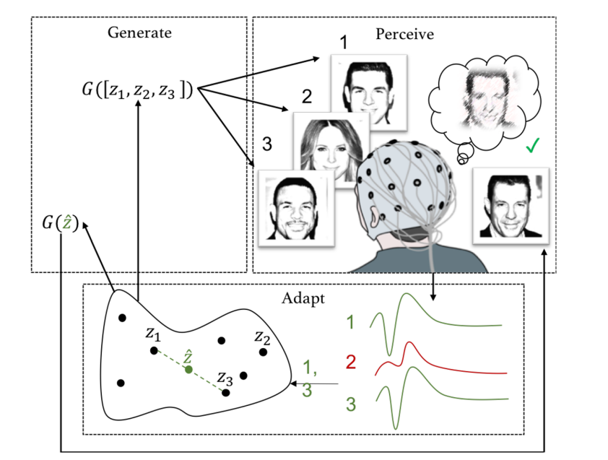
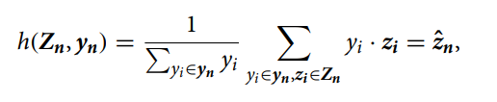
Method
Modelling:
Generate: A latent model G : Z → X, which provides a mapping from a latent space Z to an image space X
Perceive: A participant who views images Xn while their brain signals Sn are measured.
Adapt: A brain signal classifier f : S → Y, where Y is the predicted relevance of the stimulus; and an intention model updating function h : Z, Y → Z mapping the predictions made by the classifier to the latent space Z.

Slide 5
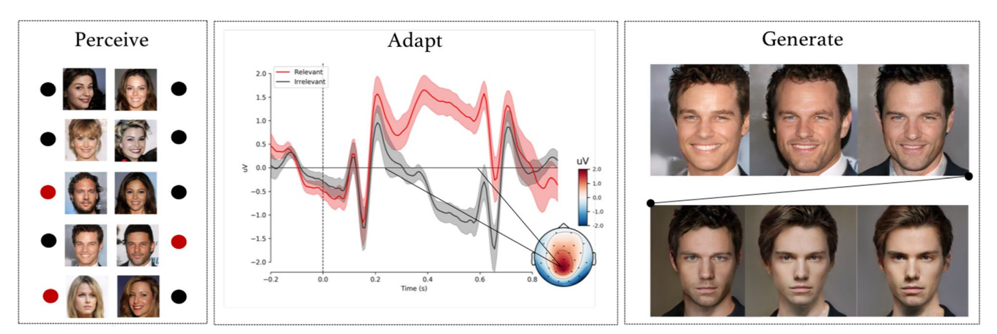
Result
The result shows that it correspond with the literature on the P300 with regards to latency, topography, and task-dependence. Researcher identified the grand average effect with the P300.

