Slide 1

Flight Delay Prediction System
Using Weather Conditions, Airport Data, and Flight Schedules
FINAL YEAR ENGINEERING PROJECT

Slide 2

The Cost of Flight Delays
Financial Loss
Operational Chaos
Airlines lose $28B annually globally due to delays — including fuel waste, crew overtime, and compensation payouts.
Cascading disruptions ripple through schedules, gate assignments, and ground operations, straining airport resources.
Passenger Impact
Over 20% of commercial flights experience delays, causing missed connections, lost productivity, and diminished trust.

Slide 3
Existing System Limitations
How It Works Today
Critical Gaps
Manual analysis of historical flight records
Static rule-based thresholds for delay classification
Siloed data across airlines, airports, and weather services
Reactive decision-making after disruptions occur
Low prediction accuracy — unable to model complex, multi-variable interactions
No real-time weather or runway traffic integration
Cannot estimate delay duration, only binary delayed/on-time status
Lack of actionable, role-specific insights for stakeholders

Slide 4

Project Objectives & Scope
1
2
Predict Delay Likelihood
Estimate Delay Duration
ML models classify flights as on-time or delayed with high confidence using multi-source data.
Regression models forecast expected delay minutes, enabling proactive resource planning.
3
4
Centralized Data Platform
Actionable Dashboards
Secure, scalable ingestion of weather, airport operations, schedules, and historical records.
Role-based visualizations for airlines, airports, agencies, and passengers.

Slide 5
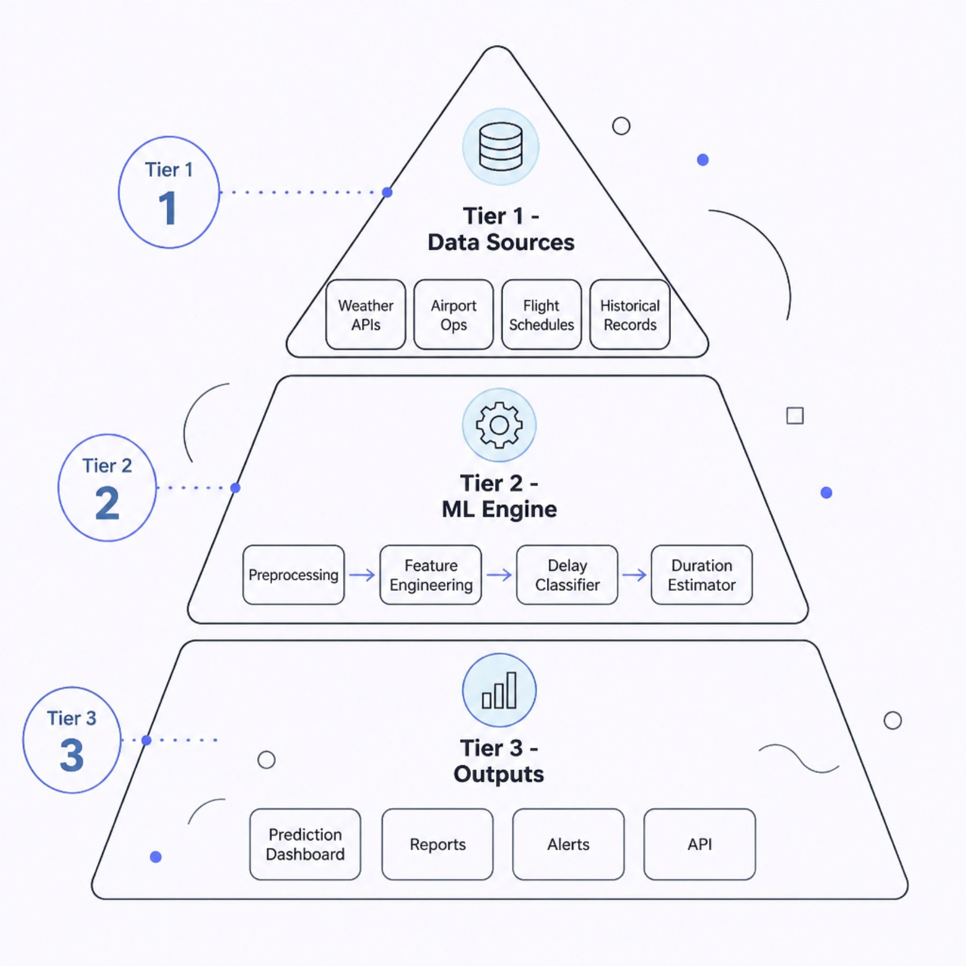
System Architecture
The system follows a three-tier architecture — data ingestion, ML processing, and presentation — enabling real-time predictions at scale.
Data Layer: APIs, databases, and streaming pipelines
Processing Layer: Feature engineering, model training, and inference
Presentation Layer: Dashboards, reports, and alert APIs

Slide 6

Overall System Workflow
Data Collection
Preprocessing
ML Prediction
Dashboard & Alerts
The pipeline processes data in near real-time, generating updated predictions as new weather and operational data becomes available — enabling proactive rather than reactive decisions.

Slide 7





Core Modules & Data Integration
Weather Data Integration
Live feeds from NOAA and METAR APIs — wind, visibility, precipitation, and temperature.
Airport Operations
Runway availability, ground traffic, gate occupancy, and historical throughput metrics.
Flight Data Management
Airline schedules, aircraft type, route history, and carrier performance data.
ML Prediction Engine
Random Forest, XGBoost, and LSTM models for classification and duration regression.

Slide 8
ML Pipeline & Prediction Dashboard
Prediction Workflow
Dashboard Capabilities
01
Real-time delay probability scores per flight
Estimated delay duration with confidence intervals
Weather impact heatmaps and trend charts
Role-based views: airline ops, airport managers, passengers
Automated PDF and CSV report generation
Raw Data Ingestion
Weather, schedules, airport ops
02
Feature Engineering
Encoding, scaling, temporal features
03
Model Inference
Delay probability + duration output
04
Insight Delivery
Dashboard, alerts, reports

Slide 9

Technology Stack & Security
Technology Stack
Security & Privacy
RBAC: Role-based access control for all user types
Encryption: TLS in transit, AES-256 at rest
Compliance: GDPR and aviation data regulations
Audit Logs: Full traceability of data access and predictions
Backend
Frontend
Python, Flask/FastAPI, Scikit-learn, XGBoost, TensorFlow
React.js, D3.js, Plotly, Chart.js
Data
Cloud
Agile methodology with CI/CD pipelines ensures iterative delivery and rapid model retraining.
PostgreSQL, Redis, Apache Kafka
AWS/GCP, Docker, Kubernetes

Slide 10


Outcomes, Benefits & Future Vision
Expected Outcomes
Real-World Applications
Higher prediction accuracy, reduced operational costs, and improved on-time performance for airlines and airports.
Deployable by airlines, airport authorities, travel agencies, and regulatory bodies for proactive aviation management.
Future Enhancements
Real-time satellite weather integration, deep learning models, and predictive maintenance correlation for next-gen accuracy.
This system transforms aviation from reactive to proactive, data-driven operations — reducing delays, costs, and passenger inconvenience at scale.

