Slide 1
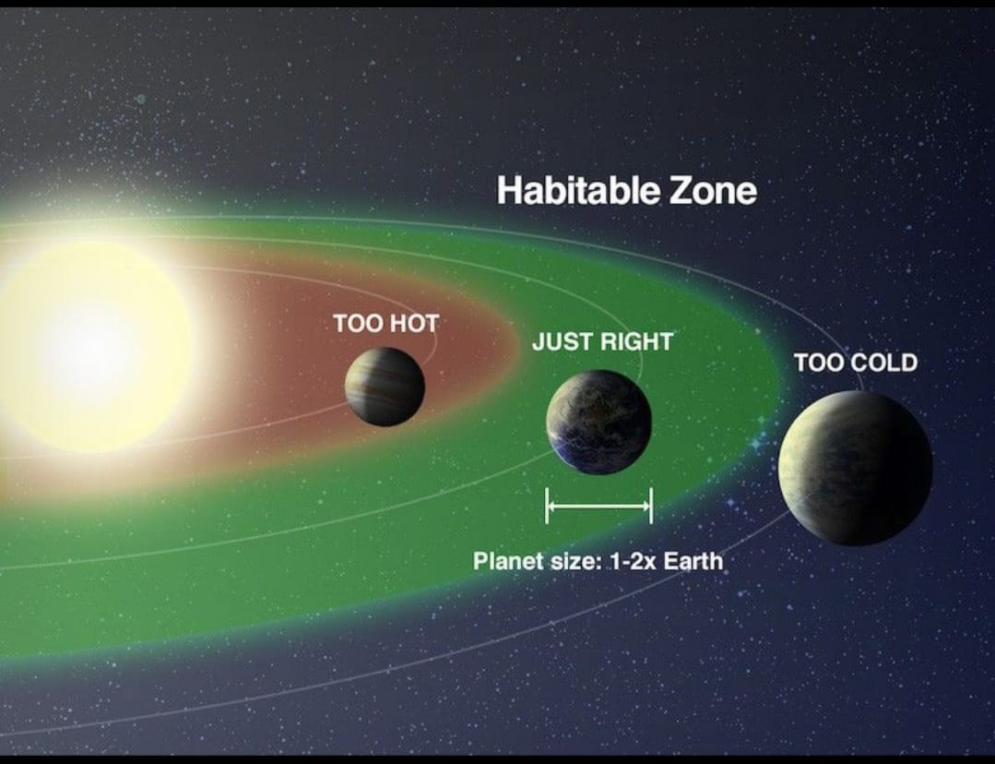
Predicting the Habitability of Exoplanets
Using Machine Learning
Internship Project Presentation

Slide 2
Problem Statement
Thousands of exoplanets are discovered, but identifying habitable ones is complex.
Manual analysis is time-consuming and error-prone.
We need an automated, data-driven habitability prediction system.

Slide 3
Project Objectives
Predict habitability score of exoplanets using ML
Rank top 10 most habitable exoplanets
Provide interactive dashboard & CSV upload
Enable Excel & PDF report export

Slide 4
Technologies Used
Python, Flask (Backend)
HTML, CSS, JavaScript (Frontend)
Machine Learning (XGBoost / Regression)
SQLite Database
Plotly for Visualizations
Render Cloud for Deployment

Slide 5
Dataset & Features
NASA Exoplanet Dataset
Planet Radius (pl_rade)
Planet Mass (pl_bmasse)
Equilibrium Temperature (pl_eqt)
Orbital Period (pl_orbper)
Star Temperature (st_teff)
Star Radius (st_rad)

Slide 6
System Architecture
User interacts with Web UI
Flask backend receives input
ML model predicts habitability score
Results stored & visualized
Dashboard shows charts and rankings

Slide 7
Key Features
Manual habitability prediction
CSV upload & automatic top-10 ranking
Feature importance visualization
Habitability score distribution
Star-planet correlation plots

Slide 8
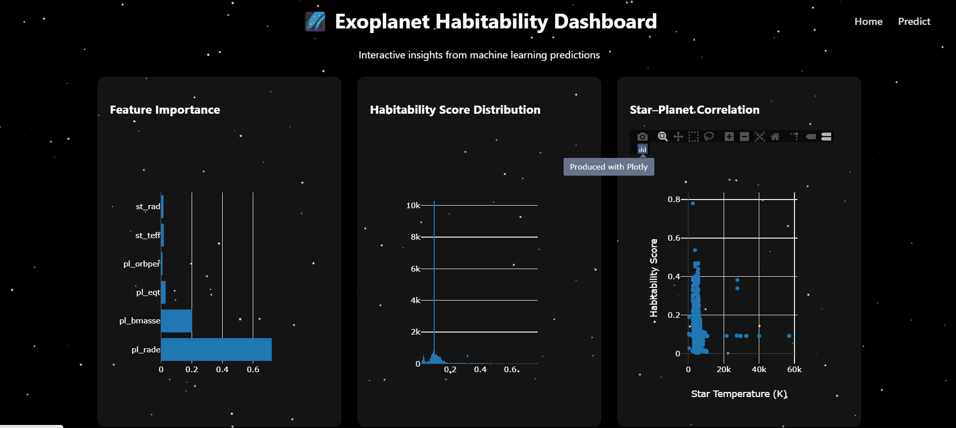
Dashboard Overview
Interactive charts using Plotly
Top 10 ranked planets table
CSV-based ranking display
Excel & PDF export options

Slide 9
Deployment
GitHub for version control
Render cloud platform
Gunicorn production server
Render url:-https://predicting-the-habitability-of-loit.onrender.com
Drive link:-https://drive.google.com/file/d/1w57gY_ZXp1BQGlhOKjgIg5TUDjwelxEq/view?t=7

Slide 10
Results
Accurate habitability predictions
Automated ranking of planets
User-friendly web interface
Fast and scalable deployment

Slide 11
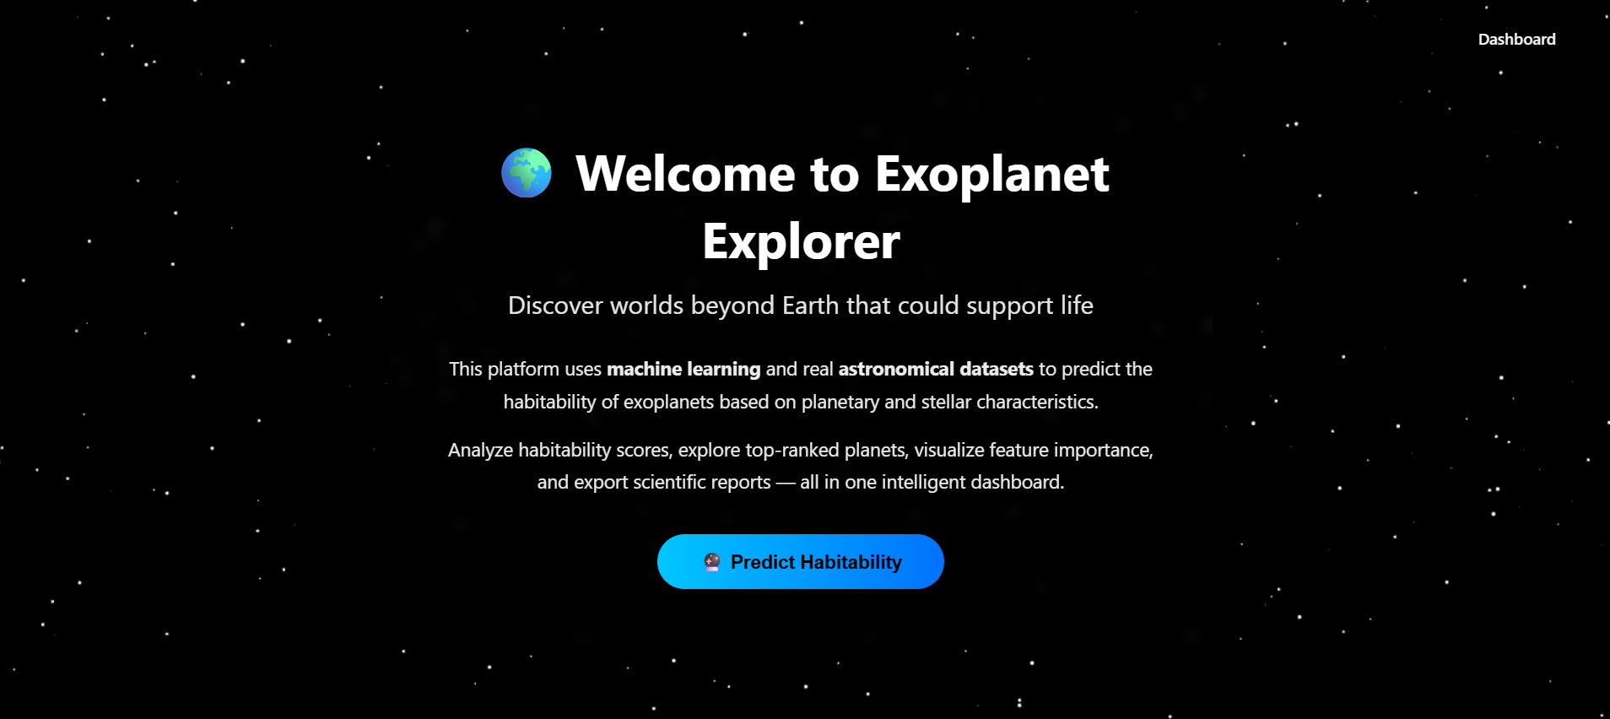
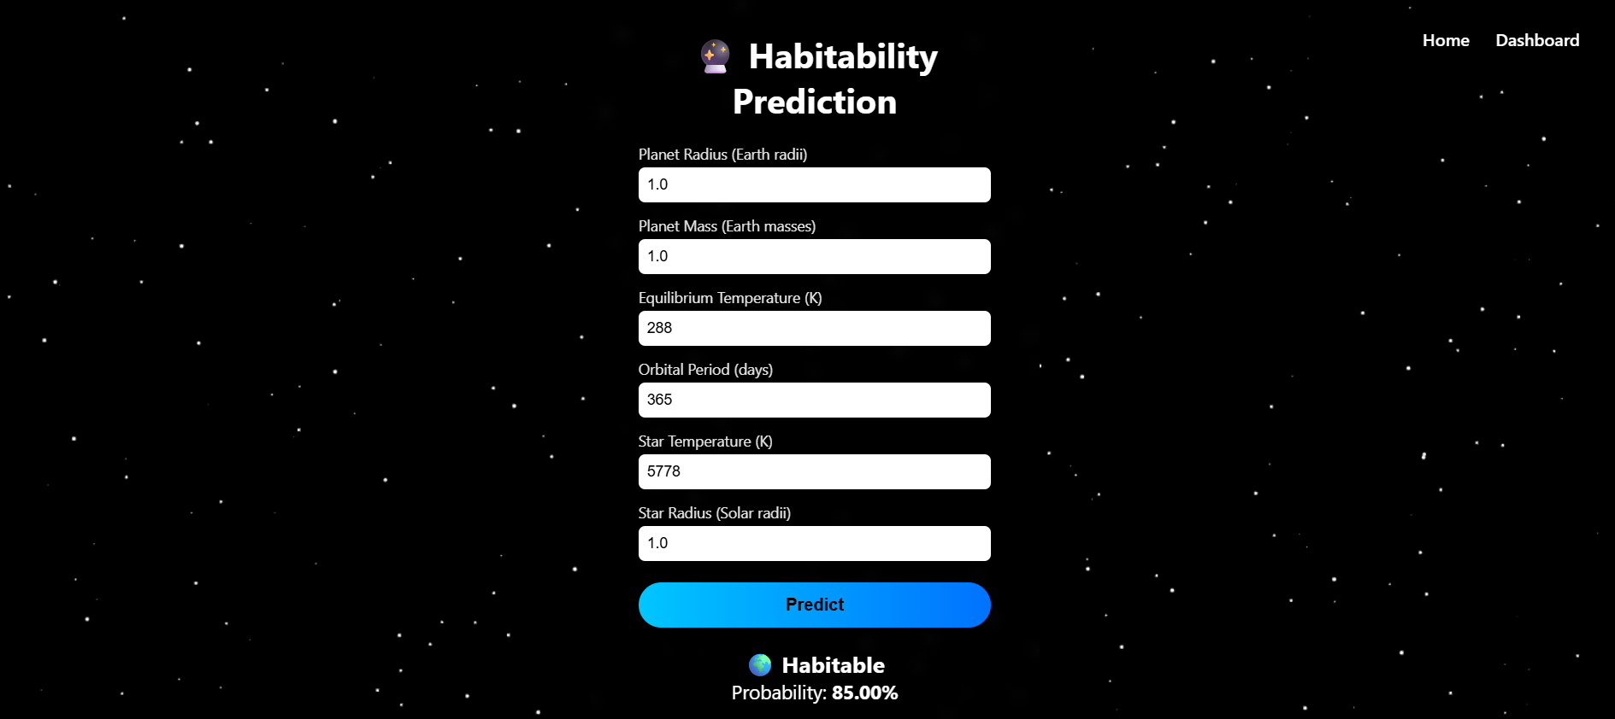

Slide 13
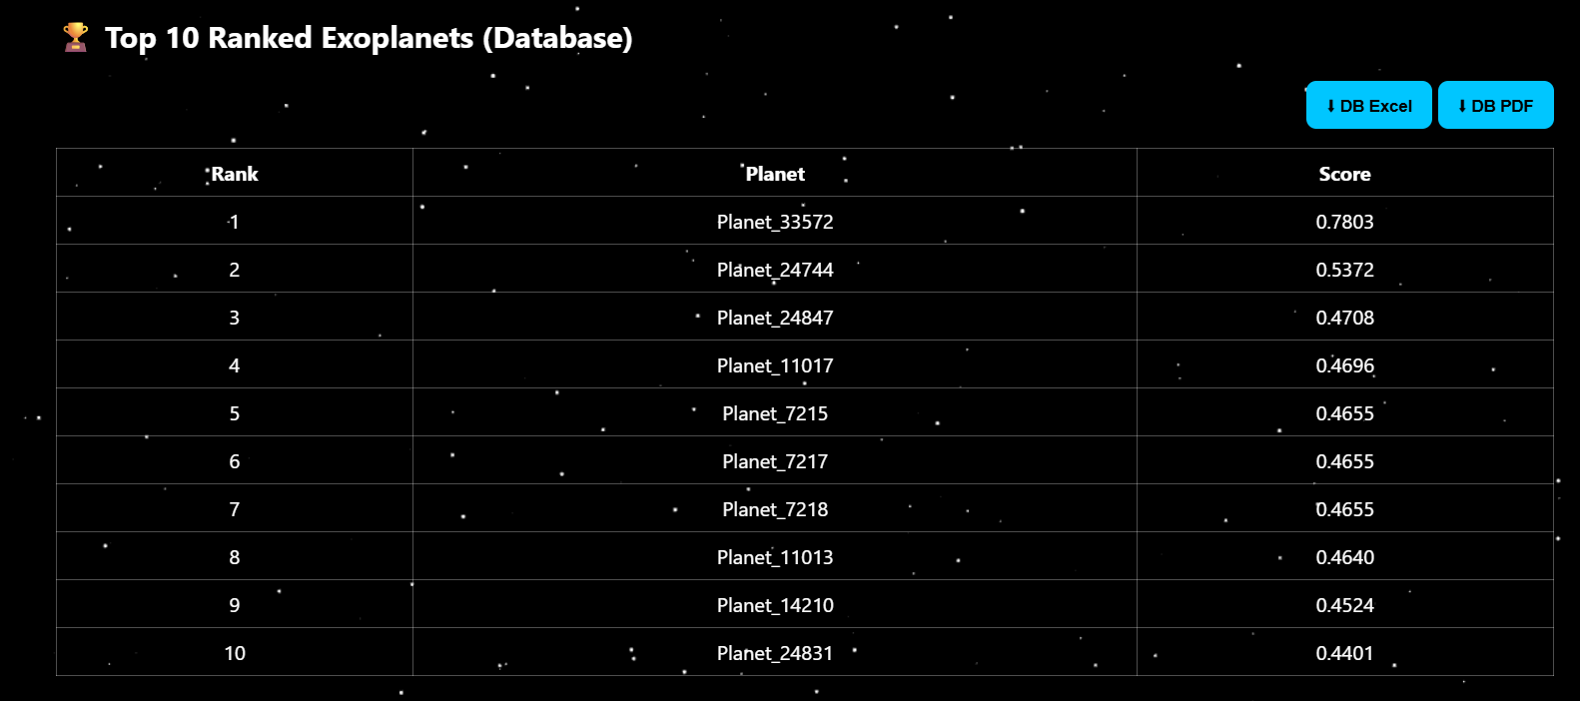
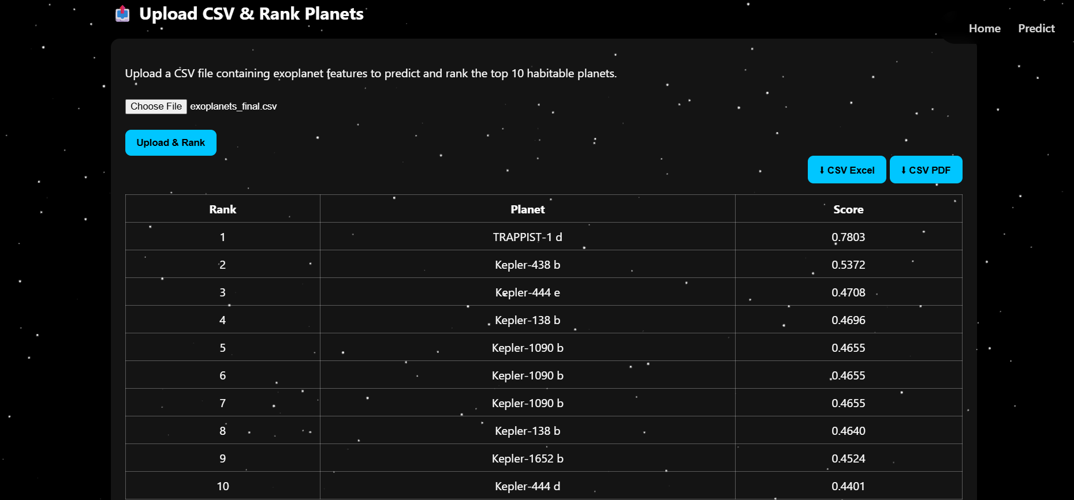

Slide 14
Conclusion
ML simplifies exoplanet habitability analysis
Project demonstrates full-stack ML deployment
Can be extended with more astronomical data
Useful for research and space exploration studies

Slide 15
Thank You

