Slide 1



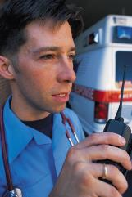

CAR CRASH DETECTION AND PREVENTION
SAVE LIVES

Slide 2
PROBLEM STATEMENT
In today’s busy industrial world, people are more prone to accidents on highways due to heavy traffic, rash driving, unsatisfactory maintenance of roads, environmental factors, and other such reasons.
Our project aims at helping people who have met with accidents and are unable to reach any emergency services on time, which can result in loss of lives.
“Save Lives” is an enterprise that helps these people by tracking such situations with our Sensor Systems and contact emergency services on their behalf.

Slide 3
APROACH
“Save Lives” is an emergency-response based enterprise, which works by taking in the responses of the sensors that are pre-installed in the cars registered by their customers.
When an accident occurs, an emergency signal is sent to their “Customer Service Organization” along with the location, priority and customer details.
An employee of that organization sends the request based on priority to a Hospital in the location that the accident occurred. Also, the police in that area is notified.

Slide 4
APPROACH (contd.)
The hospital enterprise in that location gets the request from the “Save Lives” enterprise, and the help desk organization of the hospital checks the availability of the doctors in that hospital.
Based on the availability, the case gets assigned to that particular doctor.
When that doctor logs in, he can see the case he is allocated. He treats the patient and generates a report based on the result of the treatment.
The help desk sends all the processed cases and their reports back to the “Save Lives Enterprise”.

Slide 5
APPROACH (CONTD.)
The police enterprise in that location gets the request from the “Save Lives” enterprise as well, and the front desk organization sends the request to all the police officers. Any police officer may respond to the case and investigate the accident.
The police then makes an individual report based on the findings. The help desk then sends all the reports to the “Save Lives” enterprise.

Slide 6
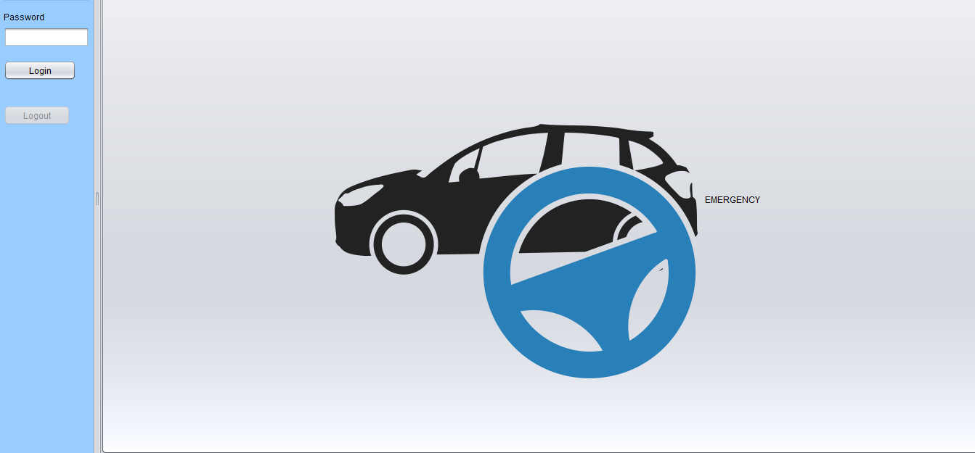
USE CASES
In order to represent a real-time emergency signal sent by the crash sensors in the car, a logic was implemented that on the click of the Emergency Button, a random customer is allocated random values of location and priority level of the accident.

Slide 7
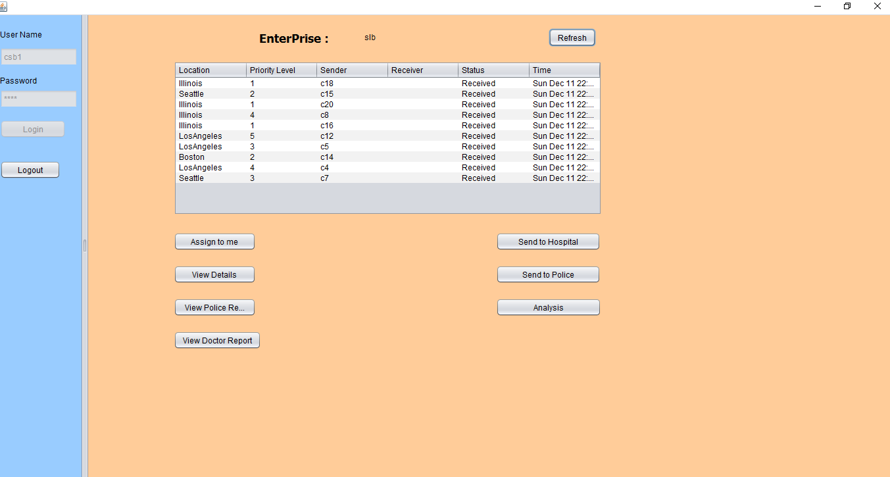

Slide 8
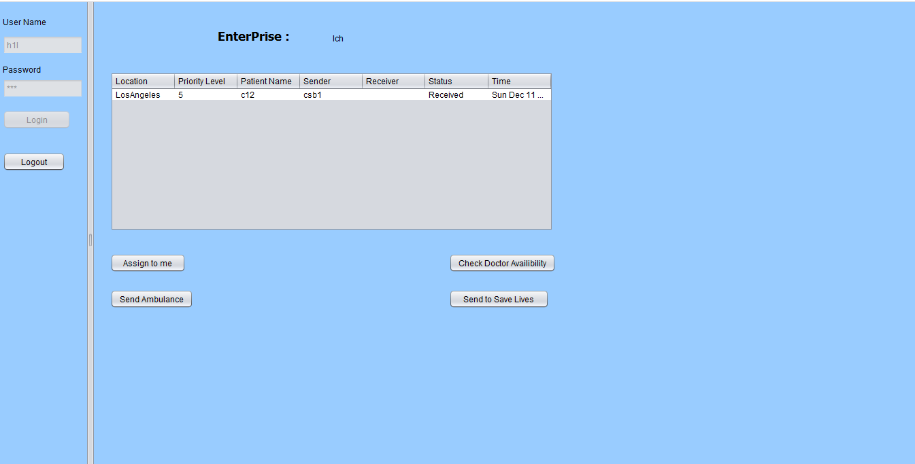
USE CASES
The customer service organization of the “Save Lives” enterprise sends a request to the hospital and police in the location that the accident took place.

Slide 9
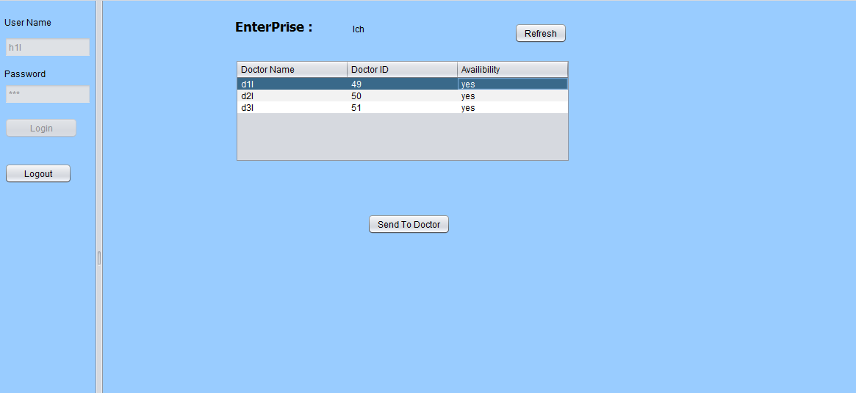
Use cases
The hospital help desk organization will check the availability of the doctor. If the doctor is not available, it will assign the case to another doctor who is available. If non of the doctors are available, he will wait for one of them to be free.

Slide 10
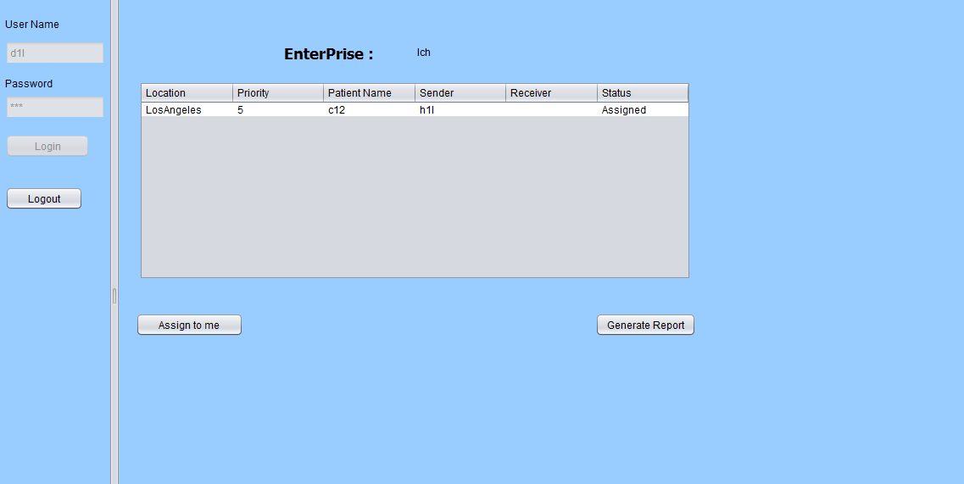
Use cases
Also, the hospital help desk organization will assign the request to one particular doctor. So, only that doctor can view the case and treat the person.

Slide 11
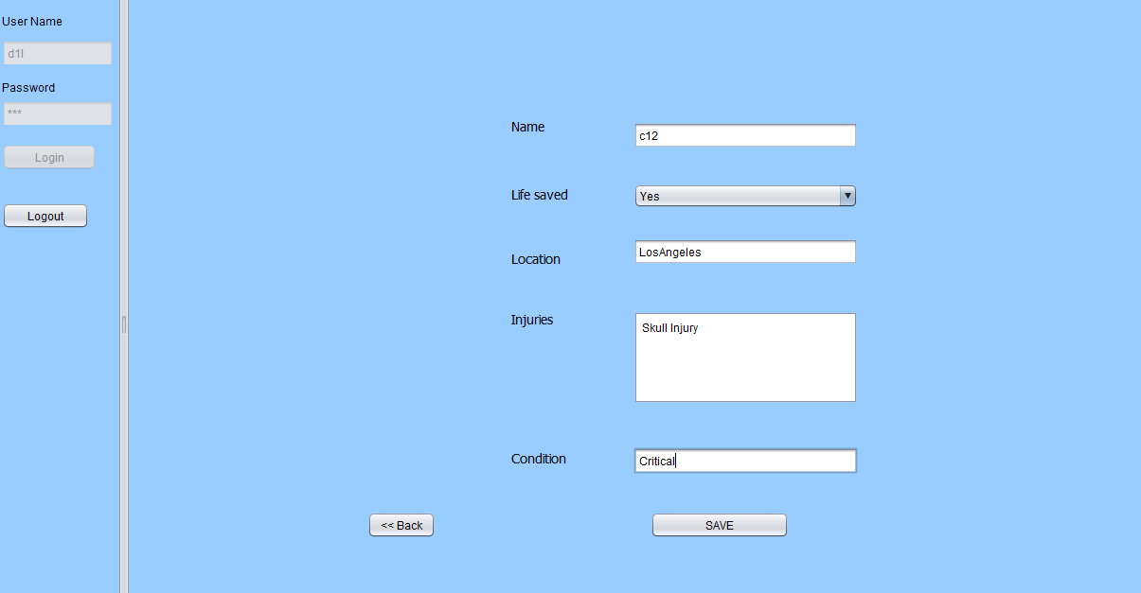
Use cases
The doctor organization will treat the case assigned to him and generate a report which states the condition and injuries of the patient after the treatment.

Slide 12
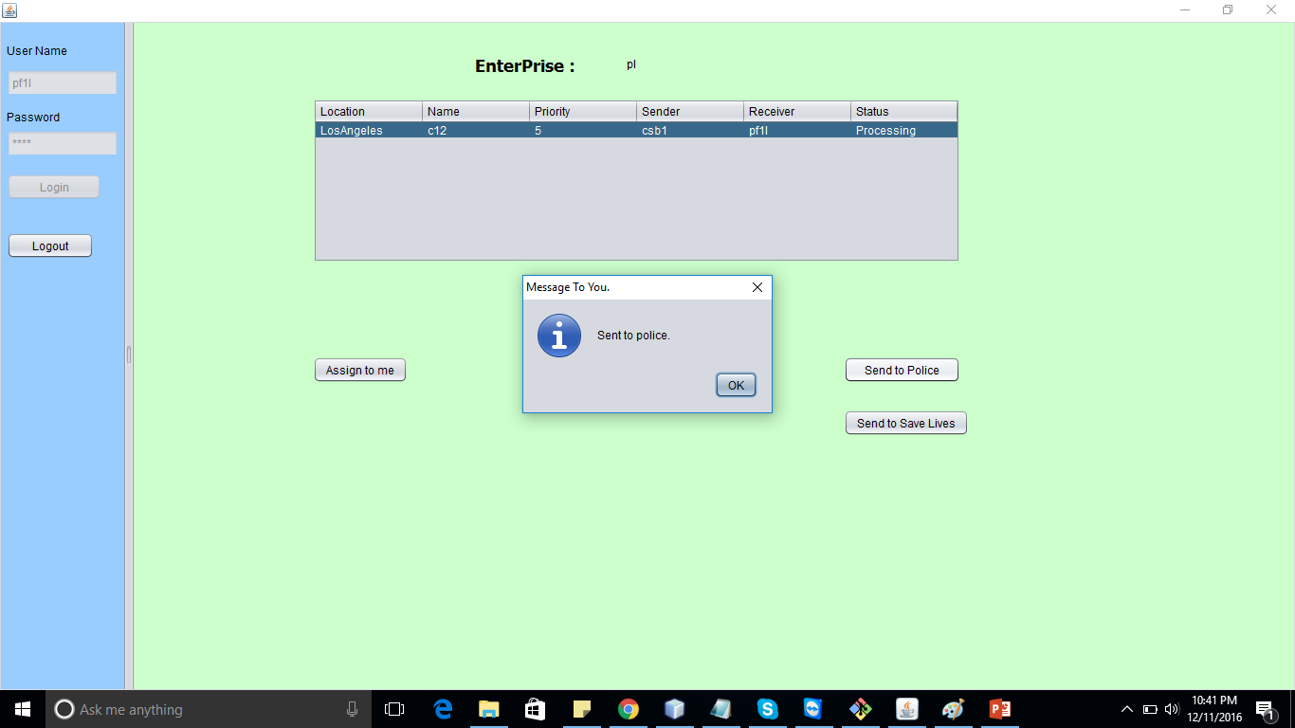
Use cases
The police front desk organization will send the case to all the police in their police organization based on priority.

Slide 13
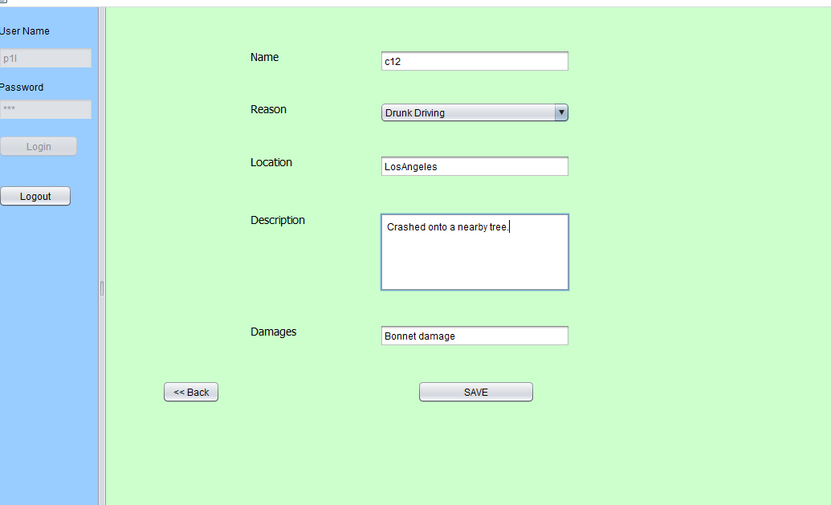
Use cases
Any of the police can assign a request to themselves. Then, they generate a report based on their investigation such as the cause of accident and the damages.

Slide 14
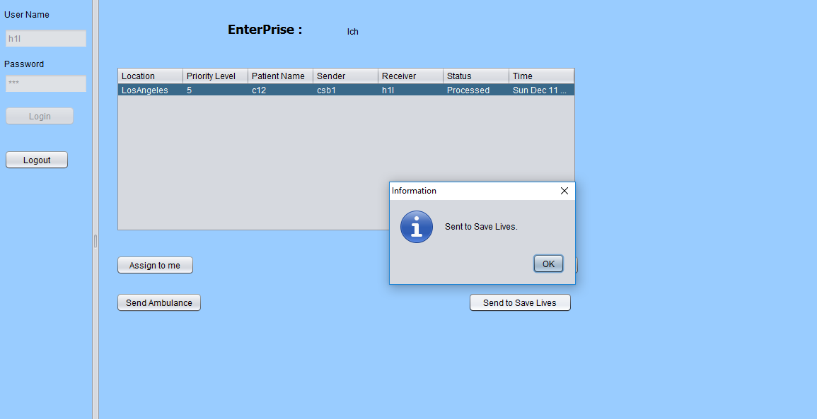
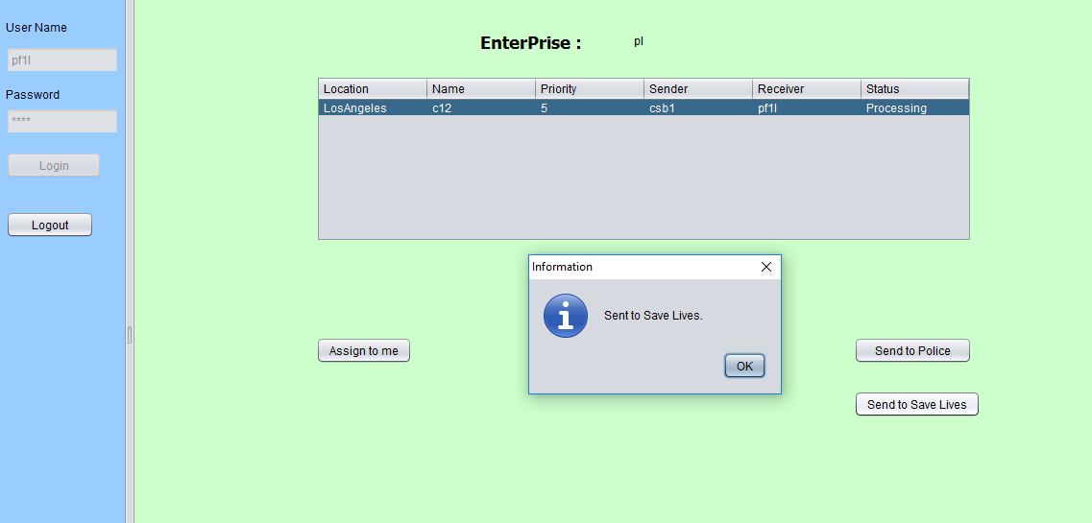
Use cases
The hospital help desk organization employees from hospital enterprise and the police front desk employees from the police enterprise have a similar duty of sending all the processed cases details and reports back to “Save Lives” enterprise.

Slide 15
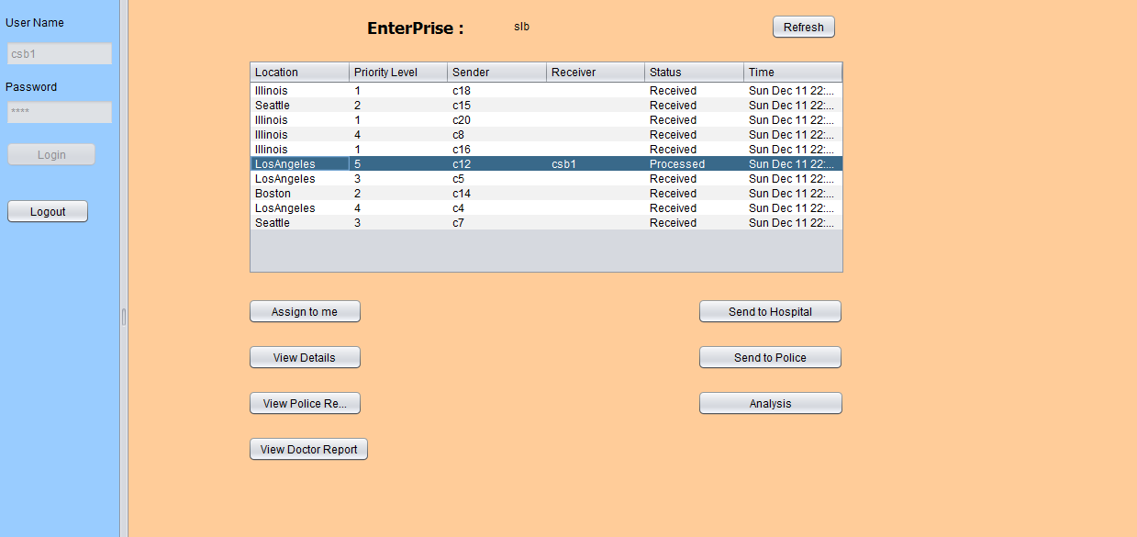
USE CASES
When the customer service organization employees of “Save Lives” enterprise log in, they can view the individual doctor reports and police reports of any customers that are processed.

Slide 16
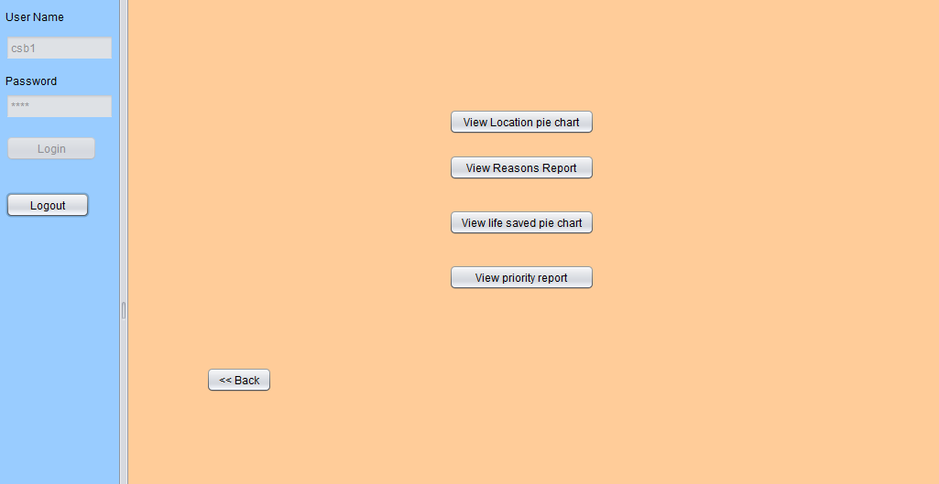
Use cases
Also, the “Save Lives” employees generate various reports by performing thorough analysis on the data obtained by the police and hospital enterprises in all the locations in their network.

Slide 17
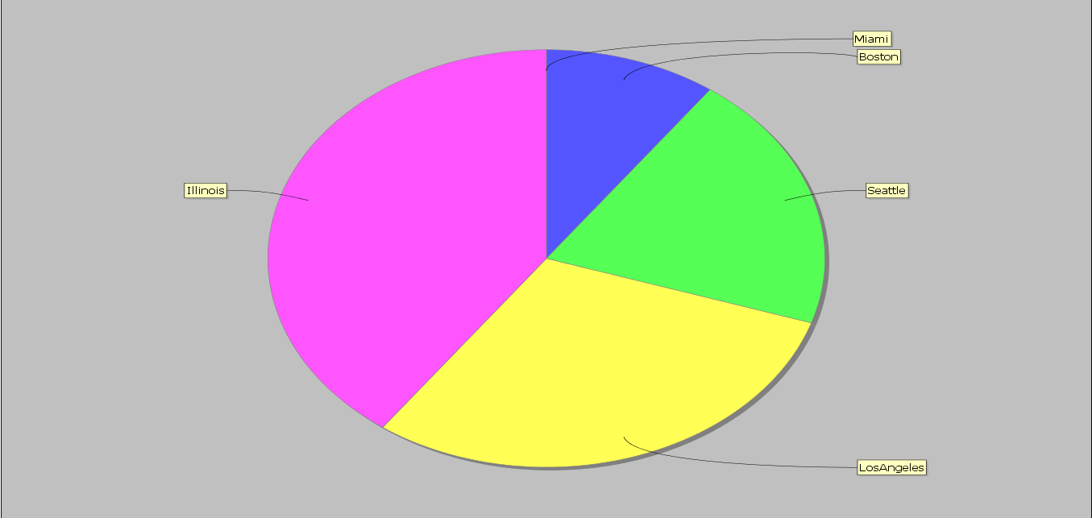
Analysis of accidents in every location

Slide 18
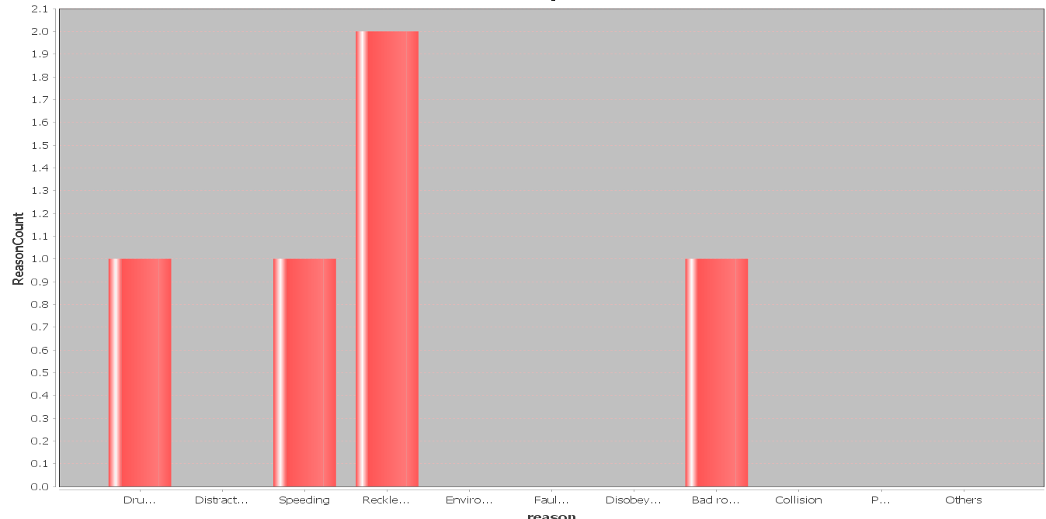
Analysis of the reason for maximum accidents.

Slide 19
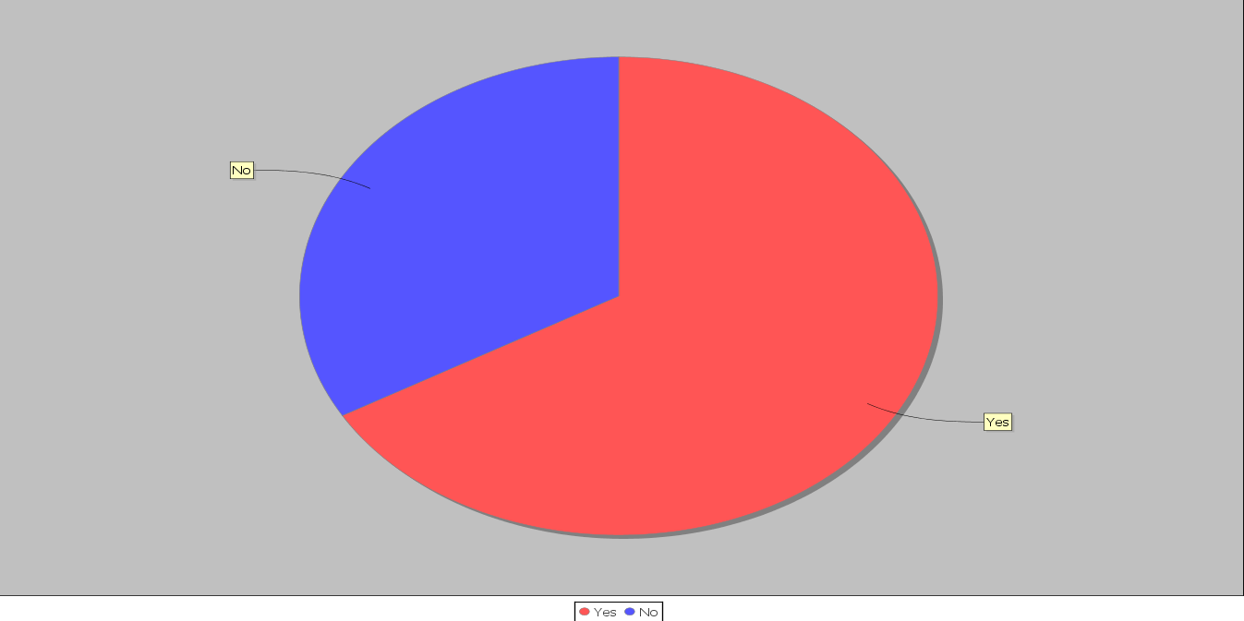
Analysis report of number of lived saved.

Slide 20
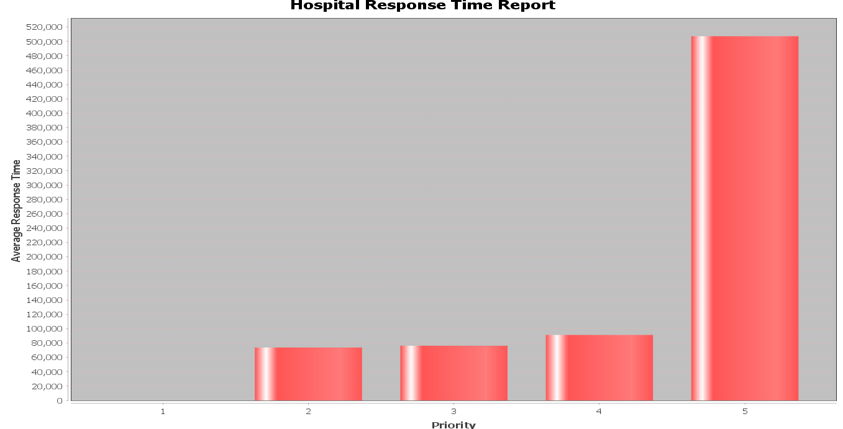
Average response time for each priority(time in milliseconds)

