Slide 1

Resume - ATS Check Project
Guide: Bhavik Gandhi
Group: 1

Slide 2

Meet Our Team
Beema Sajeev (c0891941)
Kuncheria Tom (c0900973)
Prince Thomas (c0894907)
Remya Kannankandari (c0895293)
Rewant Sharma (c0894265)
Rohit Kumar (c0895100)
Saurabh Laltaprasad Gangwar (c0894380)
Shanmuga Priyan (c0889053)
Sravya Somala (c0907007)

Slide 3

What is an Applicant Tracking System (ATS)?
Applicant Tracking Systems (ATS) are software programs used by employers to automate the recruitment process. They analyze resumes and applications, filtering candidates based on keywords and criteria. This allows employers to quickly identify the most qualified applicants.
Automated Screening: ATS automatically scan resumes and applications for relevant keywords and skills.
Candidate Ranking: Based on keywords and criteria, ATS rank candidates, presenting the best matches to the employer.
Time-Saving Tool: ATS help employers save time by automating the initial screening process, allowing them to focus on interviewing top candidates.

Slide 4

Importance of ATS-friendly resumes
ATS-friendly resumes are crucial for increasing your visibility to potential employers. By optimizing your resume for ATS, you ensure it gets past the initial screening stage, giving you a better chance of being considered for an interview.
Increased Visibility: ATS-friendly resumes have a higher chance of being noticed and reviewed by employers.
Improved Chances: A well-optimized resume helps you stand out from other candidates and increases your chances of landing an interview.
Effective Screening: ATS-friendly resumes streamline the screening process, allowing employers to quickly identify the best candidates.

Slide 5

Problem Statement
Up to 75% of resumes are rejected by ATS due to formatting and keyword issues, leading to longer hiring processes and missed talent.

Slide 6

Why Choose Our Solution
Predicts ATS scores using real resumes and job postings from various industries.
Uses advanced NLP techniques for precise and reliable score predictions.
Trained on actual hiring data to reflect real-world recruitment.
Aligns with industry-specific ATS criteria to maximize resume pass-through rates.

Slide 7
About The Datasets
Resume Dataset (livecareer.com): Content: Over 2,400 resumes in string and PDF formats, categorized by job fields such as HR, IT, and Finance etc. Use: Analyzes resume formats and categorizations to optimize ATS compatibility. Source: Kaggle - Resume Dataset
LinkedIn Job Postings Dataset (2023 - 2024): Content: Detailed records of 124,000+ job postings with attributes like title, salary, and company details. Use: Provides insights into job requirements and industry demands to align candidate profiles better. Source: Kaggle - LinkedIn Job Postings
Key Insights: These datasets facilitate the development of models that assess resume-job alignment, helping enhance job application success. Enables deep analysis of hiring trends and ATS optimization strategies.

Slide 8
Methodology
Database Integration: Utilized SQL cross joins to merge resume and job description datasets effectively.
ATS Score Calculation: Obtained ATS scores for the dataset using LangChain and Google PaLM (LLM).
Prediction Analysis: Leverage Natural Language Processing to build predictive models that analyze resume compatibility with job descriptions, significantly refining ATS score predictions.

Slide 9
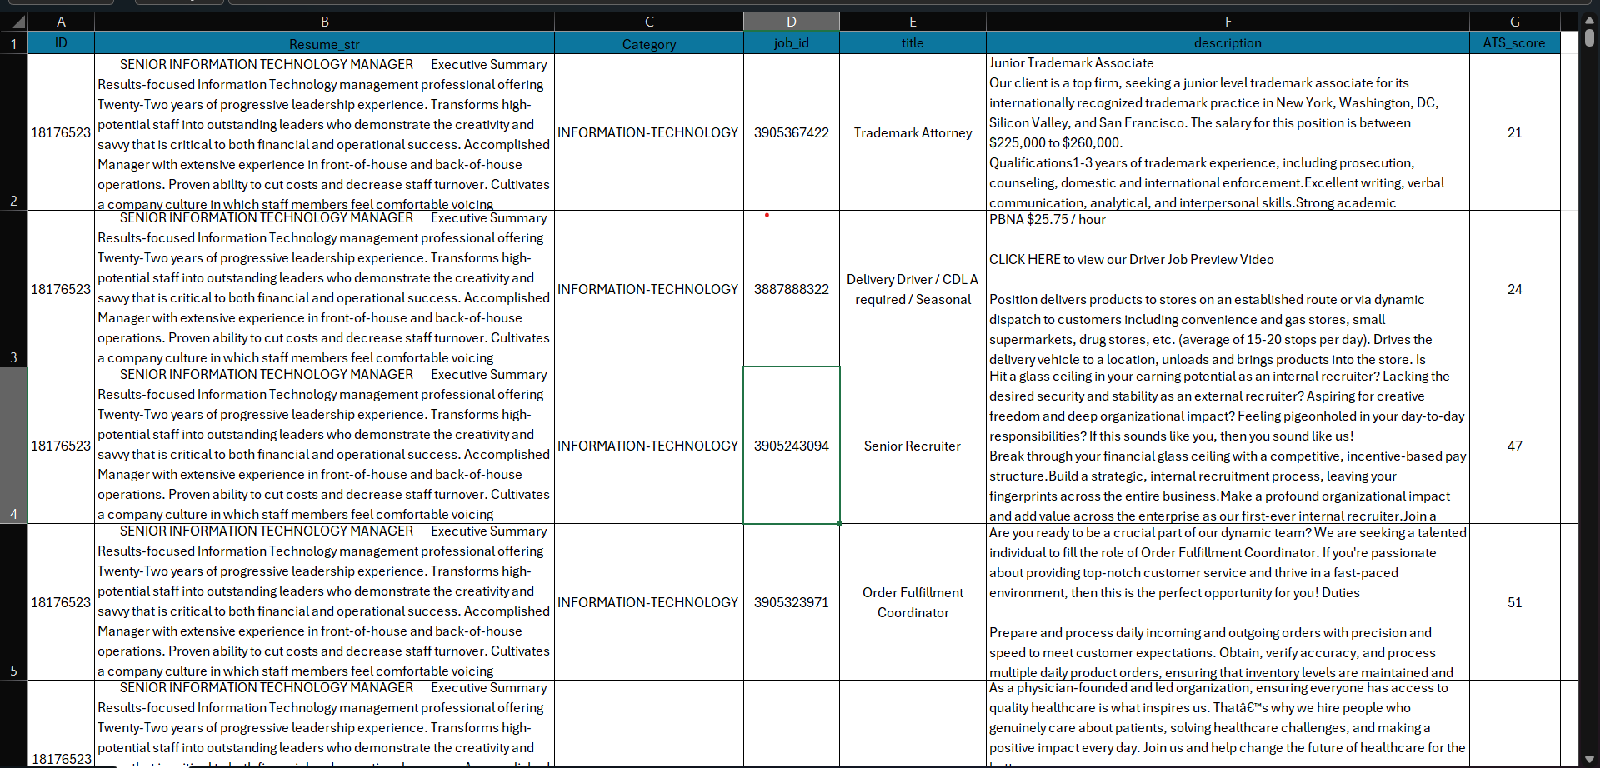
Dataset Overview

Slide 10

Project Implementation
Data Collection: Gathered resume and job description datasets from Kaggle.
Data Processing: Cleaned and prepared the data for analysis using SQL and Python.
Model Development: Created ATS scoring algorithms and predictive models using NLP techniques.
Testing and Refinement: Iteratively tested and improved the models for accuracy and efficiency.

Slide 11
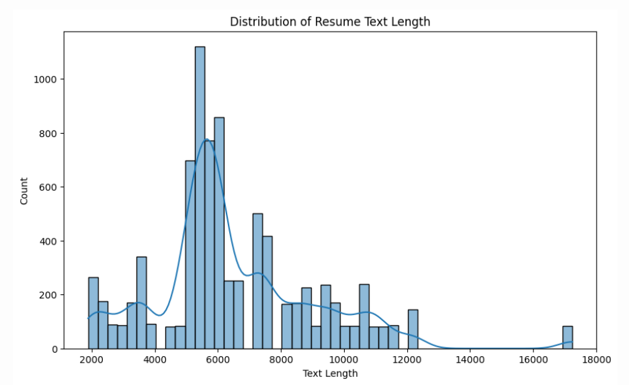
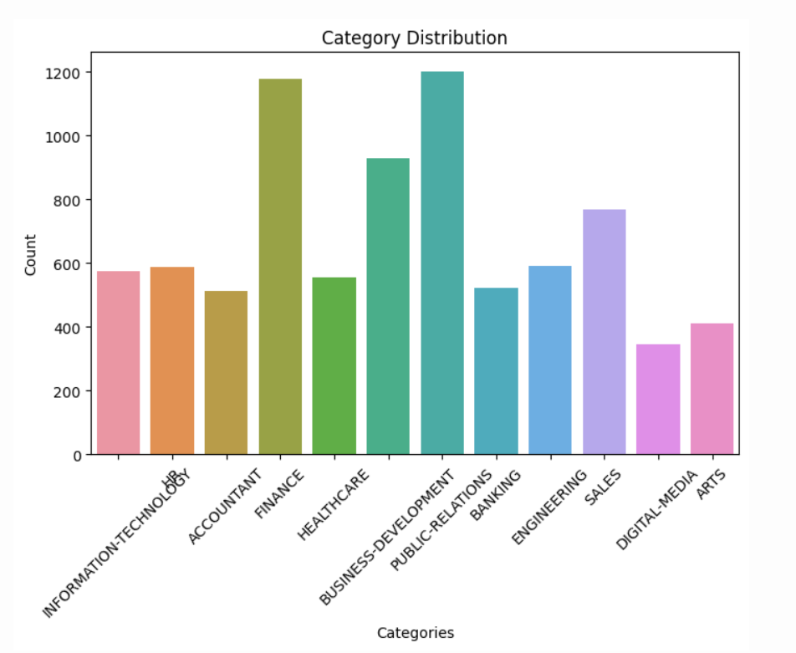
Visualizations

Slide 12
GitHub
Project Board: Project Board · ATS Resume Checker Project Board (github.com)
Repository: ATS_Resume_Checker_Repository

Slide 13

Next Steps
Expand Training Data: We plan to improve our model by adding more resumes and job descriptions to our dataset, helping it understand a wider range of job types and skills.
1
Enhance Model Architecture: Experiment with advanced neural network architectures like transformers to capture more complex linguistic patterns.
2
Develop a User-Friendly Interface: Create an intuitive web application that allows users to easily interact with our NLP recommendations
3

Slide 14

Thank YOU

