Slide 1
OpenCL Host Framework
Easy Kernel Development, Zero Host Code
60-Minute Technical Presentation
Notes:
SLIDE 1: Title (1 min)
Welcome everyone. Today I'm going to show you a framework that will fundamentally change how you develop OpenCL image processing algorithms.
The tagline says it all: "Easy Kernel Development, Zero Host Code."
By the end of this hour, you'll understand how to go from writing your first kernel to deploying on Android — without writing a single line of host code.
TIP: Start with energy. Make eye contact. Let the title sink in before moving on.

Slide 2
Agenda
Part I: OCLExample Introduction
Part II: Two-Phase Architecture
•
Introduction / Features
•
Recap
•
General OpenCL Host Flow
•
Why Two-Phase Architecture
•
Standard CL vs CL Extension
•
Compilation Phase
•
Caching Mechanism
•
Execution Phase
•
JSON Configuration
•
Cross-Platform Deliverable
•
Summary & Q&A
Notes:
SLIDE 2: Agenda - Part I (30 sec)
We'll cover this in two parts. Let me walk you through our agenda.
Part I focuses on OCLExample Introduction — what this framework is, why you need it, and how to use it.
Part II goes deeper into the two-phase architecture for execution deliverable.
We're starting with Introduction and Features.
TIP: Point to the highlighted item. Give a quick overview of the journey.

Slide 3
The Problem We Solve
Traditional OpenCL Development Pain Points
✗
Writing 500+ lines of host code for each algorithm
✗
Managing OpenCL contexts, queues, buffers manually
✗
Compiling kernels and handling errors
✗
Setting up arguments and work sizes
✗
Verifying results against CPU reference
✗
Repeating this for every kernel variant
Solution: This framework eliminates all the boilerplate!
Notes:
SLIDE 4: The Problem We Solve (3 min)
Let me start with a question: How many of you have written OpenCL host code before?
[Pause for hands]
Then you know the pain. Every time you want to test a new kernel, you need to write 500 lines of boilerplate.
[Read each pain point, let audience nod in recognition]
This framework eliminates ALL of that boilerplate. You focus on your kernel — we handle the rest.
TIP: Build the frustration before revealing the solution.
TRANSITION: "So what does the solution look like?"

Slide 4
Introduction / Features
•
The problem: 500+ lines of boilerplate for each OpenCL algorithm
•
The solution: JSON-driven configuration, zero host code
•
Six key benefits of the framework
•
User journey: Build → Run → Learn
•
High-level architecture overview
Notes:
SLIDE 3: Section Overview - Introduction / Features (1 min)
In this section, we'll cover:
• The PROBLEM — why traditional OpenCL development is painful
• The SOLUTION — how this framework eliminates boilerplate
• SIX KEY BENEFITS you get from using it
• USER JOURNEY — the Build, Run, Learn cycle
• ARCHITECTURE — how your code interacts with the framework
Let's start with the problem.

Slide 5
Framework Benefits
✓
✓
✓
Zero Host Code
Instant Comparison
Platform Switching
JSON-driven configuration
Run multiple variants
Standard GPU vs CL Extension
✓
✓
✓
Auto-Verification
Binary Caching
Easy Extension
GPU output vs CPU reference
Fast re-runs with cached kernels
Add new algorithms with scaffold
Notes:
SLIDE 5: Framework Benefits (3 min)
Here are the six key benefits:
ZERO HOST CODE — Your configuration lives in JSON. No C/C++ host code to write.
INSTANT COMPARISON — Compare v0 against v1 of your kernel instantly.
PLATFORM SWITCHING — Switch between standard OpenCL and vendor extensions with one config line.
AUTO-VERIFICATION — Every GPU output is compared against CPU reference automatically.
BINARY CACHING — After first run, compiled kernel is cached. Subsequent runs skip compilation.
EASY EXTENSION — Adding a new algorithm? We have a scaffold for you.
TIP: Touch each card as you explain. Let benefits build momentum.

Slide 6
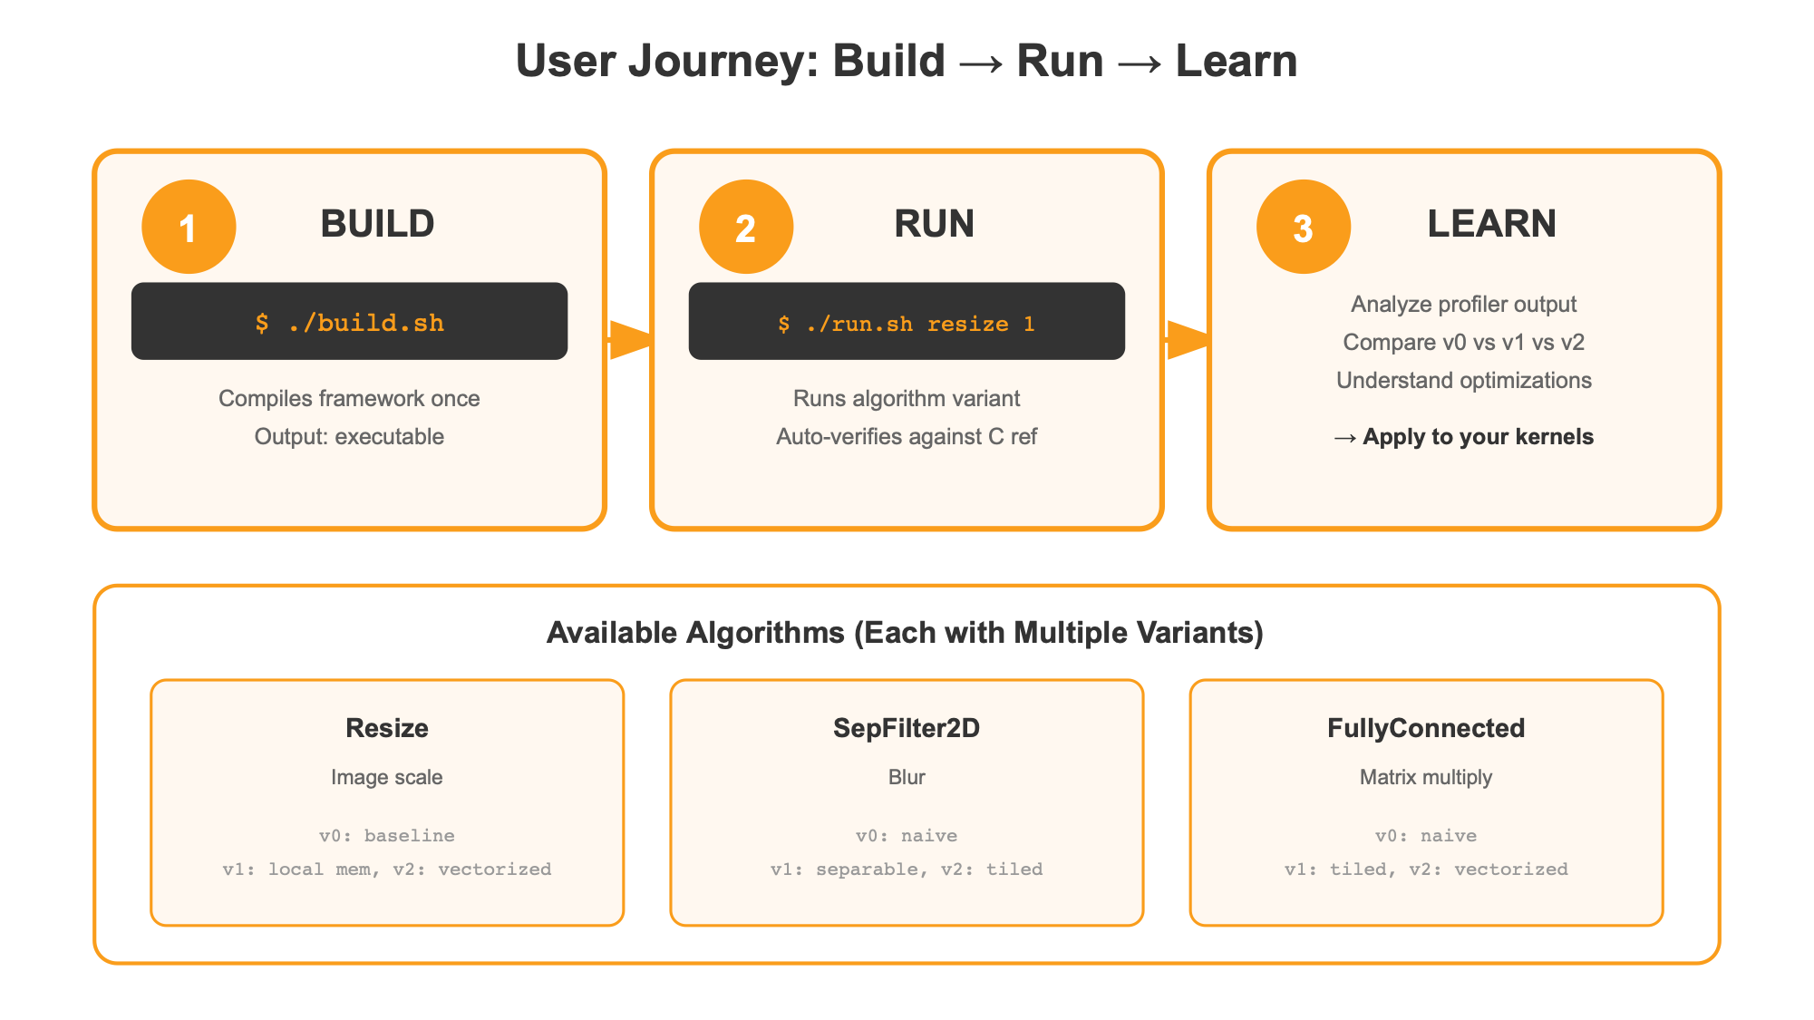
User Journey: Build → Run → Learn
Notes:
SLIDE 6: User Journey (3 min)
The typical user journey has three phases: Build, Run, and Learn.
BUILD: Write your kernel in OpenCL C. Create a JSON config. That's it — no host code.
RUN: Execute using our command-line tool. It compiles, sets up OpenCL, runs, and produces output.
LEARN: Get detailed profiling data. Compare against CPU reference. Iterate.
This cycle is how you go from concept to optimized production kernel.
TIP: Trace the flow with your hand. Emphasize simplicity.

Slide 7
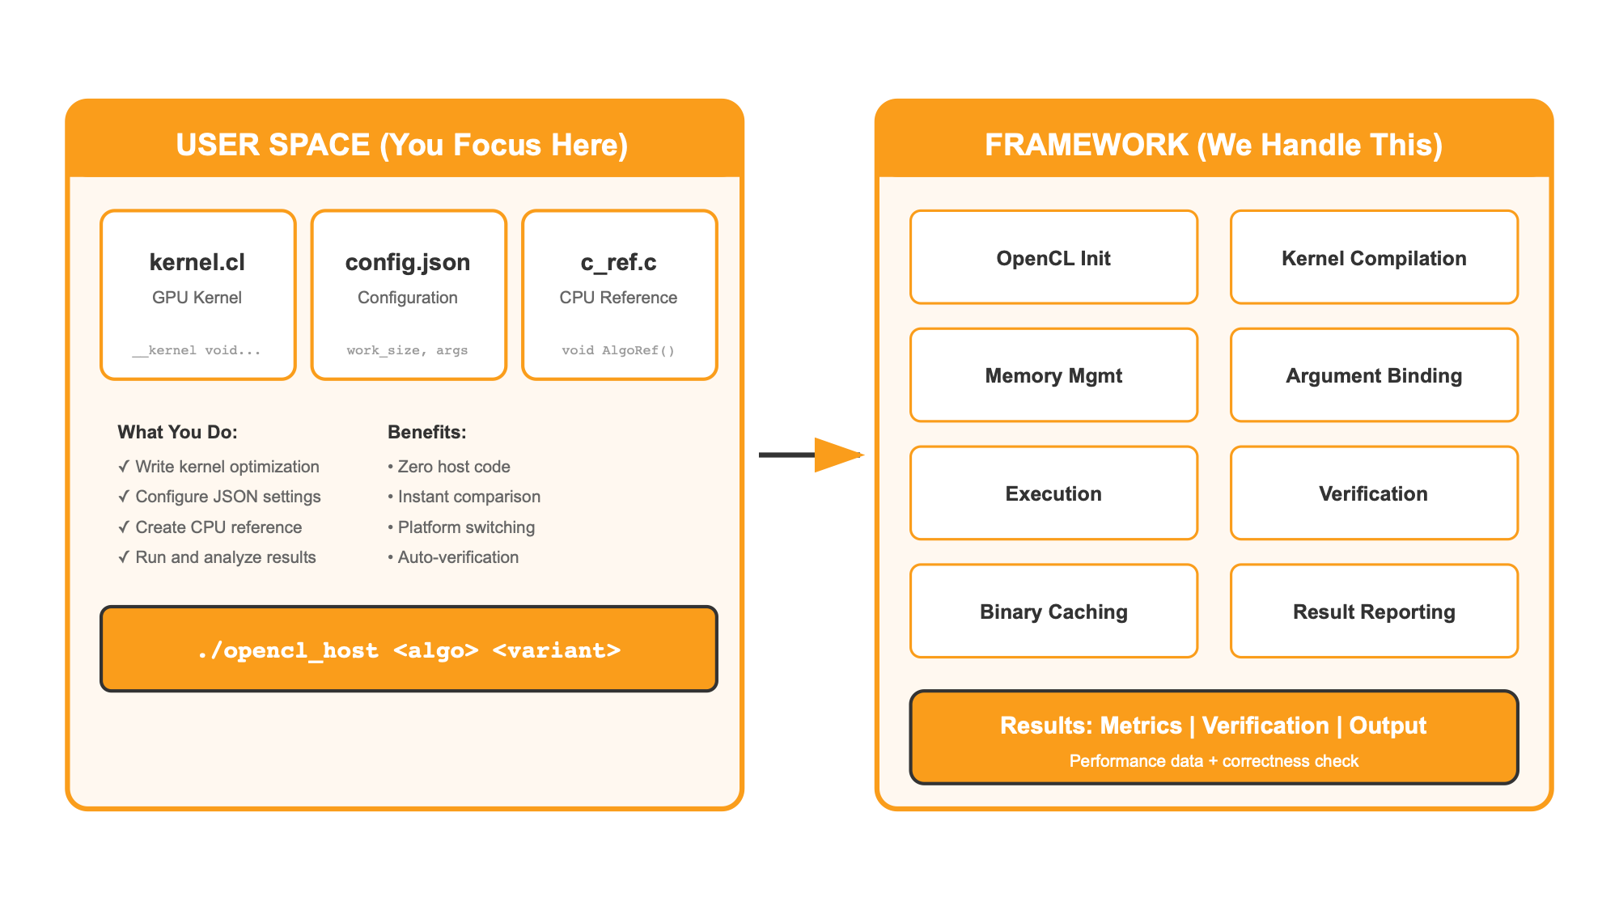
High-Level Architecture
Notes:
SLIDE 7: High-Level Architecture (3 min)
On the left is YOUR code — just the kernel and JSON config.
On the right is the FRAMEWORK — it handles everything else.
Notice the clear separation: you stay in "user space" with your algorithm logic. The framework handles all the "plumbing".
TIP: Use two-hand gestures — left for "your code", right for "framework".
TRANSITION: "Now let's look at what happens inside the framework."

Slide 8
General OpenCL Host Flow
•
The 6-step standard OpenCL host flow
•
What the framework handles automatically
•
Key timing: ~100ms compilation overhead
•
Why this matters for iteration speed
Notes:
SLIDE 9: Section Overview - General OpenCL Host Flow (30 sec)
In this section, we'll look at:
• The 6 STEPS every OpenCL program must perform
• What the FRAMEWORK HANDLES for you
• The ~100MS COMPILATION overhead — important for later
• Why this MATTERS for your development speed
Let's walk through the flow.

Slide 9
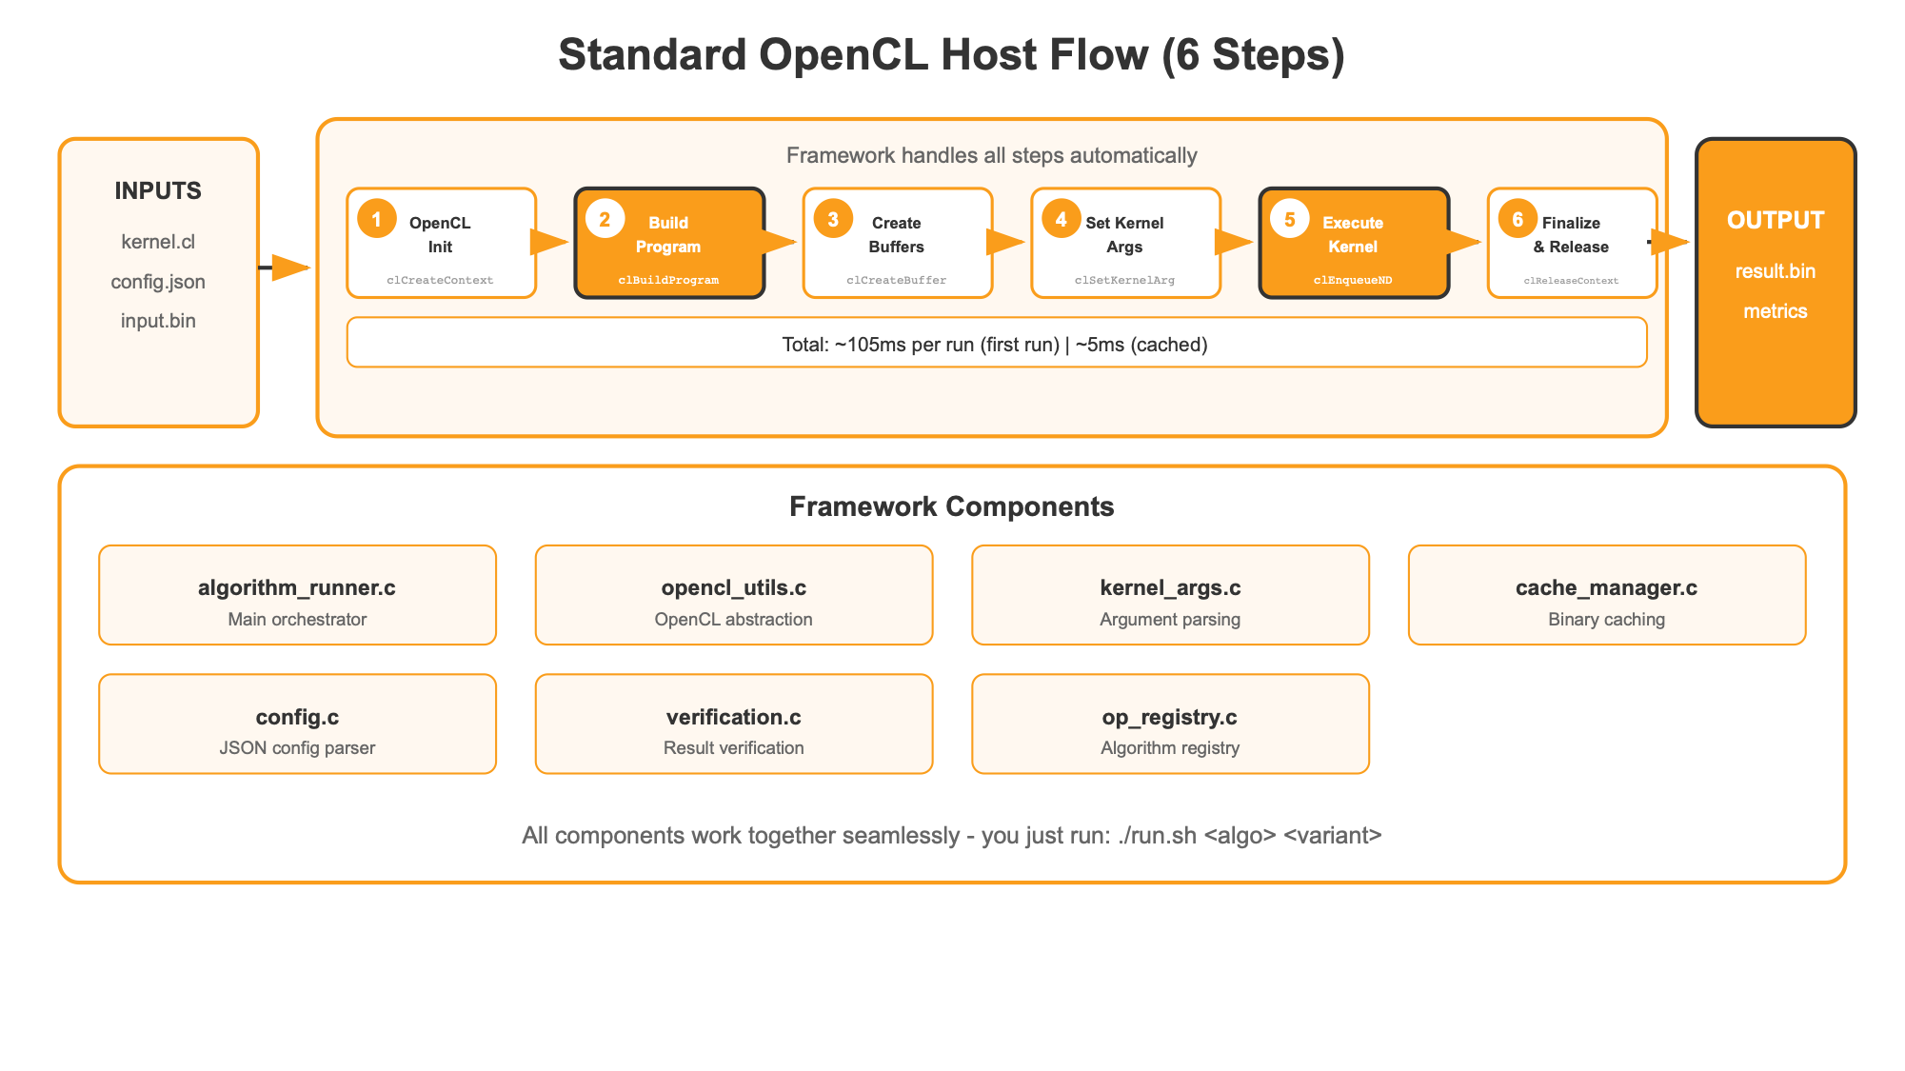
Standard OpenCL Host Flow
Notes:
SLIDE 10: Standard OpenCL Host Flow (4 min)
This is the standard OpenCL host flow — 6 steps every OpenCL program must perform.
STEP 1: Platform & Device — Find available GPUs.
STEP 2: Context & Queue — Create execution context.
STEP 3: Build Program — Compile kernel. Notice: ~100ms. Significant cost.
STEP 4: Create Kernel — Extract runnable kernel.
STEP 5: Setup Args & Buffers — Allocate GPU memory, set arguments.
STEP 6: Execute & Read — Run kernel, read results.
The framework does ALL of this for you.
Pay attention to that ~100ms compilation time — we'll see how caching eliminates this.
TIP: Walk through each step. Emphasize ~100ms compilation.

Slide 10
Standard CL vs CL Extension
•
Two platform types: Standard OpenCL and CL Extension
•
Standard CL: Works on any GPU, great for development
•
CL Extension: Vendor-optimized, maximum performance
•
One-line config change to switch between them
Notes:
SLIDE 12: Section Overview - Standard CL vs CL Extension (30 sec)
In this section:
• TWO PLATFORM TYPES the framework supports
• STANDARD CL — portable, works everywhere
• CL EXTENSION — vendor-optimized SDK
• ONE-LINE SWITCH between them
Let me show you the branching.

Slide 11
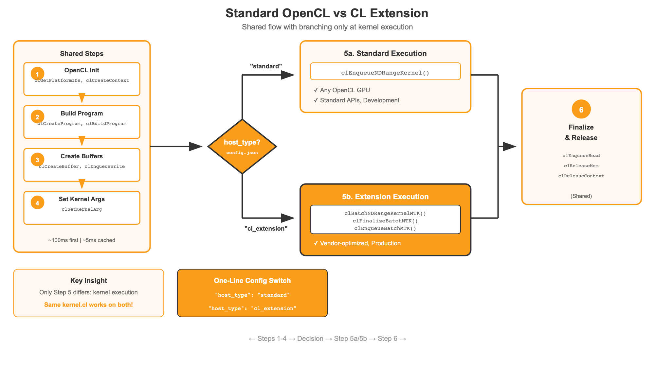
Platform Branching
Notes:
SLIDE 13: Platform Branching (4 min)
The framework supports two platform types — choose with a single JSON config line.
STANDARD OPENCL on the left — uses only standard APIs. Works on ANY OpenCL GPU. Perfect for development.
CL EXTENSION on the right — uses vendor-specific extensions. Maximum performance.
Key insight: your kernel code stays the same. Only the config changes.
One line change from Standard CL to CL Extension
TIP: Point to both columns. Emphasize "same kernel, different platform".

Slide 12
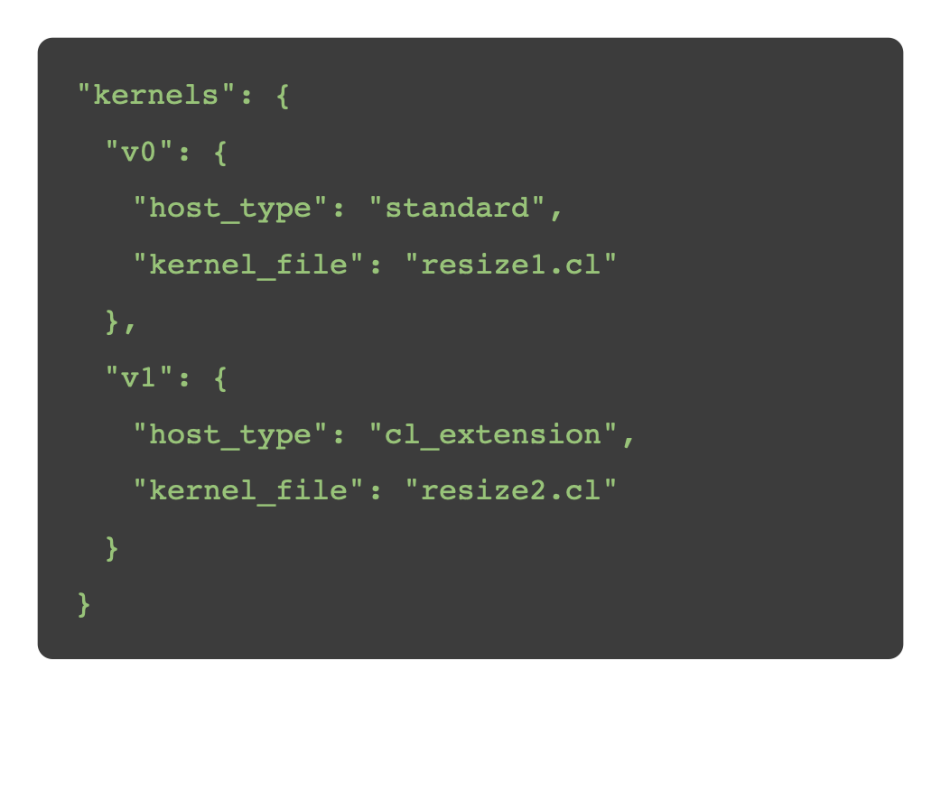
Platform Configuration in JSON
Key Benefits
✓
Runtime platform selection
✓
No code changes required
✓
No rebuild needed
✓
Switch with one line change
✓
Run both variants to compare
✓
Same kernel.cl works on both
Easy to switch between Standard CL and CL Extension
Notes:
SLIDE 14: Platform Configuration in JSON (2 min)
Here's what it looks like in practice.
Same algorithm — ReLU — two variants.
v0 uses host_type: standard. Runs on any GPU.
v1 uses host_type: cl_extension. Runs with vendor optimizations.
KEY BENEFITS to emphasize:
• Runtime platform selection — choose at execution time
• No code changes required — just config
• No rebuild needed — same binary, different config
• One line change to switch
• Run both variants to compare performance
• Same kernel.cl works on both platforms
TIP: Point to the host_type field. Emphasize no rebuild needed.

Slide 13
Caching Mechanism
•
Binary caching eliminates repeated compilation
•
Cache miss: First run compiles (~100ms), saves binary
•
Cache hit: Load cached binary (~5ms) — 20x faster!
•
Automatic invalidation when source changes (SHA256)
Notes:
SLIDE 16: Section Overview - Caching Mechanism (30 sec)
In this section:
• BINARY CACHING — how it works
• CACHE MISS — first run compiles and saves
• CACHE HIT — subsequent runs are 20x faster
• AUTOMATIC INVALIDATION when you change code
Let's see the flow.

Slide 14
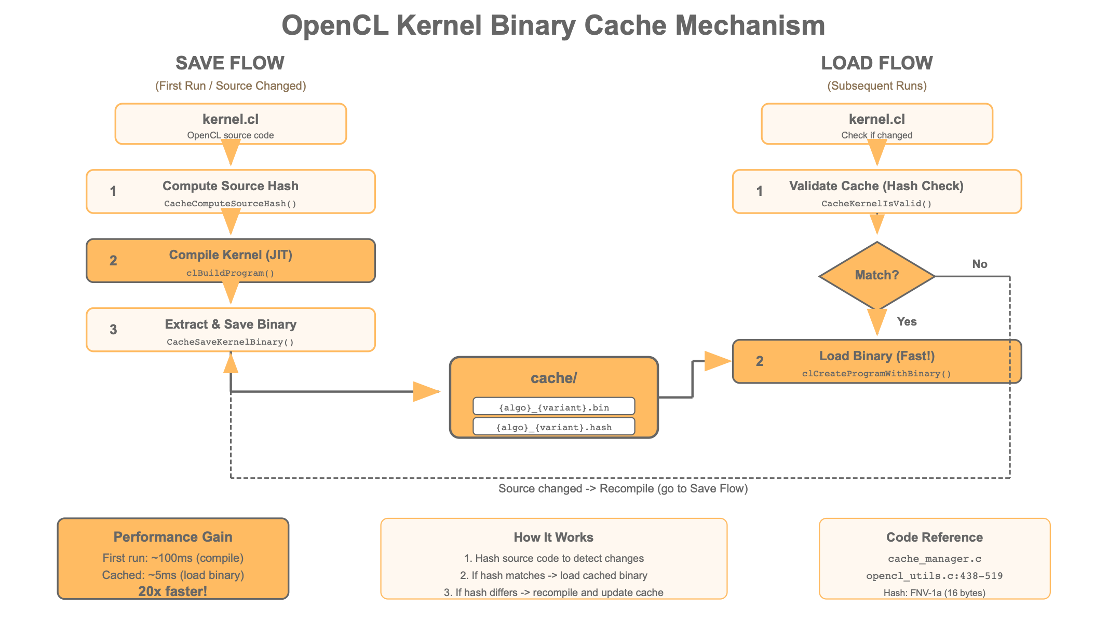
Binary Caching
Notes:
SLIDE 17: Binary Caching (4 min)
The framework uses binary caching to eliminate repeated compilation.
CACHE MISS — First run, no cache. Compile from source: ~100ms. Save binary to cache.
CACHE HIT — Subsequent runs find cached binary. Load directly: ~5ms. That's 20x speedup!
Cache is invalidated automatically when kernel source changes (SHA256 hashing).
First run is slow, every run after is fast. Change your kernel? One slow compile, then fast again.
TIP: Trace both paths — emphasize 100ms vs 5ms. Key selling point.

Slide 15
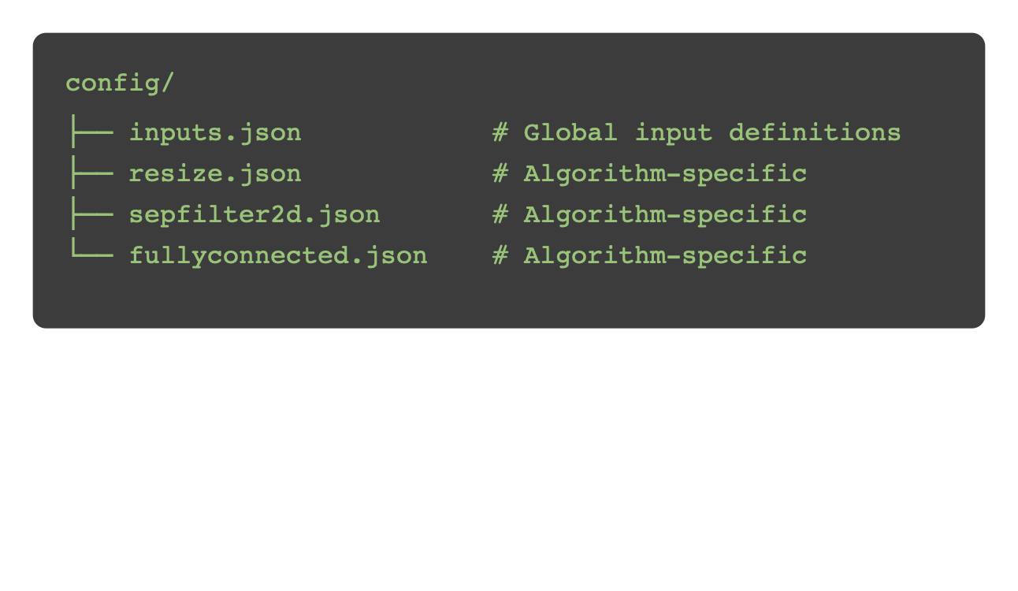
JSON Configuration
•
Configuration file structure in config/ directory
•
Global inputs.json and algorithm-specific configs
•
Complete kernel configuration with all parameters
•
Six supported argument types for any kernel pattern
Notes:
SLIDE 19: Section Overview - JSON Configuration (30 sec)
In this section:
• FILE STRUCTURE — how configs are organized
• GLOBAL vs ALGORITHM-SPECIFIC configs
• COMPLETE KERNEL CONFIG — all the fields you need
• ARGUMENT TYPES — covering any kernel pattern
Let's look at the structure.

Slide 16
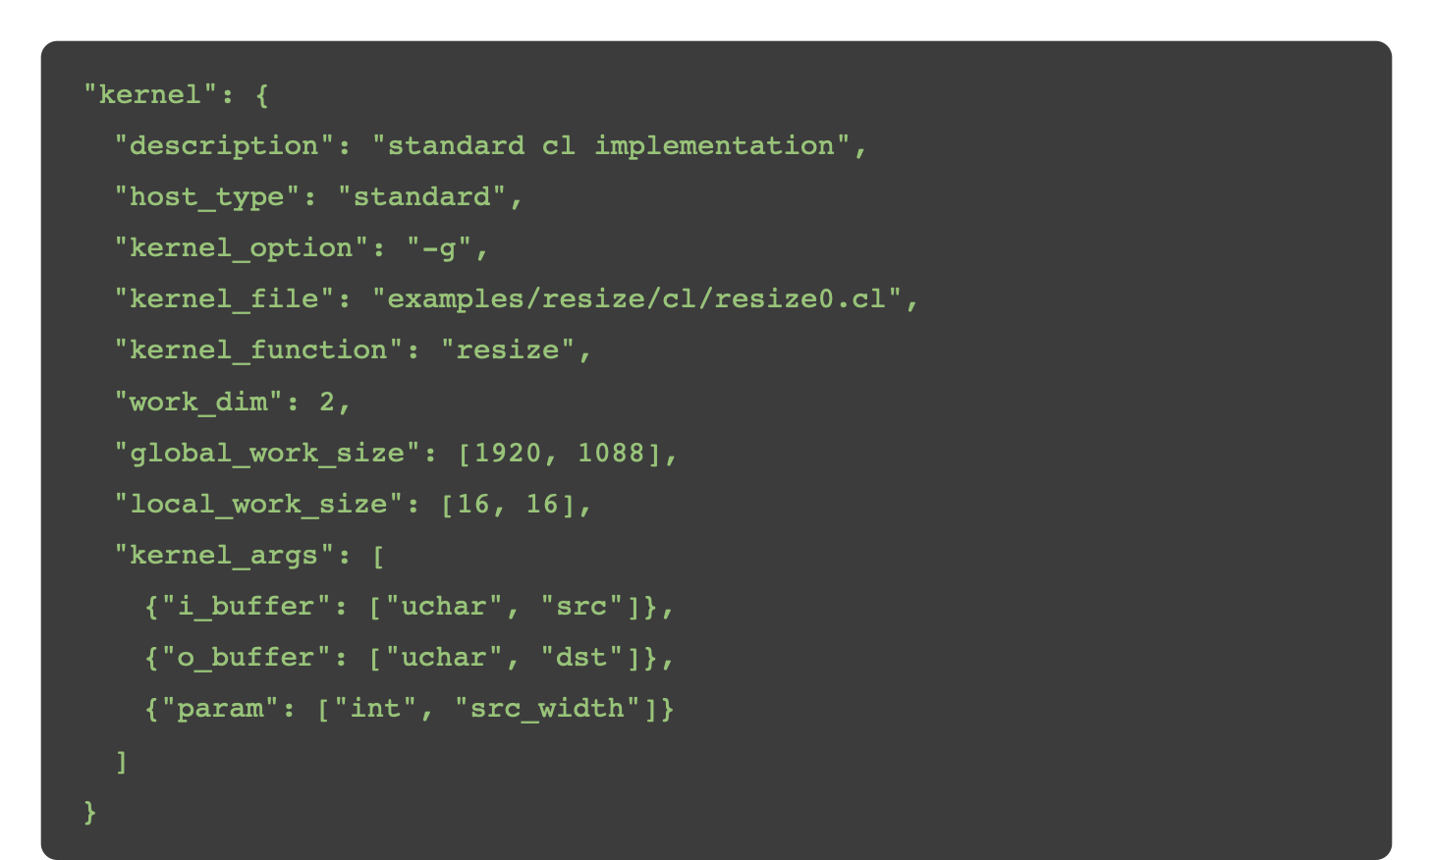
Kernel Configuration
Notes:
SLIDE 21: Kernel Configuration (3 min)
Complete kernel configuration for one variant.
Key fields:
• host_type: standard or cl_extension
• kernel_file: path to .cl source
• kernel_function: function name to call
• work_dim, global_work_size, local_work_size: NDRange config
• kernel_args: argument list with types
This is ALL the information the framework needs to run your kernel.
TIP: Highlight each field. Emphasize completeness.

Slide 17
Supported Argument Types
Type | Syntax | Description
Input Buffer | {"i_buffer": ["uchar", "src"]} | Read-only image
Output Buffer | {"o_buffer": ["uchar", "dst"]} | Write-only result
Parameter | {"param": ["int", "width"]} | Auto from image
Scalar | {"scalar": ["float", "sigma"]} | Custom value
Custom Buffer | {"buffer": ["float", "wts", 100]} | User-defined
Struct | {"struct": ["a", "b", "c"]} | Packed scalars
Notes:
SLIDE 22: Supported Argument Types (2 min)
Six argument types:
• INPUT BUFFER: Read-only data
• OUTPUT BUFFER: Where results go
• PARAMETER: Auto-extracted from images (width, height)
• SCALAR: Custom constants
• CUSTOM BUFFER: User-defined buffers
• STRUCT: Pack multiple scalars
These cover virtually every kernel argument pattern.
TIP: Quick scan of table — reference material.

Slide 18
Part I Summary
Topic | Key Points
Introduction / Features | Zero host code, JSON-driven configuration
OpenCL Host Flow | 6-step flow handled by framework
Platform Options | Standard CL vs CL Extension — one-line switch
Caching | Binary caching: 100ms → 5ms
Configuration | JSON-based kernel and I/O setup
Any questions before Part II?
Notes:
SLIDE 23: Part I Summary (2 min)
Let's recap Part I:
• Framework eliminates host code — just kernel + JSON
• 6-step OpenCL flow handled for you
• Two platforms: Standard CL for dev, CL Extension
• Binary caching: 100ms → 5ms
• JSON configuration: structured, reusable
Any questions before Part II?
[Genuine pause for questions]
TRANSITION: "Ready for Part II? Let's talk about deliverable."

Slide 19
Agenda
Part I: OCLExample Introduction
Part II: Two-Phase Architecture
•
Introduction / Features
•
Recap
•
General OpenCL Host Flow
•
Why Two-Phase Architecture
•
Standard CL vs CL Extension
•
Compilation Phase
•
Caching Mechanism
•
Execution Phase
•
JSON Configuration
•
Cross-Platform Deliverable
•
Summary & Q&A
Notes:
SLIDE 20: Agenda - Part II (30 sec)
Now we're moving to Part II: Two-Phase Architecture.
"Compile Once, Run Anywhere."
In Part I, we saw how to develop and test kernels. Now let's see how to deploy them to execution platforms— including Android devices.
Starting with a quick recap.
TIP: Note that Part II is now highlighted. Point to Recap.

Slide 20
Part I Recap
Framework Benefits
User Journey
Zero host code, JSON-driven
Build → Run → Learn
Platform Options
JSON Configuration
Standard CL vs CL Extension
Kernel config, I/O setup
Now: How we split the host into two phases
Notes:
SLIDE 25: Part I Recap (1 min)
Quick recap:
• Framework benefits — zero host code
• User journey — Build, Run, Learn
• Platform options — Standard vs Extension
• JSON configuration
Now: how we split the host into two distinct phases — Compilation and Execution.
TIP: Brief review. Point to the orange banner.

Slide 21
Why Two-Phase Architecture
✗
Every run recompiles kernel (~100ms overhead)
✗
Source code must be present on target
✗
Can't pre-compile for different devices
✗
No binary distribution possible
Solution: Split into Compilation + Execution phases
Notes:
SLIDE 28: The Problem with Monolithic Flow (3 min)
Why two phases? Monolithic flow has serious problems:
1. Every run recompiles — ~100ms matters for real-time apps
2. Source code must be on target — do you want to ship source?
3. Can't pre-compile for different devices
4. No binary-only distribution
Solution: split into Compilation + Execution. Compile on dev machine, execute on target.
TIP: Build the problem before the solution.

Slide 22
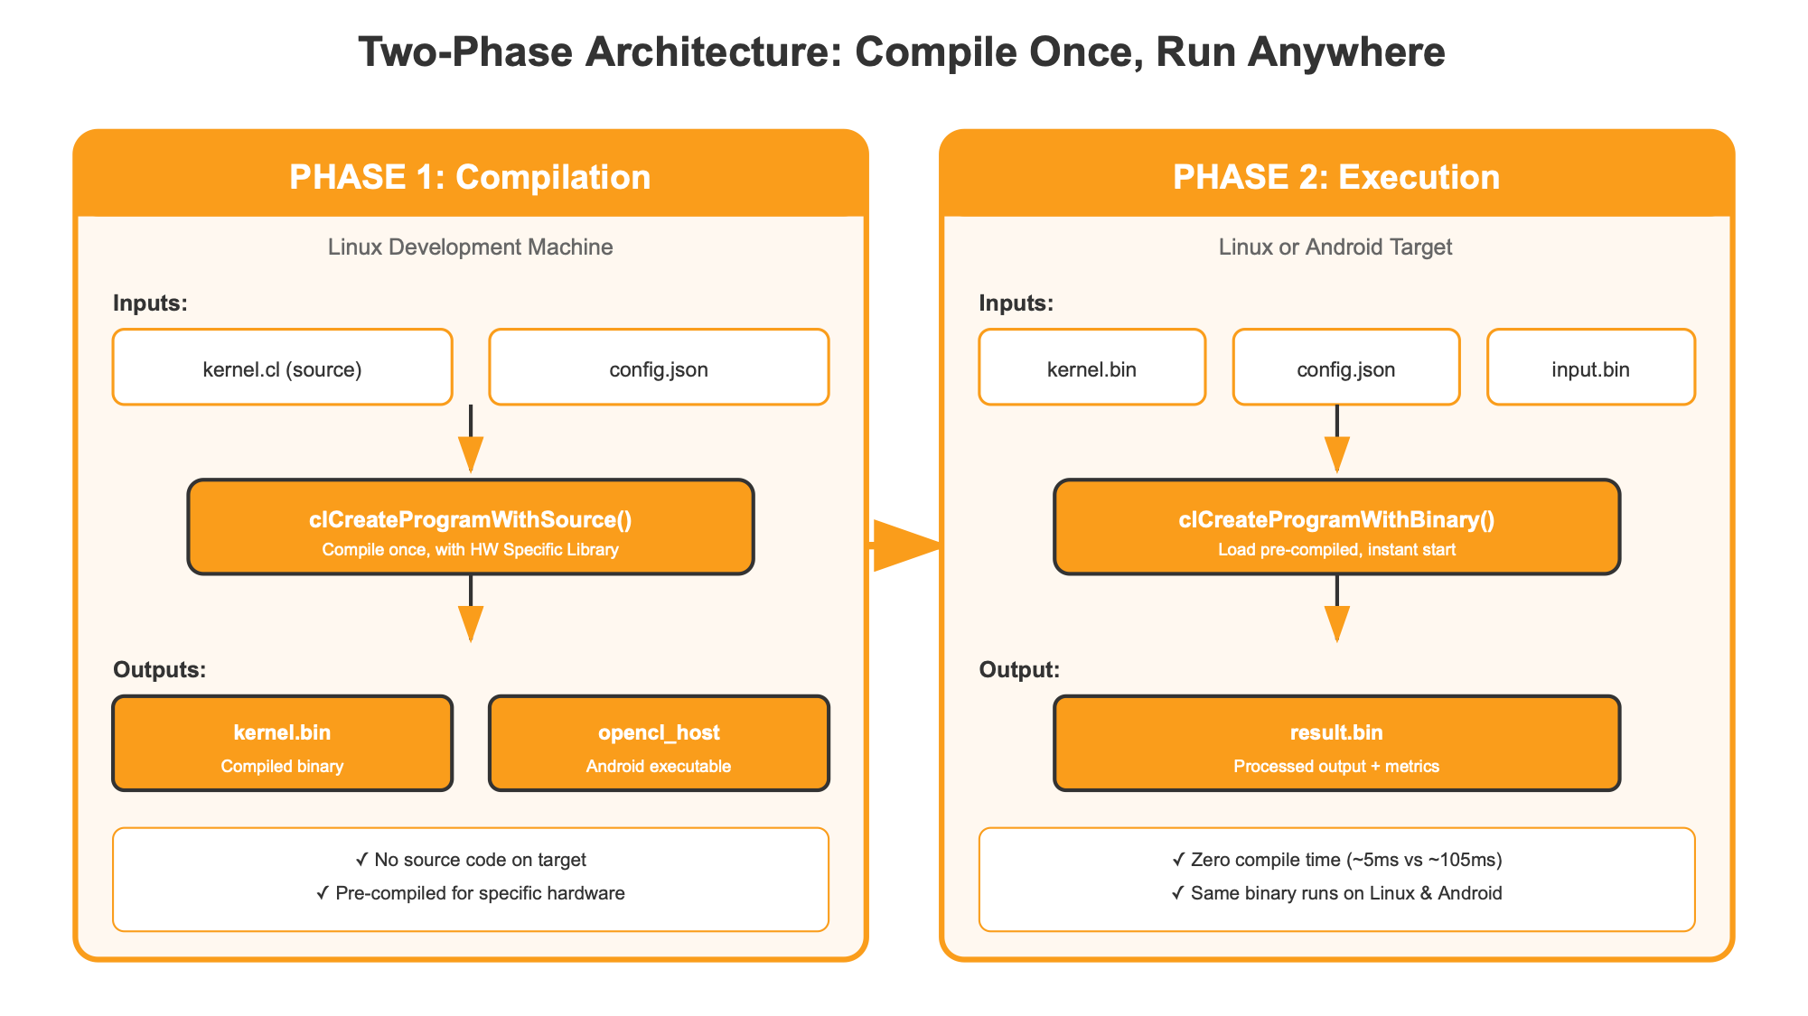
Two-Phase Architecture
Notes:
SLIDE 31: Two-Phase Architecture (4 min)
LEFT — COMPILATION PHASE: Runs on Linux dev machine. Takes kernel source + JSON config. Outputs compiled binary + executor program.
RIGHT — EXECUTION PHASE: Runs on target (Linux/Android). Takes pre-compiled binary + runtime config. Produces output.
Key insight: compilation happens ONCE. Execution happens MANY times — without compiling.
This is how you get fast startup, binary-only distribution, cross-platform deliverable.
TIP: Draw invisible line between phases. Emphasize "once" vs "many times".

Slide 23
Compilation Phase (WIP)
•
Runs once on Linux development machine
•
Input: kernel.cl source + config.json
•
Output: kernel.bin (compiled) + gpu_host (executor) OR mvpu_host (executor)
•
kernel.bin includes metadata for target device (how about batch binary ?!)
Notes:
SLIDE 30: Section Overview - Compilation Phase (30 sec)
In this section:
• WHEN and WHERE compilation runs
• INPUTS — source and config
• OUTPUTS — binary and executor
• What's INSIDE kernel.bin
Let's see the architecture.

Slide 24
Compilation Phase (WIP)
Purpose: Convert source + config into deliverable-ready binaries
Inputs
Outputs
• kernel.bin — Compiled binary
gpu_host — Linux executable
• mvpu_host (Player) — Linux executable
• mvpu_host (Player) — Android executable
• kernel.cl — Source code
• config.json — Configuration
kernel.bin contains:
• Compiled kernel binary (device-specific)
• Metadata (device name, OpenCL version)
• Compile options used
Notes:
SLIDE 32: Compilation Phase Details (3 min)
INPUTS: Kernel source + JSON configuration.
OUTPUTS:
1. kernel.bin — compiled binary for target device
2. opencl_host — Android-ready executable
kernel.bin contains not just binary, but metadata: device name, OpenCL version, compile options.
Run compilation once per target device type. Then ship the binary.
TIP: Show input → output flow. Emphasize metadata.

Slide 25
Execution Phase (WIP)
•
Runs many times on target device (Linux/Android)
•
Input: kernel.bin (pre-compiled) + config + data
•
Uses clCreateProgramWithBinary() — no compilation!
•
Performance: ~5ms vs ~105ms — 20x faster startup
Notes:
SLIDE 34: Section Overview - Execution Phase (30 sec)
In this section:
• WHERE execution runs — Linux or Android
• INPUTS — pre-compiled binary, config, data
• The KEY API — clCreateProgramWithBinary()
• PERFORMANCE gain — 20x faster
Let's see the details.

Slide 26
Execution Phase (WIP)
Purpose: Run kernel without compilation overhead
Inputs
Output
• kernel.bin — Pre-compiled
• config.json — Runtime config
• Input data
• result.bin — Processed output
Using clCreateProgramWithBinary()
Performance: ~5ms vs ~105ms (with compilation)
Loading pre-compiled binary eliminates 100ms compilation overhead
Notes:
SLIDE 35: Execution Phase (3 min)
INPUTS: Pre-compiled kernel.bin + runtime config + input data.
OUTPUT: Processed result.
The magic: clCreateProgramWithBinary(). Load pre-compiled binary directly.
Performance: ~5ms vs ~105ms. That's 20x improvement.
For real-time image processing, this difference is critical.
TIP: Emphasize clCreateProgramWithBinary(). Performance banner draws attention.

Slide 27
Cross-Platform Deliverable
•
Develop and compile on Linux (full toolchain)
•
Deploy to Linux (GPU/MVPU) OR Android (MVPU) devices
•
Only 3 types of files: opencl_host(s) + kernel.bin + config.json
•
Deliver offline compiler: No host source code, headers are needed on target
Notes:
SLIDE 37: Section Overview - Cross-Platform Deliverable (30 sec)
In this section:
• DEVELOP on Linux with full toolchain
• DEPLOY to Linux or Android
• WHAT TO SHIP — just 3 files
• What you DON'T ship — source stays home
Let's see the flow.

Slide 28
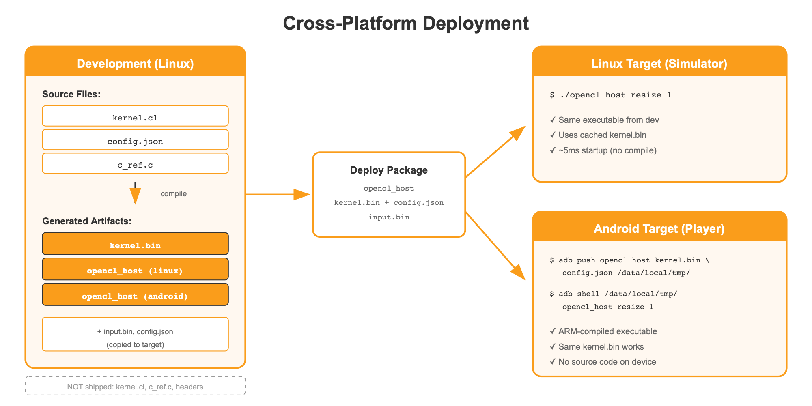
Cross-Platform Deliverable
Notes:
SLIDE 38: Cross-Platform Deliverable (3 min)
Develop on Linux — full toolchain available.
Produce deliverable package: executor binary + compiled kernel.
Deploy to Linux servers OR Android devices. Same package, different targets.
Android doesn't need compilation infrastructure — just executor + pre-compiled binary.
TIP: Show flow left to right. Emphasize Android without toolchain.

Slide 29
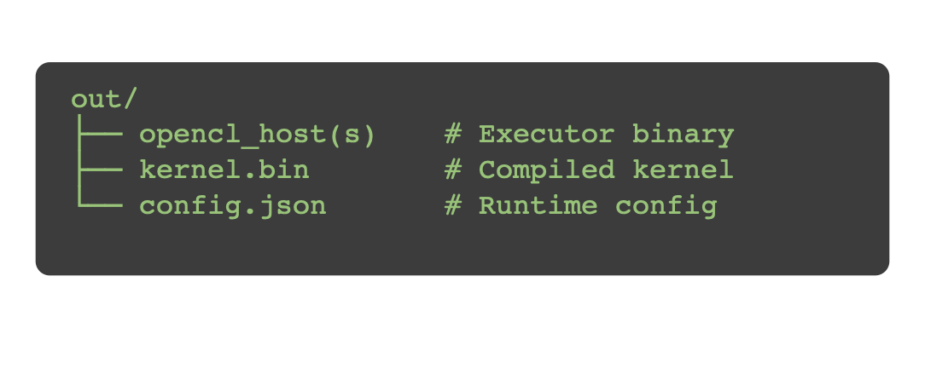
What to Deliver
Execution Package:
NOT required in execution:
✗ kernel.cl (source code)
✗ include/ (headers)
✗ Host code build tools
✗ Host code development dependencies
Benefits: Smaller footprint • No source exposure • Faster startup
Notes:
SLIDE 39: What to Ship (3 min)
WHAT YOU SHIP (3 files):
• opencl_host — executor binary
• kernel.bin — compiled algorithm
• config.json — runtime config
WHAT YOU DON'T SHIP:
• Source code — stays on dev machine
• Headers — not needed at runtime
• Build tools — no compilation on target
• Dev dependencies — execution is lean
Benefits: smaller footprint, no source exposure, faster startup.
TIP: Contrast the two lists. "Ship this, not that."

Slide 30
Summary
Phase | When | Where | Output
Compilation | Once | Linux | kernel.bin + opencl_host
Execution | Many times | Linux/Android | result.bin
Key Benefits:
✓ Zero compile time after first run
✓ Binary-only deliverable
✓ Cross-platform support (GPU + MVPU)
✓ Smaller execution footprint
Notes:
SLIDE 41: Summary (3 min)
COMPILATION: Once, on Linux, produces kernel.bin + opencl_host.
EXECUTION: Many times, on Linux/Android, produces results.
Key benefits:
• Zero compile time after first run
• Binary-only deliverable
• Cross-platform support
• Smaller execution footprint
You now have everything to go from development to execution .
TIP: Touch table, then benefits. Build to confident conclusion.

Slide 31
Questions & Discussion
Thank you!
Notes:
SLIDE 33: Q&A (5+ min)
Thank you for your attention!
Let's open the floor for questions.
[If no immediate questions, seed with:]
• "A common question is about performance vs hand-written host code..."
• "Some teams ask about integrating with existing build systems..."
• "You might be wondering about debugging kernel issues..."
POTENTIAL Q&A:
Q: How does this compare to vendor SDKs?
A: Vendor SDKs lock you in. Our framework abstracts both standard CL and vendor extensions. You get portability AND performance.
Q: What's the learning curve?
A: If you know OpenCL kernels, you're 90% there. JSON config takes maybe an hour. Most people are productive within a day.
Q: Can I use existing kernels?
A: Absolutely. Just create a JSON config. No code changes needed.
Q: What about debugging?
A: Framework provides detailed error messages and profiling. For kernel debugging, use standard OpenCL tools.
[For closing:]
Feel free to reach out if you have questions after this session.
Thank you!

