Slide 1
Bluestock MF Capstone
Executive summary, performance analysis, and dashboard highlights

Slide 2
Problem & Objective
Assess mutual fund returns, risk, and benchmark performance across 40 schemes.
Build a repeatable analytics pipeline for ETL, EDA, and performance reporting.
Deliver a professional dashboard and final report for decision support.

Slide 3
Data Sources
Fund master, NAV history, AUM, SIP inflows, category inflows, folio counts, holdings, transactions, and benchmarks.
Cleaned data is stored under data/processed for downstream analytics.

Slide 4
Architecture
Modular ETL with ingestion, cleaning, validation, analytics, and reporting steps.
Processed CSV outputs and static dashboard artifacts support reproducible delivery.

Slide 5
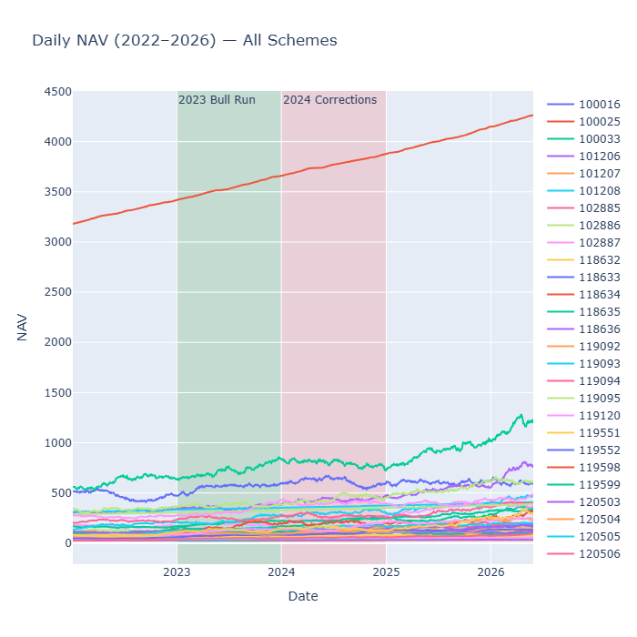
EDA Highlight 1
NAV trending across schemes reveals market cycles and fund movement.

Slide 6
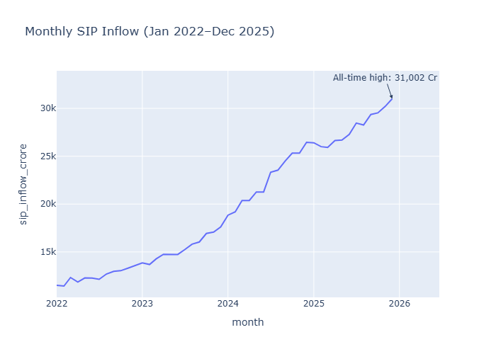
EDA Highlight 2
Monthly SIP inflows show strong retail contribution to fund flows.

Slide 7
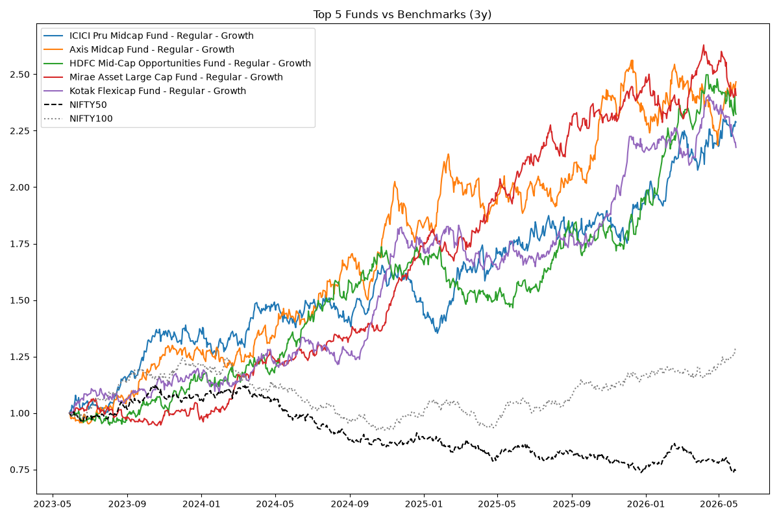
Performance Metrics
Top funds compared with NIFTY benchmarks to validate strategy performance.

Slide 8
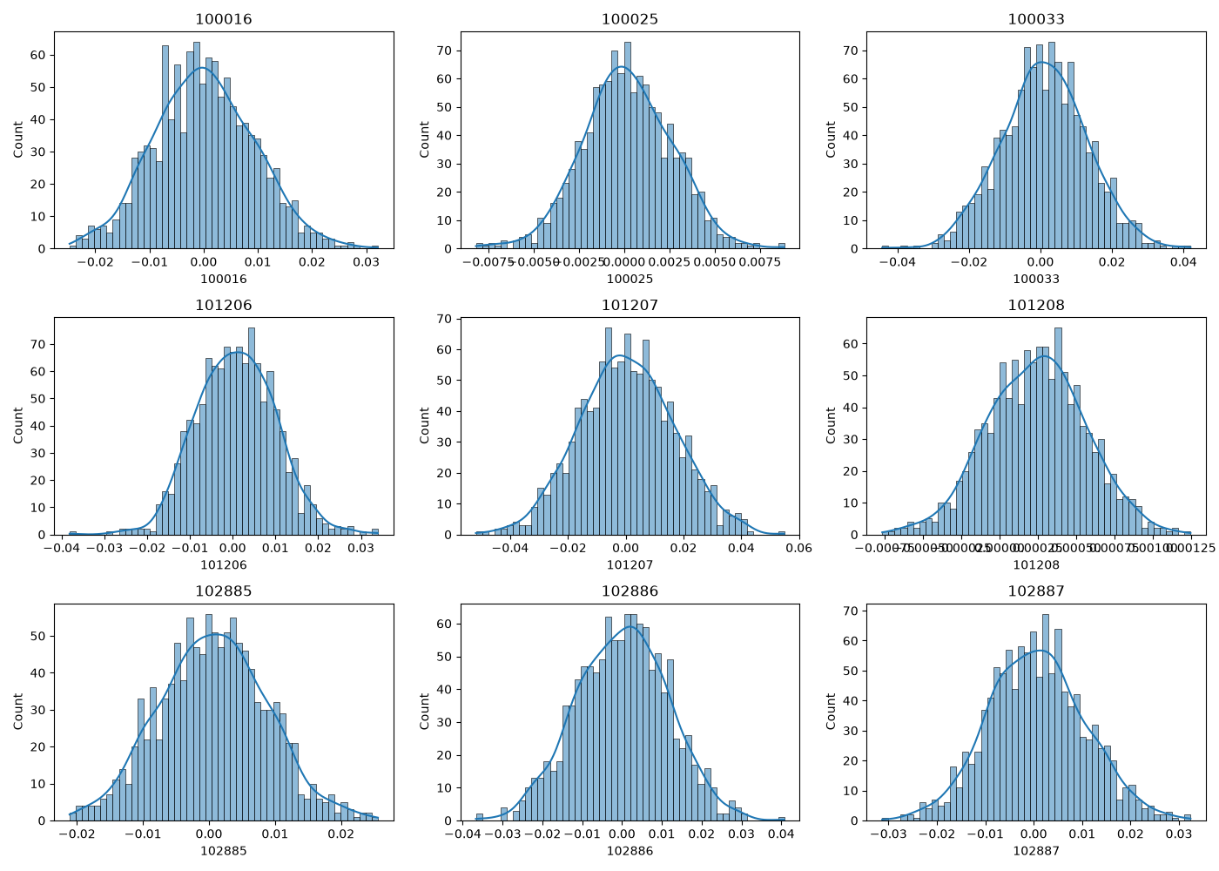
Risk Metrics
Daily return distributions and volatility are used to quantify downside exposure.

Slide 9
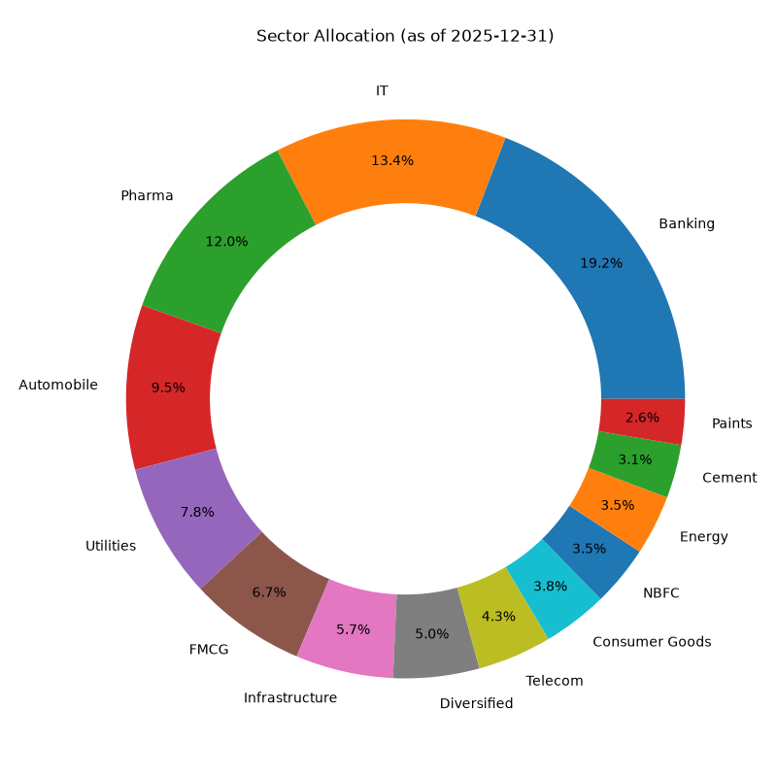
Dashboard Screenshot
Sector allocation and AUM distribution provide quick portfolio insight.

Slide 10
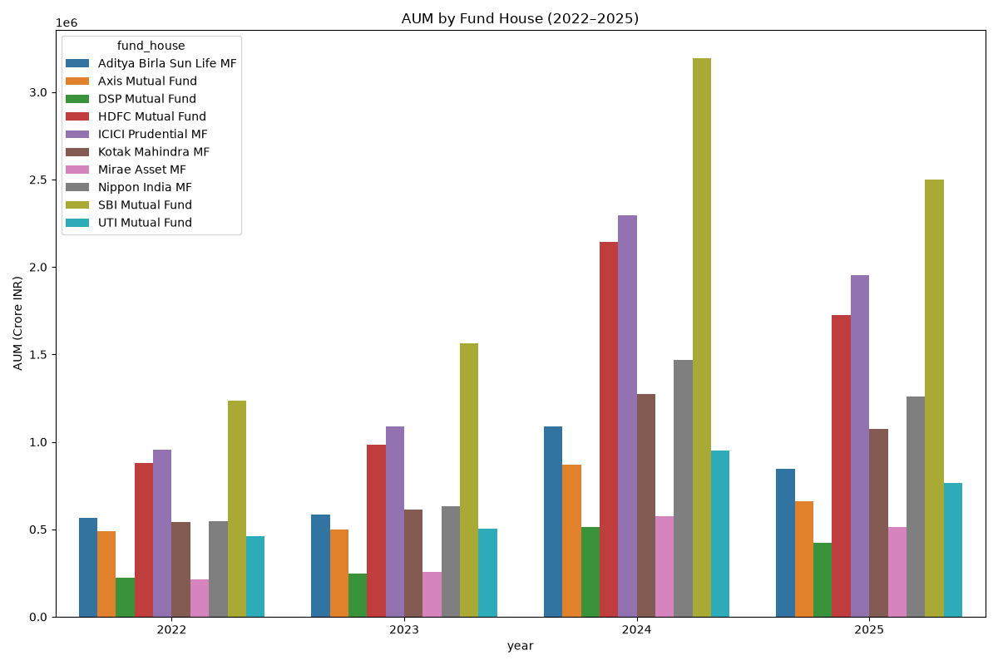
Dashboard Screenshot
AUM by fund house highlights concentration and market share.

Slide 11
Key Findings
Strong SIP inflows and AUM growth indicate continued investor confidence.
Top-ranked funds show favorable risk-adjusted returns versus benchmarks.
Correlation analysis underlines the importance of diversification across themes and sectors.

Slide 12
Thank You
Contact: Bluestock Analytics
Repository includes final report, slide deck, and dashboard artifacts.

