Slide 1
Simulation World:- ROS Package
ROS
Robot Operating System is an open source, robotic middleware unix based platform
It provides the services like hardware abstraction, low-level device control, implementation of commonly-used functionality, message-passing between processes, and package management
Comes with tools and libraries for obtaining, building, writing, and running code across multiple computers
Distributed framework of processes (nodes) enables code reuse which can be use across robotics research and development
RVIS-ROS
3D visualization tool for ROS
Gazebo-ROS
Simulation environment providing platform to evaluate robot design and control software

Slide 2
Simulation World:-Development path
Phase.01 (Gazebo Model… Simulation) | Phase.02 (Model… Control and Feature Software.. Simulation) | Phase.03 | Phase.04
Model(wheelchair + drive unit)
Model update(Sensor + Camera)
Drive unit Control Sw development
Features development
Simulation world development
Model simulation in Gazebo

Slide 3
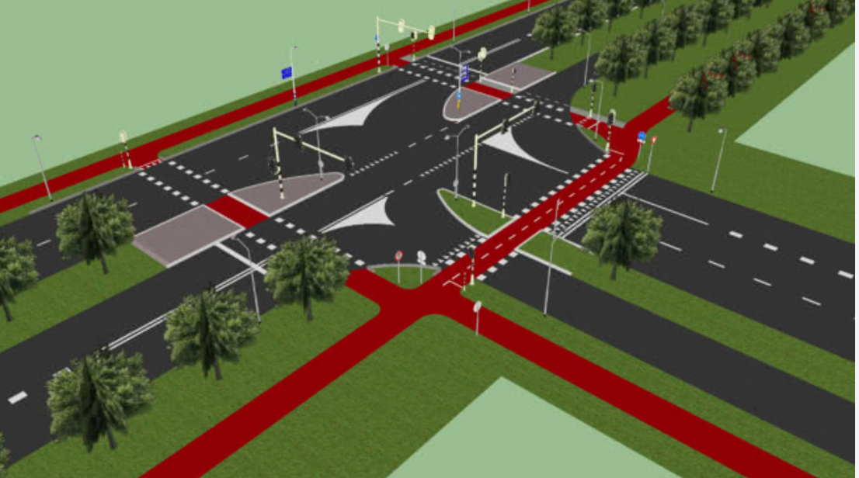
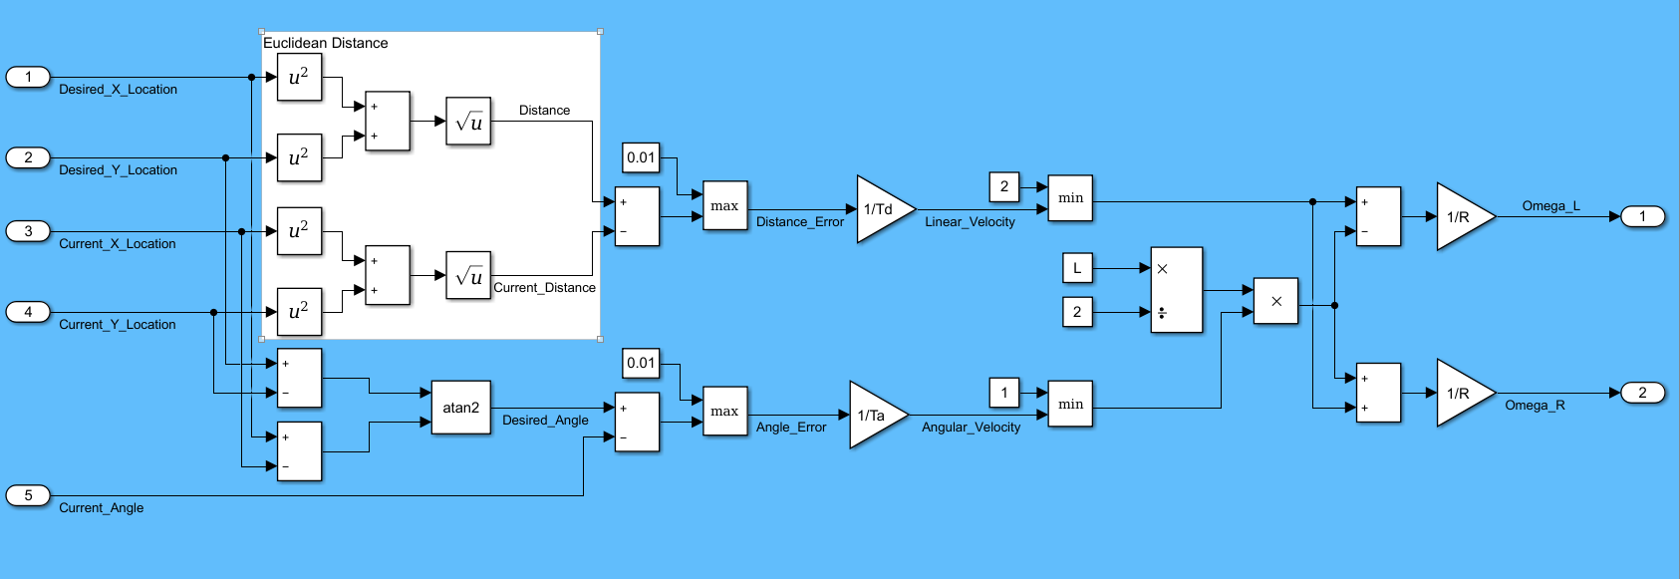
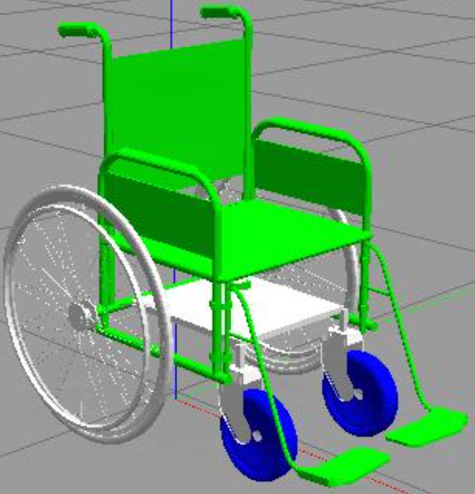
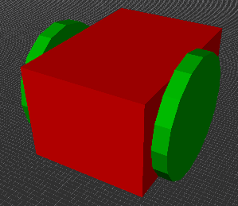
Simulation World:-Development path
*WC+DU model
* WC+DU model with sensors * Control / feature Sw
*Complete Simulation Environment
(model+world)
* Control /feature Sw * World development for simulation
WC – Wheel Chair
DU – Drive Unit
Sw - Software

Slide 4
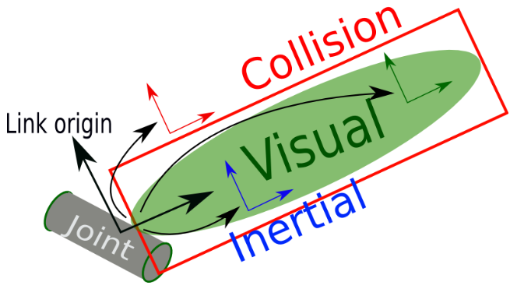
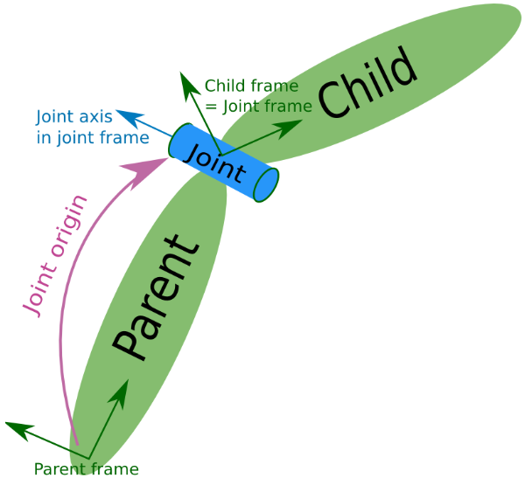
Where is Physics ?
Simulation Model
Model in RVIS is combination of links and joints
Link can be shape of robot or particular part of robot
Joint connects 2 links and also defined how that connection will behave
in simulation world
Physical Properties
Inertia :- In 3D visualization, inertia matrix can be defined for a link
with mass M and constant density w.r.t its shape
Contact Coefficient :- Defines how the links behave when they are in contact with one another. This is done by specifying 3 different attributes
mu – friction coefficient
kp – stiffness coefficient
kd – dampening coefficient
Joint Dynamics :- Defines dynamic of joint. There are two attributes here
friction – The physical static friction
damping – The physical damping

Slide 5
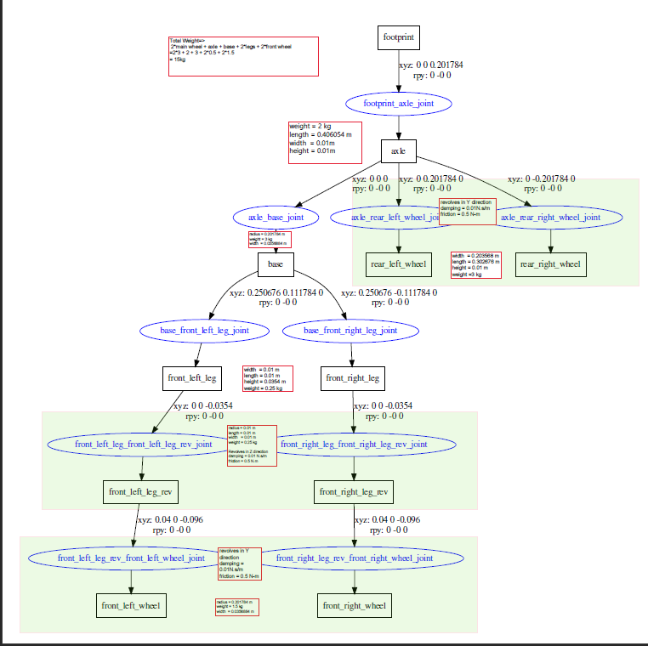
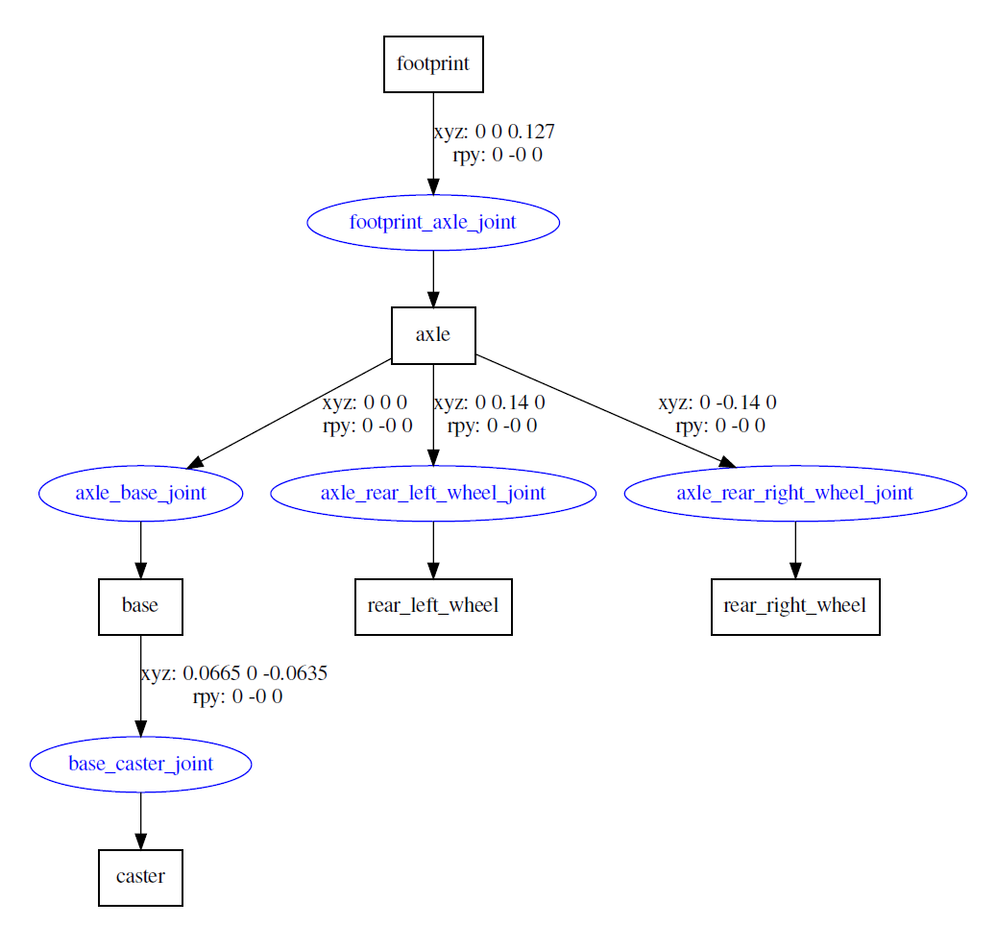

Slide 6
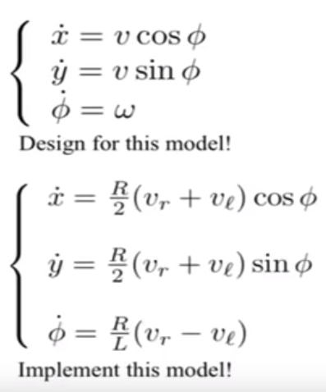
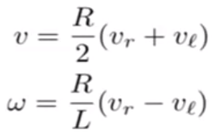
Divide And Concur
Control Strategy
Controller with strategies specific to different conditions – Behavior
→ go to goal
→ avoid obstacle
→ track target
Controlling parameter :- linear velocity (translational motion v)
Angular velocity (rate at which it can turn w)
linear velocity can help to determine robot’s position (x,y co-ordinates) and angular velocity can give robot’s orientation(α). As per below expression, v and w can directly translated into respective wheel velocities (vr and vl)
angle
(X,Y)
x =vcos(α)
y =vsin(α)
α = w
By equating LHS and RHS
Differential drive robot model

Slide 7
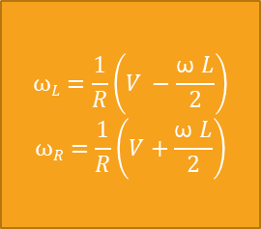
Simulation World:-Development path
Control Strategy
Kp
Desired positon
-
error
*
V
$$ωL=\frac{1}{R}\left(V −\frac{\text{ω} L}{2}\right)$$
$$ωR=\frac{1}{R}\left(V+\frac{\text{ω} L}{2}\right)$$
ω_{L}
Current position
Desired orientation
-
error
*
ω
ω_{R}
Current orientation
Kp

Slide 8
Simulation World:-Development path
Control Design

Slide 9
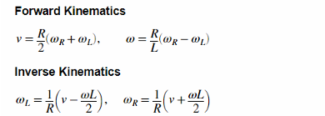
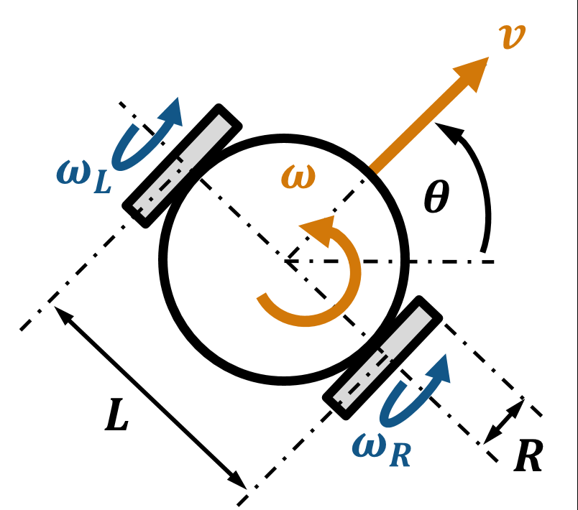

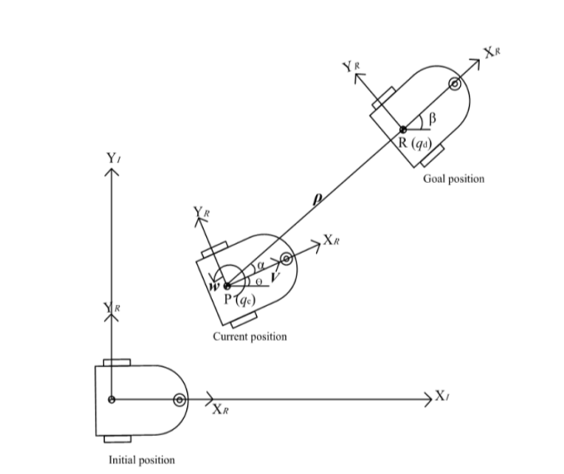
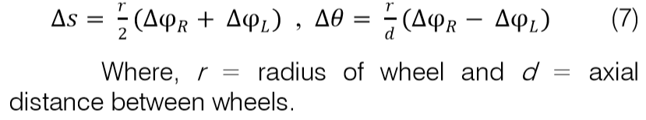
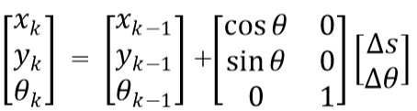

Slide 10
Simulation World:-Development path
Model + Sensors
Wheel Chair + Drive Unit in Gazebo(model)
ROS GAZEBO
platform understanding
Phase.01
Phase.02
Phase.03
Phase.05
Phase.04

