Slide 1

RetailIQ
An End-to-End E-Commerce Customer and Sales Analytics Platform
Data Science Project Review-3
 | Under the Guidance of Dr. N. Sunanda Associate Professor Department of Computer Science and Engineering, KLH CSE Bowrampet Campus
Team 7: Name: B. Kundana Mani Roll Number: 2420030558 Name: M. Sai Kridhay Kumar Roll Number: 2420030211

Slide 2
Outline of Project Work
Introduction
Problem Statement
Literature Survey
Challenges
Research Objectives
Conclusion & Future Work
References
Publications Details

Slide 3
INTRODUCTION
RetailIQ is a full-cycle e-commerce analytics project focused on understanding customer behaviour and overall sales performance using retail transaction data.
Analyses customer, product, sales and revenue data
Uses Exploratory Data Analysis (EDA) to identify patterns and trends
Applies statistical analysis and visualization techniques
Provides an interactive dashboard for business monitoring
Converts raw transaction data into meaningful business insights

Slide 4
PROBLEM STATEMENT
E-commerce businesses generate large volumes of transaction data, but raw data is difficult to interpret and use for decision-making.
Customer purchasing patterns are difficult to identify.
Product and category performance is not easily compared.
Sales and revenue trends can be hidden within large datasets.
Identifying valuable customer segments requires detailed analysis.
Manual analysis of transaction data is time-consuming.
Businesses need a centralized view of important performance metrics.

Slide 5
OBJECTIVES
Customer Analysis – Understand customer purchasing behaviour and spending patterns.
Product Analysis – Identify top-performing and low-performing products.
Sales Analysis – Analyse sales trends across different time periods.
Revenue Analysis – Identify major contributors to overall revenue.
Customer Segmentation – Group customers based on their purchasing behaviour.
Dashboard Development – Present important metrics and insights through an interactive dashboard.

Slide 6
EXPECTED OUTCOMES
Clean and structured retail transaction dataset
Identification of important customer purchasing patterns
Identification of high-performing products and categories
Analysis of sales and revenue trends
Meaningful customer segments
Interactive visualization of key business metrics
Centralized dashboard for easier interpretation
Insights to support data-driven decision-making

Slide 7
DATASET
Source: Kaggle – E-Commerce Sales and Customer Analytics
Type: Simulated Indian e-commerce data
Datasets: 7 CSV files
Dataset Size:
Customers: 25,000
Orders: 1,00,000
Order Items: 2,54,331
Products: 550
Payments: 1,00,000
Returns: 12,075
Reviews: 77,530
Purpose: Analyse customer behaviour, sales, product performance, returns, and payments.

Slide 8
LITERATURE SURVEY
Authors | Title | Methodology | Inferences | Limitation / Future Work
Chen et al. (2012) | Data Mining for Online Retail Industry | RFM, K-Means | Effective customer segmentation | Mainly customer-focused
Hong & Kim (2012) | Customer Segmentation in Online Stores | SOM, K-Means, KNN | Identifies customer groups | Limited business-wide analysis
Griva et al. (2018) | Retail Business Analytics | Market Basket, Clustering | Identifies shopping patterns | Focuses mainly on customer visits
Wong et al. (2024) | Customer Segmentation in E-Commerce | RFM, Clustering | Identifies valuable customer groups | Mainly segmentation-focused

Slide 9
PROBLEM GAP IDENTIFICATION
Existing Focus
Customer Segmentation – grouping customers based on their purchasing behaviour.
RFM Analysis – evaluating customers using Recency, Frequency and Monetary value.
Purchase Behaviour – analysing what, when and how frequently customers purchase.
Market Basket Analysis – identifying products that are frequently purchased together.
Sales Analysis – analysing sales performance and trends.
Identified Gap
Most approaches focus on specific aspects of e-commerce analytics rather than providing a unified view of the complete business.
There is a need to integrate:
Customer Behaviour + Product Performance + Sales + Revenue
RetailIQ
RetailIQ addresses this gap by bringing these analytical aspects together and presenting the results through visualization and an interactive dashboard.
Transaction Data → Data Analysis → Visualization → Business Insights

Slide 10
Integrated e-commerce analytics
Customer behaviour analysis
Product performance analysis
Sales & revenue analysis
INNOVATION

Slide 11
Interactive dashboard
Visual KPI representation
Easy-to-understand business insights
CREATIVITY

Slide 12
Unified view of customer, product, sales and revenue information in one analytics platform.
NOVELTY

Slide 13
FEASIBILITY
Technical Feasibility
Python-based data analysis
Pandas & NumPy
Data visualization tools
Interactive dashboard
Economic Feasibility
Open-source tools
Existing computing resources
Low development cost
Operational Feasibility
Easy-to-understand visualizations
Centralized business insights
Supports data-driven decisions

Slide 14
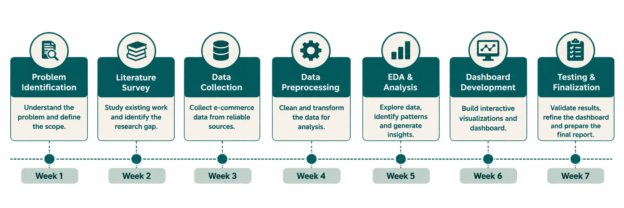
PROJECT PLAN

Slide 15
METHODOLOGY
1. Data Cleaning: Handled missing values using median values (for age and ratings)
2. Data Integration: Merged 7 separate business tables (customers, orders, items, products, payments, returns, reviews) into one master dataset (retailiq_master.csv).
3. Feature Engineering: Created 15+ new metrics like item-level profit, profit margin %, customer lifetime days, discount amounts, and order time features.
4. Customer Behavioral Modeling: Computed RFM metrics (Recency, Frequency, Monetary) to assess customer purchasing habits.
5. Machine Learning Segmentation: Standardized RFM features and grouped customers into data-driven clusters using K-Means.
6. Operations & Sentiment Analysis: Evaluated return causes, payment gateway failure rates, and customer review sentiments.
7. Interactive BI Dashboard: Developed a multi-page interactive Streamlit dashboard with Plotly charts for decision-making.

Slide 16
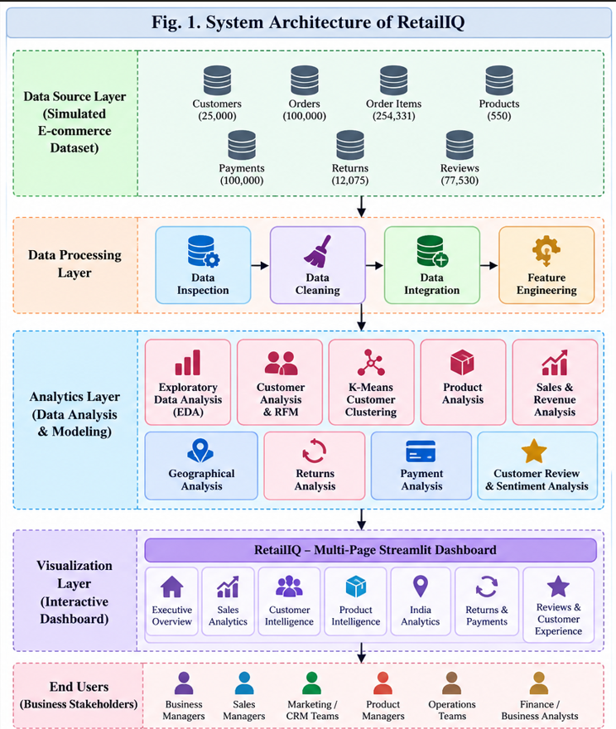
ARCHITECTURE

Slide 17
IMPLEMENTATION
Programming Language: Python
Core Libraries:
  Data Processing: Pandas, NumPy
  Machine Learning: Scikit-Learn (KMeans, StandardScaler, silhouette_score)
  Data Visualization: Plotly Express & Graph Objects, Matplotlib
  Web Application: Streamlit (with custom dark-mode CSS theme)
Dataset Scale: 100,000 orders, 25,000 customers, 254,331 line items, 550 products across India.

Slide 18
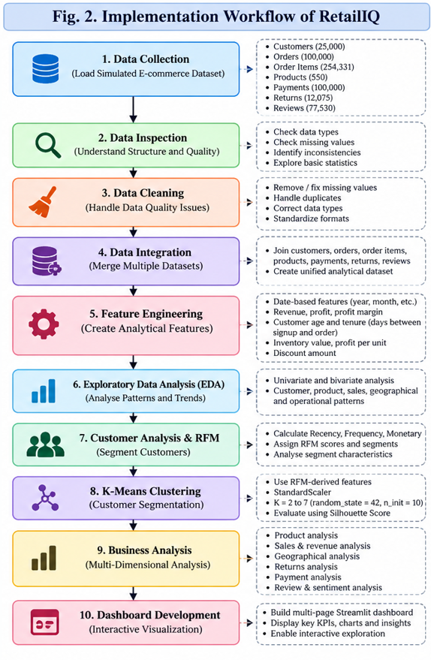
IMPLEMENTATION

Slide 19
ALGORITHMS USED
1. RFM Scoring & Quantile Binning:
  Divides customers into 5 quantile ranks (1 to 5) based on Recency (last purchase date), Frequency (order count), and Monetary (total spent).
  Automatically assigns customer segments: Champions, Loyal, New, At Risk, and High-Value At Risk.
2. K-Means Clustering (sklearn.cluster.KMeans):
  An unsupervised ML algorithm that automatically groups 25,000 customers into distinct behavioral clusters based on similarity in RFM features.
3. StandardScaler (Z-Score Normalization):
  Rescales RFM values so large money values (thousands of Rupees) don't overpower small order frequency counts (1 to 10 orders).
  4. Sentiment Classification Logic:
  Rules-based text & rating mapping that classifies reviews into Positive, Neutral, or Negative to detect dissatisfaction drivers.

Slide 20
THANK YOU

