Slide 1

RETAILIQ
An End-to-End E-Commerce Customer and Sales Analytics Platform
Final Project Review | Department of CSE | KLH
TEAM MEMBERS
2420030558 – B. Kundana Mani
2420030211 – M. Sai Kridhay Kumar
Guide: N. Sunanda, Associate Professor | Academic Year: 2026–27
Notes:
Title slide. Replace all bracketed text. Use the full project title, list every team member with registration number, and name your guide. Insert the institution logo in the dashed box.

Slide 2
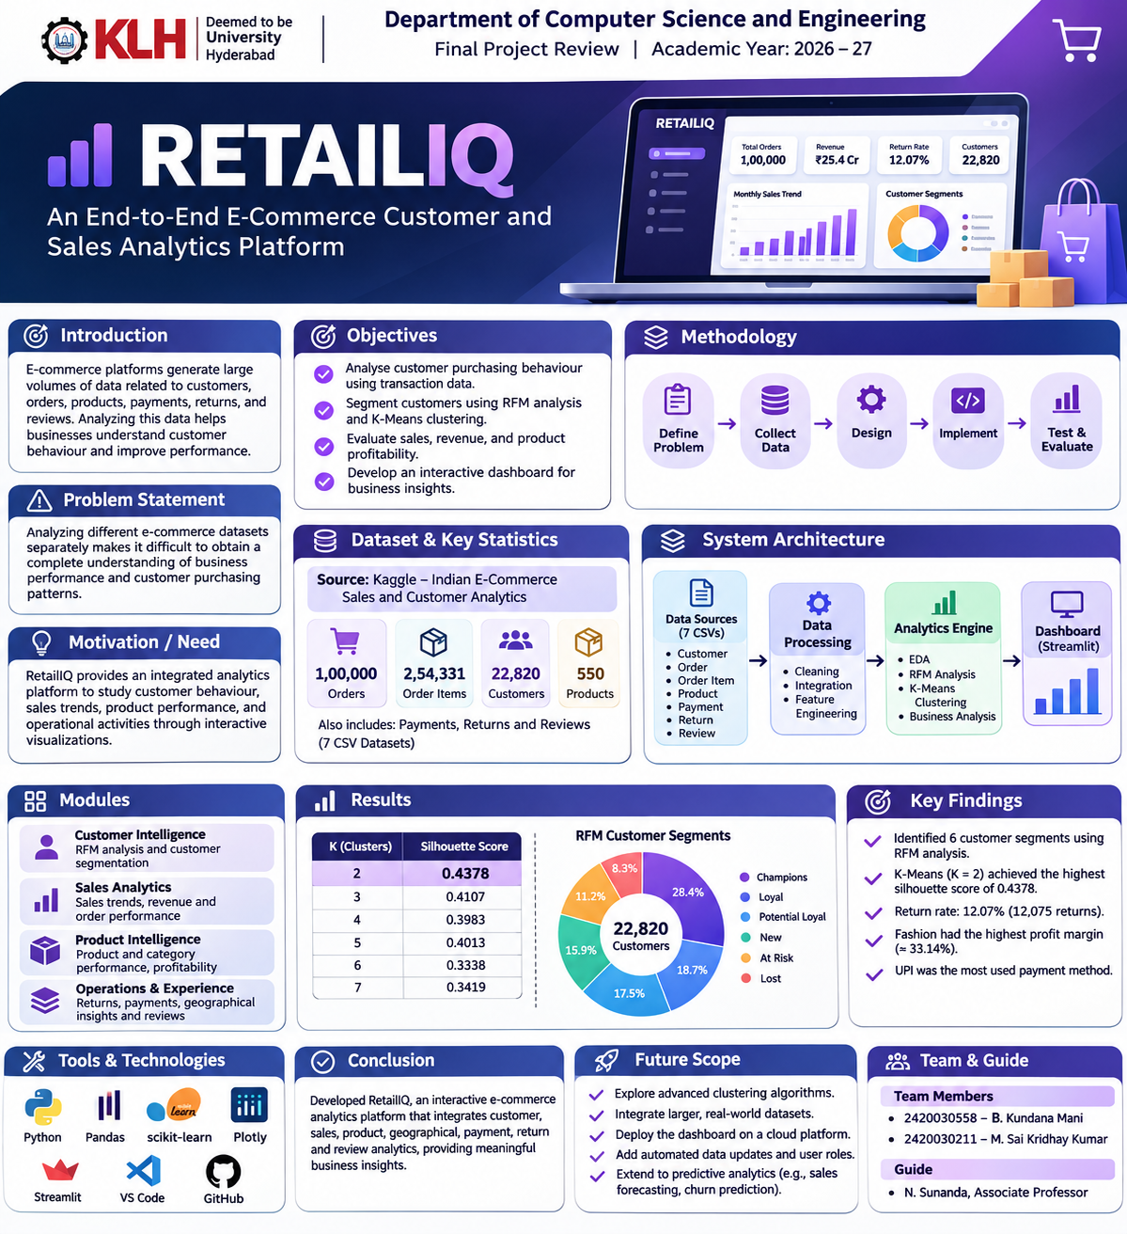



Introduction & Problem Statement
Background
E-commerce platforms generate large amounts of data related to customers, orders, products, payments, returns, and reviews. Analyzing this data helps businesses understand customer behaviour and sales performance.
Problem Statement
Analyzing different e-commerce datasets separately makes it difficult to obtain a complete understanding of business performance and customer purchasing patterns.
Motivation / Need
RetailIQ provides an integrated analytics platform to study customer behaviour, sales trends, product performance, and operational activities through interactive visualizations.
Notes:
State the domain, the exact problem and why it matters. Keep it to about 2 minutes. Add one real-world statistic if you can, with a citation.

Slide 4


Objectives & Scope
Objectives
1
Analyse customer purchasing behaviour using transaction data.
2
Segment customers using RFM analysis and K-Means clustering.
3
Evaluate sales, revenue, and product profitability.
4
Develop an interactive dashboard for business insights.
Scope
Includes customer, sales, product, geographical, payment, return, and review analytics using simulated Indian e-commerce data. Real-time data collection and predictive forecasting are outside the current scope.
Notes:
Objectives should be measurable and start with action verbs. The scope slide tells the panel what you did and did not attempt.

Slide 5

Literature Survey
S.No | Author(s) & Year | Method / Technique | Key Findings | Limitation / Gap
1 | Ngai et al. (2009) | Data mining in CRM | Data mining supports customer identification and retention. | Broad CRM focus.
2 | Chen and Huang (2007) | RFM analysis | Identifies customer purchasing patterns and value. | Focuses mainly on customer analysis.
3 | MacQueen (1967) | K-Means clustering | Groups similar data points into clusters. | Requires selecting the number of clusters.
4 | Rousseeuw (1987) | Silhouette coefficient | Evaluates clustering quality. | Does not measure business usefulness directly.
Research Gap
Existing approaches often address individual analytical tasks. RetailIQ combines customer segmentation, sales, product, geographical, payment, return, and review analytics in one interactive platform.
Notes:
Summarise four to six relevant papers or existing systems. End with the research gap, because that gap justifies your project.

Slide 6





Proposed System & Methodology
STEP 1
STEP 2
STEP 3
STEP 4
STEP 5
Define Problem
Collect Data
Design
Implement
Test & Evaluate
Identify the need for an integrated platform to analyse e-commerce customer and business data.
Collect seven CSV datasets containing customer, order, order-item, product, payment, return, and review information.
Design the data processing pipeline using Python, RFM analysis, K-Means clustering, and visualization techniques.
Develop data cleaning, integration, feature engineering, analytics modules, and a Streamlit dashboard.
Validate dataset relationships, evaluate clustering using silhouette scores, and verify dashboard outputs.
Key Novelty / Contribution
RetailIQ integrates customer segmentation, sales, product, geographical, payment, return, and review analytics into a single interactive dashboard, providing a consolidated view of e-commerce business performance.
Notes:
Walk through the five steps left to right. Rename the steps to match your project (for example, Requirement Analysis, Design, Coding, Testing, Deployment). End with your novelty.

Slide 7
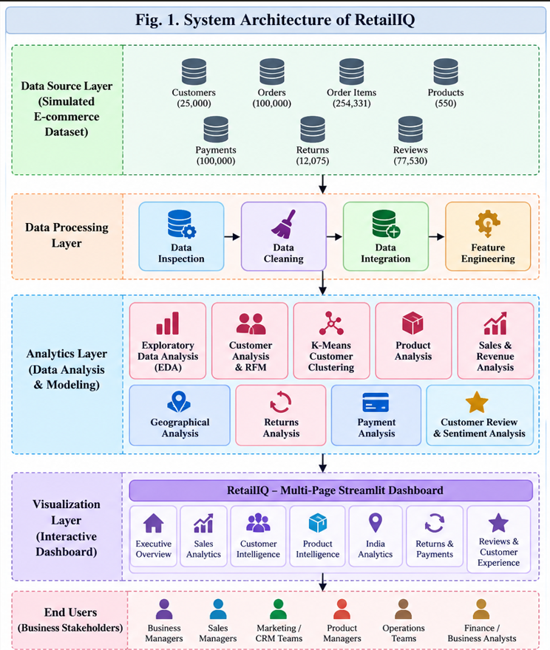
System Architecture
Components
1
Data Sources
Contains seven datasets related to customers, orders, products, payments, returns, and reviews.
2
Data Processing
Performs cleaning, integration, and feature engineering using Python and Pandas.
3
Analytics Engine
Performs EDA, RFM analysis, K-Means clustering, and business analysis.
4
Dashboard
Displays analytical results through interactive charts and visualizations using Streamlit and Plotly.
Notes:
Insert a clear block diagram: input, processing, storage, output. Number each block and explain them on the right. Redraw the figure yourself rather than copying it.

Slide 8


Hardware & Software Requirements
Hardware
Software & Tools
Libraries / Frameworks
Processor: Multi-core CPU
RAM: Depends on the local system
Storage: Sufficient space for datasets and project files
Operating System: Windows
Programming Language: Python
IDE: Visual Studio Code
Version Control: Git and GitHub
Pandas and NumPy
Matplotlib and Seaborn
Scikit-learn
Plotly and Streamlit
Deployment / Platform
Local machine using Streamlit
Notes:
List only what you actually used, with versions. For a pure software project, shorten the hardware list and add cloud or deployment resources.

Slide 9
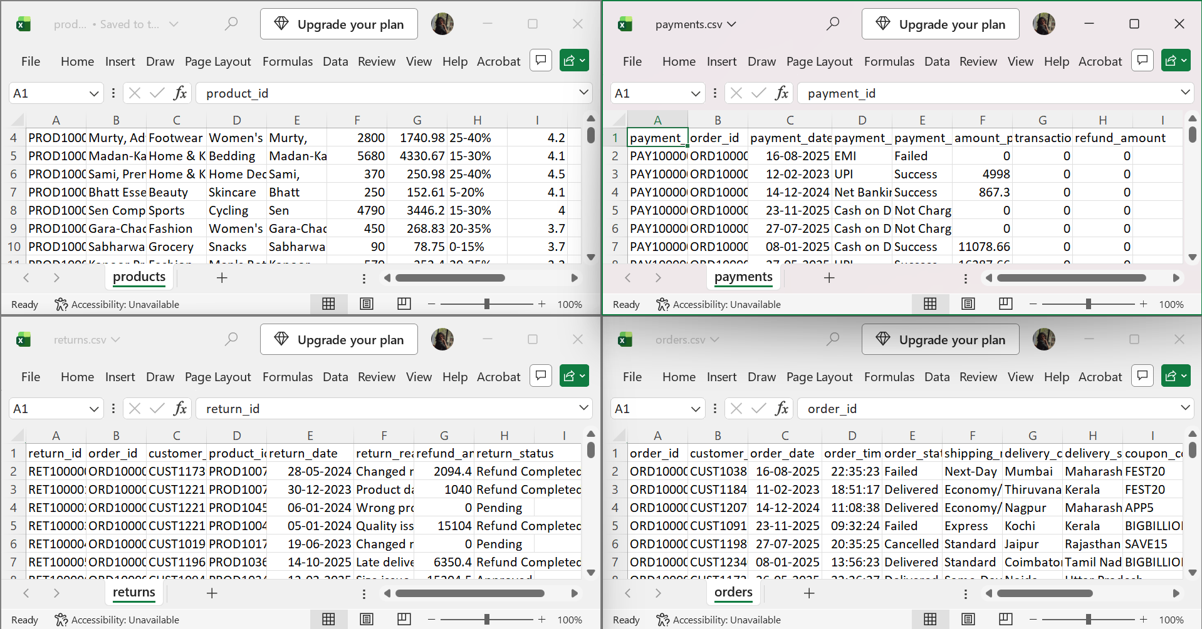
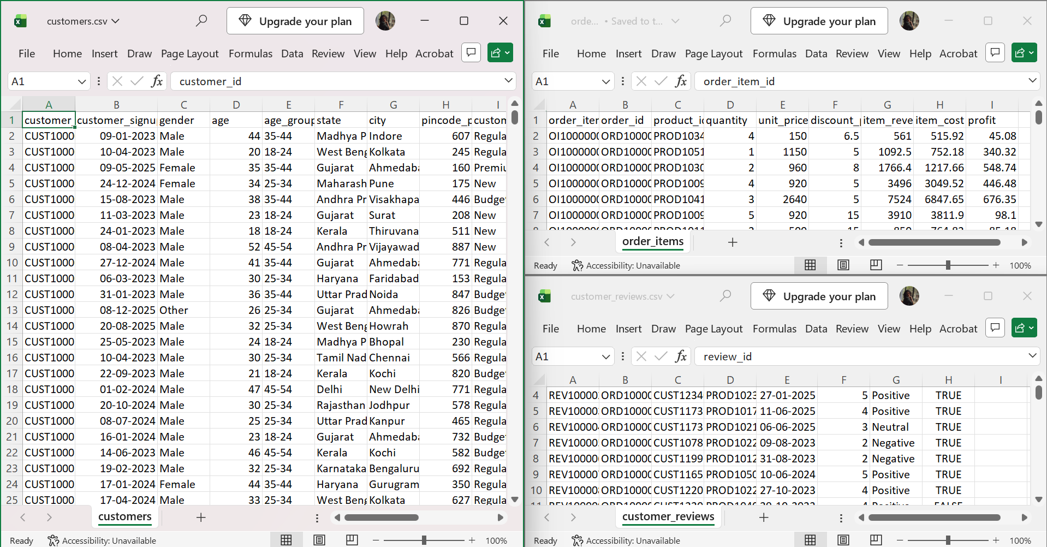
Dataset / Data Understanding
2,54,331
7
Order-item records
CSV datasets
25,000
550
Customer records
Product records
Source: Kaggle – Indian E-Commerce Sales and Customer Analytics.
Features: Customer details, order dates, product information, quantities, prices, payments, returns, and customer ratings.
Quality: Missing values were handled, data types were standardized, and relationships between datasets were checked.
Notes:
Explain where the data came from and what it contains. Show a screenshot of the first rows or the info summary. For non-data projects, replace this slide with “Requirement Analysis” or “Input Specification”.

Slide 10
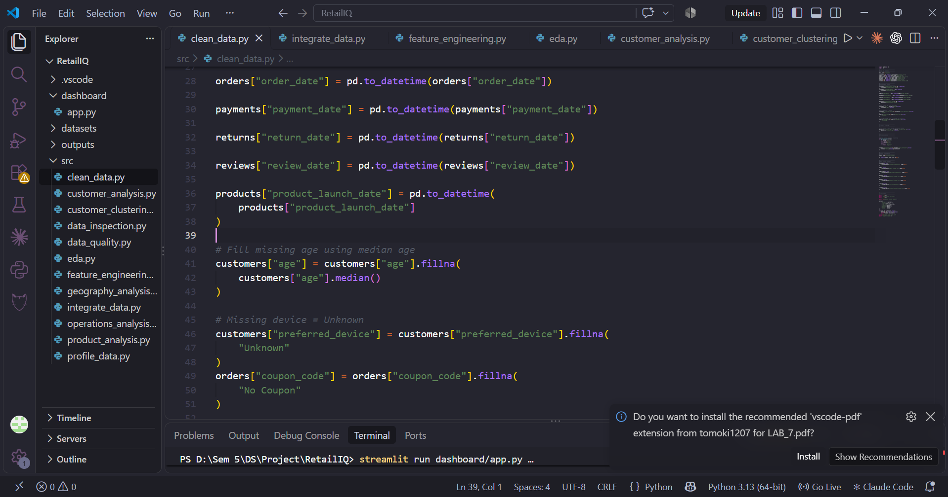
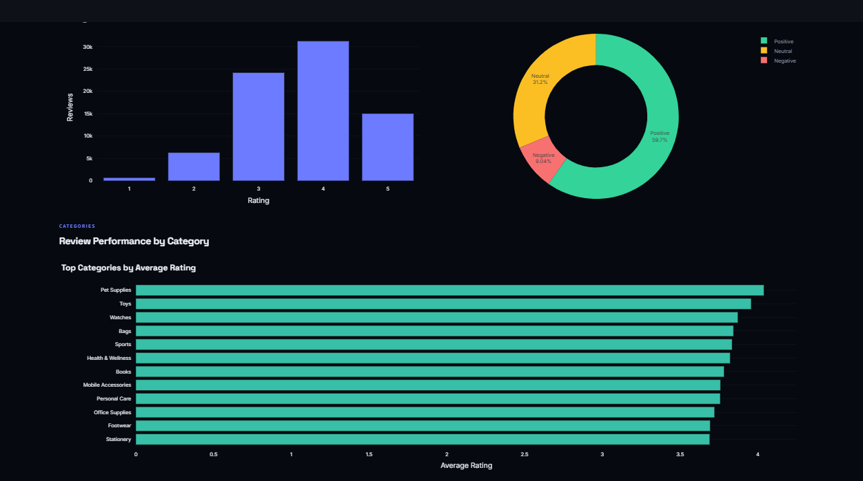



Data Preprocessing & Exploratory Analysis
Cleaning
Transformation
Feature Selection
Handled missing values using suitable imputation methods.
Standardized date formats and data types.
Checked duplicate records and dataset relationships.
Integrated customer, order, order-item, and product datasets.
Created revenue, profit margin, and discount features.
Applied StandardScaler to RFM features for clustering.
Selected Recency, Frequency, and Monetary (RFM) features for K-Means clustering.
Used transaction, product, and customer attributes for business analysis.
Notes:
Show two or three plots that tell a story: distributions, correlations, outliers. Explain what each plot told you and what you did about it.

Slide 11
Module-wise Description
1
Customer Intelligence Module
2
Sales Analytics Module
Purpose: Analyze customer behaviour and purchasing patterns.
Input → Output: Customer and order data → RFM scores and customer segments.
Developed collaboratively by the project team
Purpose: Analyze sales trends, revenue, and order performance.
Input → Output: Order and order-item data → Sales and revenue insights.
Developed collaboratively by the project team
3
Product Intelligence Module
4
Operations and Experience Module
Purpose: Evaluate product and category performance.
Input → Output: Product and order-item data → Product revenue and profitability analysis.
Developed collaboratively by the project team
Purpose: Analyze returns, payments, geographical patterns, and reviews.
Input → Output: Operational datasets → Business and customer-experience insights.
Developed collaboratively by the project team
Notes:
Divide the project into three to five modules. For each, state its purpose, inputs, outputs and who built it. Duplicate a card if you have more modules.

Slide 12

Algorithms & Technologies Used
RFM Analysis
K-Means Clustering
Silhouette Coefficient
Why chosen:
Identifies customer value using purchasing behaviour.
Key parameters:
Recency, Frequency, and Monetary value.
Output: Six customer segments.
Why chosen:
Groups customers with similar purchasing patterns.
Key parameters:
K = 2 to 7, StandardScaler, random_state = 42, n_init = 10.
Output: Two customer clusters.
Why chosen:
Evaluates the quality of customer clusters.
Key parameter:
Silhouette score for K = 2 to 7.
Best result: K = 2 with a silhouette score of 0.4378.
Selection criteria: K-Means with K = 2 was selected because it achieved the highest Silhouette Score (0.4378) among K = 2 to 7.
Notes:
Name each model, algorithm or technology, say why you chose it, and list the key settings. Then explain how you picked the final one.

Slide 13
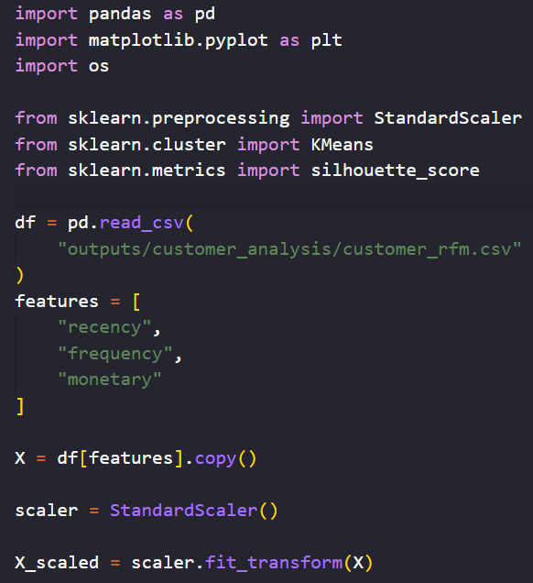
Implementation / Model Building
Feature Selection
Selected recency, frequency, and monetary value for customer clustering.
Preprocessing Pipeline
Cleaned the datasets, integrated related records, generated analytical features, and standardized RFM values before clustering.
Data Splitting
Not applicable. The project performs descriptive analytics and unsupervised clustering rather than supervised model training.
Configuration
Clustering algorithm: K-Means
Number of clusters: 2
Random state: 42
Initialization: 10 runs
Notes:
Describe the build in the order you did it. Paste only the most important code or pseudocode, not entire files. For hardware projects, show the circuit or wiring summary instead.

Slide 14
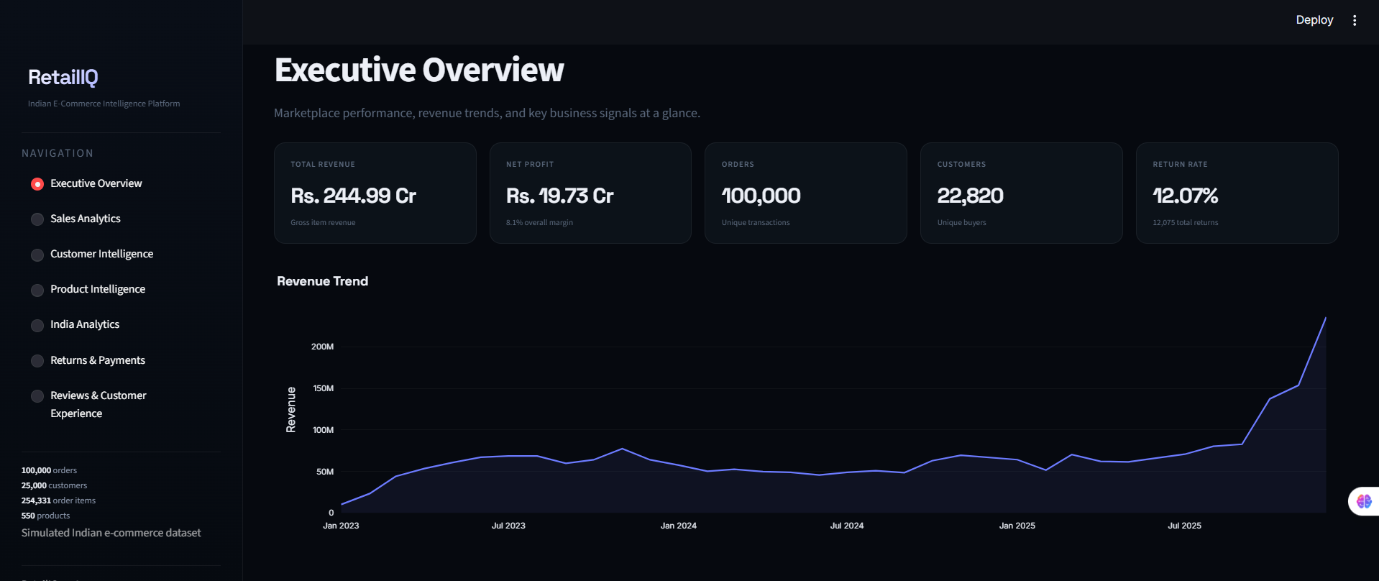
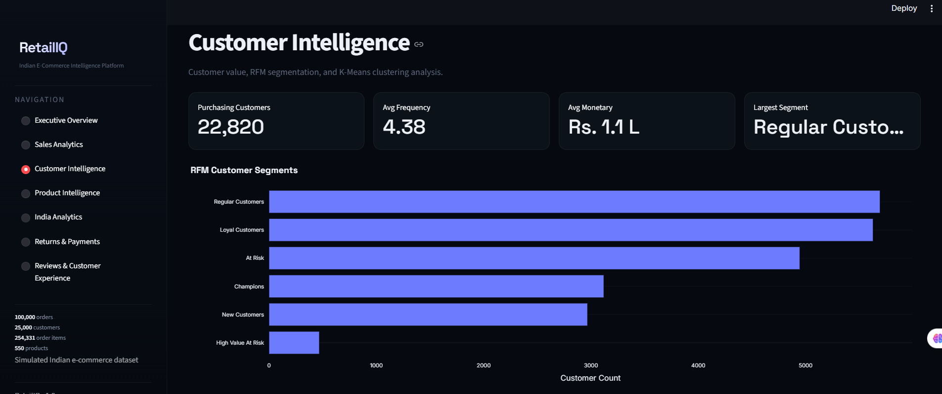
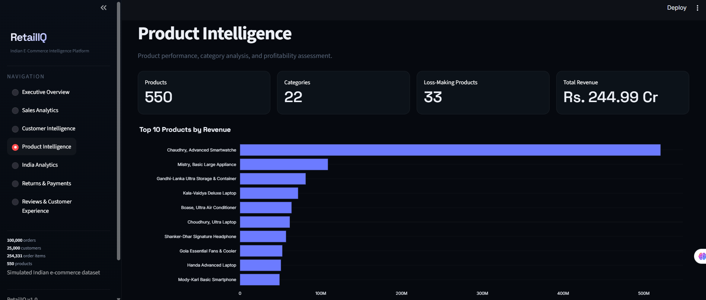
Working Prototype / Output Screens
Executive Overview
Displays overall sales, revenue, order and customer KPIs.
Customer Intelligence
Displays RFM segments and K-Means customer clusters.
Product Intelligence
Displays product and category revenue and profitability.
Notes:
Show real screenshots, photos of the hardware or a short demo video link. Caption each one with what the viewer should notice.

Slide 15
Results & Performance Comparison
Number of Clusters (K) | Silhouette Score
2 | 0.4378
3 | 0.4107
4 | 0.3983
5 | 0.4013
6 | 0.3338
7 | 0.3419
Best: K-Means (K = 2) – Silhouette Score = 0.4378
Higher silhouette scores indicate better cluster separation and cohesion. K = 2 achieved the highest score among the tested configurations.
Notes:
Right-click the chart and choose Edit Data to enter your real numbers. Replace the metrics with the ones that fit your project (accuracy, latency, power, throughput, user rating). State clearly which option performed best.

Slide 16
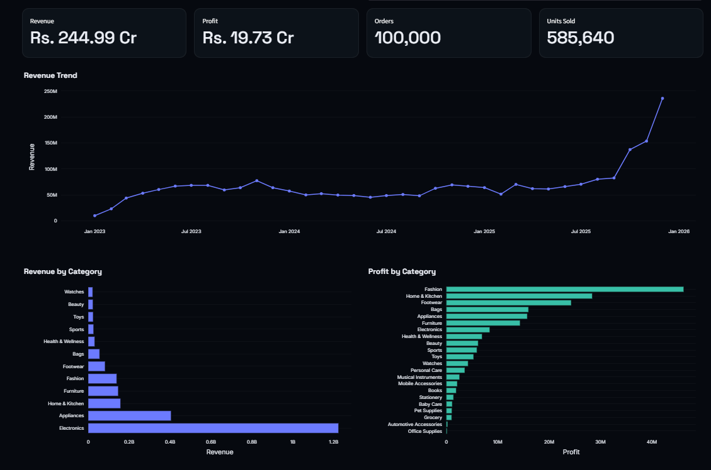
Analysis & Key Findings
0.4378
Highest Silhouette Score (K = 2)
Interpretation: K-Means identified two customer groups with different purchasing patterns. Cluster 1 has higher average frequency and monetary value.
Operational finding: 12,075 returns were recorded, representing approximately 12.07% of 100,000 orders.
Product finding: 33 products were identified as loss-making.
Notes:
Explain what the numbers mean. Use a confusion matrix, ROC curve, feature-importance chart or output comparison. Be honest about weak results; panels value that.

Slide 17

Testing & Validation
Test ID | Test Description | Expected Result | Actual Result | Status
TC-01 | Orders-to-customers reference check | No missing customer references | 0 missing references | Pass
TC-02 | Items-to-orders reference check | No missing order references | 0 missing references | Pass
TC-03 | Items-to-products reference check | No missing product references | 0 missing references | Pass
TC-04 | K-Means cluster evaluation | Compare K = 2 to 7 | Best score: 0.4378 at K = 2 | Pass
Functional Testing
Validation Method
Performance Testing
No formal load or response-time benchmark was conducted. Dashboard outputs were checked for consistency with generated analysis files.
Checked data cleaning, integration, feature engineering, analytical outputs, and dashboard navigation.
Validated dataset relationships and compared K-Means configurations using the Silhouette Coefficient.
Notes:
List representative test cases with expected and actual outcomes. Name the validation methods you used. Delete rows you do not need.

Slide 18


Challenges & Limitations
Challenges Faced
Limitations
Multiple dataset formats → standardized data types and date fields.
Missing and inconsistent values → handled through suitable imputation and default values.
Choosing cluster count → compared K = 2 to 7 using silhouette scores.
The dataset is simulated and does not represent a specific real company.
The dashboard uses static CSV data rather than live data feeds.
The project focuses on descriptive analytics and segmentation, not predictive forecasting.
Notes:
Be candid. Pair every challenge with how you solved it, and list limitations that the panel would otherwise spot themselves.

Slide 19

Conclusion
Developed a multi-page Streamlit dashboard using seven simulated Indian e-commerce datasets.
1
Final Outcome
Analyzed 22,820 customers with transaction activity; K-Means achieved its best Silhouette Score of 0.4378 at K = 2.
7
2
CSV datasets analyzed
4 core analytical modules
Integrated customer, sales, product, geographical, payment, return, and review analysis into one platform.
3
Notes:
Revisit each objective and say whether you met it. Quote your headline result with numbers. Do not introduce new material here.

Slide 20



Future Scope & Applications
Improve Performance
Explore alternative clustering methods and compare segmentation quality.
Applications
Customer segmentation and retention analysis
Sales and product performance monitoring
Returns, payment and customer-experience analysis
Potential users: business, sales, marketing and product teams
Expand Data / Features
Use larger real-world datasets and additional customer and transaction attributes.
Deploy & Build an Interface
Deploy the Streamlit dashboard and automate dataset refreshes.
Scale & Secure
Introduce access controls, secure data handling, and scalable hosting.
Notes:
Give concrete next steps, ideally tied to the limitations. Then name two or three real-world uses.

Slide 21
Team Contribution
Reg. No. | Name | Contribution / Modules Handled
2420030558 | B. Kundana Mani | Collaborative work across data preparation, analytics, dashboard development and documentation.
2420030211 | M. Sai Kridhay Kumar | Collaborative work across data preparation, analytics, dashboard development and documentation.
Notes:
Show that work was planned and shared. Every member should be able to explain their own module.

Slide 22

References
[1] R. Y. Wang and D. M. Strong, “Beyond accuracy: What data quality means to data consumers,” Journal of Management Information Systems, vol. 12, no. 4, pp. 5–33, 1996.
[2] J. MacQueen, “Some methods for classification and analysis of multivariate observations,” in Proc. Fifth Berkeley Symposium on Mathematical Statistics and Probability, 1967, pp. 281–297.
[3] P. J. Rousseeuw, “Silhouettes: A graphical aid to the interpretation and validation of cluster analysis,” Journal of Computational and Applied Mathematics, vol. 20, pp. 53–65, 1987.
[4] E. W. Ngai, L. Xiu, and D. C. K. Chau, “Application of data mining techniques in customer relationship management: A literature review and classification,” Expert Systems with Applications, vol. 36, no. 2, pp. 2592–2602, 2009.
[5] Kaggle, “Indian E-Commerce Sales and Customer Analytics.” [Online]. Available: https://www.kaggle.com/datasets/shiyalkishan01/indian-e-commerce-sales-and-customer-analytics
[6] Scikit-learn documentation. [Online]. Available: https://scikit-learn.org/
[7] Streamlit documentation. [Online]. Available: https://docs.streamlit.io/
Project Links
GitHub: https://github.com/kundanamani-23/RetailIQ-DataScience
Dataset: https://www.kaggle.com/datasets/shiyalkishan01/indian-e-commerce-sales-and-customer-analytics
Notes:
Use IEEE style, numbered in order of first citation in the deck. Include datasets, documentation and code repositories.

Slide 23
THANK YOU
Questions & Discussion
B. Kundana Mani | M. Sai Kridhay Kumar
Guide: N. Sunanda, Associate Professor
Department of Computer Science and Engineering, KLH
Notes:
Leave this slide up during questions. Make sure every team member can answer questions about their own module.

