Slide 1
A hands-free banking assistant
on Meta smart glasses
The relationship manager looks, asks and listens. The glasses recognise the customer, read documents and answer questions, spoken back through the glasses speaker.
Know the customer
Read the paperwork
Answer by voice
On-phone face match pulls up the profile, accounts and history
“Hey Meta, scan” captures a document; summary, risk flags and actions follow
Ask about the customer or the document, with up to 8 turns of follow-up
Meta glasses → Android phone → NVIDIA Jetson Orin Nano · Updated Oct 2026
Notes:
WF Meta turns Meta smart glasses into a relationship manager's assistant. Three jobs: recognise the customer from the live camera stream, read a document the RM looks at, and answer spoken questions about either. Everything is spoken back through the glasses speaker, so the RM keeps eye contact with the customer instead of looking at a screen. Customer data in this demo is fictional.

Slide 2
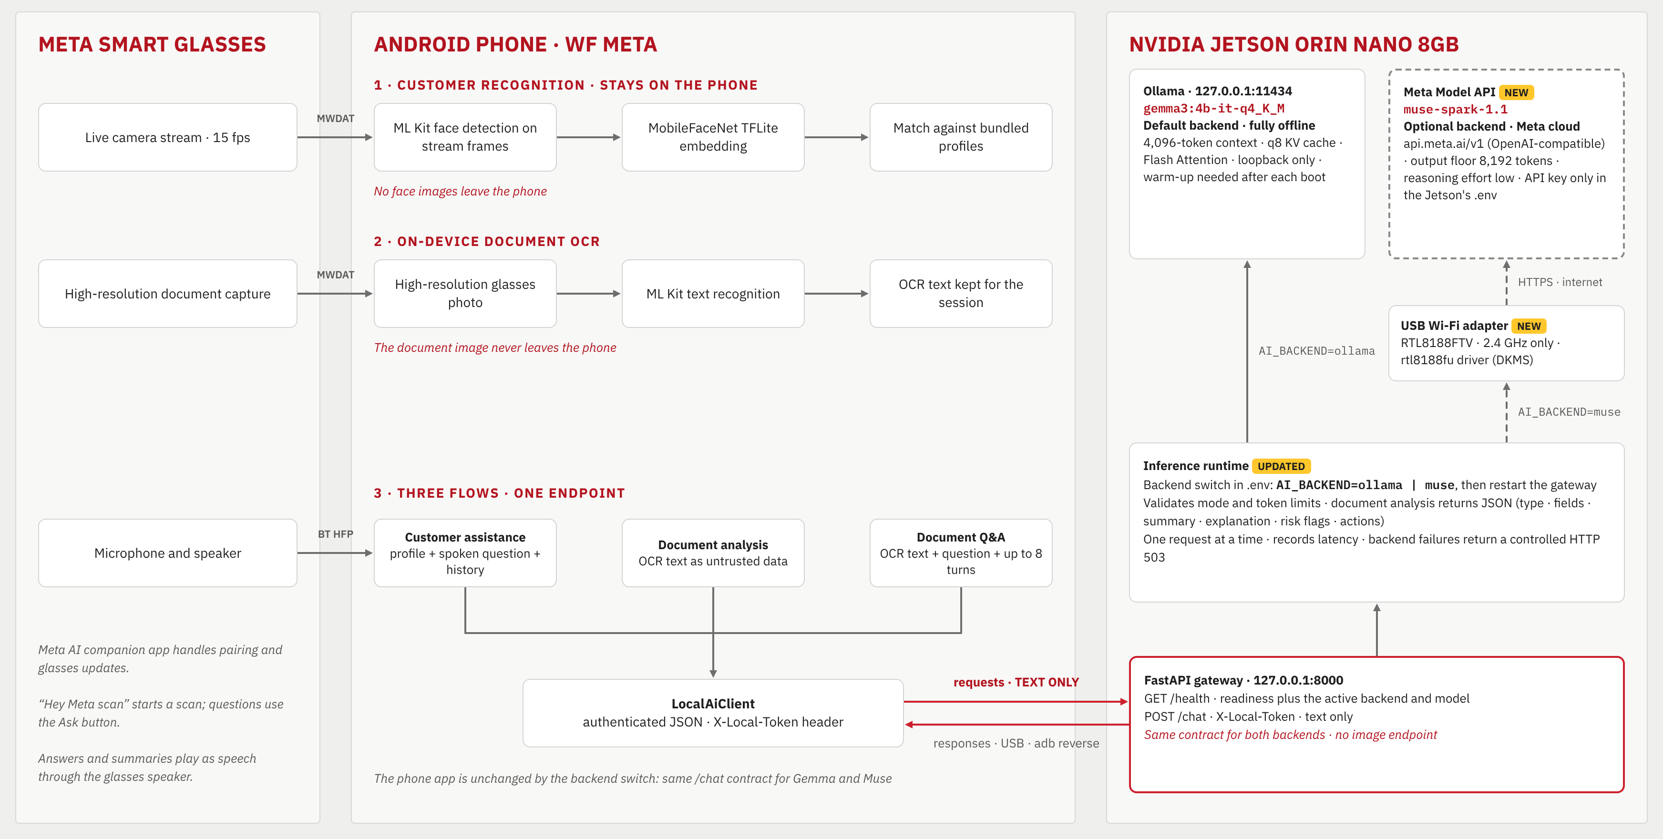
How it works: glasses, phone, Jetson
Notes:
Left: the glasses stream video, capture photos and carry audio. Middle: the phone recognises faces and reads document text itself; only text is sent on. Right: the Jetson gateway answers using local Gemma 3 by default, or Meta's Muse Spark 1.1 when AI_BACKEND is set to muse. The phone app is identical in both modes.

