Slide 1

VIT-AP UNIVERSITY, AMARAVATI
School of Computer Science and Engineering (SCOPE)
Community Detection
in Social Networks
A Comparative, Robustness and Role-Aware Study of Five Algorithms
SUBMITTED BY
D. Harshitha | 23BCB7271
Kundan Karthikey Naidu | 23BCB7098
B.Tech — Computer Science and Business Systems

Slide 2
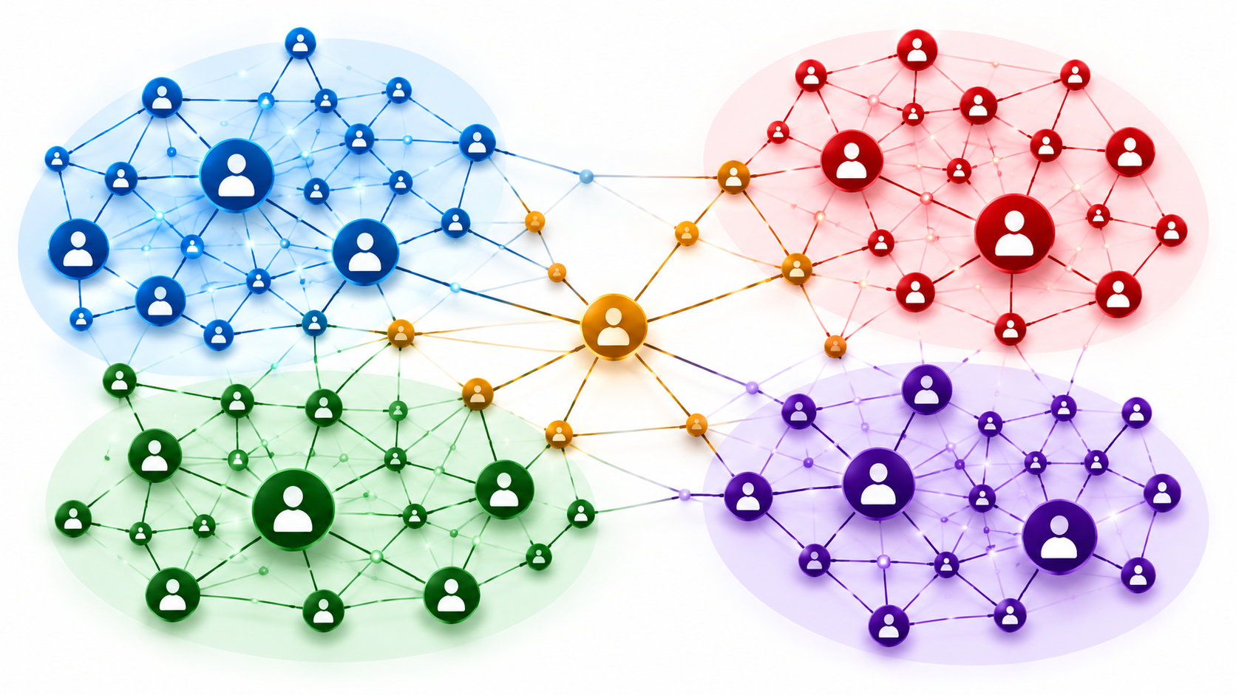
Problem Statement: Why Detect Communities?
THE PROBLEM
Social networks contain groups that are densely connected internally but sparsely connected to other groups. Community detection seeks to discover these groups from network connections, often without labelled ground truth.
WHY IT IS CHALLENGING
• Different algorithms may find different partitions.
• Some methods are fast but unstable on noisy graphs.
• Missing edges can change the detected communities.
• A high modularity score does not automatically prove significance.
Goal: compare quality, robustness, stability, scalability and node-role interpretation.
Community Detection in Social Networks
2

Slide 3

Project Objectives and Scope
WHAT THIS PROJECT DOES
• Implements five representative algorithms through a common framework.
• Measures quality using modularity, coverage, performance and conductance.
• Uses NMI and ARI to compare partitions with known structure.
• Tests LFR robustness and stability after random edge removal.
• Benchmarks runtime up to 8,000 nodes.
• Classifies hubs and bridges using community-aware measures.
• Checks significance against degree-preserving random networks.
Scope: algorithm comparison + robustness + roles + significance
Community Detection in Social Networks
3

Slide 4
The Five Algorithms at a Glance
Algorithm | How it works | Strength / limitation
Louvain | Move nodes to improve modularity; aggregate communities | Fast, scalable; stochastic
Greedy Modularity | Merge pairs that increase modularity | Can under-segment small groups
Label Propagation | Adopt the most common neighbour label | Very fast; can collapse
Spectral Clustering | Embed using normalized adjacency eigenvectors; apply k-means | Good quality; choose k
Girvan–Newman | Remove highest edge-betweenness edges repeatedly | Expensive on large graphs
The project evaluates each method on community quality, agreement with ground truth, robustness to noise, stability under missing edges and runtime.
Community Detection in Social Networks
5

Slide 5
Datasets and Experimental Design
Dataset | Nodes | Edges | Role in study
Karate Club | 34 | 78 | Known two-faction split
Les Miserables | 77 | 254 | Weighted co-appearance network
LFR benchmark | 250 per graph | ~1,000 per graph | 40 graphs; μ = 0.1–0.8
Planted-partition | 200–8,000 | Up to 46,000 | Scalability tests
EXPERIMENTS
METRICS
• E1–E2: real network comparison and interpretation
• E3–E4: robustness and stability
• E5: runtime scaling
• Q, coverage, performance and conductance
• NMI and ARI
• Runtime, z-score and participation coefficient
Community Detection in Social Networks
11

Slide 6
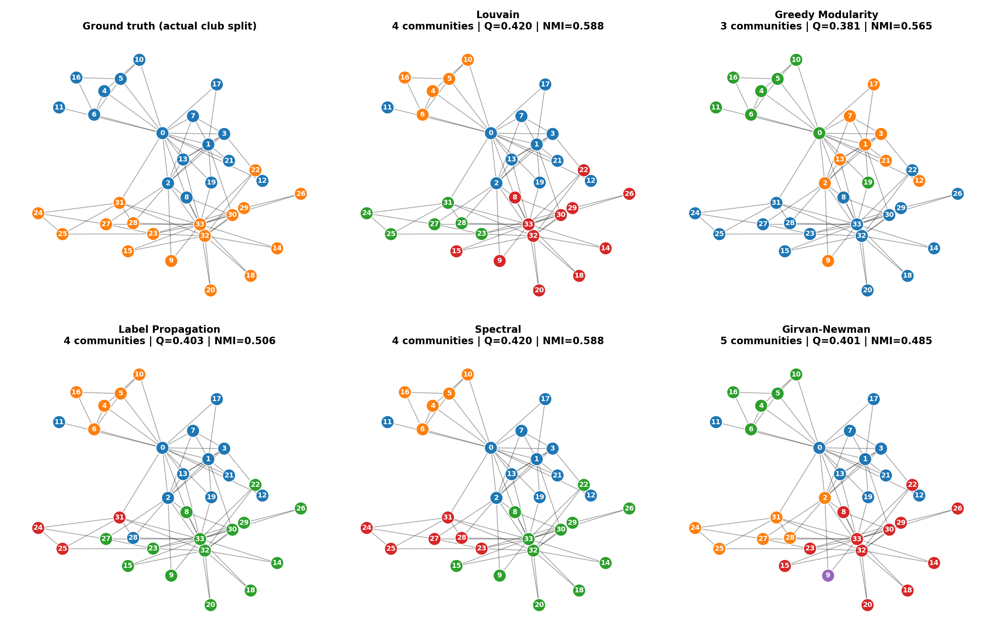
Output 1: Karate Club Partition Comparison
MODULARITY RESULTS
Algorithm | Communities | Q
Louvain | 4 | 0.420
Greedy | 3 | 0.381
Label Propagation | 4 | 0.403
Spectral | 4 | 0.420
Girvan–Newman | 5 | 0.401
• Best Q: Louvain and Spectral (0.4198).
• Highest ARI: Greedy Modularity (0.568).
• Actual two-faction split has Q = 0.358.
Community Detection in Social Networks
12

Slide 7
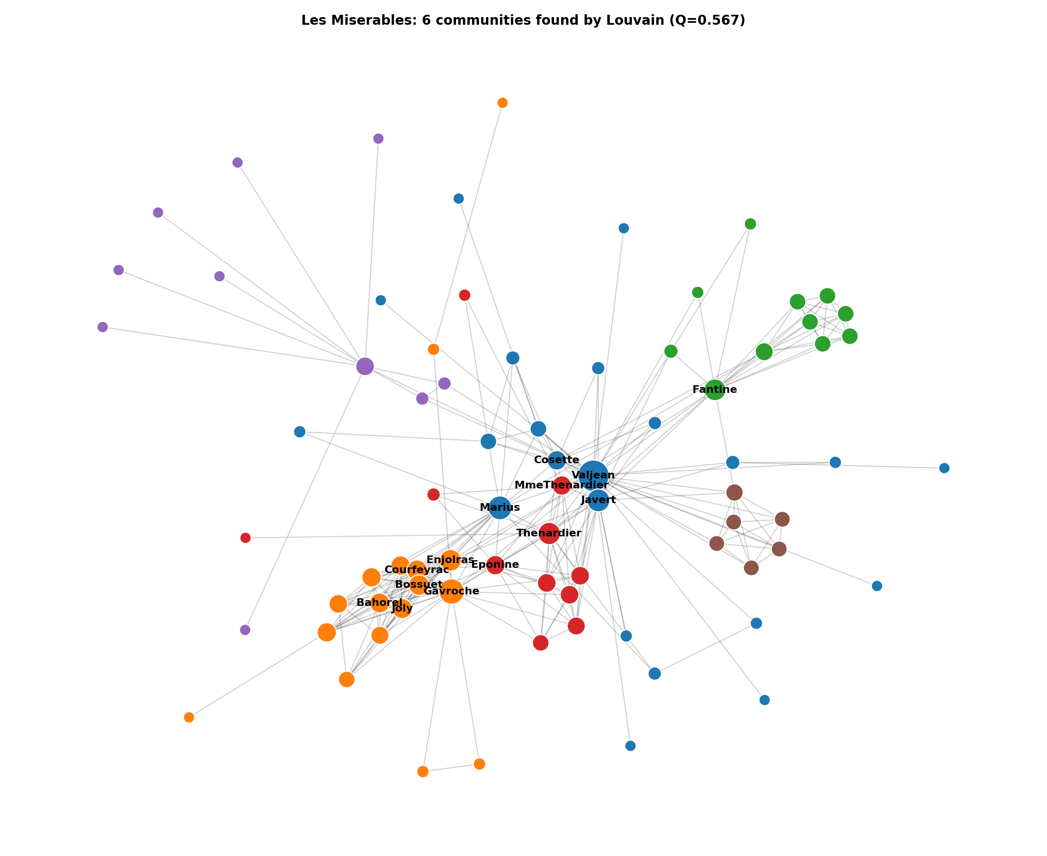
Output 2: Les Miserables Communities
INTERPRETATION
• Six communities detected by weighted Louvain.
• Community sizes: 22, 17, 11, 11, 10 and 6.
• Groups align with protagonists, revolutionaries, Fantine's storyline, Thenardier associates, Myriel's household and the trial.
• Valjean links multiple narrative groups.
Reported community-summary Q = 0.567.
Community Detection in Social Networks
13

Slide 8
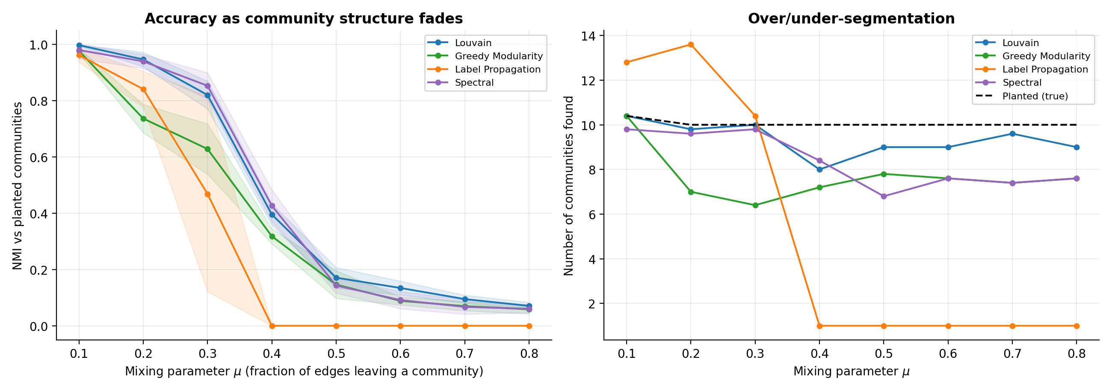
Output 3: Robustness as Community Structure Weakens
• μ is the fraction of a node's links that leave its community.
• At μ = 0.1, all evaluated methods perform strongly.
• Louvain and Spectral keep NMI above 0.8 through μ = 0.3.
• At μ = 0.4, Label Propagation collapses to one community (NMI = 0).
• At μ ≥ 0.5, planted structure is difficult to recover.
Community Detection in Social Networks
14

Slide 9
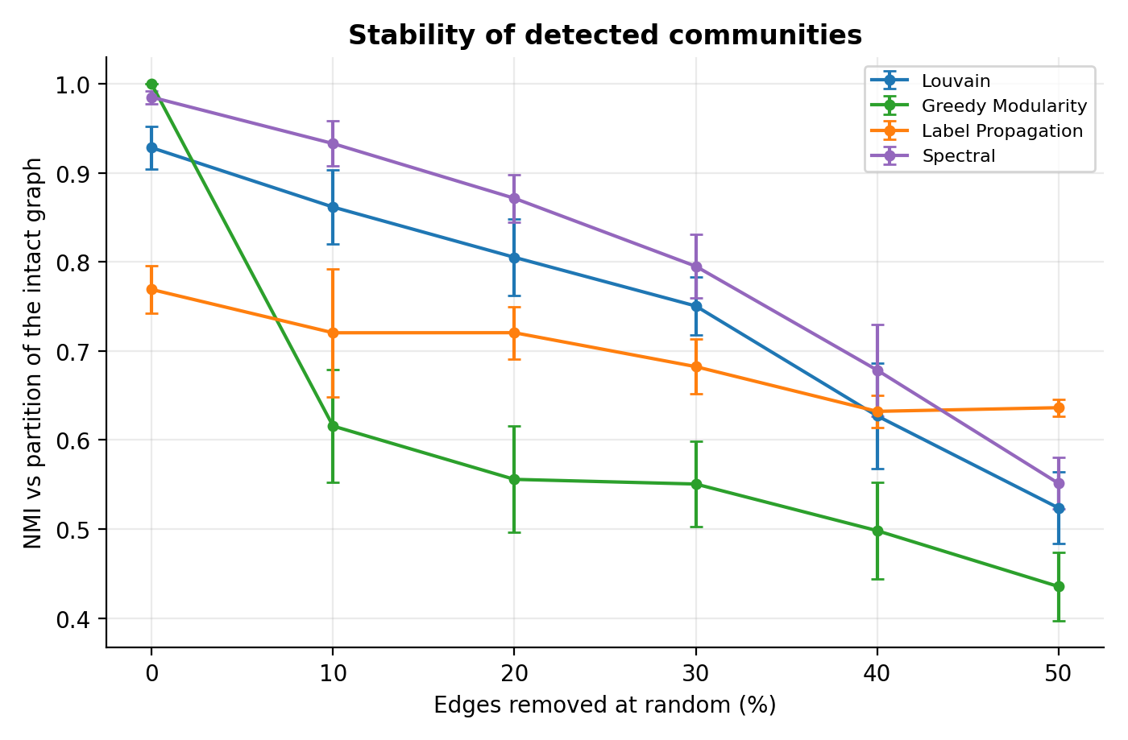
Output 4: Stability Under Missing Edges
• Edges were randomly removed from the LFR graph.
• At 10% removal: Spectral NMI = 0.933; Louvain = 0.862.
• Greedy Modularity drops to NMI = 0.616 after 10% removal.
• At 50% removal, all methods show reduced agreement.
• Practical takeaway: incomplete graph data can change community assignments.
Community Detection in Social Networks
15

Slide 10
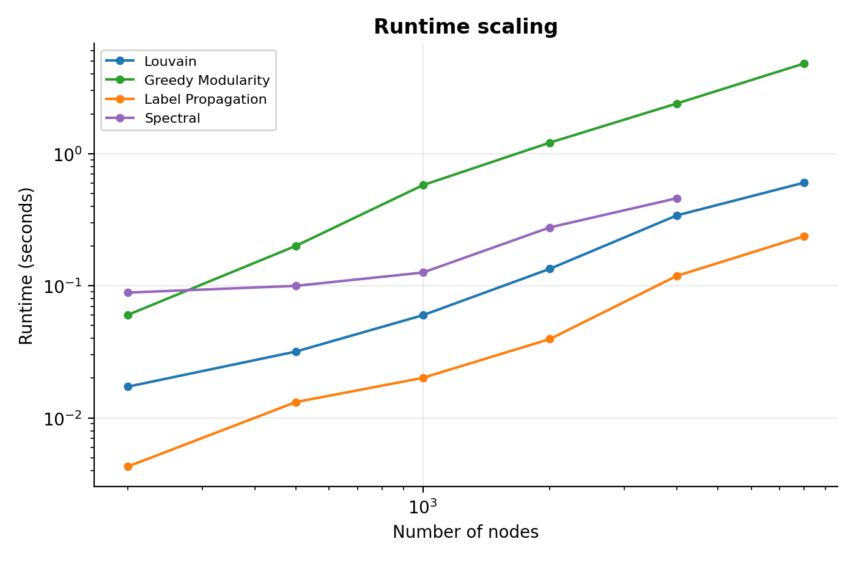
Output 5: Runtime Scalability
RUNTIME AT 8,000 NODES
Algorithm | Time
Label Propagation | ~0.25 s
Louvain | ~0.60 s
Greedy Modularity | ~4.81 s
Interpretation: Label Propagation is fastest, while Louvain offers a strong balance of runtime and reliability. Spectral Clustering was measured up to 4,000 nodes.
Community Detection in Social Networks
16

Slide 11
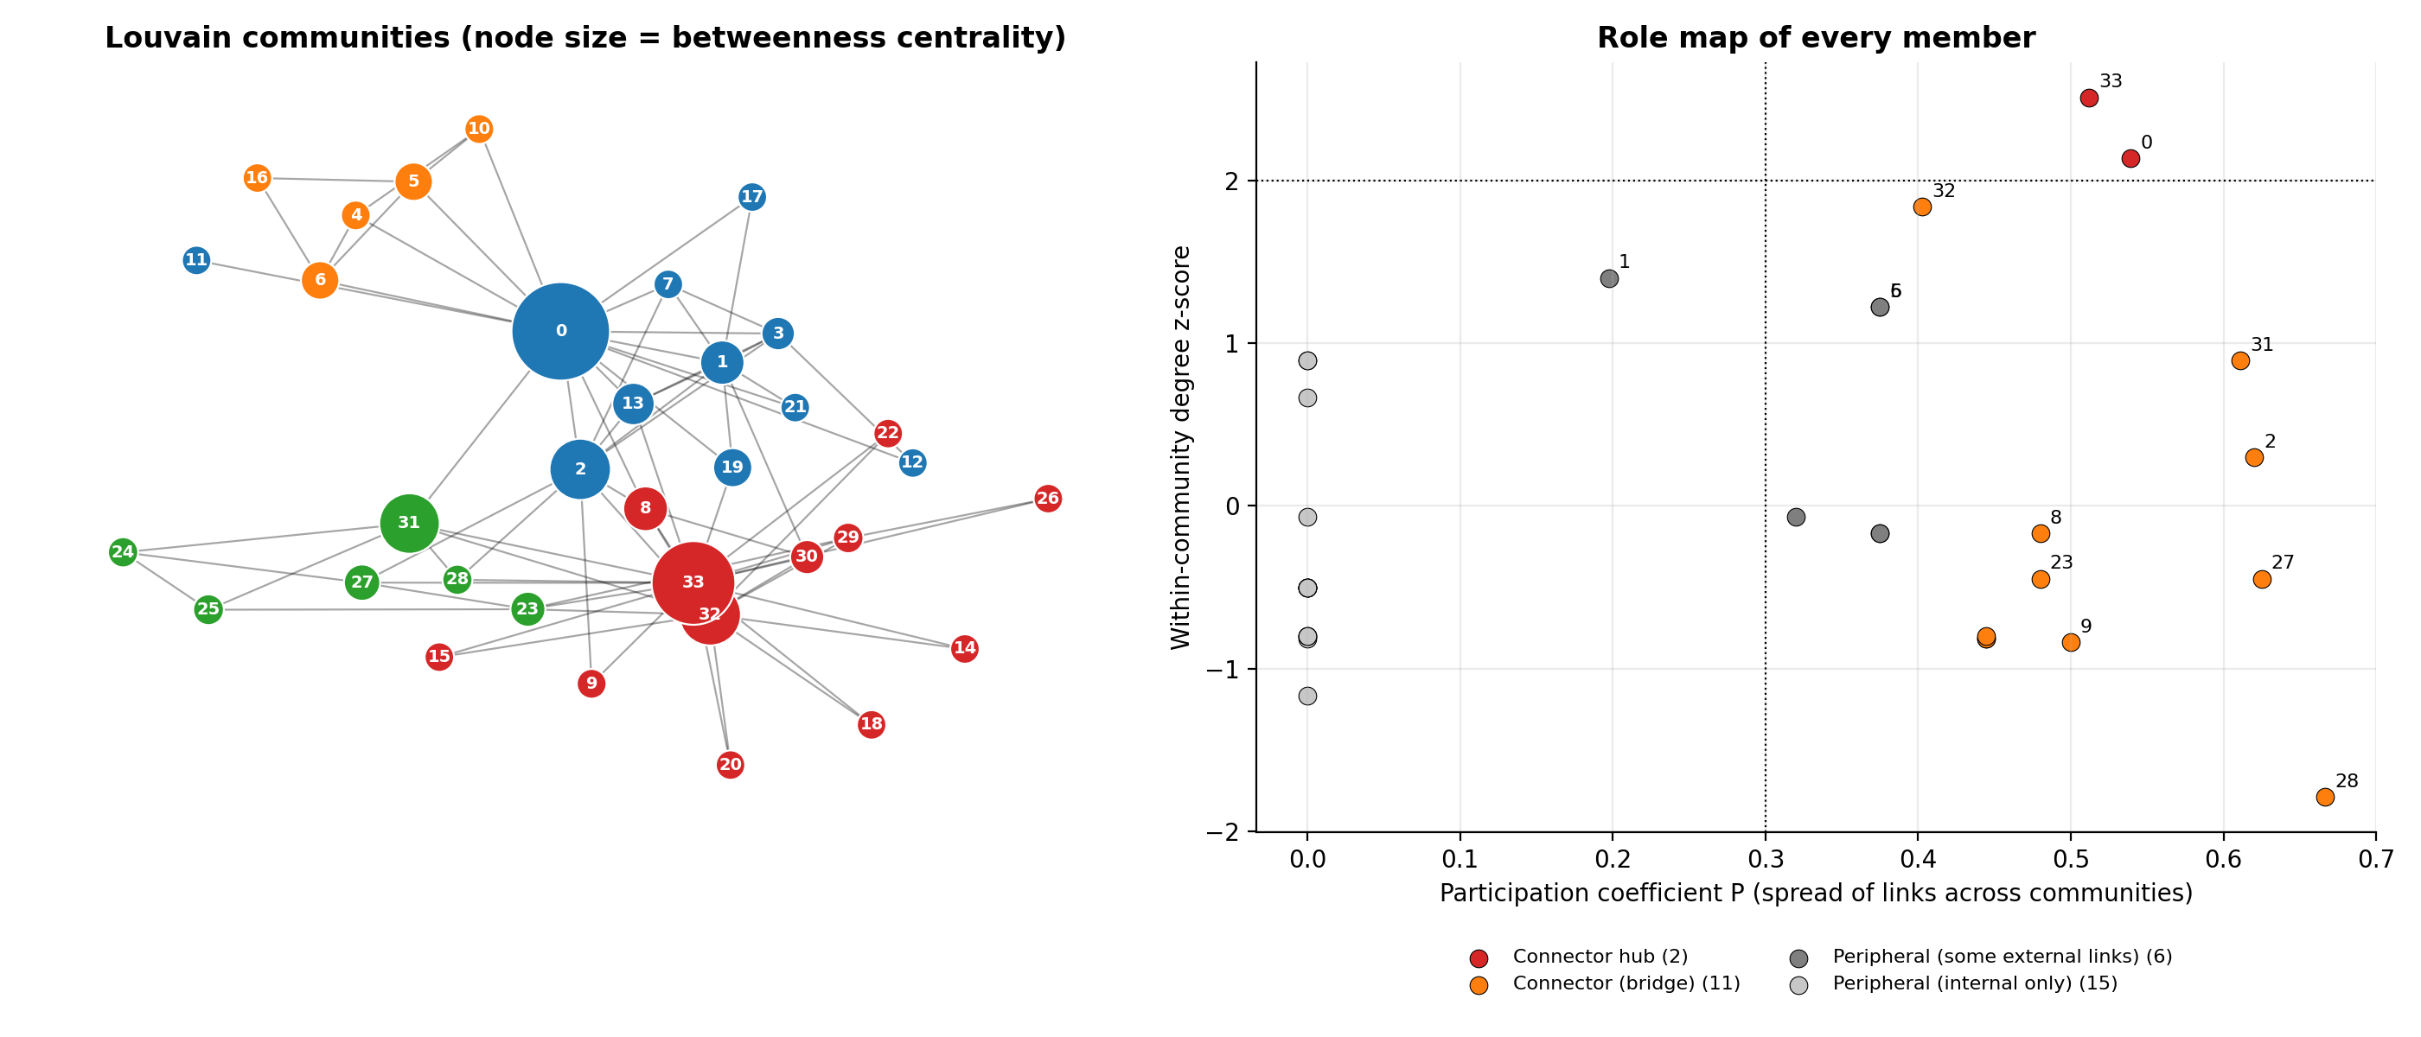
Output 6: Hubs and Bridge Nodes
• Node 0 and node 33 are connector hubs.
• Node 28 has participation coefficient P = 0.667 despite only three friends.
• Eleven members were classified as bridges.
• Within-community z-score measures prominence inside a group.
• Participation coefficient measures links spread across groups.
• These properties are not interchangeable.
Community Detection in Social Networks
17

Slide 12
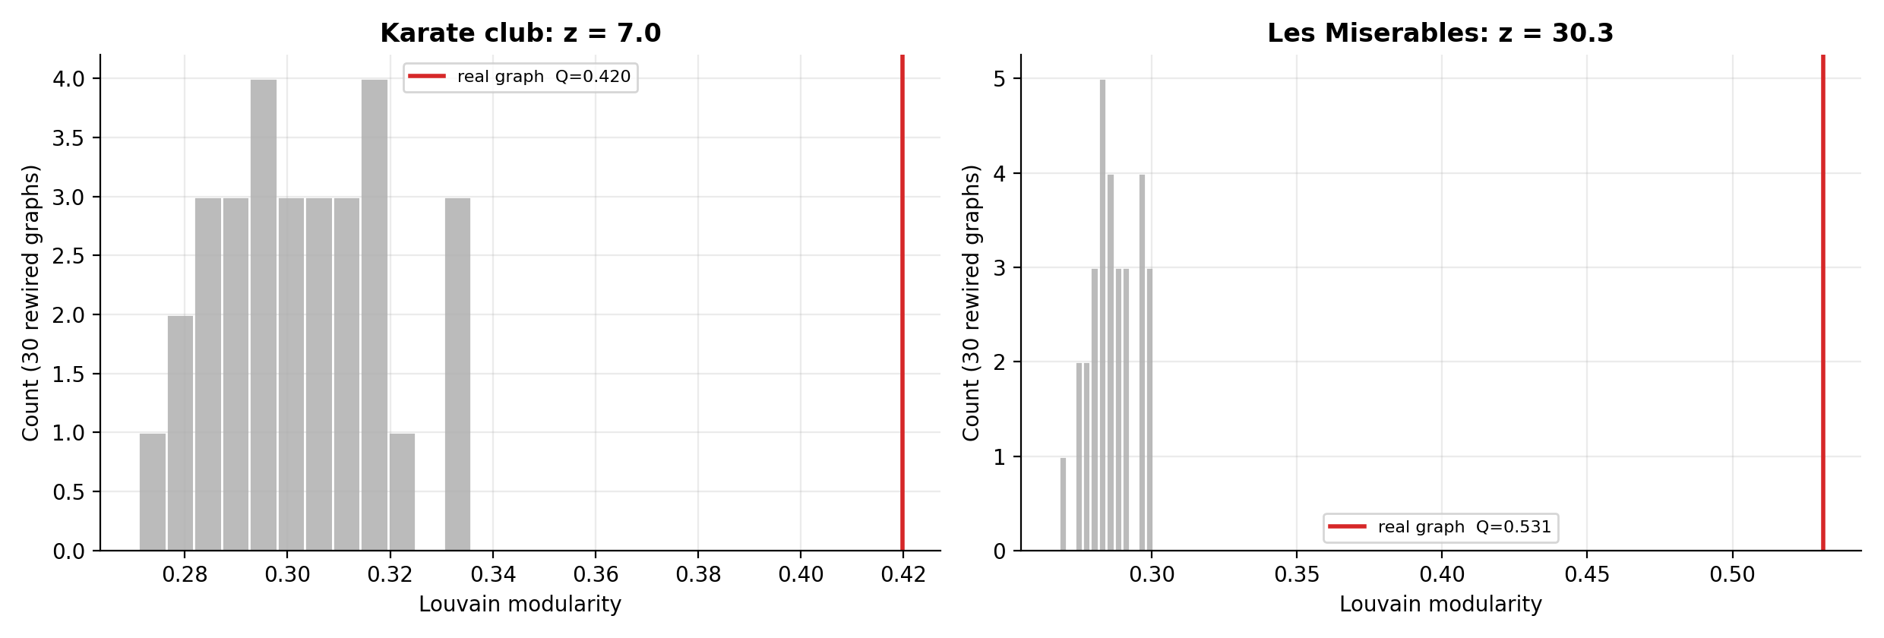
Output 7: Statistical Significance of Communities
Network | Real Q | Null mean | Z-score
Karate Club | 0.420 | 0.303 | 7.0
Les Miserables | 0.531 | 0.287 | 30.3
METHOD AND INTERPRETATION
• Compared observed modularity with 30 degree-preserving random rewiring trials.
• Both real networks lie well outside the null distribution; the degree sequence alone does not explain the observed structure.
Community Detection in Social Networks
18

Slide 13
Conclusions, Limitations and Future Work
CONCLUSIONS
LIMITATIONS
FUTURE WORK
• Louvain is the best general-purpose choice in this study.
• Spectral is competitive on quality and robustness.
• Label Propagation is fastest but can fail on weak structure.
• Greedy may merge small groups; Girvan–Newman is costly.
• Bridge detection requires role-aware measures.
• Only Karate Club has real ground truth among the two real networks.
• Limited algorithms in LFR and scalability tests.
• Runtime measured on one machine.
• Five LFR graphs per mixing setting.
• Role thresholds adapted for a small graph.
• Evaluate larger SNAP datasets.
• Add Leiden, Infomap and overlapping-community methods.
• Study temporal networks and community evolution.
Community Detection in Social Networks
20

Slide 14
VIT-AP UNIVERSITY | SCOPE
THANK YOU
D. Harshitha | 23BCB7271
Kundan Karthikey Naidu | 23BCB7098
Community Detection in Social Networks

