Slide 2
Agenda
• Spring Cloud Background
• Key Projects
• Getting Down and Dirty With Spring Cloud
• Questions?

Slide 3
Why Spring Cloud?
• In general, cloud native apps are a good thing, just not easy
• It is easy for big companies to put forth the resources to succeed with Cloud Native, but what about the little guys?
• Why do we have to reinvent the wheel each time someone wants to build a Cloud Native app?
• Follow the Spring Boot model of providing useful defaults for Cloud Native apps with the ability to easy configure them
• Cloud Agnostic

Slide 4
Spring Cloud Components
Configuration Service Discovery
Routing and Messaging
Tracing
API Gateway
Circuit Breakers

Slide 5
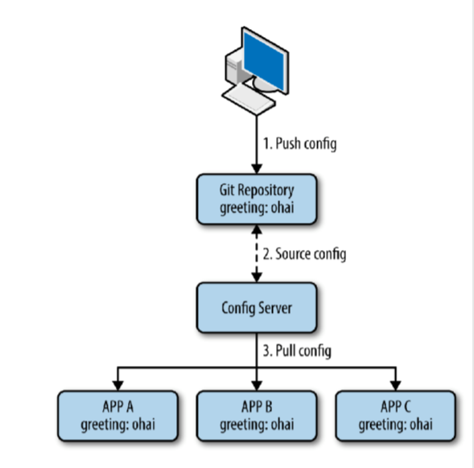
Configuration
• We want to remove the configuration out of the application to a centralized store across all environments
• Spring cloud Config Server can use Git, SVN, filesystem and Vault to store config
• Config clients (microservice apps) retrieve the configuration from the server on startup
• Can be notified of changes and process changes in a refresh event

Slide 6
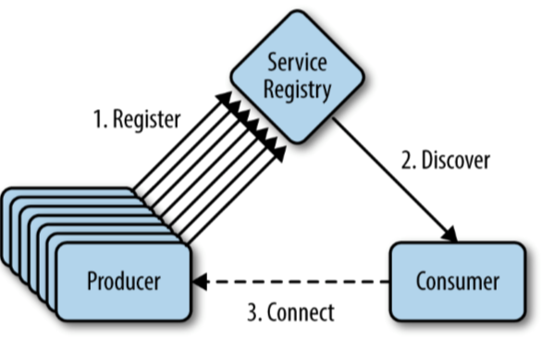
With the dynamic nature of any cloud native application, depending on things like URLs can be problematic
• Service Discovery allows micro services to easily discover the routes to the services it needs to use
• Netflix Eureka
• Zookeeper
• Consul

Slide 7
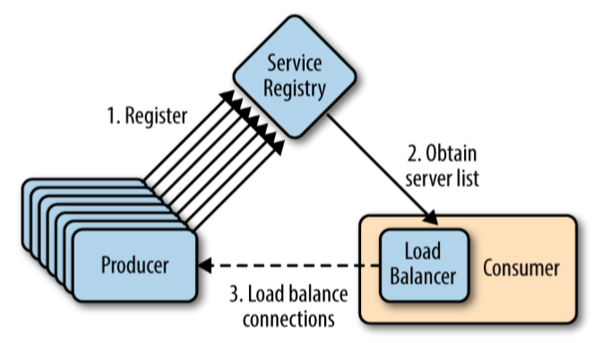
Your cloud native app will be composed of many microservices so communication will be critical
• Spring Cloud supports communication via HTTP requests or via messaging
• Routing and Load Balancing:
• Netflix Ribbon and Open Feign
• Messaging:
• RabbitMQ or Kafka

Slide 8
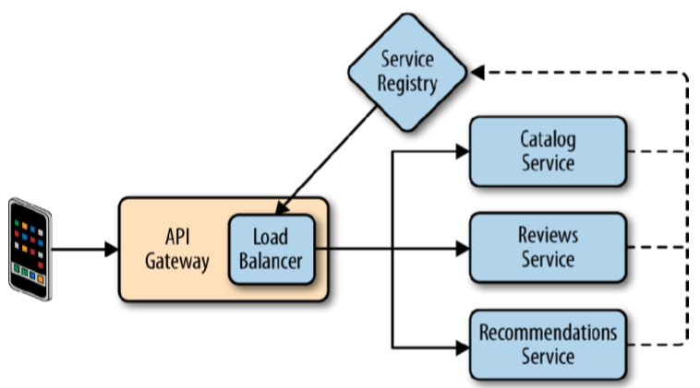
API Gateways allow you to route API requests (internal or external) to the correct service • Netflix Zuul
• Leverages service discovery and load balancer
• Spring Cloud Gateway

Slide 9
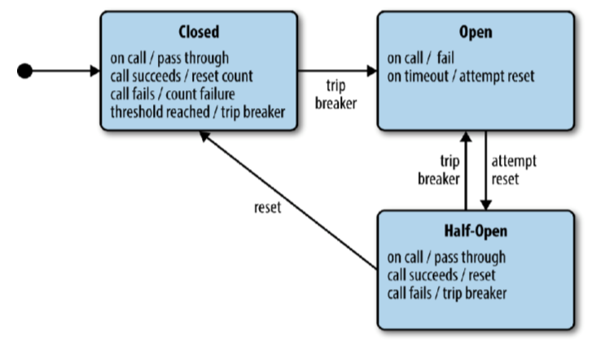
Failure is inevitable, but your user’s don’t need to know
• Circuit breakers can help an application function in the face of failure
• Netflix Hystrix

Slide 10
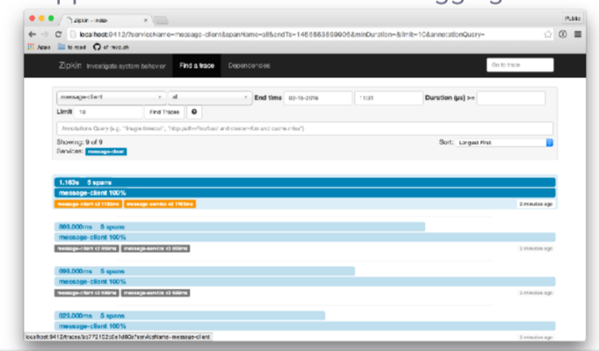
A single request to get data from your application may result in an exponentially larger number of requests to various microservices
• Tracing these requests through the application is critical when debugging issues
• Spring Cloud Sleuth and Zipkin

