Slide 1

Spring Cloud
COORDINATE ANYTHING: DISTRIBUTED SYSTEMS SIMPLIFIED
https://spring.io/projects/spring-cloud

Slide 2
Agenda
• Spring Cloud Background
• Key Projects
• Getting Down and Dirty With Spring Cloud
• Questions?

Slide 3
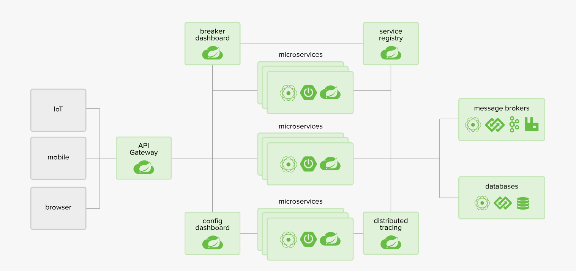
Introduction
Building distributed systems doesn't need to be complex and error-prone. Spring Cloud offers a simple and accessible programming model to the most common distributed system patterns, helping developers build resilient, reliable, and coordinated applications. Spring Cloud is built on top of Spring Boot, making it easy for developers to get started and become productive quickly.
Spring Cloud is a framework for building robust cloud applications. The framework facilitates the development of applications by providing solutions to many of the common problems faced when moving to a distributed environment.
Applications that run with microservices architecture aim to simplify development, deployment, and maintenance. The decomposed nature of the application allows developers to focus on one problem at a time. Improvements can be introduced without impacting other parts of a system.
On the other hand, different challenges arise when we take on a microservice approach:
Externalizing configuration so that is flexible and does not require rebuild of the service on change
Service discovery
Hiding complexity of services deployed on different hosts
https://www.baeldung.com/spring-cloud-tutorial

Slide 4
Why Spring Cloud?
• In general, cloud native apps are a good thing, just not easy
• It is easy for big companies to put forth the resources to succeed with Cloud Native, but what about the little guys?
• Why do we have to reinvent the wheel each time someone wants to build a Cloud Native app?
• Follow the Spring Boot model of providing useful defaults for Cloud Native apps with the ability to easy configure them

Slide 5
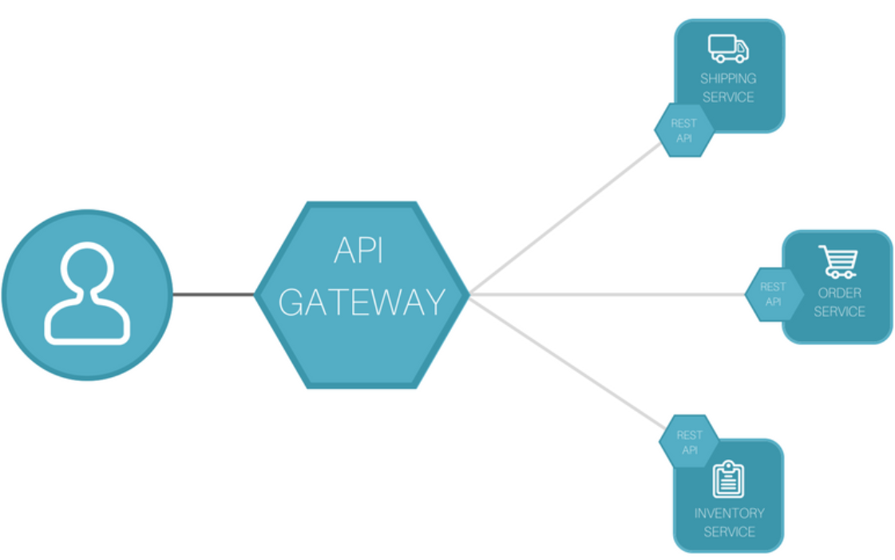
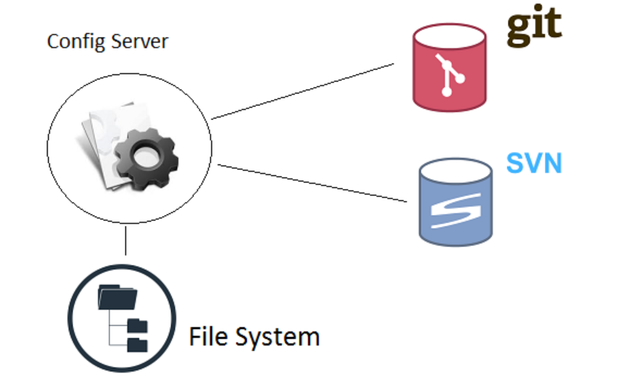
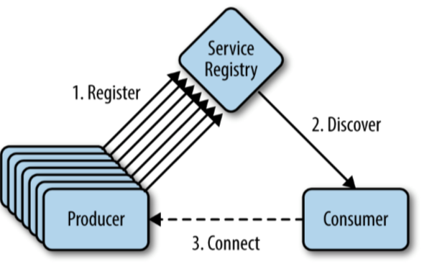
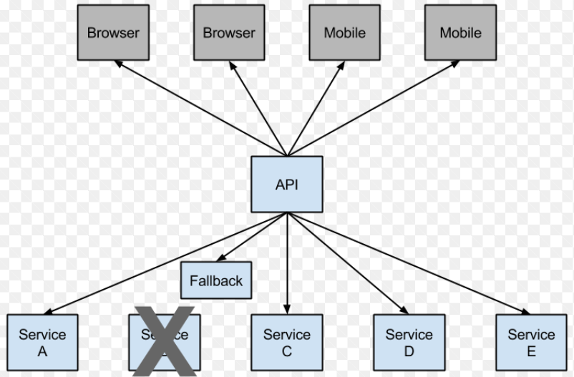
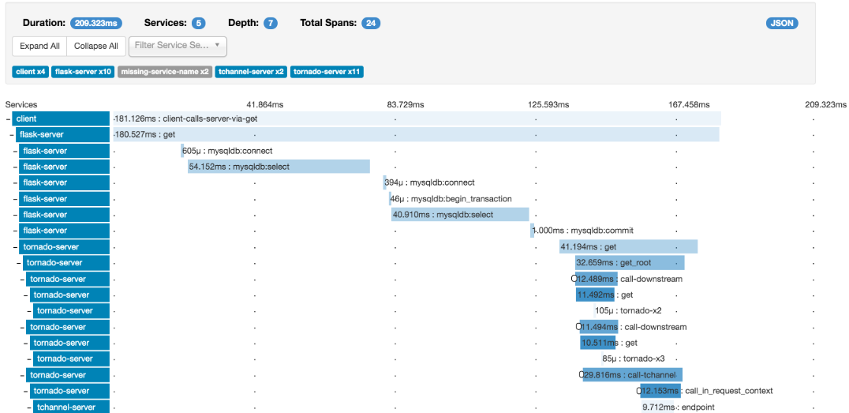
Spring Cloud Components
Configuration Server
Service Discovery
API Gateway
Routing and Messaging
OAut2
https://spring.io/projects/spring-cloud
Tracing
Circuit Breakers

Slide 6
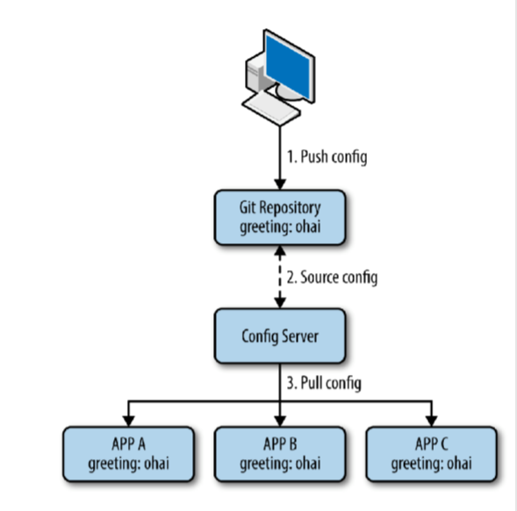
Configuration Server
• We want to remove the configuration out of the application to a centralized store across all environments
• Spring cloud Config Server can use Git, SVN, filesystem and Vault to store config
• Config clients (microservice apps) retrieve the configuration from the server on startup
• Can be notified of changes and process changes in a refresh event
https://www.youtube.com/watch?v=aO3W-lYnw-o
https://github.com/ryanjbaxter/beginners-guide-to-spring-cloud/
https://spring.io/guides/gs/centralized-configuration/

Slide 7
Service Discovery
• With the dynamic nature of any cloud native application, depending on things like URLs can be problematic
• Service Discovery allows micro services to easily discover the routes to the services it needs to use
• Netflix Eureka
• Zookeeper
• Consul
https://www.baeldung.com/spring-cloud-netflix-eureka

Slide 8
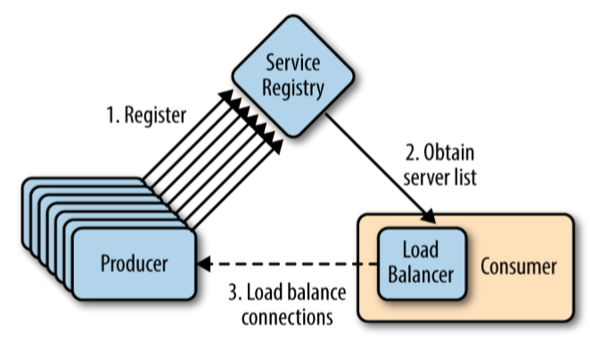
Routing and Messaging
• Your cloud native app will be composed of many microservices so communication will be critical
• Spring Cloud supports communication via HTTP requests or via messaging
Routing and Load Balancing:
• Netflix Ribbon and Open Feign
Messaging:
• RabbitMQ or Kafka
https://www.youtube.com/watch?v=KqwS6H8Fxro

Slide 9
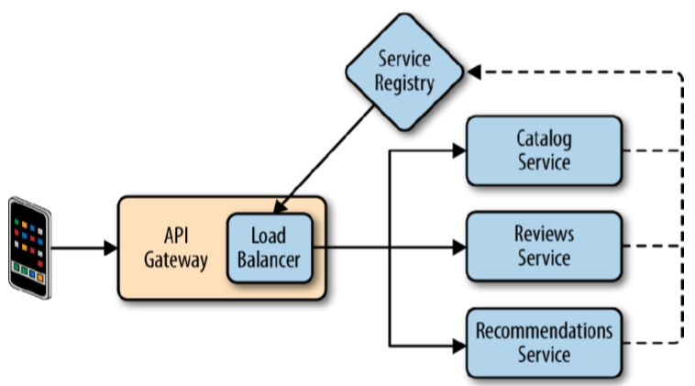
API Gateway
API Gateways allow you to route API requests (internal or external) to the correct service • Netflix Zuul
• Leverages service discovery and load balancer
• Spring Cloud Gateway

Slide 10
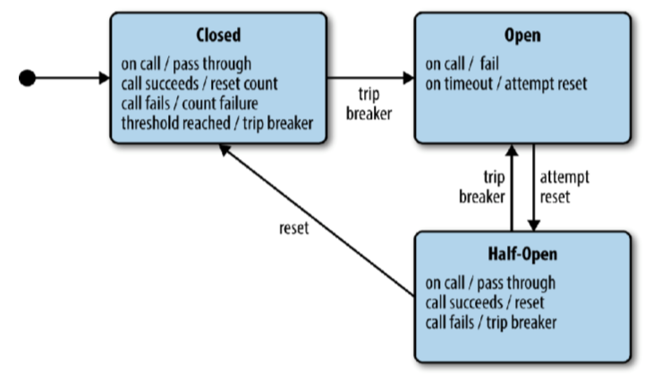
Circuit Breakers
• Failure is inevitable, but your user’s don’t need to know
• Circuit breakers can help an application function in the face of failure
• Netflix Hystrix
https://www.youtube.com/watch?v=cCEvFDhe3os&t=130s

Slide 11
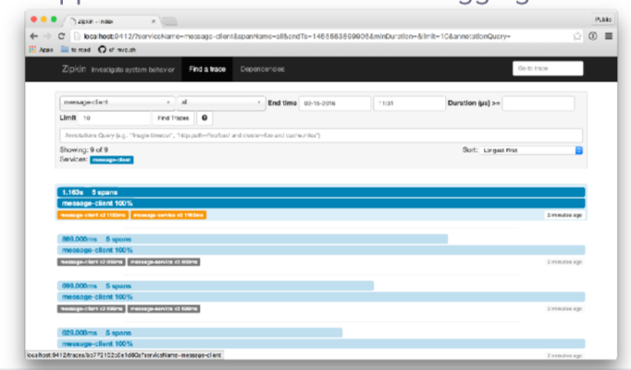
Tracing
• A single request to get data from your application may result in an exponentially larger number of requests to various microservices
• Tracing these requests through the application is critical when debugging issues
• Spring Cloud Sleuth and Zipkin

Slide 12
Demo
https://github.com/kundankumarjha/springclouddemo
http://bit.ly/2UU5gWg

