Slide 1
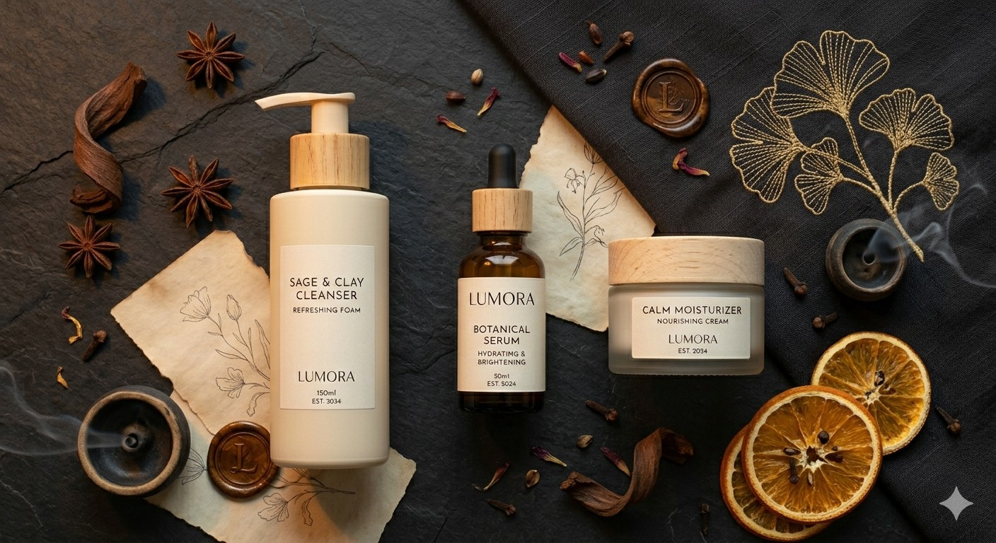
L
CAPSTONE PROJECT · FACEBOOK ADS
Lumora Skincare
A Full-Funnel Facebook Ads Practice Campaign for the
Vitamin C Glow Serum Launch
Submitted By: Kundan Singh Tanwar

Slide 2
L
What We'll Cover
A complete walkthrough of strategy, creative, setup, and results
1
Business & Brand Overview
2
Strategy & Objectives
Get familiar with Lumora Skincare and the Vitamin C Glow Serum launch.
A full-funnel approach: Awareness, Consideration, and Conversion.
3
Audience & Budget
4
Creative Concepts
Who we're reaching, and how the $1,200 practice budget is allocated.
Three ad concepts: image, carousel, and short-form video.
5
Campaign Setup
6
Performance & Reflection
How the campaign is structured inside Meta Ads Manager.
Simulated results, key learnings, challenges, and next steps.
LUMORA SKINCARE · FACEBOOK ADS PRACTICE CAMPAIGN
2

Slide 3
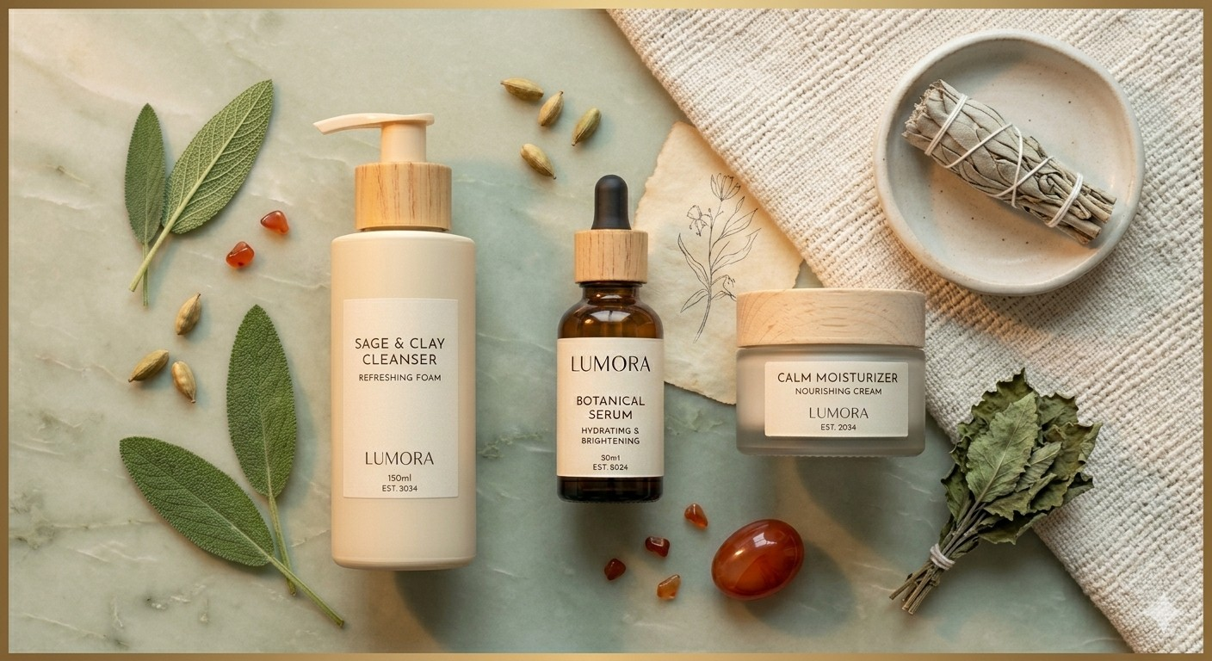

L
Meet Lumora Skincare
The fictional brand at the center of this practice campaign
Lumora Skincare is a clean-beauty startup built for busy professionals who want effective, simple skincare without harsh chemicals or ten-step routines.
Every product is vegan, cruelty-free, and formulated with dermatologist-reviewed active ingredients — designed to feel premium without the premium markup.
For this practice campaign, Lumora is launching its hero product to a digital-first audience of skincare-conscious millennials and Gen Z professionals.
Vitamin C Glow Serum
“Brighter skin, backed by science.”
Category: Facial Serum
Price: $34.00 USD
Size: 30 mL
Key Ingredients: 15% Vitamin C · Hyaluronic Acid · Niacinamide
Website (fictional): lumoraskincare.com
LUMORA SKINCARE · FACEBOOK ADS PRACTICE CAMPAIGN
3

Slide 4



L
A Full-Funnel Campaign Strategy
Three connected campaigns guide a stranger toward a purchase
→
→
Awareness
Consideration
Conversion
Objective: Brand Awareness / Reach
Format: Video (Reels & Stories)
KPI: CPM & Video Views
Objective: Traffic / Engagement
Format: Carousel (Feed)
KPI: Link Clicks & CTR
Objective: Sales (Conversions)
Format: Image + Retargeting
KPI: Purchases & ROAS
Together, these three campaigns move a potential customer from first impression to purchase — rather than asking one ad to do everything.
LUMORA SKINCARE · FACEBOOK ADS PRACTICE CAMPAIGN
4

Slide 5
L
Campaign Objectives by Funnel Stage
What each stage is built to accomplish, and how it's measured
Stage | Meta Objective | Primary Goal | KPI to Track
Awareness | Brand Awareness / Reach | Introduce Lumora to a cold, relevant audience | CPM, Video Views, Reach
Consideration | Traffic | Educate on the 3-step routine; drive site visits | CTR, Link Clicks, CPC
Conversion | Sales (Conversions) | Turn warm visitors into first-time buyers | Purchases, CPA, ROAS
Secondary (all stages) | Leads | Capture emails via 15%-off signup offer | Email Sign-ups, CPL
LUMORA SKINCARE · FACEBOOK ADS PRACTICE CAMPAIGN
5

Slide 6




L
Who We're Targeting
A focused audience built around clean-beauty intent, not just demographics
Demographics
Ages 24–40, all genders (skew ~70% female). U.S. metro areas: New York, LA, Chicago, Austin, Seattle.
ESTIMATED REACH
900K–1.1M
Interests
Clean beauty, skincare, sustainable living, wellness & self-care, Sephora / Ulta engagement.
Potential people reachable across core targeting before lookalike expansion.
Behaviors
Engaged shoppers and frequent online shoppers — people primed to buy, not just browse.
CORE METRO AREAS
New York · Los Angeles · Chicago · Austin · Seattle
Custom & Lookalike Audiences
Website visitors (180 days), email subscriber list, and a 1–3% lookalike built from early purchasers.
Mobile-first delivery via Meta's Advantage+ placement defaults.
LUMORA SKINCARE · FACEBOOK ADS PRACTICE CAMPAIGN
6

Slide 7




L
Budget Allocation & Bidding
A practice budget split proportionally to funnel priority
Total Practice Budget
$1,200 across all three funnel-stage campaigns.
Campaign Duration
4 weeks (28 days) of simulated delivery.
Daily Average Spend
Roughly $43/day, scaled by Campaign Budget Optimization (CBO).
Bid Strategy
Cost Cap targeting a ~$18 cost-per-purchase once the conversion stage exits the learning phase.
LUMORA SKINCARE · FACEBOOK ADS PRACTICE CAMPAIGN
7

Slide 8
L
Creative Formats Across the Funnel
Matching ad format to what each stage needs to communicate
Funnel Stage | Ad Format | Placement Focus | Primary Goal
Awareness | 15-second Video | Reels, Stories, In-Stream | Brand storytelling & reach
Consideration | Carousel (3 cards) | Feed, Marketplace | Educate on the routine; drive clicks
Conversion | Single Image + Retargeting | Feed, Stories, Audience Network | Drive purchases; maximize ROAS
All three formats are produced for every relevant aspect ratio (1:1, 4:5, 9:16) so delivery isn't limited by missing creative sizes.
LUMORA SKINCARE · FACEBOOK ADS PRACTICE CAMPAIGN
8

Slide 9

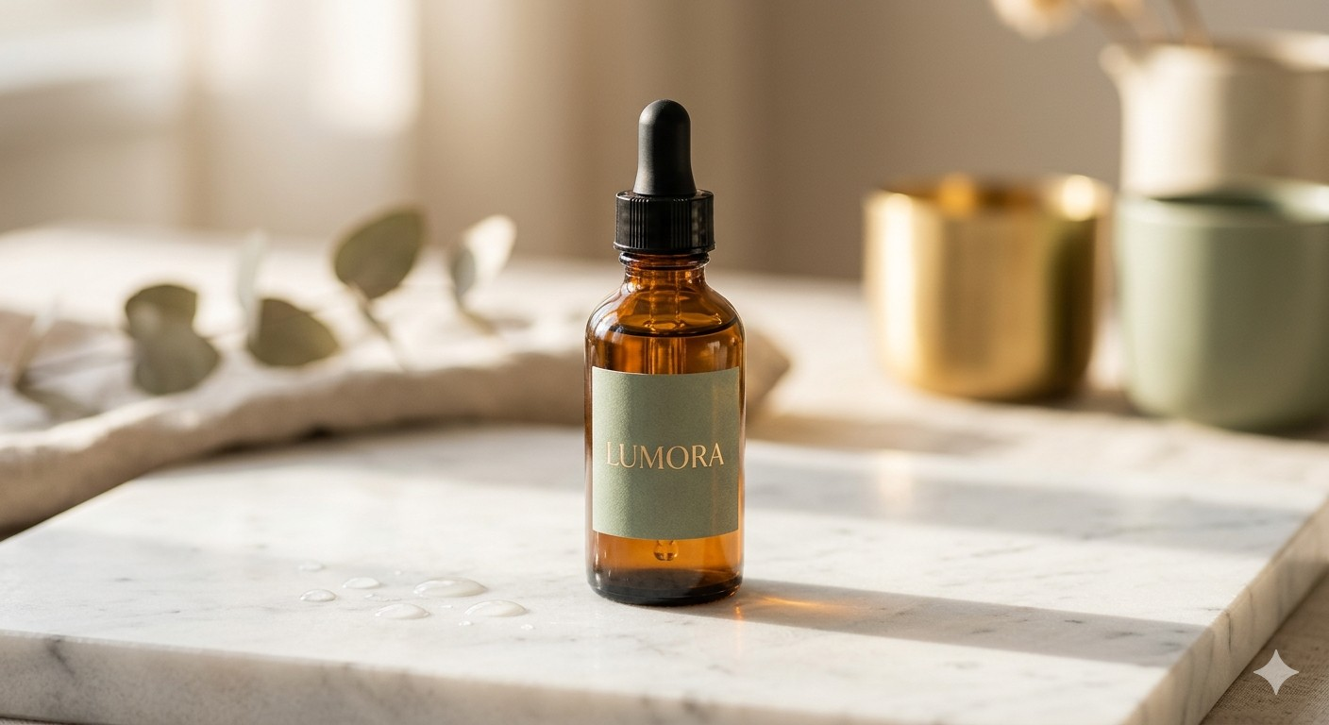




L
Creative Concept 1: “Glow Up”
Single image ad — Conversion stage
Why This Works
Lumora Skincare
Sponsored
Objective
Your skin deserves better mornings. ✨ The Vitamin C Glow Serum brightens and hydrates in a 60-second step. 15% off your first order — today only.
Sales (Conversions) — the bottom-of-funnel ask.
Audience
Core interest-based targeting now; warm retargeting once site-visitor data builds.
Placement
[ Product flat-lay — marble surface, soft morning light ]
Facebook & Instagram Feed, Stories.
Hook
Lumora Skincare | Glow Starts Here
A clean product visual plus a clear, time-limited offer to create urgency.
lumoraskincare.com
Shop Now
LUMORA SKINCARE · FACEBOOK ADS PRACTICE CAMPAIGN
9

Slide 10




L
Creative Concept 2: “3-Step Glow Routine”
Carousel ad — Consideration stage
Why This Works
Lumora Skincare
Sponsored
Objective
Glow doesn't happen by accident. Here's your 3-step morning ritual — swipe through →
Traffic — educate and move people to the product page.
Audience
Broader interest-based audience layered with engaged shoppers.
1. Cleanse
2. Glow Serum
3. Protect
Format Fit
Carousels reward swipe engagement and let each step earn its own card.
Card 1 of 3 →
Placement
Lumora Skincare | Learn the Routine
Facebook Feed and Marketplace, where carousels perform best.
Learn More
LUMORA SKINCARE · FACEBOOK ADS PRACTICE CAMPAIGN
10

Slide 11
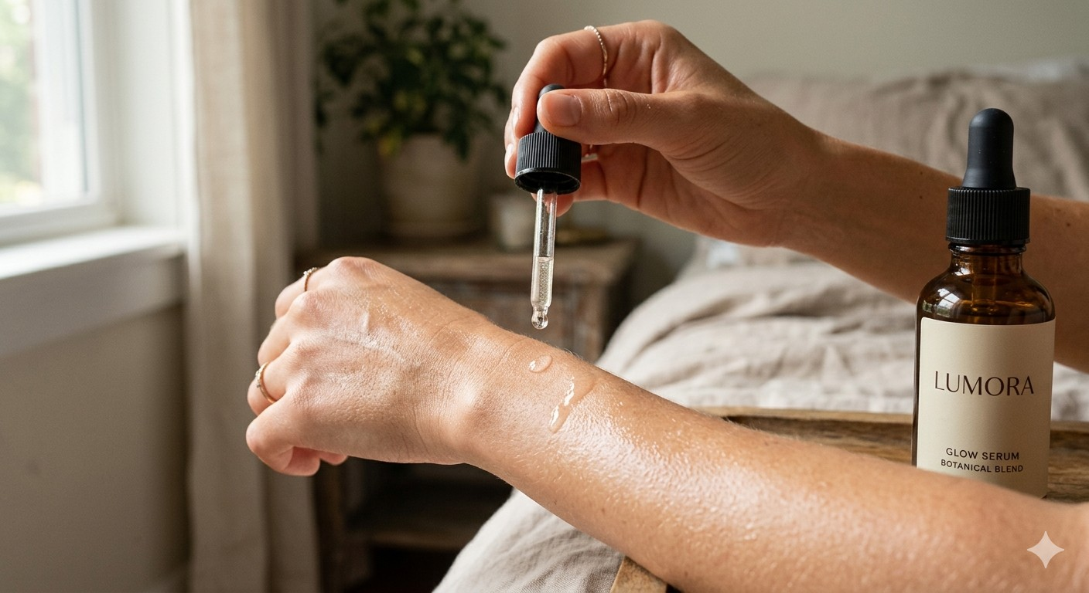

L
Creative Concept 3: “Real Skin, Real Results”
15-second UGC-style video — Awareness stage
Why This Works
Lumora Skincare
Sponsored
Objective
Real skin. Real routine. Real results. Use code WELCOME15 for 15% off your first Lumora order.
Brand Awareness / Reach — the top of the funnel.
Audience
Broad clean-beauty and wellness interest targeting.
0–5s
5–10s
10–15s
Hook
Demo
CTA
Format Fit
Relatable morning-skin frustration
Serum applied; visible glow
Discount code + Shop Now
Native, UGC-style video builds trust faster than polished studio footage.
Lumora Skincare | Glow Starts Here
Placement
Shop Now
Reels, Stories, and in-stream video for full-screen attention.
LUMORA SKINCARE · FACEBOOK ADS PRACTICE CAMPAIGN
11

Slide 12
L
Campaign Structure in Ads Manager
Three campaigns, each with its own ad set and creative
Awareness
Consideration
Conversion
CAMPAIGN
CAMPAIGN
CAMPAIGN
Objective: Brand Awareness
Objective: Traffic
Objective: Sales (Conversions)
AD SET
AD SET
AD SET
Budget: $360 (30%)
Audience: Broad interest-based
Placement: Reels, Stories, In-stream
Budget: $360 (30%)
Audience: Engaged shoppers + site visitors (30d)
Placement: Feed, Marketplace
Budget: $480 (40%)
Audience: Retargeting (14d) + 1% LAL purchasers
Placement: Feed, Stories, Audience Network
AD
AD
AD
Format: 15s Video
Creative: “Real Skin, Real Results”
CTA: Shop Now
Format: Carousel (3 cards)
Creative: “3-Step Glow Routine”
CTA: Learn More
Format: Single Image
Creative: “Glow Up” + discount code
CTA: Shop Now
LUMORA SKINCARE · FACEBOOK ADS PRACTICE CAMPAIGN
12

Slide 13
L
Detailed Targeting & Placements
The full parameter set, as it would be entered in Ads Manager
Parameter | Setting
Locations | United States — metro radius around New York, LA, Chicago, Austin, Seattle
Age | 24–40
Gender | All (skewed ~70% female in delivery)
Interests | Clean beauty, skincare, sustainable living, wellness & self-care, Sephora / Ulta
Behaviors | Engaged shoppers, frequent online shoppers
Custom Audiences | Website visitors (180 days), email subscriber list
Lookalike Audiences | 1–3% LAL from purchasers / email list (introduced Week 3+)
Placements | Advantage+ (Automatic): Feed, Stories, Reels, Marketplace, Audience Network
Devices | Mobile-first via Advantage+ defaults; no manual device restriction
LUMORA SKINCARE · FACEBOOK ADS PRACTICE CAMPAIGN
13

Slide 14


L
Optimization & A/B Testing Plan
How the campaign would improve itself over the 4-week run
Creative A/B Testing
Audience Testing
Test image vs. video creative within each ad set; pause underperformers after 3–5 days of data.
Run interest-based and lookalike audiences in parallel ad sets to see which holds a lower cost per result.
Retargeting Sequence
Weekly Budget Reallocation
Website visitors (14 days) → cart abandoners (7 days) → purchasers excluded from future ads.
Shift budget toward the best-performing ad set each week based on Ads Manager performance data.
LUMORA SKINCARE · FACEBOOK ADS PRACTICE CAMPAIGN
14

Slide 15
L
Simulated Performance Snapshot
Projected estimates for learning purposes — no live ad spend was used
1.4%
$0.95
CTR
CPC
$14.50
3.2x
CPM
ROAS
4-week totals (projected): ~218K reach · ~2,400 link clicks · ~71 conversions · ~$18 cost per purchase
LUMORA SKINCARE · FACEBOOK ADS PRACTICE CAMPAIGN
15

Slide 16

L
What I Learned
The most useful takeaways from building this campaign end-to-end
Full-Funnel Thinking
Audience Segmentation Matters
Splitting objectives by funnel stage clarified what each ad needed to accomplish, instead of asking one ad to do everything.
Narrow, well-defined interest groups outperform broad targeting assumptions made without data.
Creative Variety Prevents Fatigue
Tracking Requires Setup, Not Hope
Pairing each concept with multiple formats (image, carousel, video) gives Meta's algorithm more signal to optimize against.
UTM parameters and the Conversions API need to be planned before launch, not added afterward.
LUMORA SKINCARE · FACEBOOK ADS PRACTICE CAMPAIGN
16

Slide 17

L
Challenges Along the Way
Honest friction points worth naming for next time
Estimating Realistic Benchmarks
Designing for Every Placement
Without a live ad account, CTR, CPC, and ROAS figures had to be modeled from industry benchmarks rather than real data.
Each format (Feed, Stories, Reels) needs its own aspect ratio and safe zones for text and CTA buttons.
Balancing a Limited Budget
Understanding the Learning Phase
Splitting $1,200 across three funnel stages meant real trade-offs between reach and conversion volume.
Meta's algorithm needs roughly 50 conversions per ad set before stabilizing, which affects how soon results can be trusted.
LUMORA SKINCARE · FACEBOOK ADS PRACTICE CAMPAIGN
17

Slide 18
L
Recommendations Going Forward
What I'd do next if this campaign were to keep running
1
Scale the best-performing ad set's budget once it exits the learning phase.
2
Shift more budget toward retargeting once a warm audience (site visitors, email list) is built.
3
Test Meta Advantage+ Shopping Campaigns for automated, AI-driven optimization.
4
Build a library of UGC-style content — it tends to outperform polished studio creative for trust.
5
Implement the Conversions API for more accurate, privacy-resilient tracking.
LUMORA SKINCARE · FACEBOOK ADS PRACTICE CAMPAIGN
18

Slide 19
L
Thank You
Questions & Discussion
[Yby Kundan Singh Tanwar ] · [kundansinghtanwar607@gmail.com] · Lumora Skincare Facebook Ads Practice Campaign

