Slide 1
HACKATHON
Delivery Route
Optimizer
Shortest delivery tour using Dynamic Programming & Branch and Bound
Team: SAI BHARGAV [25MVCMR0233]
KUNDAN SREETEJA [25MVCSMR0228]
DEEKSHITH REDDY [25MVCSMR0261]
SHIVA MANI [25MVCSMR0216]
College: MALLAREDDY TECHNICAL CAMPUS
Problem Domain • Algorithms / Optimization

Slide 2
2. The Challenge
Turning a real delivery requirement into a precise optimization problem.
REAL-WORLD PROBLEM
KEY CHALLENGES
A delivery vehicle must visit multiple customer locations, minimize travel distance, and return to the starting depot.
Route explosion
Possible tours grow factorially as locations increase.
Exact optimization
A good-looking route is not enough; we need the minimum-distance tour.
Start from a chosen depot
Visit every customer exactly once
Explainability
Judges and users need to see why a route was selected.
Return to the depot
Comparison
Use two exact approaches and compare their behavior on the same input.
Minimize total route distance / cost
This is modeled as the Travelling Salesman Problem (TSP).

Slide 3
3. Our Innovation
A visual, interactive optimizer that makes the algorithm visible—not just the final number.
Interactive input
CORE IDEA
Two exact methods
Visual proof
Add, edit, or remove locations and coordinates.
“Give the user the route,
the reason, and the evidence.”
Held-Karp DP + Branch & Bound on the same instance.
Route order, arrows, coordinates, and distance matrix.
The system lets a user change locations, choose a starting depot, select an algorithm, and watch the optimized route appear on the canvas.
Judge-friendly comparison
Distance, runtime, state/node counts, and pruning.
Differentiator: the user can see the optimization process through two algorithmic lenses.

Slide 4
4. How It Works
Input → distance model → algorithm → optimal route → visual output
1
Input
2
Distance Matrix
3
Algorithm
4
Output
Locations + X/Y coordinates
Starting depot
Euclidean distance
between every pair
Held-Karp DP
or Branch & Bound
Optimal tour + distance
+ runtime/statistics
User journey
Add / edit locations
Choose depot
Select DP / B&B
Optimize
Compare + visualize
Key idea: both algorithms receive the same locations and optimize the same TSP objective, so their final optimal distance can be compared fairly.

Slide 5
5. Technology & Algorithm
A lightweight browser-based prototype with a small Express API layer.
TECH STACK
ALGORITHMS
React + Vite
Interactive UI
Held-Karp Dynamic Programming
Branch & Bound
JavaScript
State = current node + visited set
Builds partial candidate routes
Algorithm implementation
SVG / CSS
Reuses overlapping subproblems
Computes a lower bound
Route visualization
Exact route reconstruction
Prunes non-promising branches
Node.js + Express
Backend REST/API layer
Complexity
Brute Force: O(n!)
Held-Karp DP: O(n²·2ⁿ)
B&B: exponential worst case
Distance model: Euclidean distance between the entered coordinates.

Slide 6
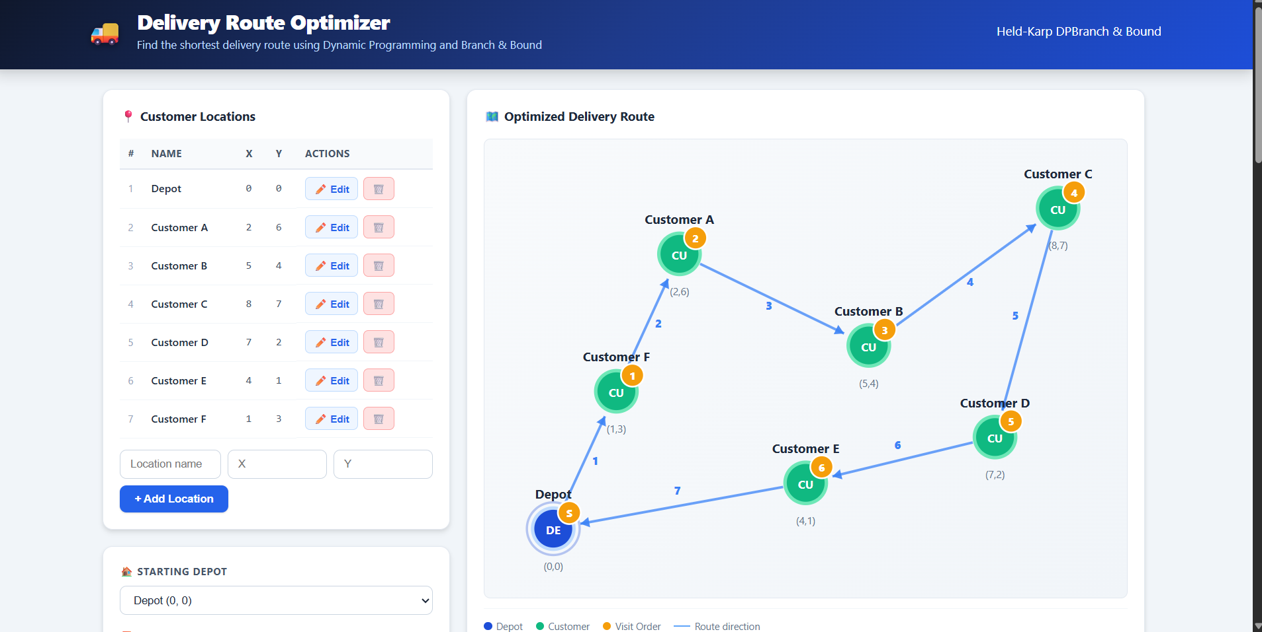
6. Demo & Impact
A working optimizer with an understandable visual result.
WHAT THE JUDGE SEES
1 → 6 → 1
Depot → customers → depot
2 exact
DP + Branch & Bound
Real-time
Route + distance + stats
Practical benefits
Makes route planning explainable
LIVE DEMO SCREENSHOT
The current demo shows 1 depot + 6 customers, an optimized route, visit order, and route direction.

Slide 7
7. Future Vision
Where the prototype can go next.
Current achievement
Future improvements
Scalability
Working TSP optimizer
Real map / road-network distances
Heuristics for larger inputs
Interactive location input
Delivery time windows
Caching repeated route states
DP + Branch & Bound comparison
Vehicle capacity constraints
Batch optimization jobs
Route visualization + API layer
Multiple vehicles / depots
Cloud deployment + monitoring
Thank You • Q&A
FINAL TAKEAWAY
We turn a combinatorial delivery problem into an interactive, explainable optimization demo.
GitHub
github.com/kundansreeteja-cloud/DeliveryRouteOptimizer

