Slide 1
Linux synchronization
Journey to making lockless software

Slide 2
Agenda
A) Kernel Synchronization techniques
1. Atomic variables internals and implementation
2. Spinlocks internals
B) Userspace atomic and gcc locking primitives
1. Locking in user space details and implementation
C) Making lockless
1. RCU details and implementation
2. SPDK completely lockless programming

Slide 3
Linux synchronization : Requirement
Concurrent modules sharing memory shall synchronize.
Multiple CPUs modify the same RAM address can lead to inconsistency.
Global variable modifications by multiple threads
Shared data structure modification(Shared linked list, RB tree etc.) shall be synchronized
Popular Primitives
Atomic variables
Spinlocks
RCU
Per CPU/Per thread variables (lockless)
User space
Pthread 1
Pthread 2
Pthread N
CPU 0
CPU 2
CPU M
Shared memory
Kernel space
Kernel thread
Process context
CPU X
CPU Y
Shared memory
Interrupt context
CPU Z

Slide 4
Linux synchronization : Atomic variable
Atomic operations are sequences of instructions that guarantee atomic accesses and updates of shared single word variables. This means that atomic operations cannot protect accesses to complex data structures in the way that locks can, but they provide a very efficient way of serializing access to a single word.
In a multiprocessor system, there are cases when resources are being shared between processes. In such a scenario, modification (addition/subtraction) of a resource by more than one process can lead to a race condition, which can result in erroneous results. For such scenarios, the Linux kernel has “atomic_t” structures. These structures provide a way to atomically modify values of a variable, which prevents race conditions.
Let’s take atomic_add() as an example for atomic operation.
Shared variable
CPU 0
Independent
Load (Shared_variable) Increment (Shared_variable) Save(Shared variable )
CPU N
Independent
Load (Shared_variable) Increment (Shared_variable) Save(Shared variable )
Inconsistent results

Slide 5
atomic_add() Internals
Instead of using of v = v + I for atomic we use
Atomic_t v;
Atomic_add(&v, 1);
Atomic_add calls “arch_atomic_add_return()”.
arch_atomic_add_return() function calls the function “xadd()”
“xadd” calls “__xadd()”
“__xadd()” calls “__xchg_op()”
“__xchg_op()” macro first executes the “LOCK_PREFIX” “lock” and after that it executes the “xadd” instruction on the parameters.
#define xadd(ptr, inc) __xadd((ptr), (inc), LOCK_PREFIX)
#define __xadd(ptr, inc, lock) __xchg_op((ptr), (inc), xadd, lock)
#define __xchg_op(ptr, arg, op, lock) \
({ \
__typeof__ (*(ptr)) __ret = (arg); \
switch (sizeof(*(ptr))) { \
case __X86_CASE_B: \
asm volatile (lock #op "b %b0, %1\n" \
: "+q" (__ret), "+m" (*(ptr)) \
: : "memory", "cc"); \
Break;

Slide 6
LOCK_PREFIX
Cache Synchronization
The LOCK_PREFIX is the key to making the multiple instructions atomic, In this way the CPU cannot be preempted before the operation takes effect. It prevents processors from writing to the same memory location at the same time. This ensures that the processor has exclusive use of any shared memory. This makes sure that the 3 steps (READ, MODIFY and WRITE) appears as a single step to other processors.
The LOCK # signal is asserted during execution of the instruction following the LOCK_PREFIX. This signal can be used in a multiprocessor system to ensure exclusive use of shared memory while LOCK # is asserted.
In older generation architectures, the LOCK_PREFIX was executed by asserting a lock on the bus, which came with a big hit in performance. But with newer architectures, the lock is asserted on the cache line. This change, along with the cache coherency protocol, ensures that the access to the shared memory is managed. Disadvantage: Lock on the memory bus or locking of cache results in performance hit.
CPU 0
CPU 1
CPU N
Cache
Shared memory(Copy in cache)
Cache
Shared memory(Copy in cache)
Cache
Shared memory(Copy in cache)
Shared memory(RAM) 0xffffffff824c7be0

Slide 7
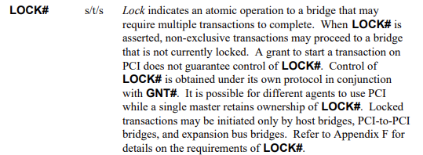

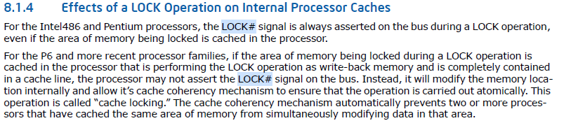
LOCK_PREFIX
PCI Bus specification mentioning the LOCK # signal
Intel Architecture Sofware Development manual mentioning the lock prefix

Slide 8
Spin lock
A spin lock is a way to protect a shared resource from being modified by two or more processes simultaneously. The first process that tries to modify the resource "acquires" the lock and continues on its way, doing what it needed to with the resource. Any other processes that subsequently try to acquire the lock get stopped; they are said to "spin in place" waiting on the lock to be released by the first process.
The spinlock is a low-level synchronization mechanism which in simple words, represents a variable which can be in two states: acquired and released.
Each process which wants to acquire a spinlock, must write a value which represents spinlock acquired state to this variable and write spinlock released state to the variable. If a process tries to execute code which is protected by a spinlock, it will be locked while a process which holds this lock will release it.
In this case all related operations must be atomic to prevent race conditions state.
The spinlock is represented by the spinlock_t type in the Linux kernel. simple definition of spinlock_t
typedef struct spinlock {
union {
struct raw_spinlock rlock;
};
} spinlock_t;

Slide 9
Spinlock …
Simple definition of raw_spinlock (Excluded the debug statements)
typedef struct raw_spinlock {
arch_spinlock_t raw_lock;
} raw_spinlock_t;
Definition of arch_spinlock_t:
typedef struct qspinlock { union { atomic_t val;
struct { u8 locked; u8 pending; };
struct { u16 locked_pending; u16 tail; }; };
} arch_spinlock_t;

Slide 10
Spinlock Acquisition and dependency on lock prefix
Acquiring a spinlock
spin_lock() -> raw_spin_lock() -> _raw_spin_lock() -> __raw_spin_lock()
static inline void __raw_spin_lock(raw_spinlock_t *lock)
{
preempt_disable();
spin_acquire(&lock->dep_map, 0, 0, _RET_IP_);
LOCK_CONTENDED(lock, do_raw_spin_trylock, do_raw_spin_lock);
}
LOCK_CONTENDED LOCK_CONTENDED() -> do_raw_spin_lock() -> arch_spin_lock() -> queued_spin_lock() -> atomic_try_cmpxchg_acquire() -> arch_atomic_try_cmpxchg_acquire-> arch_atomic_try_cmpxchg_relaxed-> arch_atomic_cmpxchg-> arch_cmpxchg-> __cmpxchg- >
#define __raw_cmpxchg(ptr, old, new, size, lock) \
({ \
__typeof__(*(ptr)) __ret; \
__typeof__(*(ptr)) __old = (old); \
__typeof__(*(ptr)) __new = (new); \
switch (size) { \
case __X86_CASE_B: \
{ \
volatile u8 *__ptr = (volatile u8 *)(ptr); \
asm volatile(lock "cmpxchgb %2,%1" \
: "=a" (__ret), "+m" (*__ptr) \
: "q" (__new), "0" (__old) \
: "memory"); \
break; \
} \
case _

Slide 11
Userspace SYNCHRONIZATION primitives
Let's write see the behavior of a program with 2 threads modifying same variable. Without any locks the modification leads to undefined values for the resultant variable.
Pthread 1 Pthread2
Output is : Thread 1 Thread 2 time taken 0.001365 secs Thread 1 returns: 0 Thread 2 returns: 0 counter = 100602 --- this shall be 200000
Volatile int counter = 0;
Thread_func1()
{
for (int i = 0;i < 100000; i++)
counter = counter + 1;
}
Volatile int counter = 0;
Thread_func2()
{
for (int i = 0;i < 100000; i++)
counter = counter + 1;
}

Slide 12
Userspace primitives (Atomic variable )
Let's protect the global variable using the atomic primitive
Pthread 1 Pthread2
Output is : Thread 1 Thread 2 time taken 0.007320 secs --- 7 times more if we use atomic Thread 1 returns: 0 Thread 2 returns: 0 counter = 200000
Let's do a disassembly of __sync_add_and_fetch and see return __sync_add_and_fetch(atomic, val); 11d8: 8b 4d f4 mov -0xc(%rbp),%ecx 11db: 48 8b 55 f8 mov -0x8(%rbp),%rdx 11df: 89 c8 mov %ecx,%eax 11e1: f0 0f c1 02 lock xadd %eax,(%rdx) --- lock prefix usage 11e5: 01 c8 add %ecx,%eax
int counter = 0;
Thread_func1()
{
for (int i = 0;i < 100000; i++)
__sync_add_and_fetch(&counter, 1);
}
int counter = 0;
Thread_func2()
{
for (int i = 0;i < 100000; i++)
__sync_add_and_fetch(&counter, 1);
}

Slide 13
Userspace primitives (pthread spinlock)
Let's protect the global variable using the pthread_spin_lock primitive
Pthread 1 Pthread2
Output is : Thread 1 Thread 2 time taken 0.033543 secs --- 30 times more delay Thread 1 returns: 0 Thread 2 returns: 0 counter = 200000
Let's do a disassembly of pthread_spin_lock and see
objdump -S libc.so.6 > ~/libc_disasm.txt 000000000009be30 <pthread_spin_lock@@GLIBC_2.34>:
9be30: f3 0f 1e fa endbr64
9be34: f0 ff 0f lock decl (%rdi)
9be37: 75 07 jne 9be40 <pthread_spin_lock@@GLIBC_2.34+0x10>
9be39: 31 c0 xor %eax,%eax
9be3b: c3 ret
9be3c: 0f 1f 40 00 nopl 0x0(%rax)
9be40: f3 90 pause
9be42: 83 3f 00 cmpl $0x0,(%rdi)
9be45: 7f ed jg 9be34 <pthread_spin_lock@@GLIBC_2.34+0x4>
9be47: eb f7 jmp 9be40 <pthread_spin_lock@@GLIBC_2.34+0x10>
9be49: 0f 1f 80 00 00 00 00 nopl 0x0(%rax)
Volatile int counter = 0;
Thread_func1()
{
for (int i = 0;i < 100000; i++)
{
pthread_spin_lock(&my_lock);
counter ++;
pthread_spin_unlock(&my_lock);
}
}
Volatile int counter = 0;
Thread_func2()
{
for (int i = 0;i < 100000; i++)
{
pthread_spin_lock(&my_lock);
counter ++;
pthread_spin_unlock(&my_lock);
}
}
Summary :
In userspace also the performance deteriorates because of lock prefix usage which leads to synchronization across multiple CPUs

Slide 14
Making lockless (RCU )
Atomic counters and spinlocks doesn’t scale good
RCU locks work in a way that all the reads happen without usage of atomic variables. The places we are iterating over a linked list, and the linked list is not modified frequently, RCU will be very useful.
Basic RCU primitives : 1. rcu_read_lock()/unlock() - RCU read lock shall be taken when doing a read of critical section data 2. rcu_dereference() - Within a read lock we shall use this API to dereference a pointer 3. rcu_assign_pointer() - Use this API to write to a shared variable. The Write shall also be protected by means of locks, 4.synchronize_rcu() - Wait for all the read RCUs to complete. This is a blocking call and waits

Slide 15
Making lockless (RCU )
Doing a read with RCU
We can see that rcu_read_lock() is taken when we have to only read the data, without modifying it :
rcu_read_lock();
retval = rcu_dereference(gbl_foo)->a;
rcu_read_unlock();
Doing a write with RCU
Updating the variable, we see that we take a spin lock and modify the data(write). After modifying the variable, we can release the spinlock and call synchronize_rcu(). After a call to synchronize_rcu() we can free the variable.
spin_lock(&foo_mutex);
old_fp = rcu_dereference_protected(gbl_foo,lockdep_is_held(&foo_mutex));
*new_fp = *old_fp;
new_fp->a = new_a;
rcu_assign_pointer(gbl_foo, new_fp);
printk("updated pointer\n");
spin_unlock(&foo_mutex);
printk("synchronize rcu\n");
synchronize_rcu();

Slide 16
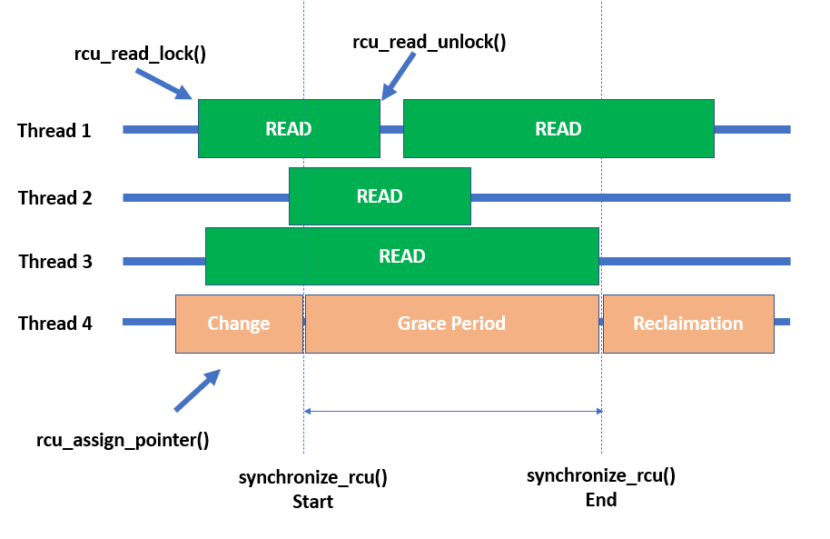
Making lockless (RCU Details)
Writes need to be protected using any normal lock
Reads we just need to take the rcu_read_lock(). As rcu_read_lock doesnt use any atomic variables, it can scale good
Update/write a variable we protect the same with locks.
After we are done with write, we call synchronize_rcu()
synchronize_rcu() call waits for a context switch at all the other processors
Context switch happens at other processors, we will be sure that the old shared data is not longer accessed by the other threads.

Slide 17
Making lockless (RCU Implementation )
No lock Prefix used in reads
rcu_read_lock()
static __always_inline void rcu_read_lock(void)
{
__rcu_read_lock();
__acquire(RCU);
rcu_lock_acquire(&rcu_lock_map);
RCU_LOCKDEP_WARN(!rcu_is_watching(),
"rcu_read_lock() used illegally while idle");
}
static inline void __rcu_read_lock(void)
{
preempt_disable();
}
Basically, the rcu_read_lock just do preempt_disable.
What will happen if CPU with read critical section gets interrupt
we shall disable the interrupt on this CPU(we can use local_irq_save() ) we shall disable the interrupt on this CPU(we can use local_irq_save() )
synchronize_rcu()
void synchronize_rcu(void)
{
RCU_LOCKDEP_WARN(lock_is_held(&rcu_bh_lock_map) ||
lock_is_held(&rcu_lock_map) ||
lock_is_held(&rcu_sched_lock_map),
"Illegal synchronize_rcu() in RCU read-side critical section");
if (rcu_blocking_is_gp())
return;
if (rcu_gp_is_expedited())
synchronize_rcu_expedited();
else
wait_rcu_gp(call_rcu);
}
__wait_rcu_gp is initiating the completions on all CPUS and waiting for them to complete.

Slide 18
SPDK lockless architecture – per thread variables
SPDK presented a entirely new software architecture.
Because of changed architecture, SPDK started providing 7-8Times IOPS than the legacy architecture .
This was required for the newest Intel optane devices which could provide more IOPs. All existing software, were not able to provide more than 200,000 IOPS.
The older software are limited by A)User space <-> Kernel space system calls B)Copying of data from user space to kernel space C)Interrupts are used instead of polling D)Locks shared across multiple CPUS are used
SPDK came up with its software architecture which used per thread variables
If different threads have to interact they will do so using lockless messaging

Slide 19
SPDK lockless architecture(per Thread variables)
Lockless implementation
Based on per thread variables. The per thread variables are named as channels
SPDK creates IO channels per device per SPDK thread for providing lockless IO path.
The variables are created as a part of IO channel creation.
At the time of IO submission, the data-structures for only that specific thread are accessed.
SPDK reactor thread 0(CPU 0)
SPDK reactor thread 1(CPU 1)
SPDK reactor thread N(CPU N)
IO Device
SPDK IO channel (thread 0)
Variables
SPDK IO channel (thread 1)
Variables
SPDK IO channel (thread N)
Variables
NVMe queue 0
NVMe queue 1
NVMe queue N
Disk
Notes:
Use event per thread mechanism. Say in case we get an event for new namespace addition, then this event is sent to each IO submission thread.
Each thread then creates its own list of namespaces.

Slide 20
SPDK APIs
spdk_io_device_register
Creates and add the io_device to global io_device_tree
RB_INSERT(io_device_tree, &g_io_devices, dev);
bdev_channel_create – will be called for all threads/perPCPU and calls spdk_get_io_channel()
spdk_get_io_channel
Create the channel for io_device per thread.
RB_INSERT(io_channel_tree, &thread->io_channels, ch);
Fetch the io_channel
RB_FIND(io_channel_tree, &thread->io_channels, &find);
spdk_for_each_thread(spdk_msg_fn fn, void *ctx, spdk_msg_fn cpl)
rc = spdk_thread_send_msg(ct->cur_thread, _on_thread, ct);
No use of atomic or other locks across multiple CPUs

Slide 21
References
PCI Bus Specification https://www.ics.uci.edu/~harris/ics216/pci/PCI_22.pdf
Intel SDM (Software Developer’s Manuals) https://www.intel.com/content/www/us/en/developer/articles/technical/intel-sdm.html
https://cdrdv2.intel.com/v1/dl/getContent/671200
Atomic fetch and add https://en.wikipedia.org/wiki/Fetch-and-add
RCU Usage and internals https://sklinuxblog.blogspot.com/2021/02/linux-rcu-usage.html
SPDK lockless and concurrency https://spdk.io/doc/concurrency.html
User space RCU https://lwn.net/Articles/573424/
These slides are present on GitHub https://github.com/kundanthebest/osi2022

