Slide 1

Global Development Analysis
Anusha Chebolu
Shalini Cherukuri
Nikhil Sai Jaddu
Kundhana Harshitha Paruchuru

Slide 2

Community/Population
Target Community: Economists and Policymakers
Macro-Level Influence: Economists guide governments in resource allocation, impacting economic outcomes and societal well-being.
Global Relevance: Indicators like GDP growth and labour trends inform policies aligning national strategies with global standards.
Comprehensive Impact: Supports data-driven decisions to reduce poverty, create jobs, and foster sustainable growth.

Slide 3


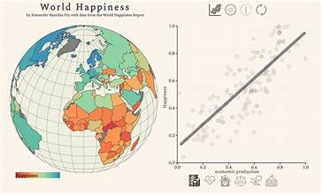
Data Sources
The World Bank: https://data.worldbank.org/
Provides economic and demographic data.
World Happiness Report: https://worldhappiness.report/data/
Offers well-being and societal indicators.
Transparency Report: https://www.transparency.org/en/cpi/2018
Supplies governance data, particularly corruption perceptions
The combined dataset is titled as World Development Data and is chosen from Kaggle.

Slide 4
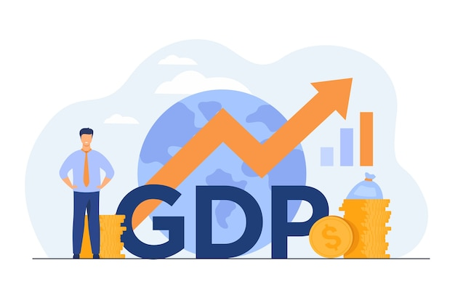

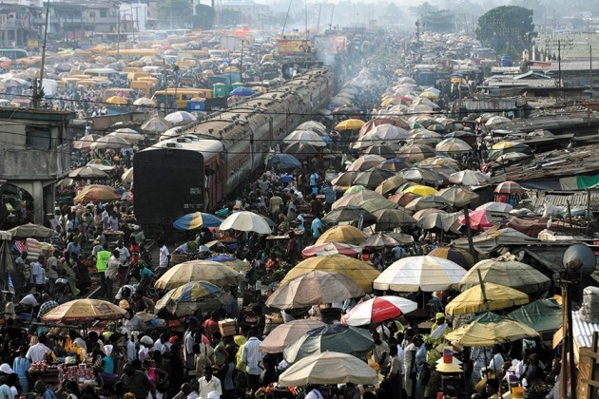

Dataset Outline
This dataset covers a wide range of indicators such as, population growth, literacy rates, life expectancy, and poverty levels.
It includes data on over 180 countries, over three years from 2015 to 2018, allowing for both time-series and cross-sectional analysis.

Slide 5
Tables Creation
Country
Country_id
Name
Economy
Economy_id
Country_id (FK)
Social
Social_id
Social_support
Health
Labor
Amenities
Corruption
Land area
Population
Population density(*)
GDP
GDP_per_capita(*)
Income_class
Freedom
Generosity
Health_id
Alcohol_consumption
Air_pollution
Adult_literacy
Life_expectancy
Labor_id
Labor_rate
Labor_force
Unemployement_rate
Amenity_id
Water_access
Electricity_access
Corruption_id
Cpi
Country_id (FK)
Country_id (FK)
Country_id (FK)
Country_id (FK)
Country_id (FK)

Slide 6

Problems addressed by the dataset
How can labor force indicators be used to identify labor market health?
Does a higher GDP per capita lead to increased social support and freedom to make life choices?
What is the correlation between corruption perception and income class across countries?
How can health-related indicators be used to assess public health and environmental sustainability?

Slide 7
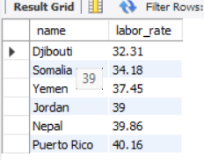
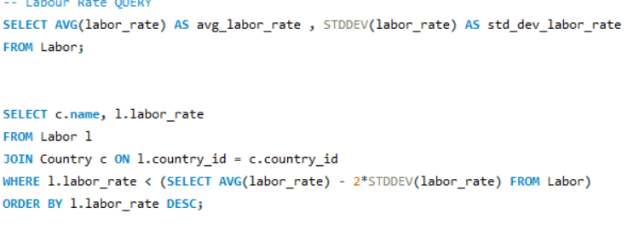
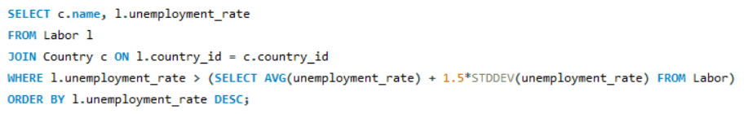
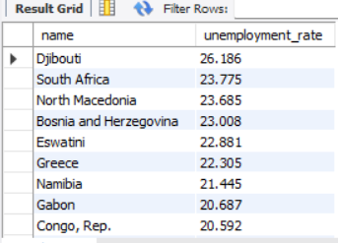
How can labor force indicators be used to identify labor market health?
Possible Policies :
Incentives for Private Sector Hiring, Support for Elderly and Disabled Workers, Microloans and Grants for small businesses and startups.

Slide 8
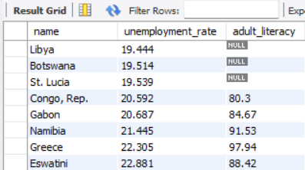
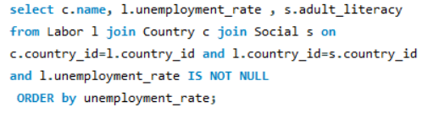
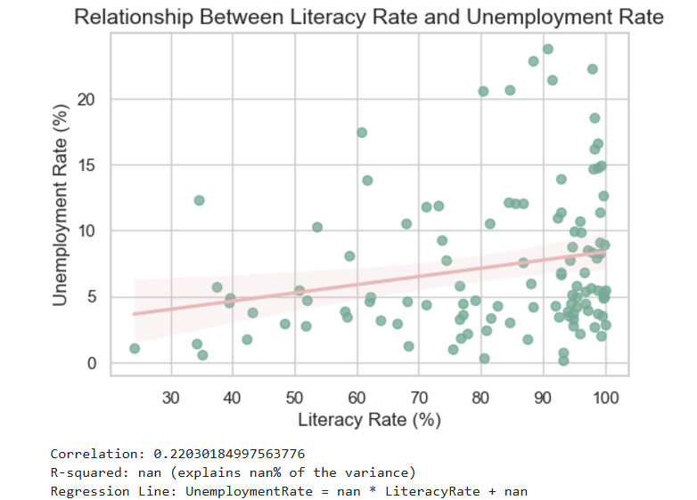
How can labor force indicators be used to identify labor market health?
Conventionally, one might expect a negative correlation between literacy rates and unemployment rates.
Reasons for positive correlation:
Skills Mismatch, structural unemployment. In developing economies, literacy might improve faster than job opportunities are created.
Possible Policies:
Job creation strategies, Industry Collaboration, Skill alignment, Invest in Emerging Sectors, Attract Foreign Investment, Support Labor Mobility, Boost Small and Medium Enterprises (SMEs) by providing tax benefits, subsidies.

Slide 9
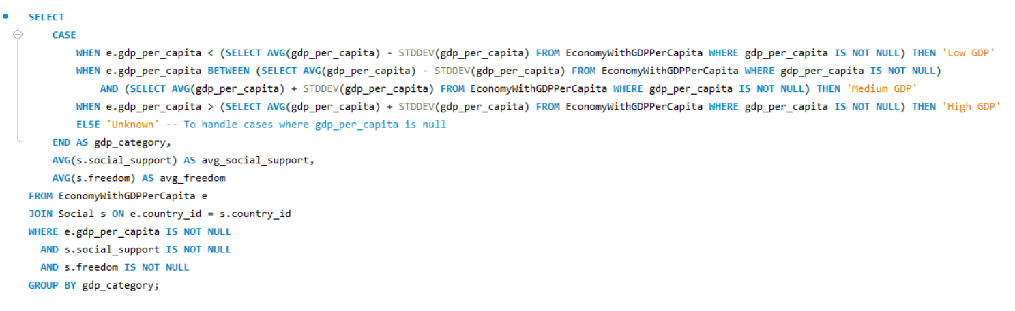

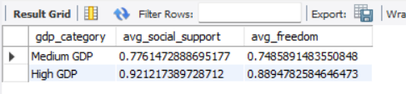
Does a higher GDP per capita lead to increased social support and freedom to make life choices?

Slide 10
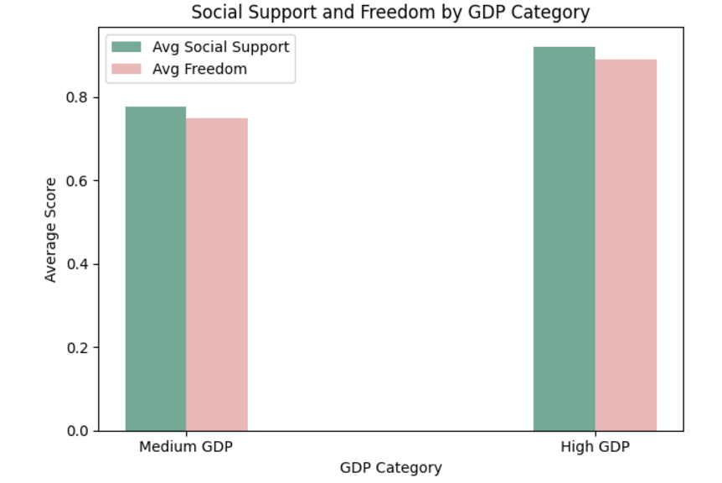
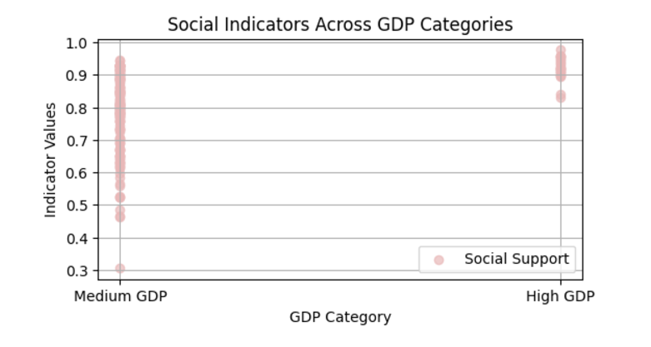
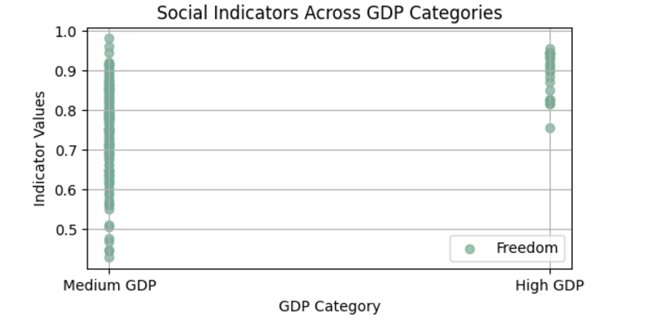
Possible Policies:
Support Innovation, Protecting civil liberties, Promoting work-life balance

Slide 11
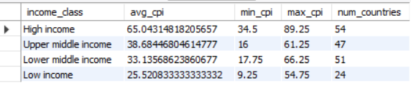
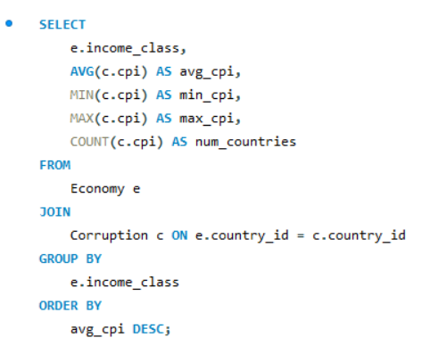
What is the correlation between corruption perception and income class across countries?
Possible policy solutions
Low-Income Countries: Focus on improving government transparency.
Middle-Income Countries: Use technology to reduce corruption and encourage fair business practices.
High-Income Countries: Tighten rules to stop illegal money flows and hold big companies accountable.

Slide 12
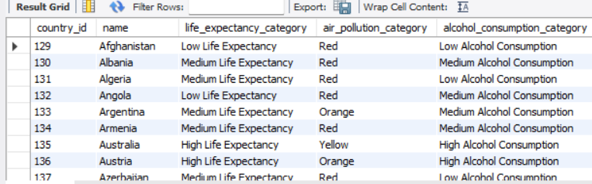
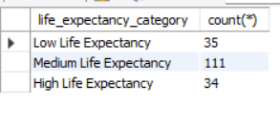
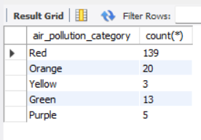
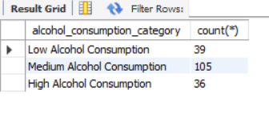
How can health-related indicators be used to assess public health and environmental sustainability?
This query categorizes countries based on Life Expectancy, Air Pollution, and Alcohol Consumption using average values and standard deviations.
Life Expectancy: Categorized into Low, Medium, or High based on the average ± standard deviation.
Air Pollution: Categorized into Green, Yellow, Orange, Red, or Purple based on pollution levels.
Alcohol Consumption: Categorized into Low, Medium, or High based on the average ± standard deviation.
This classification helps in assessing public health and environmental sustainability across countries.

Slide 13

Possible policy solutions​:
For Low Life Expectancy:
Improve healthcare access and promote healthier lifestyles in countries with low life expectancy.
For High Air Pollution:
Reduce air pollution through stricter environmental laws and investment in clean energy.
For High Alcohol Consumption:
Control alcohol consumption with regulations and public education campaigns to address health concerns.

Slide 14
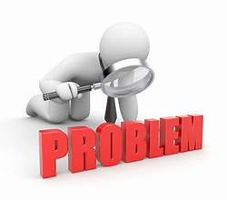
Addressing Privacy Concerns
Country-Level Aggregation
Data is aggregated at the national level, avoiding individual-level privacy risks.
Focuses on trends and patterns across countries, not personal data.
Policy-Driven Analysis
Insights are aimed at informing policy interventions to improve social and economic outcomes.
Emphasis on providing constructive recommendations for countries needing targeted support.

Slide 15

Challenges faced when creating database
Splitting and Insertion
Used staging table and python script to run transfer queries.
Usage of derived attribute
Generated Column which dynamically sets the column value.
Derived attribute is dependent on another entity
Created view which joins tables and calculates value of derived attribute.
Used view to calculate derived values on-the-fly, is a much cleaner and more efficient solution than using triggers or stored generated columns, especially when dealing with values derived from other tables.

Slide 16


