Slide 1
Recipe Web blog
Submitted by:
Kundi, Jagdeep Singh
1831970
Mohit Goyal
Submitted to:
Salima Hassaine
Web server application development I

Slide 2
Table of content
Introduction
Languages used
Users

Slide 3
Introduction
Recipe web blog is a freshly modelled website letting people search & view a recipe consisting of/without any particular ingredient along with nutritional insights.
Users can perform certain tasks depending upon their roles.
Users may contact the admin by filling the contact form with their query.

Slide 4
Languages used:
HTML
CSS
PHP
Bootstrap
Javascript

Slide 5
Users
Guest/ visitor: Users who are not registered & can only search & view recipes.
Members: Users who are registered & can search, view recipes and after logging in can manage their favourite recipe, leave & read reviews & ratings.
Admin: Can add, update or delete any recipe along with all the member rights.

Slide 6
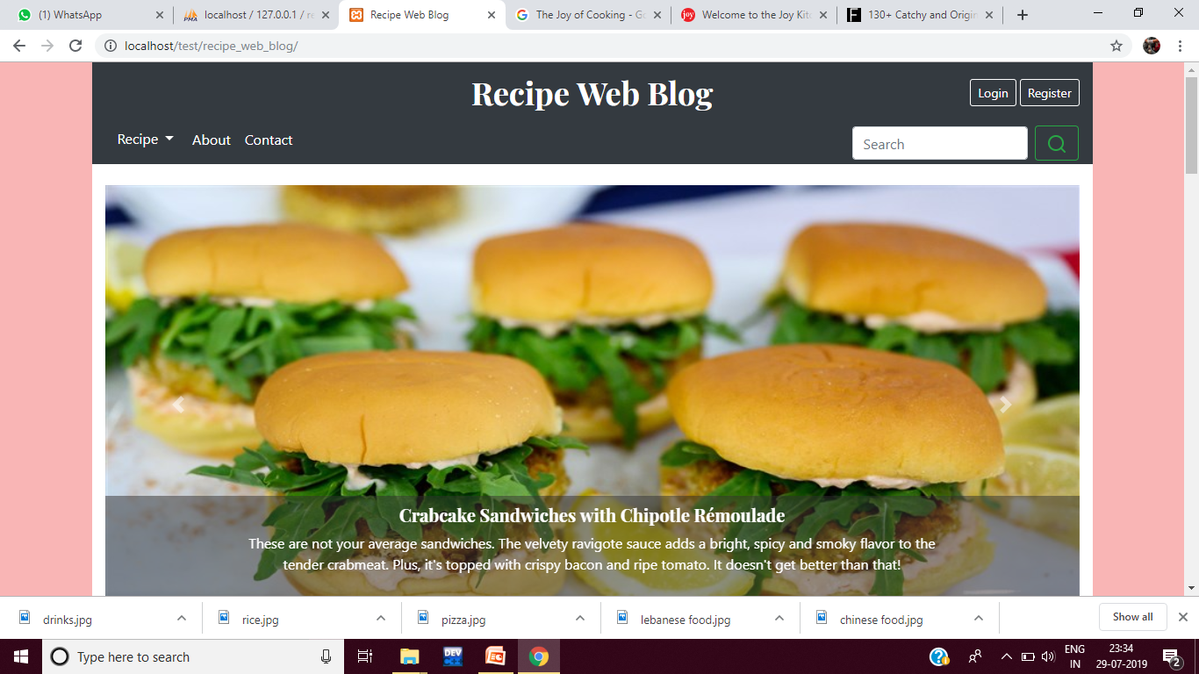
Screenshot – Home page

Slide 7
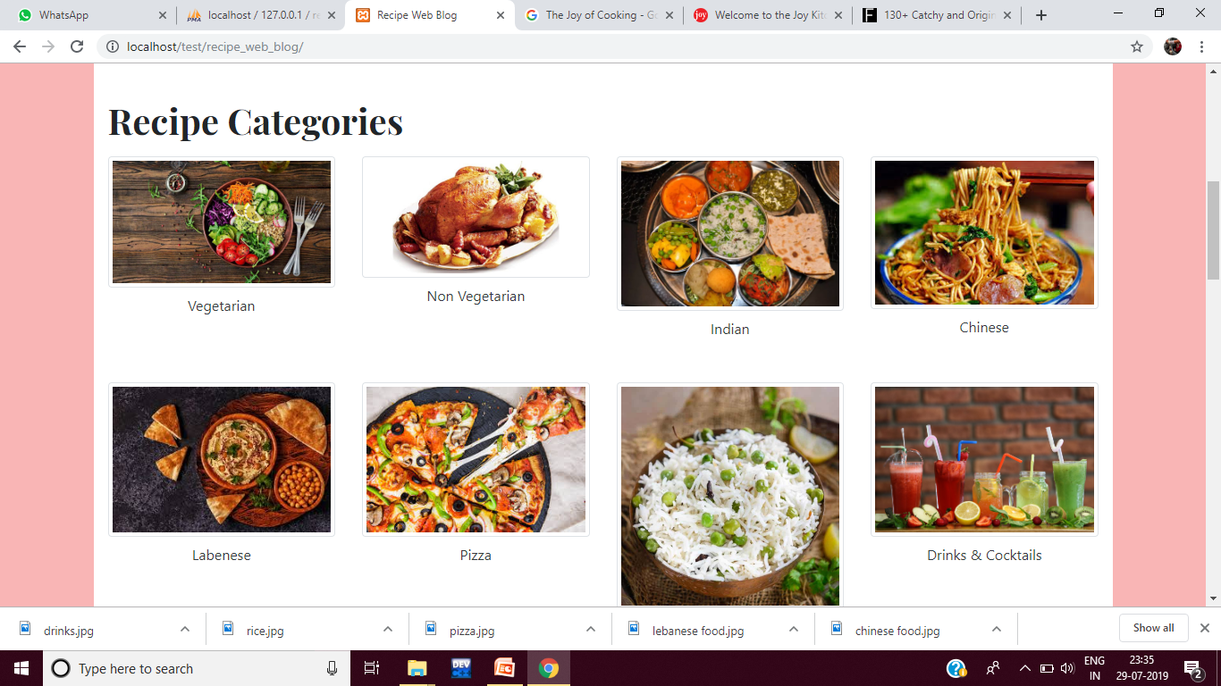
Screenshot – Home page

Slide 8
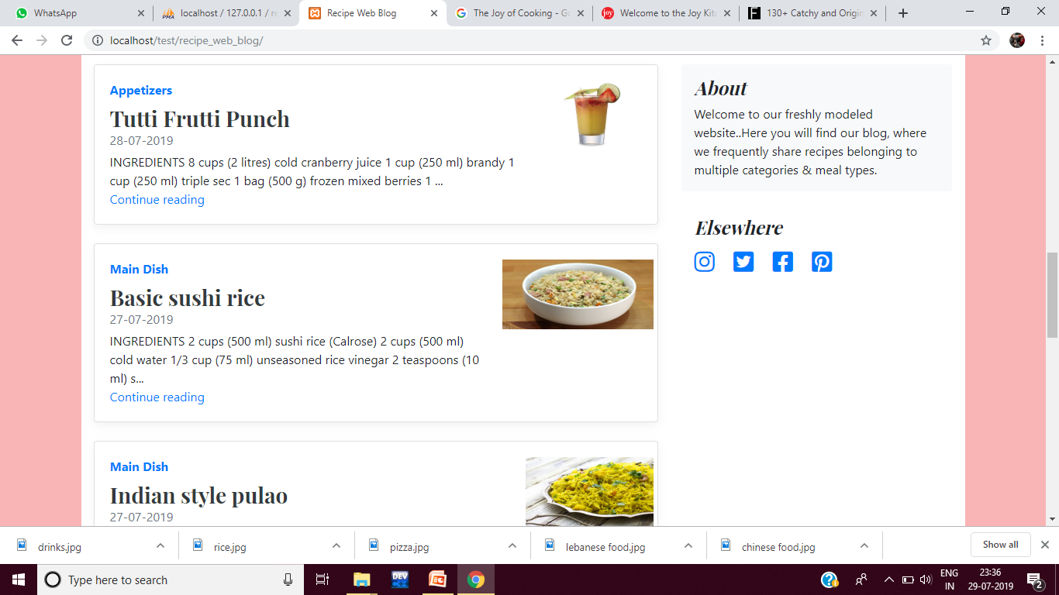
Screenshot – Home page

Slide 9
Screenshot – Home page

Slide 10
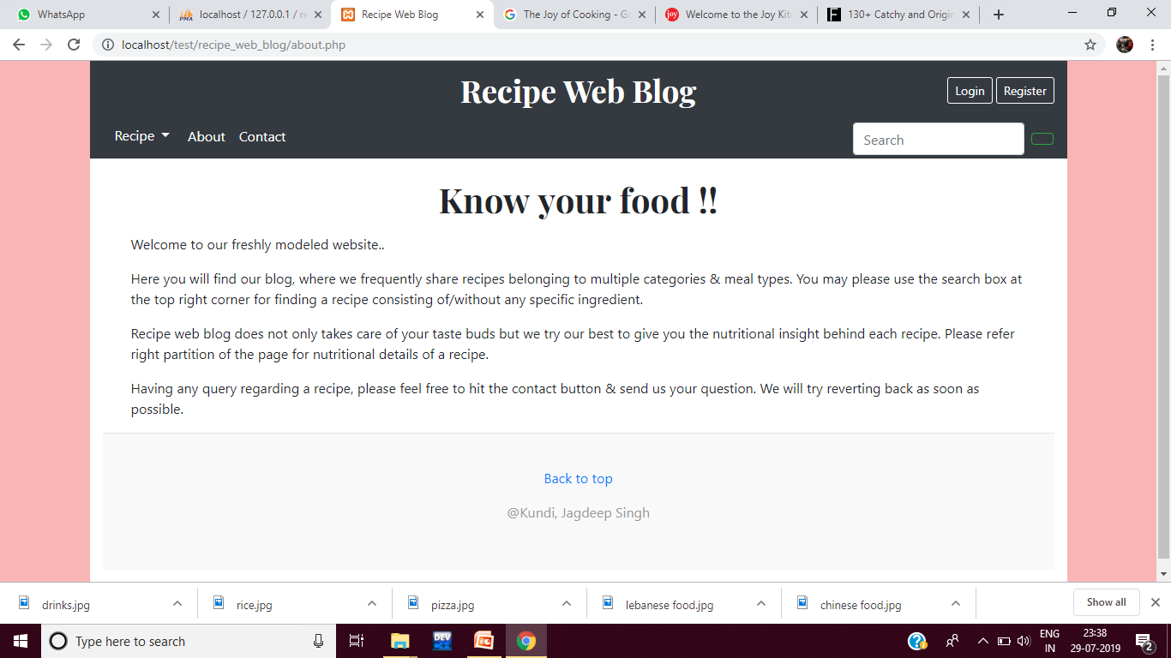
Screenshot – About page

Slide 11
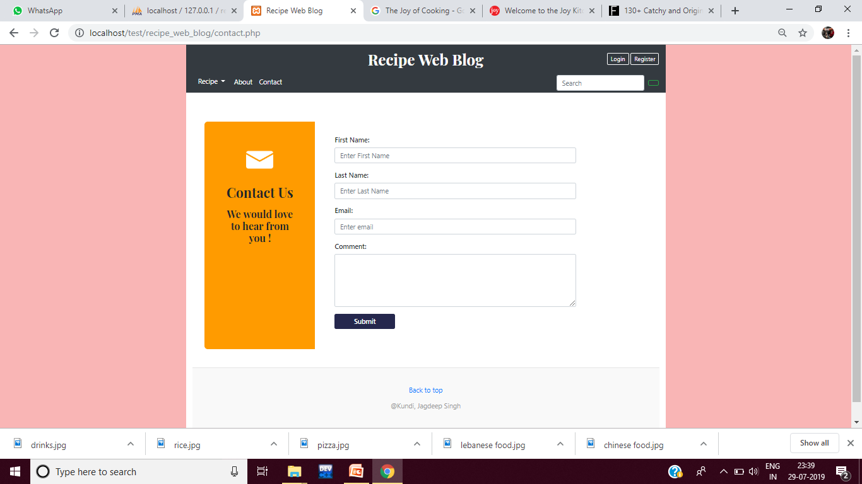
Screenshot – contact page

Slide 12
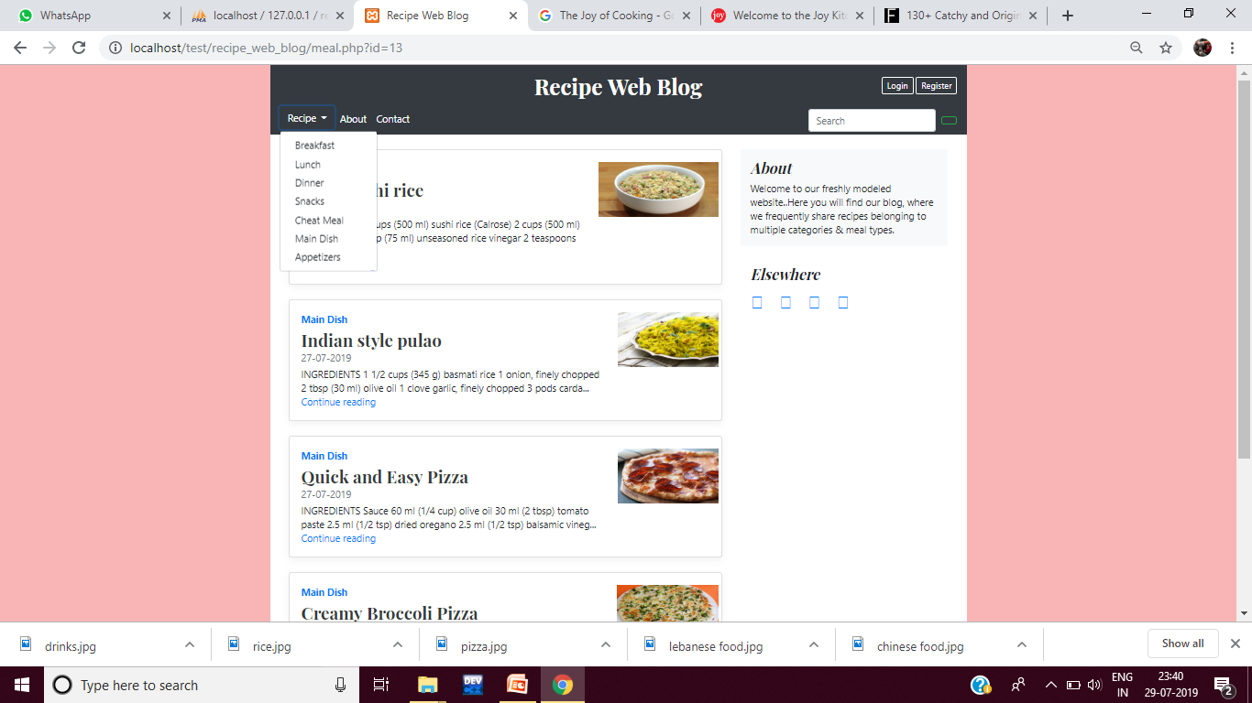
Screenshot – recipe page

Slide 13
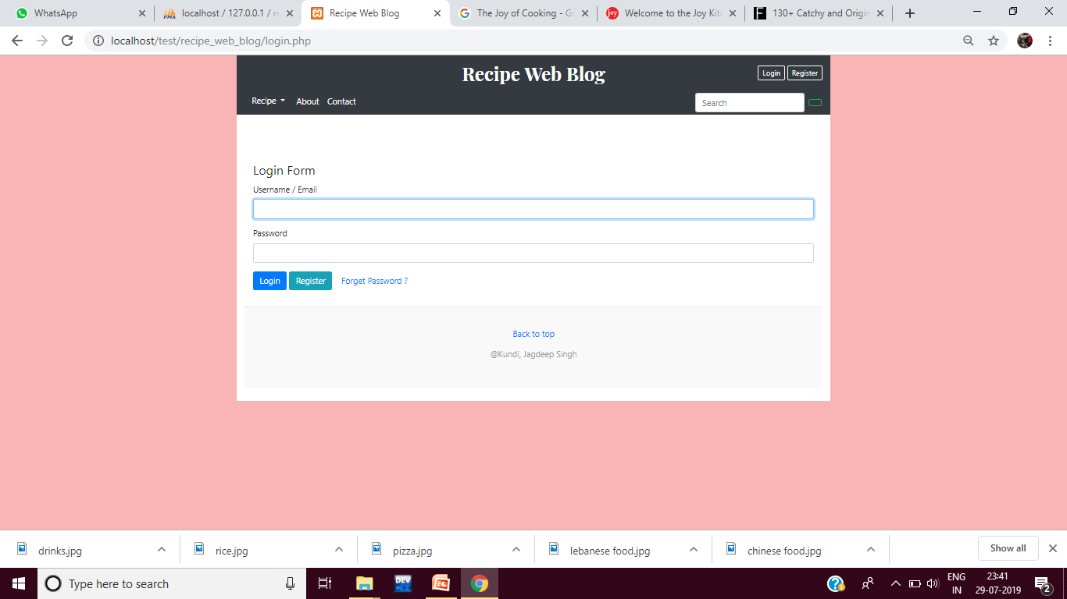
Screenshot – Login page

Slide 14
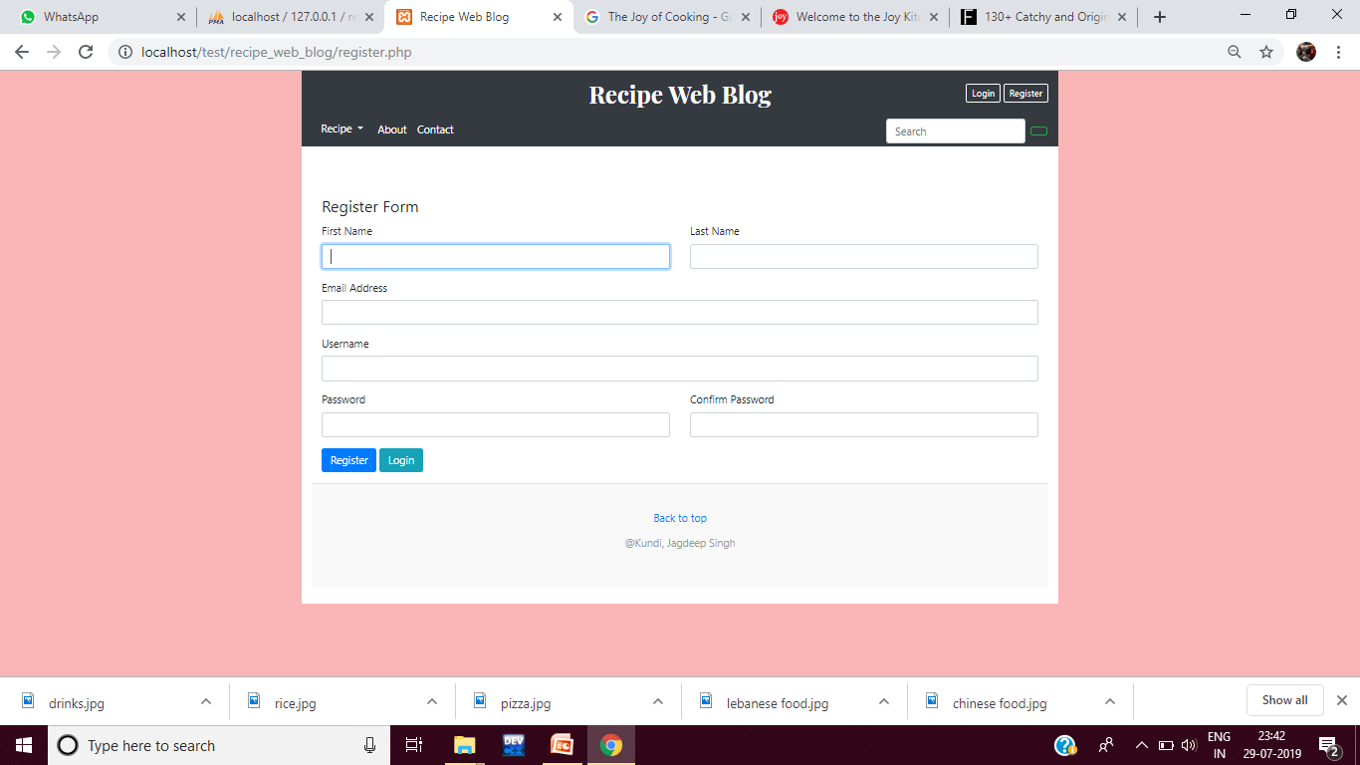
Screenshot – Register page

Slide 15
Screenshot – Register page

Slide 16
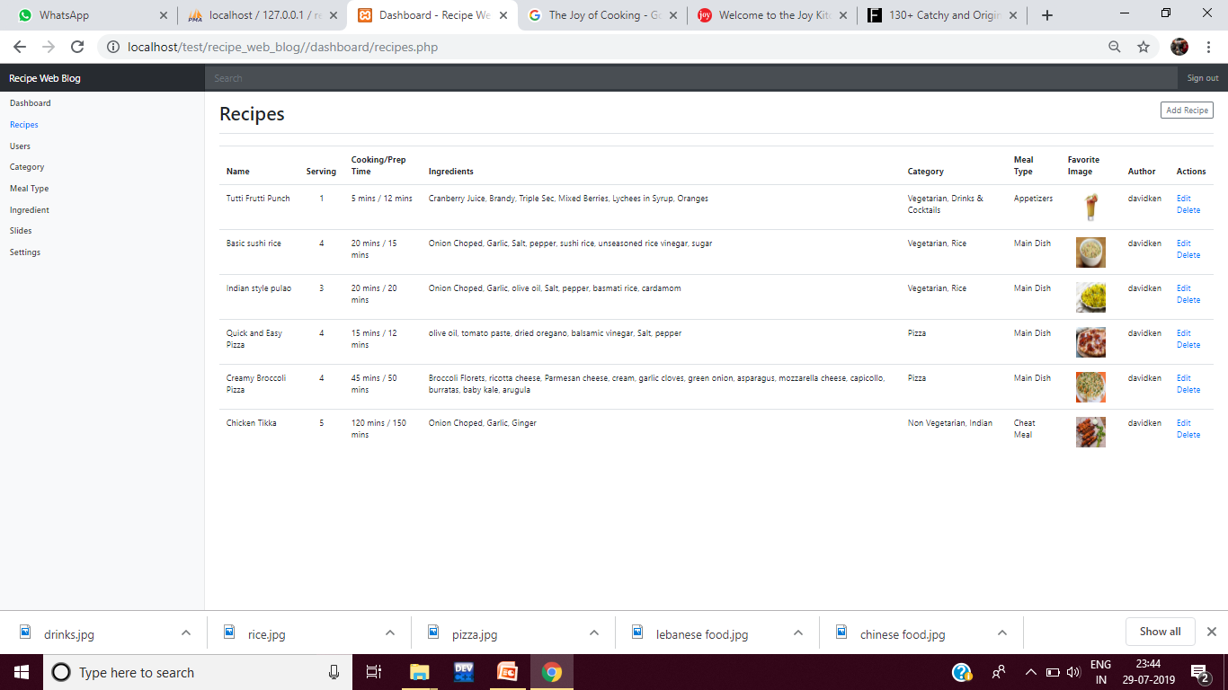
Screenshot – Dashboard page

Slide 17
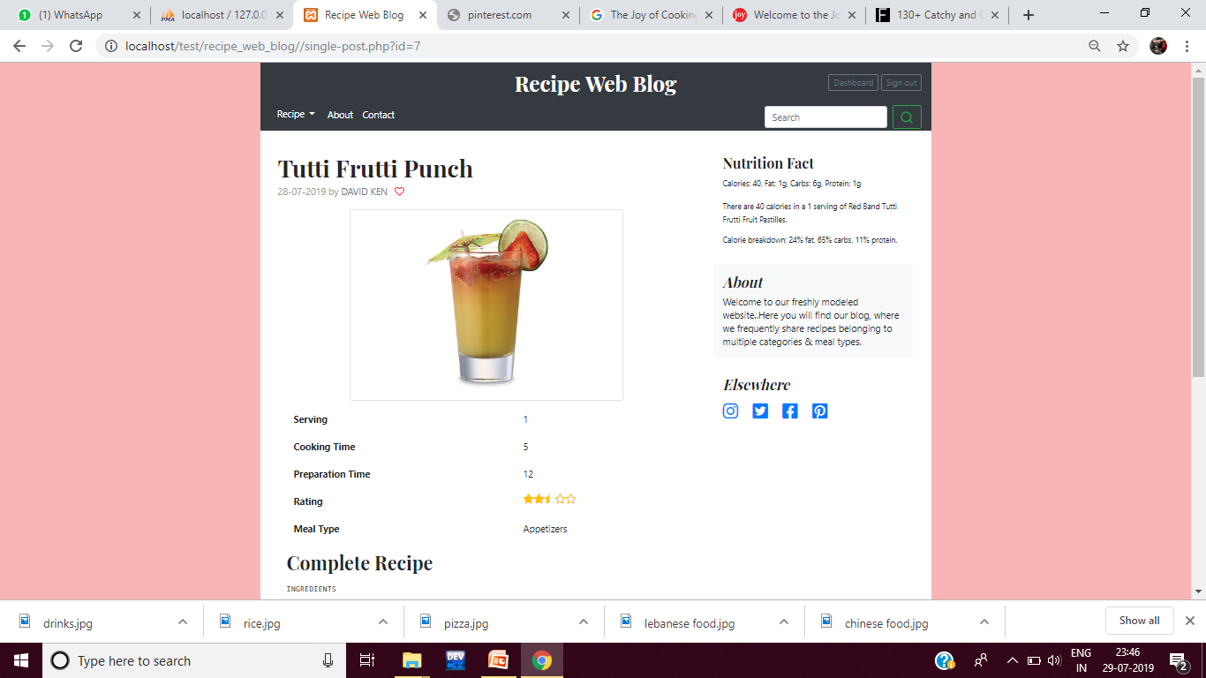
Screenshot – Specific recipe page

Slide 18
Thank you!!

