Slide 1

10 Questions for your
Scrum Master
Interview
David J Bland
david@scrumology.net

Slide 2

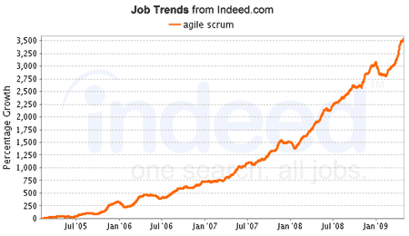
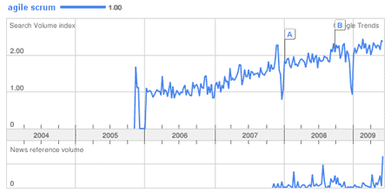
Agile / Scrum Job Data
Notes:
Indeed.com job trend data can be found: http://www.indeed.com/jobtrends
Google.com search volume data can be found: http://google.com/trends

Slide 3

Interview
your
Interviewer
Just how Agile
is this position?
Notes:
You need to ask precise questions to determine agility.
The Interviewer may not offer up these insights with a bit of prodding from your side.

Slide 4
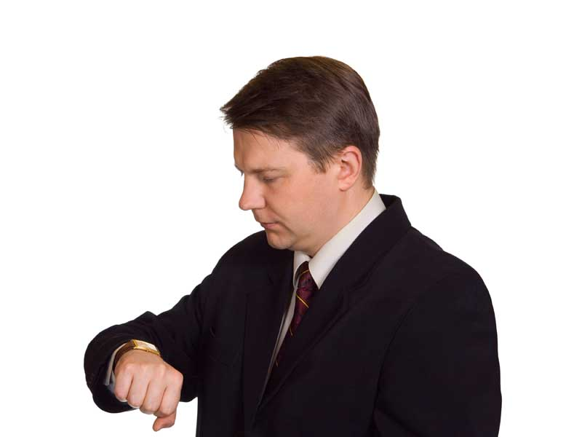
Question #1
Can you describe
your iterations?
(Agile) – 2 weeks max
(Agile?) – Over 1 month
(Red Flag!) – What’s an iteration?
Notes:
Ideally this is 2 weeks, but if it is close within reason it is a positive sign. Be wary of extremely long answers that slip into months, as these are not agile characteristics.

Slide 5

Question #2
What is the team
size & make up?
(Agile) – Small & cross functional
(Agile?) – Large but collaborative
(Red Flag!) – 20+ members in vertical silos
Notes:
Small, cross functional teams are important. Take note of any answers that lean towards large silos of developers. You may also want to follow up on whether or not the team is distributed or co-located.

Slide 6

Question #3
Are Product Owners
available for Q&A?
(Agile) – Yes & often
(Agile?) – Yes about once a week
(Red Flag!) – They weigh in after launch
Notes:
A non-existent Product Owner can wreak havoc on an agile team. This could be why the Scrum Master position is vacant!

Slide 7

Question #4
Can you explain your
code deployments?
(Agile) – Automated continuous integration
(Agile?) – Frequent manual deployments
(Red Flag!) – Very large, infrequent batches
Notes:
It is difficult to remain true to the tenets of agile with a clunky batch process for code deployment. Try to pin them down on what tools they use here to prevent them from sidestepping the question.

Slide 8

Question #5
Do you practice Test
Driven Development?
(Agile) – Yes & Behavior Driven Development
(Agile?) – Yes on the important bits
(Red Flag!) – We have QA for testing
Notes:
Similar to CI above, TDD is another indicator of agility. Again try to find out the tool set they use for this process, as it will vary by technology stack.

Slide 9

Question #6
Can you describe
your requirements
documentation?
(Agile) – User Stories with INVEST model
(Agile?) – Small paragraphs of requirements
(Red Flag!) – Large SRS documents
Notes:
There is no one perfect answer for this, but they should touch on small excerpts of functionality that are on a task board or in project management software. Lengthy SRS or functional specifications should raise a red flag.

Slide 10

Question #7
How do you use
project metrics?
(Agile) – Story Points for Release Planning
(Agile?) – We estimate most of our tasks
(Red Flag!) – Only use MS Project with Gantt
Notes:
Points or hours should be sufficient. I’d pay attention on whether or not their fibonnacci scale goes to extremes. Measuring actuals vs estimates can lead the conversation to some interesting areas. Try to determine whether or not actuals are used against team members.

Slide 11

Question #8
How often do your
teams meet?
(Agile) – Daily Stand Ups
(Agile?) – A couple times a week
(Red Flag!) – Only monthly status meetings
Notes:
This should be every day if you are playing the role of a true Scrum Master. This can be more challenging with distributed teams in different time zones.

Slide 12

Question #9
Do you have executive
buy-in for Agile?
(Agile) – Yes and we’ve trained our teams
(Agile?) – They suggested we try it out
(Red Flag!) – My boss thinks it is a fad
Notes:
Agile isn’t only bottom, it is also top down. Try to determine if the person selling you on this agile position actually has any say within the company.

Slide 13

Question #10
Can you explain other
responsibilities for the
Scrum Master?
(Agile) – Mentor, Tester, Coder, Designer
(Agile?) – Also Project Manager
(Red Flag!) – Also the Product Owner
Notes:
Depending on the organization this can vary, but it is worth asking especially if they responsibilities do not interest you in the least. It is better to know about them now!

Slide 14
Good luck future
Scrum Masters!
David J Bland
david@scrumology.net

