Slide 1
Gullu Mosiac Technologies

Slide 2
Home
About Us
News & Events
Resources
Demos
Contact us
GULLU MOSIAC
-----------------------------------
Unleashing the Power of an Innovative Mind
NLP
Image Processing
Video Analytics
Recommender Systems
Others
Sentiment Analytics
Text Summarization
Natural language Translation
view more

Slide 3
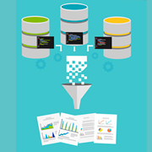


Home
About Us
News & Events
Resources
Demos
Contact us
GULLU MOSIAC
-----------------------------------
Unleashing the Power of an Innovative Mind
NLP
Image Processing
Video Analytics
Recommender Systems
Others
Data Extraction and Statistical Sentiment Analysis
Semi Automated Data labelling Technique
Sentiment Analysis with Deep Learning
Presentation
White Paper
Presentation
White Paper
Presentation
White Paper
Case Studies
Videos
Case Studies
Videos
Case Studies
Videos
Demo
Demo
Demo

Slide 4
Configuration
Dashboard - Batch
Dashboard – Streaming
GULLU MOSIAC
-----------------------------------
Unleashing the Power of an Innovative Mind
Add Source

Slide 5
Configuration
Dashboard
GULLU MOSIAC
-----------------------------------
Unleashing the Power of an Innovative Mind
Add Source
Choose Source
Twitter
Facebook
Instagram
Custom

Slide 6
Configuration
Dashboard - Batch
Dashboard – Streaming
GULLU MOSIAC
-----------------------------------
Unleashing the Power of an Innovative Mind
Add Source
Choose Source
Custom
List of source URL

Slide 7
Configuration
Dashboard - Batch
Dashboard – Streaming
GULLU MOSIAC
-----------------------------------
Unleashing the Power of an Innovative Mind
Add Source
Choose Source
Twitter
List of source URL
Batch Config
Daily
Frequency
Weekly
Monthly
List of search words
List of users
Streaming Config
List of search words
Save

Slide 8
Configuration
Dashboard - Batch
Dashboard – Streaming
GULLU MOSIAC
-----------------------------------
Unleashing the Power of an Innovative Mind
Twitter
Face book
Frequency : Daily
List of search words : xyz, abc
List of users : xyz, abc
Edit

Slide 9
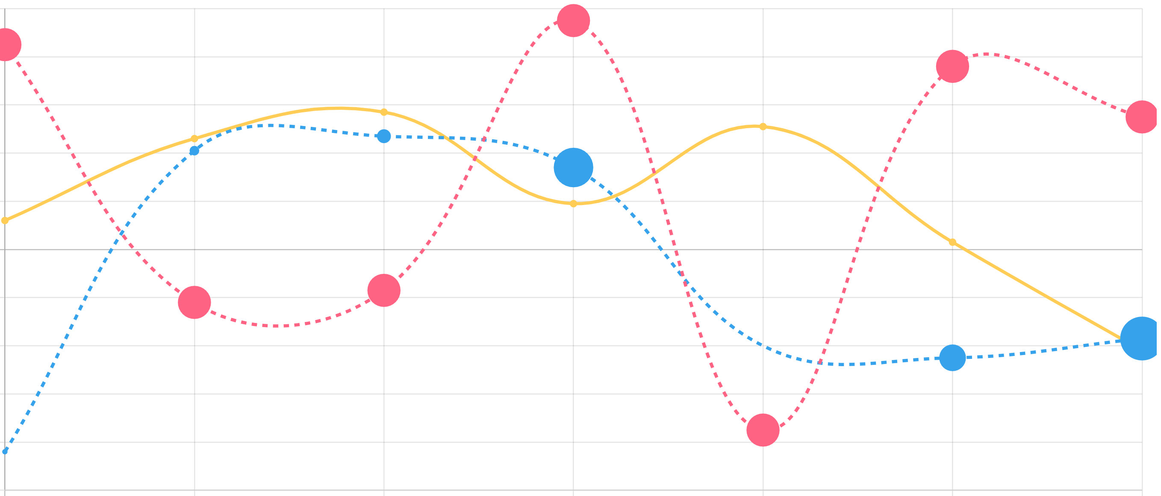

Configuration
Dashboard - Batch
Dashboard – Streaming
GULLU MOSIAC
-----------------------------------
Unleashing the Power of an Innovative Mind
3 days
7 days
15 days
30 days
Total Records Fetched : XXXX
Sentiment Meter
Word Cloud
xxx
xxx
xxx
xxx
Slightly Positive
Twitter
Blogs
News Feeds
Facebook
Evolving Sentiment with Influencers
Sentiment by location
Frequency
Time stamp (date:hr)

