Slide 1
Gullu Mosiac Technologies

Slide 2
Home
About Us
News & Events
Resources
Demos
Contact us
GULLU MOSIAC
-----------------------------------
Unleashing the Power of an Innovative Mind
NLP
Image Processing
Video Analytics
Recommender Systems
Others
Social Media Analysis
Text Summarization
Natural language Translation
view more

Slide 3
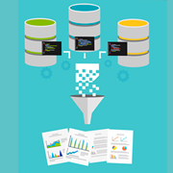


Home
About Us
News & Events
Resources
Demos
Contact us
GULLU MOSIAC
-----------------------------------
Unleashing the Power of an Innovative Mind
NLP
Image Processing
Video Analytics
Recommender Systems
Others
Data Extraction and Social Media Analysis
Semi Automated Data labelling Technique
Sentiment Analysis with Deep Learning
Presentation
White Paper
Presentation
White Paper
Presentation
White Paper
Case Studies
Videos
Case Studies
Videos
Case Studies
Videos
Demo
Demo
Demo

Slide 4
Configuration
Dashboard - Batch
Dashboard – Streaming
GULLU MOSIAC
-----------------------------------
Unleashing the Power of an Innovative Mind
Add Source

Slide 5
Configuration
Dashboard
GULLU MOSIAC
-----------------------------------
Unleashing the Power of an Innovative Mind
Add Source
Choose Source
Twitter
Facebook
Instagram
Custom

Slide 6
Configuration
Dashboard - Batch
Dashboard – Streaming
GULLU MOSIAC
-----------------------------------
Unleashing the Power of an Innovative Mind
Add Source
Choose Source
Custom
List of source URL

Slide 7
Configuration
Dashboard - Batch
Dashboard – Streaming
GULLU MOSIAC
-----------------------------------
Unleashing the Power of an Innovative Mind
Add Source
Choose Source
Twitter
List of source URL
Batch Config
Daily
Frequency
Weekly
Monthly
List of search words
List of Influencers
Streaming Config
List of search words
Save

Slide 8
Configuration
Dashboard - Batch
Dashboard – Streaming
GULLU MOSIAC
-----------------------------------
Unleashing the Power of an Innovative Mind
Twitter
Face book
Frequency : Daily
List of search words : xyz, abc
List of Influencers : xyz, abc
Edit

Slide 9
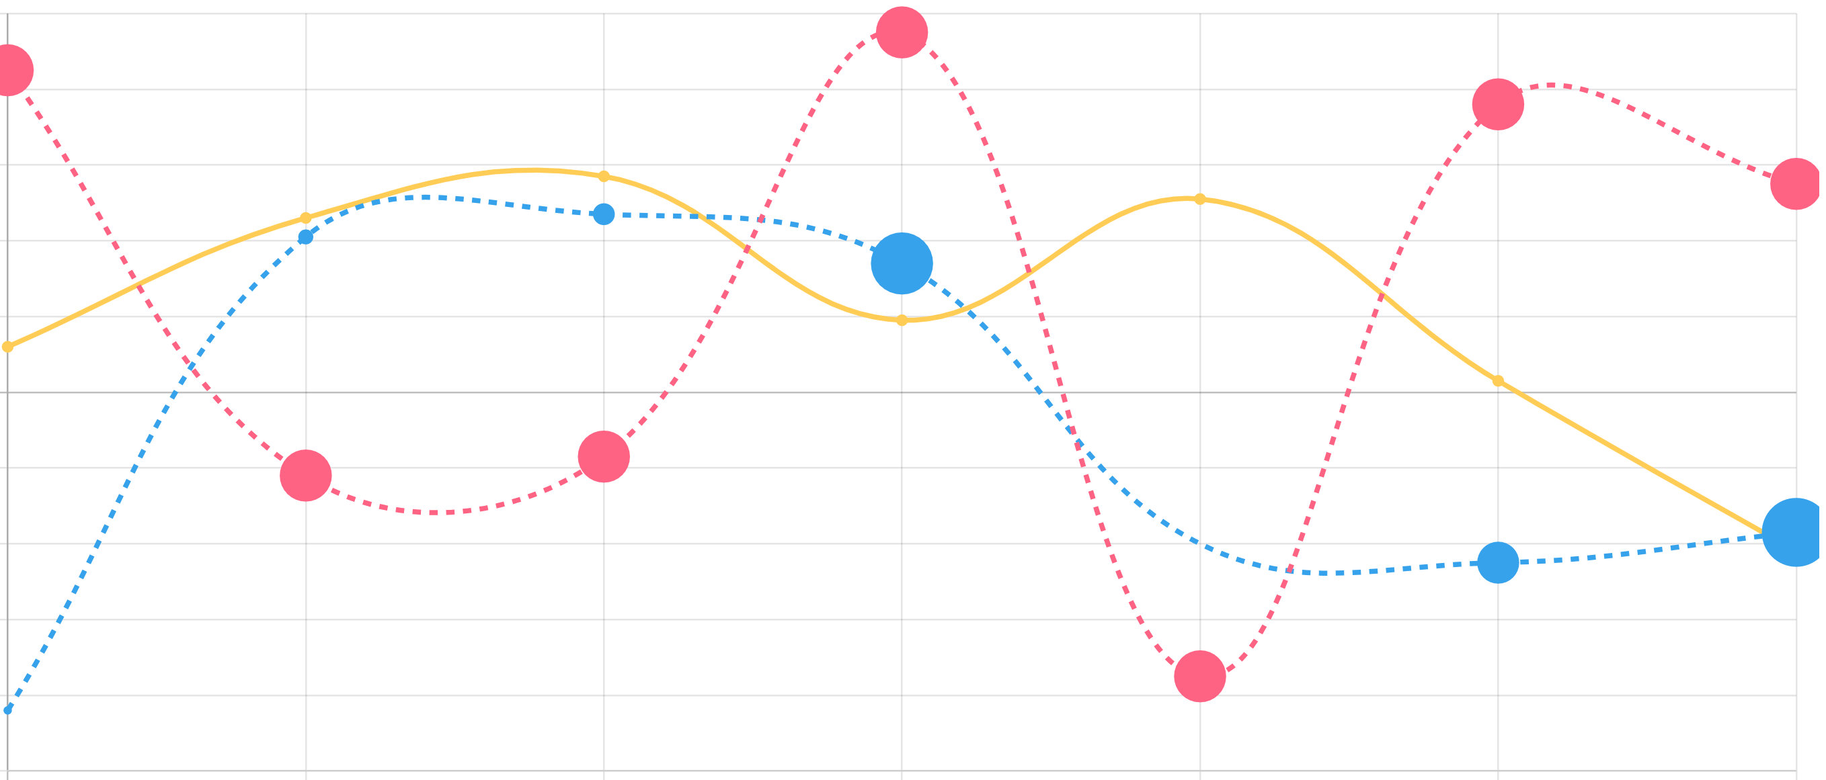

Configuration
Dashboard - Batch
Dashboard – Streaming
GULLU MOSIAC
-----------------------------------
Unleashing the Power of an Innovative Mind
3 days
7 days
15 days
30 days
Total Records Fetched : XXXX
Sentiment Meter
Activity on Your Content
xxx
xxx
xxx
xxx
Twitter
Total # of Tweets: xxx
# of time users saw Tweets: xx
# of times users interacted: xxx
Click for top 5 tweets
Facebook
Total # of Post: xxx
# of time users saw Post: xx
# of times users interacted: xxx
Click for top 5 post
Slightly Positive
Twitter
Blogs
News Feeds
Facebook
Evolving Sentiment with Influencers
Influencer & Engagements
Sentiment by location
Frequency
User 1:
User-1 has xxx followers.
User-1 has xxx friends.
User-1 has xxx mutual friends
Xxx friends are not following user-1 back
Xxx followers are not followed back by User-1
….
……..
………
………..
Time stamp (date:hr)

