Slide 1
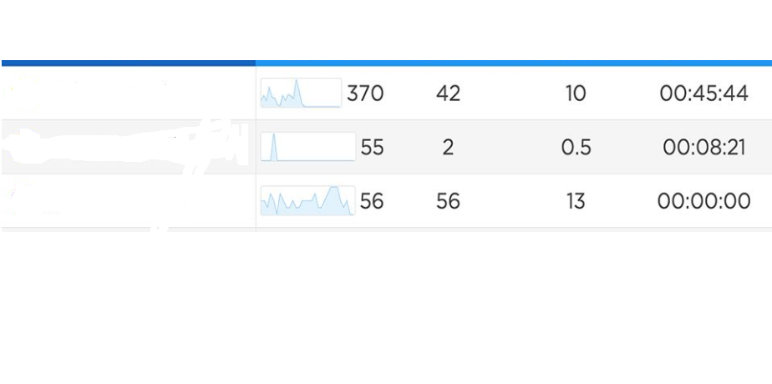
User Tweets monitor Dash Board
likes
Comments Retweets Time
#first tweet
#second tweet
#third tweet
ML is Dashboard cluster of similar tweet by user

Slide 2
ML in User Tweet
Create Tweet :
Recommended tweets by topic :
1. first tweet
2.Secound tweet
ect
Predictions in 1 hour :
likes : 10k
Comments : 2 k
Retweets : 1 k
POST

Slide 3
https://analytics.twitter.com/user/AnilKunduru/tweets

