Slide 1
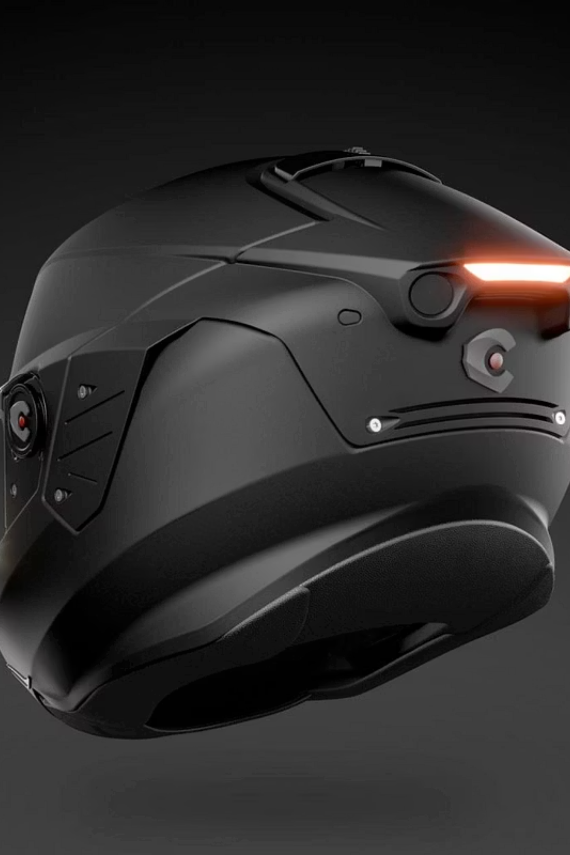
Smart Helmet using Ignition System
Team Members: P. H.PADMAVATHI - 24L31A4482
K. KARTHIK - 24L31A4468
S.RENUKA - 24L31A4499
SK.RIZWANA - 24L31A44A5
T.THRISHITHA - 24L31A44B6

Slide 2
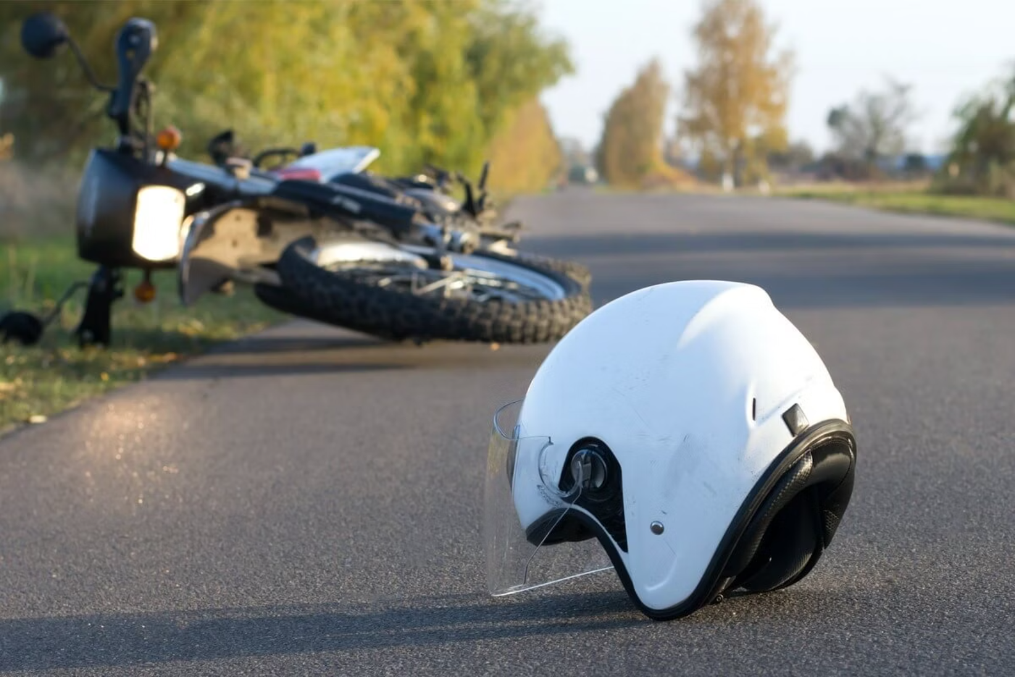

PROBLEM STATEMENT
Ignored Safety Rules
Riders routinely skip helmets despite legal requirements
No Automated Enforcement
Manual police checks are infrequent and easy to evade
High Injury Rates
Head trauma is the leading cause of two-wheeler fatalities
Human Forgetfulness
Even safety-conscious riders sometimes forget

Slide 3

The Problem We're Solving
Rising Accidents
Helmet Neglect
Road accidents are increasing daily — many preventable
Riders routinely ignore helmet safety
No Enforcement
No system prevents bike ignition without a helmet

Slide 4
System Components
Helmet Unit
Bike Unit
Pressure Sensor
Arduino Nano
Detects helmet wear status
Receives and processes signals
Arduino Nano
Processes sensor input
HC-05 Bluetooth
Paired receiver module
LED Indicator
Relay Module
Visual helmet status feedback
Controls motor power supply
Buzzer Alert
Audio warning system
DC Motor
Bike engine demonstration
HC-05 Bluetooth
12V Battery
Wireless communication module
External power source

Slide 5

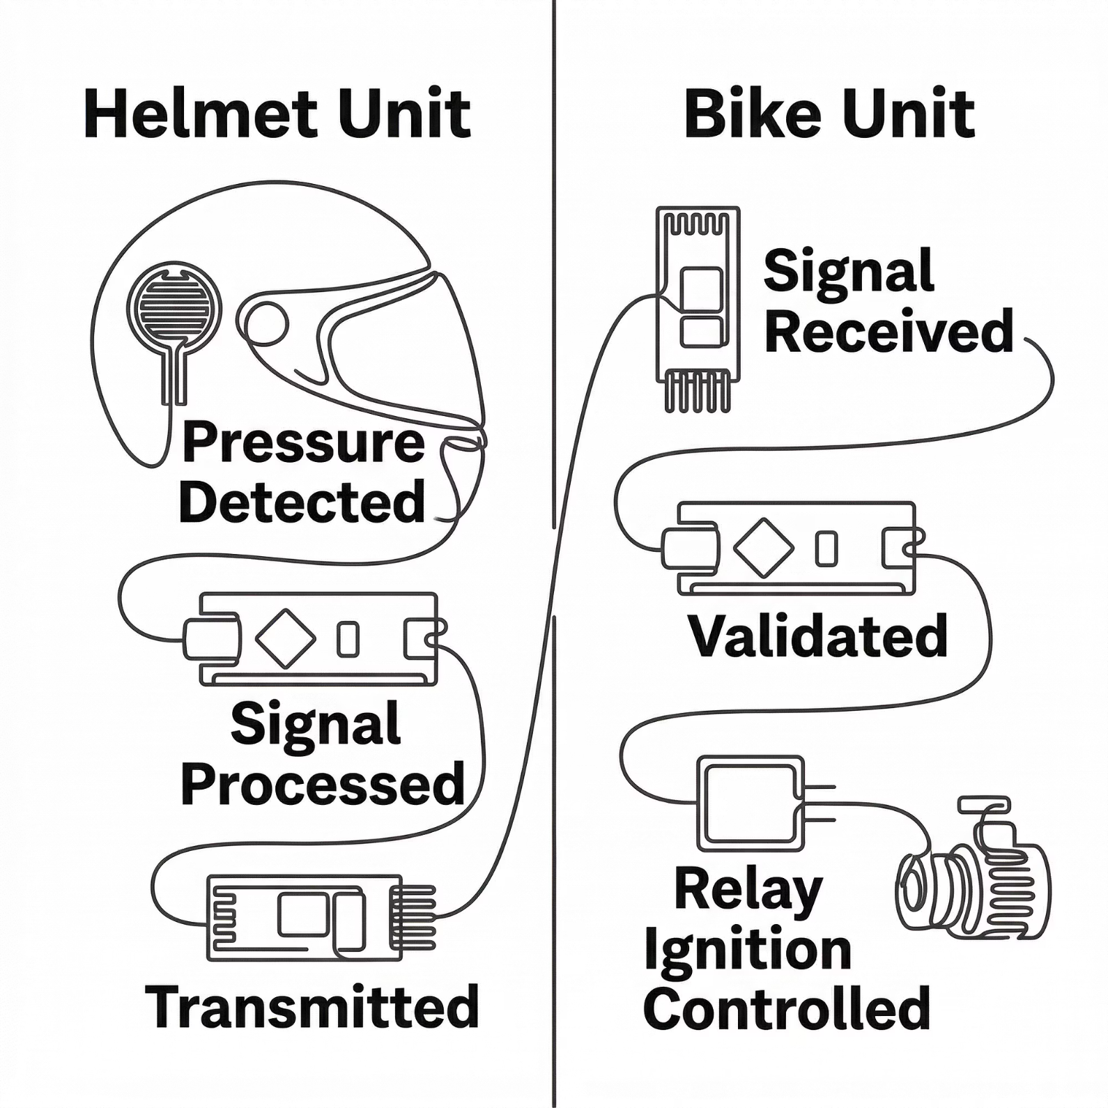

System Architecture
The system is split into two independent units that communicate wirelessly via Bluetooth.
🪖 Helmet Unit
🏍️ Bike Unit
Sensor → Arduino → Bluetooth TX
Bluetooth RX → Arduino → Motor

Slide 6
Working Principle
01
System Power ON
02
Sensor Detection
03
Signal Transmission
Both helmet and bike units initialize
Helmet proximity sensor checks wearer presence
Bluetooth sends status (1/0) to bike unit
04
Ignition Control
05
Motor Operation
06
Continuous Monitoring
Arduino enables or disables relay
switch
Engine runs only when helmet is detected
System tracks helmet status during ride

Slide 7
Team Contributions
Helmet Hadware
Helmet Arduino Code
Bluetooth Communication
Paired HC-05 modules between helmet and bike units. Ensured stable wireless connection and tested signal transmission reliability.
Assembled helmet circuit using proximity sensor, LED, and buzzer components. Ensured proper wiring and verified functionality before coding phase.
Developed detection algorithm to identify helmet usage. Programmed LED and buzzer indicators. Implemented Bluetooth signal transmission (1/0).
Bike Hardware
Built bike-side circuit with relay and DC motor. Connected external battery power supply. Verified safe relay switching operations.
Bike Arduino Code
Wrote receiver code to process Bluetooth signals.
Implemented relay crequiresontrol logic based on helmet status. Ensured motor operation helmet detection.

Slide 8

Website & Output
🌐 Project Website
✅ Output Results
01
Helmet On
Helmet Off
Home Page — Project overview
LED ON · Motor ON · Bluetooth confirmed
Motor OFF · Buzzer alert triggered
02
How It Works — System explanation
03
WebSite Link : https://smarthelmate.netlify.app/
Components — Hardware details
04
Instructions — Setup & usage guide

Slide 9


Benefits & Future Development
Advantages
Future Scope
Enhanced Safety
GPS Tracking
Mandatory helmet usage reduces injury risk
Real-time location monitoring for riders
Accident Prevention
Accident Detection
Enforces safety discipline automatically
Automatic emergency alerts during crashes
Cost-Effective
Alcohol Sensor
Affordable components for widespread adoption
Prevents ignition with impaired judgment
Easy Implementation
Mobile App
Simple integration with existing vehicles
Companion app for notifications and analytics

Slide 10
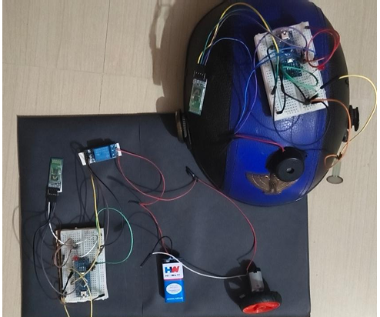
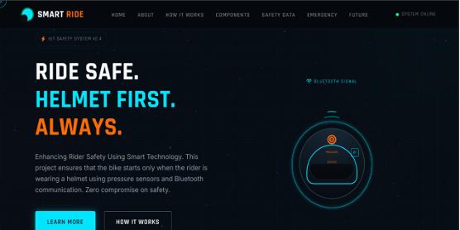
Result & Output
Functional Prototype
Successfully developed and tested a working model, validating the core ignition control concept.
Enhanced Safety Enforcement
Proven mechanism to prevent vehicle ignition without correct helmet usage, improving road safety.
Positive User Experience
Seamless operation with intuitive feedback, encouraging consistent adoption by riders.
Scalable & Adaptable
Modular design allows for integration with various motorcycle models and future feature expansions.

Slide 11
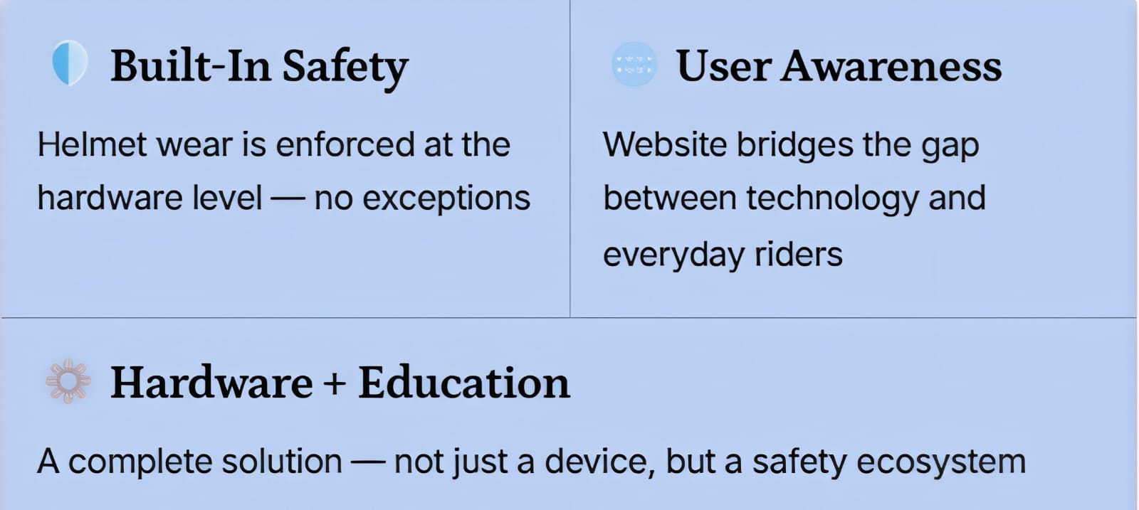
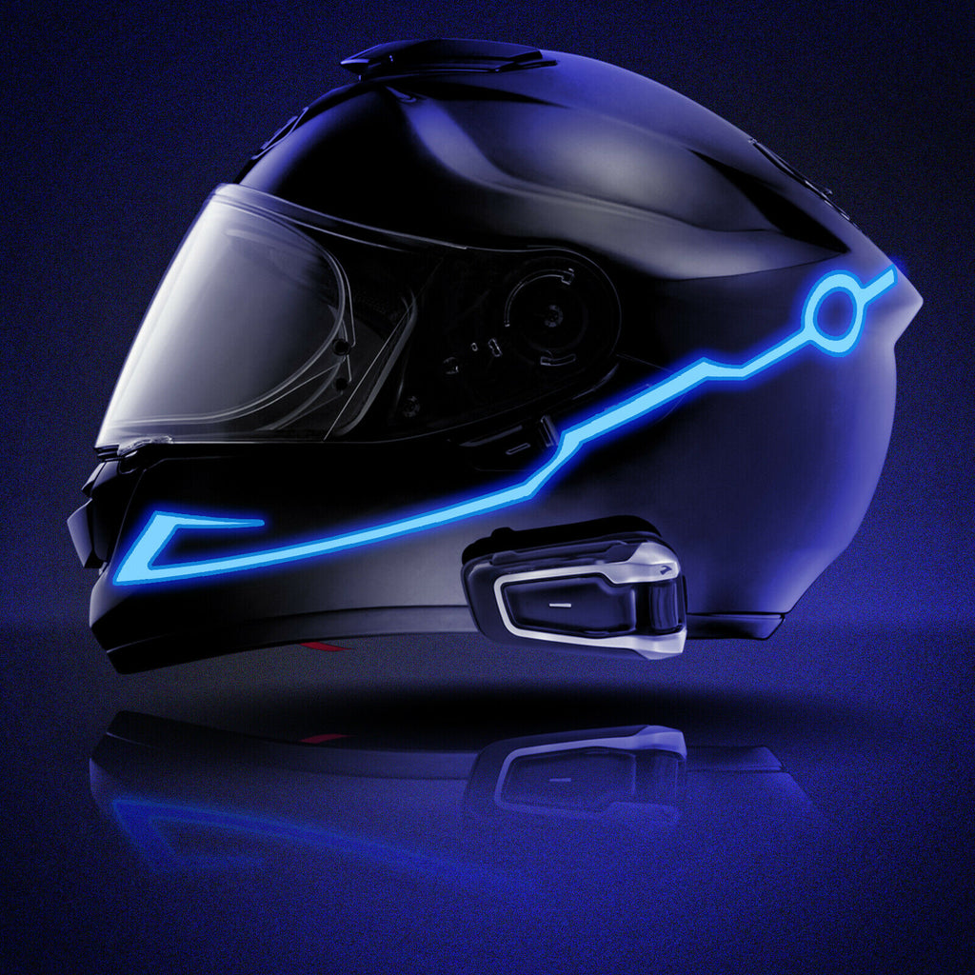
Conclusion
"Not just a product — a complete safety solution with user guidance built in."

