Slide 1



Jérôme Kunegis

Slide 2
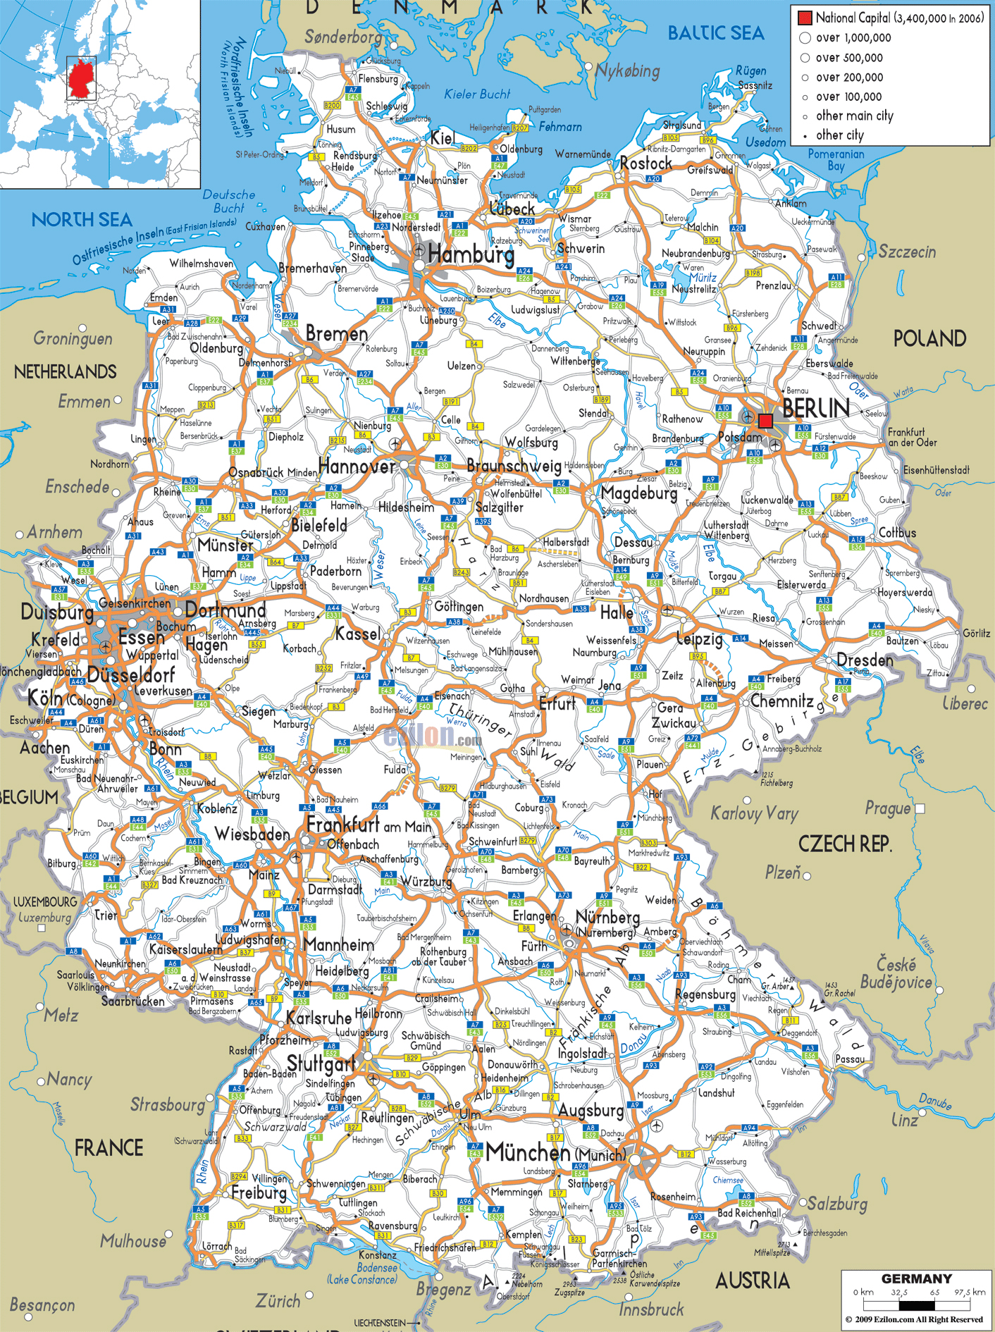
Koblenz

Slide 3
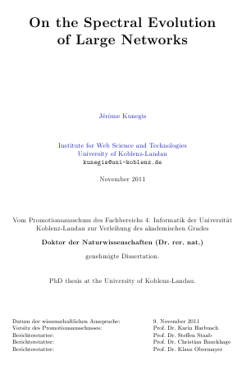
My PhD Thesis

Slide 4

The Trick Is…

Slide 5

Everything Is a NETWORK !

Slide 6
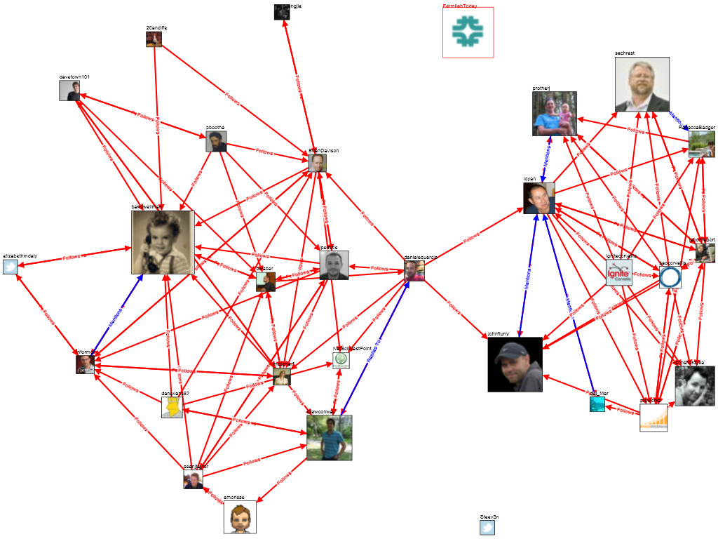

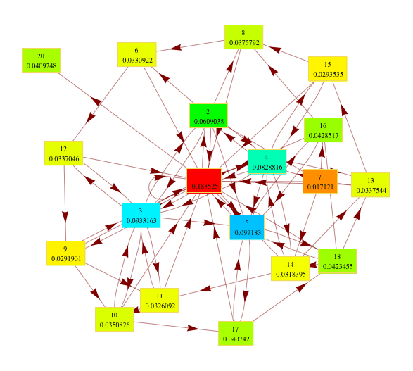
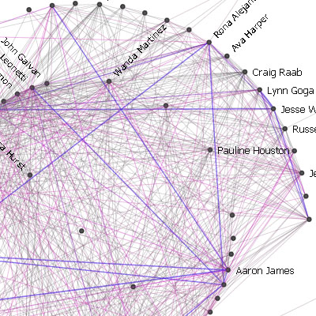
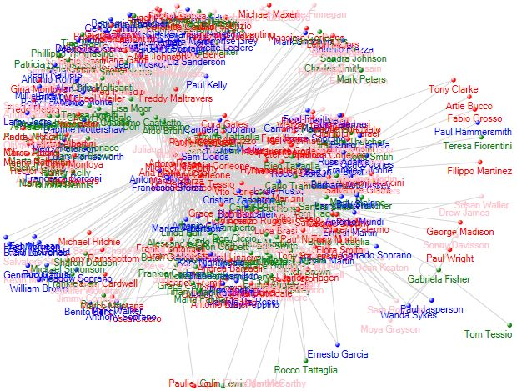
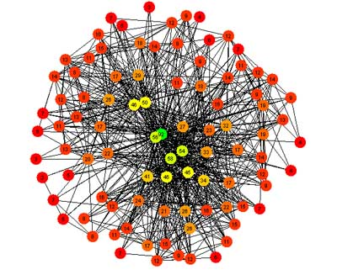
Networks Are Everywhere
Authorship
Friendship
Trust
Communication
Interaction
Co-occurrence

Slide 7
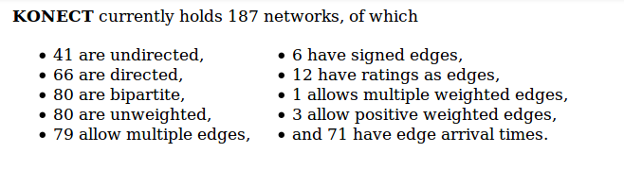
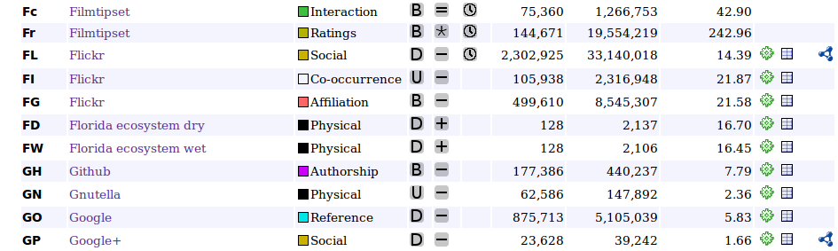
KONECT – The Koblenz Network Collection
konect.uni-koblenz.de
.
.
.

Slide 8
Diversity of Web Network Datasets

Slide 9
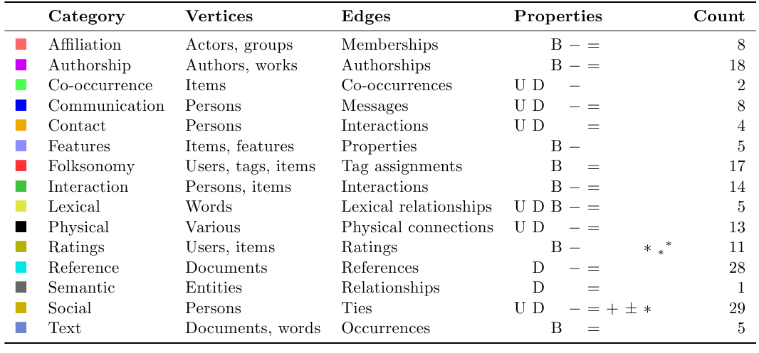
Overview
+ 18 new networks

Slide 10

It's All Online
konect.uni-koblenz.de

Slide 11
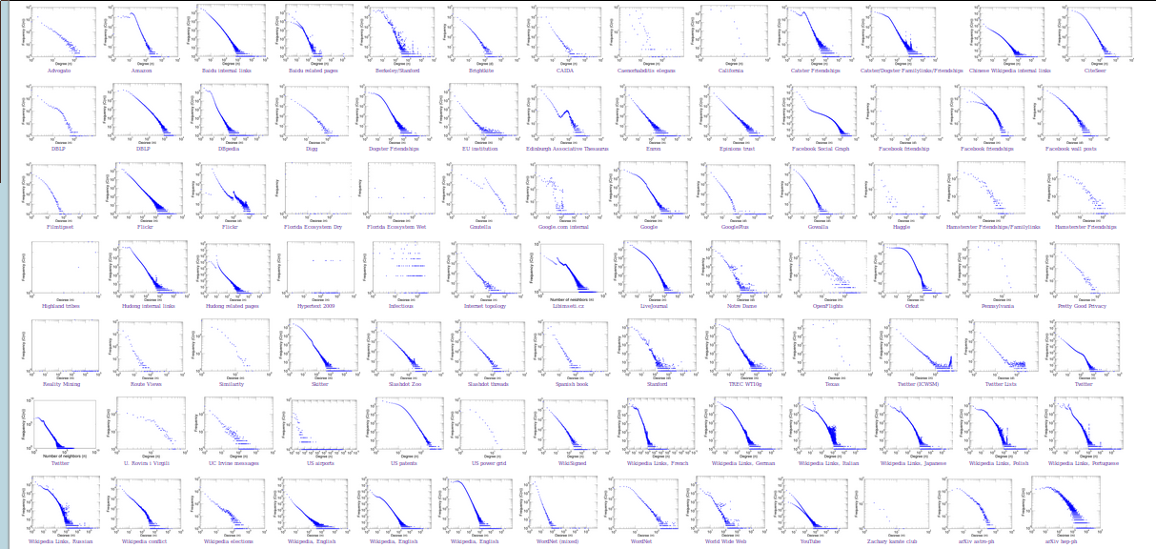
Why We Need Many Datasets
Are real-world networks power laws?

Slide 12
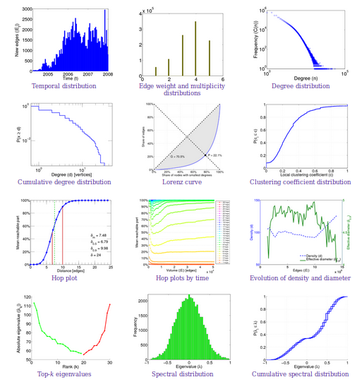
What Can You Do with a Network?

Slide 13
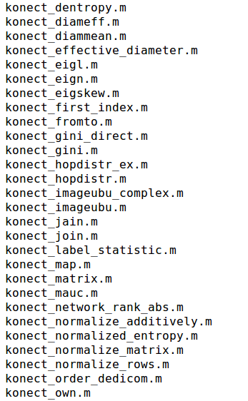
Matlab Toolbox

Slide 14
What I Want to Do
Goals:
  Understand the structure of real-world graphs
  Understand the growth of real-world graphs
Principles:
  Models should be probabilistic to be comparable
  Use maximum likelihood to learn parameters
  Use Bayes information criterion to compare models

Slide 15

Erdős–Rényi
Each edge has
probability p of existing
P(G) = p^{m} (1 − p)^{(M − m)}
m = #edges
M = max possible #edges

Slide 16
Extension of Erdős–Rényi
Goal: Add a parameter that controls the number of triangles.
Idea: The E–R model with parameter p is an exponential family; the extension should be too.
P(G) = (1 / C) p^{m} (1 − p)^{(M − m)} q^{t} (1 − q)^{(T − t)}
where t is the #triangles, T is the maximum possible #triangles.
Note: q = 1/2 gives the ordinary Erdős–Rényi model.

Slide 17
Exponential Random Graphs
P(G) = (1 / C) Πi pi ^ si(G) = (1 / C) exp(Σi ai si(G))
where pi, ai are constants, and si are numerical statistics of the network, and the product (or sum) is over all chosen network statistics.
⇒ Can use any choice of network statistics: #triangles, clustering coefficient, diameter, algebraic connectivity, …
Problem: The constant C depends on p (or a), and cannot be computed.
C = ΣG exp(Σi ai si(G))
where the outer sum is over all graphs with n nodes.

Slide 18
Maximum Likelihood
As a function of the parameters ai, P(G) is known as the likelihood.
Thus, the likelihood cannot be computed.
Thus, maximum-likelihood cannot be used to fit the parameters.
Thus, Bayes information criterion cannot be used to compare models.
Solution: Compute the pseudo-likelihood
Assumption: The existence of edges is independent of each other, as in
the Erdős–Rényi model.
This is only sensible if we restrict the model to a subset of non-
incident edges. This makes sense for link prediction: we don't want to
predict all edges in the network.

Slide 19
Link Prediction
When using exponential random graph models for link prediction:
Maximizing the pseudo-likelihood reduces to solving a logistic regression problem based on link prediction features that equal the change in each network statistic when adding each edge
  Node pair (s₁ - s₁') (s₂ - s₂') (s₃ - s₃') … Edge?
  (1,2) 0 1 5 1
  (2,4) 1 1 4 1
  (1,4) 0 0 0 0
  (3,7) 0 1 3 1
              .
            .
              .

Slide 20
Link Prediction Features
Choose network statistics whose change after adding an edge
can be easily computed: Counts of subgraph patterns.
Examples:
    Triangles
    Paths
    Cycles
    Stars
    Directed edges / directed triangles
    Weighted edges (rating networks)
    Signed edges (“friends and foes”)
    Labeled edges (semantic networks)
    Bipartite patterns
    Patterns based on node properties

Slide 21
Interpret Results
What is the dominant pattern in a directed network: symmetry or bipartivity?
(e.g., Email network vs Twitter network)
Give a probabilistic solution to patterns defined in the social sciences
(e.g., dyads, triads)
Discover patterns in edge weights / signs
(e.g., the enemy of my enemy, people who did not like this also didn't like that)
Discover patterns based on node properties
(e.g., older friends vs younger friends)
Discover semantic patterns
(e.g., bands related to a band of a given genre…)

Slide 22

Dr. Jérôme Kunegis
October 2 – December 14
(minus November 11–20: project meetings “SocialSensor” & “KoMePol”)
@kunegis

