Slide 1






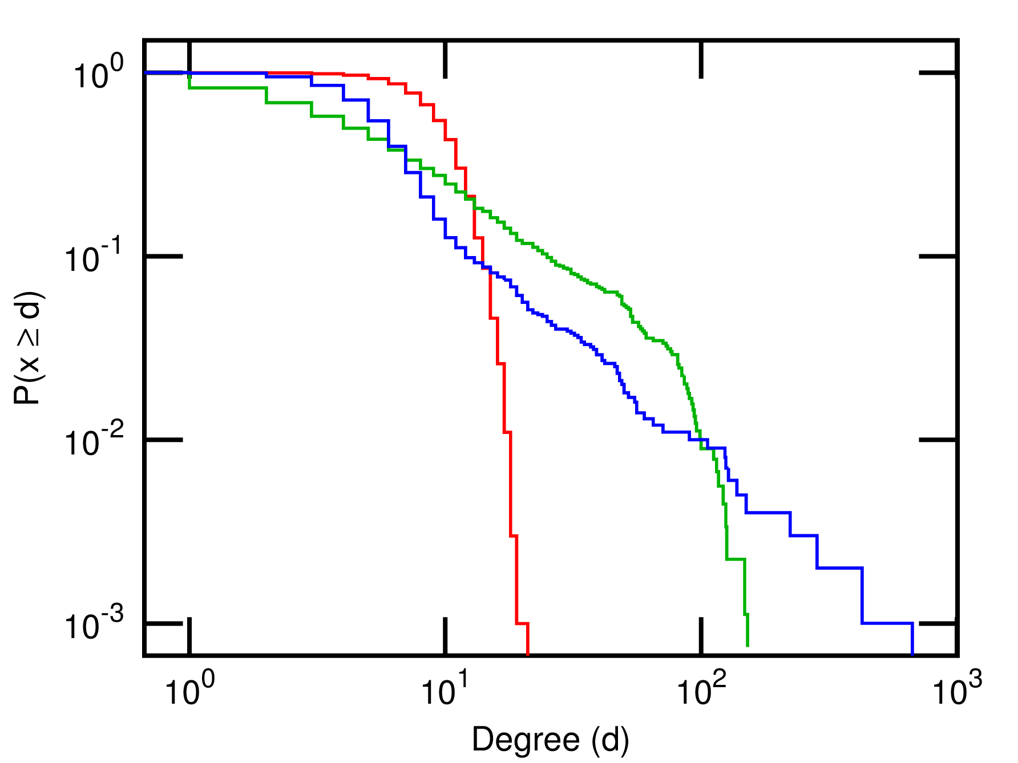
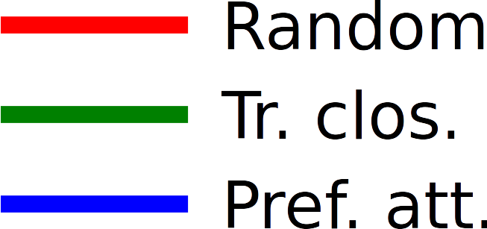
The Problem of Action at a Distance in Networks
and the Emergence of Preferential Attachment from Triadic Closure
Jérôme KUNEGIS¹³; Fariba KARIMI²³; SUN Jun³
¹University of Namur, Belgium; ²GESIS, Cologne, Germany; ³University of Koblenz–Landau, Germany
Rough Analogy
m₂
u
Physics
mass
force
Newton's law
general relativity
Networks
degree
edge probability
preferential attachment
triangle closing
P ~ d(u)d(v)
emerges from
|F| ~ m₁m₂
Skewness of Preferential Attachment
vs Triangle Closing
emerges from
Argument by Hidden Triangles
Preferential attachment is like
« action at a distance ».
How can it be explained?
VISIBLE
NODES
expected #triangles ~ d(u)d(v)
Degree Distribution of Preferential
Attachment vs Triangle Closing
HIDDEN
NODES
As measured by the Gini coefficient (J. Kunegis & J. Preusse; Fairness on
the Web: Alternatives to the Power Law, WebSci 2012)
P ~ d(u)d(v)
m₁
|F| ~ m₁m₂
Learn more:
The Problem of Action at a Distance in Networks
and the Emergence of Preferential Attachment from
Triadic Closure; Jérôme Kunegis, Fariba Karimi,
Jun Sun; J. of Interdisciplinary Methodologies and
Issues in Science 2, 2017.
http://jimis.episciences.org/paper/view/id/3285
v

