Slide 1
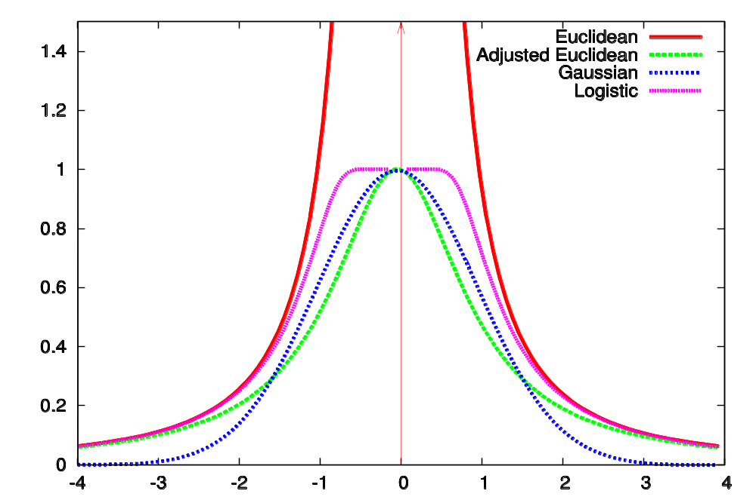
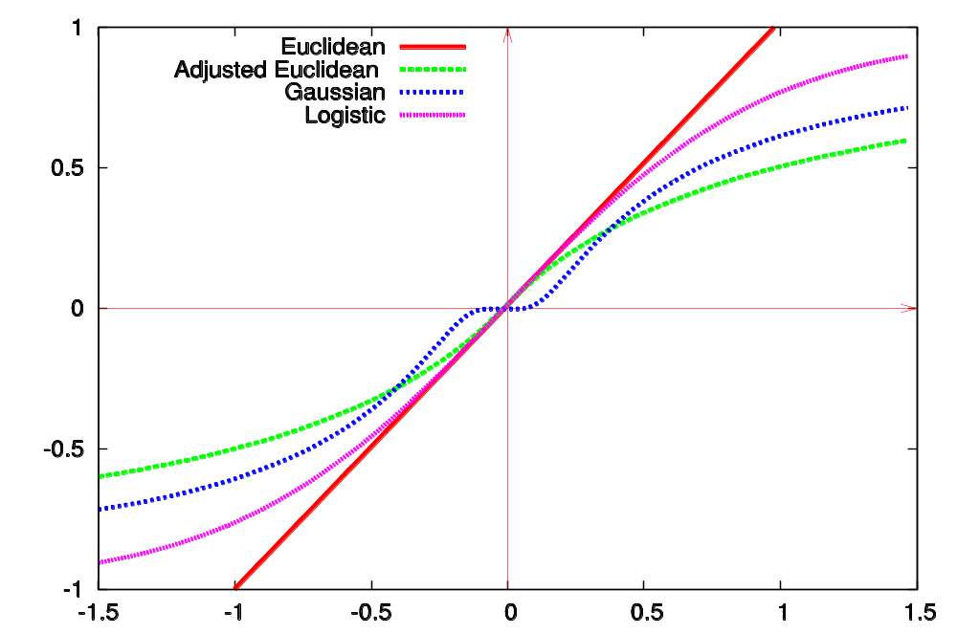
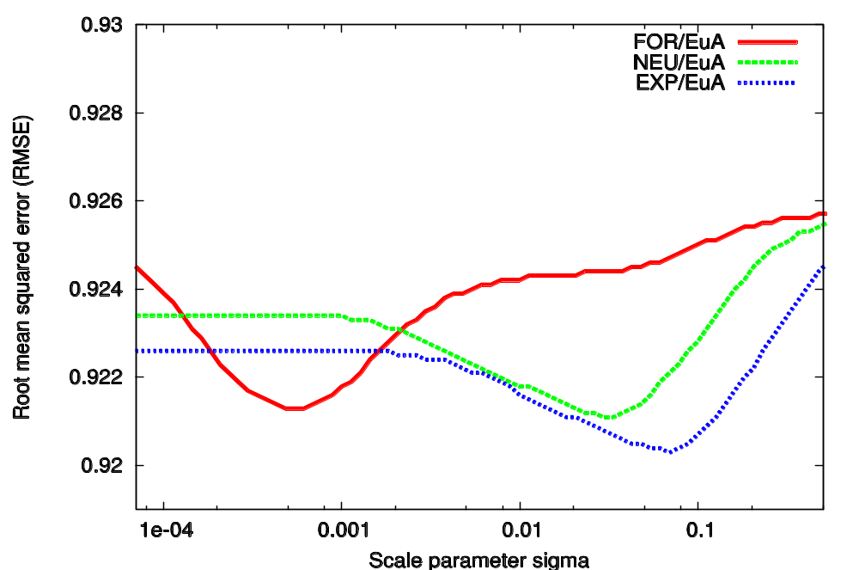
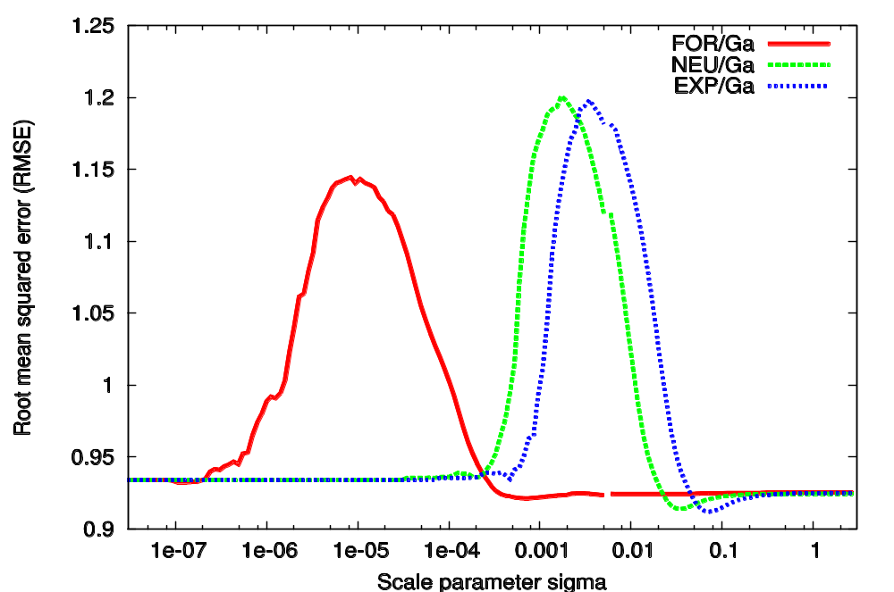
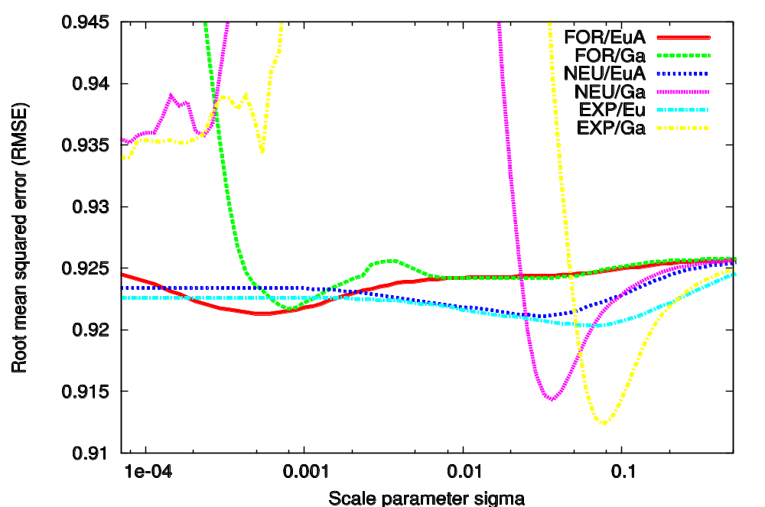
Alternative Similarity Functions for Graph Kernels
Jérôme Kunegis¹, Andreas Lommatzsch¹ & Christian Bauckhage²
¹DAI-Labor, Technische Universität Berlin ²Deutsche Telekom Laboratories
kunegis@dai-lab.de, andreas@dai-lab.de, christian.bauckhage@iais.fraunhofer.de
Abstract
  Given a bipartite graph of collaborative ratings, the task of recommendation and rating prediction can be modeled with graph kernels. We interpret these graph kernels as the inverted squared Euclidean distance in a space defined by the underlying graph and show that this inverted squared Euclidean similarity function can be replaced by other similarity functions. We evaluate several such similarity functions in the context of collaborative item recommendation and rating prediction, using the exponential diffusion kernel, the von Neumann kernel, and the random forest kernel as a basis. We find that the performance of graph kernels for these tasks can be increased by using these alternative similarity functions.
Collaborative Filtering with Graph Kernels
  Predict ratings for User×Item pair (u,i)
  Given the bipartite rating graph with symmetric adjacency matrix A
  Predict ratings by weighted mean of known ratings (user-based) using similarity function sim(u,v)
  P(u,i) = (Σ_{v} sim(u,v))⁻¹ Σ_{v} sim(u,v) R_{vi}
  Define graph kernel K_{A} (forest, exp., von Neuman)
  K_{FOR} = (I + D − A)⁻¹ (forest kernel)
  K_{EXP} = exp(αA) = Σ_{i=0}∞ α^{i} / i! A^{i} (exponential kernel)
  K_{NEU} = (I − αA)⁻¹ = Σ_{i=0}∞ α^{i} A^{i} (von Neumann kernel)
  Instead of using K_{A}(u,i) as similarity, use distance
  d(u,v) = K_{A}(u,u) + K_{A}(v,v) − K_{A}(u,v) − K_{A}(v,u)
Bipartite rating graph with signed edge weights
Me
Items
Other users
Similarity Functions
  Use similarity functions based on d(u,v)
sim_{Eu} = σ² / d² (inverted Euclidean distance)
sim_{EuA} = 1 / (1 + d² / σ²) (adjusted Euclidean distance)
sim_{Ga} = exp(−½ d² / σ²) (Gaussian kernel)
  Parameter σ² denotes variance
  For small σ², adjusted Euclidean corresponds to unadjusted Euclidean
Similarity functions in function of d and 1/d
(a) d
(b) 1/d
Evaluation
  Predict ratings on subset of Netflix Prize Corpus
  3,216 users, 1,307 movies and 57,507 ratings
  Compute the Root mean squared error (RMSE)
(a) Euclidean
(b) Gaussian
(c) Overall
References
[1] Learning Semantic Similarity, J. Kandola et al., KDD 2003
[2] Diffusion Kernels on Graphs and Other Discrete Structures, R. Kondor et al., ICML 2002
Observations
  Best prediction accuracy for specific value of σ²
  Bad performance for adjacent values of σ² with Gaussian kernel
  Overall best is Gaussian similarity function

