Slide 1
The Slashdot Zoo
Mining a Social Network with Negative Edges
Jérôme Kunegis, Andreas Lommatzsch & Christian Bauckhage
DAI-Labor, Technische Universität Berlin, Germany
18th Int. World Wide Web Conference, Madrid 2009

Slide 2
Outline
  Signed networks and the multiplication rule
  The Slashdot Zoo
  Analysis at global level: Signed clustering coefficient
  Analysis at node level: Trust and troll detection
  Analysis at edge level: Link sign prediction
  Conclusion

Slide 3
Signed Networks and the Multiplication Rule
  Signed social networks have enemy relations in addition to friend relations
  Assumption: The enemy of my enemy is my friend
    See e.g. (Hage&Harary 1983)
    Assumption of structural balance (Harary 1953)
  Mathematical formulation: if edges are weighted by ±1, relationships between unconnected nodes may be predicted by multiplying the weights along a path
  Study a social network with negative edges
    At the global level
    At the node level
    At the edge level
+1
?
−1
−1

Slide 4

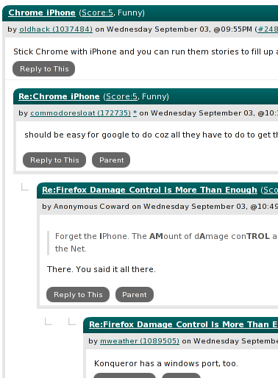
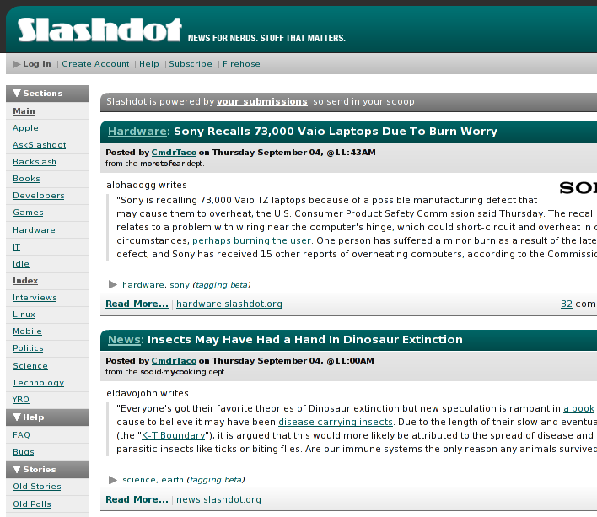
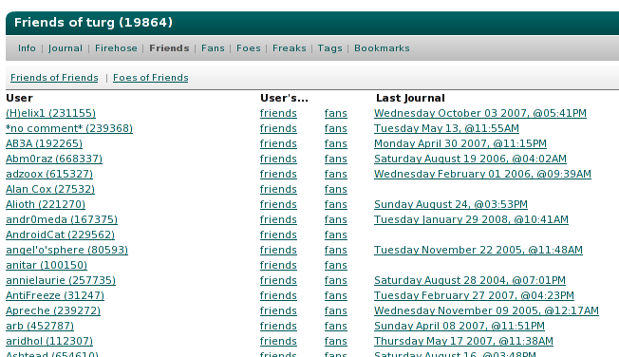
Slashdot- http://slashdot.org/
  Technology news website founded in 1997 by Rob Malda (a.k.a. CmdrTaco)
  Powered by Slash (http://slashcode.org/)
  Features: user accounts, threads, moderation, tags, journals and the zoo (and more)

Slide 5
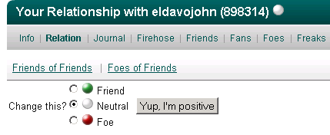
The Slashdot Zoo
Slashdot Zoo: Tag users as friends and foes
You are the fan of your friends and the freak of your foes.
Graph has two types of edges: friendship and enmity
Foe
Friend
me
Freak
Fan
The resulting graph is sparse, square, asymmetric and has signed edge weights.

Slide 6
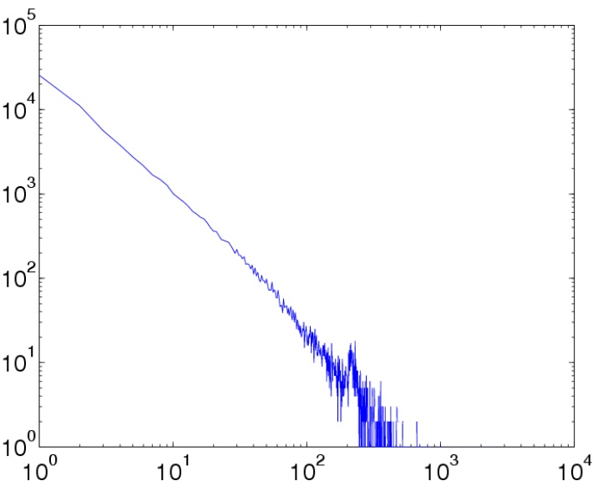
Statistics about the Slashdot Zoo
Statistics about the giant connected component:
77,985 users
510,157 endorsements (388,190 friends / 122,967 foes)
75.9% of all endorsements are positive
Sparsity: 0.00839% of all possible edges exist
Mean links per user: 6.54 (4.98 friends / 1.56 foes)
Median number of links: 3
Diameter = 6, Radius = 3
Degree distribution: power law

Slide 7
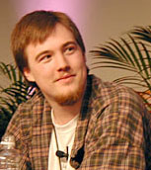

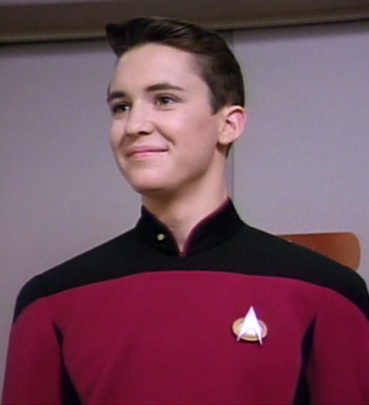
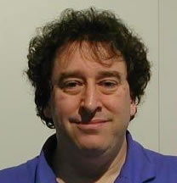
Famous (and Popular?) Slashdotters
From left to right:
  CmdrTaco (Rob Malda, founder/editor)
  John Carmack (Quake, Doom, etc.)
  Bruce Perens (Debian, Open Source Definition)
  CleverNickName (Wil Wheaton, Star Trek)

Slide 8
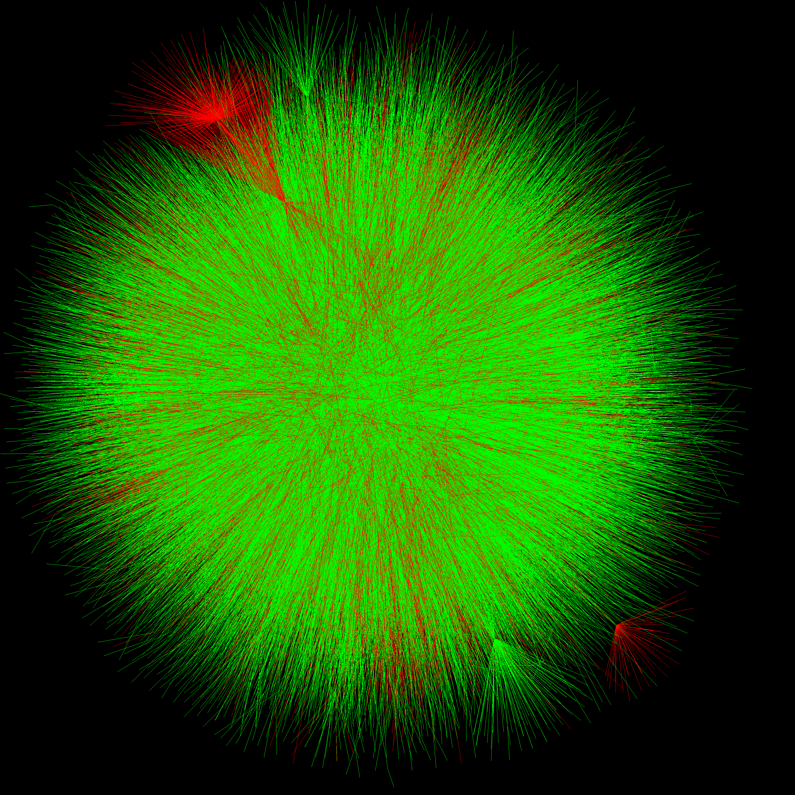
The Slashdot Zoo
GREEN: friend link
RED: foe link
Centered at CmdrTaco

Slide 9
Analysis at the Global Level: The Clustering Coefficient
Characteristic number of a network, 0 ≤ C ≤ 1 (Watts & Strogatz, 1998)
Def.: Percentage of incident edge pairs completed by an edge to form a triangle.
C = |Â o Â²|₊ / |Â²|_{+ Â = abs(a)}
High clustering coefficient: clustered graph with many cliques. (Graph is clustered when the value higher than that predicted by random graph models.)
Slashdot Zoo has C = 3.22%
(vs. 0.0095% random)
Also works for directed graphs.
Edge present ?

Slide 10
Signed Clustering Coefficient
“The enemy of my enemy is my friend”
→ multiplication rule
Denote the amount to which the network is balanced by counting “wrongly” signed edges negatively
C_{S} = |A o A²|₊ / |Â²|₊
Range: −1 ≤ C_{S} ≤ +1
Slashdot Zoo has C_{S} = +2.46% (vs. 0 for random)
Relative signed clustering coefficient: C_{S} / C = 76.4%
u
v
± uv ?

Slide 11
Analysis at the Node Level: Centrality
Measures that apply to single nodes: centrality, trust, reputation, etc.
Simple functions:
Fan count minus freak count
Algebraic function:
PageRank, ignoring edge sign (Page&Brin 1998)
Signed variants of PageRank, e.g. (Kamvar 2003)

Slide 12
PageRank and the Multiplication Rule
Let A be the network‘s adjacency matrix
Compute PageRank by iterated multiplication of a vector with normalized, A (+ extra node for teleportation)
Result: Dominant eigenvector of matrix A given by repeated multiplication with A
Implicit assumption: powers of A denote relations in the network
Matrix multiplication:
(AA)_{ij} = ∑_{k} A_{ik} A_{kj}
Observation: Matrix multiplication relies on edge weight products
Thus: Methods based on matrix multiplication assume the validity of the multiplication rule.

Slide 13
Top Users
For each user score, show the top 6
 | #1 | #2 | #3 | #4 | #5 | #6
Fans minus Freaks | CleverNickName | Bruce Perens | CmdrTaco | John Carmack | NewYorkCountryLawyer | $$$$$exyGal
PageRank | FortKnox | SamTheButcher | Ethelred Unraed | turg | Some Woman | gmhowell
Signed PageRank | FortKnox | SamTheButcher | turg | Some Woman | Ethelred Unraed | gmhowell
Conclusion:
Fans minus Freaks denotes prominence,
PageRank denotes community.

Slide 14
Detecting Trolls
trolling, n. posting disruptive, false or offensive information to fool and provoke readers
Slashdot is known for its trolls
Task: Predict foes of blacklist “No More Trolls” (162 names^{[1]})
[1] See http://slashdot.org/~No+More+Trolls/foes/
PhysicsGenius
Profane Motherfucker
ObviousGuy
CmderTaco
Klerck
YourMissionForToday
$$$$$exyGal
IN SOVIET RUSSIA
SexyKellyOsbourne
BankofAmerica_ATM
stratjakt
j0nkatz
spinlocked
CmdrTaco (editor)
CmdrTaco (troll)
TrollBurger
Twirlip of the Mists

Slide 15
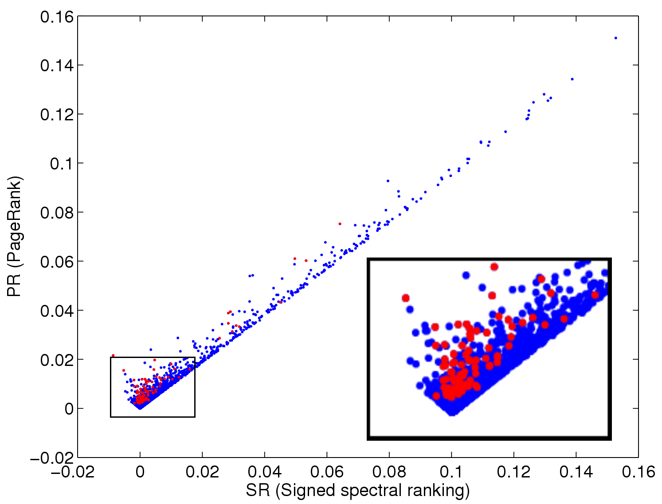
PageRank for Trolls
troll
non-troll
PageRank →
Signed PageRank →

Slide 16
Negative Rank
Observations:
  PageRank and signed PageRank are almost equal for most users
  For trolls, signed PageRank is less
Conclusion:
  Define NegativeRank = Signed PageRank − PageRank
  How does Negative Rank peform at troll prediction?

Slide 17
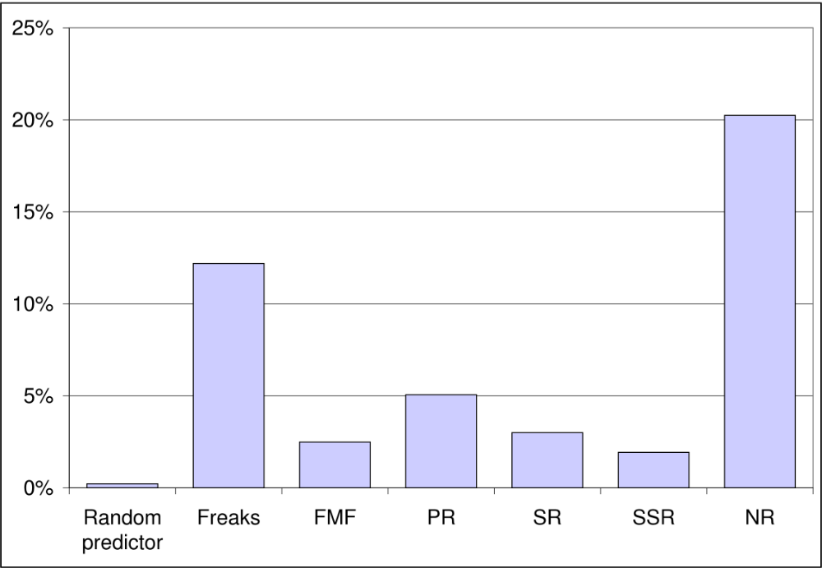
Performance at Prediction
Mean average precision (MAP) at troll prediction
Negative Rank works best!

Slide 18
Analysis at the Edge Level: Link Sign Prediction
Task: Predict the sign of links
Use the adjacency matrix A ∊ {−1, 0, +1}^{n×n}
Powers of A implement the multiplication rule
Simple algorithms
  Mutual friendship (A^{T})
  Signed triangle completion (A²)
Algebraic algorithms
  Rank reduction (A)
  Symmetric dimensionality reduction (A sym)
  Matrix exponential (A exp)
  Symmetric matrix exponential (A sym exp)
  Inverted signed Laplacian (Ls sym)

Slide 19
Algebraic Link Prediction Algorithms
Compute the rank-reduced eigenvalue decomposition:
A = U_{k} D_{k} U_{k}^{T}
Matrix exponential: (multiplication rule)
exp(A) = U_{k} exp(D_{k}) U_{k}^{T}
= I + A + 1/2 A² + 1/6 A³ + …
Inverted signed Laplacian (Kunegis 2008):
L⁺ = (D – A)⁺

Slide 20
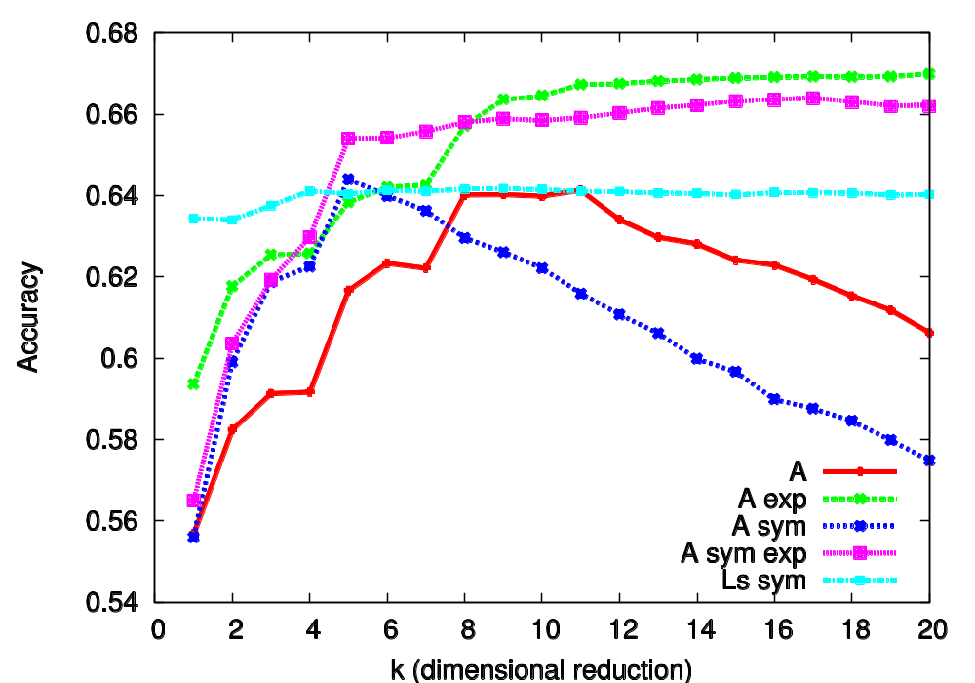
Evaluation Results
Accuracy is measured on a scale from −1 to +1.
1 | 0.517
A^{T} | 0.536
A² | 0.552
Best link sign prediction: matrix exponential, confirms multiplication rule

Slide 21
Ongoing and Future Work
More datasets
  Essembly.org, Epinions.com, LibimSeTi.cz
Study Negative Rank in detail
Social networks with semantic relationships (more than two types)
Other networks that can be extended to negative values
  Folksonomies with negative tags (e.g. tags like !funny on Slashdot)

Slide 22
Conclusions
Multiplication rule confirmed at global, nodal and relational scale
The foe relationship can be used for trust computation and link sign prediction in social networks
New concepts:
  Signed clustering coefficient
  Negative Rank
  Link sign prediction in signed networks

Slide 23
Thank You

Slide 24
References
S. Brin and L. Page. The anatomy of a large-scale hypertextual Web search engine, Proc. Int. Conf. on World Wide Web, pages 107–117, 1998.
P. Hage and F. Harary. Structural models in anthropology, Cambridge University Press, 1983.
F. Harary. On the notion of balance of a signed graph, Michigan Math. J., 2:143–146, 1953.
S. D. Kamvar, M. T. Schlosser, and H. Garcia-Molina. The EigenTrust algorithm for reputation management in P2P networks, Proc. Int. Conf. on World Wide Web, pages 640–651, 2003.
J. Kunegis, S. Schmidt, C. Bauckhage, M. Mehlitz and S. Albayrak. Modeling Collaborative Similarity with the Signed Resistance Distance Kernel, Proc. Eur. Conf. On Artificial Intelligence, pages 261–265, 2008.
D. J. Watts and S. H. Strogatz. Collective dynamics in ‘small-world’ networks, Nature 393(6684):440–442, 1998.

Slide 25
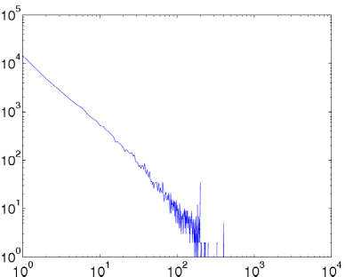
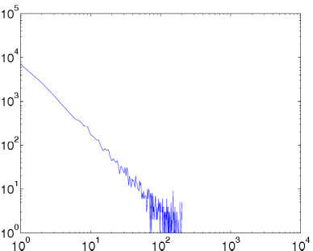
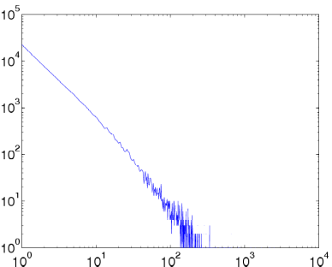
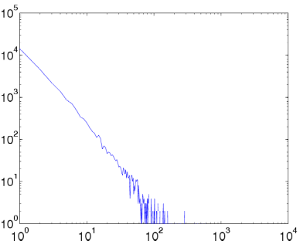
Appendix -- Degree Distributions
Friends
Foes
Fans
Freaks
Observation: power laws for all four relationship types
Total

Slide 26
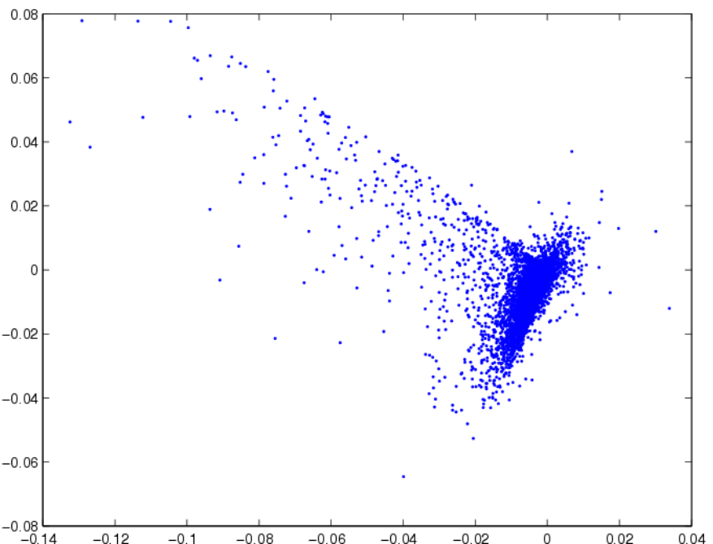
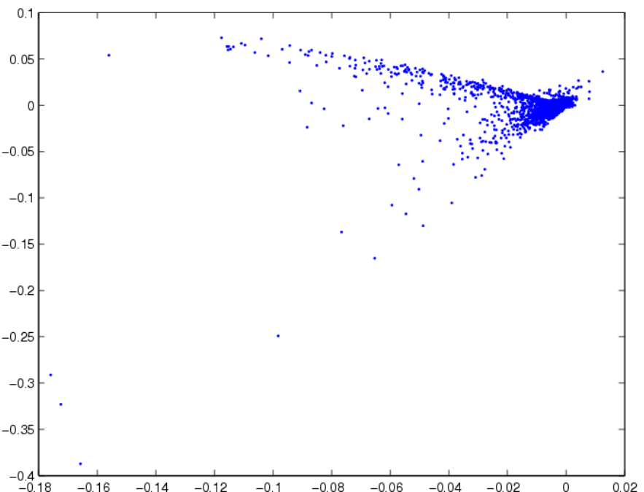
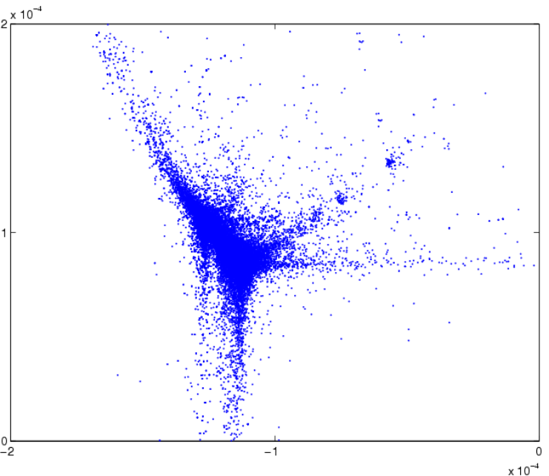
By ratings given
By ratings received
Appendix --
Principal Component Analysis
By graph Laplacian

Slide 27
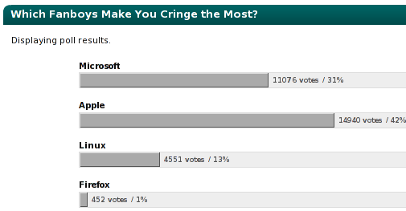
Appendix – Screenshots

