Slide 1
Learning Spectral Graph Transformations for Link Prediction
Jérôme Kunegis & Andreas Lommatzsch
DAI-Labor, Technische Universität Berlin, Germany
26th Int. Conf. on Machine Learning, Montréal 2009

Slide 2
Outline
  The Problem
    Link prediction
    Known solutions
  Learning
    Spectral transformations
    Finding the best spectral transformation
  Variants
    Weighted and signed graphs
    Bipartite graphs and the SVD
    Graph Laplacian and normalization
  Some Applications

Slide 3
The Problem: Link Prediction
  Motivation: Recommend connections in a social network
  Predict links in an undirected, unweighted network
  Using the adjacency matrices A and B,
  Find a function F(A) giving prediction values corresponding to B
  F(A) = B
Known links (A)
Links to be predicted (B)

Slide 4
Path Counting
  Follow paths
  Number of paths of length k given by A^{k}
  Nodes connected by many paths
  Nodes connected by short paths
  Weight powers of A: αA² + βA³ + γA⁴ … with α > β > γ … [ > 0 ]
  Examples:
  Exponential graph kernel: e^{αA} = Σ_{i} α^{i}/i! A^{i}
  Von Neumann kernel: (I − αA)⁻¹ = Σ_{i} α^{i} A^{i}
  (with 0 < α < 1)

Slide 5
Laplacian Link Prediction Functions
  Graph Laplacian L = D − A
  “Resistance Distance” L⁺ (a.k.a. commute time)
  Regularized Laplacian (I + αL)⁻¹
  Heat diffusion kernel e^{−αL}

Slide 6
Computation of Link Prediction Functions
eigenvalue decomposition: A = UΛU^{T}
  Adjacency matrix
  Matrix polynomial Σ_{i} α_{i}A^{i}
  Matrix exponential e^{αA}
  Von Neumann kernel (I − αA)⁻¹
  Rank reduction A_{(k)}
  Graph Laplacian
  Resistance distance L⁺
  Regularized Laplacian (I + αL)⁻¹
  Heat diffusion kernel e^{−αL}
= U (Σ_{i} α_{i}Λ^{i}) U^{T}
  = U e^{αΛ} U^{T}
  = U (I − αΛ)⁻¹ U^{T}
  = U Λ_{(k)} U^{T}
eigenvalue decomposition: L = D − A = UΛU^{T}
= U Λ⁺ U^{T}
= U (I + αΛ)⁻¹ U^{T}
= U e^{−αΛ} U^{T}
Spectral transformation

Slide 7
Learning Spectral Transformations
  Link prediction functions are spectral transformations of A or L
  F(A) = UF(Λ)U^{T}
  F(Λ)_{ii} = f(Λ_{ii})
  A spectral transformation F corresponds to a function of reals f
  Matrix polynomial F(A) = Σ_{i} α_{i}A^{i} f(x) = Σ_{i} α_{i}x^{i} Real polynomial
  Matrix exponential F(A) = e^{αA} f(x) = e^{αx} Real exponential
  Matrix inverse F(A) = (I ± αA)⁻¹ f(x) = 1 / (1 ± αx) Rational function
  Pseudoinverse F(A) = A⁺ f(x) = 1/x when x > 0, 0 otherwise
  Rank-k approximation F(A) = A_{(k)} f(x) = x when |x| ≥ x₀, 0 otherwise

Slide 8
Finding the Best Spectral Transformation
  Find the best spectral transformation on test set B
  min_{F} ‖F(A) − B‖_{F}
  Reduce minimization problem
  = min_{F} ‖UF(Λ) U^{T} − B‖_{F}
  = min_{F} ‖F(Λ) − U^{T}BU‖_{F}
  Reduce to diagonal, because off-diagonal in F(Λ) is constant zero
  min_{f} Σ_{i} (f(Λ_{ii}) − (U^{T}BU)_{ii})²
  The best spectral transformation is given by a one-dimensional least-squares problem
(norm is preserved by U)

Slide 9
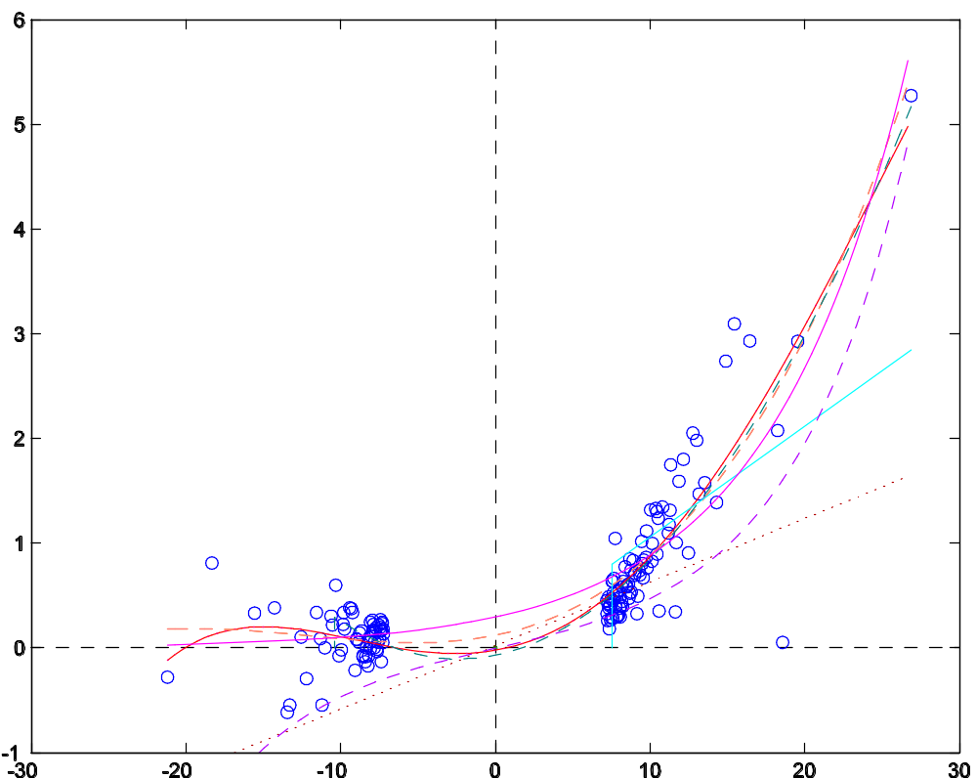
Example: DBLP Citation Network (undirected)
  DBLP citation network
  Symmetric adjacency matrices A = UΛU^{T}, B
(U^{T}BU)_{ii}
αx³ + βx² + γx + δ
βe^{αx}
Λ_{ii}
x when x < x₀, else 0

Slide 10
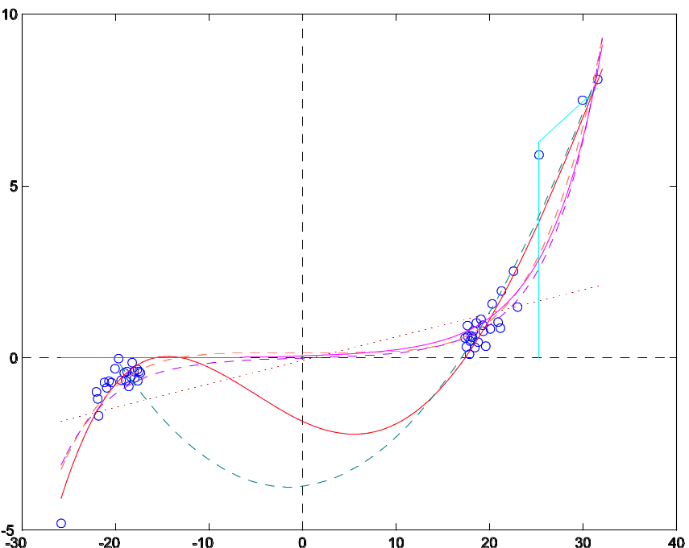
Variants: Weighted and Signed Graphs
  Weighted undirected graphs: use A and L = D − A as is
  Signed graphs: use D_{ii} = Σ_{j} |A_{ij}| (signed graph Laplacian)
  Example: Slashdot Zoo
  (social network with negative edges)

Slide 11
Bipartite Graphs
  Bipartite graphs: paths have odd length
  Compute sum of odd powers of A
  The resulting polynomial is odd
    αA³ + βA⁵ + …
  For other link prediction functions, use the odd component
  e^{αA} sinh(αA)
    (I − αA)⁻¹ αA (I − α²A²)⁻¹

Slide 12
Singular Value Decomposition
  Odd power of a bipartite graph’s adjacency matrix
  A^{2n+1} = [0 R; R^{T} 0]^{2n+1} = [0 (RR^{T})^{n}R; R^{T}(RR^{T})^{n} 0]
  Using the singular value decomposition R = UΣV^{T}
  (RR^{T})^{n}R = (UΣV^{T} VΣU^{T})^{n} UΣV^{T} = (UΣ²U^{T})^{n} UΣV^{T} = UΣ^{2n+1}V^{T}
  Odd powers of A are given by odd spectral transformations of R

Slide 13
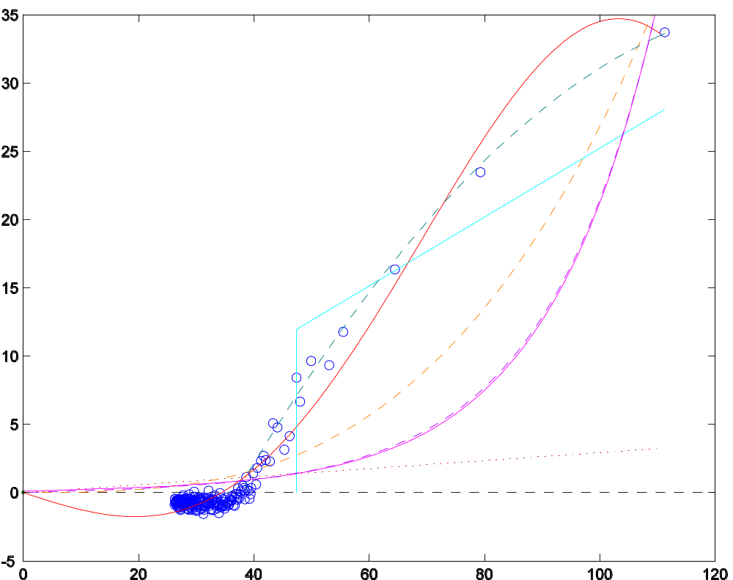
SVD Example: Bipartite Rating Graph
  MovieLens
  rating graph
  Rating values
  {−2, −1, 0, +1, +2}
αx⁵ + βx³ + γx
β sinh(αx)
α x (x < x₀)
sgn(x) (α |x|²+β|x|+γ (x < x₀))

Slide 14
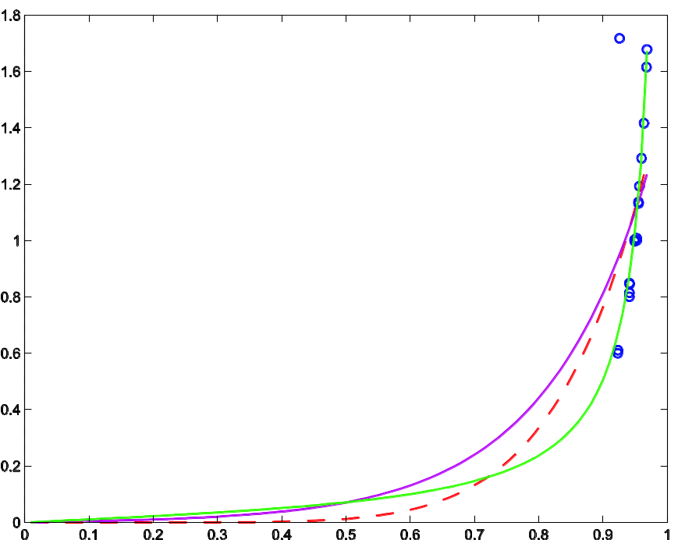
Base Matrices
  Base matrices A and L
  Normalized variants: D^{−1/2}AD^{−1/2}, D^{−1/2}LD^{−1/2} = I − D^{−1/2}AD^{−1/2}
  Example: D^{−1/2}AD^{−1/2}
  Trust network Advogato
  Note: ignore eigenvalue 1
  (constant eigenvector)
αx² + βx + γ [α,β,γ≥0]
βe^{αx}
β / (1 – αx)

Slide 15
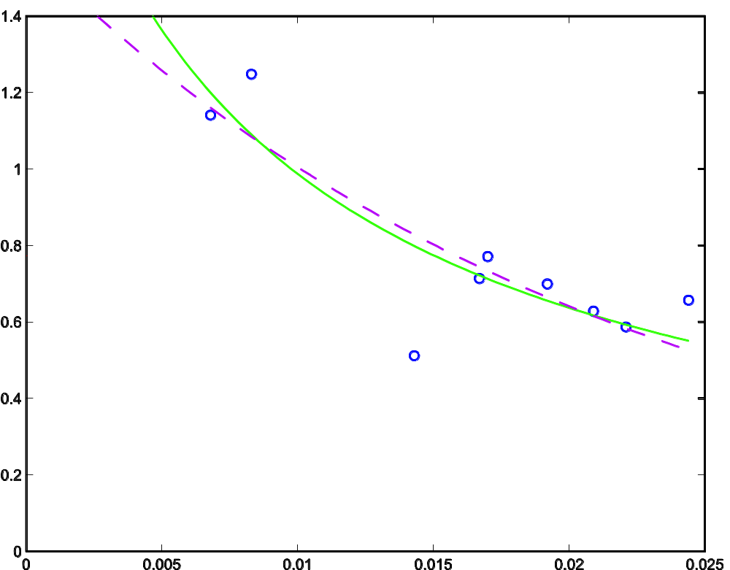
Learning Laplacian Kernels
  Epinions (signed user-user network), using L
  Note: Λ_{ii} > 0 because
  the graph is signed
  and unbalanced
β / (1 + αx)
β e^{−αx}

Slide 16
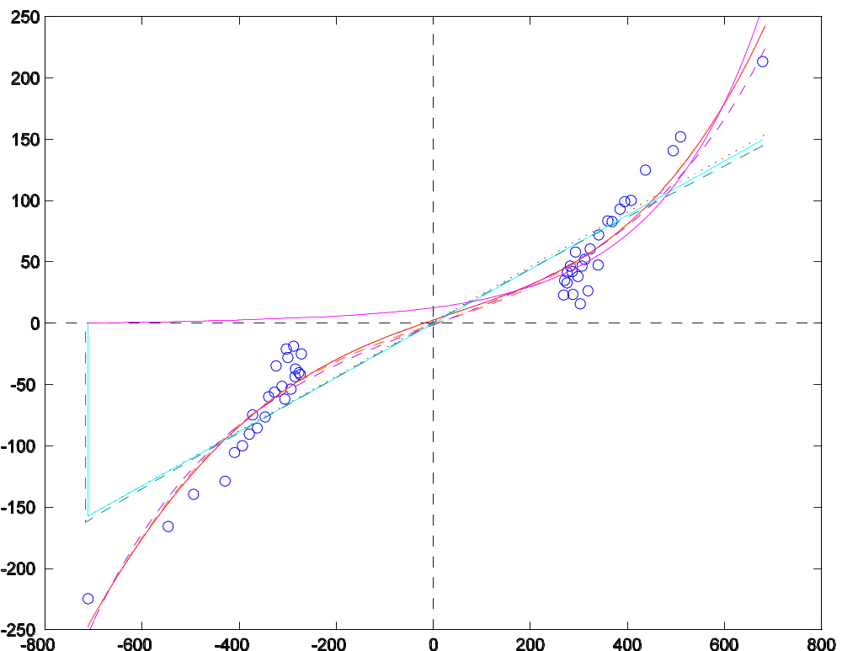
Almost Bipartite Networks
  Dating site LíbímSeTi.cz: (users rate users)
  Some networks are “almost” bipartite
  Plot has near central symmetry
  Bipartition: men/women
αx³ + βx² + γx + δ
β sinh(αx)

Slide 17
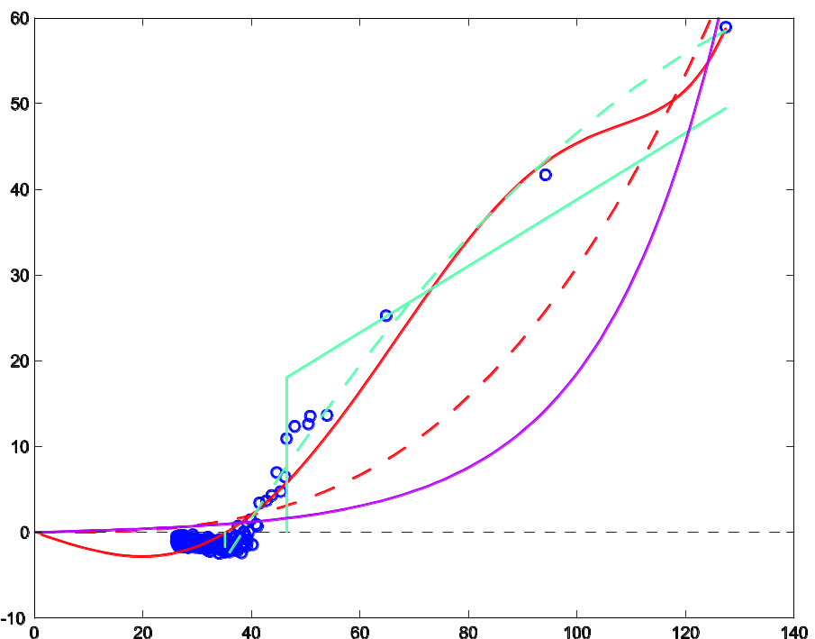
Learning the Reduced Rank k
  Some plots suggest a reduced rank k
  Example: MovieLens/SVD
  Learned: k = 14
(U^{T}BU)_{ii} ≈ 0
significant sing. values

Slide 18
Conclusion & Ongoing Research
  Conclusions
  Many link prediction functions are spectral transformations
  Spectral transformations can be learned
  Ongoing Research
  New link prediction function: sinh(A), odd von Neumann (pseudo-)kernel
  Signed graph Laplacian
  Other matrix decompositions
  Other norms
  More datasets
Thank You

