Slide 1
On the Spectral Evolution
of Large Networks
Jérôme Kunegis
Committee: Prof. Dr. Staab
Prof. Dr. Bauckhage
Prof. Dr. Obermayer

Slide 2
Outline
1. Algebraic Link Prediction
2. Spectral Transformations
3. Learning Link Prediction

Slide 3






1. Example: Recommend Friends on Facebook
?
j
i
A network of friends connected by friendship links
Recommendation: Given a person i, find new friends j for that person
Link prediction: Find edges (i, j) that will appear in the future

Slide 4
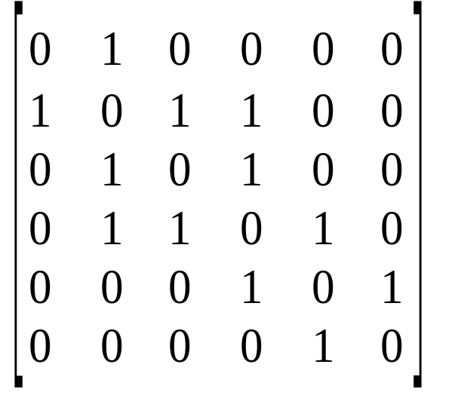
Algebraic Graph Theory
3
1
2
4
5
6
Represent a network
by an adjacency matrix A:
A_{ij} = 1 when i and j are connected
A_{ij} = 0 when i and j are not connected
A is square and symmetric.
1
2
3
4
5
6
1
2
3
A =
4
5
6

Slide 5
Eigenvalue Decomposition
Write the matrix A as a product:
A = U Λ U^{T}
where
U is an orthogonal matrix, i.e. U^{T} U = I
Λ is a diagonal matrix, i.e. Λ_{ij} = 0 when i ≠ j
The eigenvalue decomposition always exists for symmetric matrices.

Slide 6
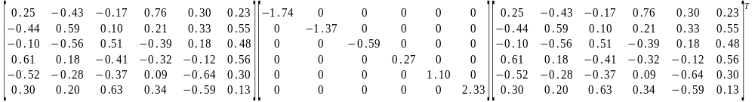
Eigenvalue Decomposition: Example
3
0.48
1
2
4
5
6
A
0.23
0.55
0.56
0.30
0.13
=
U
Λ
U
1
Eigenvector
Eigenvalue
U contains eigenvectors, Λ contains eigenvalues

Slide 7
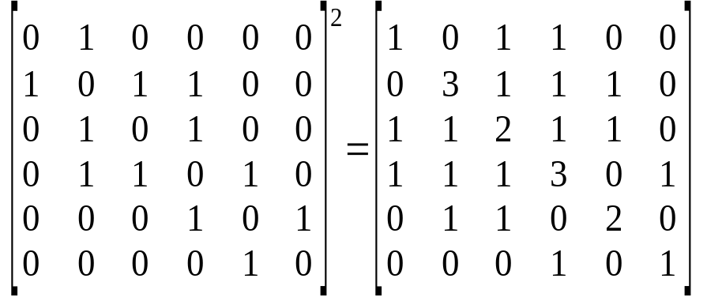
Implementing the Friend of a Friend Model
The eigenvalue decomposition can be used to imp­lement the Friend of a Friend count for link prediction:
Consider the matrix product A A = A²
(A²)_{ij} contains the number of paths of length two between i and j, i.e. the friend-of-a-friend score
3
1
2
4
5
6

Slide 8
Computing A²
Use the eigenvalue decomposition A = U Λ U^{T}
A² = U Λ U^{T} U Λ U^{T} = U Λ Λ U^{T} = U Λ² U^{T}
Exploit U and Λ:
U^{T} U = I because U is orthogonal
(Λ²)_{ii} = Λ_{ii}² because Λ is diagonal
Result: Just square all eigenvalues!
We call this a spectral transformation.

Slide 9
Spectral Transformation
A spectral transformation is a function of a matrix A that can be expressed as a transformation of A's eigenvalues.
Given the eigenvalue decomposition
A = U Λ U^{T},
then F is a spectral transformation when
F(A) = U F(Λ) U^{T}
and F(Λ) is diagonal.

Slide 10
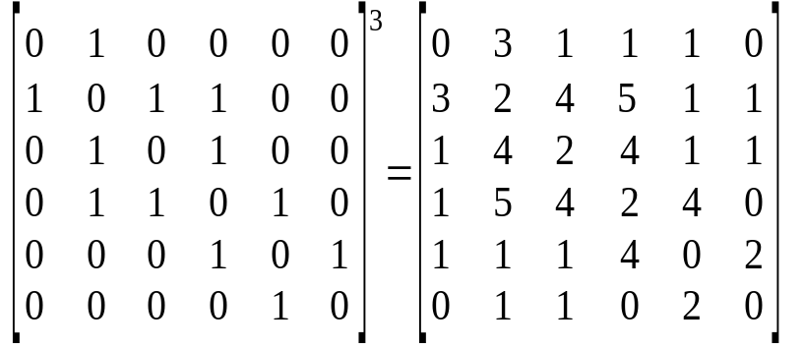
Friend of a Friend of a Friend
3
Compute the number of friends-of-friends-of-friends:
A³ = U Λ U^{T} U Λ U^{T} U Λ U^{T} = U Λ³ U^{T}
1
2
4
5
6
1
2
3
4
5
6
1
2
3
4
5
6

Slide 11
Link Prediction with Power Sums
Use power sums as link prediction functions:
Every power A^{n} represents the number of paths of length n between all node pairs
→ New edges more likely to appear when there are many paths already
A power sum a A² + b A³ + c A⁴ + ⋯ represents a sum over all paths between all node pairs
→ When a > b > c > ⋯ > 0, short paths are weighted more

Slide 12
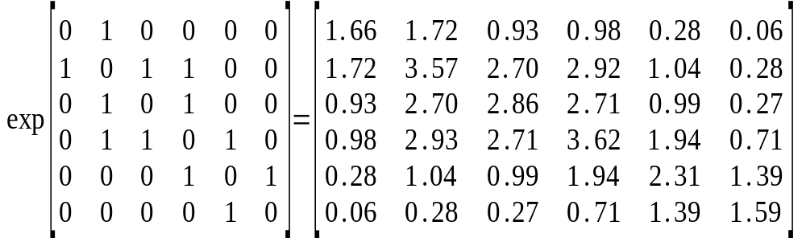
Matrix Exponential
3
1
2
4
5
6
The matrix exponential can be written as a power sum with decreasing coefficients:
exp(A) = I + A + ½ A² + ⅙ A³ + ⋯
Example: To ①, recommend ④, ③, ⑤, then ⑥
1
2
3
4
5
6
1
2
3
4
5
6
6

Slide 13
Computing Power Sums
Let p(A) be a power sum:
p(A) = a A² + b A³ + c A⁴ + ⋯
= a U Λ² U^{T} + b U Λ³ U^{T} + c U Λ⁴ U^{T} + ⋯
= U (a Λ² + b Λ³ + c Λ⁴ + ⋯) U^{T}
= U p(Λ) U^{T}
Because Λ is diagonal, we have p(Λ)_{ii} = p(Λ_{ii})
Therefore:
Power sums are spectral transformations!

Slide 14
2. Looking at Real Facebook Data
Dataset: Facebook New Orleans friendship links (Viswanath 2009)
http://socialnetworks.mpi-sws.org/data-wosn2009.html
63,731 persons
1,545,686 friendship links with formation dates
Let A_{t} be the adjacency matrix at time t (1 ≤ t ≤ n = 71)
A_{t} contains all edges formed before time t
Compute all eigenvalue decompositions A_{t} = U_{t} Λ_{t} U_{t}^{T}

Slide 15
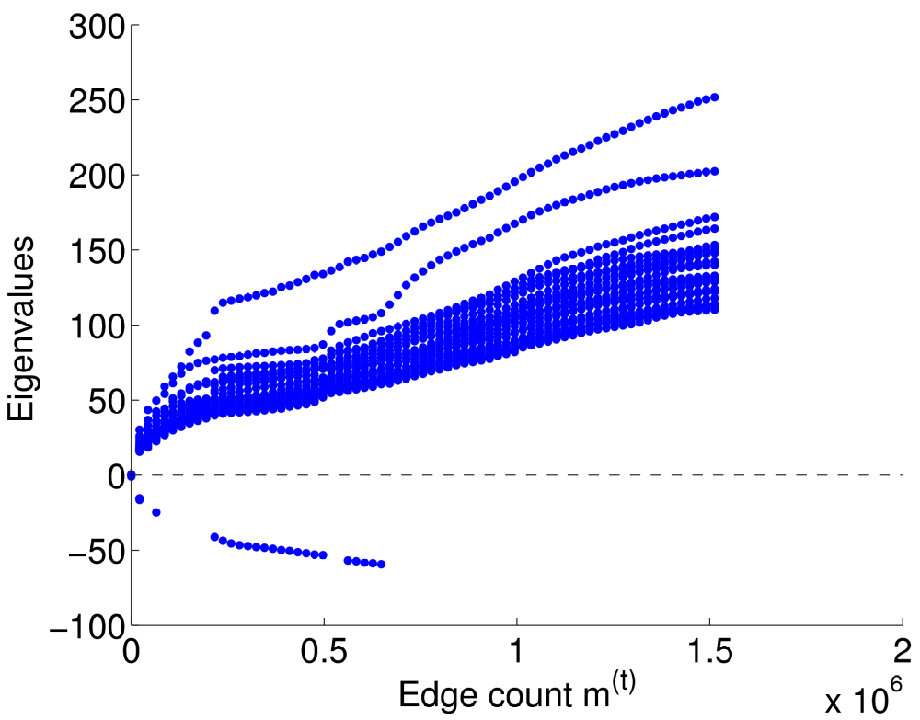
Evolution of Eigenvalues
Plot (Λ_{t})_{ii} in function of t
Observation:
Eigenvalues grow

Slide 16
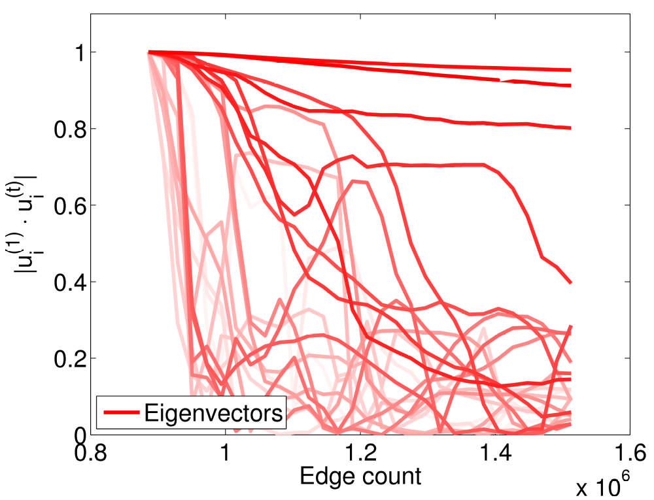
Eigenvector Evolution
For each eigenvector nr. i, cosine similarity of each eigenvector with initial value (1 = same eigenvector)
Observations:
No clear pattern
A few eigenvectors stay constant

Slide 17
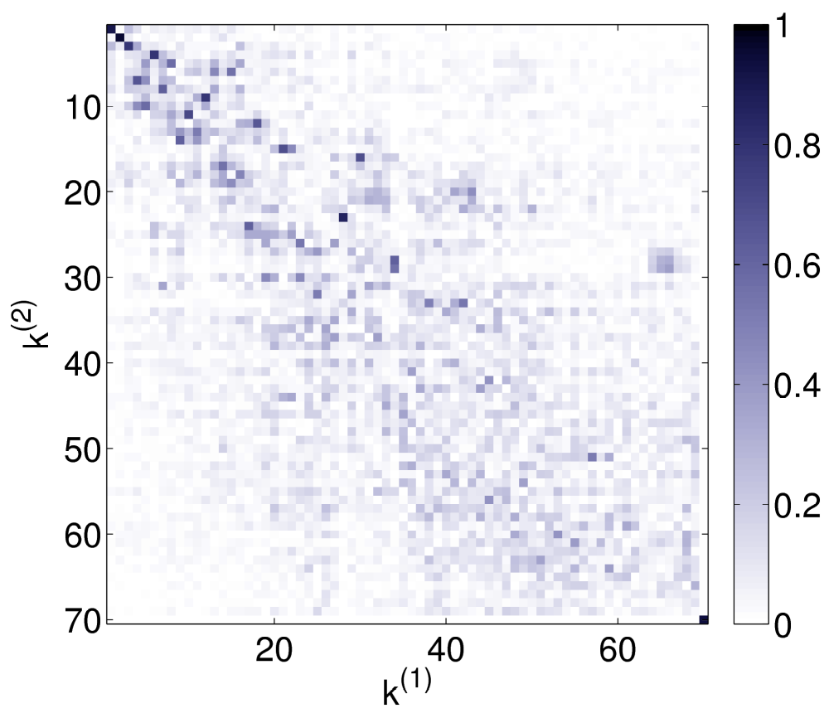
Eigenvector Permutation
For all pairs (i,j), compare the i^{th} eigenvector at m = (3/4)n with the j^{th} eigenvector at time n, using the cosine similarity (1 = same eigenvector)
Observations:
Some eigenvectors
permute

Slide 18
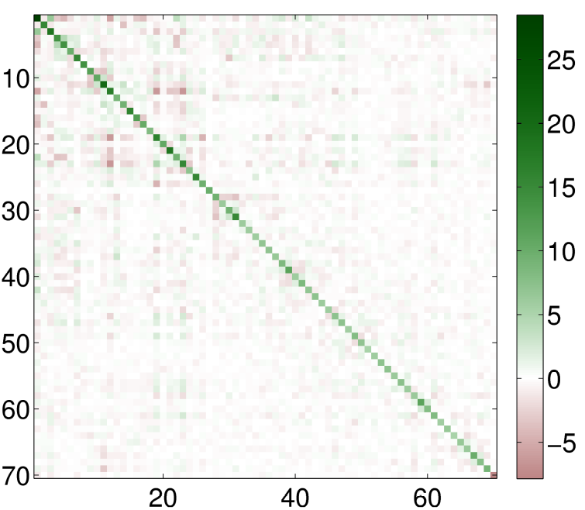
Diagonality Test (Kunegis 2010)
Let 1 ≤ m ≈ ¾ n ≤ n.
Diagonalize A_{n} − A_{m} using the eigenvectors of A_{m}
A_{m} = U Λ U^{T}
A_{n} − A_{m} = U X U^{T}
⇒ X = U^{T} (A_{n} − A_{m}) U
Observation:
X is nearly diagonal
Growth is spectral!
| U is orthogonal
X =

Slide 19
3. Learning Link Prediction (Kunegis 2009)
To predict links, find a spectral transformation mapping past data to present data, and apply it to present data.
Idea: Use the adjacency matrices A_{m} and A_{n} for 1 ≤ m ≤ n with m ≈ ¾ n.
A_{m} A_{n} − A_{m}
A_{n} ?
f
f

Slide 20
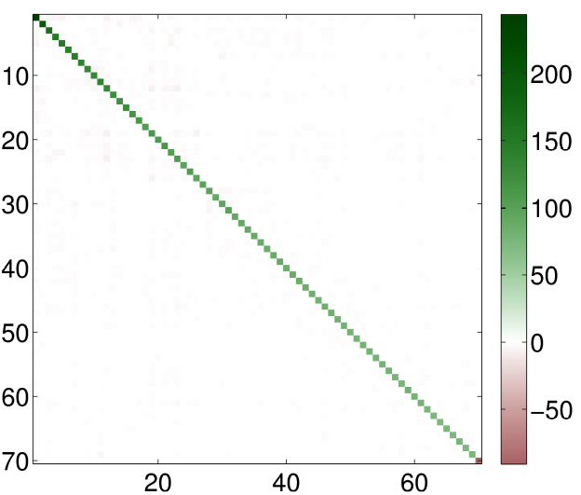
Learning a Spectral Transformation
A_{m} |  | A_{n} − A_{m}
U Λ U^{T} |  | U U^{T} (A_{n} − A_{m}) U U^{T}
Λ |  | U^{T} (A_{n} − A_{m}) U

Slide 21
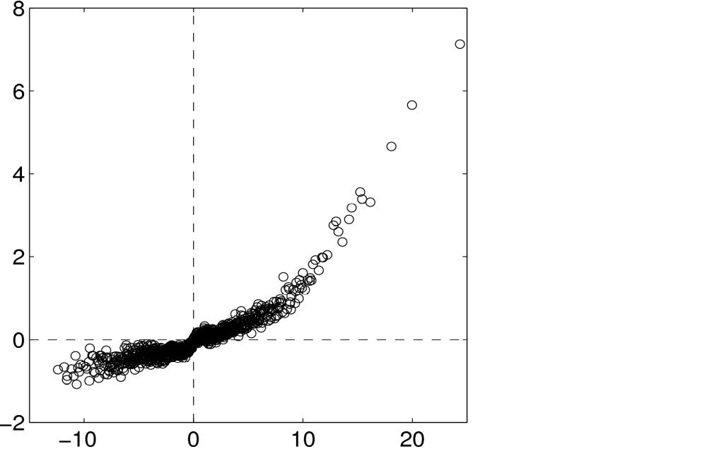
Curve Fitting
This is a one-dimensional curve-fitting problem.
Find f(x) such that (U^{T} (A_{n} − A_{m}) U)_{ii} − Λ_{ii} is small.
(U^{T} (A_{n} − A_{m}) U)_{ii}
Λ_{ii}

Slide 22
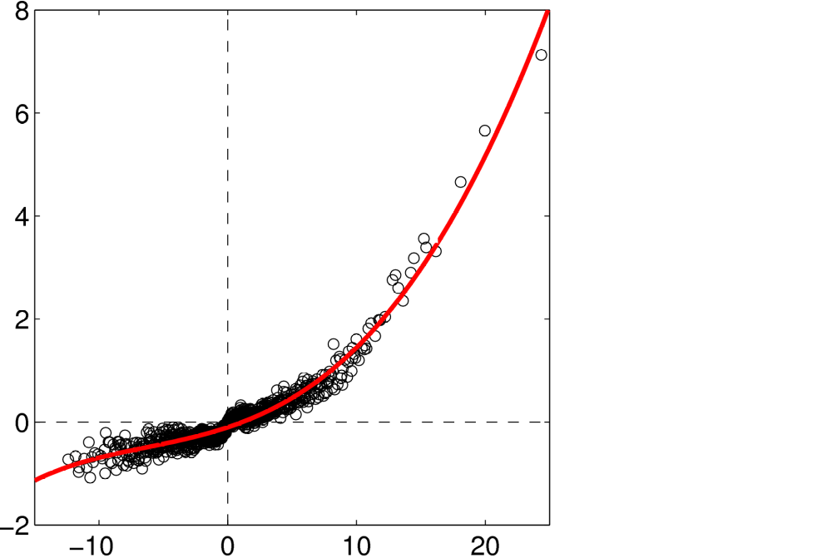
Polynomial Curve Fitting
Fit a polynomial a + b x + c x² + d x³ + e x⁴

Slide 23
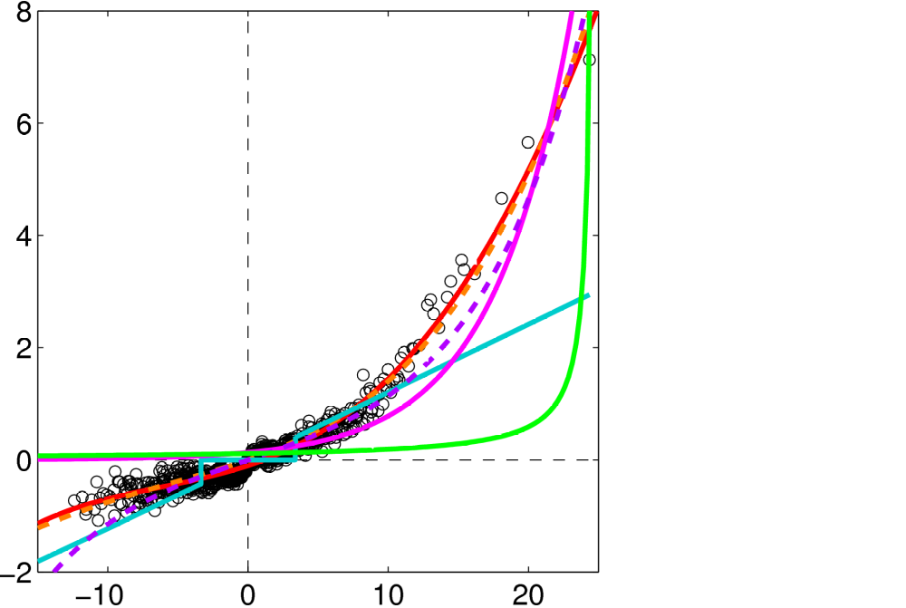
Other Curves
Polynomial
a + b x + c x² + d x³ + e x⁴
Nonnegative Polynomial
a + … + h x⁷ a, …, h ≥ 0
Von Neumann kernel
b / (1 − a x)
Matrix exponential
b exp(a x)
Hyperbolic sine
b sinh(a x)
Rank reduction
a x if |x| ≥ x₀, 0 otherwise

Slide 24
Experiments
Methodology:
Split each dataset into three edge sets by formation date (training, validation, test)
Learn the spectral transformation from training to validation set
Predict edges in test set
Dataset | Best spectral transformation | Mean average precision (MAP)
Facebook friendship | Hyperbolic sine | 0.667
Astro-ph coauthorship | Polynomial | 0.690
DBLP coauthorship | Matrix exponential | 0.759
Internet topology | Matrix exponential | 0.726

Slide 25
Conclusion
Can the eigenvalue decomposition model the growth of networks?
Yes, because only eigenvalues change, not eigenvectors.
Is there an explanation for constant eigenvectors?
There are several: Graph kernels, triangle closing, the sum-over-paths model, rank reduction, etc.
Can we exploit this in recommender systems?
Yes, by learning the spectral transformation for a given dataset.
Is this scalable?
Yes, because we can reduce the learning problem to a one dimensional curve fitting problem.

Slide 26
References
J. Kunegis, A. Lommatzsch, Learning spectral graph transformations for link prediction. In Proc. Int. Conf. on Machine Learning, pp. 561–568, 2009.
J. Kunegis, D. Fay, C. Bauckhage, Network growth and the spectral evolution model. In Proc. Conf. on Information and Knowledge Management, pp. 739–748, 2010.
B. Viswanath, A. Mislove, M. Cha, K. P. Gummadi, On the evolution of user interaction in Facebook. In Proc. Workshop on Online Social Networks, pp. 37–42, 2009.

Slide 27
Backup: Other Findings
Evaluation on 114 network datasets
Control tests: Spectral evolution is not observed in random graph growth models
Link prediction by extrapolation of the spectrum
Networks with positive and negative edges: Powers of the adjacency matrix implement the multiplication rule
Directed networks: Use the singular value decomposition
Bipartite networks: Use the singular value decomposition
Spectral transformations of the Laplacian matrix
The Laplacian matrix with negative edges

