Slide 1
On the Spectral Evolution
of Large Networks
Jérôme Kunegis
Committee: Prof. Dr. Staab
Prof. Dr. Bauckhage
Prof. Dr. Obermayer

Slide 2
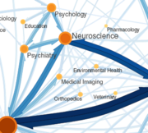
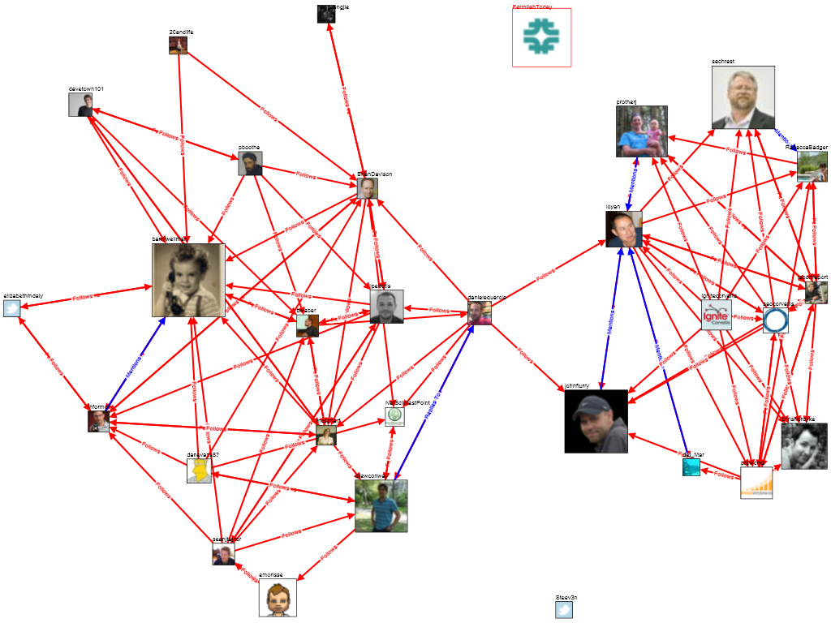
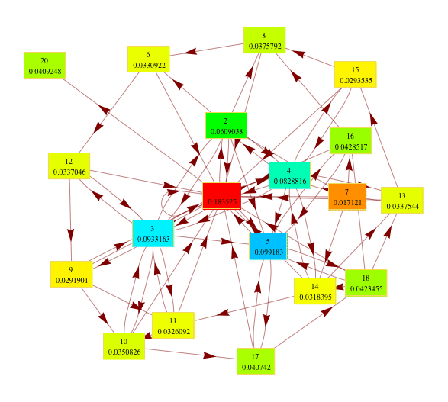
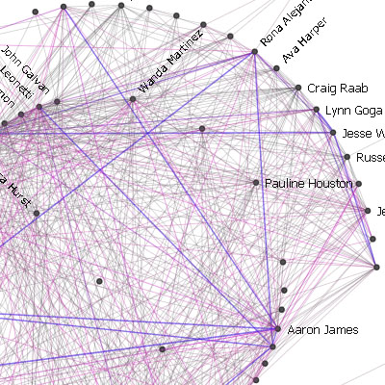
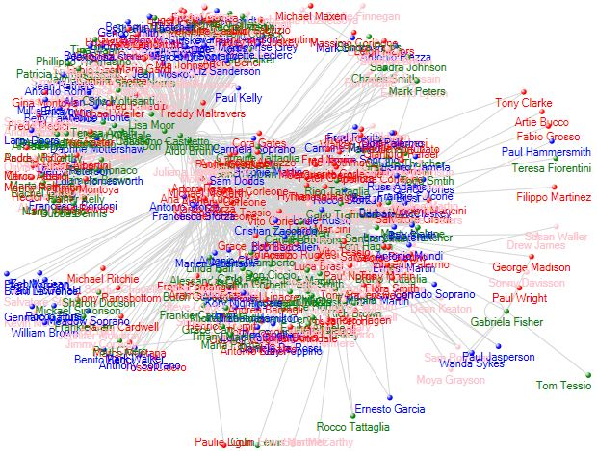
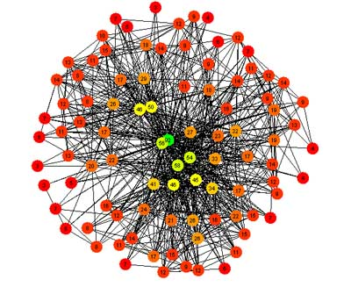
Networks
…are everywhere
How can we exploit the information contained in them?
Collaboration
Friendship
Trust
c
Communication
Co-occurrence
Interaction

Slide 3






Use Networks for Recommendation
:-(
Idea: Predict who a person will connect with
Facebook's algorithm: find friends-of-friends
→ Problem: Rest of the network is ignored!
me

Slide 4
Outline
1. Algebraic Link Prediction
2. Spectral Transformations
3. Learning Link Prediction
4. Special Cases
Take into account the whole network

Slide 5
Algebraic Graph Theory
3
1
2
4
5
6
Represent a network
by an adjacency matrix A:
A_{ij} = 1 when i and j are connected
A_{ij} = 0 when i and j are not connected
A is square and symmetric.
1
2
3
4
5
6
1
2
3
A =
4
5
6

Slide 6

Baseline: Friend of a Friend Model
Count the number of ways a person can be found as the friend of a friend.
Consider the matrix product A A = A²
3
2
=
1
2
4
5
6

Slide 7
Eigenvalue Decomposition
Write the matrix A as a product:
A = U Λ U^{T}
where
U are the eigenvectors U^{T} U = I
Λ are the eigenvalues Λ_{ij} = 0 when i ≠ j

Slide 8
Computing A²
Use the eigenvalue decomposition A = U Λ U^{T}
A² = U Λ U^{T} U Λ U^{T} = U Λ² U^{T}
Exploit U and Λ:
U^{T} U = I because U contains eigenvectors
(Λ²)_{ii} = Λ_{ii}² because Λ contains eigenvalues
Result: Just square all eigenvalues!

Slide 9
Friend of a Friend of a Friend
3
Compute the number of friends-of-friends-of-friends:
A³ = U Λ U^{T} U Λ U^{T} U Λ U^{T} = U Λ³ U^{T}
1
2
4
5
6
3
1
2
3
4
5
6
1
2
=
3
4
5
6

Slide 10
Power Sums
A^{n}
= Number of paths of length n
a A² + b A³ + c A⁴ + …
= Number of paths, weighted by path length
→ New edges more likely to appear when there are many paths already
→ When a > b > c > ⋯ > 0, short paths are weighted more

Slide 11
Matrix Exponential
3
1
2
4
5
6
The matrix exponential can be written as a power sum with decreasing coefficients:
exp(A) = I + A + ½ A² + ⅙ A³ + ⋯
Example: To ①, recommend ④, ③, ⑤, then ⑥
1
2
3
4
5
6
1
2
exp =
3
4
5
6
6

Slide 12
Computing Power Sums
Let p(A) be a power sum:
p(A) = a A² + b A³ + c A⁴ + ⋯
= a U Λ² U^{T} + b U Λ³ U^{T} + c U Λ⁴ U^{T} + ⋯
= U (a Λ² + b Λ³ + c Λ⁴ + ⋯) U^{T}
= U p(Λ) U^{T}
Therefore:
Power sums change only the eigenvalues!

Slide 13
Outline
1. Algebraic Link Prediction
2. Spectral Transformations
3. Learning Link Prediction
4. Special Cases
Why does it work?

Slide 14
Spectral Transformations
A² = U Λ² U^{T}
A³ = U Λ³ U^{T}
exp(A) = U exp(Λ) U^{T}
Friend of a friend
Friend of a friend of a friend
Matrix exponential
…are link prediction functions!

Slide 15
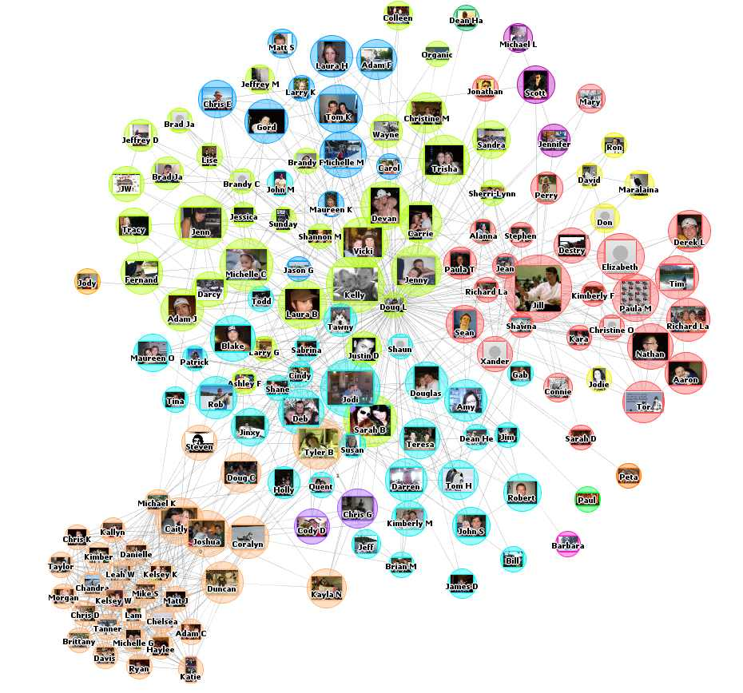

Looking at Real Facebook Data
Dataset: Facebook New Orleans
(Viswanath 2009)
63,731 persons
1,545,686 friendship links with creation dates
Let A_{t} be the adjacency matrix at time t (1 ≤ t ≤ n = 75)
A_{t} contains all edges formed before time t
Compute all eigenvalue decompositions A_{t} = U_{t} Λ_{t} U_{t}^{T}

Slide 16
Evolution of Eigenvalues
Plot (Λ_{t})_{ii} in function of t
Growing eigenvalue
Constant eigenvalue
Λt ii

Slide 17
Eigenvector Evolution
Cosine similarity between Ut i and Ut+x i
cos(Ut i, Ut+x i)
Constant
Sudden change

Slide 18
Eigenvector Permutation
Split: old edges A = UA ΛA UA^{T}
new edges B = UB ΛB UB^{T}
Eigenvectors permute
cos(UA i, UB j)

Slide 19
Diagonality Test
CIKM 2010
Diagonalize AB using the eigenvectors of A_{A}
A_{A} = UA ΛA UA^{T}
A_{B} = UA X UA^{T}
⇒ X = UA^{T} AB UA
Nearly diagonal!
X =

Slide 20
Outline
1. Algebraic Link Prediction
2. Spectral Transformations
3. Learning Link Prediction
    Learning by Extrapolation
    Learning by Curve Fitting
4. Special Cases
What spectral transformation is best?

Slide 21
Learning by Extrapolation
CIKM 2010
Extrapolate the growth of the spectrum
Potential problem:
overfitting
Good when growth
is irregular

Slide 22
Learning by Curve Fitting
f
AA
AB
UA ΛA UA^{T}
AB
ΛA
UA^{T} AB UA
f

Slide 23
Curve Fitting
(UA^{T} AB UA)_{ii}
(ΛA) _{ii}

Slide 24
Polynomial Curve Fitting
Fit a polynomial a + b x + c x² + d x³ + e x⁴

Slide 25
Other Curves
ICML 2009
Polynomial
a + b x + c x² + d x³ + e x⁴
Nonnegative Polynomial
a + … + h x⁷ a, …, h ≥ 0
Von Neumann kernel
b / (1 − a x)
Matrix exponential
b exp(a x)
Hyperbolic sine
b sinh(a x)
Rank reduction
a x if |x| ≥ x₀, 0 otherwise

Slide 26
Evaluation Methodology
All edges E
Training set
Apply
Test set E
c
Source set E
Learn
Target Set E
a
b
Edge creation time
3-way split of edge set by edge creation times

Slide 27
Experiments
Precision of link prediction (1 = perfect)
Curve
fitting

Slide 28
Outline
1. Algebraic Link Prediction
2. Spectral Transformations
3. Learning Link Prediction
4. Special Cases
    Signed networks
    Directed networks
    Bipartite networks
Not all networks are simple

Slide 29
Signed Networks
Friend
Enemy
Two link types: positive and negative

Slide 30
Signed Networks: Algebraic Analysis
WWW 2010
SDM 2010
2
3
?
1
6
A =
4
5
The square A² counts common friends / enemies
(A²)_{ij} = Σ_{k} A_{ik} A_{jk}
(A²)₂₆ = (+1)(+1) + (+1)(−1) + (+1)(−1) = −1
‘The enemy of my enemy is my friend’

Slide 31
Directed Networks
Trust
Distrust
Links have a direction

Slide 32
Directed Networks: Algebraic Analysis
2
3
?
1
6
A =
4
5
The square A² counts directed paths
(A²)_{ij} = Σ_{k} A_{ik} A_{kj}
(A²)₂₆ = (+1)(−1) + (+1)(−1) = −2

Slide 33






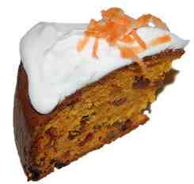

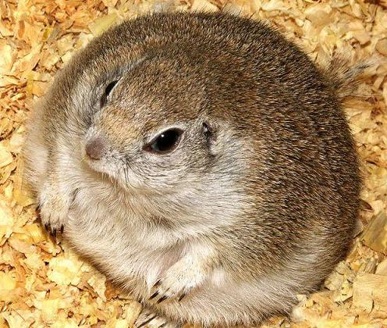
Bipartite Networks
Links between two different node types

Slide 34
Bipartite Networks: Spectral Analysis
IPMU 2010
Rectangular matrix B =
Singular value decomposition of B:
B = U Σ V^{T}
Left and right
eigenvectors
are different

Slide 35
Conclusion
Can the eigenvalue decomposition model the growth of networks?
Yes, because only eigenvalues change, not eigenvectors.
Is there an explanation for constant eigenvectors?
There are several: Graph kernels, triangle closing, the sum-over-paths model, rank reduction, etc.
Can we exploit this in recommender systems?
Yes, by learning the spectral transformation for a given dataset.
Is this scalable?
Yes, because we can reduce the learning problem to a one dimensional curve fitting problem.

Slide 36
Selected Publications
The Slashdot Zoo: Mining a social network with negative edges
J. Kunegis, A. Lommatzsch and C. Bauckhage
In Proc. World Wide Web Conf., pp. 741–750, 2009.
Learning spectral graph transformations for link prediction
J. Kunegis and A. Lommatzsch
In Proc. Int. Conf. on Machine Learning, pp. 561–568, 2009.
Spectral analysis of signed graphs for clustering, prediction and visualization
J. Kunegis, S. Schmidt, A. Lommatzsch and J. Lerner
In Proc. SIAM Int. Conf. on Data Mining, pp. 559–570, 2010.
Network growth and the spectral evolution model
J. Kunegis, D. Fay and C. Bauckhage
In Proc. Conf. on Information and Knowledge Management, pp. 739–748, 2010.

Slide 37
References
B. Viswanath, A. Mislove, M. Cha, K. P. Gummadi, On the evolution of user interaction in Facebook. In Proc. Workshop on Online Social Networks, pp. 37–42, 2009.

Slide 38







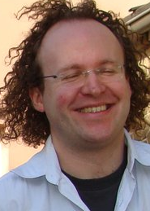




















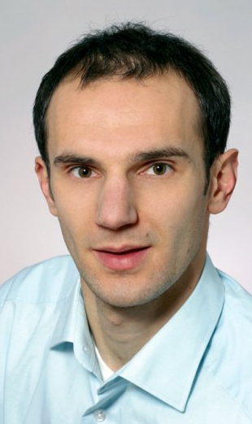



Acknowledgements

Slide 39
Backup: Other Findings
Evaluation on 114 network datasets
Control tests: Spectral evolution is not observed in random graph growth models
Spectral transformations of the Laplacian matrix
The Laplacian matrix with negative edges

Slide 40
Backup: Eigenvalue Decomposition: Example
3
0.48
1
2
4
5
6
0.23
0.55
0.56
0.30
0.13
A
=
U
Λ
U
1
T
Eigenvector
Eigenvalue
U contains eigenvectors, Λ contains eigenvalues

