Slide 1
On the Spectral Evolution
of Large Networks
Jérôme Kunegis

Slide 2
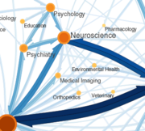
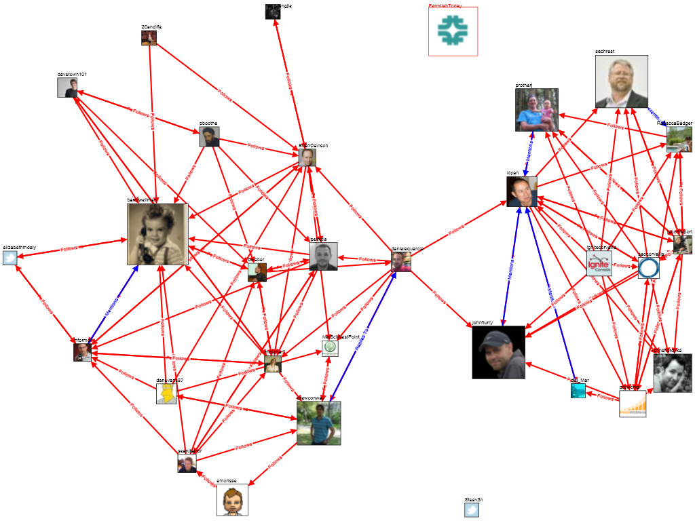
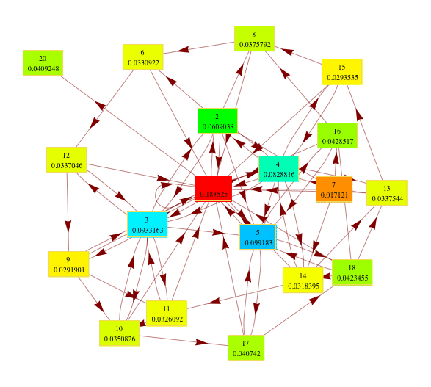
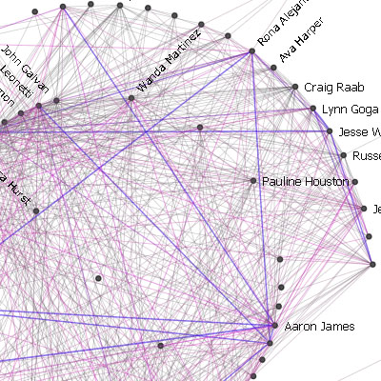
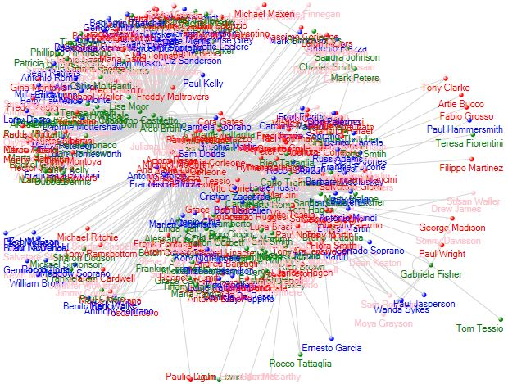
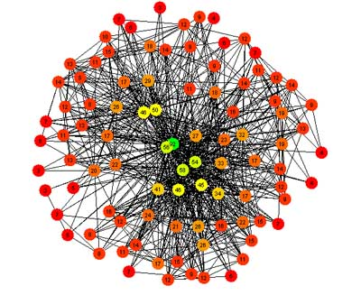
Networks
…are everywhere
Authorship
Friendship
Trust
c
Communication
Co-occurrence
Interaction

Slide 3







Social Network
Person
Friendship

Slide 4

Trust Network
Trust

Slide 5

Signed Social Network
Friend
Foe

Slide 6









Interaction Network

Slide 7
Recommender Systems
:-(
Predict who I will add as friend next
Facebook's algorithm: find friends-of-friends
→ Problem: Rest of the network is ignored!
me
Notes:
- restrict to unweighted, undirected, unipartite graphs.

Slide 8
Outline
1. Algebraic Link Prediction
2. Spectral Transformations
3. Learning Link Prediction
Take into account the whole network

Slide 9
Adjacency Matrix
3
1
2
4
5
6
A_{ij} = 1 when i and j are connected
A_{ij} = 0 when i and j are not connected
A is square and symmetric
1
2
3
4
5
6
1
2
3
A =
4
5
6

Slide 10
Baseline: Friend of a Friend Model
Count the number of ways a person can be found as the friend of a friend
Matrix product AA = A²
3
2
A² =
=
1
2
4
5
6

Slide 11
Friend of a Friend of a Friend
3
Compute the number of friends-of-friends-of-friends:
Problem: A³ is not sparse!
1
2
4
5
6
3
1
2
3
4
5
6
1
2
A³ =
=
3
4
5
6

Slide 12
Eigenvalue Decomposition
A = UΛU^{T}
where
U are the eigenvectors U^{T}U = I
Λ are the eigenvalues Λ_{ij} = 0 when i ≠ j

Slide 13
Computing A³
Use the eigenvalue decomposition A = UΛU^{T}
A³ = UΛU^{T} UΛU^{T} UΛU^{T} = UΛ³U^{T}
Exploit U and Λ:
U^{T}U = I because U contains eigenvectors
(Λ^{k})_{ii} = Λ_{ii}^{k} because Λ contains eigenvalues
Result: Just cube all eigenvalues!

Slide 14
Matrix Exponential
3
0.98
0.76
0.22
1
2
4
5
6
7
exp(A) = I + A + 1/2 A² + 1/6 A³ + . . .
1
2
3
4
5
6
7
1
2
3
exp =
4
5
6
6
7

Slide 15
Spectral Transformations
A² = UΛ²U^{T}
A³ = UΛ³U^{T}
exp(A) = Uexp(Λ)U^{T}
Friend of a friend
Friend of a friend of a friend
Matrix exponential
…are link prediction functions!

Slide 16
Outline
1. Algebraic Link Prediction
2. Spectral Transformations
3. Learning Link Prediction
Why does it work?

Slide 17
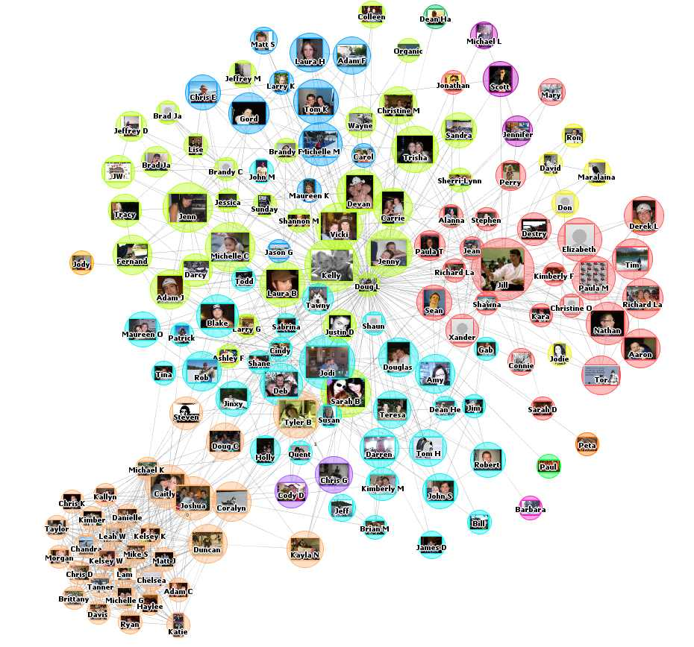

Looking at Real Facebook Data
Dataset: Facebook New Orleans
(Viswanath et al. 2009)
63,731 persons
1,545,686 friendship links with creation dates
Adjacency matrix A_{t} at time t (t = 1 . . . 75)
Compute all eigenvalue decompositions A_{t} = U_{t}Λ_{t}U_{t}^{T}
Notes:
* real data
* if the spectral evolution hypothesis is correct, only Λ should change oder time, not U

Slide 18
Evolution of Eigenvalues
Constant eigenvalue
(Λt)ii
Growing eigenvalue
Notes:
* explain graph
----
* observations

Slide 19
Eigenvector Evolution
Cosine similarity between (Ut)•i and (Ut+x)•i
Constant
Sudden change

Slide 20
Eigenvector Permutation
Time split: old edges A = UΛU^{T}
new edges B = VDV^{T}
Eigenvectors permute
|U•i·V•j|

Slide 21
Outline
1. Algebraic Link Prediction
2. Spectral Transformations
3. Learning Link Prediction
    Learning by Extrapolation
    Learning by Curve Fitting
What spectral transformation is best?

Slide 22
a) Learning by Extrapolation
CIKM 2010
Extrapolate the growth of the spectrum
Good when growth
is irregular
Potential problem:
overfitting

Slide 23
b) Learning by Curve Fitting
f
A
B
UΛU^{T}
B
Λ
U^{T}BU
f
Diagonal

Slide 24
Curve Fitting
(U^{T}BU)_{ii}
Λ_{ii}

Slide 25
Polynomial Curve Fitting
Fit a polynomial a + bx + cx² + dx³ + ex⁴

Slide 26
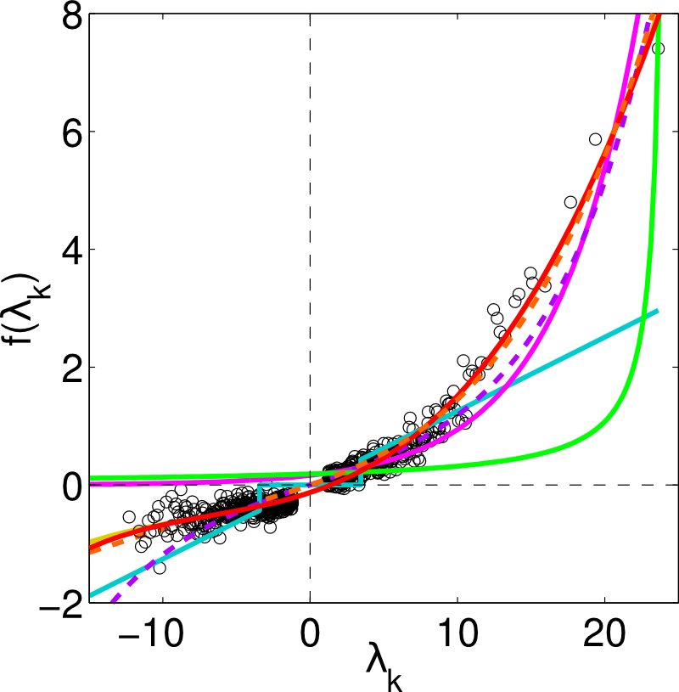
Other Curves
ICML 2009
Friend of a Friend
a + bx + cx²
Polynomial
a + bx + cx² + dx³ + ex⁴
Nonnegative polynomial
a + . . . + hx⁷ a, . . ., h ≥ 0
Matrix exponential
b exp(ax)
Neumann kernel
b / (1 − ax)
Rank reduction
ax if |x| ≥ x₀, 0 otherwise

Slide 27
Evaluation Methodology
All edges E
Training set Ea ∪ Eb
Apply
Test set E_{c}
˙
Source set E_{a}
Learn
Target set E_{b}
Edge creation time
3-way split of edge set by edge creation time

Slide 28
Experiments
Precision of link prediction (1 = perfect)
All datasets available at konect.uni-koblenz.de

Slide 29
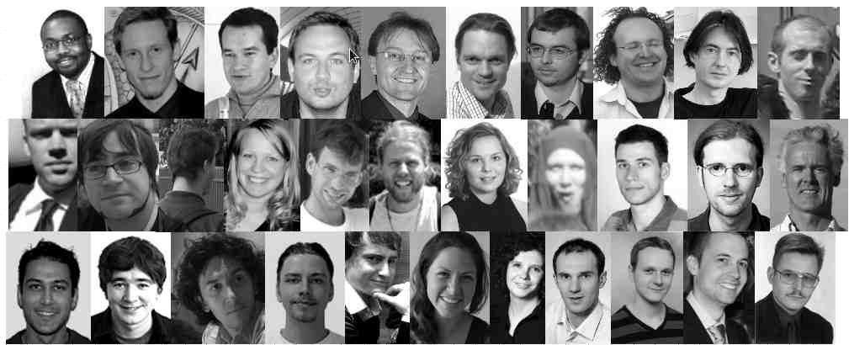
Conclusion
Observation
  Eigenvalue change, eigenvectors are constant
Why?
  Graph kernels, triangle closing, the sum-over-paths model, rank reduction, etc.
Application to recommender systems
  By learning the spectral transformation for a given dataset
ACKNOWLEDGMENTS →
Thank You!

Slide 30
Selected Publications
The Slashdot Zoo: Mining a social network with negative edges
J. Kunegis, A. Lommatzsch and C. Bauckhage
In Proc. World Wide Web Conf., pp. 741–750, 2009.
Learning spectral graph transformations for link prediction
J. Kunegis and A. Lommatzsch
In Proc. Int. Conf. on Machine Learning, pp. 561–568, 2009.
Spectral analysis of signed graphs for clustering, prediction and visualization
J. Kunegis, S. Schmidt, A. Lommatzsch and J. Lerner
In Proc. SIAM Int. Conf. on Data Mining, pp. 559–570, 2010.
Network growth and the spectral evolution model
J. Kunegis, D. Fay and C. Bauckhage
In Proc. Conf. on Information and Knowledge Management, pp. 739–748, 2010.

Slide 31
References
B. Viswanath, A. Mislove, M. Cha, K. P. Gummadi, On the evolution of user interaction in Facebook. In Proc. Workshop on Online Social Networks, pp. 37–42, 2009.

Slide 32



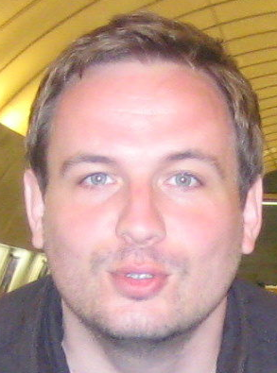


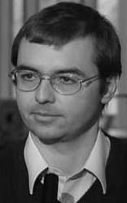
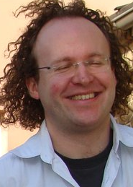




















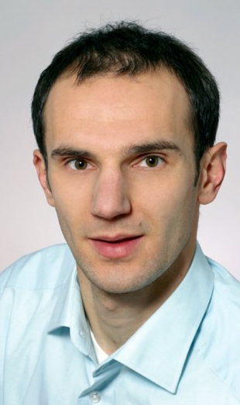



Acknowledgements

Slide 33
Backup: Other Findings
Evaluation on 114 network datasets [KONECT]
Control tests: Spectral evolution is not observed in random graph growth models
Spectral transformations of the Laplacian and normalized adjacency matrix
The Laplacian matrix with negative edges (algebraic conflict, signed graph drawing, signed spectral clustering, signed resistance distance)

Slide 34
Backup: Eigenvalue Decomposition: Example
3
0.48
1
2
4
5
6
0.23
0.55
0.56
0.30
0.13
A
=
U
Λ
U
1
T
Eigenvector
Eigenvalue
U contains eigenvectors, Λ contains eigenvalues

Slide 35
Backup: Why the Matrix Exponential
A^{n}
= Number of paths of length n
aA² + bA³ + cA⁴ + . . .
= Number of paths, weighted by path length
→ New edges more likely to appear when there are many paths already
→ When a > b > c > . . . > 0, short paths are weighted more

Slide 36
Backup: Power Series
p(A) = aA² + bA³ + cA⁴ + . . .
= aUΛ²U^{T} + bUΛ³U^{T} + cUΛ⁴U^{T} + . . .
= U(aΛ² + bΛ³ + cΛ⁴ + . . .)U^{T}
= Up(Λ)U^{T}
Power series are spectral transformations!

Slide 37
Backup: Scalability
Is this scalable?
Yes, because we can reduce the learning problem to a one dimensional curve fitting problem.

