Slide 1
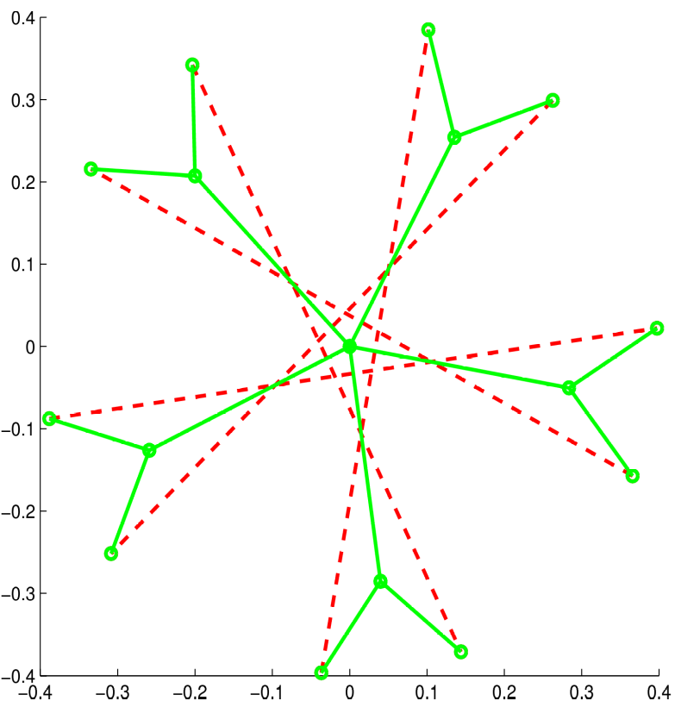
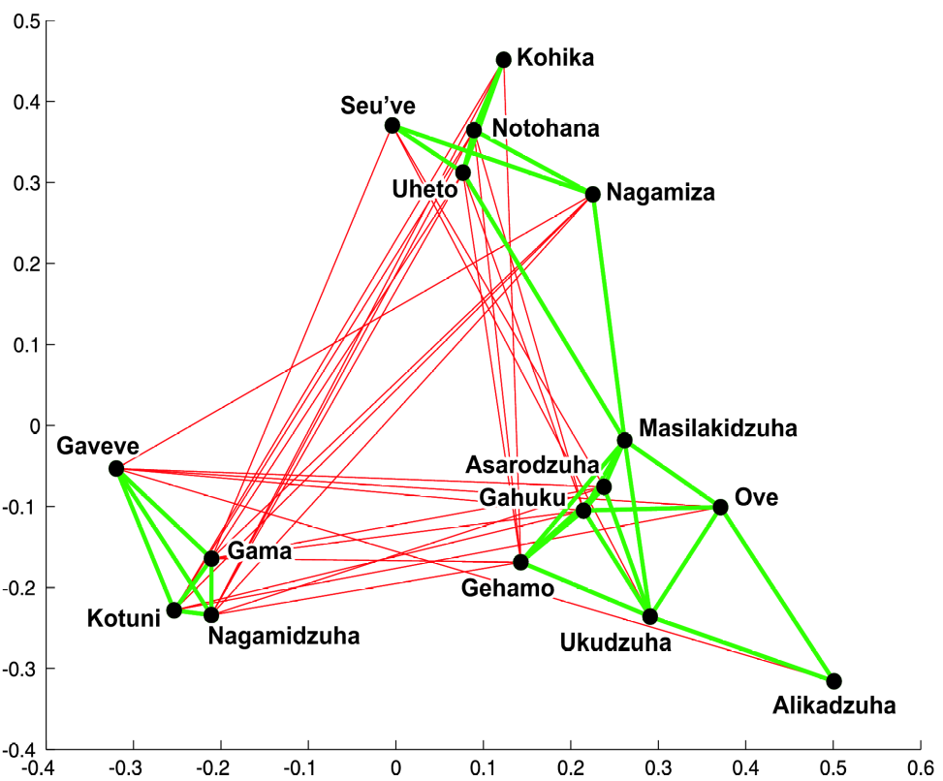
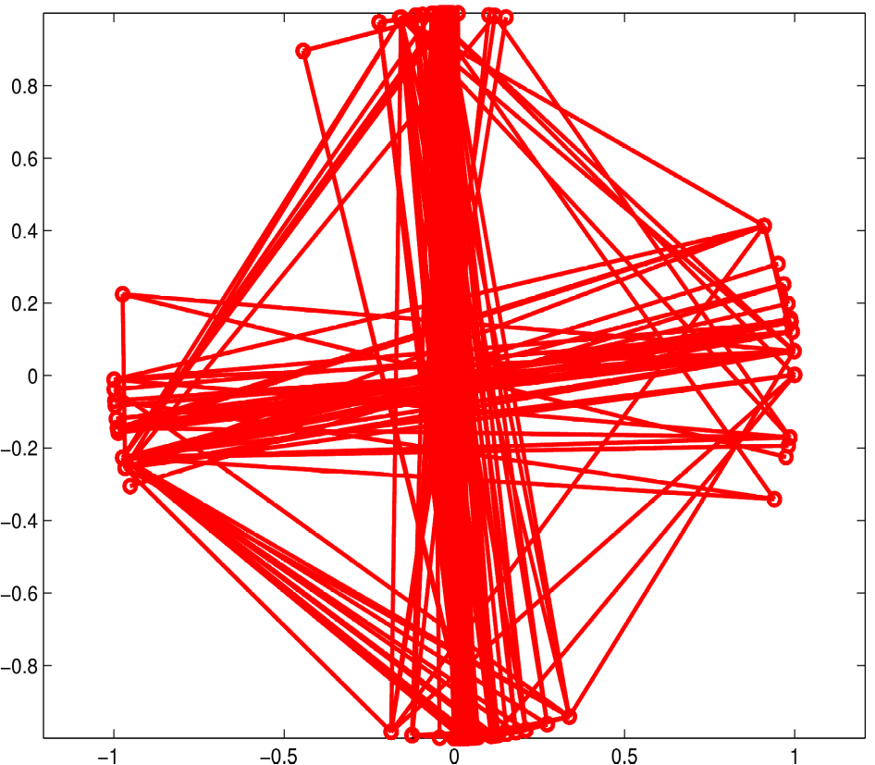
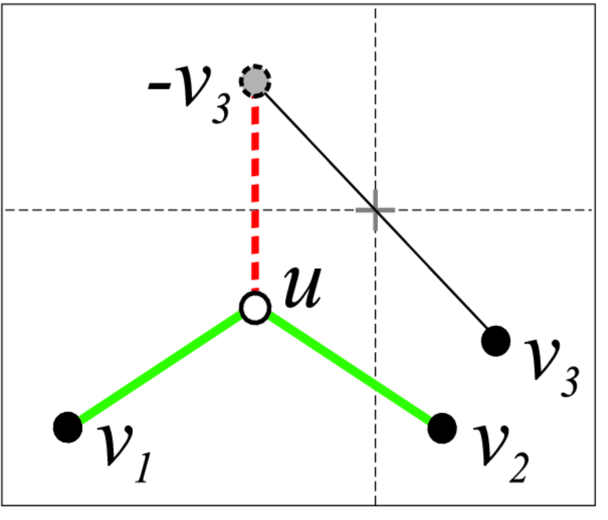
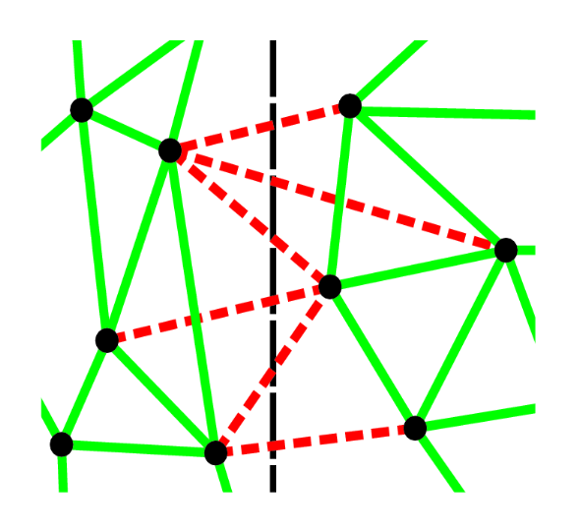
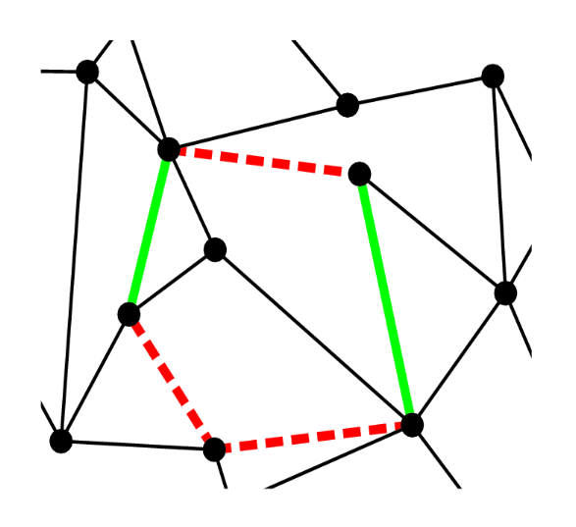
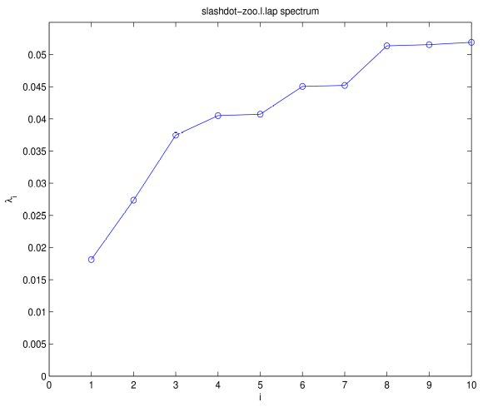
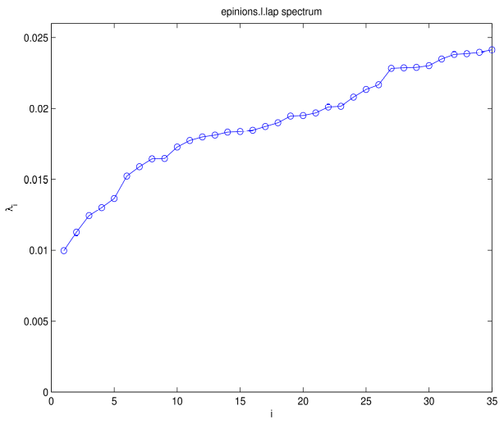
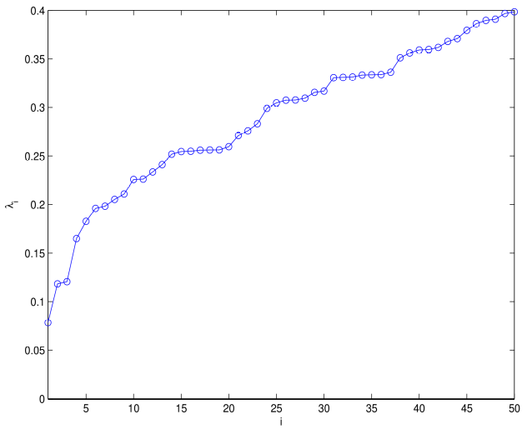
On the Spectral Evolution of Large Networks
Jérôme Kunegis
DAI Lab, Technische Universität Berlin, Germany jerome.kunegis@dai-labor.de
Summary
Networks are universal (… 2010) and have various types: signed (WWW 2009, SDM 2010), bipartite (IPMU 2010)
Graph kernels are spectral transformations (ICML 2009)
Spectral transformations can be predicted (ICML 2009)
Network evolution is spectral (… 2010)
Examples – Signed Graphs
Synthetic example
Tribal groups of the Eastern Central Highlands of New Guinea
Friends (‘Rova’) and
Foes (‘Hina’)
Wikipedia reverts
on controversial article
‘Criticism of Prem Rawat’
Signed Graph Drawing
Place node near positive neighbors
Place node far from negative neighbors
u = (1/3) (v1 + v2 − v3)
Leads to lower eigenvectors of
signed Laplacian L = D − A
The Signed Graph Laplacian
A = {0, +1, −1}^{n×n} Adjacency matrix
D_{ii} = Σ_{j} |A_{ij}| Degree matrix
L = D − A Signed Laplacian
Is positive semidefinite: x^{T}Lx = Σ_{ij} (x_{i} − sgn(A_{ij}) xj)² ≥ 0
Is positive definite when the network is unbalanced
Smallest eigenvalue denotes conflict: it is zero when the network is balanced and larger when there is conflict
Balance and Conflict
A network is balanced when:
There is a 2-clustering consistent with edge signs
All cycles have an odd number of negative edges
Signed Spectral Clustering
Communities in signed graphs:
Positive edges inside communities
Negative edges between communities
Minimize the signed ratio cut:
min (2 pos(X,Y) − neg(X,X) − neg(Y,Y)) (|X|⁻¹ + |Y|⁻¹)
pos(X,Y) counts the positive edges between X and Y
neg(X,Y) counts the negative edges between X and Y
Relaxation gives the lower eigenvalues of L
Balance Conflict
Signed Spectrum of Large Networks
Slashdot Zoo Epinions MovieLens

