Slide 1
DSCI 510 Principles of programming for data science
Itay Hen
Supervising Computer Scientist/Principal Scientist, Information Sciences Institute, University of Southern California

Slide 2
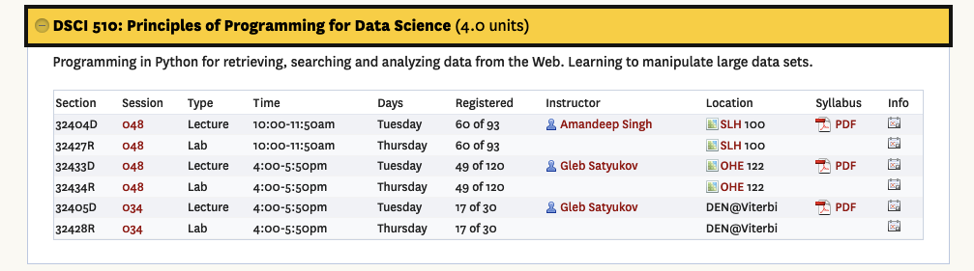
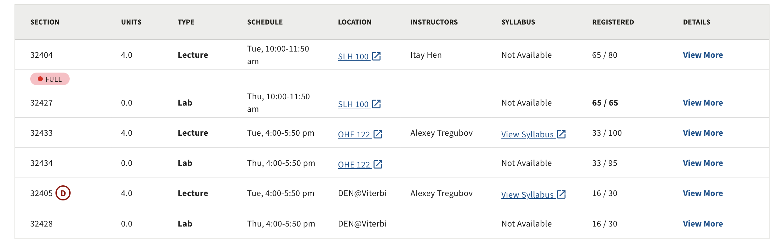
Class Sections

Slide 3
Syllabus
Course Objective
Office Hours
Textbook
USC Libraries
Class Structure and Schedule
Grading Scheme
Academic Conduct

Slide 4
Section Details (1)
Lecture
Who: Itay Hen
hen@usc.edu Please put DSCI 510 in the subject line!
Office Hours:
Tuesday – 1:00 pm – 2:00 pm, TBD
Otherwise, send me an email with DSCI 510 in the subject line
When: Tuesday, 10:00 am – 11:50 am, with a break at some point.
Where: SLH 100
Lab
Who: Emily Jia
eyjia@usc.edu Please put DSCI 510 in the subject line
When: Thursday 10:00 am – 11:50 am
Graders:
TBD

Slide 5
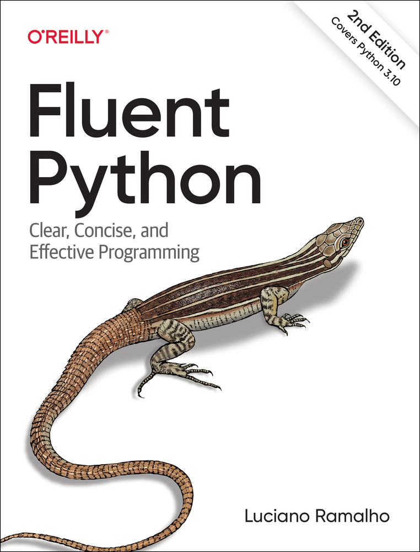
Section Details (2)
Platform: BrightSpace
https://brightspace.usc.edu/d2l/home/219847
Class Textbook:
Python for Everybody, Exploring Data Using Python 3 by C. R. Severance
https://www.py4e.com/book
Free to download as PDF
Other resources are available on the site: slides, videos, etc.
You may also consult: Fluent Python (2nd Edition)
Available on USC Libraries
The Internet is out there: Use it! Check out:
https://stackoverflow.com/: question/answer forum
https://www.python.org/: official site, documentation
https://www.google.com/: A good place to start

Slide 6
Section Details (3)
Software
Brightspace
BrightSpace/Github Classroom (for assignment submission)
Zoom
Python
Jupyter Lab
Code Editors:
Up to you.
I am used to IDLE (stands for Integrated Development and Learning Environment)

Slide 7
Lectures hybrid format (?)
I will most likely be delivering the lectures in a hybrid mode, with both in-person and Zoom participation. However:
Precedence will be given to in-person attendees.
You must attend lab! In many ways, more important than lecture.
Practice! Practice! Practice!

Slide 8
Acknowledgements
Many of the slides we use were created by Dr. Chuck Severance, the author of our book.
You’ll typically recognize them by their black backgrounds .
They are Copyright 2010–2017 Charles R. Severance and are made available under a Creative Commons Attribution 4.0 License.
Most of the slides we use were created by a former instructor of DSCI-510, Amandeep Singh, and updated by me.

Slide 9
About Me
Academic background:
Computational Physicist (PhD in Physics, 2009)
At USC since 2013
Research and Programming Interests:
Physical simulation of quantum many-body systems
Algorithm development; mostly scientific algorithms (C++ mostly, Mathematica, some Python)
Quantum Monte Carlo, Discrete optimization
Quantum Computing

Slide 10
About You
Who is here?
How many not in Data Science?
Who has any Programming Experience?
Expert/Novice
In what Programming Language(s)?
Java/R/Go/Python/Rust/C
What do you expect from class?

Slide 11
Grading*
Lab Assignments: 30%
Mid-Term: 30%
Final Project: 40%
No Final Exam!
Project Guidelines: obtain, analyze and visualize data from multiple (web) sources
*subject to change

Slide 12
The Class
I will try to stick to the published syllabus, but may deviate from it somewhat, based on class progress and interests
I expect people to read the relevant book chapters and come prepared, also with questions
Please raise your hand anytime if you have a question! Questions are not a disruption!
If you feel that you’re falling behind, speak up, come to my or the TA’s office hours.
Feel free to use AI only for learning, not assignments
No cheating, please

Slide 13
What is Cheating
Good Practice
Cheating
Searching the web for ideas
Check out StackOverflow!
Using “packages” that perform useful analysis (as long as you acknowledge)
Discussing homework problems and solutions with the instructor or the TA
Discussing final project ideas with anyone in general terms
Asking for, or receiving specific solutions from classmates or friends
Copying code you found elsewhere, whether on the web, or from other students or friends, and presenting it as your own
Looking at someone else’s exam or homework
Submitting assignment solutions from ChatGPT or other AI software

Slide 14
What We'll Do in Class
I’ll go over the basic material that the book covers
I’ll answer questions
I’ll illustrate material with snippets of code, so
Have your laptops, so you can try things out!
You’ll get to install Python and setup your programming environment in Lab 1

Slide 15
Getting Started with Python
README: https://github.com/usc-isi-i2/DSCI-510-Fall-2024/blob/main/README.md
Recommended to complete before the lab session
Get a good, simple text editor, preferably one that “understands” Python for syntax highlighting
I use IDLE; it works well on macOS.
SublimeText4 works on all platforms (license needed for long-term use) https://www.sublimetext.com/
Visual Studio Code https://code.visualstudio.com/
PyCharm Edu https://www.jetbrains.com/edu-products/download/#section=pycharm-edu

Slide 16
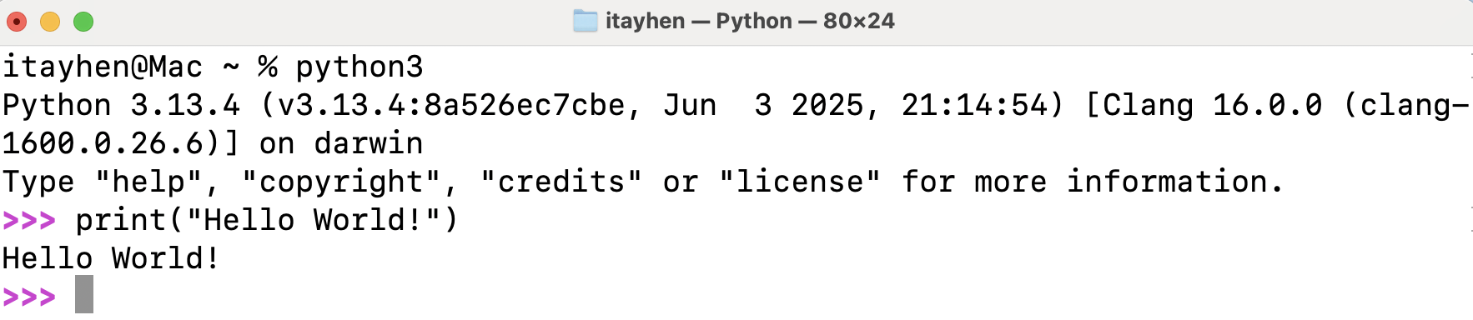
The "Terminal"
A reference to those old boxy things you see in old movies for communicating with the computer
Lets you query the basic "operating system" of the computer and send it commands to run programs
Who has never seen/used the Terminal?

Slide 17
A Crash Course in Unix https://learnpythonthehardway.org/book/appendixa.html
pwd — path, folders, directory
mkdir — make a directory
cd — change directory
ls — list directory
rmdir — remove a directory
cp — copy a file
mv — move/rename a file
less, more — view a file
cat — stream a file
rm — remove a file
exit — exit the terminal
If you are lost: cd ~ or simple cd

Slide 18
So, Let's get started
Questions Please!!

Slide 19
Python: variables, expressions, statements
Computers

Slide 20
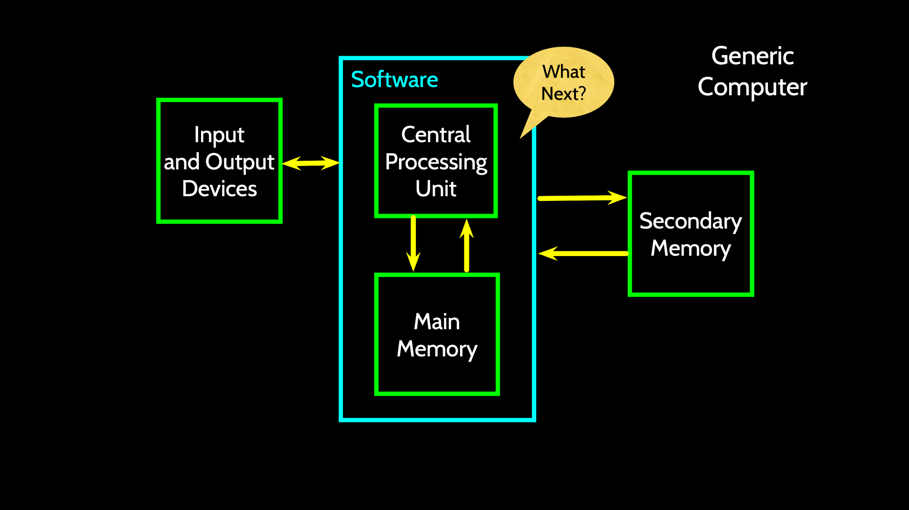
This, like many other slides are from Charles Severance's "Python for Everybody"

Slide 21
Definitions
Central Processing Unit: Runs the program – The CPU is always wondering "what to do next?" Not the brains exactly, as smart as the programmer.
Input Devices: Keyboard, Mouse, Touch Screen
Output Devices: Screen, Speakers, Printer, DVD Burner
Main Memory: Fast small temporary storage – lost on reboot – aka RAM
Secondary Memory: Slower large permanent storage – lasts until deleted – disk drive/memory stick

Slide 22
The Python Programming Language
Python was created by Guido van Rossum in the late 1980s, while at Google
Python 2.0 released in 2000 (end-of-life in 2020)
Python 3.0 in 2008, (latest Python 3.13.7, released Aug 14, 2025)
It’s how we provide instructions to the CPU
Python, like all computer languages, has a syntax
If you don’t obey it, you will get a syntax error
Don’t despair
You can always try things out in your terminal window until you’re sure you understand how Python works

Slide 23
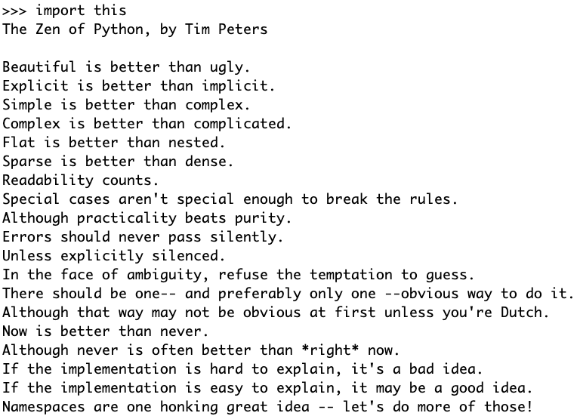
Zen Of Python - https://peps.python.org/pep-0020/

Slide 24
Programming in Python
Programming used to be much more tedious
Python is an interpreted language (as opposed to compiled)
You can type instructions, and they’re executed on the spot
Or you can load a file with a script, and it will then be run — that is, the commands will be executed in order
Everything complicated that you’ll need has probably already been written: Libraries
Pay attention to indentations — they matter!
Let’s try things

Slide 25
Go to terminal/python
Let's try things!

Slide 26
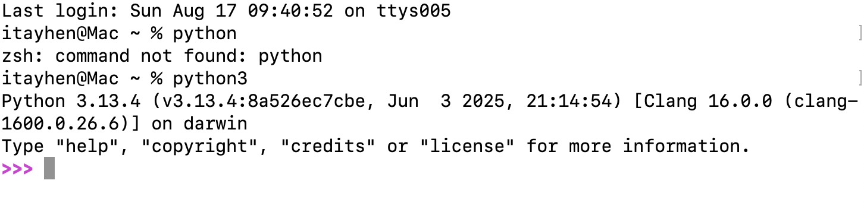
Python Terminal
What next?

Slide 27
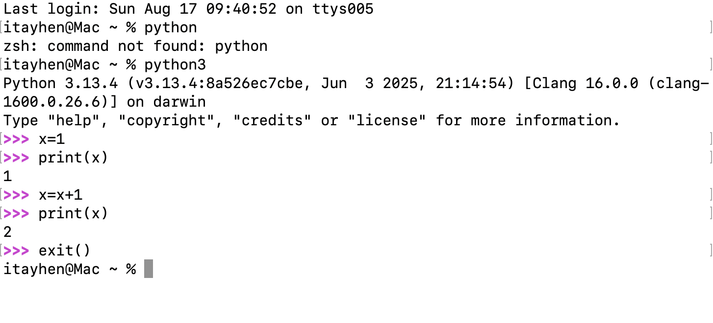
Python Terminal
This is a good test to make sure that you have Python correctly installed. Note that quit() also works to end the interactive session.

