Slide 1

SENTRA 360
Community safety, security management and emergency response for Soshanguve: every screen, explained
Prepared 10 November 2026 · screenshots from the demo company "Ubuntu Shield Security" (sample data)
Notes:
SENTRA 360 is one app for one private security company, with one sign-in page that opens the right area for homeowners, the office and security. The screenshots use sample data from a fictional demo company.

Slide 2


One sign-in, three areas
Everyone signs in at /login: the app recognises the account and opens the right area
Homeowner
Admin
Security company
/account · residents and clients
/admin · the company office
/security · control room and officers
Reports incidents with photos and GPS
Monthly plans: home, vehicle tracker, business alarm
Accepts quotations, pays by EFT, uploads proof
Big panic button with a complete profile
Turns community reporters into clients (Leads)
Checks proofs of payment, activates plans
Manages services, alerts and branding
Reports with Excel and PDF export
Live control room with map and alarm
WhatsApp call-backs, dispatches armed response
Officers update en route / on scene
Patrol check-ins and homeowner lookup
Notes:
Homeowners sign themselves up. Admin and Security company logins are created by the Admin under "Admin & security logins".

Slide 3

From community member to paying client
The commercial journey the brief asks for
1
2
3
4
5
6
7
Registers
Reports or requests
Picks a plan
Company confirms
Quotation
Accepts & pays
Plan active
Free homeowner account
Incident or service request
Home, vehicle or business
Installation booked if needed
Pre-priced from the price list
EFT + proof of payment
Armed response, priority
Every step is visible to the homeowner on a progress bar and timeline. The Admin moves the application along from the admin portal.
Notes:
Every step is visible to the homeowner on a progress bar and timeline. The Admin moves the application along from the admin portal.

Slide 4

From panic button to resolution
The emergency journey, with honest status at every step
1
2
3
4
5
6
Hold 3 seconds
Received
Seen
Call-back
Dispatched
Resolved
Prevents accidental alerts
Server confirms, with reference
Shown on the control room screen
Control room calls back on WhatsApp
Armed response for plan members
Outcome recorded
The client sees the time of each step. If it is not acknowledged within 2 minutes, the app tells them to phone the emergency line or 10111.
Notes:
The client sees the time of each step. If it is not acknowledged within 2 minutes, the app tells them to phone the emergency line or 10111.

Slide 5




Built to be honest and private
What makes it safe to rely on, and safe to show to clients
A report is not a dispatch
Nothing is faked
Statuses separate submitted, received, assigned and resolved, so nobody assumes help is coming when it is not.
SMS and email say plainly when they are not set up, and payments are only confirmed after the Admin checks the proof. Messages are never shown as "sent" when they were not.
Offline warnings
Privacy (POPIA)
The panic screen warns that alerts need internet. Offline, the app shows the emergency numbers instead.
Consent is recorded, contact details are masked in lists, every record view is logged, and homeowners can delete their account.

Slide 6
At a glance
Where the app stands today
45
34
22
R0
screens across the public site and three portals
automated tests passing, including every page
incident categories from the brief
monthly hosting today (Render + TiDB free plans)
Live at https://sentra360-t9tq.onrender.com
Not yet connected: SMS and email delivery, a custom domain. Payments are EFT with proof of payment (no card processing, by design). Mobile and email verification is switched off for now.

Slide 7

Public site
What anyone can see, before signing in: the branded company site, services, the three sign-in pages and sign-up. (6 screens)

Slide 8
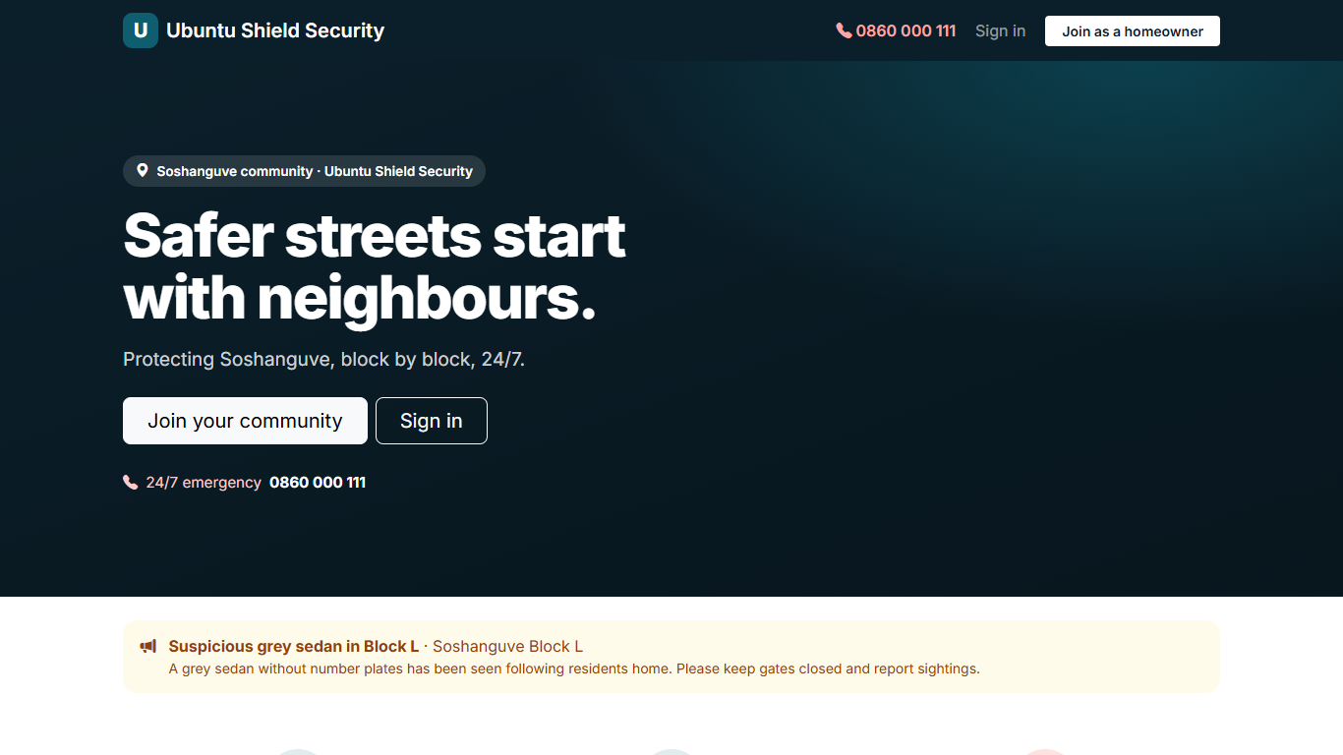
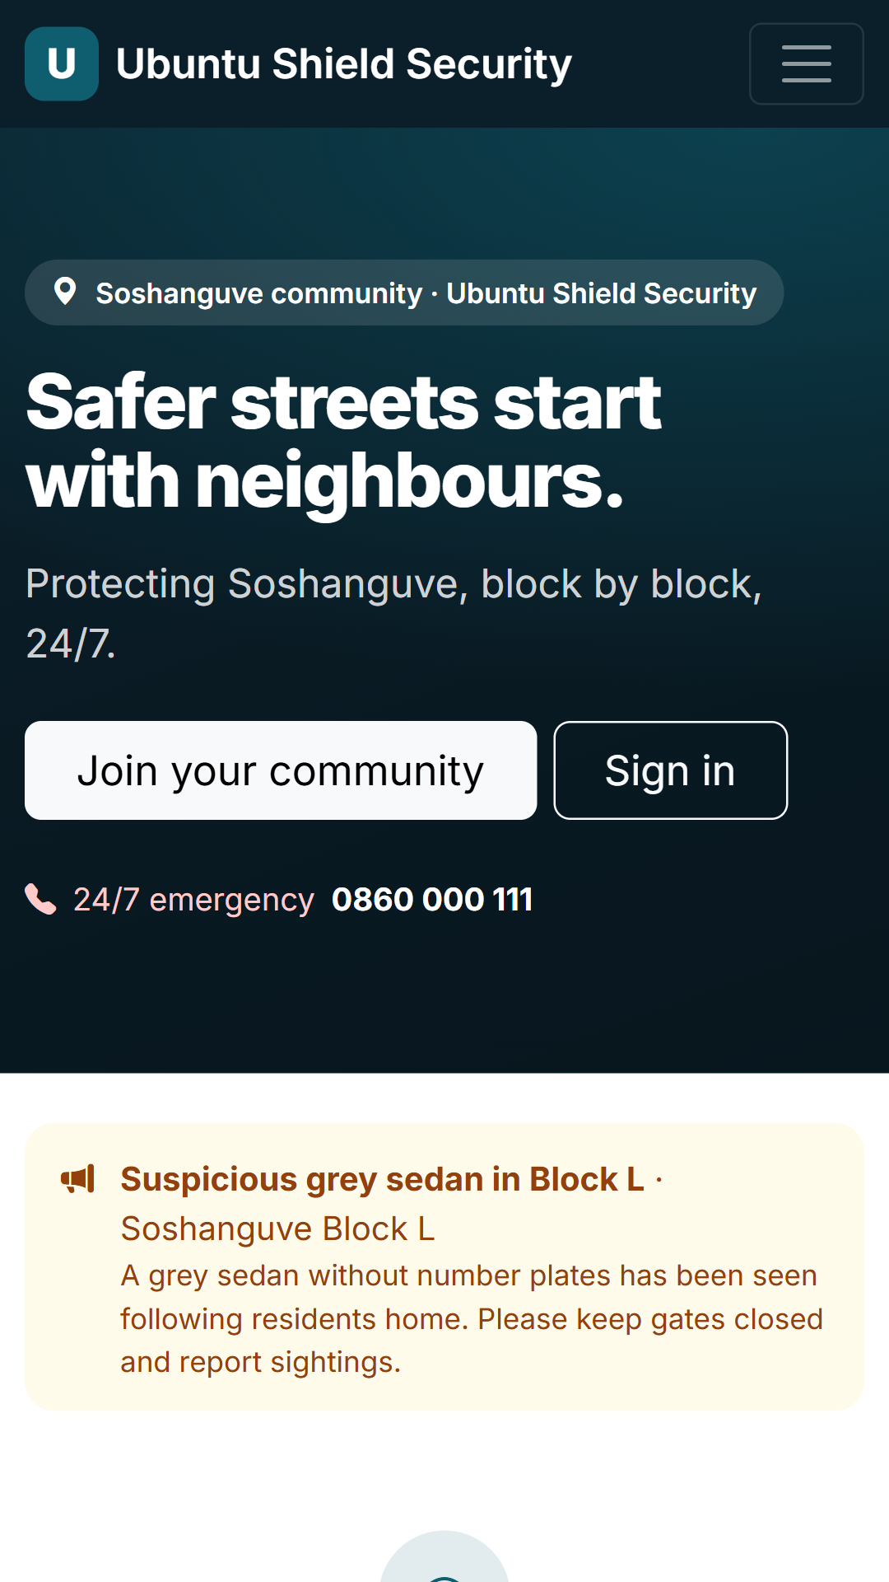
Community home page
PUBLIC SITE · /
A simple, community-first welcome for Soshanguve: "Safer streets start with neighbours", live safety alerts, the 24/7 emergency number and three steps to join.
Notes:
Community home page (/). A simple, community-first welcome for Soshanguve: "Safer streets start with neighbours", live safety alerts, the 24/7 emergency number and three steps to join.

Slide 9
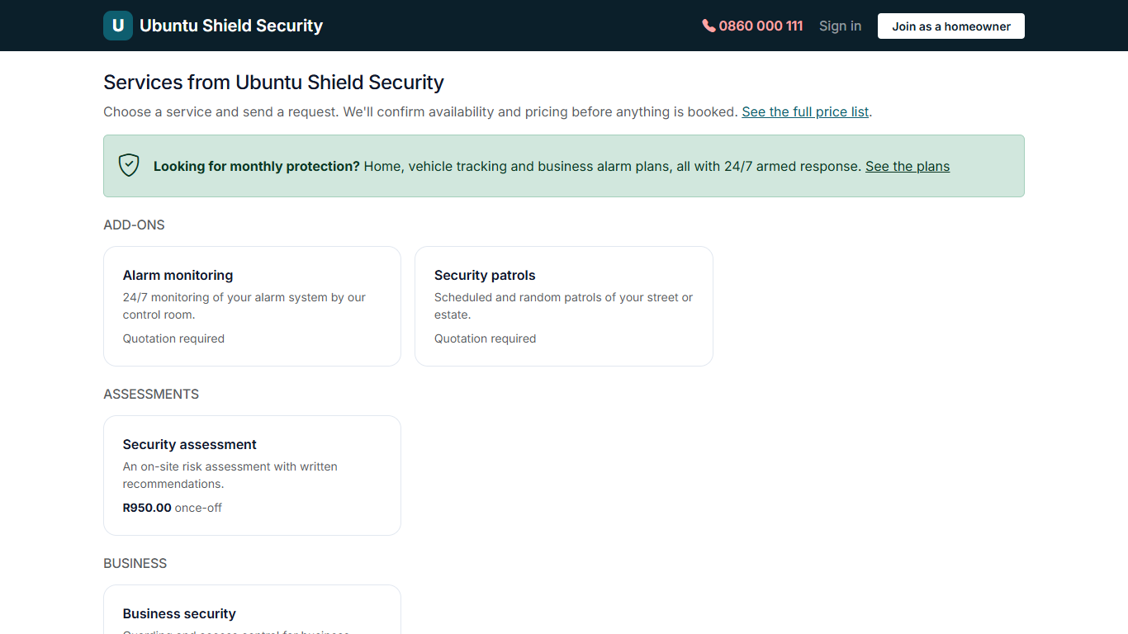
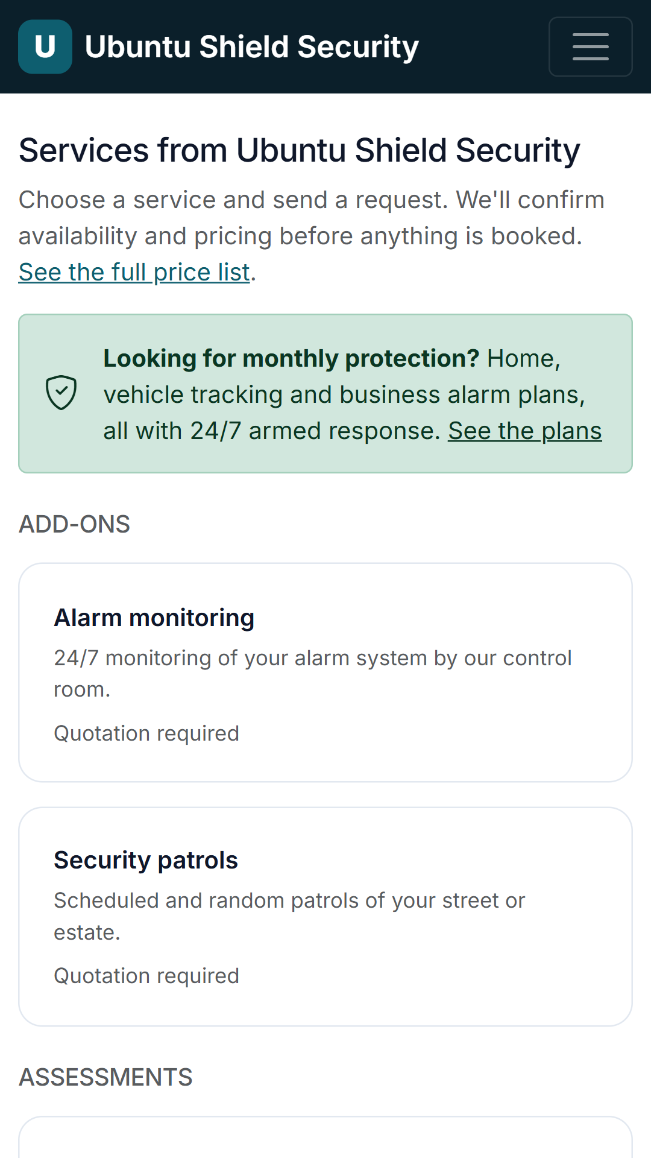
Services marketplace (public)
PUBLIC SITE · /services
Anyone can browse the security services on offer, with prices or "quotation required". Booking needs a free account.
Notes:
Services marketplace (public) (/services). Anyone can browse the security services on offer, with prices or "quotation required". Booking needs a free account.

Slide 10
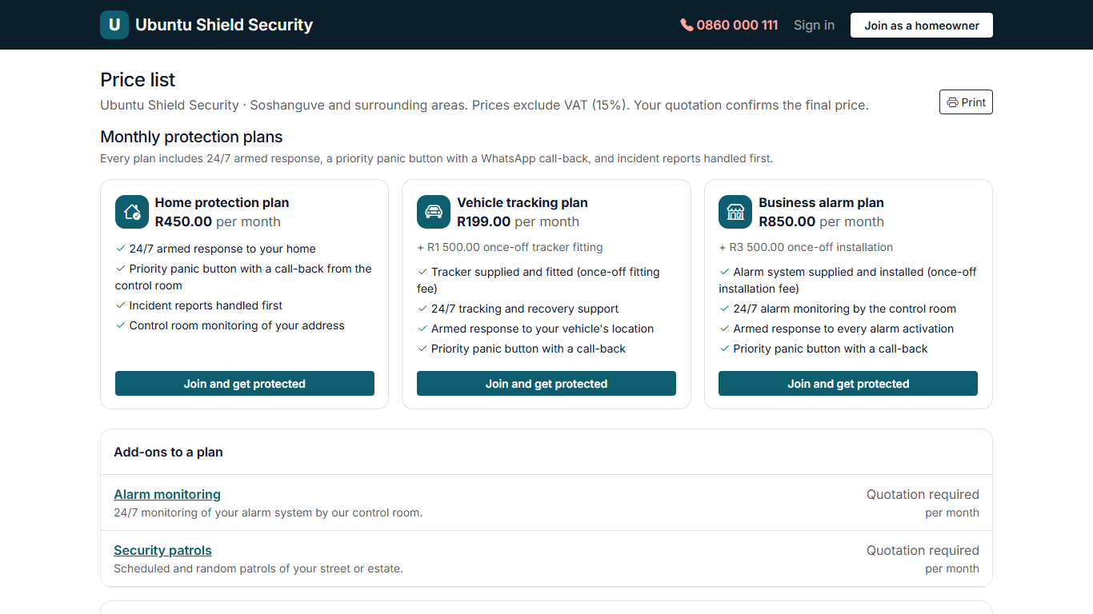
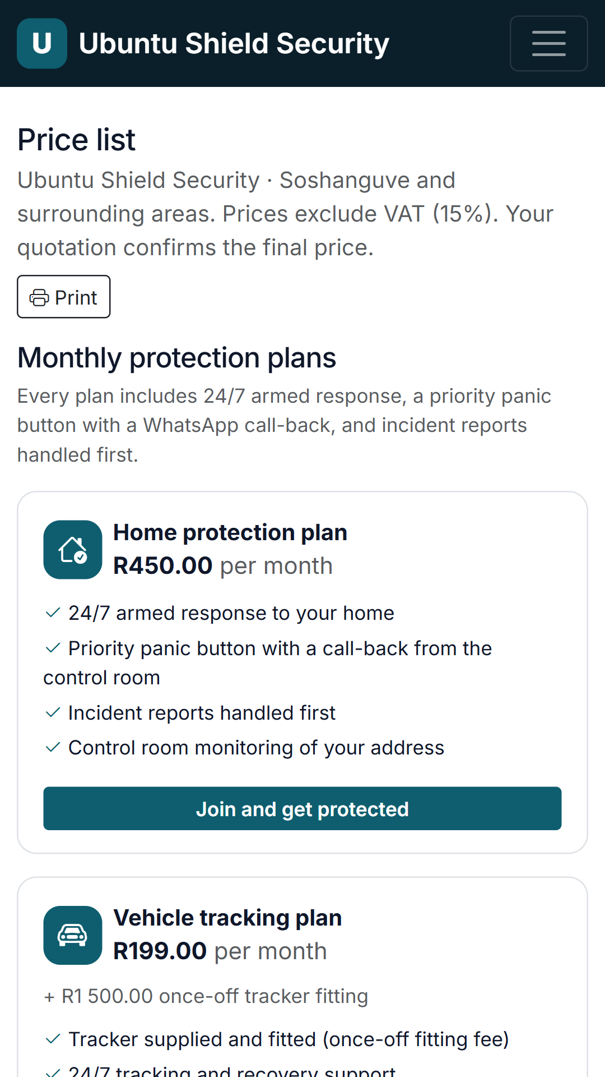
Price list
PUBLIC SITE · /pricelist
Every listed service with its price, home protection first. Printable, and also inside the app under Services.
Notes:
Price list (/pricelist). Every listed service with its price, home protection first. Printable, and also inside the app under Services.

Slide 11
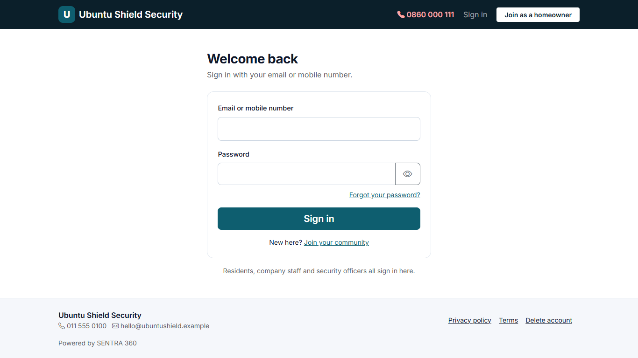
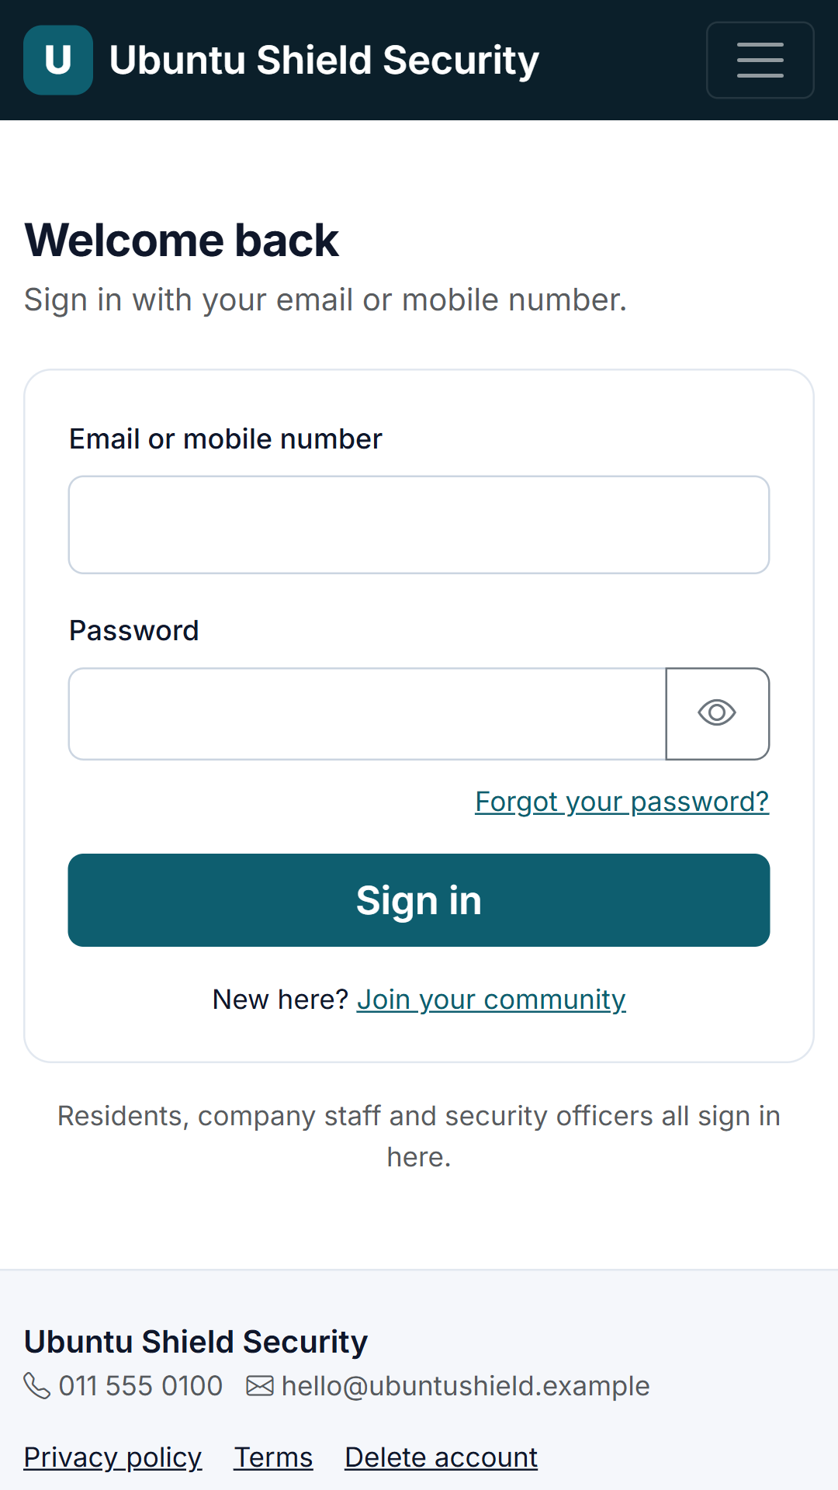
One sign-in for everyone
PUBLIC SITE · /login
Residents, the company office and security officers all sign in here. The app recognises the account and opens the right area automatically.
Notes:
One sign-in for everyone (/login). Residents, the company office and security officers all sign in here. The app recognises the account and opens the right area automatically.

Slide 12
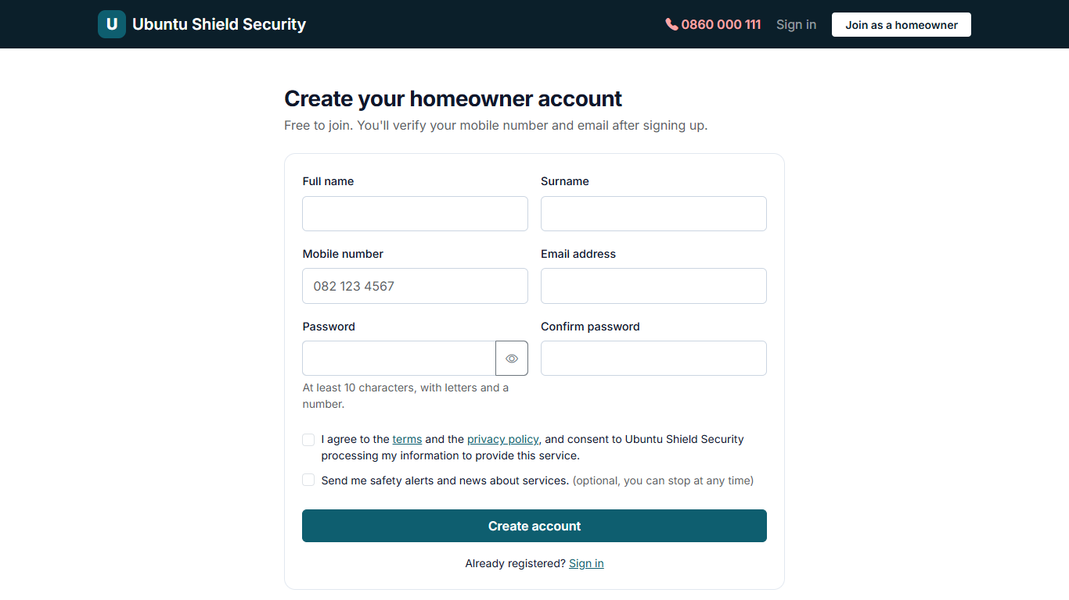
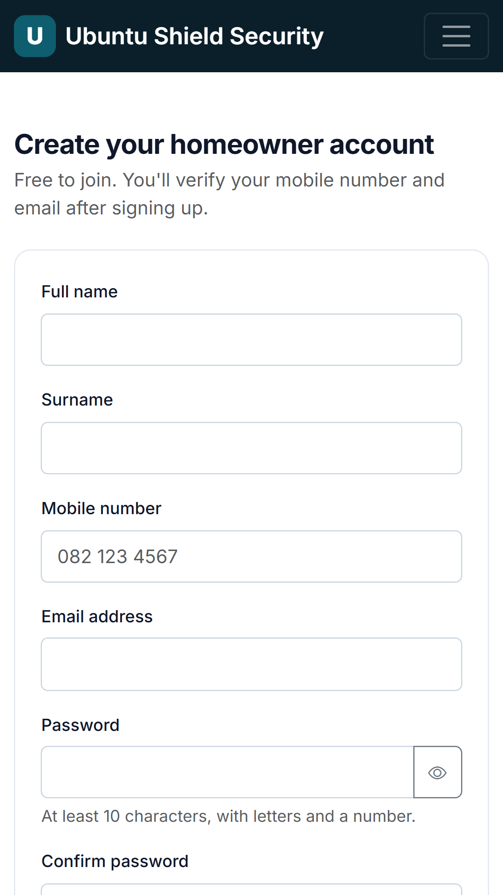
Create a homeowner account
PUBLIC SITE · /register
Residents join for free with name, mobile, email and password, and give POPIA consent. Accounts are active immediately (verification is switched off for now).
Notes:
Create a homeowner account (/register). Residents join for free with name, mobile, email and password, and give POPIA consent. Accounts are active immediately (verification is switched off for now).

Slide 13
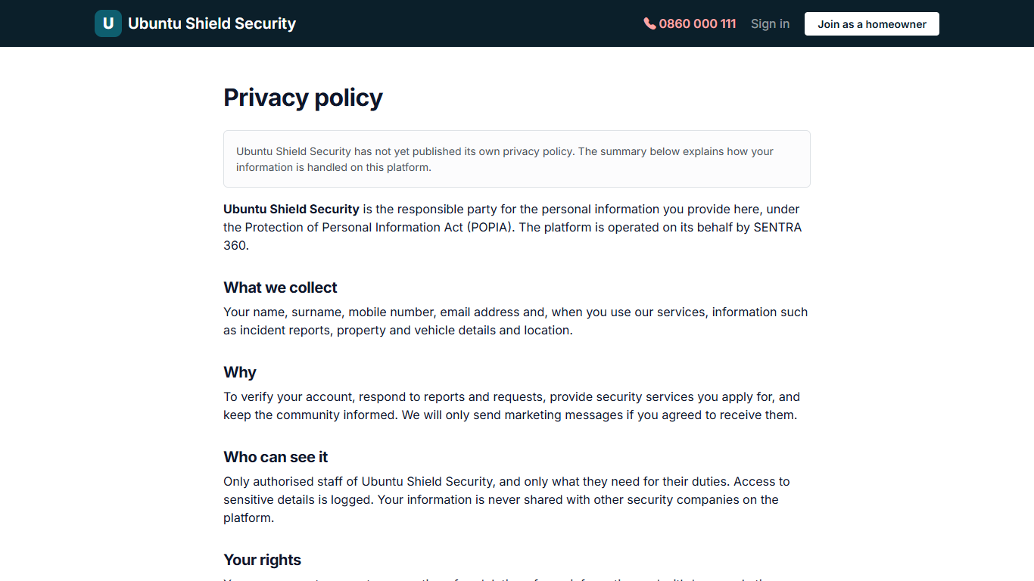
Privacy policy
PUBLIC SITE · /privacy
POPIA-aligned privacy notice in the company's name. The Admin can replace it with their own policy.
Notes:
Privacy policy (/privacy). POPIA-aligned privacy notice in the company's name. The Admin can replace it with their own policy.

Slide 14
Homeowner
Residents and clients: reports, the panic button, properties and vehicles, applications, quotations, bookings and their profile. (17 screens)

Slide 15
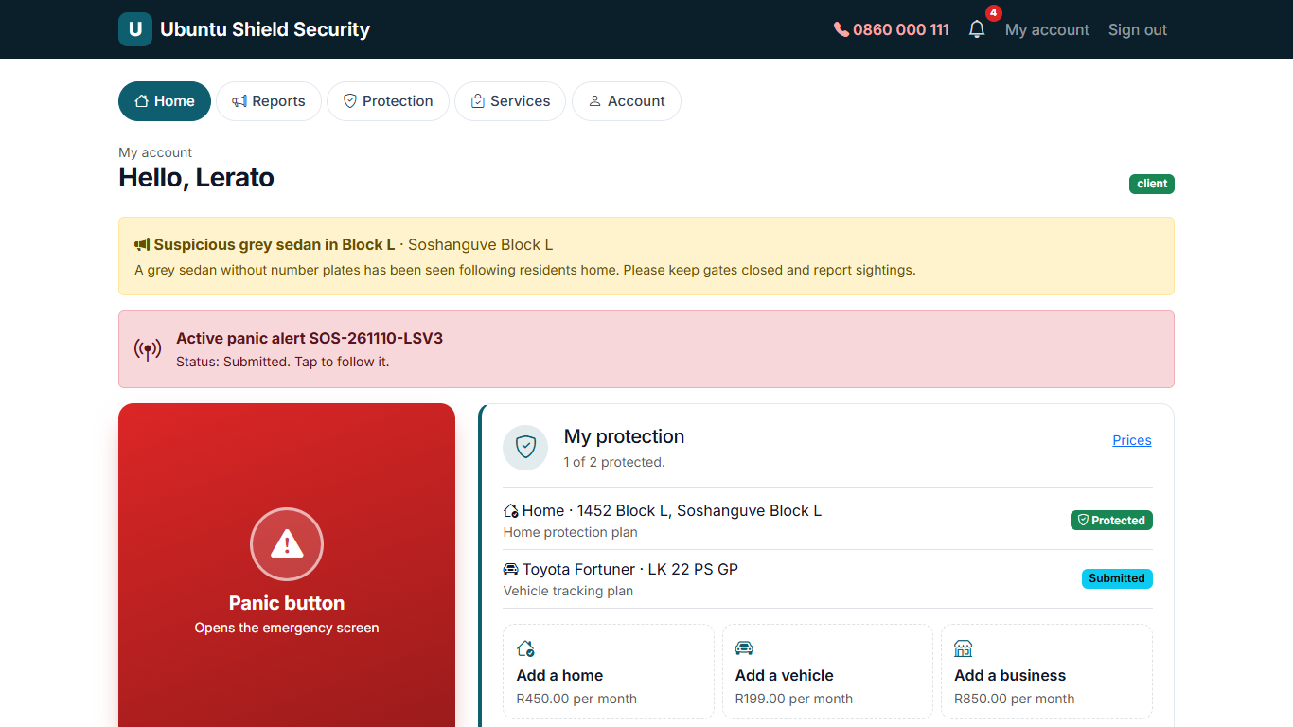
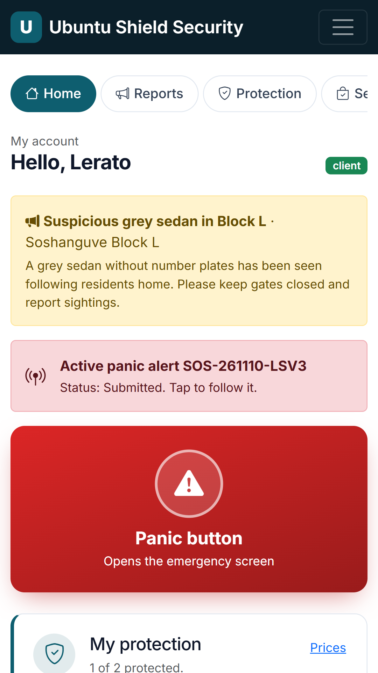
Homeowner dashboard
HOMEOWNER · /account
Panic button, My protection (each home, business and vehicle with its plan and status, plus one-tap Add a home / vehicle / business with monthly prices), safety alerts and quick actions including WhatsApp the control room.
Notes:
Homeowner dashboard (/account). Panic button, My protection (each home, business and vehicle with its plan and status, plus one-tap Add a home / vehicle / business with monthly prices), safety alerts and quick actions including WhatsApp the control room.

Slide 16
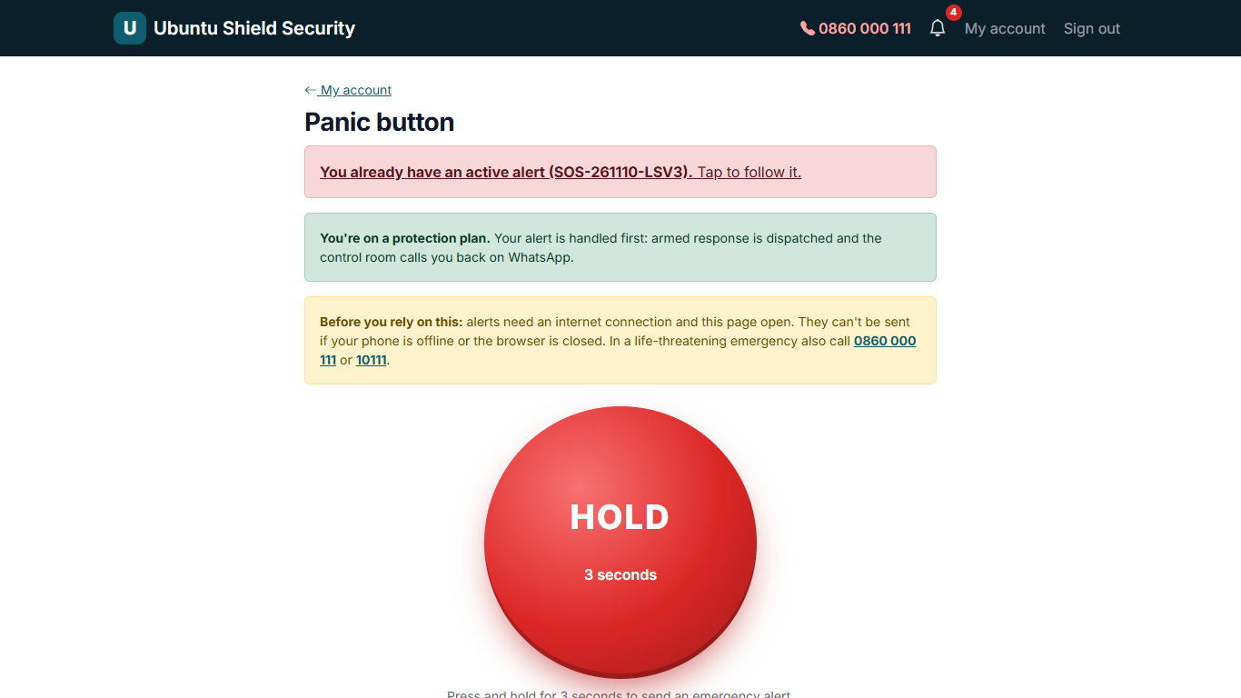
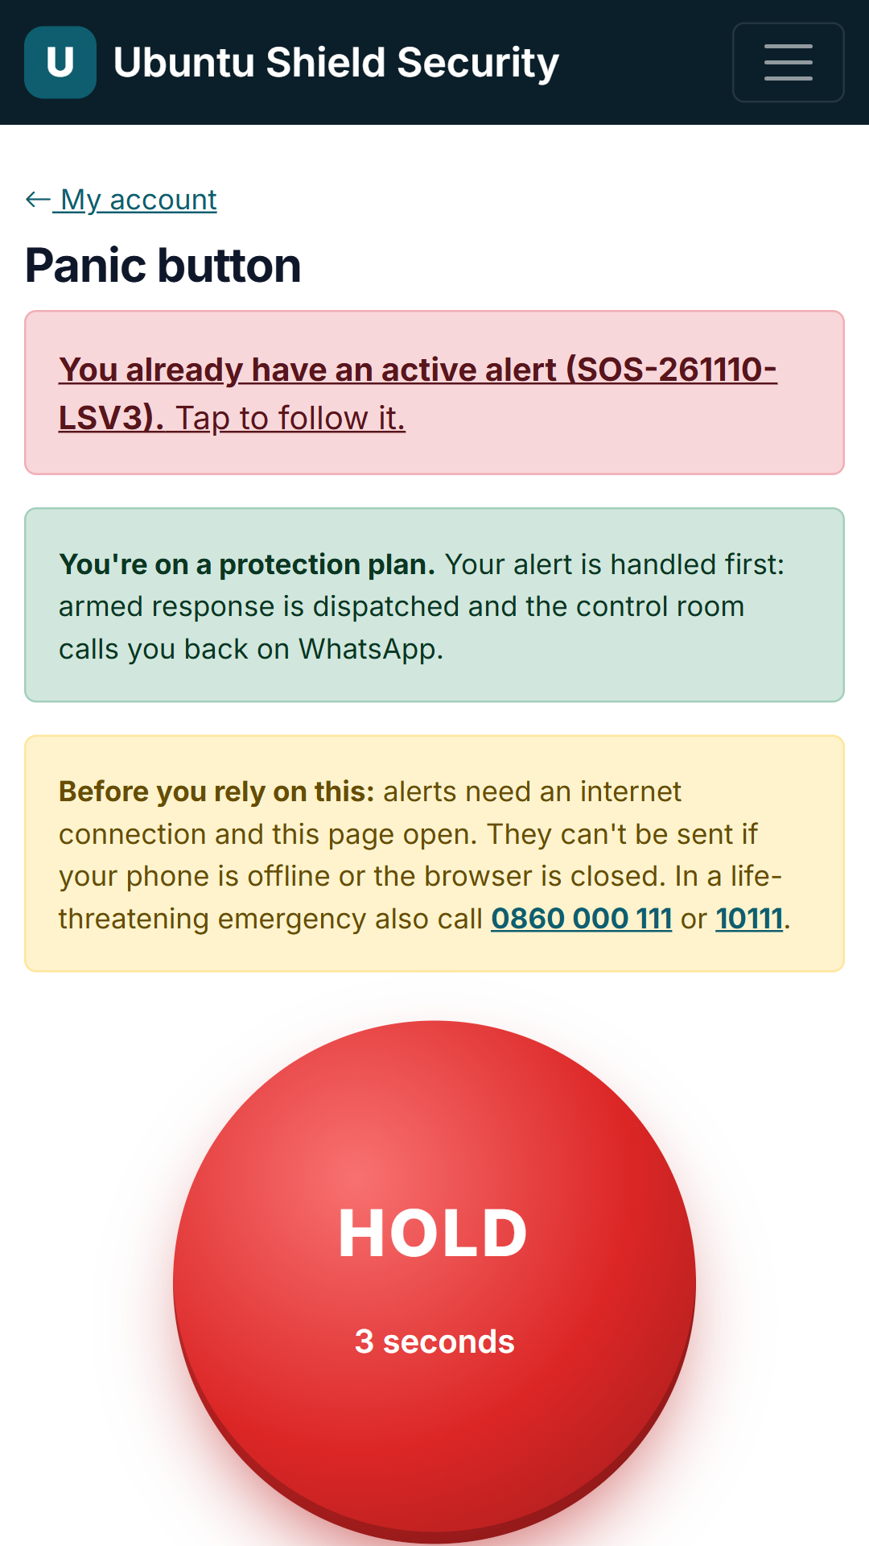
Panic button
HOMEOWNER · /account/panic
Anyone with a complete profile (home address + emergency contact) holds the big red button for 3 seconds. Plan members get armed response; everyone gets a WhatsApp call-back from the control room. GPS where allowed, optional silent alert.
Notes:
Panic button (/account/panic). Anyone with a complete profile (home address + emergency contact) holds the big red button for 3 seconds. Plan members get armed response; everyone gets a WhatsApp call-back from the control room. GPS where allowed, optional silent alert.

Slide 17
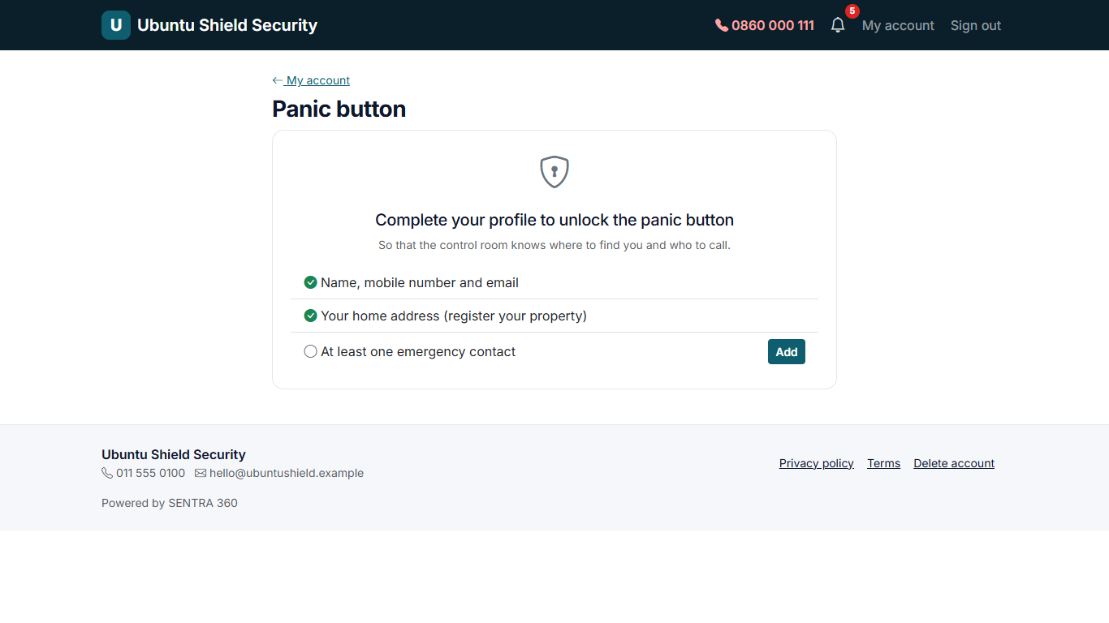
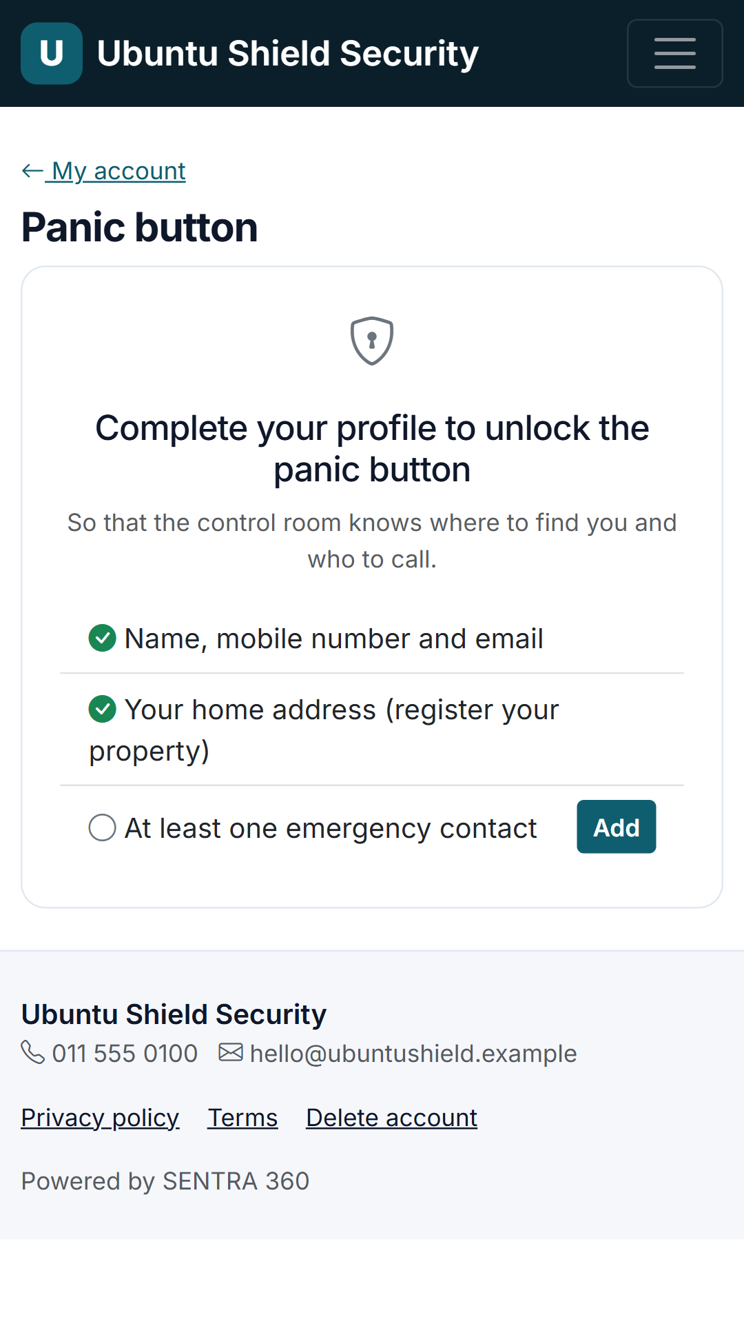
Panic button: finish your profile first
HOMEOWNER · /account/panic
Until a resident has a home address and an emergency contact on file, the panic page shows a short checklist instead of the button, so responders always know where to go and who to call.
Notes:
Panic button: finish your profile first (/account/panic). Until a resident has a home address and an emergency contact on file, the panic page shows a short checklist instead of the button, so responders always know where to go and who to call.

Slide 18
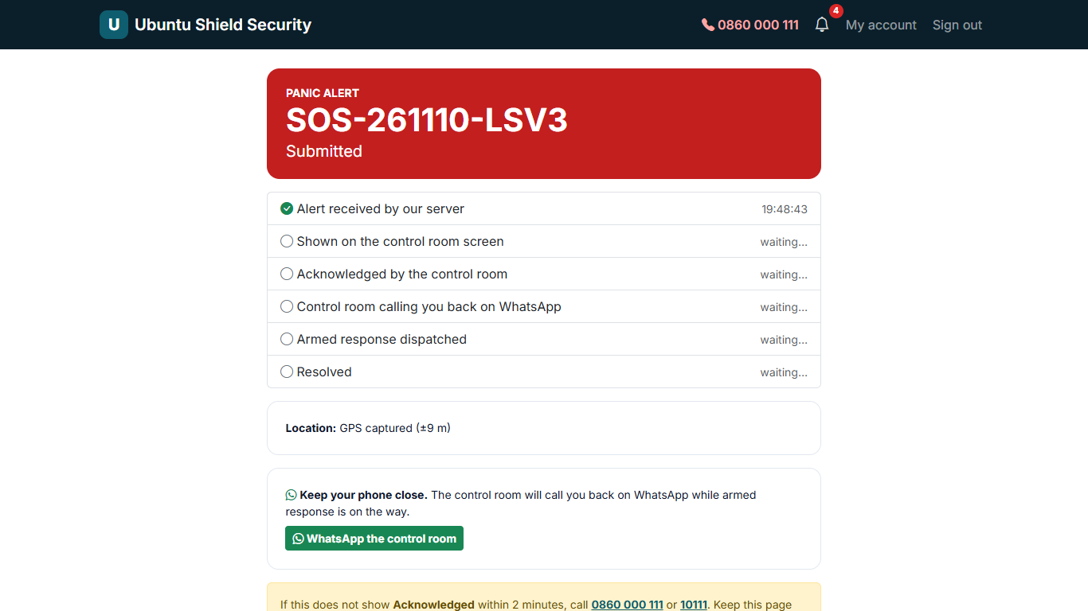
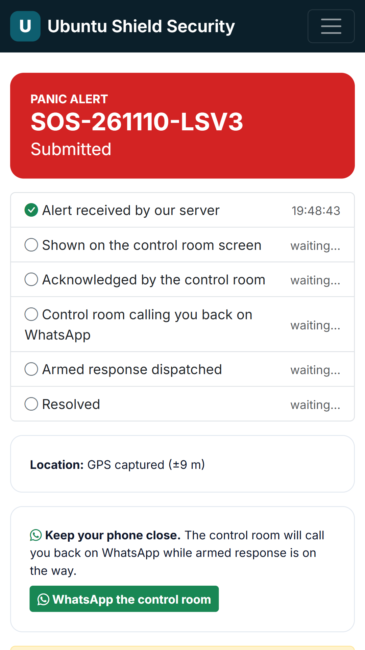
Panic alert status
HOMEOWNER · /account/panic/SOS-261110-LSV3
After sending, the client sees each step with times: received by server, shown in the control room, acknowledged, officer dispatched, resolved. Location keeps updating.
Notes:
Panic alert status (/account/panic/SOS-261110-LSV3). After sending, the client sees each step with times: received by server, shown in the control room, acknowledged, officer dispatched, resolved. Location keeps updating.

Slide 19
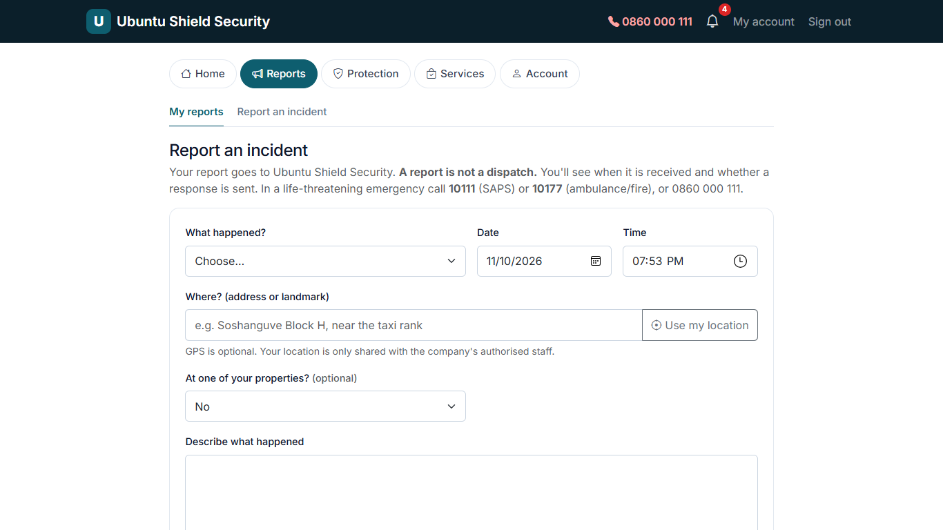
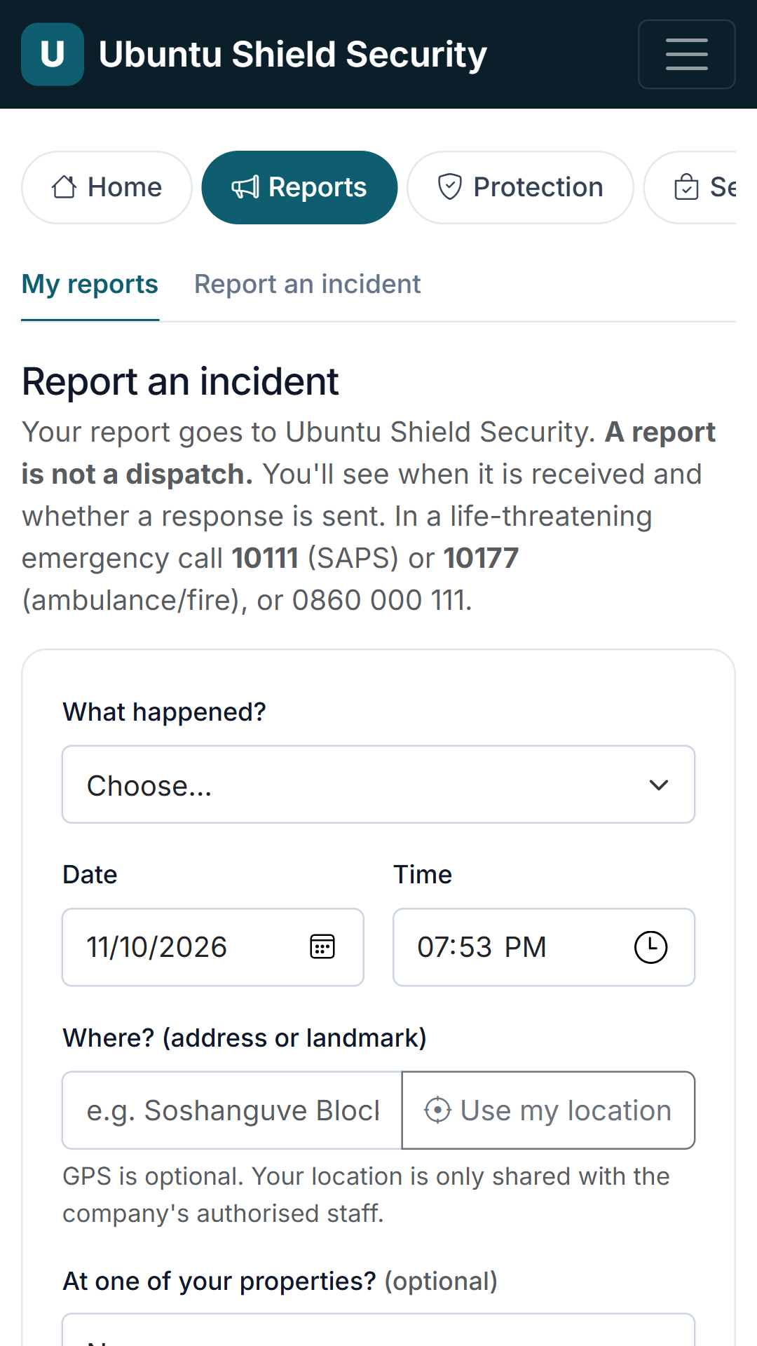
Report an incident
HOMEOWNER · /account/incidents/new
22 crime and emergency categories, date and time, place with optional GPS, description, witnesses, injuries, and up to 5 photos, documents or videos.
Notes:
Report an incident (/account/incidents/new). 22 crime and emergency categories, date and time, place with optional GPS, description, witnesses, injuries, and up to 5 photos, documents or videos.

Slide 20
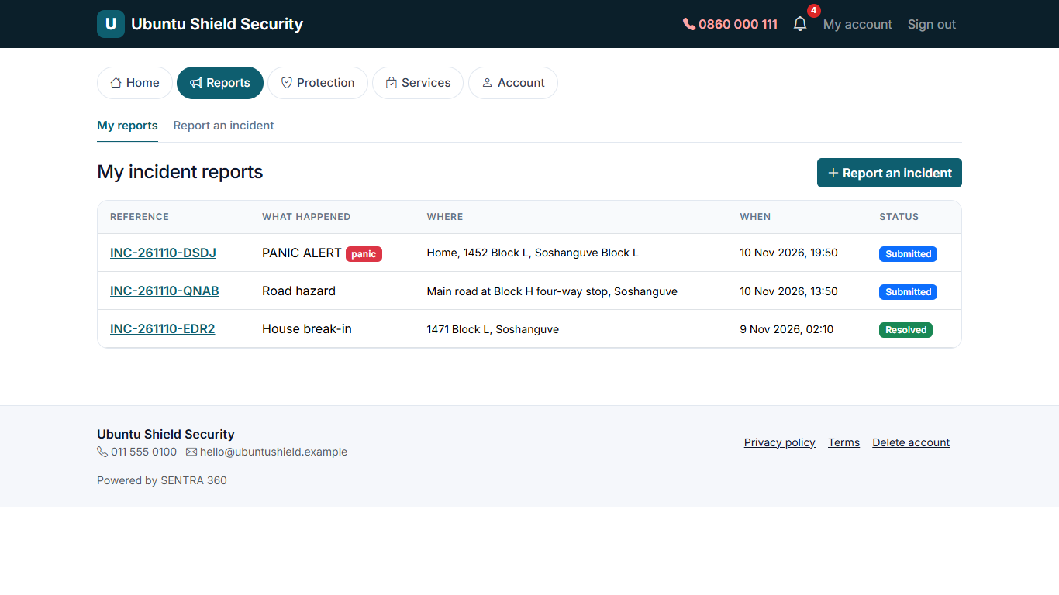
My incident reports
HOMEOWNER · /account/incidents
Every report with its reference number and current status.
Notes:
My incident reports (/account/incidents). Every report with its reference number and current status.

Slide 21
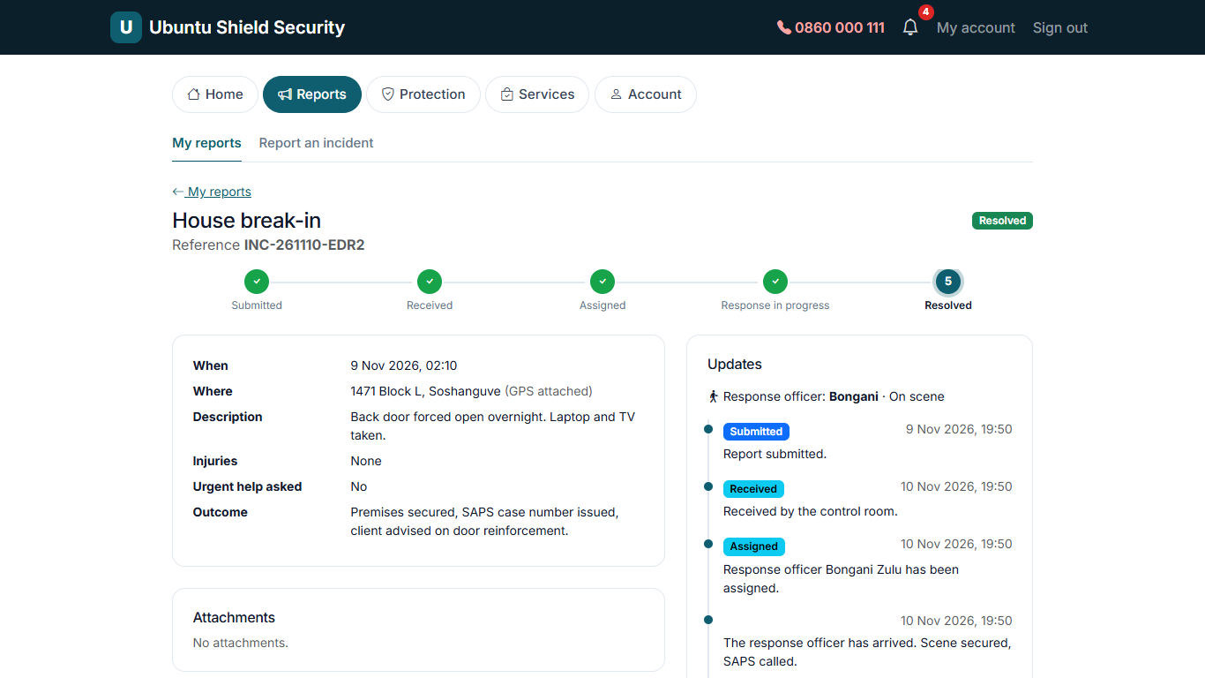
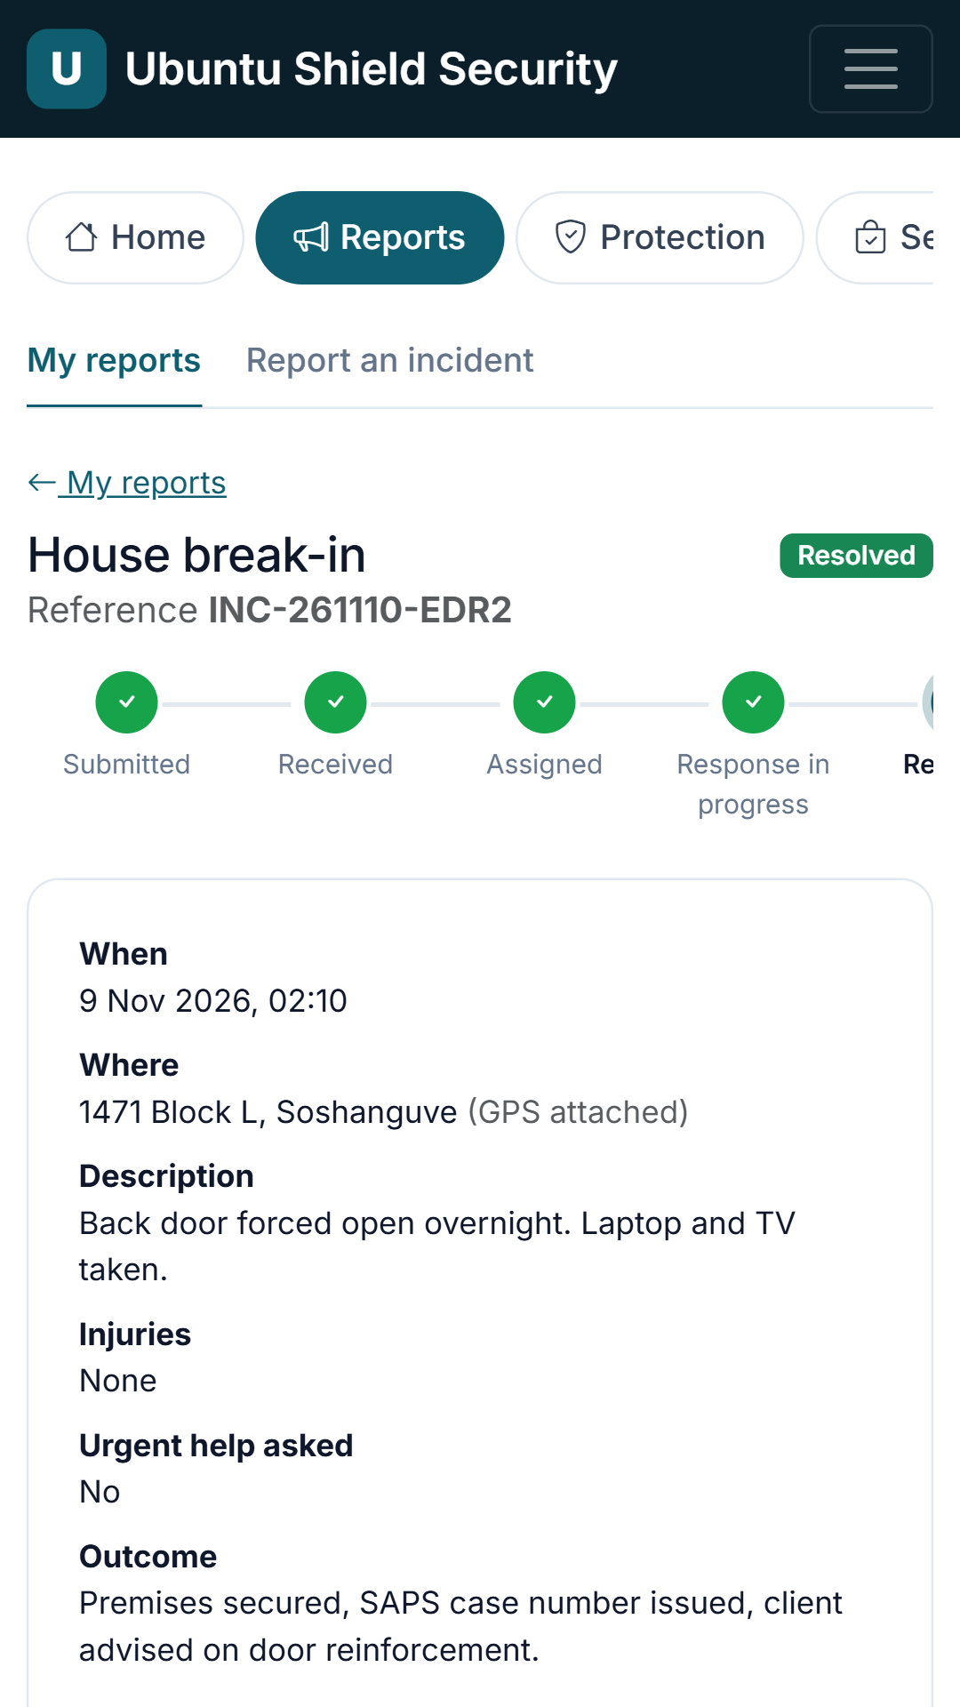
Incident progress
HOMEOWNER · /account/incidents/2
Progress steps and a timeline of updates from the company: received, officer assigned, on scene, resolved, with the outcome.
Notes:
Incident progress (/account/incidents/2). Progress steps and a timeline of updates from the company: received, officer assigned, on scene, resolved, with the outcome.

Slide 22
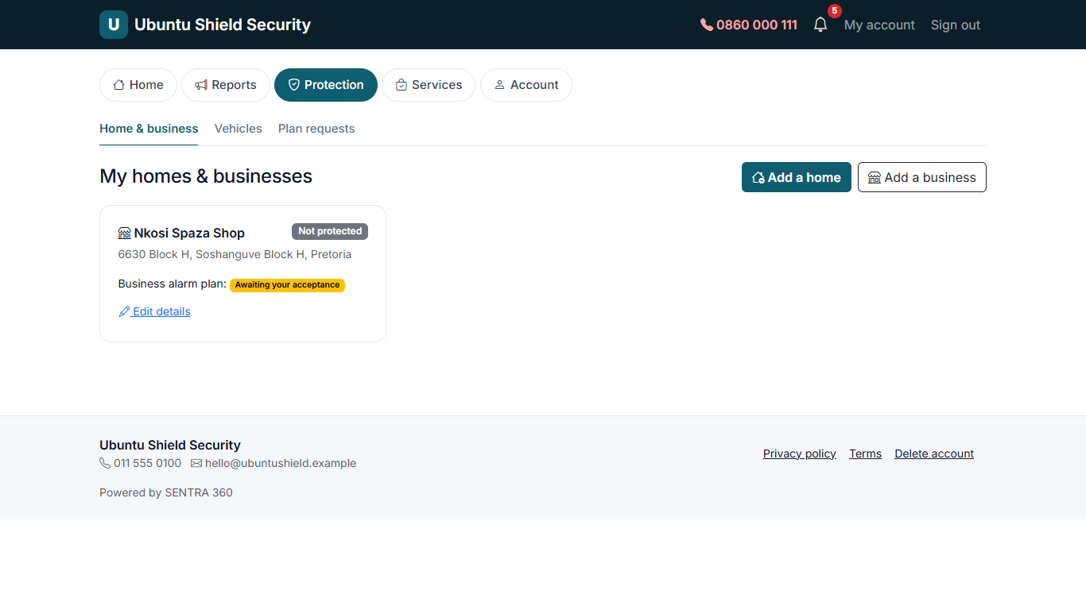
Home & business
HOMEOWNER · /account/assets/property
Each home or business shows its plan (Home protection or Business alarm), its status, and a one-tap "Get protected" with optional extras.
Notes:
Home & business (/account/assets/property). Each home or business shows its plan (Home protection or Business alarm), its status, and a one-tap "Get protected" with optional extras.

Slide 23
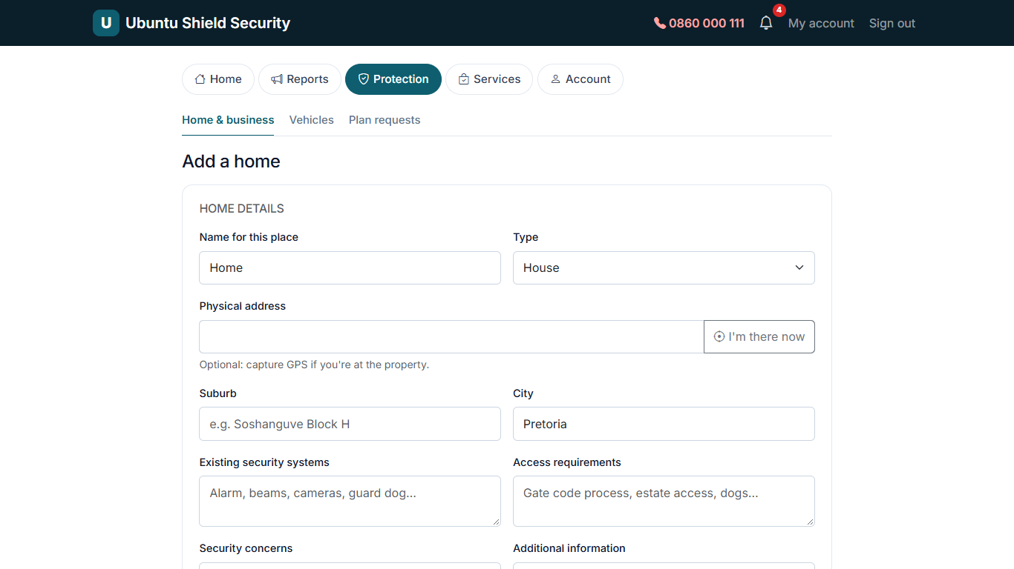
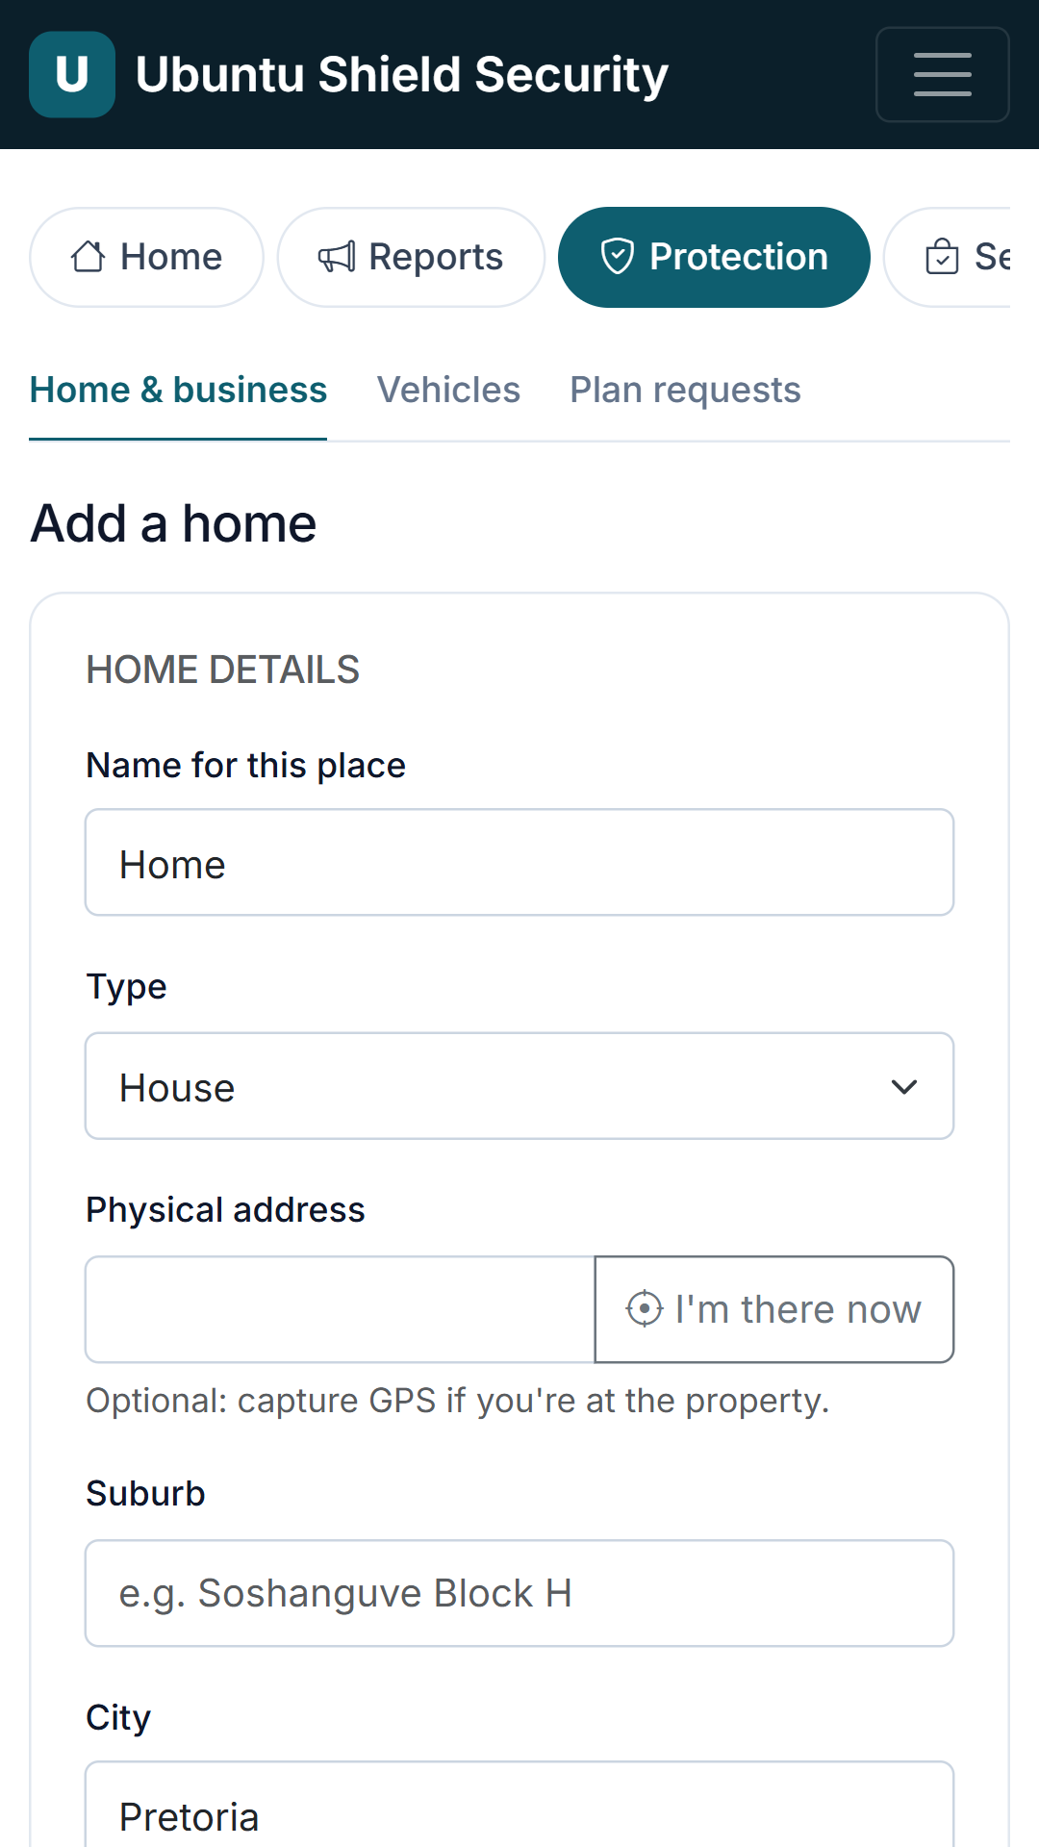
Add a home and choose the plan
HOMEOWNER · /account/assets/property/new
Address, GPS, security details and photos. The matching monthly plan is shown with what it includes; tick to sign up and add optional extras.
Notes:
Add a home and choose the plan (/account/assets/property/new). Address, GPS, security details and photos. The matching monthly plan is shown with what it includes; tick to sign up and add optional extras.

Slide 24
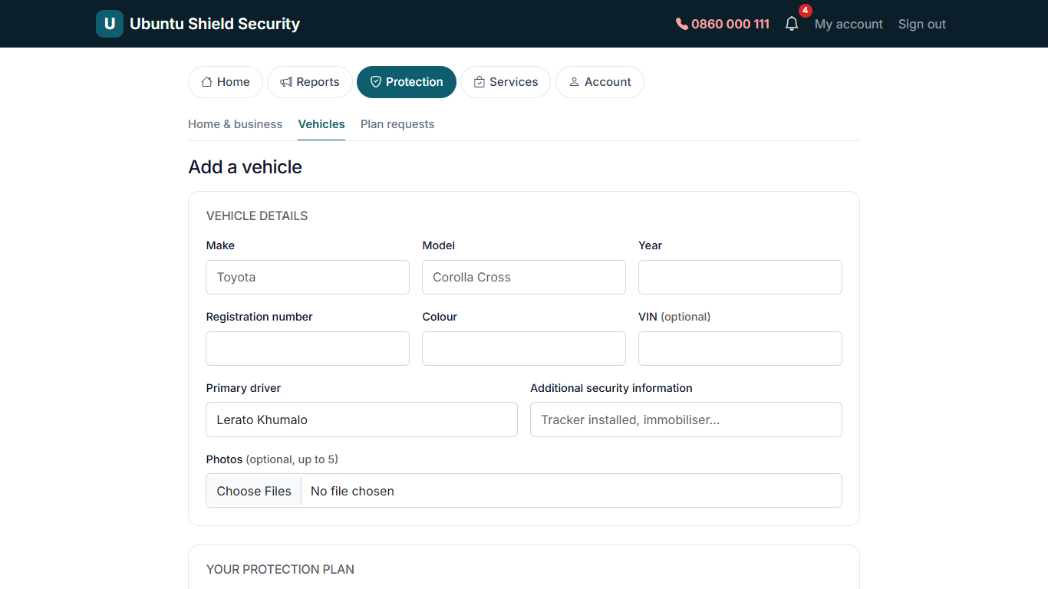
Register a vehicle
HOMEOWNER · /account/assets/vehicle/new
Make, model, registration, colour, year, VIN, driver and photos, with an application for vehicle protection.
Notes:
Register a vehicle (/account/assets/vehicle/new). Make, model, registration, colour, year, VIN, driver and photos, with an application for vehicle protection.

Slide 25
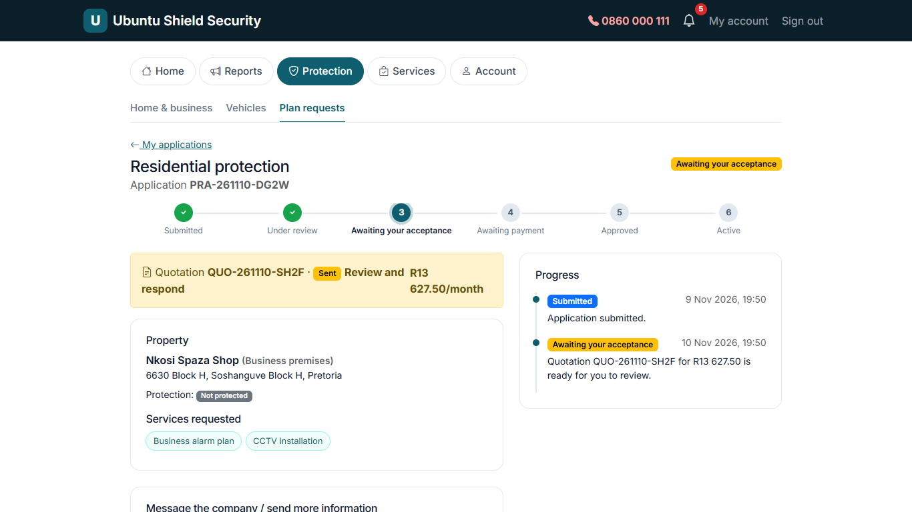
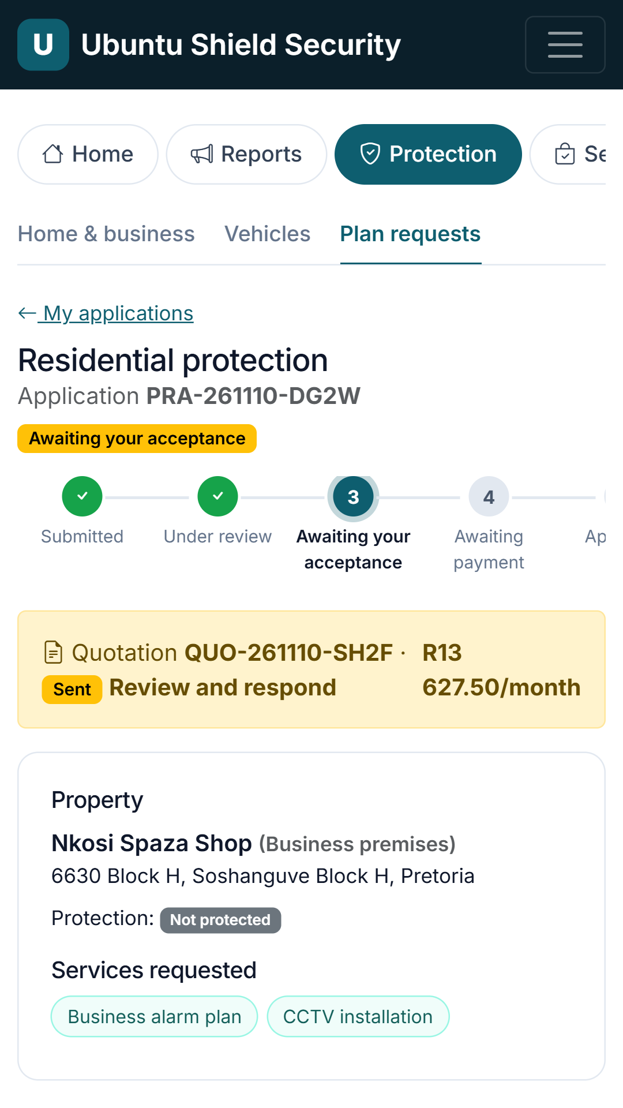
Application tracking
HOMEOWNER · /account/applications/property/2
The customer follows the application through review, quotation, payment and activation, and can message the company or send documents.
Notes:
Application tracking (/account/applications/property/2). The customer follows the application through review, quotation, payment and activation, and can message the company or send documents.

Slide 26
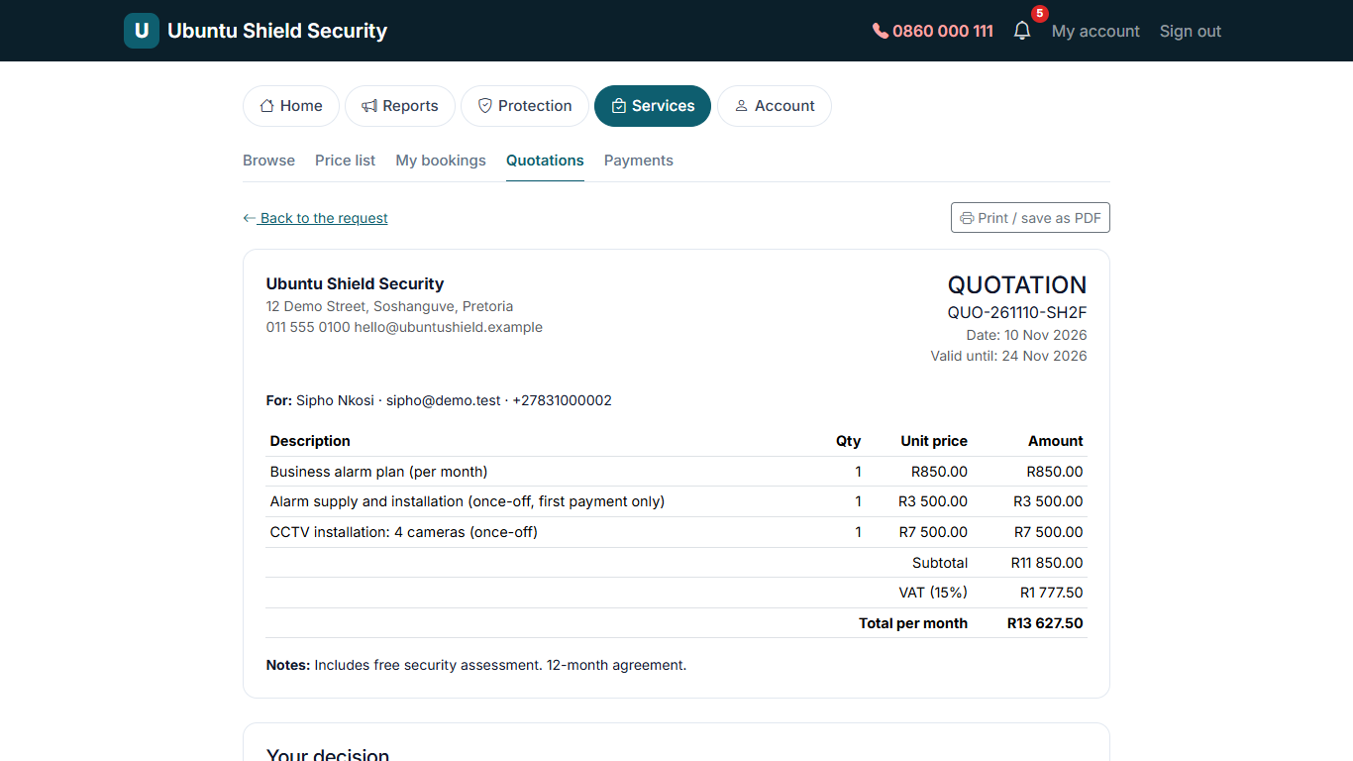
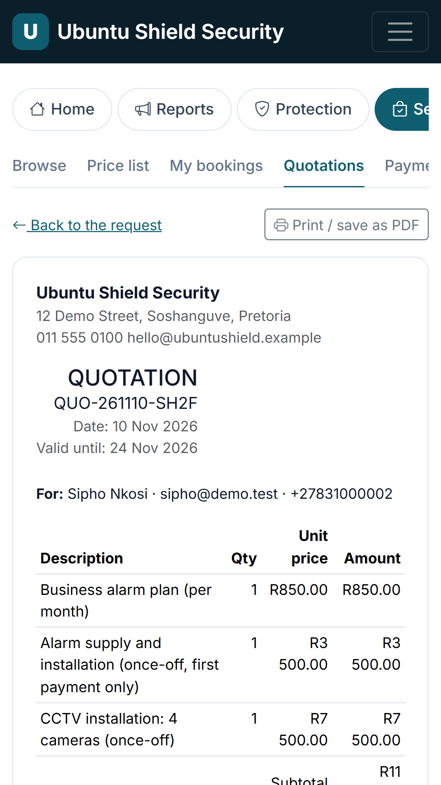
Quotation to accept
HOMEOWNER · /account/quotations/1
The plan quotation, pre-priced from the price list (monthly fee + once-off installation). Accept online, then pay by EFT and upload proof of payment.
Notes:
Quotation to accept (/account/quotations/1). The plan quotation, pre-priced from the price list (monthly fee + once-off installation). Accept online, then pay by EFT and upload proof of payment.

Slide 27
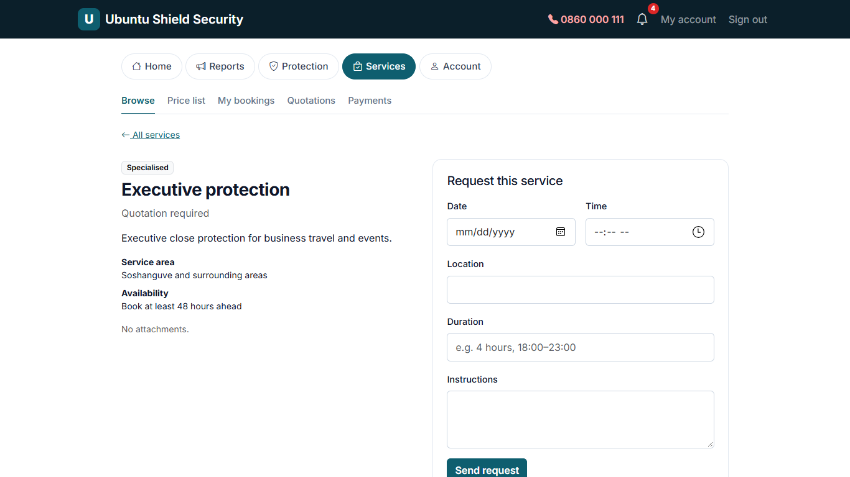
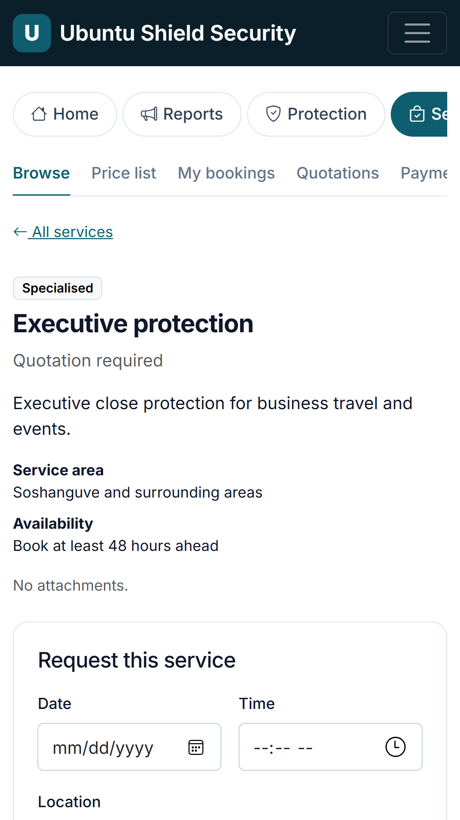
Book a service
HOMEOWNER · /account/services/4
Pick date, time, place and duration and add instructions. The company confirms availability and price before it is booked.
Notes:
Book a service (/account/services/4). Pick date, time, place and duration and add instructions. The company confirms availability and price before it is booked.

Slide 28
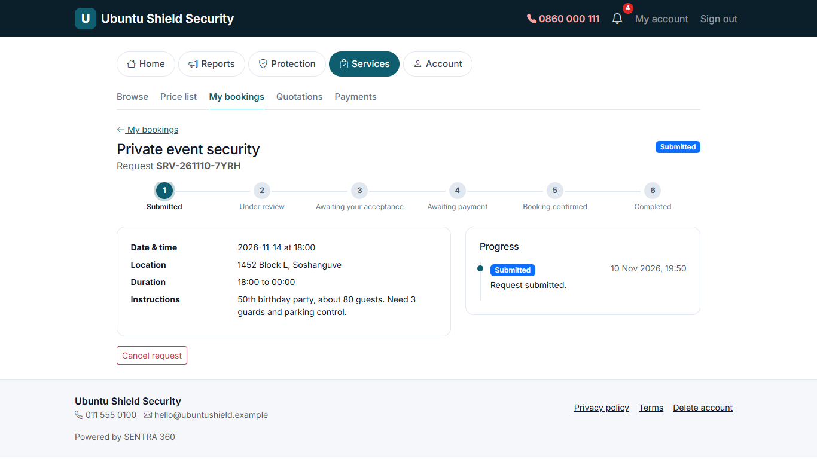
Booking request
HOMEOWNER · /account/requests/1
The service request with its progress and any quotation from the company.
Notes:
Booking request (/account/requests/1). The service request with its progress and any quotation from the company.

Slide 29
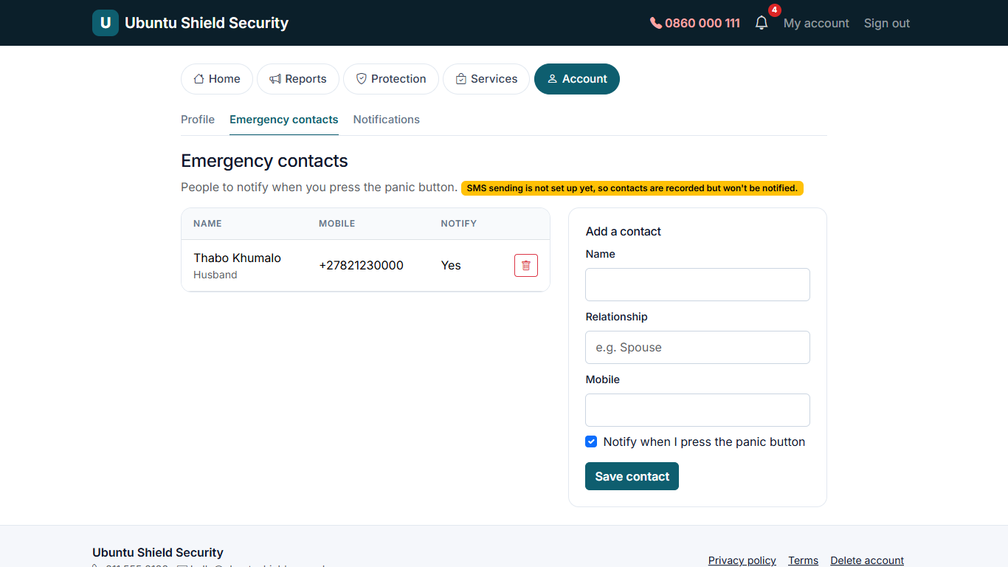
Emergency contacts
HOMEOWNER · /account/contacts
Up to 5 people to notify when the panic button is pressed (SMS sending switches on once a provider is connected).
Notes:
Emergency contacts (/account/contacts). Up to 5 people to notify when the panic button is pressed (SMS sending switches on once a provider is connected).

Slide 30
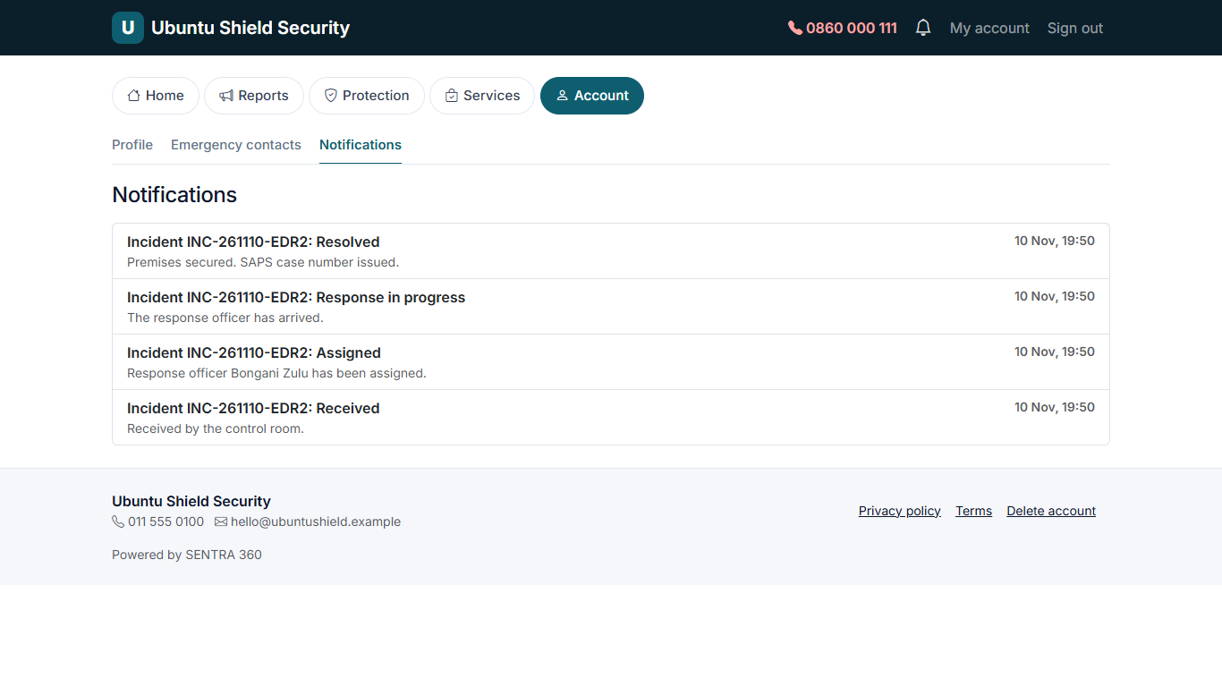
Notifications
HOMEOWNER · /account/notifications
In-app updates about reports, applications, quotations, payments and bookings.
Notes:
Notifications (/account/notifications). In-app updates about reports, applications, quotations, payments and bookings.

Slide 31
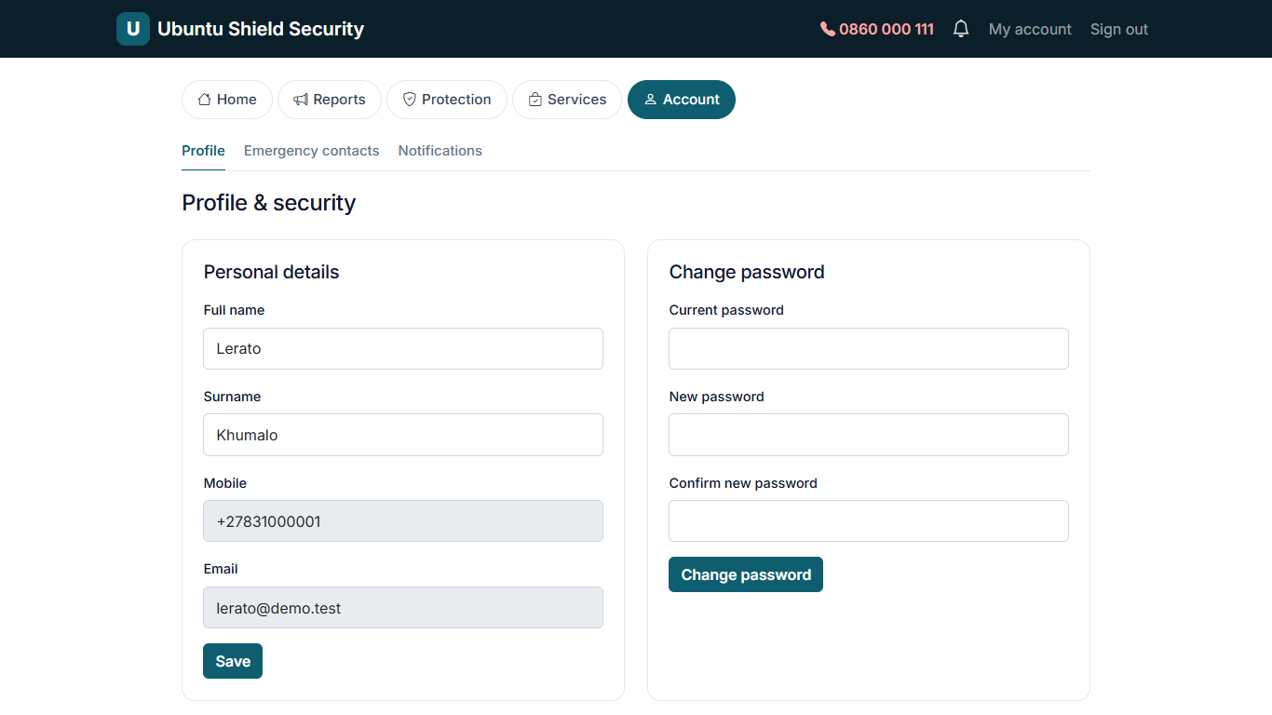
Profile & security
HOMEOWNER · /account/profile
Change details and password, see signed-in devices, sign out everywhere, and view POPIA consent records.
Notes:
Profile & security (/account/profile). Change details and password, see signed-in devices, sign out everywhere, and view POPIA consent records.

Slide 32
Security company
Control room operators and response officers: the live control room, responding to incidents, assignments and patrols. (6 screens)

Slide 33
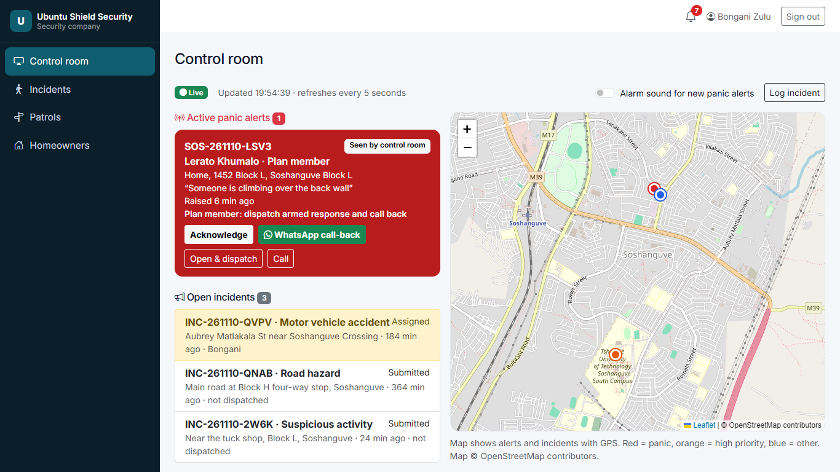
Live control room
SECURITY COMPANY · /security
Panic alerts (plan members first) and open incidents on a live map, refreshing every 5 seconds. Acknowledge, WhatsApp call-back, open and dispatch, or call.
Notes:
Live control room (/security). Panic alerts (plan members first) and open incidents on a live map, refreshing every 5 seconds. Acknowledge, WhatsApp call-back, open and dispatch, or call.

Slide 34
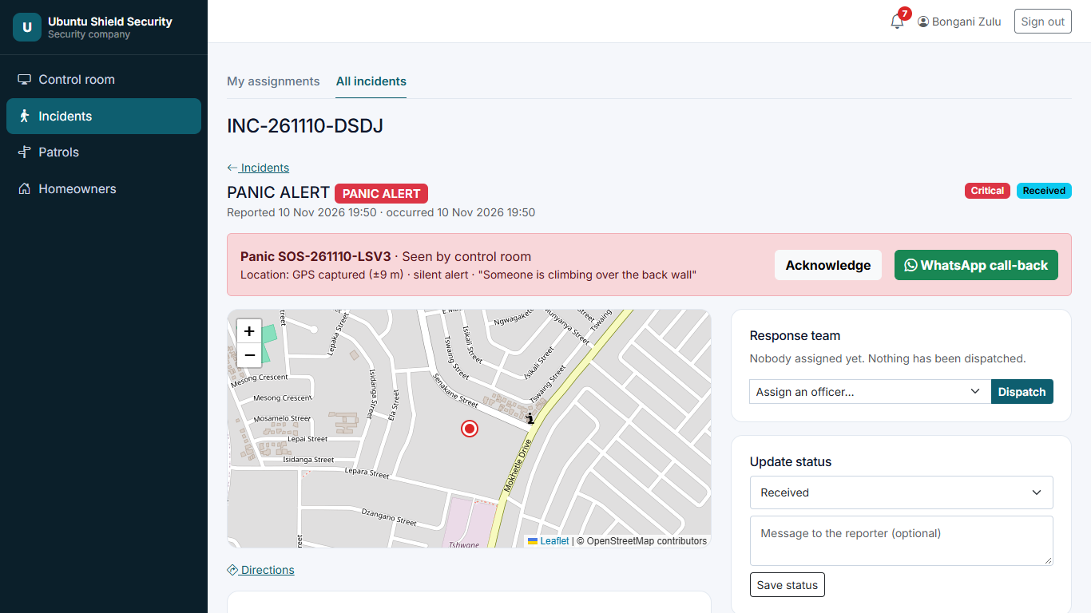
Panic incident: respond
SECURITY COMPANY · /security/incidents/5
Map with the client's location trail, protected property and access notes, emergency contacts, dispatch to an officer, status updates and notes.
Notes:
Panic incident: respond (/security/incidents/5). Map with the client's location trail, protected property and access notes, emergency contacts, dispatch to an officer, status updates and notes.

Slide 35
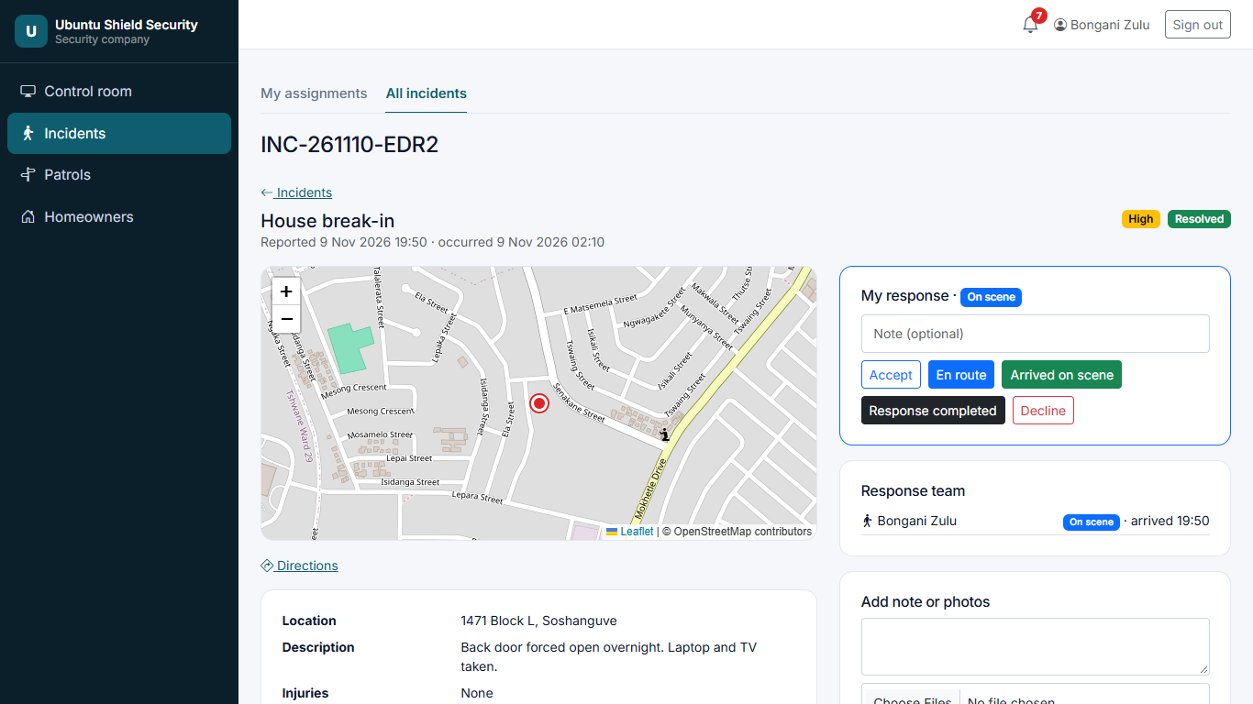
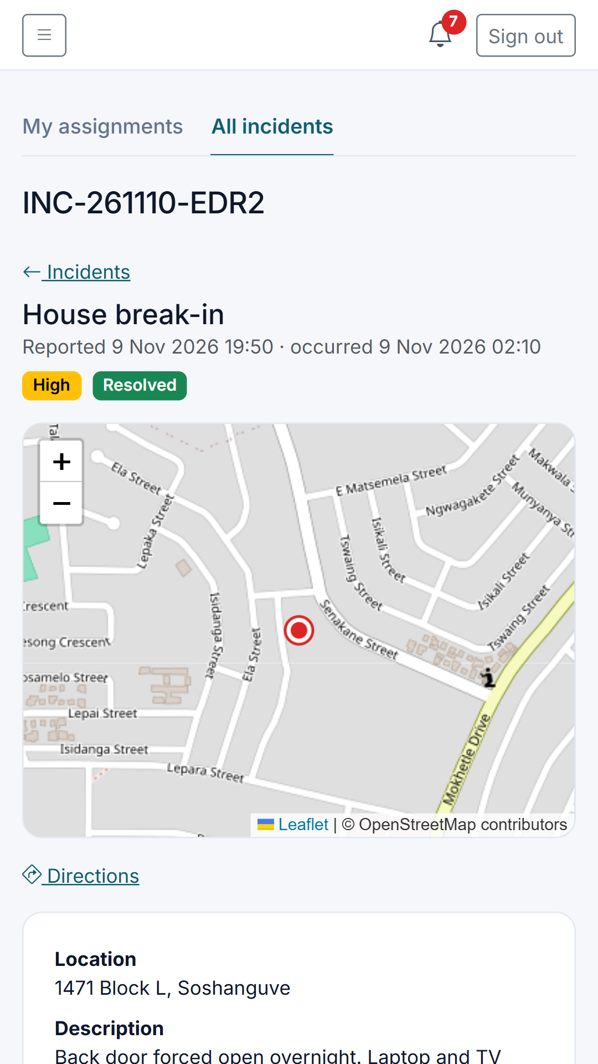
Officer response
SECURITY COMPANY · /security/incidents/2
The assigned officer marks Accepted, En route, On scene (arrival time recorded) and Completed, and adds photos and notes.
Notes:
Officer response (/security/incidents/2). The assigned officer marks Accepted, En route, On scene (arrival time recorded) and Completed, and adds photos and notes.

Slide 36
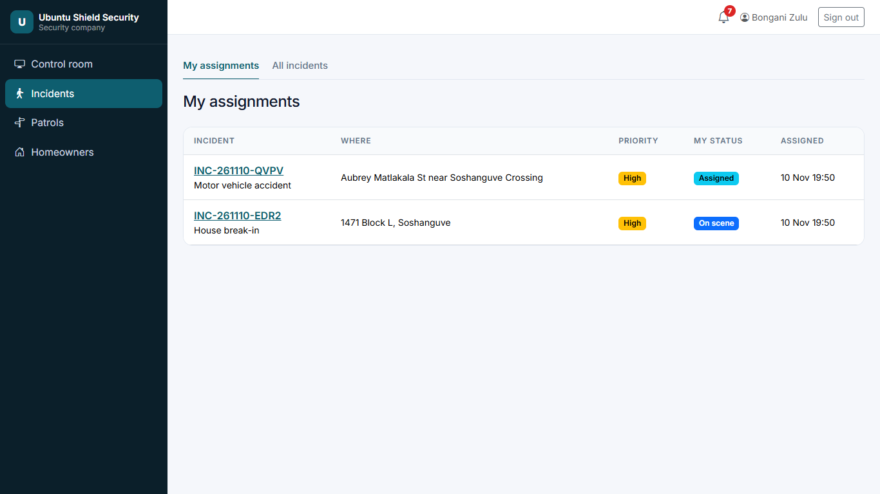
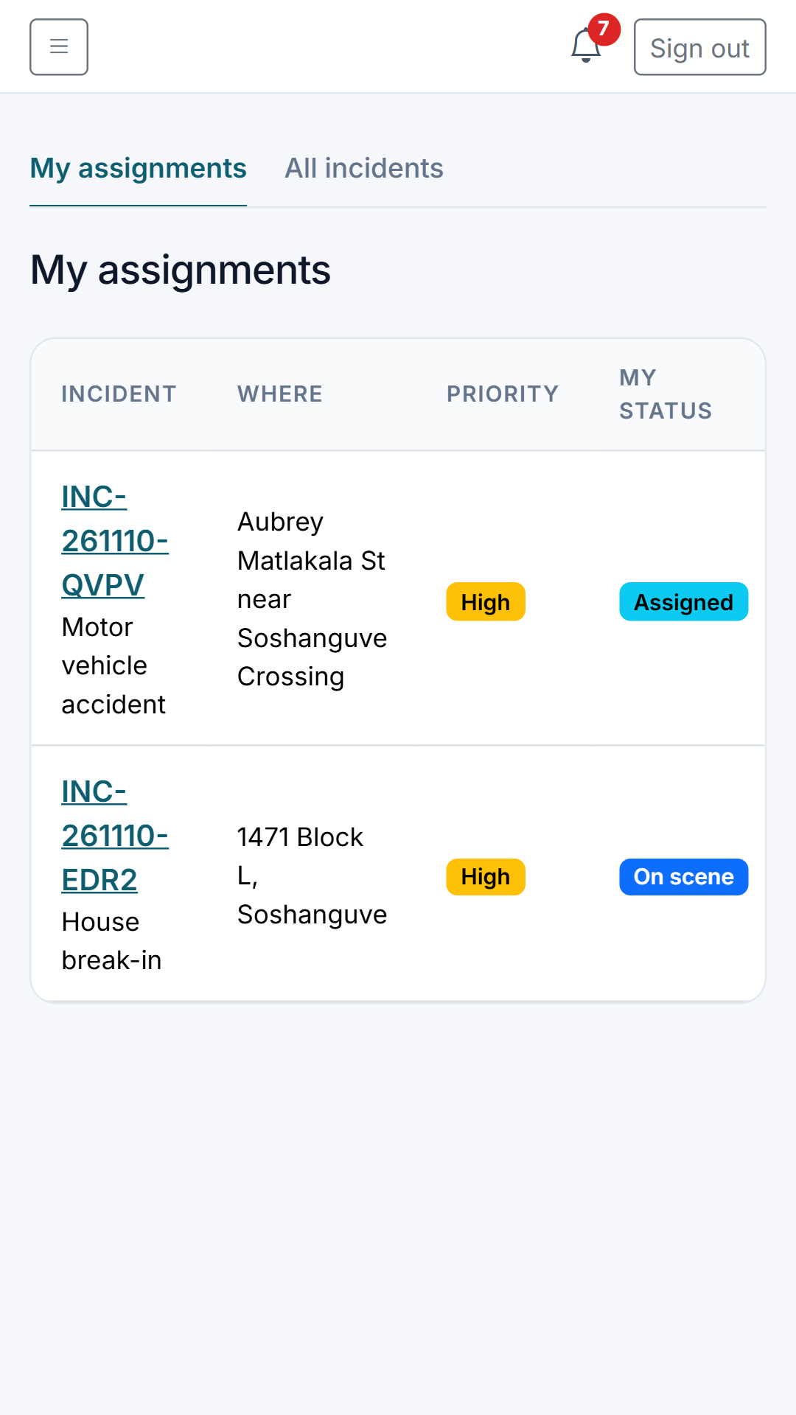
My assignments
SECURITY COMPANY · /security/assignments
Each officer sees the incidents assigned to them.
Notes:
My assignments (/security/assignments). Each officer sees the incidents assigned to them.

Slide 37
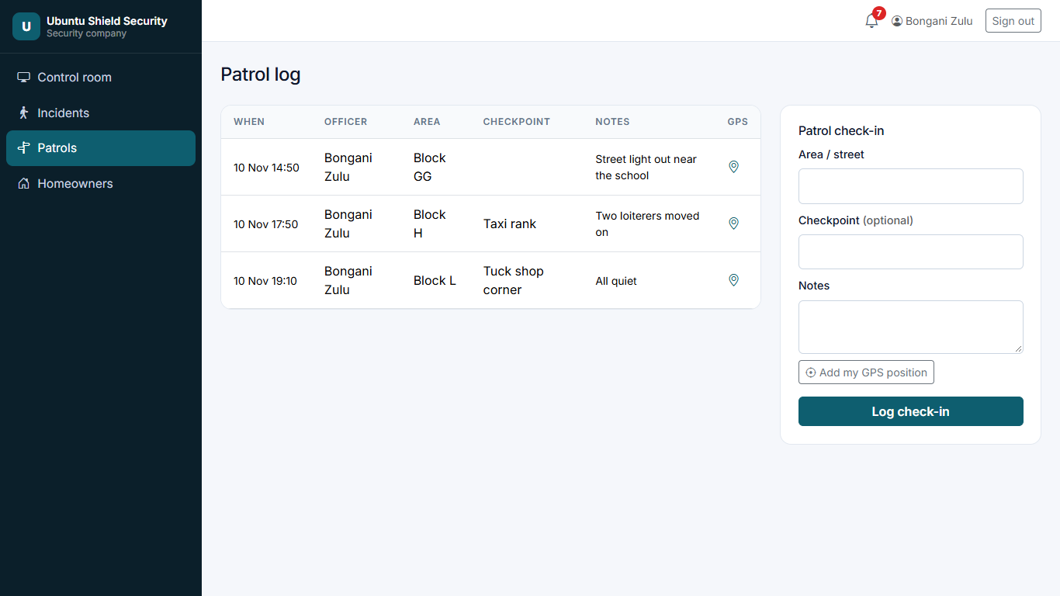
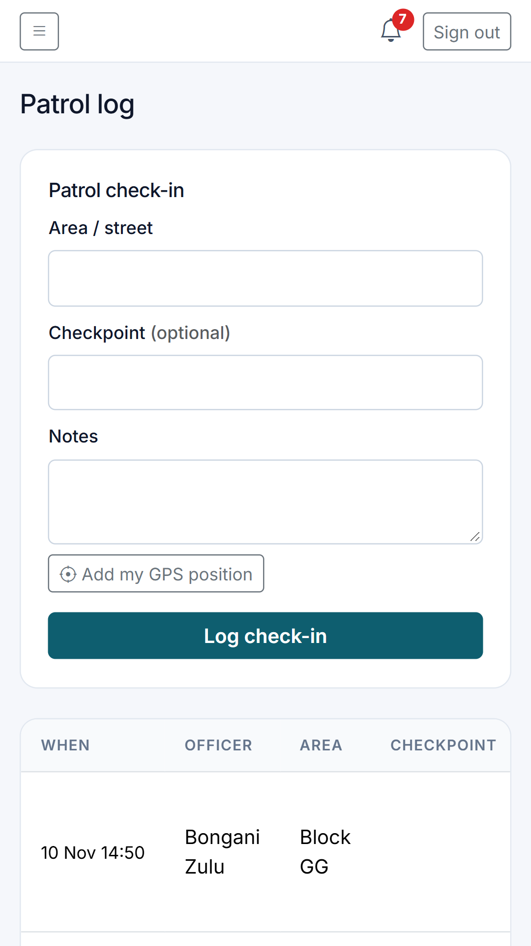
Patrol log
SECURITY COMPANY · /security/patrols
Officers check in at areas and checkpoints with notes and optional GPS.
Notes:
Patrol log (/security/patrols). Officers check in at areas and checkpoints with notes and optional GPS.

Slide 38
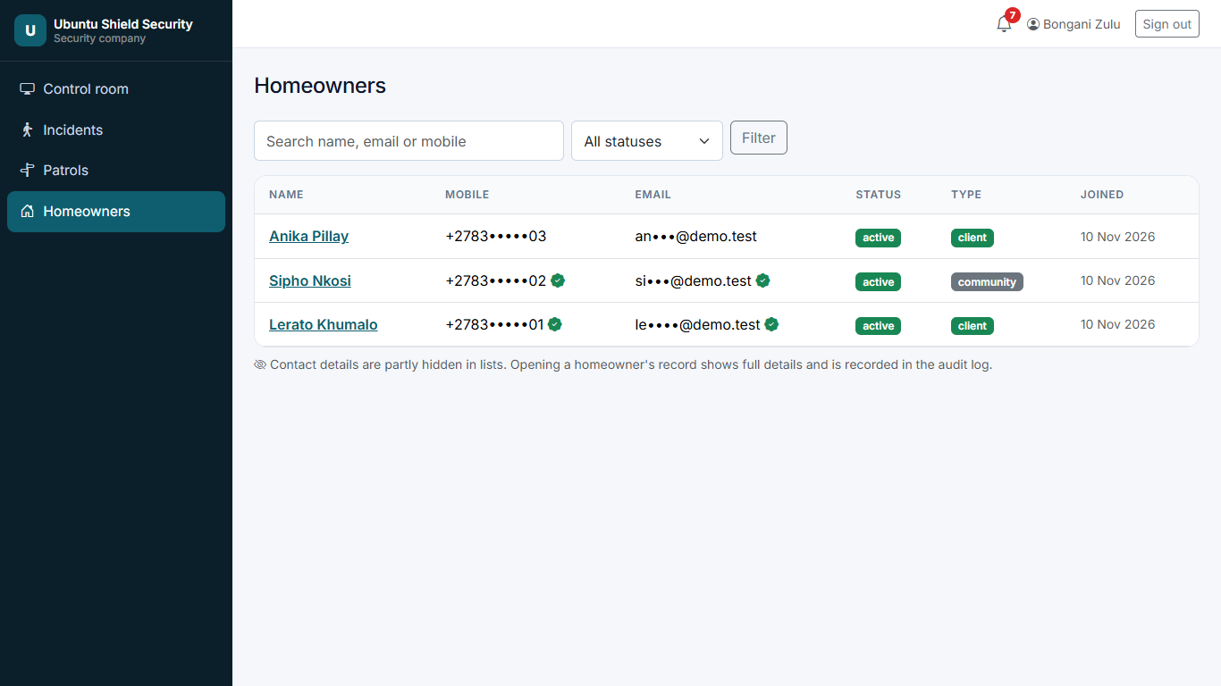
Homeowner lookup
SECURITY COMPANY · /security/homeowners
Read-only lookup of homeowners. Contact details are partly hidden in lists, and opening a record is logged.
Notes:
Homeowner lookup (/security/homeowners). Read-only lookup of homeowners. Contact details are partly hidden in lists, and opening a record is logged.

Slide 39
Admin
The company office: incidents, plan requests to activation, quotations and proofs of payment, services, alerts, reports, logins and branding. (18 screens)

Slide 40
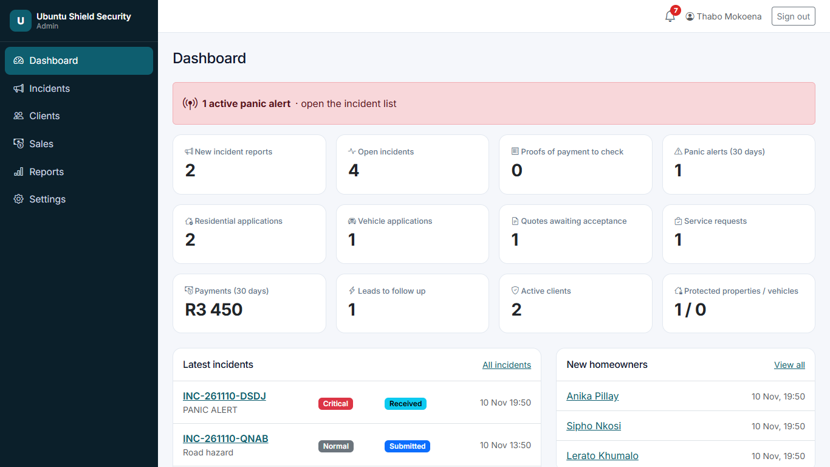
Admin dashboard
ADMIN · /admin
New reports, open incidents, active emergencies, applications, quotations awaiting acceptance, service requests, payments, clients and protected properties.
Notes:
Admin dashboard (/admin). New reports, open incidents, active emergencies, applications, quotations awaiting acceptance, service requests, payments, clients and protected properties.

Slide 41
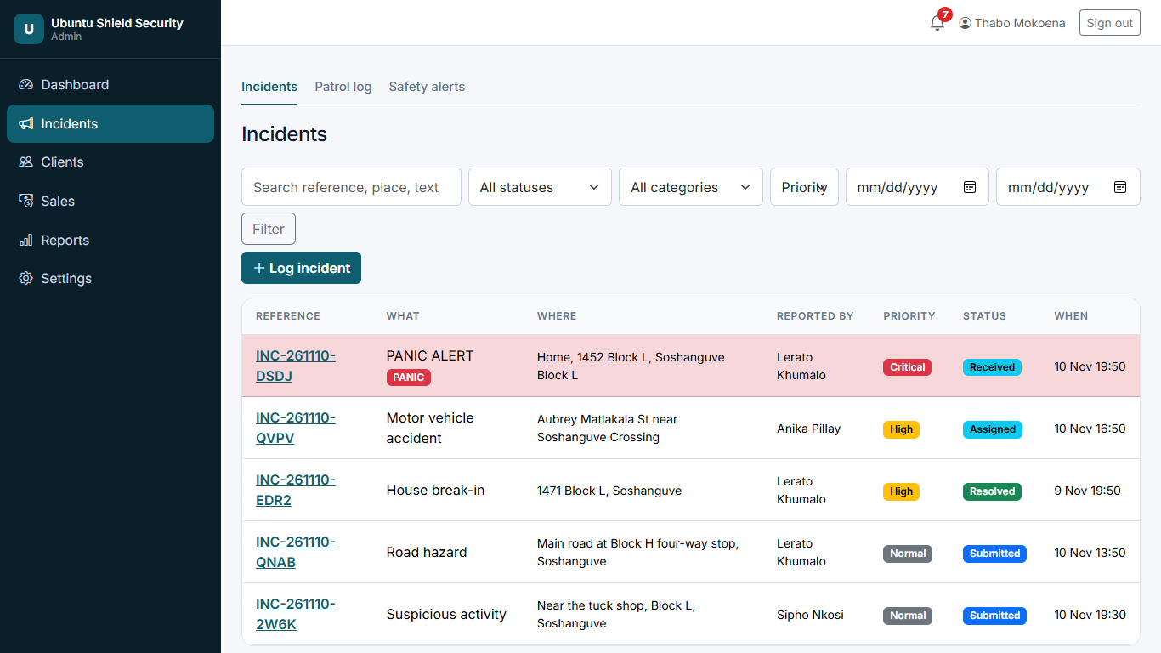
Incident management
ADMIN · /admin/incidents
Search and filter by status, category, priority and dates. Panic alerts are highlighted.
Notes:
Incident management (/admin/incidents). Search and filter by status, category, priority and dates. Panic alerts are highlighted.

Slide 42
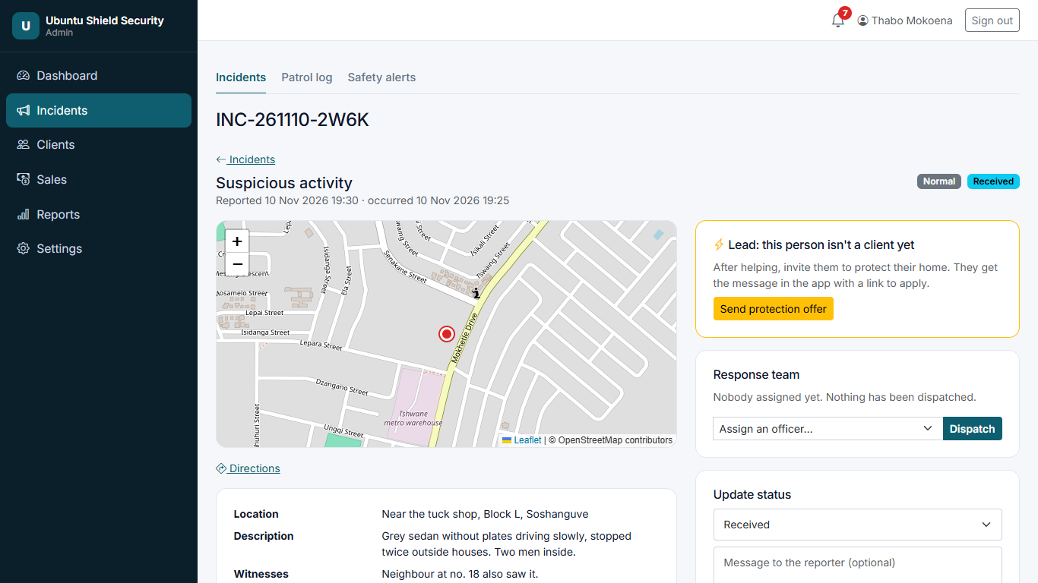
Incident detail (admin)
ADMIN · /admin/incidents/1
Evidence, reporter details, map, internal notes, dispatch and status changes. Opening it marks the report as received.
Notes:
Incident detail (admin) (/admin/incidents/1). Evidence, reporter details, map, internal notes, dispatch and status changes. Opening it marks the report as received.

Slide 43

Protection applications
ADMIN · /admin/applications
Residential and vehicle applications that need attention.
Notes:
Protection applications (/admin/applications). Residential and vehicle applications that need attention.

Slide 44

Application review & activation
ADMIN · /admin/applications/property/3
Review the property and services, require an assessment, request info, prepare a quotation, approve, and activate protection (the customer becomes a client).
Notes:
Application review & activation (/admin/applications/property/3). Review the property and services, require an assessment, request info, prepare a quotation, approve, and activate protection (the customer becomes a client).

Slide 45

Prepare a quotation
ADMIN · /admin/quotations/new/property/2
Line items, quantities, prices, monthly or once-off, validity and VAT. Save a draft or send it to the customer.
Notes:
Prepare a quotation (/admin/quotations/new/property/2). Line items, quantities, prices, monthly or once-off, validity and VAT. Save a draft or send it to the customer.

Slide 46

Quotation & payments
ADMIN · /admin/quotations/2
The printable quotation, its status, and recording EFT, cash or card payments against it.
Notes:
Quotation & payments (/admin/quotations/2). The printable quotation, its status, and recording EFT, cash or card payments against it.

Slide 47

Service requests & bookings
ADMIN · /admin/requests
Incoming bookings by date, to review, quote, confirm and complete.
Notes:
Service requests & bookings (/admin/requests). Incoming bookings by date, to review, quote, confirm and complete.

Slide 48

Services
ADMIN · /admin/services
The company manages its services marketplace: prices, availability, area and photos.
Notes:
Services (/admin/services). The company manages its services marketplace: prices, availability, area and photos.

Slide 49

Price list management
ADMIN · /admin/pricelist
Set the pricing type, price, unit, order and visibility of every service on one screen. Nothing is deleted; untick Listed to hide a service.
Notes:
Price list management (/admin/pricelist). Set the pricing type, price, unit, order and visibility of every service on one screen. Nothing is deleted; untick Listed to hide a service.

Slide 50

Payments & proofs of payment
ADMIN · /admin/payments
Customers pay by EFT and upload proof of payment. The Admin checks each proof against the bank statement and approves (activating the plan) or rejects it with a reason. All payments export to Excel.
Notes:
Payments & proofs of payment (/admin/payments). Customers pay by EFT and upload proof of payment. The Admin checks each proof against the bank statement and approves (activating the plan) or rejects it with a reason. All payments export to Excel.

Slide 51

Homeowners
ADMIN · /admin/homeowners
All homeowners with status and client type. Verify, suspend or mark as client from each record.
Notes:
Homeowners (/admin/homeowners). All homeowners with status and client type. Verify, suspend or mark as client from each record.

Slide 52

Leads
ADMIN · /admin/leads
Community members who reported incidents or pressed panic but are not clients yet. One click sends a protection offer into their app (at most once every 14 days).
Notes:
Leads (/admin/leads). Community members who reported incidents or pressed panic but are not clients yet. One click sends a protection offer into their app (at most once every 14 days).

Slide 53

Community safety alerts
ADMIN · /admin/alerts
Publish alerts that appear on the public site and every homeowner dashboard until they expire.
Notes:
Community safety alerts (/admin/alerts). Publish alerts that appear on the public site and every homeowner dashboard until they expire.

Slide 54

Reports
ADMIN · /admin/reports
Incidents by category, response times, application conversion, quotes accepted, revenue and services, with Excel export and Save as PDF.
Notes:
Reports (/admin/reports). Incidents by category, response times, application conversion, quotes accepted, revenue and services, with Excel export and Save as PDF.

Slide 55

Admin & security logins
ADMIN · /admin/staff
Create and disable Admin and Security company logins.
Notes:
Admin & security logins (/admin/staff). Create and disable Admin and Security company logins.

Slide 56

Branding & profile
ADMIN · /admin/branding
Company name, logo, colours, welcome text, services, contacts, emergency number, payment instructions and policies, without touching code.
Notes:
Branding & profile (/admin/branding). Company name, logo, colours, welcome text, services, contacts, emergency number, payment instructions and policies, without touching code.

Slide 57

Audit log
ADMIN · /admin/audit
Who did what and when: sign-ins, record views, status changes, payments and exports.
Notes:
Audit log (/admin/audit). Who did what and when: sign-ins, record views, status changes, payments and exports.

Slide 58

Going live on Google Play
The app is already installable. Google Play publishes it as a Trusted Web Activity: a small Android app that opens the site full-screen.

Slide 59


Ready for Google Play
Already prepared in docs/play-store, alongside the full step-by-step guide
Installable app: manifest, icons, offline page
App-to-website link endpoint (asset links)
Account deletion page Google requires
Privacy policy page
8 phone screenshots, 1080 × 1920
Listing text, data-safety and content-rating answers
512 × 512 app icon and 1024 × 500 feature graphic

Slide 60






What only you can do
Decisions and accounts, in order
Own domain
Render Starter plan
Play Console account
e.g. app.yourcompany.co.za. The Android app is tied to it for good.
About US$7/month, so the app never sleeps. Essential for a panic button.
US$25 once. A company account needs a D-U-N-S number.
Build the app
SMS and email provider
Plan prices & bank details
At pwabuilder.com. Keep the signing key safe.
So codes and emergency-contact messages are really sent.
Set your real monthly prices (Price list) and EFT details + WhatsApp number (Branding).

Slide 61
Try it now
Website: https://sentra360-t9tq.onrender.com
Everyone signs in at /login (admin, security and homeowners)
Homeowners sign up at /register
Notes:
The first visit after 15 quiet minutes takes about 50 seconds on the free hosting plan.

