Slide 1
Local Data for Better Health
An exploration of the CDC's “500 Cities”

Slide 2
OUR DATA
500 Cities
500 Cities project 2018 release
Includes 2015 and 2016
Survey of 500 cities (at least one from each state)
Covers 27 measures of chronic disease related to
unhealthy behaviors
health outcomes
preventive health measures
Data were provided by the Centers for Disease Control and Prevention (CDC), Division of Population Health, Epidemiology and Surveillance Branch.
Census
US Census API
The original data source is very complex; we used the python wrapper (see related class exercises from week 7).

Slide 3
POSITIVE AND NEGATIVE HEALTH OUTCOMES
What factors impact health outcomes?
Investigating 500 Cities data revealed obvious answers.
Obesity and negative health outcomes
But also less obvious possibilities that we were more interested in.
Sleep and negative health outcomes
Is there a relationship between poor sleep and negative health?
Or are other factors in those cities (e.g. socio-economics) at play?

Slide 4
DATA CLEAN-UP AND EXPLORATION

Slide 5
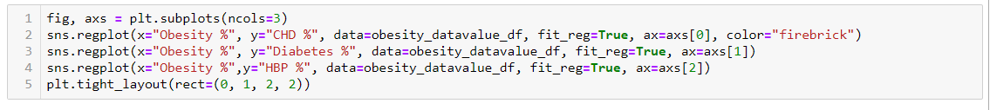
OUR DATA AND VISUALIZATIONS
Seaborn library
Like Matplotlib…but better!
regplot will plot data and a linear regression model fit, and also compute confidence intervals and represent the uncertainty of the estimate.

Slide 6
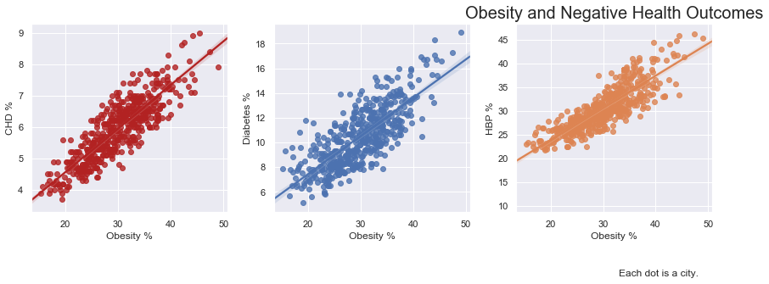
DEAD RINGER: OBESITY AND THREE NEGATIVE OUTCOMES

Slide 7
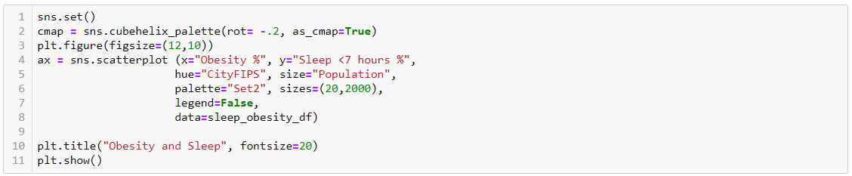
MORE DELICIOUS SEABORN CODE

Slide 8
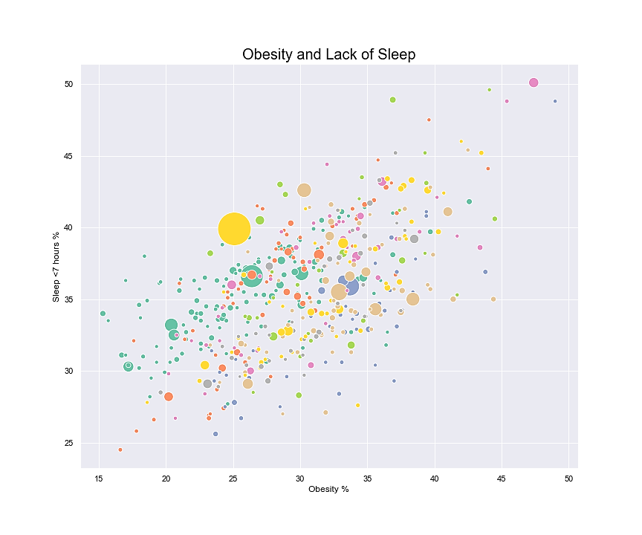
IS OBESITY RELATED TO LACK OF SLEEP?

Slide 9
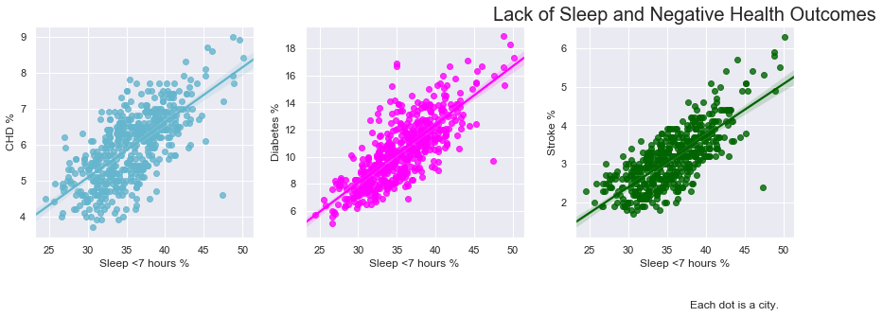
IS LACK OF SLEEP ASSOCIATED WITH OTHER NEGATIVE OUTCOMES?

Slide 10
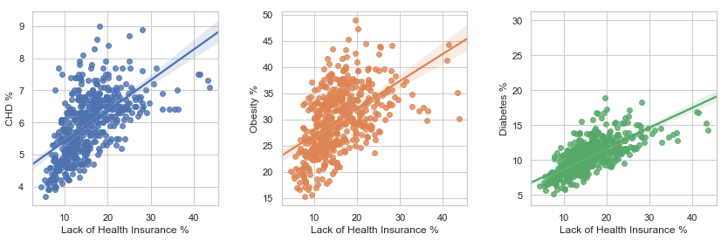
COULD THERE BE OTHER ISSUES HERE?

Slide 11
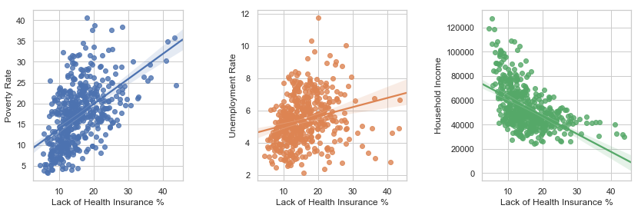
IF IT’S LACK OF INSURANCE, WHAT COULD BE DRIVING THAT ISSUE?

Slide 12
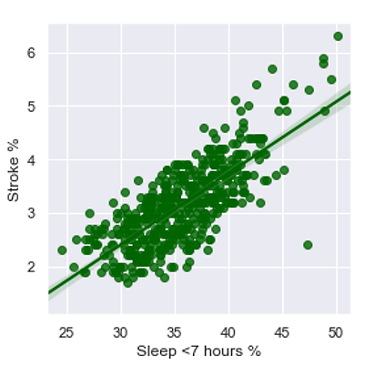
REMEMBER SLEEP AND STROKE RISK?

Slide 13
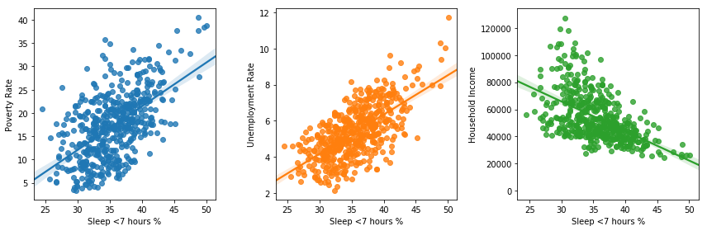
NOTE THE COMPARISON BETWEEN SLEEP AND ECONOMIC FACTORS.

Slide 14
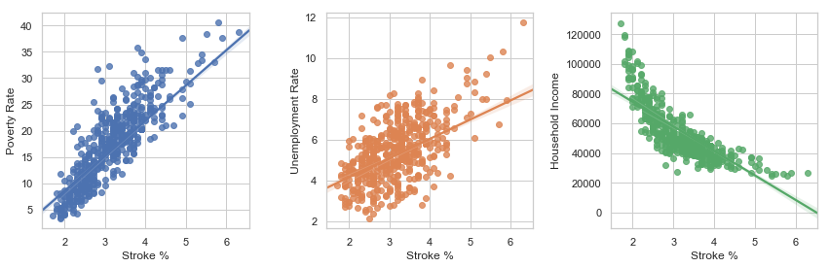
NOW NOTE THE IMPLIED CONNECTION BETWEEN STOKE AND ECONOMIC FACTORS

Slide 15
QUESTIONS?
POST MORTEM
The obstacles were not really code, but
Understanding what our data could do
So many variables, so little time!
Agreeing on the questions we wanted to chase.
Unanswered questions
Missing out on other census data, like median age, gender, ethnicity, etc.
Other health preventive measures besides lack of health insurance.

