Slide 1
Applying Machine Learning Models in real-life datasets Project Case-1.
Kunjal

Slide 2
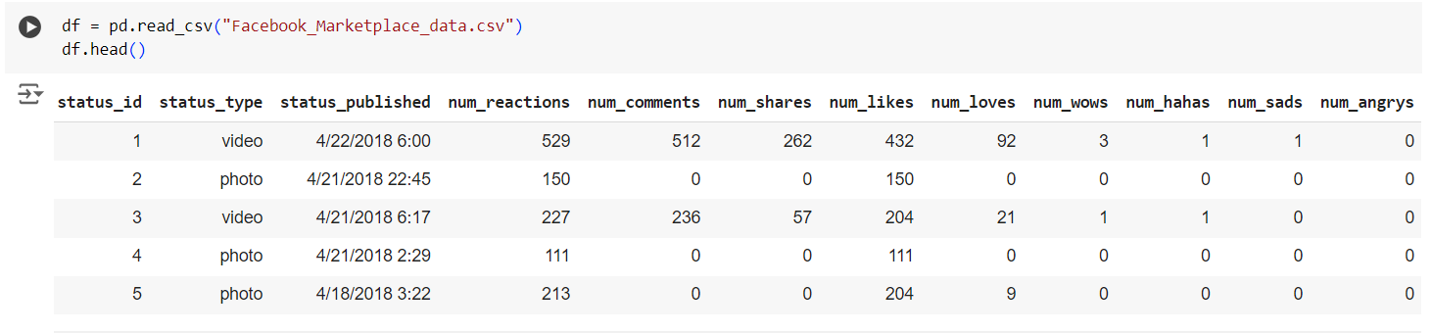
Background Facebook Marketplace dataset
The Facebook Live Sellers in Thailand dataset contains information about the Facebook pages of 10 Thai fashion and cosmetics retail sellers. Below is the head of the dataset (after removing the NaN Columns):

Slide 3
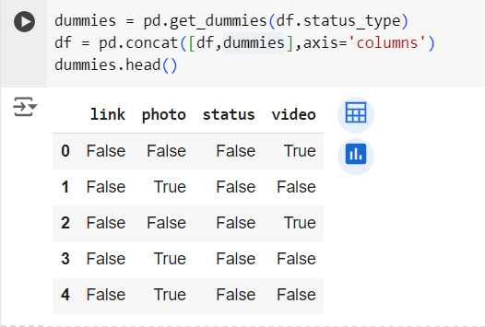
Data Pre-processing
Removed the status_id and NaN columns which were of no use.
We used pd.dummies() function to get the dummie variables dataframe of the categorical variable “status_type”.

Slide 4
Problem Statements
How does the time of upload (`status_published`) affects the `num_reaction`?
Is there a correlation between the number of reactions (num_reactions) and other engagement metrics such as comments (num_comments) and shares (num_shares)? If so, what is the strength and direction of this correlation?
Use the columns status_type, num_reactions, num_comments, num_shares, num_likes, num_loves, num_wows, num_hahas, num_sads, and num_angrys to train a K-Means clustering model on the Facebook Live Sellers dataset.
Use the elbow method to find the optimum number of clusters.
What is the count of different types of posts in the dataset?
What is the average value of num_reaction, num_comments, num_shares for each post type?

Slide 5
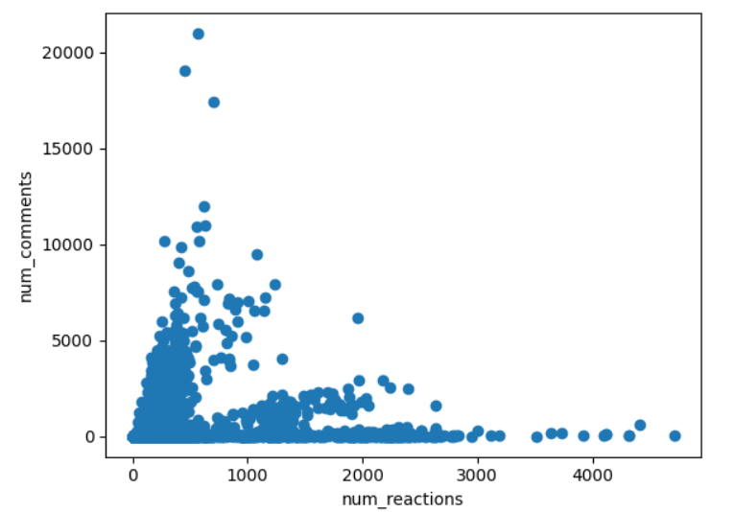
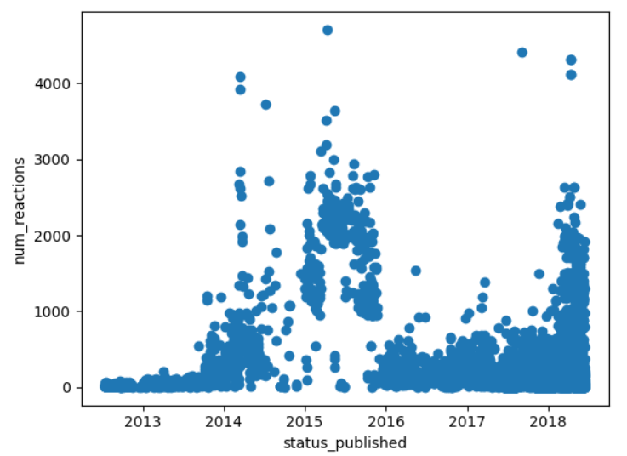
Some plotted graphs to understand the correlations (not much useful)

Slide 6
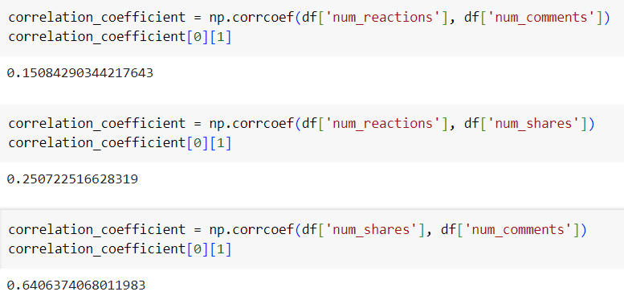
Using np.corrcoef() to understand the correlation between two attributes

Slide 7
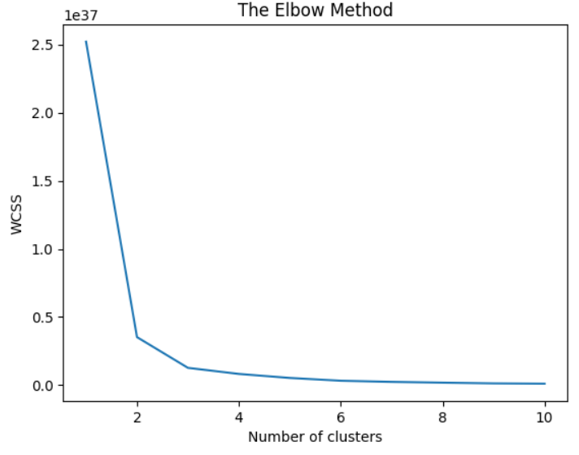
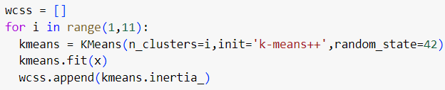
Using Elbow method to find the optimum number of clusters to fit our dataset into
We will first calculate the wcss (within cluster sum of squares) for the number of clusters in range 1-10. Then we will use the elbow method to find the sharp point which will give us the optimum number of clusters (k=3) to be made for our dataset.

Slide 8
Fit the model with k=3
As we are using Kmeans Clustering algorithm here, we have to specify the n_clusters which is 3 here and we are setting random_state = 42, which ensure that we begin from the same starting point everytime we run the algorithm.
The y_kmeans stores the category of cluster, out of 0/1/2 to which each datapoint in our dataset belongs to.

Slide 9
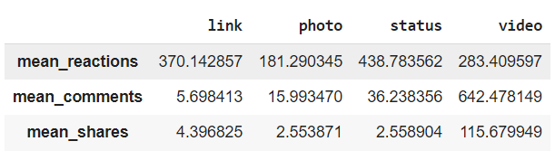
Sorting the data according to the status_type and giving the average descriptions:

Slide 10
THANK YOU!

