Slide 1
Applying Machine Learning Models in real-life datasets Project Case-2.
Kunjal

Slide 2
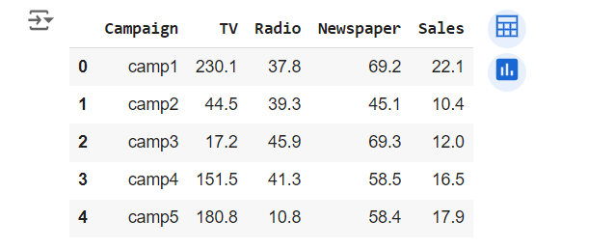
Background
SALES PREDICTION DATASET
The dataset provided contains information about the advertising expenditures of a company on various platforms (TV, Radio, newspapers) and the corresponding sales of a product. Here’s the head of the dataset:

Slide 3
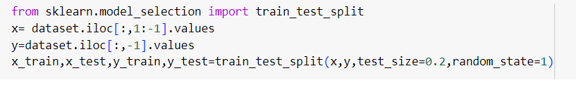
DATA PRE-PROCESSING
Handling NaN values in the dataset.(strategy = median)
Splitting the dataset into train and test subsets.

Slide 4
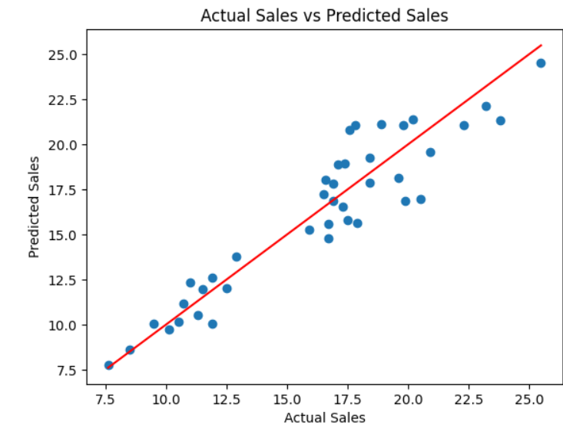
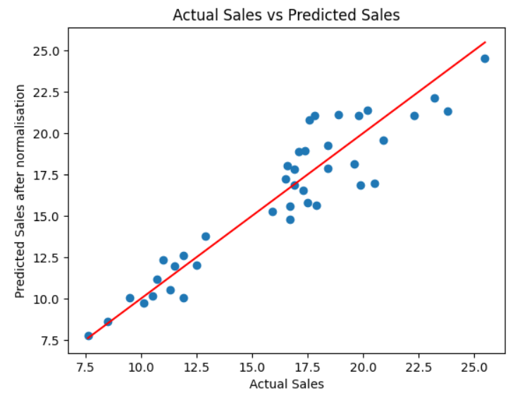
GRAPH VARIATION BEFORE AND AFTER NORMALISING THE DATASET

Slide 5
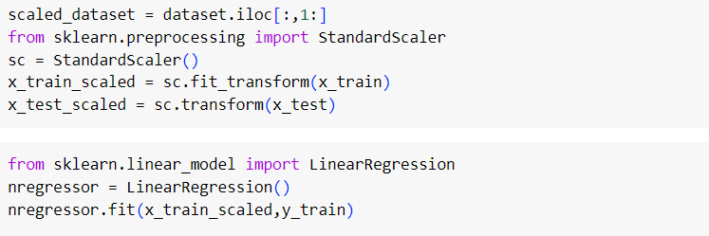
SCALING/NORMALISING THE DATASET
Scaling helps to bring all features to a similar scale. Many machine learning algorithms perform better or converge faster when features are on a relatively similar scale and close to normally distributed. This prevents features with larger ranges from dominating the learning process.

Slide 6
NORMALIZATION EFECT ON LINEAR REGRESSION MODEL
Scaling the features typically has no effect on the coefficients and predictions of a linear regression model for the following reasons:
Gradient Descent and Optimization: Unlike some other algorithms (like SVMs or neural networks), linear regression does not rely on gradient descent for optimization. Therefore, issues related to convergence speed or efficiency due to feature scales do not apply.
Coefficient Interpretation:In linear regression, the coefficients (weights) assigned to each feature are determined by minimizing the sum of squared residuals (ordinary least squares). The scale of the features affects the magnitude of the coefficients, but not the direction or significance of their relationship with the target variable. When you scale a feature, you also scale its coefficient proportionally, maintaining the same relationship.

Slide 7
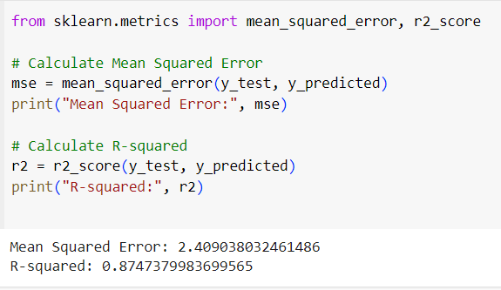
EVALUATION OF THE MODEL

Slide 8
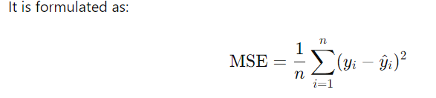
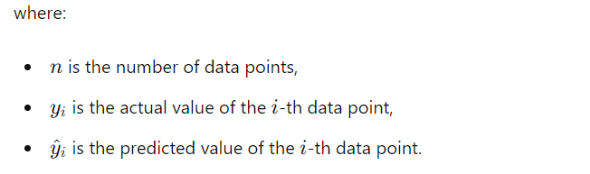
MEAN – SQUARED ERROR:
MSE is calculated as the average of the squared differences between predicted values and actual values.
MSE gives more weight to large errors due to squaring the differences. Therefore, it is useful in scenarios where large errors are particularly undesirable or costly.

Slide 9
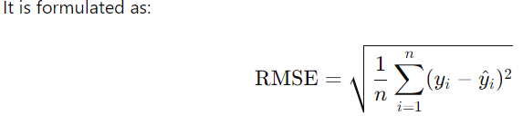
RMSE METRICS
RMSE is the square root of the MSE and provides an estimate of the standard deviation of the prediction errors.
RMSE is more interpretable than MSE because it is in the same unit as the dependent variable y.
Like MSE, RMSE also penalizes larger errors more heavily due to the square root operation.

Slide 10
THANK YOU!

