Slide 1
Ray Tracing
謝公耀

Slide 2
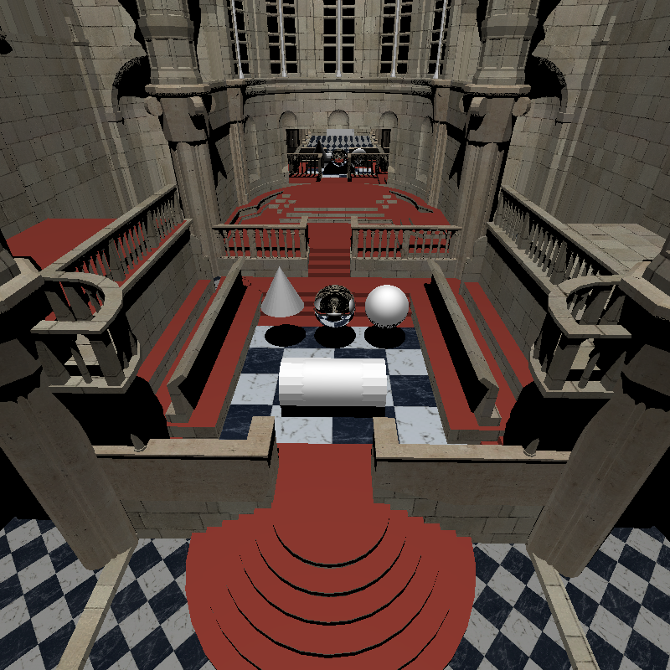
800 * 800 no jitter

Slide 3
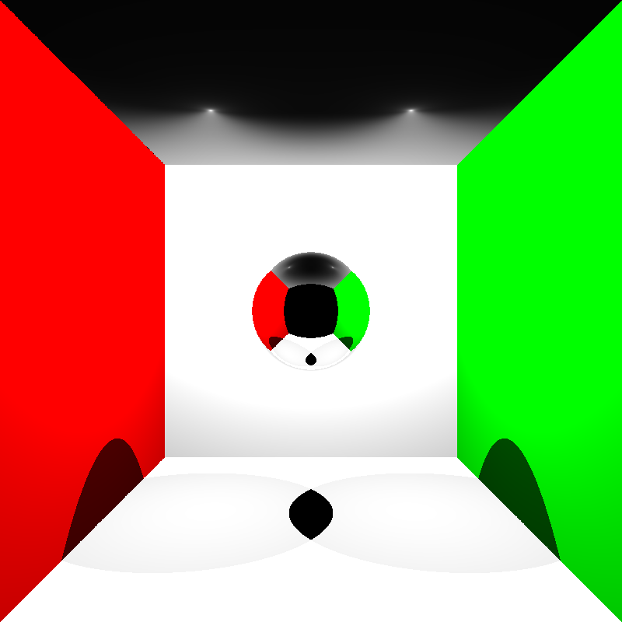
800 * 800 no jitter

Slide 4
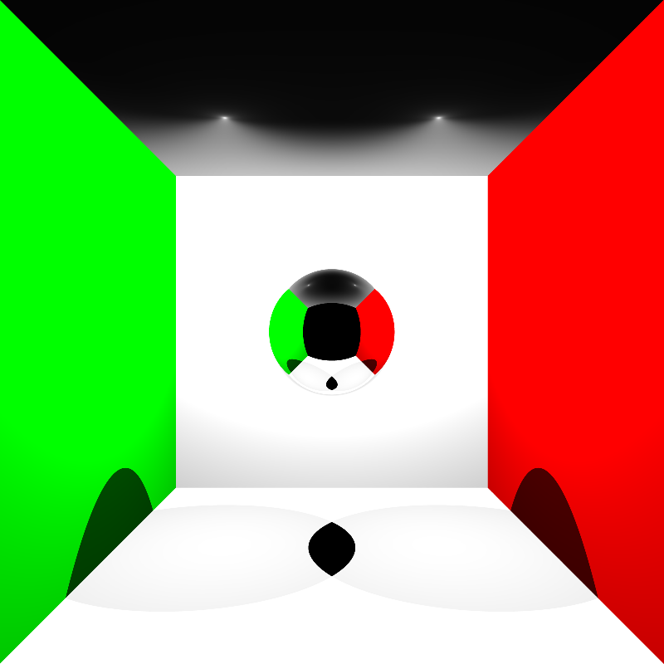
800 * 800 with jitter

Slide 5
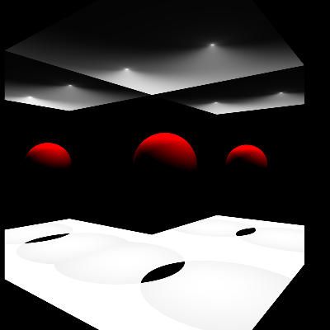
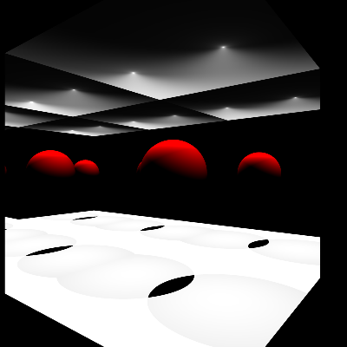
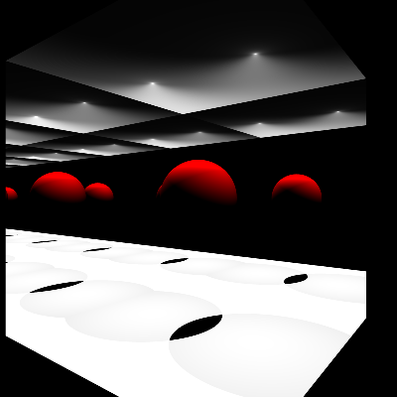
Adaptive termination criterion for tracing rays
固定遞迴次數，直到打中非透明及鏡子
Iteration 1
Iteration 3
Iteration 10

Slide 6
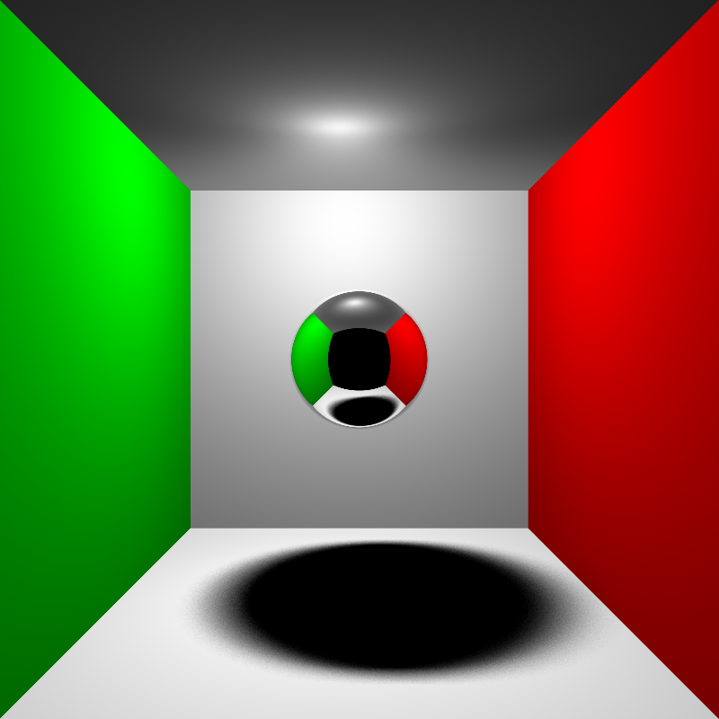
Area Light
範圍內取n * n個sample點
n = 3

