Slide 1
Inside RetroCastX

Slide 2
75
73
71
69
67
65
63
61
59
57
55
53
51
-
74
72
70
6866
64
62
60
58
56
54
52
-
SCL
TMS
PWDN
GND
IOVDD
R1
R3
IOGND
R6
R8
IOGND
G0
SDA
I2CA
RESETB
DVDD
IOGND
R0
R2
R4
R5
R7
R9
IOVDD
G1
GIN1
AVDD
AVDD
AGND
RIN2
A33GND
A33VDD
BIN3
BIN1
AGND
FIDOUT
HSOUT
-
2
4
6
8
10
12
14
16
18
20
22
24 -
SOGIN1
AGND
AGND
AVDD
RIN3
RIN1
A33VDD
A33GND
BIN2
AVDD
NSUB
VSOUT
SOGOUT
1
3
5
7
9
11
13
15
17
19
21
23
25
30
28
26
24
22
20
18
16
14
12
10
8
6
4
2
29
27
25
23
21
19
17
15
13
11
9
7
5
3
1
D1
C1
C2
E3
GND
3V3
B4
5V
D3
C17
B18
B20
F20
GND
3V3
E2
D2
B1
A3
GND
3V3
C3
GND
C4
A18
A19
B19
D20
GND
3V3
50
48
46
44
42
40
38
36
34
32
30
28
26
G3
G5
G7
G9
IOVDD
DVDD
B1
B3
B5
B7
B9
IOGND
-
G2
G4
G6
G8
IOGND
GND
B0
B2
B4
B6
B8
DTCLK
IOVDD
49
47
45
43
41
39
37
35
33
31
29
27 -
30
28
26
24
22
20
18
16
14
12
10
8
6
4
2
29
27
25
23
21
19
17
15
13
11
9
7
5
3
1
J20
L18
M18
N17
GND
3V3
U17
5V
T17
P17
R18
C18
U16
GND
3V3
SOGIN2
SOGIN3
A33GND
A33VDD
NSUB
PLLF
FILT1
PLLAVDD
PLLAGND
HSYNCA
VSYNCB
COAST
100
98
96
94
92
90
88
86
84
82
80
78
76
G20
K20
L20
N18
GND
3V3
P18
GND
U18
M17
R17
T18
K18
GND
3V3
GIN2
GIN3
GIN4
A33VDD
A33GND
PLLAG
FILT2
PLLAGND
PLLAVDD
HSYNCB
EXTCLK
VSYNCA
CLAMP
99
97
95
93
91
89
87
85
83
81
79
77
-

Slide 3
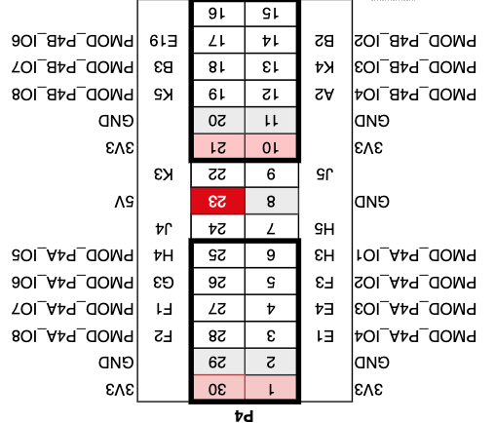
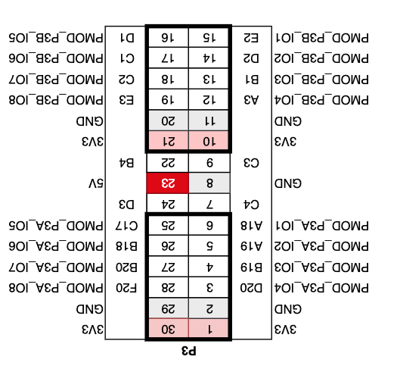
SOGIN1
AGND
AGND
AVDD
RIN3
RIN1
A33VDD
A33GND
BIN2
AVDD
NSUB
VSOUT
SOGOUT
GIN1
AVDD
AVDD
AGND
RIN2
A33GND
A33VDD
BIN3
BIN1
AGND
FIDOUT
HSOUT
-
2
4
6
8
10
12
14
16
18
20
22
24 -
1
3
5
7
9
11
13
15
17
19
21
23
25
30
28
26
24
22
20
18
16
14
12
10
8
6
4
2
29
27
25
23
21
19
17
15
13
11
9
7
5
3
1
-
E19
B3
K5
GND
3V3
K3
5V
J4
H4
G3
F1
F2
GND
3V3
-
B2
K4
A2
GND
3V3
J5
GND
H5
H3
F3
E4
E1
GND
3V3
IOVDD
DTACLK
B8
B6
B4
B2
B0
GND
IOGND
G8
G6
G4
G2
26
28
30
32
34
36
38
40
42
44
46
48
50
100
98
96
94
92
90
88
86
84
82
80
78
76
-
IOGND
B9
B7
B5
B3
B1
DVDD
IOVDD
G9
G7
G5
G3
-
27
29
31
33
35
37
39
41
43
45
47
49
99
97
95
93
91
89
87
85
83
81
79
77
-
SOGIN2
SOGIN3
A33GND
A33VDD
NSUB
PLLF
FILT1
PLLAVDD
PLLAGND
HSYNCA
VSYNCB
COAST
GIN2
GIN3
GIN4
A33VDD
A33GND
PLLAG
FILT2
PLLAGND
PLLAVDD
HSYNCB
EXTCLK
VSYNCA
CLAMP
75
73
71
69
67
65
63
61
59
57
55
53
51
SDA
I2CA
RESETB
DVDD
IOGND
R0
R2
R4
R5
R7
R9
IOVDD
G1
-
SCL
TMS
PWDN
GND
IOVDD
R1
R3
IOGND
R6
R8
IOGND
G0
-
74
72
70
6866
64
62
60
58
56
54
52
30
28
26
24
22
20
18
16
14
12
10
8
6
4
2
29
27
25
23
21
19
17
15
13
11
9
7
5
3
1
D1
C1
C2
E3
GND
3V3
B4
5V
D3
C17
B18
B20
F20
GND
3V3
E2
D2
B1
A3
GND
3V3
C3
GND
C4
A18
A19
B19
D20
GND
3V3
30
28
26
24
22
20
18
16
14
12
10
8
6
4
2
29
27
25
23
21
19
17
15
13
11
9
7
5
3
1
J20
L18
M18
N17
GND
3V3
U17
5V
T17
P17
R18
C18
U16
GND
3V3
G20
K20
L20
N18
GND
3V3
P18
GND
U18
M17
R17
T18
K18
GND
3V3

