Slide 1






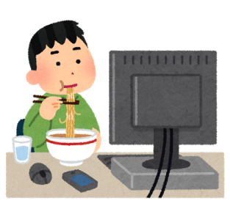
Keyword
Search result
URL
Body
2
Get page body
URL
get-search-result
get-body
1
Get search result
Body
collect
4
Analyze
3
Store

