Slide 1
BREAST CANCER DETECTION SYSTEM
Under Supervision of:
Dr. Ravindara Bhatt
Submitted by:
Parul Sharma (191206)
Kunika Sharma (191227)
Ria Mahajan (191236)

Slide 2
TABLE OF CONTENTS
PROBLEM STATEMENT
MACHINE LEARNING MODELS
DATASET
PRELIMINARIES
LITERATURE SURVEY
SYSTEM ARCHITECTURE
DEEP LEARNING MODELS
EFFICIENCY ANALYSIS
FUTURE PLANS
REFERENCES

Slide 3
PROBLEM STATEMENT
The project proposes to investigate the data available and attempt to predict the possibility that a breast cancer diagnosis is malignant or benign based on the attributes collected from the dataset.
The characteristics of the breast mass id computed from the digitized images. Further, the proposed system plans to use various Machine Learning & Convolutional Neural Networks (CNN) architectures to automatically detect breast cancer comparing the results using various performance metrics..

Slide 4
DATA SET
The following two datasets have been used in the project:
Wisconsin Breast Cancer Dataset [https://urlzs.com/dicpH]
Attribute Information:
1) ID number
2) Diagnosis (M = malignant, B = benign)
3) Ten real-valued features are computed for each cell nucleus
Breast Histopathology Dataset [https://urlzs.com/dCpWx]
1) 162 whole mount slide pictures of Breast Cancer (BCa) specimens were scanned at 40x in the original dataset.
2) 277,524 50 x 50 patches were retrieved from that (198,738 IDC negative and 78,786 IDC positive).
3) The images were in png format.
4) example uxXyYclassC.png uxXyYclassC.png

Slide 5
PRELIMINARIES
Machine Learning
Deep Learning
Python
Machine learning is closely related to(and often overlaps with) computational statistics, which also focuses on prediction-making through the use of computers.
Deep learning is part of a broader family of machine learning methods based on artificial neural networks with representation learning.
Python is a multi-paradigm programming language

Slide 6
LITERATURE SURVEY

Slide 7
AUTHORS | DATASET | METHODOLOGY | PERFORMANCE METRICS | RESULTS | LIMITATIONS
Saad Awadh Alanazi,¹ M. M. Kamruzzaman,¹ Md Nazirul Islam Sarker,² Madallah Alruwaili,³ Yousef Alhwaiti,¹ Nasser Alshammari,¹ and Muhammad Hameed Siddiqi¹ (05 Apr 2021)https://www.hindawi.com/journals/jhe/2021/5528622/ | https://www.kaggle.com/code/paultimothymooney/predict-idc-in-breast-cancer-histology-images/data | Three different CNN architectures Implemented and then compared with the machine learning (ML) algorithm. | Accuracy Precision | CNN Model 3 achieves 87% accuracy. Model 3 is best suited for this task. Model improved accuracy by 8% when compared with ML. | Using the secondary database like Kaggle, and future study should be done based on primary data for more accuracy of the results related to breast cancer identification.
Mehedi Masud, Amr E. Eldin Rashed & M. Shamim Hossain (09 October 2020) https://link.springer.com/article/10.1007/s00521-020-05394-5 | Dataset of breast ultrasound images. Data Brief. https://doi.org/10.1016/j.dib.2019.104863 | implemented eight pre-trained CNN models with fine tuning leveraging transfer learning from ultrasound images. | Accuracy (ACC), Area Under Curve (AUC), precision, recall, sensitivity, specificity, and F1-score. Confusion matrix for each model is also generated | The highest accuracy 92.4% is achieved by the ResNet50 with Adam optimizer and the highest AUC 0.97 score is achieved by VGG16. The custom model achieved 100% accuracy | all the pre-trained models have many convolutional layers and need long duration in the training phase.

Slide 8
AUTHORS | DATASET | METHODOLOGY | PERFORMANCE METRICS | RESULTS | LIMITATIONS
Huang M-W, Chen C-W, Lin W-C, Ke S-W, Tsai C-F (2017) SVM and SVM Ensembles in Breast Cancer Prediction. PLoS ONE 12(1): e0161501. https://doi.org/10.1371/journal.pone.0161501 January 6, 2017 | http://archive.ics.uci.edu/ml/, http://www.sigkdd.org/kddcup/index.php. | dataset is divided into 90% training and 10% testing sets based on the 10-fold cross validation .constructed the SVM classifiers using different kernel functions.. | accuracy, ROC, and F-measure rates | classification accuracy, ROC, and F-measure of 99.41%, 0.875, and 0.994, respectively | the computational burden can be certainly lessened.
Seyyid Ahmed Medjahed Tamazouzt Ait Saadi Abdelkader Benyettou Breast Cancer Diagnosis by using k-Nearest Neighbor with Different Distances and Classification Rules(1, January 2013) https://scholar.google.com/scholar?q=Using+three+machine+learning+techniques+for+predicting+breast+cancer+recurrence+Ahmad+2013 | (Wisconsin breast cancer database) | k-nearest neighbors that is experimented with several variants of distances, different values of k and different classification rules.The k nearest neighbors does not require learning phase | accuracy | In two types of distance that give the best results (98, 70% for Euclidean distance and 98, 48% for Manhattan with k = 1), these values are not significantly affected even when k = 1 is increased to 50 | some data may not be classified

Slide 9
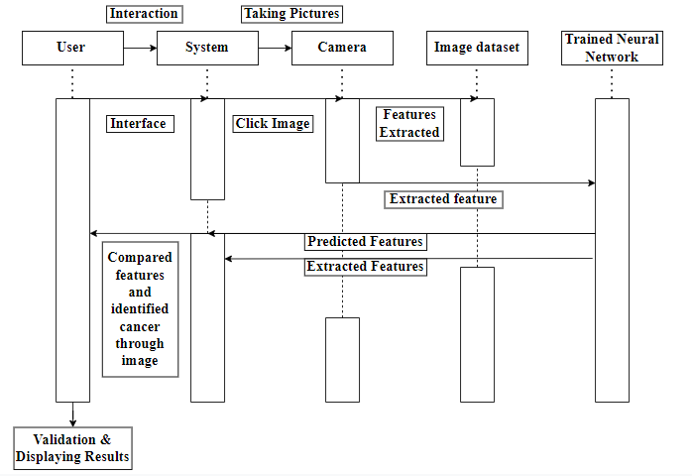
SYSTEM ARCHITECTURE

Slide 10
K Nearest Neighbour ( KNN )
Supervised Machine Learning algorithm used to solve both classification and regression tasks.
Based on the common saying “ Our Behaviour is guided by the friends we grow up with.”
Determines the class of a datapoint by majority voting principle.

Slide 11
SUPPORT VECTOR MACHINE
(SVM )
Approach to supervised pattern classification.
Capable of Performing linear or non-linear classification ,regression and outlier detection.
Well suited for classification of small or medium sized datasets.
SVM is a training algorithm for learning classification and regression rules from data.
How Does SVM Classify?
Creates a line or a hyperplane which separates the data into classes.

Slide 12
CONVOLUTIONAL NEURAL NETWORKS (CNN )
Ability to handle large amounts of data.
Uses hidden layers and has surpassed traditional techniques, especially in pattern recognition.
ADVANTAGES :
Uses multi-layered network.
The availability of large sets of image data,

Slide 13
Residual Network Pre-Trained Model (ResNet-50)
In the ResNet50 architecture, a combination of convolution filters of various sizes is used to address the deterioration issue of CNN models and reduce the training time caused by the deep structure. ResNet50 is composed of 48 convolutional layers, as well as a maxpool layer and an average pool layer. There are over 23 million trainable parameters in this architecture.

Slide 14
Virtual Geometry Group (VGG16)
The most distinguishing feature of VGG16 is that instead of a large number of hyper-parameters, they focused on having convolution layers of 3x3 filter with stride 1 and always used the same padding and maxpool layer of 2x2 filter with stride 2. Throughout the architecture, this arrangement of convolution and max pool layers is consistent. Finally, it has two FC (fully connected layers) and a softmax for output. The 16 in VGG16 refers to the fact that it has 16 weighted layers. This network is quite large in size.

Slide 15
EFFICIENCY ANALYSIS
 | ACCURACY
KNN | 96.27%
SVM | 93.7%
CNN | Custom CNN -69.71% ResNet-50 Model -92.17% VGG-16 Model -97.96%

Slide 16
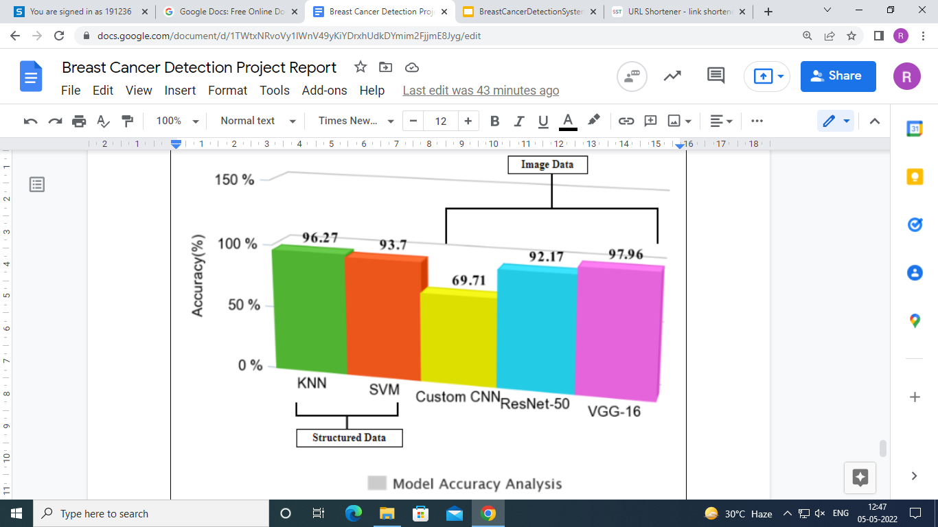

Slide 17
Future Plans
01.
Histopathological Image Analysis
02.
SCOPE
Apply other DL models like VGG19,DenseNet to the image dataset.
Designing an appropriate UI for the system

Slide 18
REFERENCES
[1] Masud, M., Eldin Rashed, A. E., & Hossain, M. S. (2020). Convolutional neural
network-based models for diagnosis of breast cancer. Neural Computing and Applications.
doi:10.1007/s00521-020-05394-5.
[2] Alanazi, S. A., Kamruzzaman, M. M., Islam Sarker, M. N., Alruwaili, M., Alhwaiti, Y.,
Alshammari, N., & Siddiqi, M. H. (2021). Boosting breast cancer detection using
convolutional neural network. Journal of Healthcare Engineering, 2021.
[3] Ahmad, L. G., Eshlaghy, A. T., Poorebrahimi, A., Ebrahimi, M., & Razavi, A. R. (2013).
Using three machine learning techniques for predicting breast cancer recurrence. J Health
Med Inform, 4(124), 3.
[4] Huang, M. W., Chen, C. W., Lin, W. C., Ke, S. W., & Tsai, C. F. (2017). SVM and SVM
ensembles in breast cancer prediction. PloS one, 12(1), e0161501.
[5] Agarap, A. F. M. (2018, February). On breast cancer detection: an application of
machine learning algorithms on the wisconsin diagnostic dataset. In Proceedings of the 2nd

