Slide 1
Vorticity
Cluster analysis

Slide 2
Outline

Slide 3
Data Structure
Variables
Dimensions
[1] "ID" | "Country“ - Factor | "Age" | "Gender“ - Factor
[5] "BSA" | "HRmin" | "SBP" | "DBP"
[9] "Etiology“- Factor | "NYHA“- Factor | "EchoLA" | "EchoIVS"
[13] "EchoPW" | "EchoDd" | "EchoDs" | "bEF"
[17] "RWT" | "LVMass" | "EchoLVMI" | "EchoEDV"
[21] "EchoESV" | "EchoSV" | "EchoEF" | "AbnormalEF50"
[25] "EchoTMfEwave" | "EchoTMfAwave" | "TimeTMFDecT" | "EchoTMfEtoA"
[29] "EchoLAVI" | "EchSepTDIe" | "EchoLatTDIe" | "EchoAveTDIe"
[33] "EchoSeptEe" | "EchoRVSP" | "EchoLVM" | "EchoLVMII"
[37] "TimePIVRRms" | "TimePIvEonset" | "TimePIvEonsetNorRR" | "TimePIvEpeak"
[41] "TimePIvEpeakNorRR" | "TimeVSonset" | "TimePeakVSE" | "Tracking"
[45] "VortexArea" | "VortexIntensity" | "VortexDepth" | "VortexLength"
[49] "EnergyDissipation" | "VorticityFluctuation" | ”KineticEnergyFluctuation" | "ShearStressFluctuation"
[53] "KineticEnergyEarlyD" | "KineticEnergyLateD" | "KineticEnergyOnsetSystole" | "LAVI35"
[57] "SeptTDIe7" | "LatTDIe10" | "EtoTDIe14" | "TRVmax"
[61] "Diastolic4count“- Factor | "DiastDysfunction3of4“- Factor | "DiastCount“- Factor | "DiastDysfunASE“- Factor
Row: 96
Columns: 64
Notes:
Used 2016 guidelines to create Dias

Slide 4
Missing Data
Low
High

Slide 5
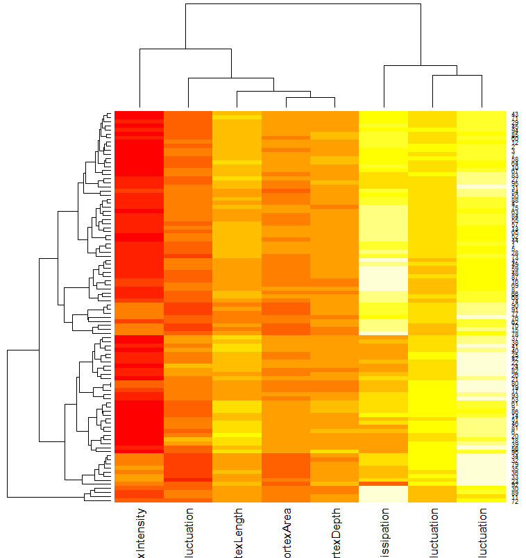
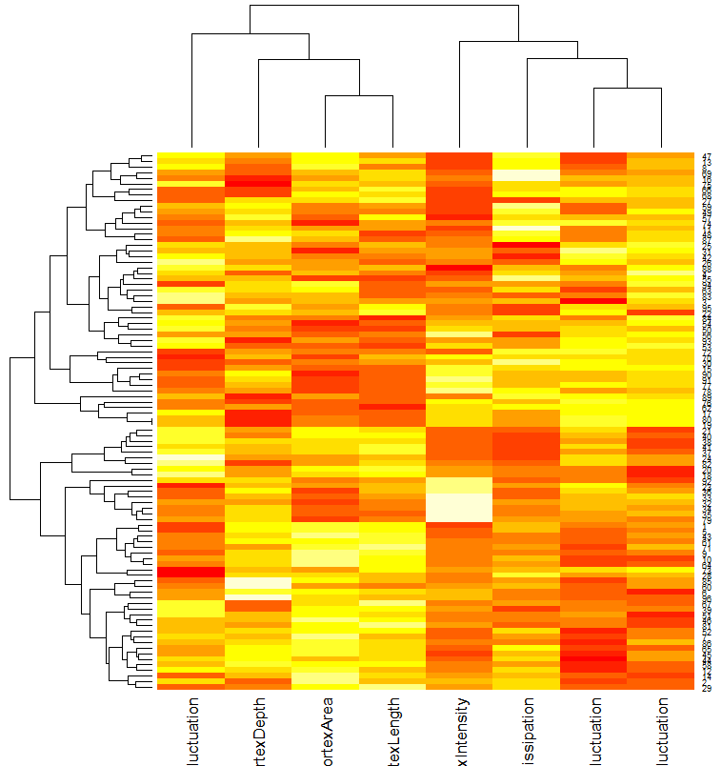
Heatmap – Vorticity Data
Un-scaled
Scaled

Slide 6
Correlation Matrix

Slide 7
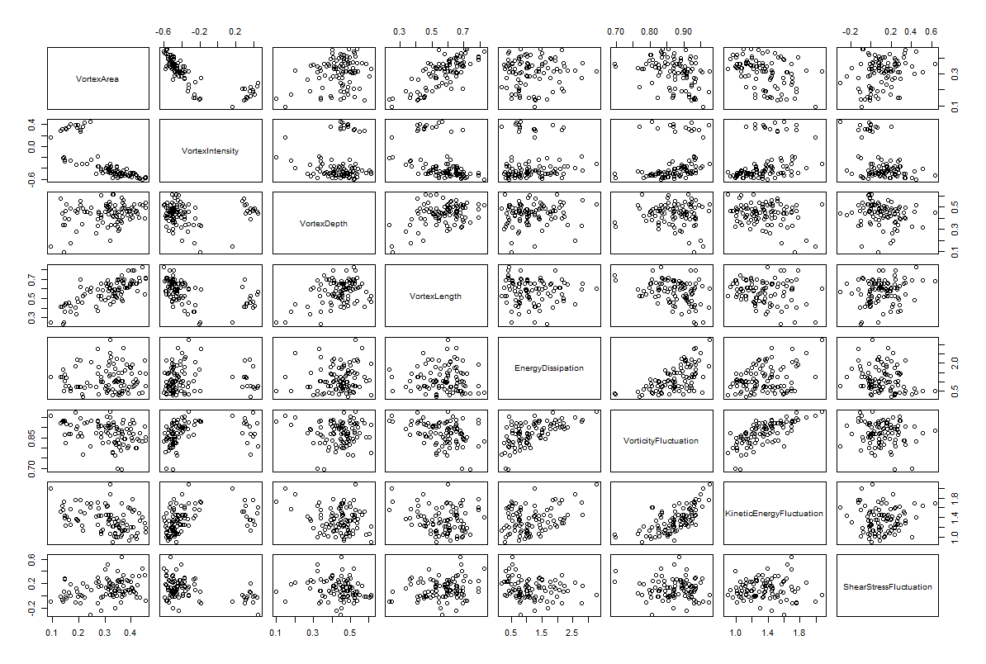
Scatterplot Matrix

Slide 8
Principal Component Analysis
Summary
Loadings

Slide 9
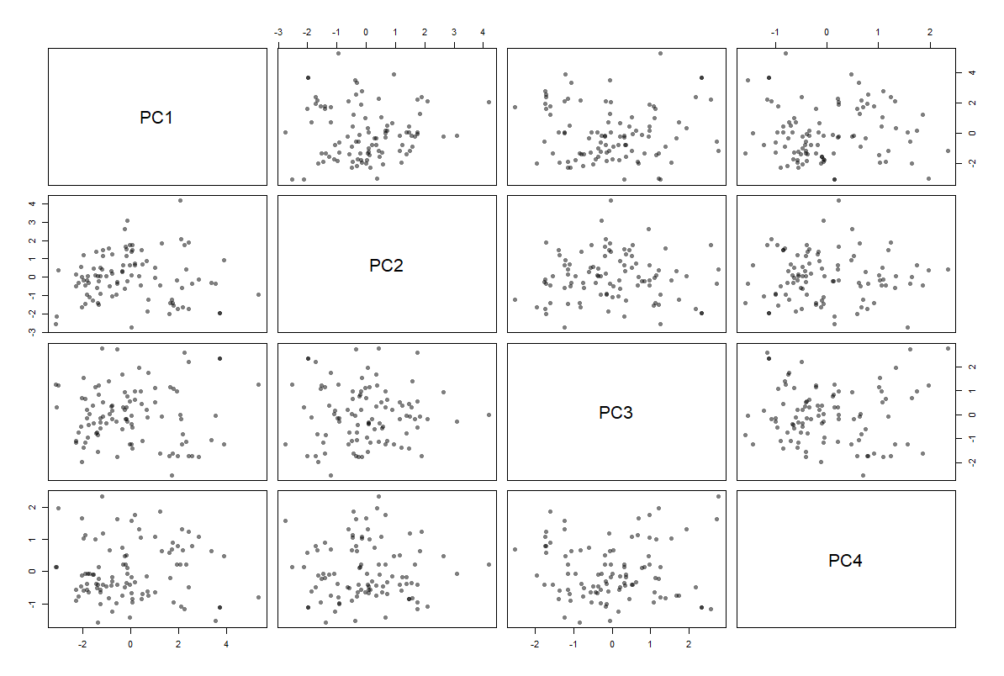
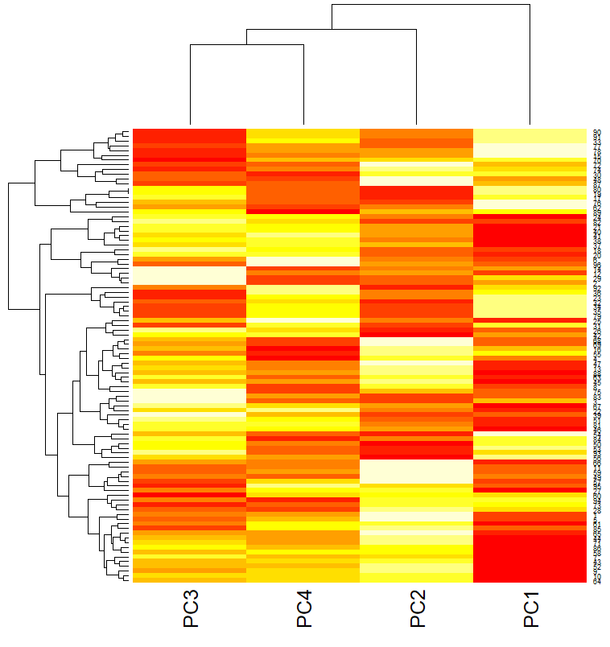
PCA – Scatterplot Matrix + Heatmap

Slide 10
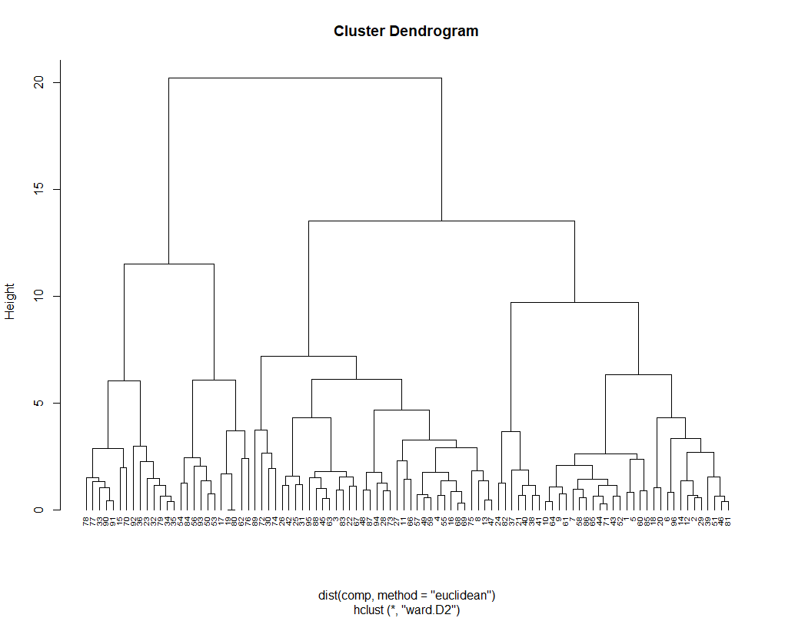
Hierarchical Clustering
Agglomerative Coefficients – a measure
of the clustering structure
Average | Single | Complete | Ward’s Method
0.7656333 | 0.6595636 | 0.8810995 | 0.9480419

Slide 11
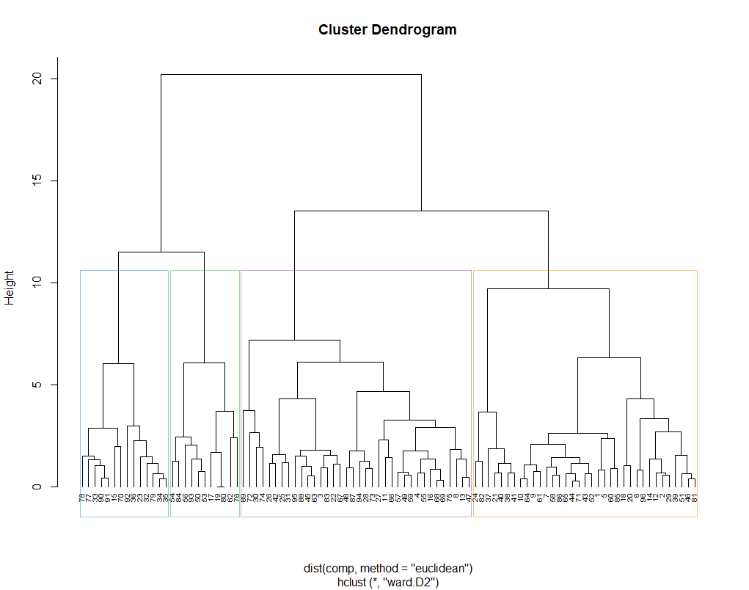
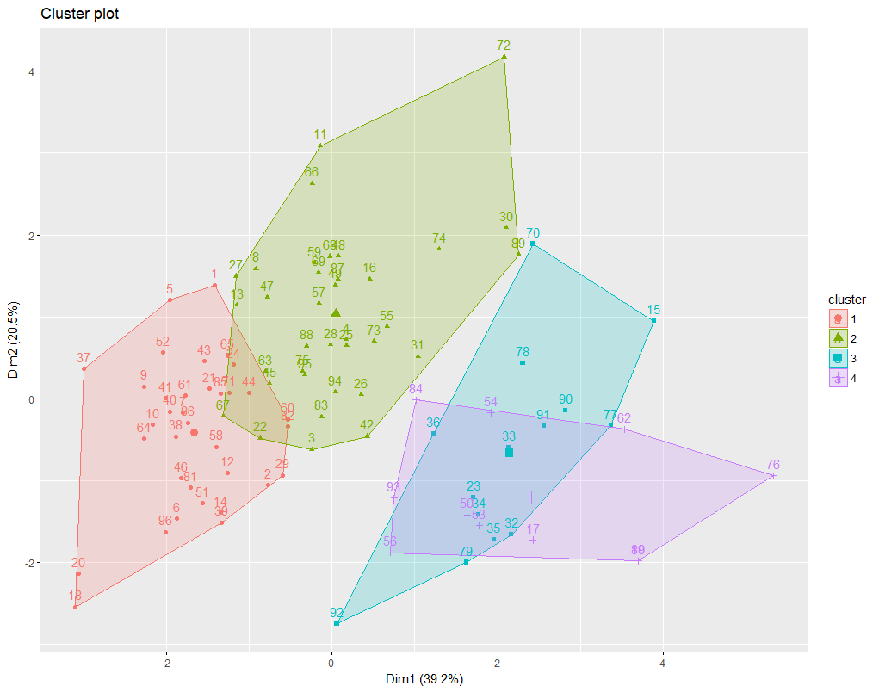
Hierarchical Clustering
Cluster (k = 4)
4 | 3 | 1 | 2
11 | 14 | 35 | 36
K = 4

Slide 12
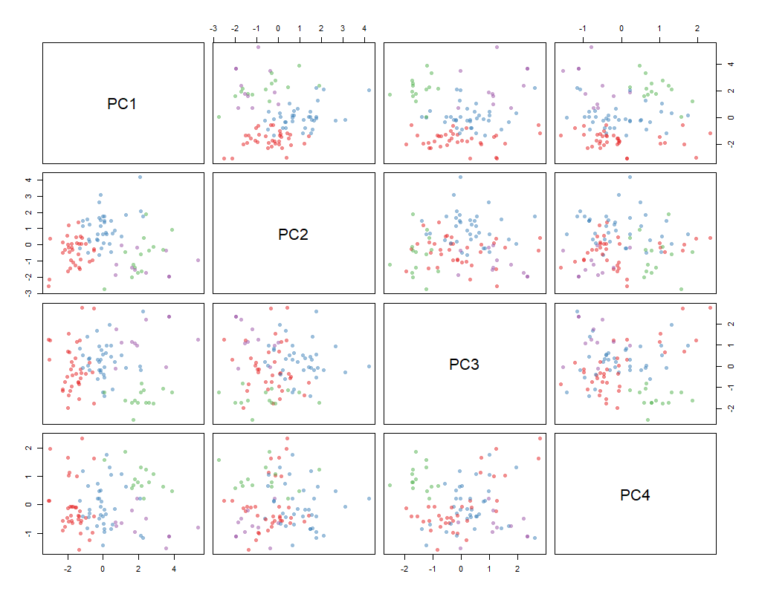
Clustering PCA

Slide 13
Descriptive Statistics – Continuous Variables

Slide 17
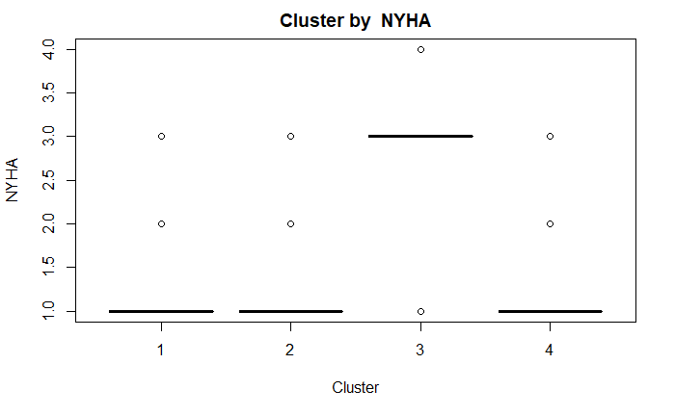
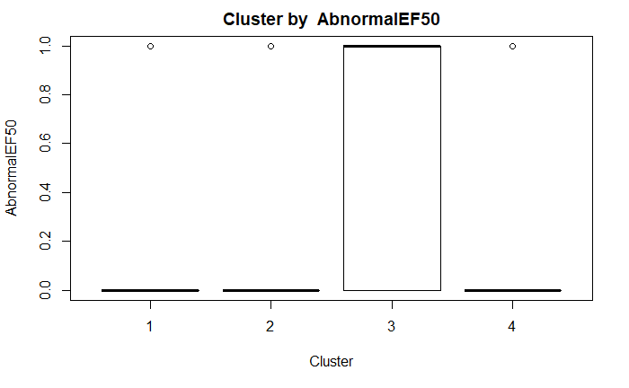
Test of Independence
Cluster vs NYHA
Cluster vs AbnormalEF50
comparison | raw.p | adj.p
1 vs. 2 | 1.0000 | 1.0000
1 vs. 3 | 0.0000 | 0.0000
1 vs. 4 | 1.0000 | 1.0000
2 vs. 3 | 0.0000 | 0.0000
2 vs. 4 | 1.0000 | 1.0000
3 vs. 4 | 0.0019 | 0.0114
comparison | raw.p | adj.p
1 vs. 2 | 0.7775 | 1.0000
1 vs. 3 | 0.0027 | 0.0159
1 vs. 4 | 1.0000 | 1.0000
2 vs. 3 | 0.0009 | 0.0055
2 vs. 4 | 1.0000 | 1.0000
3 vs. 4 | 0.0361 | 0.2164

Slide 18
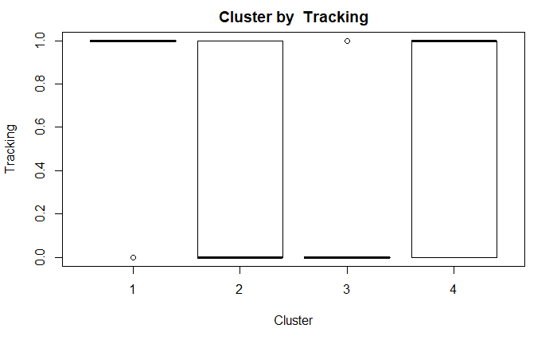
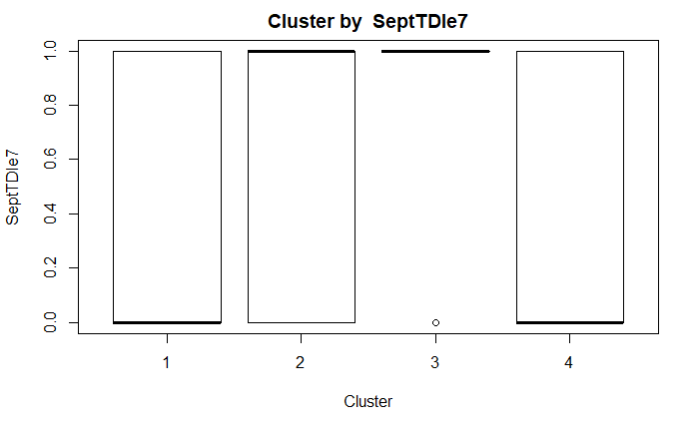
Test of Independence
Cluster vs Tracking
Cluster vs SeptTDIe7
comparison | raw.p | adj.p
1 vs. 2 | 0.0024 | 0.0145
1 vs. 3 | 0.0000 | 0.0002
1 vs. 4 | 0.4024 | 1.0000
2 vs. 3 | 0.0922 | 0.5534
2 vs. 4 | 0.2837 | 1.0000
3 vs. 4 | 0.0131 | 0.0783
comparison | raw.p | adj.p
1 vs. 2 | 0.3442 | 1.0000
1 vs. 3 | 0.0156 | 0.0937
1 vs. 4 | 0.4771 | 1.0000
2 vs. 3 | 0.0782 | 0.4694
2 vs. 4 | 0.1573 | 0.9438
3 vs. 4 | 0.0166 | 0.0998

Slide 19
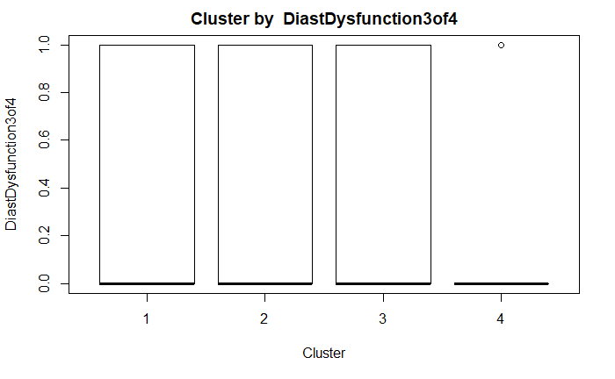
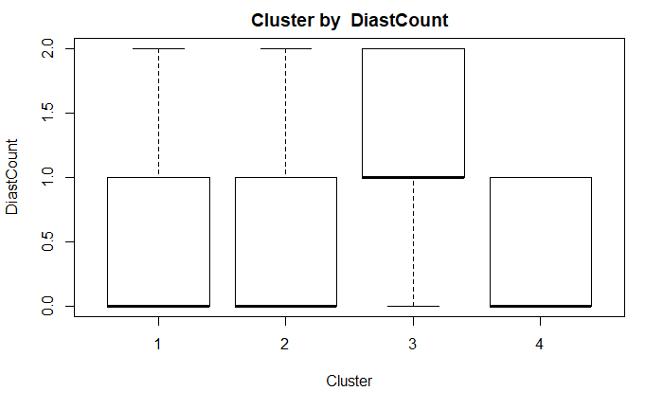
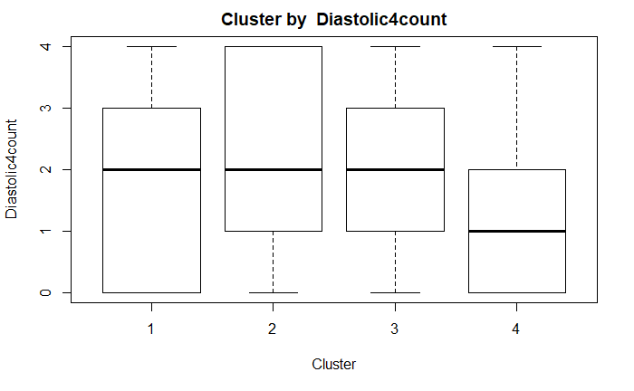
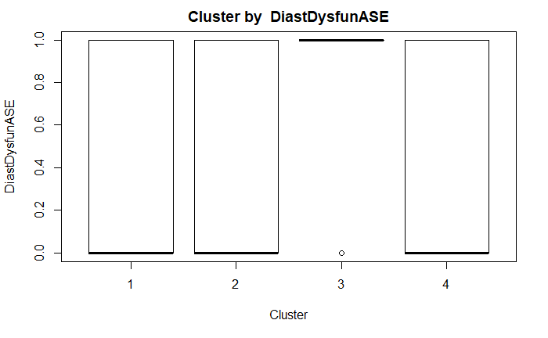
Diastolic Functions
Diastolic Dysfunction 3 of 4
Diastolic Count
Diastolic 4 Count
Diastolic Dysfunction ASE
p-value: 0.439
p-value: 0.145
p-value: 0.7745
p-value: 0.09399

Slide 26
Clusters and Cases
Cluster 1
Cluster 2
Cluster 3
Cluster 4
Cases | NYHA | Abnormal EF50
1 | 1 | 0
2 | 1 | 0
5 | 1 | 0
6 | 1 | 0
7 | 1 | 0
9 | 1 | 0
10 | 1 | 1
12 | 1 | 0
14 | 1 | 0
18 | 1 | 0
20 | 1 | 0
⁞ | ⁞ | ⁞
86 | 2 | 1
96 | NA | 1
Cases | NYHA | Abnormal EF50
3 | 1 | 0
4 | 1 | 0
8 | 1 | 0
11 | 1 | 0
13 | 1 | 0
16 | 1 | 0
22 | 1 | 0
25 | 1 | 0
26 | 1 | 0
27 | 1 | 0
28 | 1 | 0
⁞ | ⁞ | ⁞
94 | 1 | 1
95 | 3 | 1
Cases | NYHA | Abnormal EF50
15 | NA | 0
23 | 1 | 0
32 | 3 | 1
33 | 3 | 1
34 | 3 | 1
35 | 3 | 1
36 | 1 | 0
70 | NA | 0
77 | 3 | 1
78 | 3 | 1
79 | 3 | 1
90 | 4 | 1
91 | 3 | 1
92 | 3 | 1
Cases | NYHA | Abnormal EF50
17 | 1 | NA
19 | 1 | 0
50 | 1 | 0
53 | 1 | 0
54 | 1 | 0
56 | 1 | 0
62 | 3 | 1
76 | 2 | 1
80 | 1 | 0
84 | 1 | 0
93 | 1 | 0
 | Gender
Age Range |  | 0 (F) | 1 (M)
 | < 40 | 4 | 1
 | 40 - 60 | 30 | 8
 | 60 – 80 | 40 | 1
 | 80 + | 8 | 0
 | Diastolic Dysfunction 3 0f 4
Cluster |  | 0 | 1
 | 1 | 20 | 15
 | 2 | 20 | 16
 | 3 | 9 | 5
 | 4 | 9 | 2
 | Diastolic Count
Cluster |  | 0 | 1 | 2
 | 1 | 20 | 15 | 8
 | 2 | 20 | 16 | 7
 | 3 | 3 | 11 | 4
 | 4 | 7 | 4 | 0
 | Diastolic Dysfunc ASE
Cluster |  | 0 | 1
 | 1 | 20 | 15
 | 2 | 20 | 16
 | 3 | 3 | 11
 | 4 | 7 | 4
 | Diastolic 4 Count
Cluster |  | 0 | 1 | 2 | 3 | 4
 | 1 | 10 | 5 | 5 | 8 | 7
 | 2 | 5 | 9 | 6 | 6 | 10
 | 3 | 2 | 4 | 3 | 2 | 3
 | 4 | 4 | 2 | 3 | 1 | 1
Notes:
Show mean, min, max, sd for cont
Show count and percentage for factor

Slide 27
END

