Slide 1
Vorticity
Cluster analysis

Slide 2
Outline

Slide 3
Data Structure
Variables
Dimensions
[1] "ID" | "Country“ - Factor | "Age" | "Gender“ - Factor
[5] "BSA" | "HRmin" | "SBP" | "DBP"
[9] "Etiology“- Factor | "NYHA“- Factor | "EchoLA" | "EchoIVS"
[13] "EchoPW" | "EchoDd" | "EchoDs" | "bEF"
[17] "RWT" | "LVMass" | "EchoLVMI" | "EchoEDV"
[21] "EchoESV" | "EchoSV" | "EchoEF" | "AbnormalEF50"
[25] "EchoTMfEwave" | "EchoTMfAwave" | "TimeTMFDecT" | "EchoTMfEtoA"
[29] "EchoLAVI" | "EchSepTDIe" | "EchoLatTDIe" | "EchoAveTDIe"
[33] "EchoSeptEe" | "EchoRVSP" | "EchoLVM" | "EchoLVMII"
[37] "TimePIVRRms" | "TimePIvEonset" | "TimePIvEonsetNorRR" | "TimePIvEpeak"
[41] "TimePIvEpeakNorRR" | "TimeVSonset" | "TimePeakVSE" | "Tracking"
[45] "VortexArea" | "VortexIntensity" | "VortexDepth" | "VortexLength"
[49] "EnergyDissipation" | "VorticityFluctuation" | ”KineticEnergyFluctuation" | "ShearStressFluctuation"
[53] "KineticEnergyEarlyD" | "KineticEnergyLateD" | "KineticEnergyOnsetSystole" | "LAVI35"
[57] "SeptTDIe7" | "LatTDIe10" | "EtoTDIe14" | "TRVmax"
[61] "Diastolic4count“- Factor | "DiastDysfunction3of4“- Factor | "DiastCount“- Factor | "DiastDysfunASE“- Factor
Row: 96
Columns: 64

Slide 4
Missing Data
Low
High

Slide 5
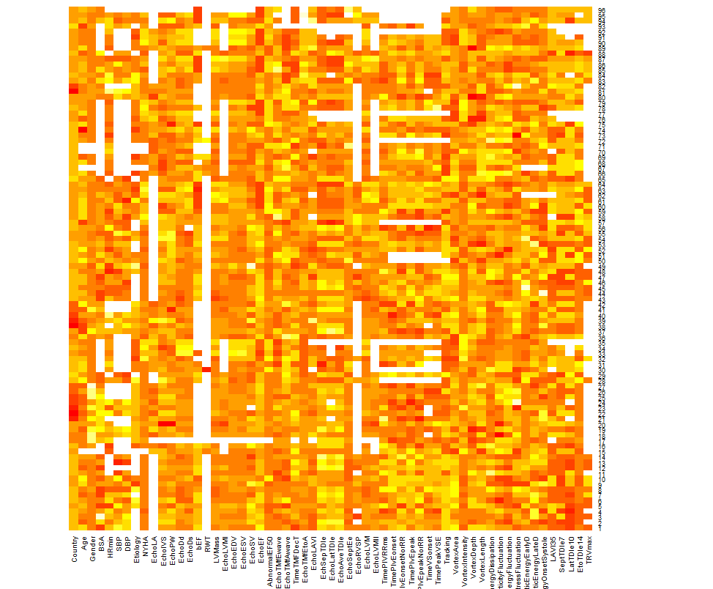
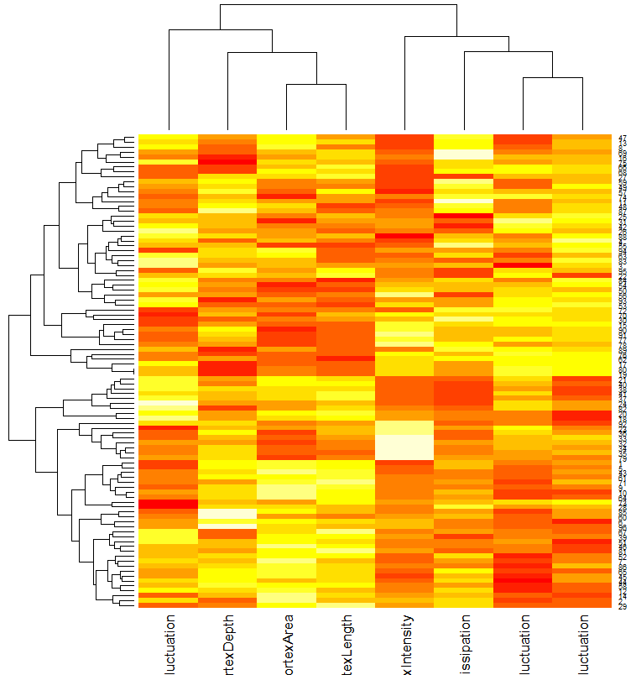
Heatmap

Slide 6
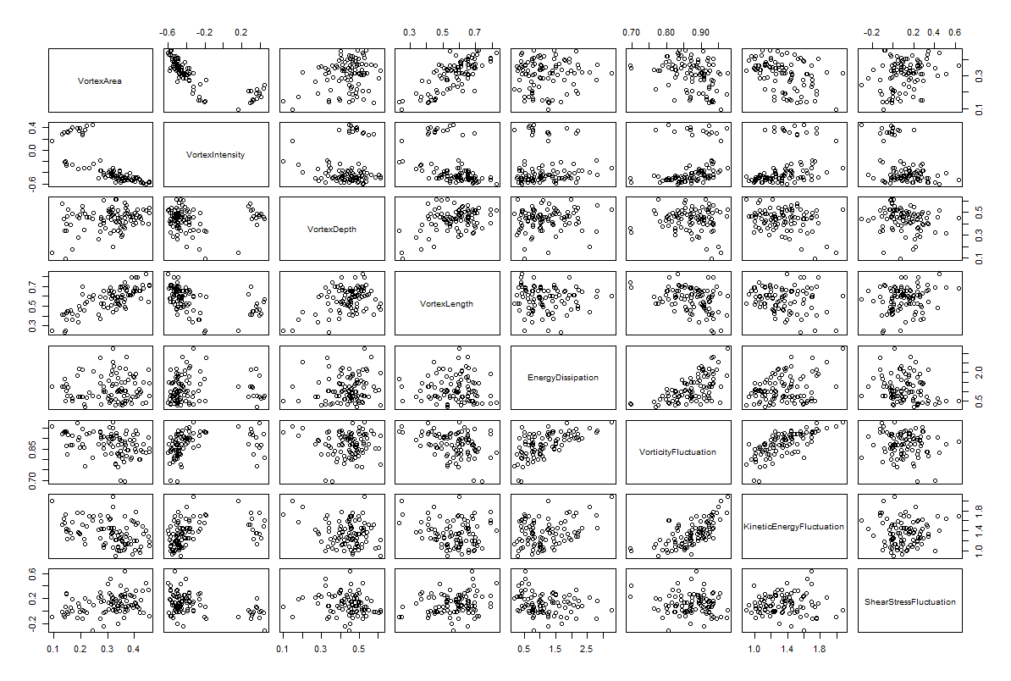
Scatterplot Matrix

Slide 7
Correlation Matrix

Slide 8
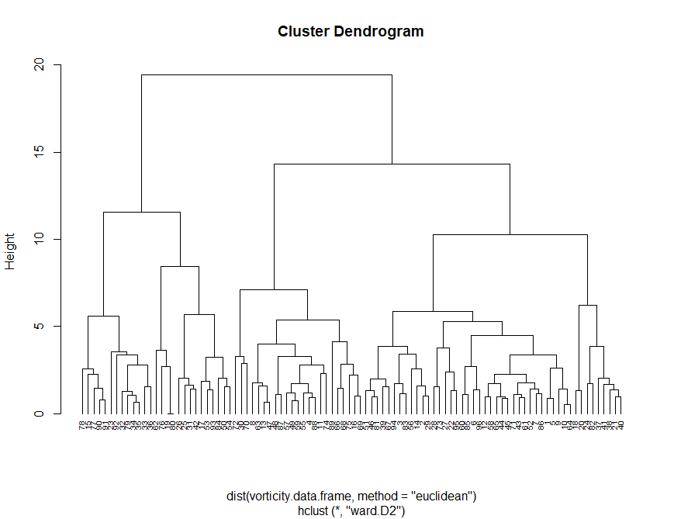
Hierarchical Clustering
Agglomerative Coefficients – a measure
of the clustering structure
Average | Single | Complete | Ward’s Method
0.7174621 | 0.5765339 | 0.8389593 | 0.9248588

Slide 9
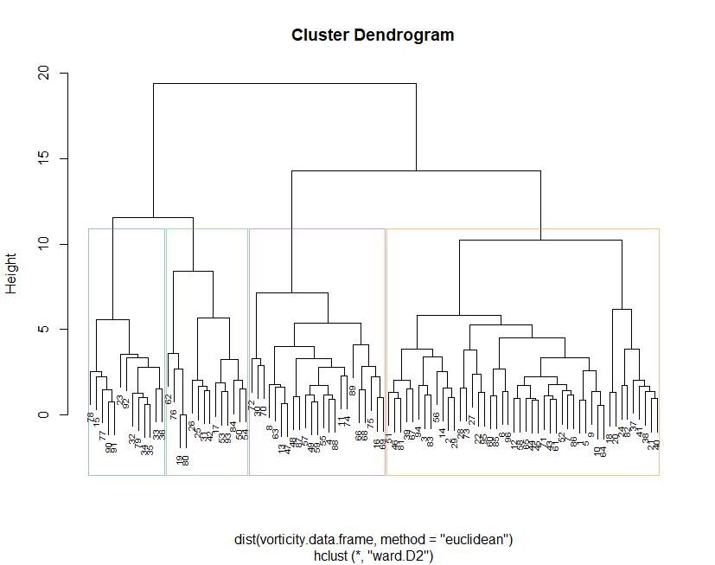
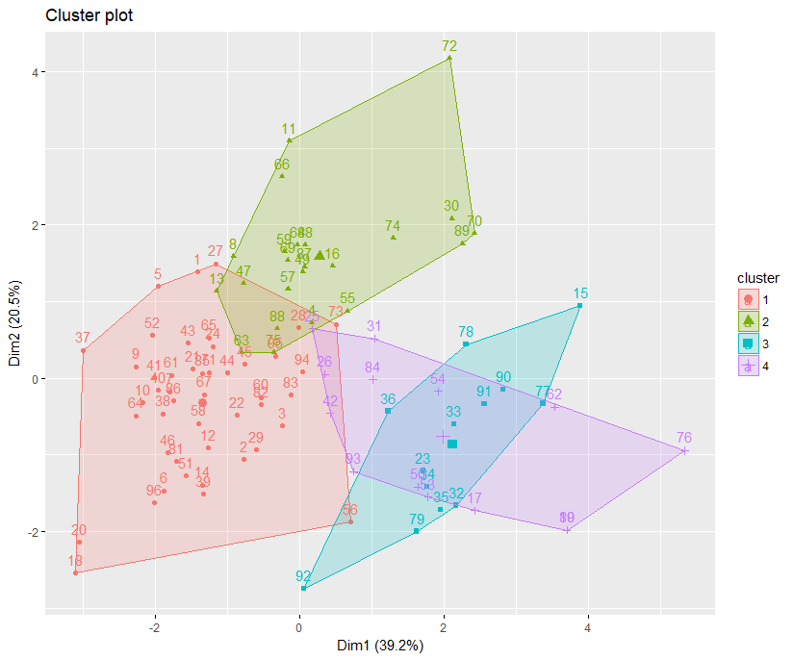
Hierarchical Clustering
Cluster (k = 4)
1 | 2 | 3 | 4
46 | 23 | 13 | 14
K = 4
Cluster | Cases
# Cluster 1 | 15 23 32 33 34 35 36 77 78 79 90 91 92
# Cluster 2 | 17 19 25 26 31 42 50 53 54 62 76 80 84 93
# Cluster 3 | 4 8 11 13 16 30 47 48 49 55 57 59 63 66 68 69 70 72 74 75 87 88 89
# Cluster 4 | 1 2 3 5 6 7 9 10 12 14 18 20 21 22 24 27 28 29 37 38 39 40 41 43 44 45 46 51 52 56 58 60 61 64 65 67 71 73 81 82 83 85 86 94 95 96

Slide 10
Vorticity Col-means
 | Cluster
 | 1 | 2 | 3 | 4
VortexArea | 0.59117402 | 0.3114149 | -1.3856472 | -1.1673668
VortexIntensity | -0.56591219 | -0.2283089 | 2.2491203 | 0.1460359
VortexDepth | 0.16559679 | 0.1419728 | 0.4447185 | -1.1902977
VortexLength | 0.51756685 | 0.2202044 | -0.7086024 | -1.4043532
EnergyDissipation | -0.46949331 | 1.3389013 | -0.2277096 | -0.4455581
VorticityFluctuation | -0.66252572 | 0.7644057 | 0.1206691 | 0.8090109
KineticEnergyFluctuation | -0.58078399 | 0.4517026 | 0.3049602 | 0.8830300
ShearStressFluctuation | 0.03838312 | 0.1429320 | -0.8119033 | 0.3929773

Slide 11
Descriptive Statistics – Continuous Variables

Slide 15
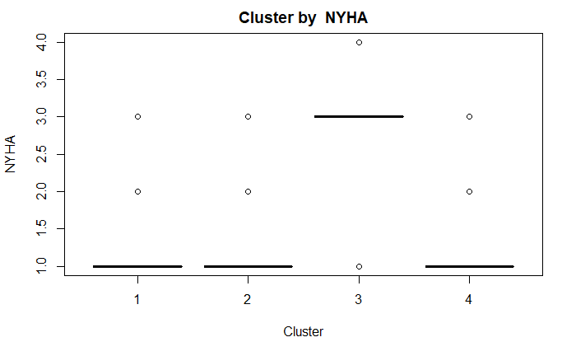
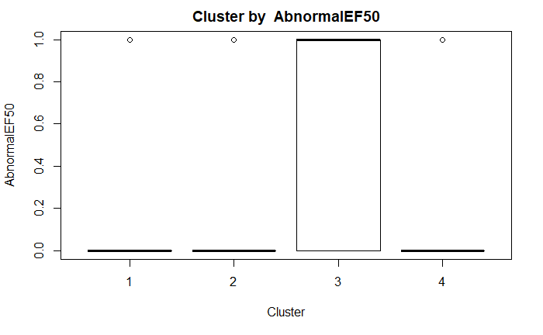
Test of Independence
Cluster vs NYHA
Cluster vs AbnormalEF50
comparison | raw.p | adj.p
1 vs. 2 | 0.5210 | 1.0000
1 vs. 3 | 0.0000 | 0.0000
1 vs. 4 | 1.0000 | 1.0000
2 vs. 3 | 0.0000 | 0.0000
2 vs. 4 | 1.0000 | 1.0000
3 vs. 4 | 0.0003 | 0.0018
comparison | raw.p | adj.p
1 vs. 2 | 0.7775 | 1.0000
1 vs. 3 | 0.0027 | 0.0159
1 vs. 4 | 1.0000 | 1.0000
2 vs. 3 | 0.0009 | 0.0055
2 vs. 4 | 1.0000 | 1.0000
3 vs. 4 | 0.0361 | 0.2164

Slide 16
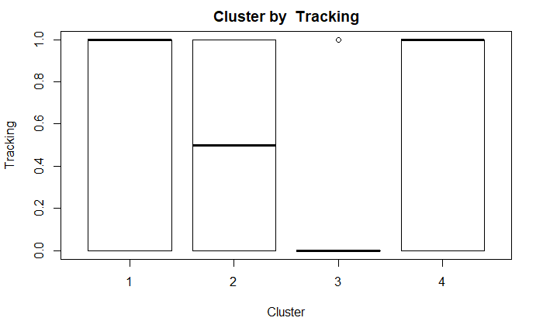
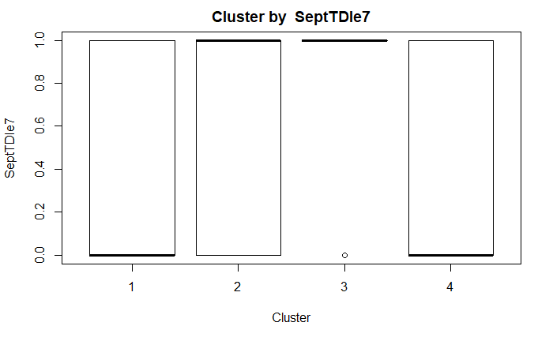
Test of Independence
Cluster vs Tracking
Cluster vs SeptTDIe7
comparison | raw.p | adj.p
1 vs. 2 | 0.0988 | 0.5930
1 vs. 3 | 0.0006 | 0.0035
1 vs. 4 | 0.1947 | 1.0000
2 vs. 3 | 0.0750 | 0.4498
2 vs. 4 | 1.0000 | 1.0000
3 vs. 4 | 0.0968 | 0.5811
comparison | raw.p | adj.p
1 vs. 2 | 0.8013 | 1.0000
1 vs. 3 | 0.0042 | 0.0251
1 vs. 4 | 0.7470 | 1.0000
2 vs. 3 | 0.0148 | 0.0887
2 vs. 4 | 0.4887 | 1.0000
3 vs. 4 | 0.0053 | 0.0321

Slide 17
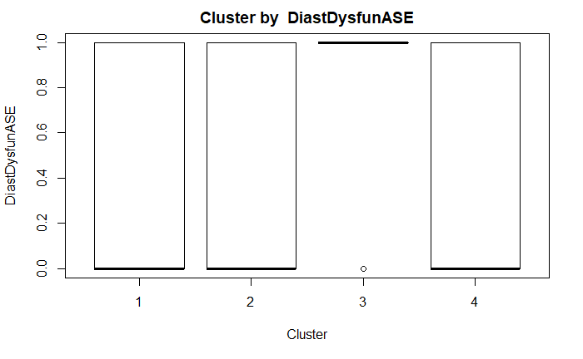
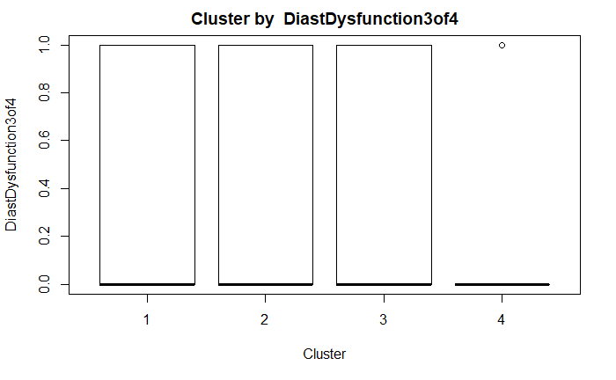
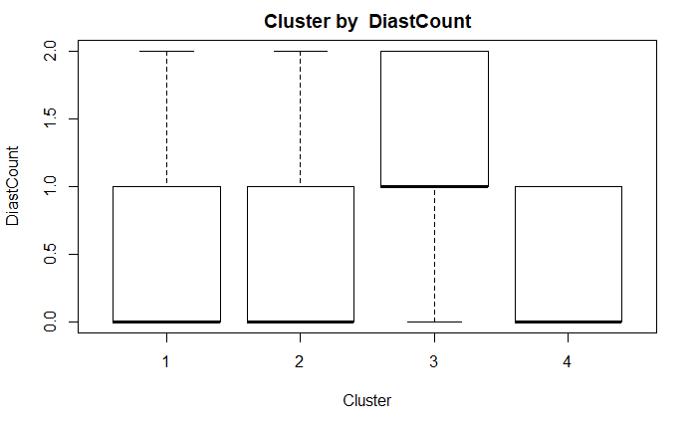
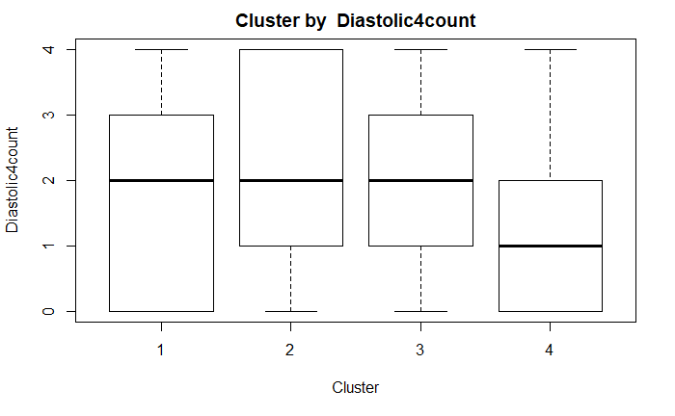
Diastolic Functions
Diastolic Dysfunction 3 of 4
Diastolic Count
Diastolic 4 Count
Diastolic Dysfunction ASE
p-value: 0.03851
comparison | raw.p | adj.p
1 vs. 2 | 1.0000 | 1.0000
1 vs. 3 | 0.0116 | 0.0699
1 vs. 4 | 0.7597 | 1.0000
2 vs. 3 | 0.0328 | 0.1971
2 vs. 4 | 0.7379 | 1.0000
3 vs. 4 | 0.0183 | 0.1098
p-value: 0.4985
p-value: 0.06059
p-value: 0.8932

Slide 18
Significant Difference in the Distributions of Values Among Cluster Groups
Variables | p-value
EchoDd | 0.0005895
EchoDs | 0.0008054
EchoEDV | 0.001283
EchoESV | 0.0003466
EchoEF | 0.002635
EchoTMfEwave | 0.04558
EchSepTDIe | 0.03306
EchoAveTDIe | 0.03434
TimePIVRRms | 0.00396
TimePIvEonset | 0.001009
TimePIvEpeak | 0.004059
TimeVSonset | 0.001588
TimePeakVSE | 0.007424
VortexArea | 7.31E-12
VortexIntensity | 5.42E-13
VortexDepth | 0.001747
VortexLength | 6.49E-09
EnergyDissipation | 4.83E-10
VorticityFluctuation | 7.29E-11
KineticEnergyFluctuation | 2.42E-07
ShearStressFluctuation | 0.002458

Slide 19
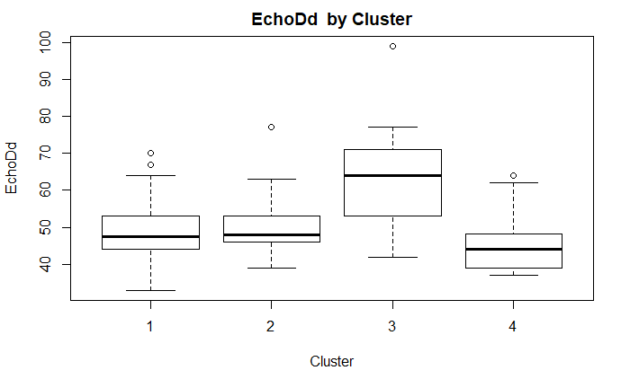
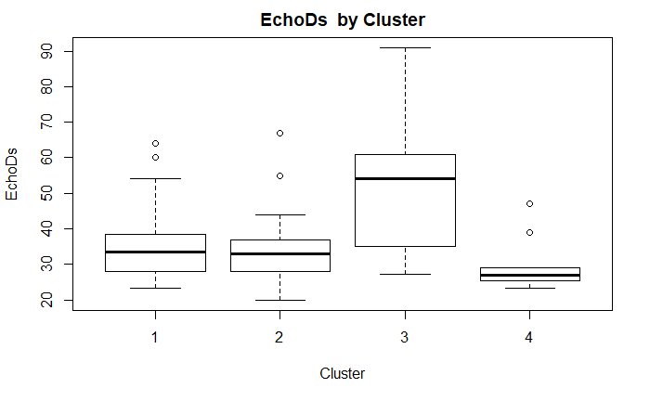
EchoDd | n | mean | sd | min | median | max
1 | 46 | 48.93778 | 7.611662 | 33 | 47.5 | 70
2 | 23 | 50.47826 | 8.223412 | 39 | 48 | 77
3 | 13 | 63.35385 | 15.10279 | 42 | 64 | 99
4 | 14 | 45.5 | 8.802178 | 37 | 44 | 64
EchoDs | n | mean | sd | min | median | max
1 | 46 | 35.2523 | 9.43629 | 23.2 | 33.55 | 64
2 | 23 | 34.4348 | 10.2462 | 20 | 33 | 67
3 | 13 | 50.3923 | 17.8709 | 27.1 | 54 | 91
4 | 14 | 29.7462 | 7.22745 | 23.3 | 27 | 47

Slide 20
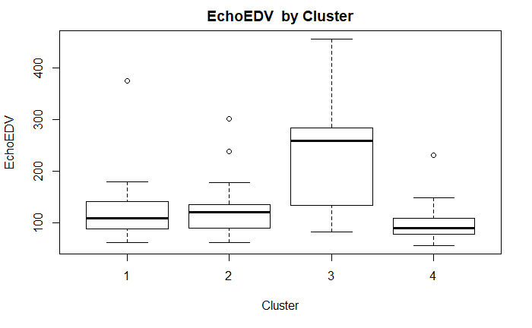
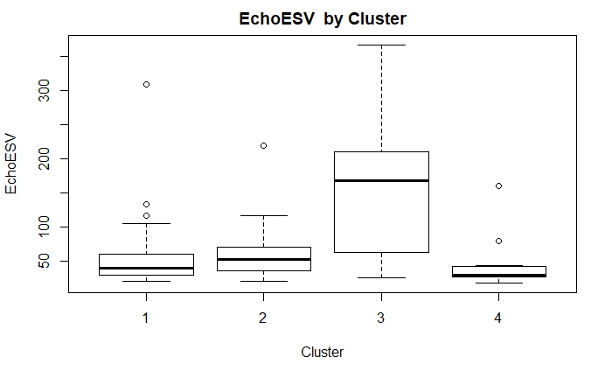
EchoEDV | n | mean | sd | min | median | max
1 | 46 | 117.2733 | 51.22395 | 63 | 109 | 374
2 | 23 | 128.6087 | 53.84383 | 63 | 121 | 302
3 | 13 | 235.5538 | 115.2898 | 83.2 | 259 | 455.5
4 | 14 | 102.3615 | 46.05308 | 57.2 | 89.9 | 231
EchoESV | n | mean | sd | min | median | max
1 | 46 | 54.66667 | 47.0001 | 21 | 40 | 309
2 | 23 | 62.08696 | 42.35125 | 20 | 53 | 219
3 | 13 | 160.9077 | 103.2027 | 25.3 | 168 | 366.5
4 | 14 | 44.68462 | 37.87428 | 18.3 | 30 | 160

Slide 21
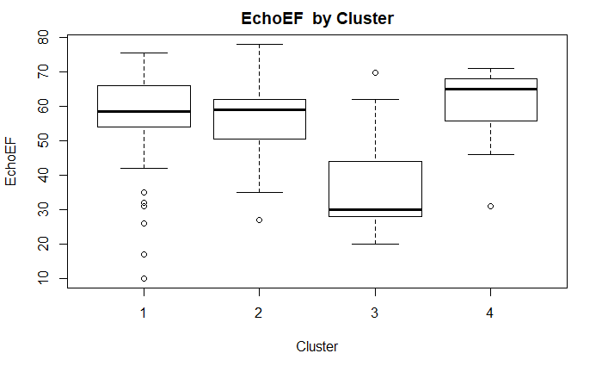
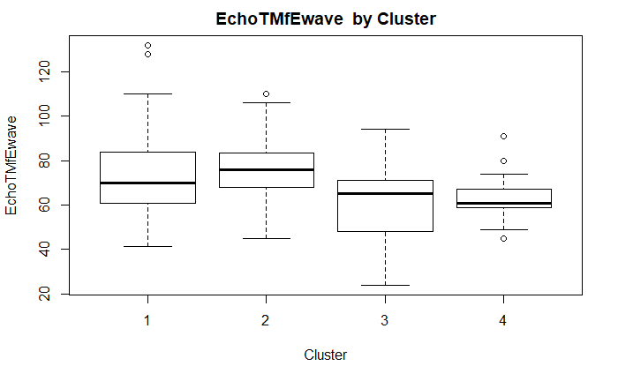
EchoEF | n | mean | sd | min | median | max
1 | 46 | 55.77587 | 14.99434 | 10 | 58.5 | 75.3
2 | 23 | 55.52174 | 11.06538 | 27 | 59 | 78
3 | 13 | 37.12308 | 15.94146 | 20 | 30 | 69.6
4 | 14 | 59.87154 | 11.4913 | 31 | 65 | 71
EchoTMfEwave | n | mean | sd | min | median | max
1 | 46 | 74.67333 | 20.61228 | 41.5 | 70 | 132
2 | 23 | 74.91304 | 16.31484 | 45 | 76 | 110
3 | 13 | 60.73077 | 18.5142 | 24 | 65 | 94
4 | 14 | 63.75385 | 12.42549 | 45 | 60.7 | 91

Slide 22
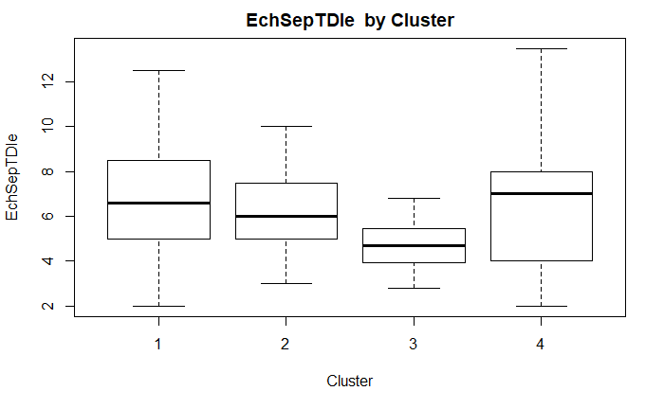
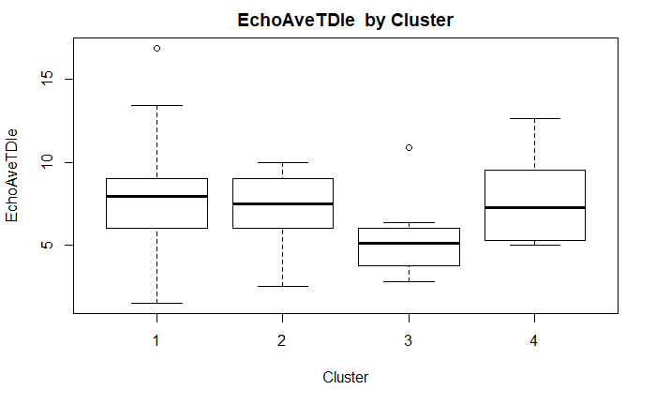
EchSeptTDIe | n | mean | sd | min | median | max
1 | 46 | 6.851739 | 2.542561 | 2 | 6.6 | 12.5
2 | 23 | 6.347826 | 1.873468 | 3 | 6 | 10
3 | 13 | 4.632 | 1.231131 | 2.8 | 4.69 | 6.82
4 | 14 | 6.545833 | 3.130642 | 2 | 7 | 13.5
EchoAveTDIe | n | mean | sd | min | median | max
1 | 46 | 7.764783 | 2.915246 | 1.5 | 7.95 | 16.9
2 | 23 | 7.23913 | 1.987858 | 2.5 | 7.5 | 10
3 | 13 | 5.285 | 2.30955 | 2.8 | 5.085 | 10.86
4 | 14 | 7.609583 | 2.381012 | 5 | 7.2625 | 12.65

Slide 23
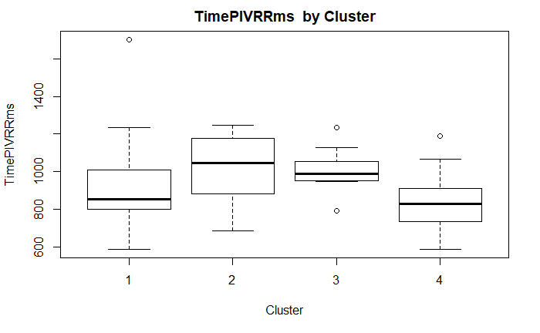
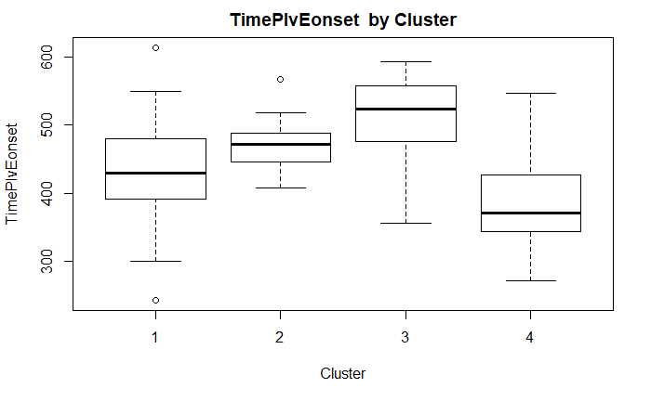
TimePIVRRms | n | mean | sd | min | median | max
1 | 46 | 900.4086 | 192.2972 | 586.87 | 850.815 | 1704
2 | 23 | 1014.515 | 171.0665 | 685 | 1043.775 | 1247.61
3 | 13 | 1011 | 117.1201 | 793 | 990 | 1233
4 | 14 | 831.1186 | 169.7252 | 586.87 | 827.37 | 1188
TimePIvEonset | n | mean | sd | min | median | max
1 | 46 | 436.1388 | 72.99198 | 242.79 | 429.63 | 614.06
2 | 23 | 471.3445 | 37.03478 | 408.05 | 471.905 | 567.9
3 | 13 | 506.983 | 68.61632 | 355.34 | 523.815 | 593.61
4 | 14 | 394.7323 | 86.63521 | 270.56 | 370.44 | 546.3

Slide 24
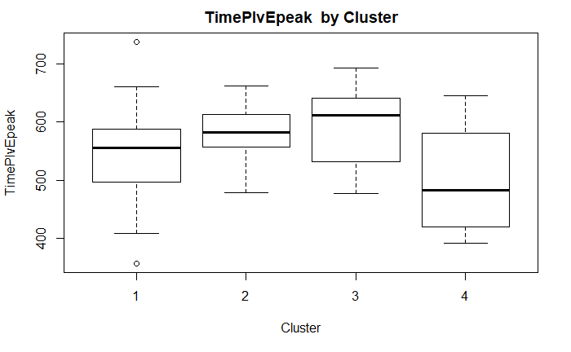
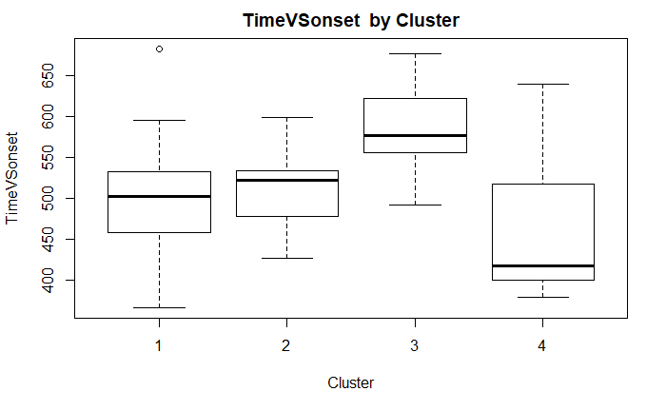
TimePIvEpeak | n | mean | sd | min | median | max
1 | 46 | 545.7871 | 77.75602 | 356.25 | 555.88 | 738.87
2 | 23 | 583.461 | 48.31251 | 477.76 | 582.125 | 662.29
3 | 13 | 596.184 | 67.5973 | 476.9 | 612.3 | 693.71
4 | 14 | 492.9677 | 85.5645 | 391.34 | 482.16 | 645.2
TimeVSonset | n | mean | sd | min | median | max
1 | 46 | 498.6757 | 59.93749 | 366 | 502 | 683
2 | 23 | 511.6 | 40.56626 | 426 | 521.5 | 599
3 | 13 | 584.5 | 56.9486 | 491 | 576.5 | 677
4 | 14 | 464.7273 | 89.20212 | 378 | 417 | 639

Slide 25
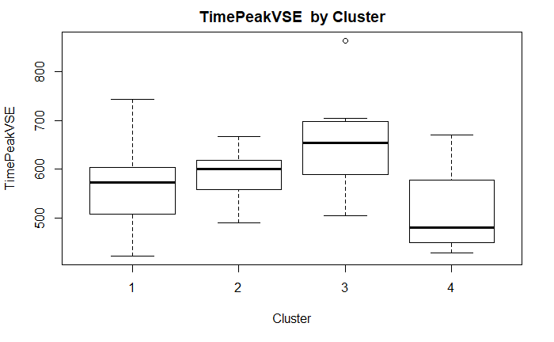
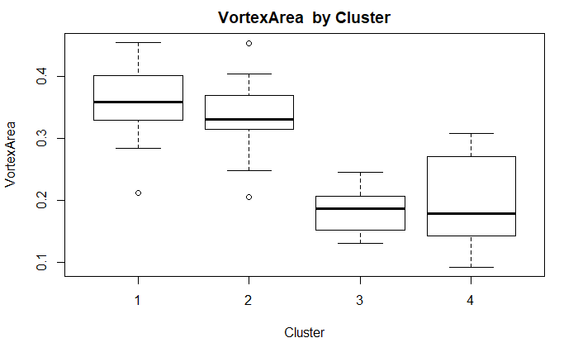
TimePeakVSE | n | mean | sd | min | median | max
1 | 46 | 569.5851 | 72.05922 | 422 | 573 | 743.8604
2 | 23 | 590.1151 | 49.82298 | 490 | 599.8599 | 667.0852
3 | 13 | 650.523 | 106.5127 | 504 | 653.3538 | 864
4 | 14 | 522.2017 | 86.93658 | 427.2049 | 480 | 670
VortexArea | n | mean | sd | min | median | max
1 | 46 | 0.360413 | 0.05117 | 0.2121 | 0.35835 | 0.4549
2 | 23 | 0.335191 | 0.055052 | 0.2059 | 0.331 | 0.4527
3 | 13 | 0.182192 | 0.035011 | 0.1315 | 0.1868 | 0.245
4 | 14 | 0.201871 | 0.071363 | 0.093 | 0.1796 | 0.3083

Slide 26
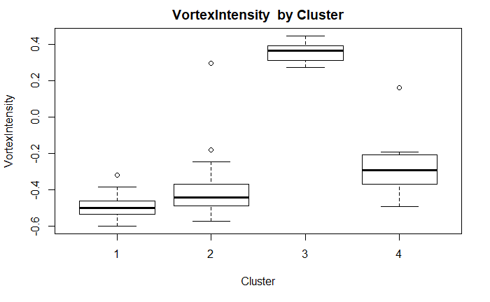
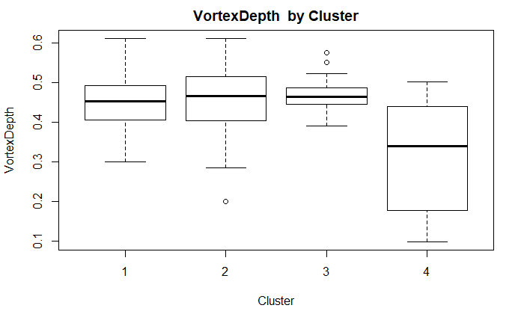
VortexIntensity | n | mean | sd | min | median | max
1 | 46 | -0.496135 | 0.059714 | -0.6 | -0.50025 | -0.3217
2 | 23 | -0.393648 | 0.175761 | -0.5739 | -0.4436 | 0.295
3 | 13 | 0.358431 | 0.054896 | 0.2737 | 0.364 | 0.4472
4 | 14 | -0.280007 | 0.157549 | -0.4935 | -0.29475 | 0.1611
VortexDepth | n | mean | sd | min | median | max
1 | 46 | 0.449854 | 0.072226 | 0.3008 | 0.45285 | 0.6118
2 | 23 | 0.447483 | 0.095817 | 0.2009 | 0.4661 | 0.6107
3 | 13 | 0.477877 | 0.048668 | 0.3914 | 0.4651 | 0.5748
4 | 14 | 0.313729 | 0.13844 | 0.099 | 0.3396 | 0.5013

Slide 27
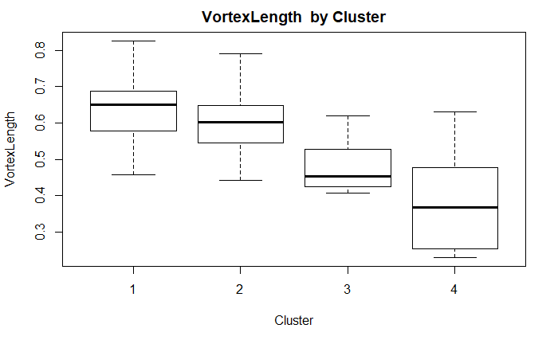
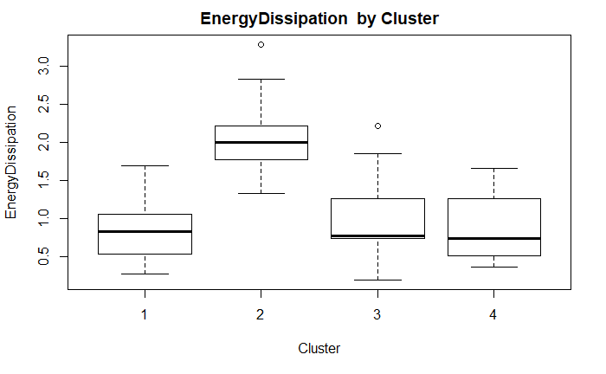
VortexLength | n | mean | sd | min | median | max
1 | 46 | 0.631107 | 0.083984 | 0.458 | 0.6497 | 0.8262
2 | 23 | 0.5942 | 0.081104 | 0.4431 | 0.6011 | 0.7904
3 | 13 | 0.478923 | 0.066867 | 0.4082 | 0.4535 | 0.6187
4 | 14 | 0.392571 | 0.128529 | 0.2305 | 0.36835 | 0.6317
EnergyDissipation | n | mean | sd | min | median | max
1 | 46 | 0.85085 | 0.374946 | 0.2696 | 0.8193 | 1.6911
2 | 23 | 2.042978 | 0.486811 | 1.324 | 1.9904 | 3.2823
3 | 13 | 1.010239 | 0.545724 | 0.1912 | 0.7661 | 2.2113
4 | 14 | 0.866629 | 0.424765 | 0.3532 | 0.72855 | 1.6533

Slide 28
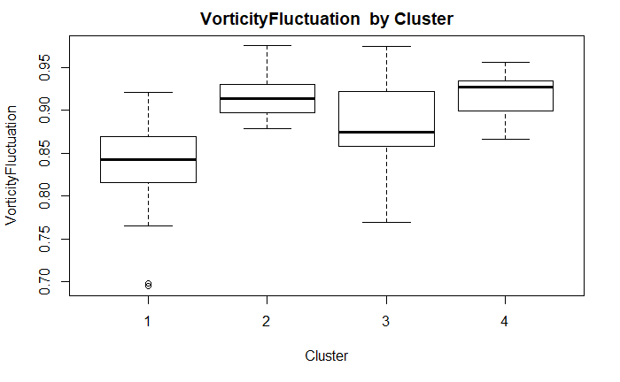
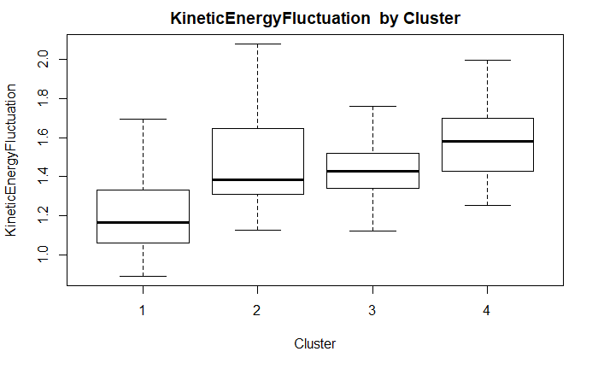
VorticityFluctuation | n | mean | sd | min | median | max
1 | 46 | 0.836737 | 0.046688 | 0.6954 | 0.8422 | 0.9209
2 | 23 | 0.915391 | 0.023267 | 0.8788 | 0.9137 | 0.9757
3 | 13 | 0.879908 | 0.056613 | 0.7694 | 0.8739 | 0.9743
4 | 14 | 0.91785 | 0.027156 | 0.8665 | 0.92655 | 0.9563
KineticEnergyFluctuation | n | mean | sd | min | median | max
1 | 46 | 1.208117 | 0.200947 | 0.8944 | 1.16545 | 1.6946
2 | 23 | 1.467665 | 0.241855 | 1.1265 | 1.383 | 2.0779
3 | 13 | 1.430777 | 0.178781 | 1.1225 | 1.427 | 1.7584
4 | 14 | 1.576093 | 0.190646 | 1.2538 | 1.5792 | 1.9925

Slide 29
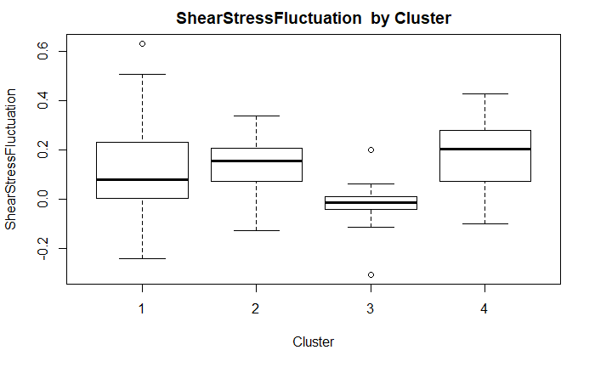
ShearStressFluctuation | n | mean | sd | min | median | max
1 | 46 | 0.116102 | 0.174849 | -0.2394 | 0.0815 | 0.6324
2 | 23 | 0.132735 | 0.117901 | -0.1245 | 0.1552 | 0.338
3 | 13 | -0.019169 | 0.113325 | -0.3042 | -0.0111 | 0.2023
4 | 14 | 0.172514 | 0.147677 | -0.0985 | 0.2032 | 0.4272

Slide 30
Clusters and Cases
Cluster 1
Cluster 2
Cluster 3
Cluster 4
Cases | NYHA | Abnormal EF50
1 | 1 | 0
2 | 1 | 0
3 | 1 | 0
5 | 1 | 0
6 | 1 | 0
7 | 1 | 0
9 | 1 | 0
10 | 1 | 1
12 | 1 | 0
14 | 1 | 0
18 | 1 | 0
⁞ | ⁞ | ⁞
95 | 3 | 1
96 | NA | 1
Cases | NYHA | Abnormal EF50
4 | 1 | 0
8 | 1 | 0
11 | 1 | 0
13 | 1 | 0
16 | 1 | 0
30 | 1 | 1
47 | 1 | 0
48 | 1 | 0
49 | 1 | 0
55 | 1 | 0
57 | 2 | 0
⁞ | ⁞ | ⁞
88 | 1 | 0
89 | 1 | 0
Cases | NYHA | Abnormal EF50
15 | NA | 0
23 | 1 | 0
32 | 3 | 1
33 | 3 | 1
34 | 3 | 1
35 | 3 | 1
36 | 1 | 0
77 | 3 | 1
78 | 3 | 1
79 | 3 | 1
90 | 4 | 1
91 | 3 | 1
92 | 3 | 1
Cases | NYHA | Abnormal EF50
17 | 1 | NA
19 | 1 | 0
25 | 1 | 0
26 | 1 | 0
31 | 1 | 0
42 | 1 | 0
50 | 1 | 0
53 | 1 | 0
54 | 1 | 0
62 | 3 | 1
76 | 2 | 1
80 | 1 | 0
84 | 1 | 0
93 | 1 | 0

Slide 31
END

