Slide 1
Vorticity
Cluster analysis

Slide 2
Outline

Slide 3
Data Structure
Variables
Dimensions
[1] "ID" | "Country“ - Factor | "Age" | "Gender“ - Factor
[5] "BSA" | "HRmin" | "SBP" | "DBP"
[9] "Etiology“- Factor | "NYHA“- Factor | "EchoLA" | "EchoIVS"
[13] "EchoPW" | "EchoDd" | "EchoDs" | "bEF"
[17] "RWT" | "LVMass" | "EchoLVMI" | "EchoEDV"
[21] "EchoESV" | "EchoSV" | "EchoEF" | "AbnormalEF50"
[25] "EchoTMfEwave" | "EchoTMfAwave" | "TimeTMFDecT" | "EchoTMfEtoA"
[29] "EchoLAVI" | "EchSepTDIe" | "EchoLatTDIe" | "EchoAveTDIe"
[33] "EchoSeptEe" | "EchoRVSP" | "EchoLVM" | "EchoLVMII"
[37] "TimePIVRRms" | "TimePIvEonset" | "TimePIvEonsetNorRR" | "TimePIvEpeak"
[41] "TimePIvEpeakNorRR" | "TimeVSonset" | "TimePeakVSE" | "Tracking"
[45] "VortexArea" | "VortexIntensity" | "VortexDepth" | "VortexLength"
[49] "EnergyDissipation" | "VorticityFluctuation" | ”KineticEnergyFluctuation" | "ShearStressFluctuation"
[53] "KineticEnergyEarlyD" | "KineticEnergyLateD" | "KineticEnergyOnsetSystole" | "LAVI35"
[57] "SeptTDIe7" | "LatTDIe10" | "EtoTDIe14" | "TRVmax"
[61] "Diastolic4count“- Factor | "DiastDysfunction3of4“- Factor | "DiastCount“- Factor | "DiastDysfunASE“- Factor
Row: 96
Columns: 64

Slide 4
Missing Data
Low
High

Slide 5
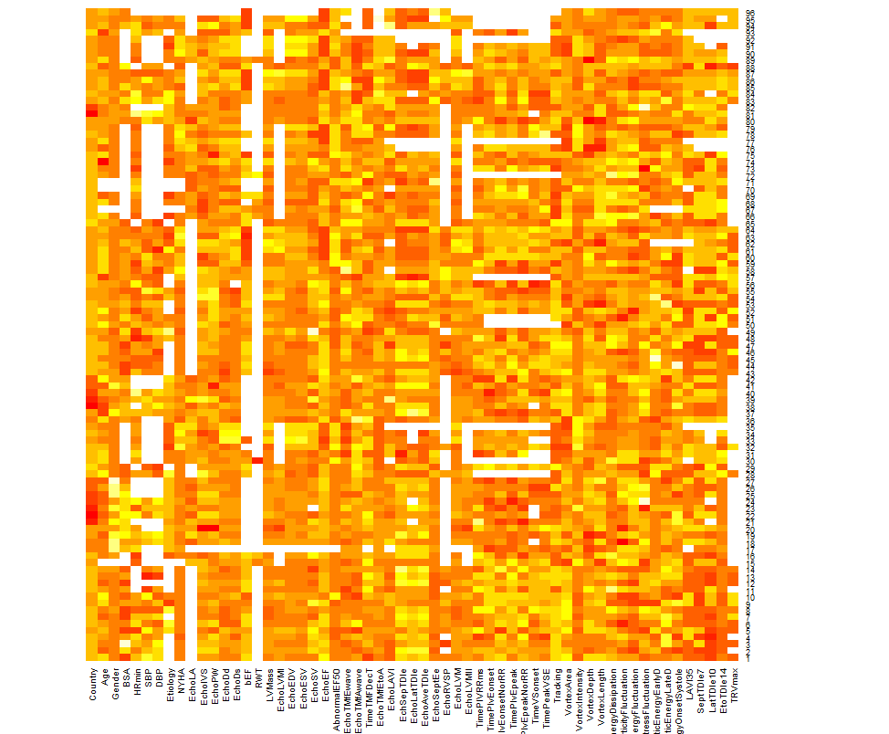
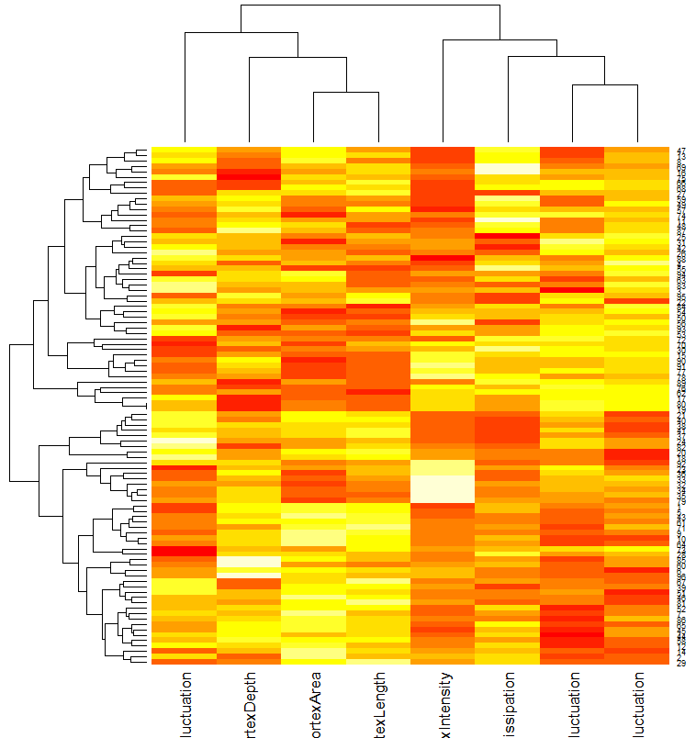
Heatmap

Slide 6
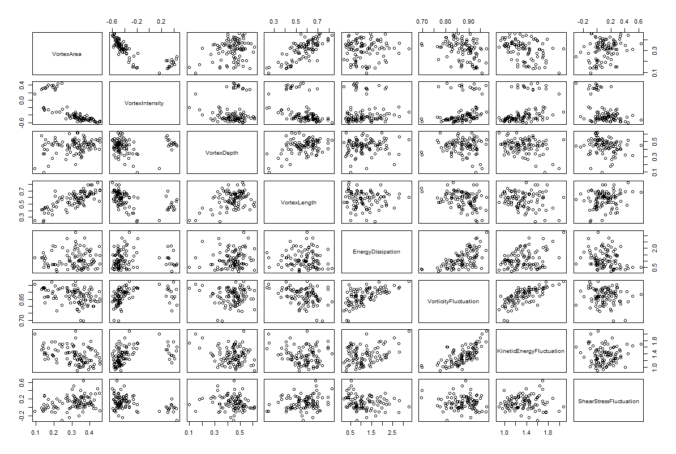
Scatterplot Matrix

Slide 7
Correlation Matrix

Slide 8
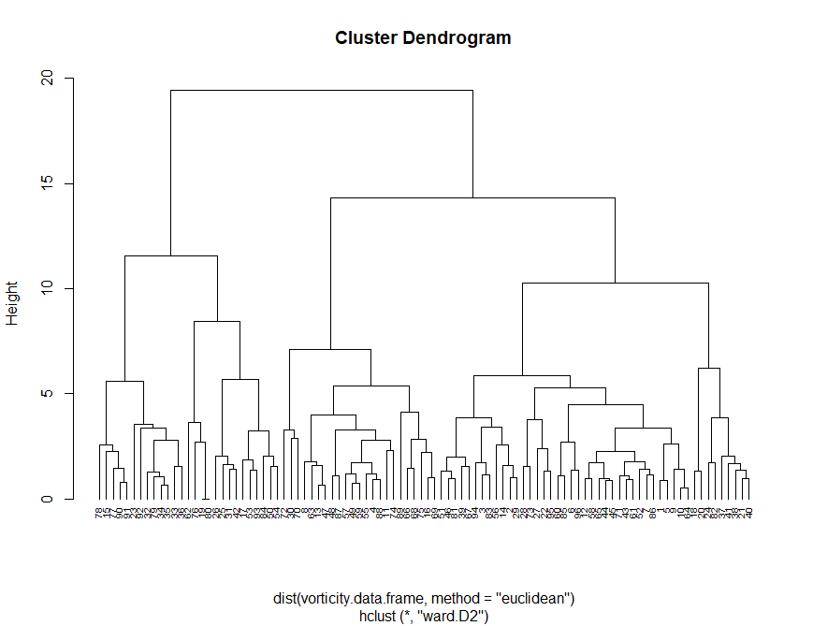
Hierarchical Clustering
Agglomerative Coefficients – a measure
of the clustering structure
Average | Single | Complete | Ward’s Method
0.7174621 | 0.5765339 | 0.8389593 | 0.9248588

Slide 9
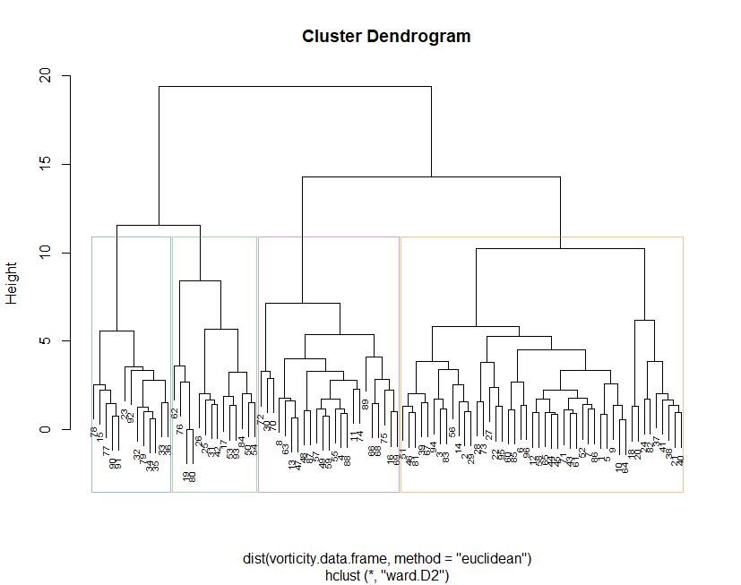
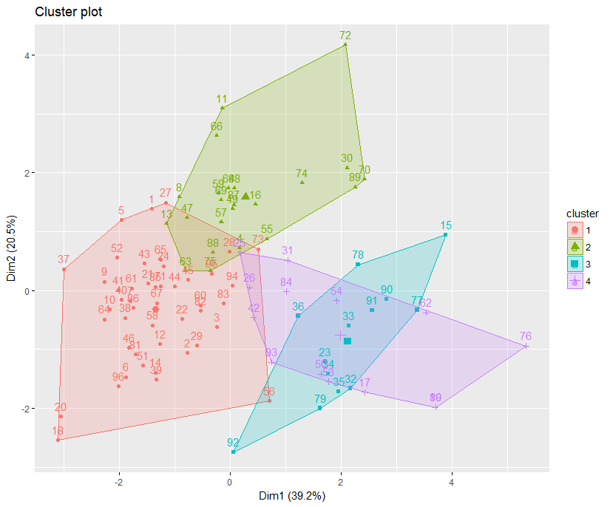
Hierarchical Clustering
Cluster (k = 4)
1 | 2 | 3 | 4
46 | 23 | 13 | 14
K = 4
Cluster | Cases
# Cluster 1 | 15 23 32 33 34 35 36 77 78 79 90 91 92
# Cluster 2 | 17 19 25 26 31 42 50 53 54 62 76 80 84 93
# Cluster 3 | 4 8 11 13 16 30 47 48 49 55 57 59 63 66 68 69 70 72 74 75 87 88 89
# Cluster 4 | 1 2 3 5 6 7 9 10 12 14 18 20 21 22 24 27 28 29 37 38 39 40 41 43 44 45 46 51 52 56 58 60 61 64 65 67 71 73 81 82 83 85 86 94 95 96

Slide 10
Vorticity Col-means
 | Cluster
 | 1 | 2 | 3 | 4
VortexArea | 0.59117402 | 0.3114149 | -1.3856472 | -1.1673668
VortexIntensity | -0.56591219 | -0.2283089 | 2.2491203 | 0.1460359
VortexDepth | 0.16559679 | 0.1419728 | 0.4447185 | -1.1902977
VortexLength | 0.51756685 | 0.2202044 | -0.7086024 | -1.4043532
EnergyDissipation | -0.46949331 | 1.3389013 | -0.2277096 | -0.4455581
VorticityFluctuation | -0.66252572 | 0.7644057 | 0.1206691 | 0.8090109
KineticEnergyFluctuation | -0.58078399 | 0.4517026 | 0.3049602 | 0.8830300
ShearStressFluctuation | 0.03838312 | 0.1429320 | -0.8119033 | 0.3929773

Slide 11
Descriptive Statistics – Continuous Variables

Slide 15
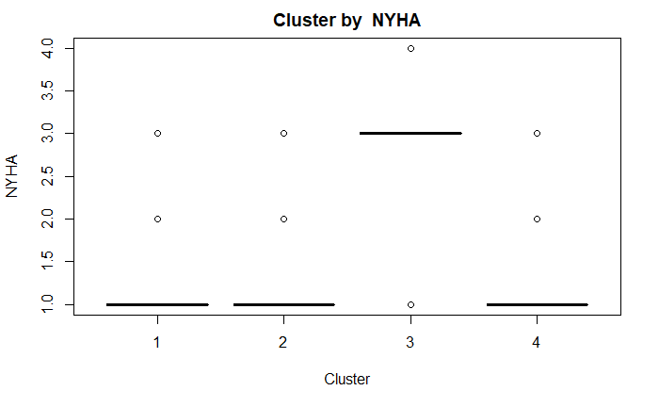
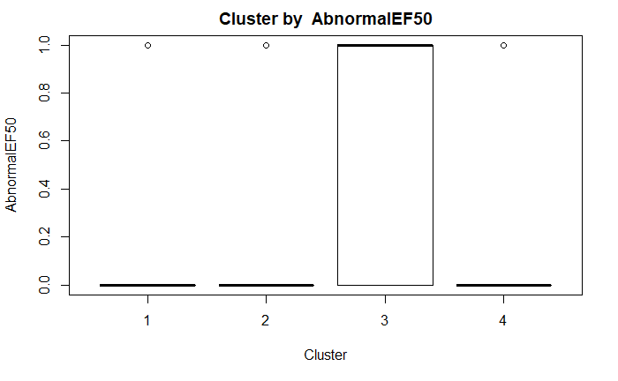
Test of Independence
Cluster vs NYHA
Cluster vs AbnormalEF50
comparison | raw.p | adj.p
1 vs. 2 | 0.5210 | 1.0000
1 vs. 3 | 0.0000 | 0.0000
1 vs. 4 | 1.0000 | 1.0000
2 vs. 3 | 0.0000 | 0.0000
2 vs. 4 | 1.0000 | 1.0000
3 vs. 4 | 0.0003 | 0.0018
comparison | raw.p | adj.p
1 vs. 2 | 0.7775 | 1.0000
1 vs. 3 | 0.0027 | 0.0159
1 vs. 4 | 1.0000 | 1.0000
2 vs. 3 | 0.0009 | 0.0055
2 vs. 4 | 1.0000 | 1.0000
3 vs. 4 | 0.0361 | 0.2164

Slide 16
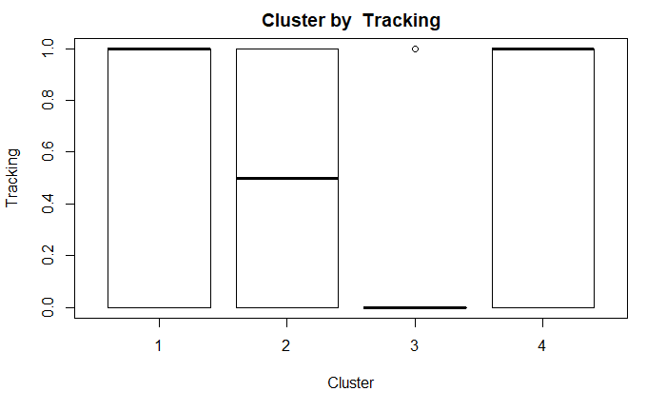
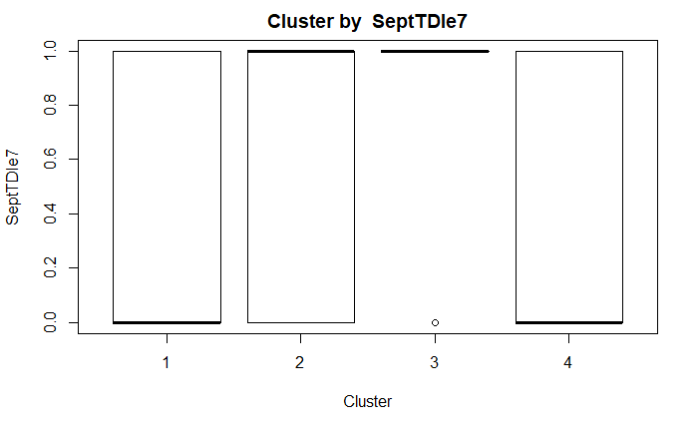
Test of Independence
Cluster vs Tracking
Cluster vs SeptTDIe7
comparison | raw.p | adj.p
1 vs. 2 | 0.0988 | 0.5930
1 vs. 3 | 0.0006 | 0.0035
1 vs. 4 | 0.1947 | 1.0000
2 vs. 3 | 0.0750 | 0.4498
2 vs. 4 | 1.0000 | 1.0000
3 vs. 4 | 0.0968 | 0.5811
comparison | raw.p | adj.p
1 vs. 2 | 0.8013 | 1.0000
1 vs. 3 | 0.0042 | 0.0251
1 vs. 4 | 0.7470 | 1.0000
2 vs. 3 | 0.0148 | 0.0887
2 vs. 4 | 0.4887 | 1.0000
3 vs. 4 | 0.0053 | 0.0321

Slide 17
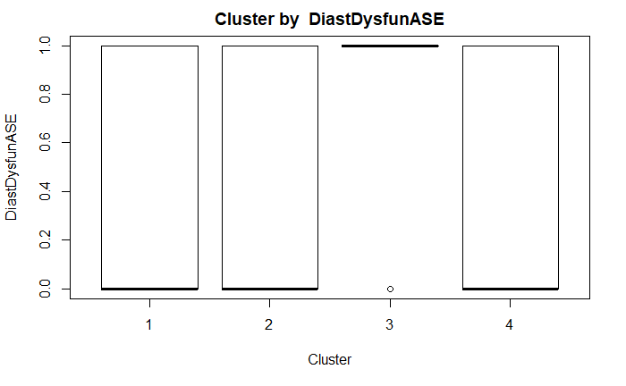
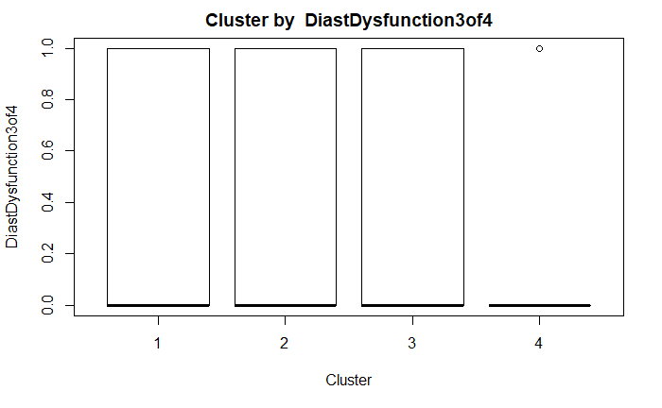
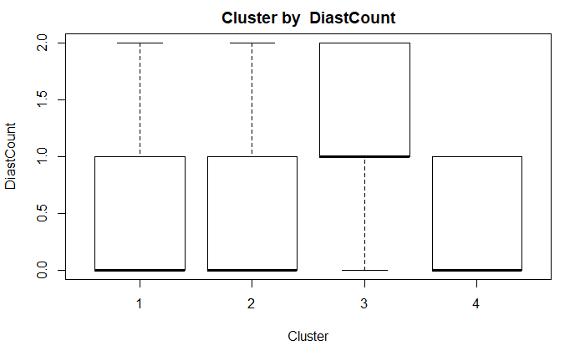
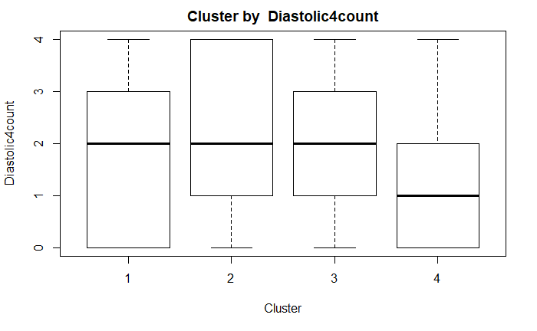
Diastolic Functions
Diastolic Dysfunction 3 of 4
Diastolic Count
Diastolic 4 Count
Diastolic Dysfunction ASE
p-value: 0.03851
comparison | raw.p | adj.p
1 vs. 2 | 1.0000 | 1.0000
1 vs. 3 | 0.0116 | 0.0699
1 vs. 4 | 0.7597 | 1.0000
2 vs. 3 | 0.0328 | 0.1971
2 vs. 4 | 0.7379 | 1.0000
3 vs. 4 | 0.0183 | 0.1098
p-value: 0.4985
p-value: 0.06059
p-value: 0.8932

Slide 23
Clusters and Cases
Cluster 1
Cluster 2
Cluster 3
Cluster 4
Cases | NYHA | Abnormal EF50
1 | 1 | 0
2 | 1 | 0
3 | 1 | 0
5 | 1 | 0
6 | 1 | 0
7 | 1 | 0
9 | 1 | 0
10 | 1 | 1
12 | 1 | 0
14 | 1 | 0
18 | 1 | 0
⁞ | ⁞ | ⁞
95 | 3 | 1
96 | NA | 1
Cases | NYHA | Abnormal EF50
4 | 1 | 0
8 | 1 | 0
11 | 1 | 0
13 | 1 | 0
16 | 1 | 0
30 | 1 | 1
47 | 1 | 0
48 | 1 | 0
49 | 1 | 0
55 | 1 | 0
57 | 2 | 0
⁞ | ⁞ | ⁞
88 | 1 | 0
89 | 1 | 0
Cases | NYHA | Abnormal EF50
15 | NA | 0
23 | 1 | 0
32 | 3 | 1
33 | 3 | 1
34 | 3 | 1
35 | 3 | 1
36 | 1 | 0
77 | 3 | 1
78 | 3 | 1
79 | 3 | 1
90 | 4 | 1
91 | 3 | 1
92 | 3 | 1
Cases | NYHA | Abnormal EF50
17 | 1 | NA
19 | 1 | 0
25 | 1 | 0
26 | 1 | 0
31 | 1 | 0
42 | 1 | 0
50 | 1 | 0
53 | 1 | 0
54 | 1 | 0
62 | 3 | 1
76 | 2 | 1
80 | 1 | 0
84 | 1 | 0
93 | 1 | 0
 | Gender
Age Range |  | 0 (F) | 1 (M)
 | < 40 | 4 | 1
 | 40 - 60 | 30 | 8
 | 60 – 80 | 40 | 1
 | 80 + | 8 | 0
 | Diastolic Dysfunction 3 0f 4
Cluster |  | 0 | 1
 | 1 | 26 | 20
 | 2 | 13 | 10
 | 3 | 8 | 5
 | 4 | 11 | 3
 | Diastolic Count
Cluster |  | 0 | 1 | 2
 | 1 | 26 | 10 | 10
 | 2 | 13 | 5 | 5
 | 3 | 2 | 7 | 4
 | 4 | 9 | 5 | 0
 | Diastolic Dysfunc ASE
Cluster |  | 0 | 1
 | 1 | 26 | 20
 | 2 | 13 | 10
 | 3 | 2 | 11
 | 4 | 9 | 5
 | Diastolic 4 Count
Cluster |  | 0 | 1 | 2 | 3 | 4
 | 1 | 11 | 7 | 8 | 9 | 11
 | 2 | 3 | 7 | 3 | 5 | 5
 | 3 | 2 | 3 | 3 | 2 | 3
 | 4 | 5 | 3 | 3 | 1 | 2

Slide 24
END

