Slide 1
Vorticity
Cluster analysis

Slide 2
Data Structure
Variables
Dimensions
[1] "ID" | "Country“ - Factor | "Age" | "Gender“ - Factor
[5] "BSA" | "HRmin" | "SBP" | "DBP"
[9] "Etiology“- Factor | "NYHA“- Factor | "EchoLA" | "EchoIVS"
[13] "EchoPW" | "EchoDd" | "EchoDs" | "bEF"
[17] "RWT" | "LVMass" | "EchoLVMI" | "EchoEDV"
[21] "EchoESV" | "EchoSV" | "EchoEF" | "AbnormalEF50"
[25] "EchoTMfEwave" | "EchoTMfAwave" | "TimeTMFDecT" | "EchoTMfEtoA"
[29] "EchoLAVI" | "EchSepTDIe" | "EchoLatTDIe" | "EchoAveTDIe"
[33] "EchoSeptEe" | "EchoRVSP" | "EchoLVM" | "EchoLVMII"
[37] "TimePIVRRms" | "TimePIvEonset" | "TimePIvEonsetNorRR" | "TimePIvEpeak"
[41] "TimePIvEpeakNorRR" | "TimeVSonset" | "TimePeakVSE" | "Tracking"
[45] "VortexArea" | "VortexIntensity" | "VortexDepth" | "VortexLength"
[49] "EnergyDissipation" | "VorticityFluctuation" | ”KineticEnergyFluctuation" | "ShearStressFluctuation"
[53] "KineticEnergyEarlyD" | "KineticEnergyLateD" | "KineticEnergyOnsetSystole" | "LAVI35"
[57] "SeptTDIe7" | "LatTDIe10" | "EtoTDIe14" | "TRVmax"
[61] "Diastolic4count“- Factor | "DiastDysfunction3of4“- Factor | "DiastCount“- Factor | "DiastDysfunASE“- Factor
Row: 96
Columns: 64

Slide 3
Missing Data
Low
High

Slide 4
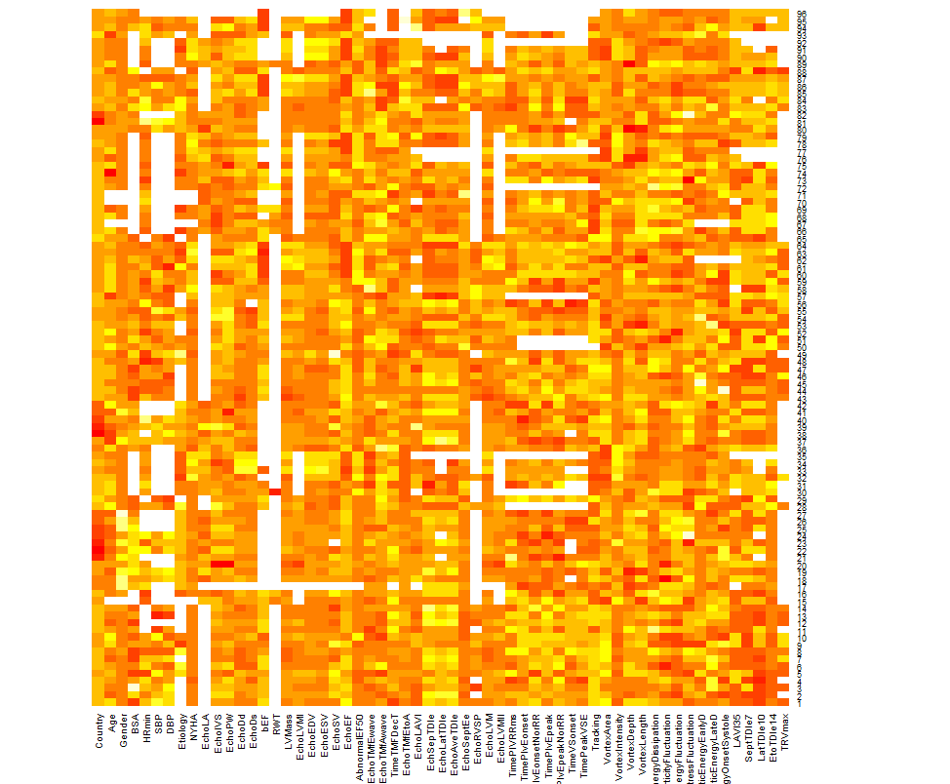
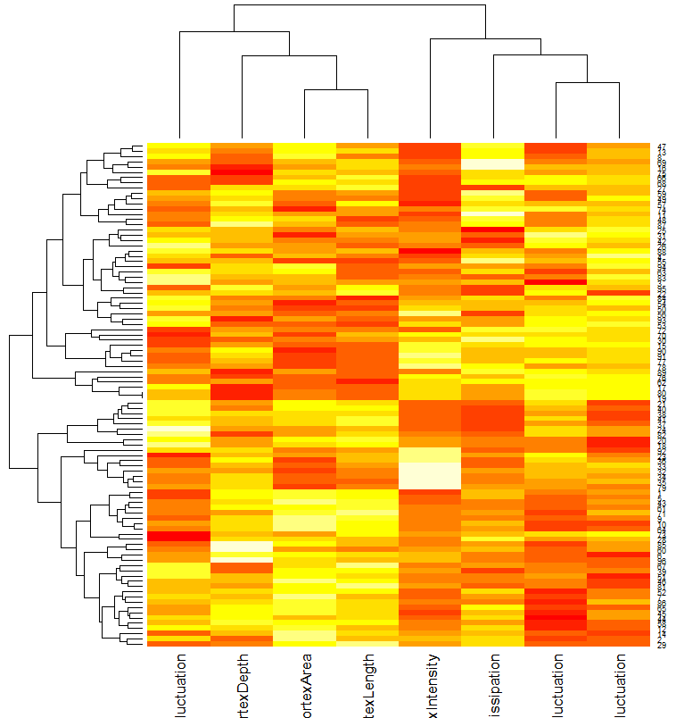
Heatmap

Slide 5
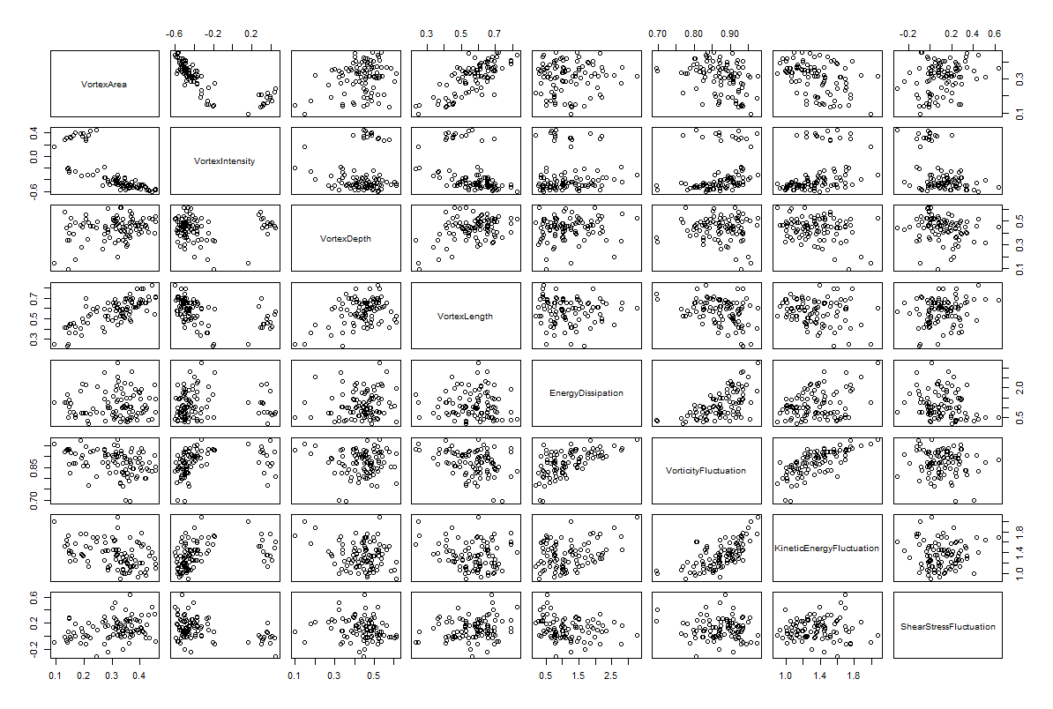
Scatterplot Matrix

Slide 6
Correlation Matrix

Slide 7
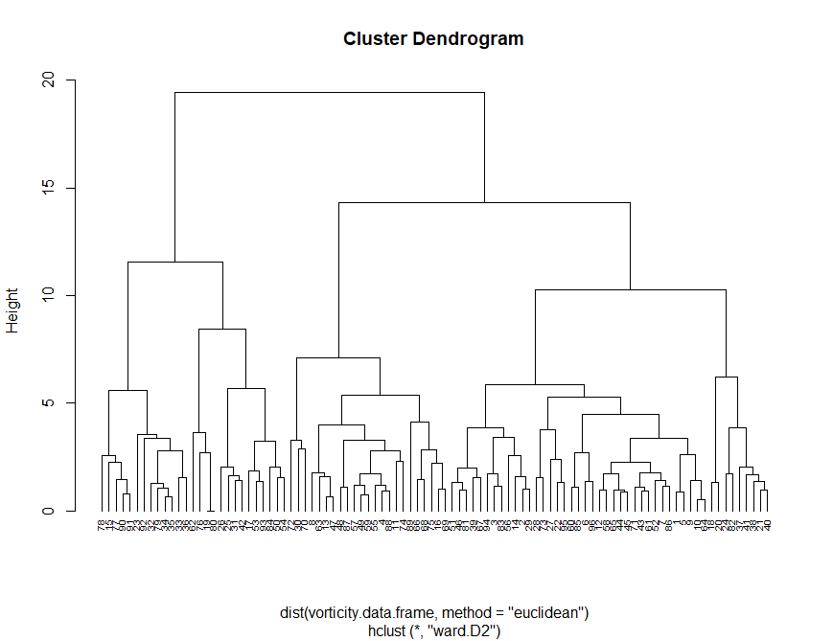
Hierarchical Clustering
Agglomerative Coefficients – a measure
of the clustering structure
Average | Single | Complete | Ward’s Method
0.7174621 | 0.5765339 | 0.8389593 | 0.9248588

Slide 8
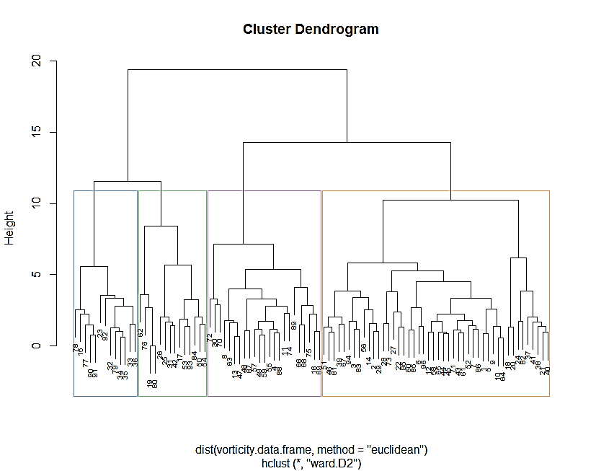
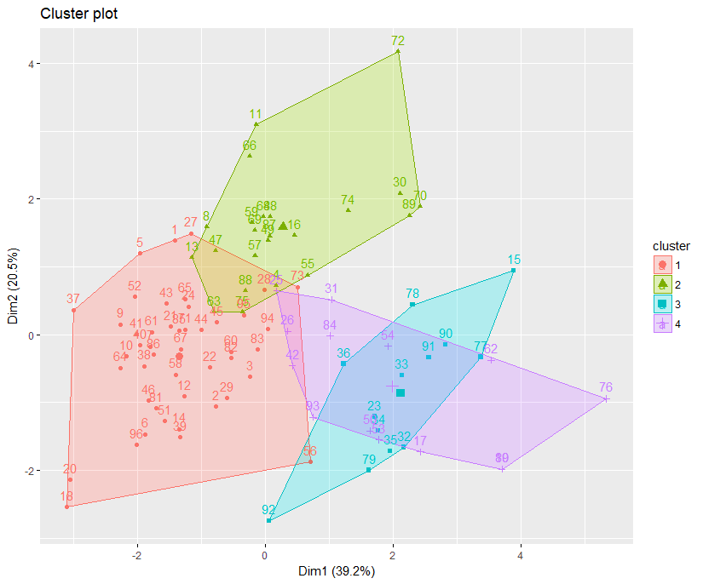
Hierarchical Clustering
Cluster (k = 4)
1 | 2 | 3 | 4
46 | 23 | 13 | 14
Cluster | Cases
# Cluster 1 (46) | 1 2 3 5 6 7 9 10 12 14 18 20 21 22 24 27 28 29 37 38 39 40 41 43 44 45 46 51 52 56 58 60 61 64 65 67 71 73 81 82 83 85 86 94 95 96
# Cluster 2 (23) | 4 8 11 13 16 30 47 48 49 55 57 59 63 66 68 69 70 72 74 75 87 88 89
# Cluster 3 (13) | 15 23 32 33 34 35 36 77 78 79 90 91 92
# Cluster 4 (14) | 17 19 25 26 31 42 50 53 54 62 76 80 84 93
K = 4

Slide 9
Summary of Vortex Data by Cluster
 | Cluster
Variables |  | Cluster 1 |  |  | Cluster 2 |  |  | Cluster 3 |  |  | Cluster 4
 |  | Mean | Median | Std.Dev | Mean | Median | Std.Dev | Mean | Median | Std.Dev | Mean | Median | Std.Dev
 | EnergyDissipation | 0.85085 | 0.8193 | 0.374946 | 2.042978 | 1.9904 | 0.486811 | 1.010238 | 0.7661 | 0.545724 | 0.866629 | 0.72855 | 0.424765
 | KineticEnergyFluctuation | 1.2081174 | 1.16545 | 0.200947 | 1.467665 | 1.383 | 0.241855 | 1.430777 | 1.427 | 0.178781 | 1.576093 | 1.5792 | 0.190646
 | ShearStressFluctuation | 0.1161022 | 0.0815 | 0.174849 | 0.132735 | 0.1552 | 0.117901 | -0.019169 | -0.0111 | 0.113325 | 0.172514 | 0.2032 | 0.147677
 | VortexArea | 0.360413 | 0.35835 | 0.051169 | 0.335191 | 0.331 | 0.055052 | 0.182192 | 0.1868 | 0.035011 | 0.201871 | 0.1796 | 0.071363
 | VortexDepth | 0.4498543 | 0.45285 | 0.072226 | 0.447483 | 0.4661 | 0.095817 | 0.477877 | 0.4651 | 0.048668 | 0.313729 | 0.3396 | 0.13844
 | VortexIntensity | -0.4961348 | -0.50025 | 0.059714 | -0.393648 | -0.4436 | 0.175761 | 0.358431 | 0.364 | 0.054896 | -0.280007 | -0.29475 | 0.157549
 | VortexLength | 0.6311065 | 0.6497 | 0.083984 | 0.5942 | 0.6011 | 0.081104 | 0.478923 | 0.4535 | 0.066867 | 0.392571 | 0.36835 | 0.128529
 | VorticityFluctuation | 0.836737 | 0.8422 | 0.046688 | 0.915391 | 0.9137 | 0.023267 | 0.879908 | 0.8739 | 0.056613 | 0.91785 | 0.92655 | 0.027156

Slide 10
Cluster means for each variables
 | Cluster
 | 1 | 2 | 3 | 4
VortexArea | 0.59117402 | 0.3114149 | -1.3856472 | -1.1673668
VortexIntensity | -0.56591219 | -0.2283089 | 2.2491203 | 0.1460359
VortexDepth | 0.16559679 | 0.1419728 | 0.4447185 | -1.1902977
VortexLength | 0.51756685 | 0.2202044 | -0.7086024 | -1.4043532
EnergyDissipation | -0.46949331 | 1.3389013 | -0.2277096 | -0.4455581
VorticityFluctuation | -0.66252572 | 0.7644057 | 0.1206691 | 0.8090109
KineticEnergyFluctuation | -0.58078399 | 0.4517026 | 0.3049602 | 0.8830300
ShearStressFluctuation | 0.03838312 | 0.1429320 | -0.8119033 | 0.3929773

Slide 11
Descriptive Statistics – Continuous Variables

Slide 12
Gender
NYHA
Gender | Freq | prop
0 | 82 | 89.13%
1 | 10 | 10.87%
 | Gender Count by Cluster
Cluster |  | Gender
 |  | 0 | 1
 | 1 | 39 | 5
 | 2 | 22 | 0
 | 3 | 11 | 1
 | 4 | 10 | 4
NYHA | Freq | prop
1 | 70 | 76.92%
2 | 6 | 6.59%
3 | 14 | 15.38%
4 | 1 | 1.10%
 | NYHA Count by Cluster
Cluster |  | 1 | 2 | 3 | 4
 | 1 | 38 | 2 | 3 | 0
 | 2 | 18 | 3 | 1 | 0
 | 3 | 2 | 0 | 9 | 1
 | 4 | 12 | 1 | 1 | 0
 | Proportion Table Gender by Cluster
 |  | Gender
Cluster |  | 0 | 1
 | 1 | 42.39% | 5.43%
 | 2 | 23.91% | 0.00%
 | 3 | 11.96% | 1.09%
 | 4 | 10.87% | 4.35%
Proportion Table NYHA by Cluster
cluster |  | 1 | 2 | 3 | 4
 | 1 | 41.76% | 2.20% | 3.30% | 0.00%
 | 2 | 19.78% | 3.30% | 1.10% | 0.00%
 | 3 | 2.20% | 0.00% | 9.89% | 1.10%
 | 4 | 13.19% | 1.10% | 1.10% | 0.00%
AbnormalEF50
LAVI35
AbnormalEF50 | Freq | prop
0 | 68 | 71.58%
1 | 27 | 28.42%
AbnormalEF50 Count by Cluster
Cluster |  | 0 | 1
 | 1 | 36 | 10
 | 2 | 18 | 5
 | 3 | 3 | 10
 | 4 | 11 | 2
LAVI35 | Freq | prop
0 | 46 | 52.27%
1 | 42 | 47.73%
 | LAVI35 Count by Cluster
Cluster |  | 0 | 1
 | 1 | 23 | 22
 | 2 | 11 | 10
 | 3 | 5 | 6
 | 4 | 7 | 4
Proportion Table AbnormalEF50 by Cluster
Cluster |  | 0 | 1
 | 1 | 37.89% | 10.53%
 | 2 | 18.95% | 5.26%
 | 3 | 3.16% | 10.53%
 | 4 | 11.58% | 2.11%
 | Proportion Table LAVI35 by Cluster
Cluster |  | 0 | 1
 | 1 | 26.14% | 25.00%
 | 2 | 12.50% | 11.36%
 | 3 | 5.68% | 6.82%
 | 4 | 7.95% | 4.55%

Slide 13
SeptTDIe7
EtoTDIe14
SeptTDIe7 | Freq | prop
0 | 39 | 42.86%
1 | 52 | 57.14%
 | SeptTDIe7 Count by Cluster
Cluster |  | 0 | 1
 | 1 | 22 | 24
 | 2 | 10 | 13
 | 3 | 0 | 10
 | 4 | 7 | 5
EtoTDIe14 | Freq | prop
0 | 62 | 68.89%
1 | 28 | 31.11%
 | EtoTDIe14 Count by Cluster
Cluster |  | 1 | 2
 | 1 | 32 | 13
 | 2 | 15 | 8
 | 3 | 6 | 4
 | 4 | 9 | 3
 | Proportion Table SeptTDIe7 by Cluster
Cluster |  | 0 | 1
 | 1 | 24.18% | 26.37%
 | 2 | 10.99% | 14.29%
 | 3 | 0.00% | 10.99%
 | 4 | 7.69% | 5.49%
Proportion Table EtoTDIe14 by Cluster
Cluster |  | 1 | 2
 | 1 | 35.56% | 14.44%
 | 2 | 16.67% | 8.89%
 | 3 | 6.67% | 4.44%
 | 4 | 10.00% | 3.33%
DiastDysfunction3of4
Daistolic4Count
DiastDysfunction30f4 | Freq | prop
0 | 58 | 60.42%
1 | 38 | 39.58%
DiastDysfunction3of4 Count by Cluster
Cluster |  | 0 | 1
 | 1 | 26 | 20
 | 2 | 13 | 10
 | 3 | 8 | 5
 | 4 | 11 | 3
Diastolic4count | Freq | prop
0 | 21 | 21.88%
1 | 20 | 20.83%
2 | 17 | 17.71%
3 | 17 | 17.71%
4 | 21 | 21.88%
 | Daistolic4Count Count by Cluster
Cluster |  | 0 | 1 | 2 | 3 | 4
 | 1 | 11 | 7 | 8 | 9 | 11
 | 2 | 3 | 7 | 3 | 5 | 5
 | 3 | 2 | 3 | 3 | 2 | 3
 | 4 | 5 | 3 | 3 | 1 | 2
Proportion Table DiastDysfunction3of4 by Cluster
Cluster |  | 0 | 1
 | 1 | 27.08% | 20.83%
 | 2 | 13.54% | 10.42%
 | 3 | 8.33% | 5.21%
 | 4 | 11.46% | 3.13%
 | Proportion Table Daistolic4Count by Cluster
Cluster |  | 0 | 1 | 2 | 3 | 4
 | 1 | 11.46% | 7.29% | 8.33% | 9.38% | 11.46%
 | 2 | 3.13% | 7.29% | 3.13% | 5.21% | 5.21%
 | 3 | 2.08% | 3.13% | 3.13% | 2.08% | 3.13%
 | 4 | 5.21% | 3.13% | 3.13% | 1.04% | 2.08%

Slide 14
DiastCount
DiastDysfunASE
DiastCount | Freq | prop
0 | 50 | 52.08%
1 | 27 | 28.13%
2 | 19 | 19.79%
DiastCount Count by Cluster
Cluster |  | 0 | 1 | 2
 | 1 | 26 | 10 | 10
 | 2 | 13 | 5 | 5
 | 3 | 2 | 7 | 4
 | 4 | 9 | 5 | 0
DiastDysfunASE | Freq | prop
0 | 50 | 52.08%
1 | 46 | 47.92%
DiastDysfunASE Count by Cluster
Cluster |  | 0 | 1
 | 1 | 26 | 20
 | 2 | 13 | 10
 | 3 | 2 | 11
 | 4 | 9 | 5
Proportion Table DiastCount by Cluster
Cluster |  | 0 | 1 | 2
 | 1 | 27.08% | 10.42% | 10.42%
 | 2 | 13.54% | 5.21% | 5.21%
 | 3 | 2.08% | 7.29% | 4.17%
 | 4 | 9.38% | 5.21% | 0.00%
Proportion Table DiastDysfunASE by Cluster
Cluster |  | 0 | 1
 | 1 | 27.08% | 20.83%
 | 2 | 13.54% | 10.42%
 | 3 | 2.08% | 11.46%
 | 4 | 9.38% | 5.21%
Tracking
Age Range
Tracking | Freq | prop
0 | 39 | 42.39%
1 | 53 | 57.61%
Tracking Count by Cluster
Cluster |  | 0 | 1
 | 1 | 12 | 33
 | 2 | 11 | 11
 | 3 | 10 | 2
 | 4 | 6 | 7
Age Range | Freq | prop
<40 | 5 | 5.43%
40-60 | 38 | 41.30%
60-80 | 41 | 44.57%
80+ | 8 | 8.70%
 | Age Range Count by Cluster
Cluster |  | <40 | 40-60 | 60-80 | 80+
 | 1 | 3 | 19 | 16 | 6
 | 2 | 1 | 8 | 13 | 0
 | 3 | 0 | 5 | 6 | 1
 | 4 | 1 | 6 | 6 | 1
Proportion Table Tracking by Cluster
Cluster |  | 0 | 1
 | 1 | 13.04% | 35.87%
 | 2 | 11.96% | 11.96%
 | 3 | 10.87% | 2.17%
 | 4 | 6.52% | 7.61%
 | Proportion Table Age Range by Cluster
Cluster |  | <40 | 40-60 | 60-80 | 80+
 | 1 | 3.26% | 20.65% | 17.39% | 6.52%
 | 2 | 1.09% | 8.70% | 14.13% | 0.00%
 | 3 | 0.00% | 5.43% | 6.52% | 1.09%
 | 4 | 1.09% | 6.52% | 6.52% | 1.09%

Slide 18
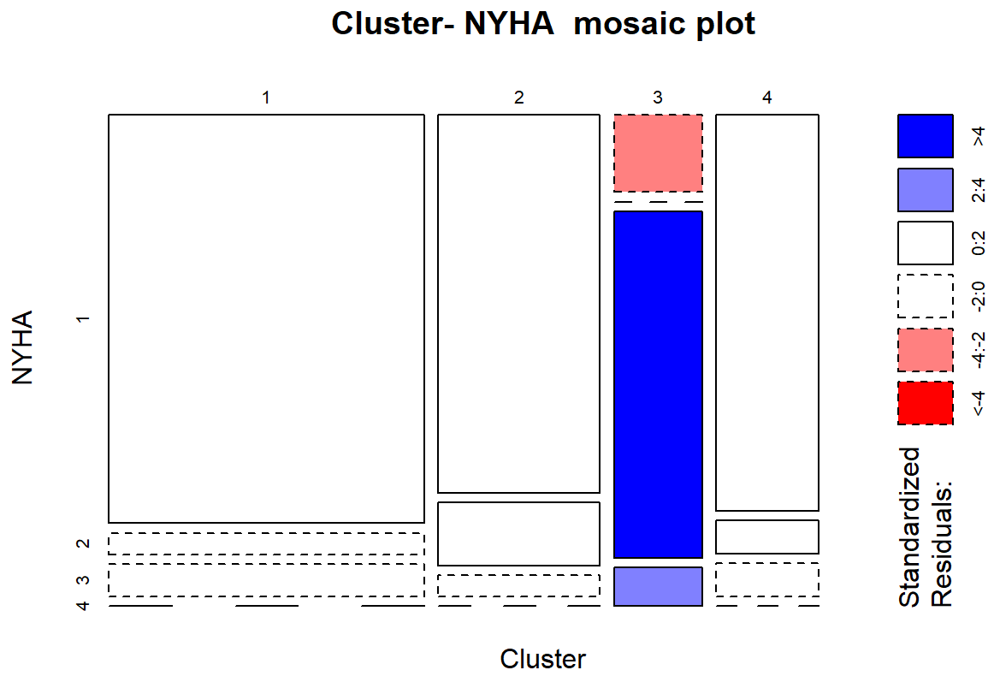
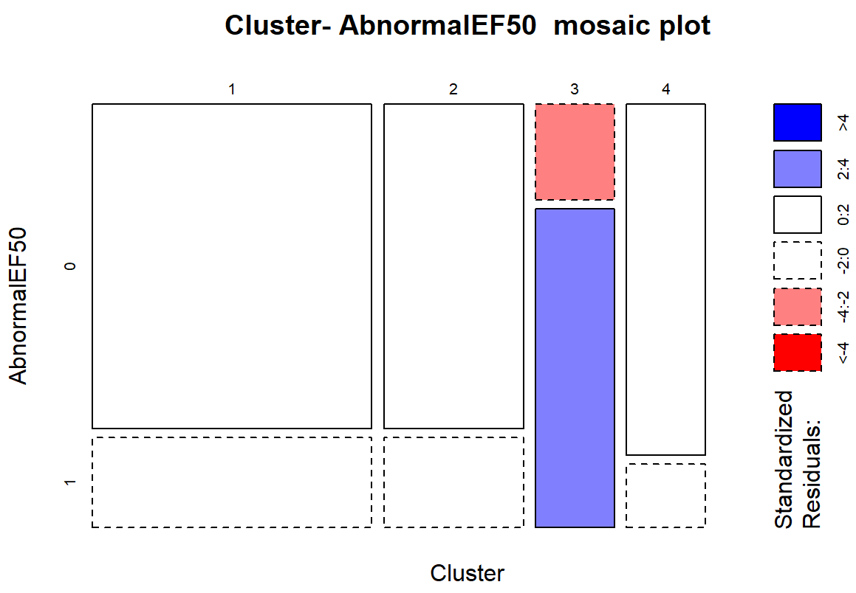
Test of Independence
Cluster vs NYHA
Cluster vs AbnormalEF50
comparison | raw.p | adj.p
1 vs. 2 | 0.5210 | 1.0000
1 vs. 3 | 0.0000 | 0.0000
1 vs. 4 | 1.0000 | 1.0000
2 vs. 3 | 0.0000 | 0.0000
2 vs. 4 | 1.0000 | 1.0000
3 vs. 4 | 0.0003 | 0.0018
comparison | raw.p | adj.p
1 vs. 2 | 1.0000 | 1.0000
1 vs. 3 | 0.0004 | 0.0027
1 vs. 4 | 1.0000 | 1.0000
2 vs. 3 | 0.0019 | 0.0117
2 vs. 4 | 1.0000 | 1.0000
3 vs. 4 | 0.0048 | 0.0290
More obs than expected under the null model
More obs than expected under the null model
Fewer obs than expected under the null model
Fewer obs than expected under the null model

Slide 19
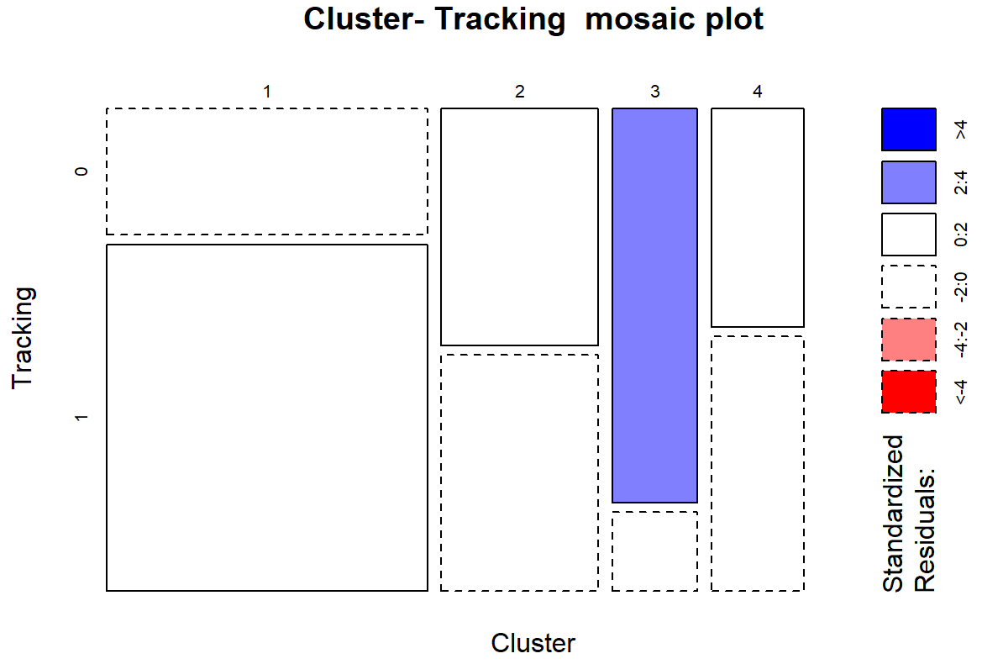
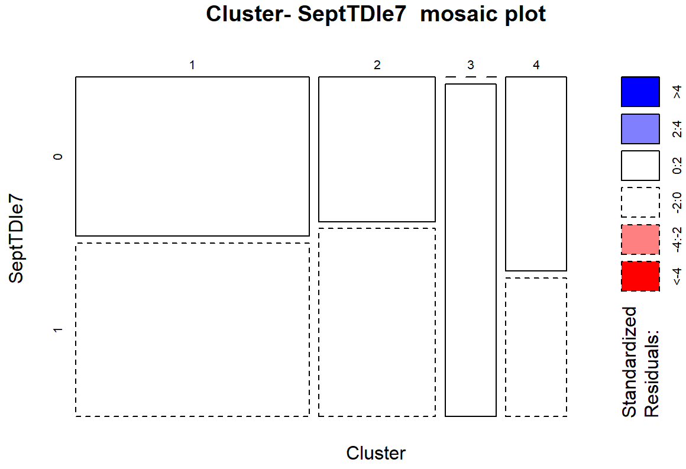
Test of Independence
Cluster vs Tracking
Cluster vs SeptTDIe7
comparison | raw.p | adj.p
1 vs. 2 | 0.0988 | 0.5930
1 vs. 3 | 0.0006 | 0.0035
1 vs. 4 | 0.1947 | 1.0000
2 vs. 3 | 0.0750 | 0.4498
2 vs. 4 | 1.0000 | 1.0000
3 vs. 4 | 0.0968 | 0.5811
comparison | raw.p | adj.p
1 vs. 2 | 0.8013 | 1.0000
1 vs. 3 | 0.0042 | 0.0251
1 vs. 4 | 0.7470 | 1.0000
2 vs. 3 | 0.0148 | 0.0887
2 vs. 4 | 0.4887 | 1.0000
3 vs. 4 | 0.0053 | 0.0321
More obs than expected under the null model
More obs than expected under the null model
Fewer obs than expected under the null model
Fewer obs than expected under the null model

Slide 20
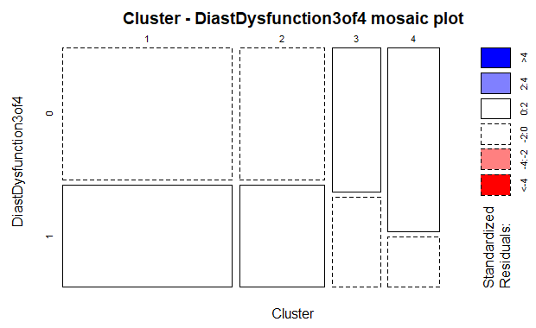
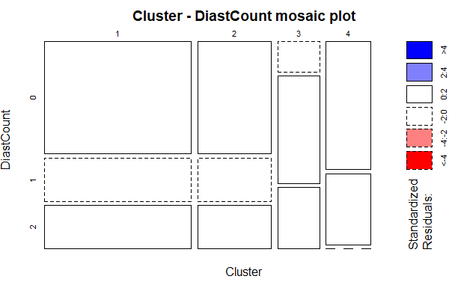
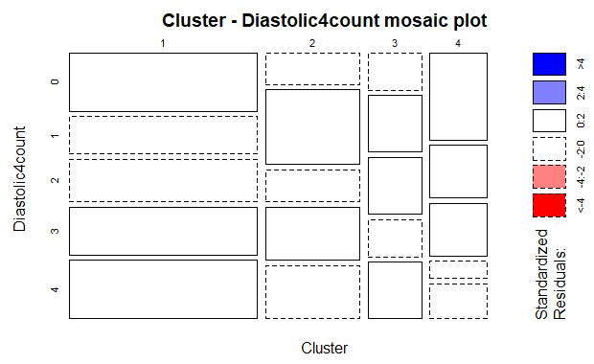
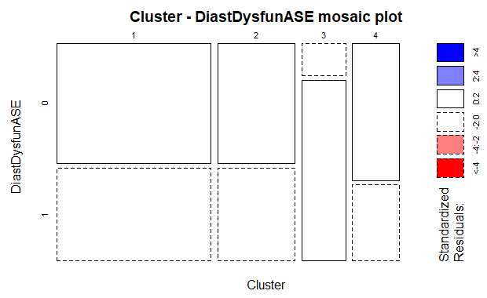
Diastolic Functions
Diastolic Dysfunction 3 of 4
Diastolic Count
Diastolic 4 Count
Diastolic Dysfunction ASE
p-value: 0.4985
p-value: 0.06059
p-value: 0.8932
p-value: 0.03851
comparison | raw.p | adj.p
1 vs. 2 | 1.0000 | 1.0000
1 vs. 3 | 0.0116 | 0.0699
1 vs. 4 | 0.7597 | 1.0000
2 vs. 3 | 0.0328 | 0.1971
2 vs. 4 | 0.7379 | 1.0000
3 vs. 4 | 0.0183 | 0.1098

Slide 21
Significant Difference in the Distributions of Values Among Cluster Groups
Variables | p-value
EchoDd | 0.0005895
EchoDs | 0.0008054
EchoEDV | 0.001283
EchoESV | 0.0003466
EchoEF | 0.002635
EchoTMfEwave | 0.04558
EchSepTDIe | 0.03306
EchoAveTDIe | 0.03434
TimePIVRRms | 0.00396
TimePIvEonset | 0.001009
TimePIvEpeak | 0.004059
TimeVSonset | 0.001588
TimePeakVSE | 0.007424
VortexArea | 7.31E-12
VortexIntensity | 5.42E-13
VortexDepth | 0.001747
VortexLength | 6.49E-09
EnergyDissipation | 4.83E-10
VorticityFluctuation | 7.29E-11
KineticEnergyFluctuation | 2.42E-07
ShearStressFluctuation | 0.002458

Slide 22
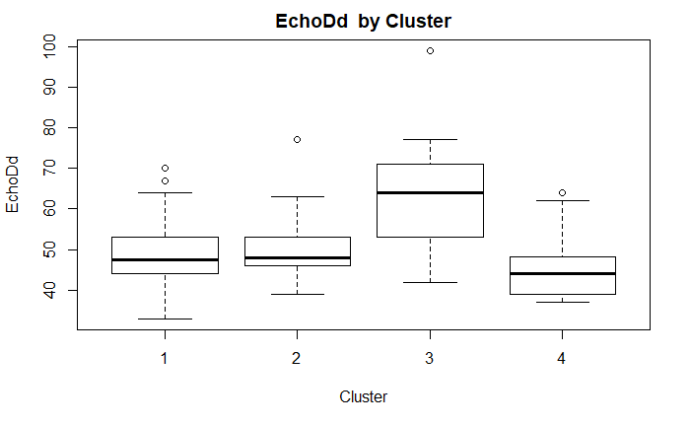
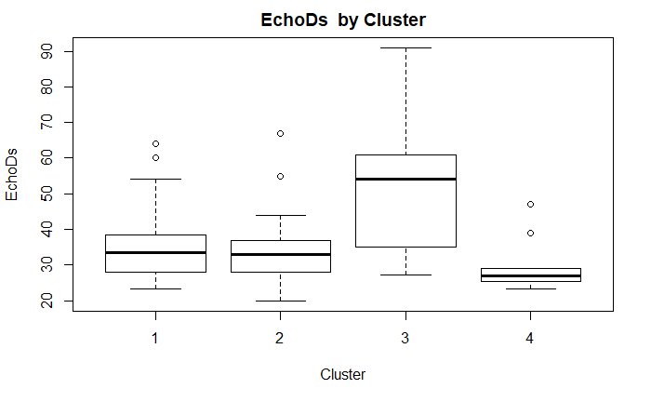
EchoDd | n | mean | sd | min | median | max
1 | 46 | 48.93778 | 7.611662 | 33 | 47.5 | 70
2 | 23 | 50.47826 | 8.223412 | 39 | 48 | 77
3 | 13 | 63.35385 | 15.10279 | 42 | 64 | 99
4 | 14 | 45.5 | 8.802178 | 37 | 44 | 64
EchoDs | n | mean | sd | min | median | max
1 | 46 | 35.2523 | 9.43629 | 23.2 | 33.55 | 64
2 | 23 | 34.4348 | 10.2462 | 20 | 33 | 67
3 | 13 | 50.3923 | 17.8709 | 27.1 | 54 | 91
4 | 14 | 29.7462 | 7.22745 | 23.3 | 27 | 47

Slide 23
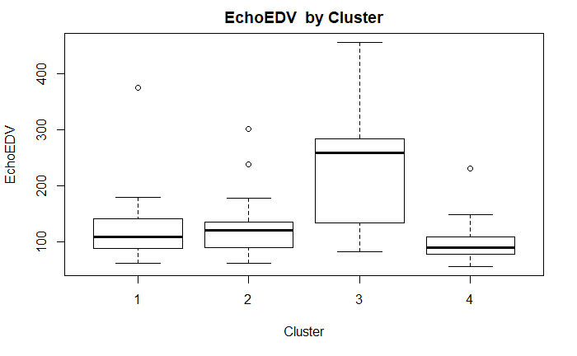
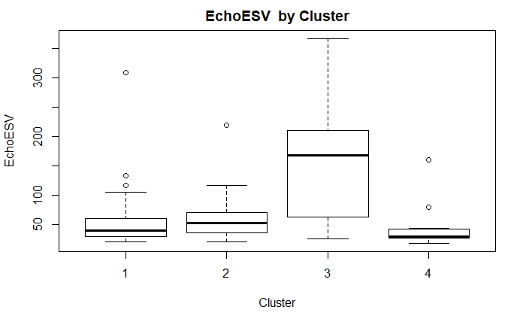
EchoEDV | n | mean | sd | min | median | max
1 | 46 | 117.2733 | 51.22395 | 63 | 109 | 374
2 | 23 | 128.6087 | 53.84383 | 63 | 121 | 302
3 | 13 | 235.5538 | 115.2898 | 83.2 | 259 | 455.5
4 | 14 | 102.3615 | 46.05308 | 57.2 | 89.9 | 231
EchoESV | n | mean | sd | min | median | max
1 | 46 | 54.66667 | 47.0001 | 21 | 40 | 309
2 | 23 | 62.08696 | 42.35125 | 20 | 53 | 219
3 | 13 | 160.9077 | 103.2027 | 25.3 | 168 | 366.5
4 | 14 | 44.68462 | 37.87428 | 18.3 | 30 | 160

Slide 24
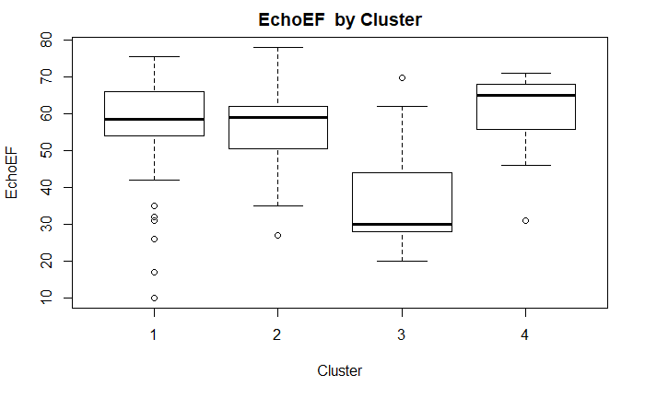
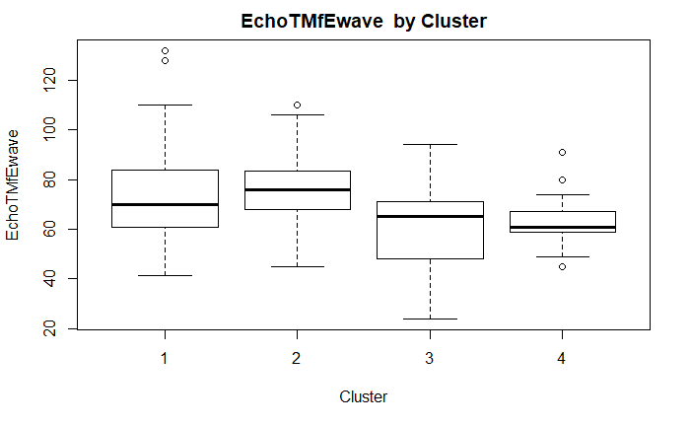
EchoEF | n | mean | sd | min | median | max
1 | 46 | 55.77587 | 14.99434 | 10 | 58.5 | 75.3
2 | 23 | 55.52174 | 11.06538 | 27 | 59 | 78
3 | 13 | 37.12308 | 15.94146 | 20 | 30 | 69.6
4 | 14 | 59.87154 | 11.4913 | 31 | 65 | 71
EchoTMfEwave | n | mean | sd | min | median | max
1 | 46 | 74.67333 | 20.61228 | 41.5 | 70 | 132
2 | 23 | 74.91304 | 16.31484 | 45 | 76 | 110
3 | 13 | 60.73077 | 18.5142 | 24 | 65 | 94
4 | 14 | 63.75385 | 12.42549 | 45 | 60.7 | 91

Slide 25
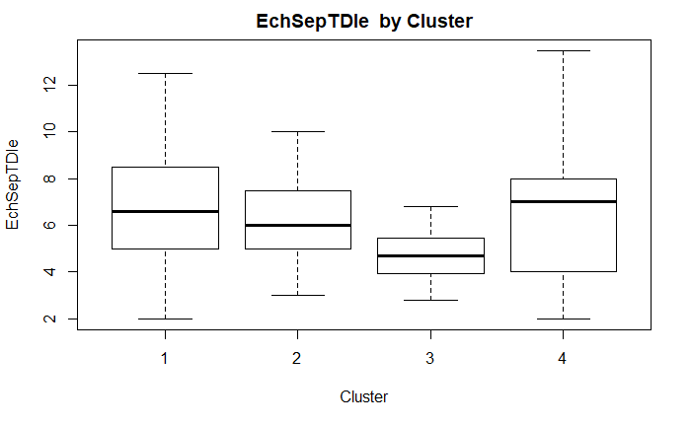
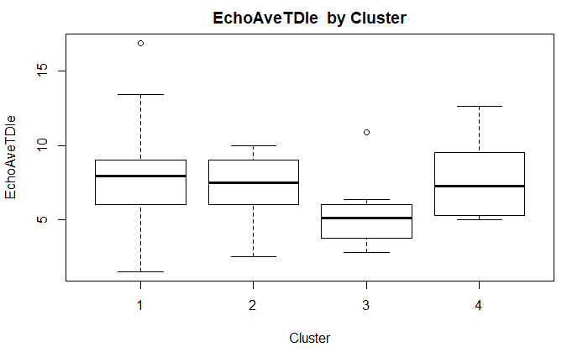
EchSeptTDIe | n | mean | sd | min | median | max
1 | 46 | 6.851739 | 2.542561 | 2 | 6.6 | 12.5
2 | 23 | 6.347826 | 1.873468 | 3 | 6 | 10
3 | 13 | 4.632 | 1.231131 | 2.8 | 4.69 | 6.82
4 | 14 | 6.545833 | 3.130642 | 2 | 7 | 13.5
EchoAveTDIe | n | mean | sd | min | median | max
1 | 46 | 7.764783 | 2.915246 | 1.5 | 7.95 | 16.9
2 | 23 | 7.23913 | 1.987858 | 2.5 | 7.5 | 10
3 | 13 | 5.285 | 2.30955 | 2.8 | 5.085 | 10.86
4 | 14 | 7.609583 | 2.381012 | 5 | 7.2625 | 12.65

Slide 26
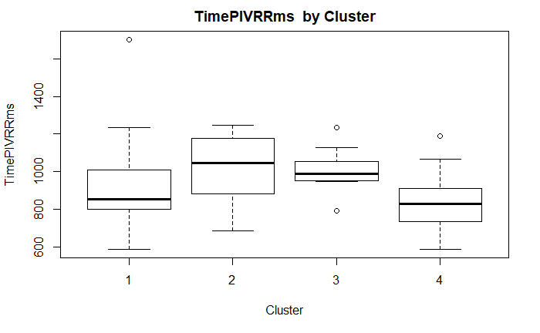
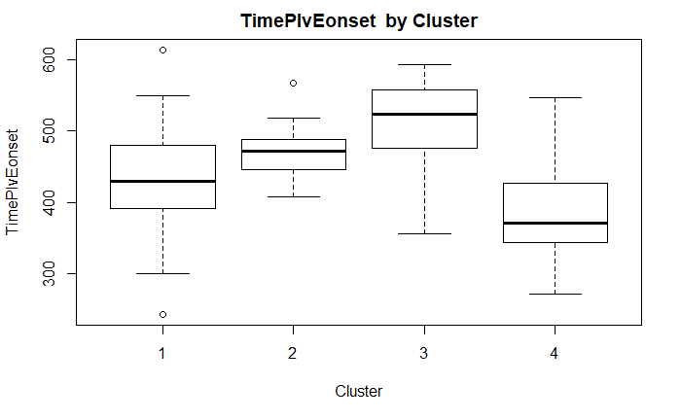
TimePIVRRms | n | mean | sd | min | median | max
1 | 46 | 900.4086 | 192.2972 | 586.87 | 850.815 | 1704
2 | 23 | 1014.515 | 171.0665 | 685 | 1043.775 | 1247.61
3 | 13 | 1011 | 117.1201 | 793 | 990 | 1233
4 | 14 | 831.1186 | 169.7252 | 586.87 | 827.37 | 1188
TimePIvEonset | n | mean | sd | min | median | max
1 | 46 | 436.1388 | 72.99198 | 242.79 | 429.63 | 614.06
2 | 23 | 471.3445 | 37.03478 | 408.05 | 471.905 | 567.9
3 | 13 | 506.983 | 68.61632 | 355.34 | 523.815 | 593.61
4 | 14 | 394.7323 | 86.63521 | 270.56 | 370.44 | 546.3

Slide 27
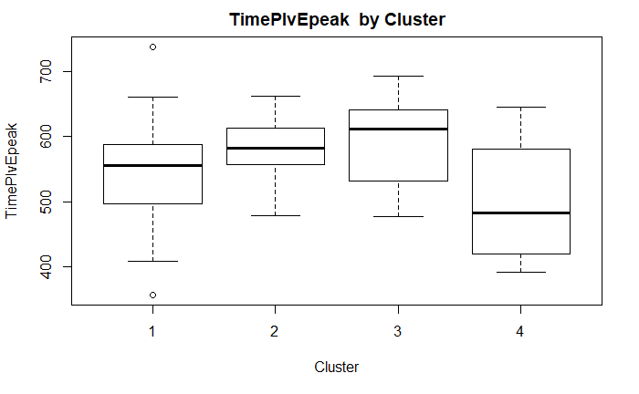
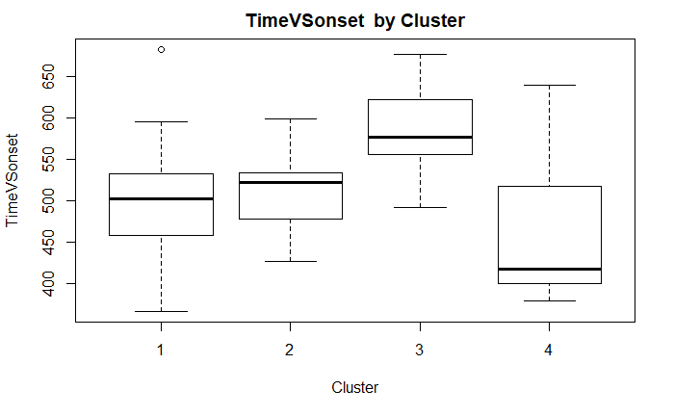
TimePIvEpeak | n | mean | sd | min | median | max
1 | 46 | 545.7871 | 77.75602 | 356.25 | 555.88 | 738.87
2 | 23 | 583.461 | 48.31251 | 477.76 | 582.125 | 662.29
3 | 13 | 596.184 | 67.5973 | 476.9 | 612.3 | 693.71
4 | 14 | 492.9677 | 85.5645 | 391.34 | 482.16 | 645.2
TimeVSonset | n | mean | sd | min | median | max
1 | 46 | 498.6757 | 59.93749 | 366 | 502 | 683
2 | 23 | 511.6 | 40.56626 | 426 | 521.5 | 599
3 | 13 | 584.5 | 56.9486 | 491 | 576.5 | 677
4 | 14 | 464.7273 | 89.20212 | 378 | 417 | 639

Slide 28
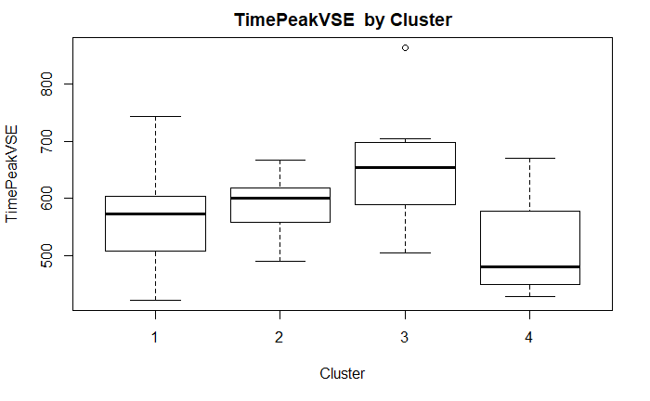
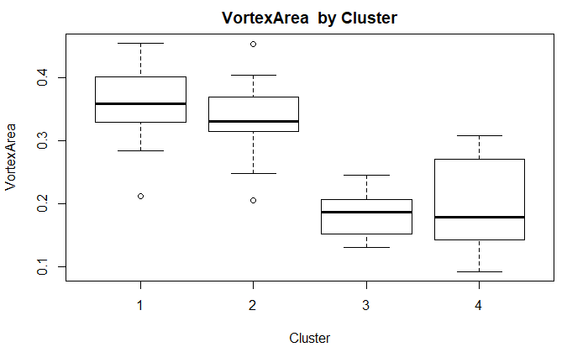
TimePeakVSE | n | mean | sd | min | median | max
1 | 46 | 569.5851 | 72.05922 | 422 | 573 | 743.8604
2 | 23 | 590.1151 | 49.82298 | 490 | 599.8599 | 667.0852
3 | 13 | 650.523 | 106.5127 | 504 | 653.3538 | 864
4 | 14 | 522.2017 | 86.93658 | 427.2049 | 480 | 670
VortexArea | n | mean | sd | min | median | max
1 | 46 | 0.360413 | 0.05117 | 0.2121 | 0.35835 | 0.4549
2 | 23 | 0.335191 | 0.055052 | 0.2059 | 0.331 | 0.4527
3 | 13 | 0.182192 | 0.035011 | 0.1315 | 0.1868 | 0.245
4 | 14 | 0.201871 | 0.071363 | 0.093 | 0.1796 | 0.3083

Slide 29
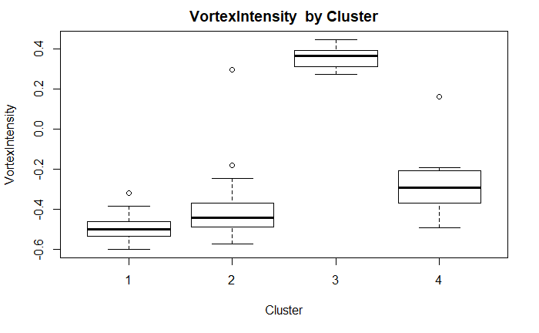
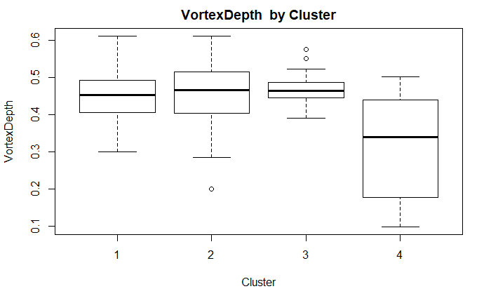
VortexIntensity | n | mean | sd | min | median | max
1 | 46 | -0.496135 | 0.059714 | -0.6 | -0.50025 | -0.3217
2 | 23 | -0.393648 | 0.175761 | -0.5739 | -0.4436 | 0.295
3 | 13 | 0.358431 | 0.054896 | 0.2737 | 0.364 | 0.4472
4 | 14 | -0.280007 | 0.157549 | -0.4935 | -0.29475 | 0.1611
VortexDepth | n | mean | sd | min | median | max
1 | 46 | 0.449854 | 0.072226 | 0.3008 | 0.45285 | 0.6118
2 | 23 | 0.447483 | 0.095817 | 0.2009 | 0.4661 | 0.6107
3 | 13 | 0.477877 | 0.048668 | 0.3914 | 0.4651 | 0.5748
4 | 14 | 0.313729 | 0.13844 | 0.099 | 0.3396 | 0.5013

Slide 30
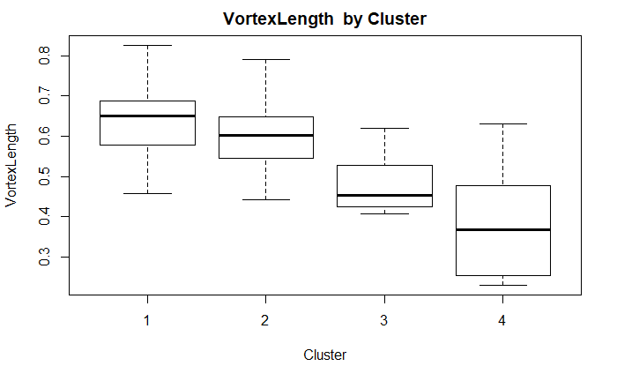
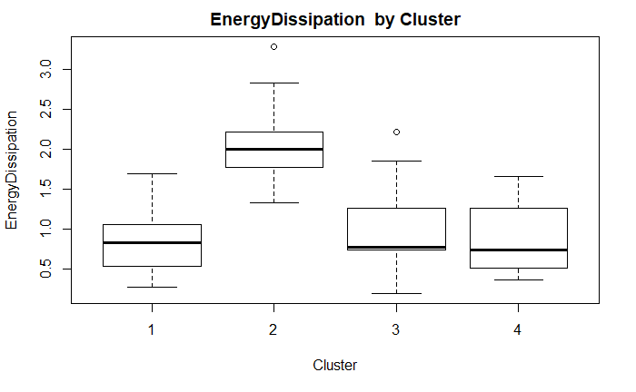
VortexLength | n | mean | sd | min | median | max
1 | 46 | 0.631107 | 0.083984 | 0.458 | 0.6497 | 0.8262
2 | 23 | 0.5942 | 0.081104 | 0.4431 | 0.6011 | 0.7904
3 | 13 | 0.478923 | 0.066867 | 0.4082 | 0.4535 | 0.6187
4 | 14 | 0.392571 | 0.128529 | 0.2305 | 0.36835 | 0.6317
EnergyDissipation | n | mean | sd | min | median | max
1 | 46 | 0.85085 | 0.374946 | 0.2696 | 0.8193 | 1.6911
2 | 23 | 2.042978 | 0.486811 | 1.324 | 1.9904 | 3.2823
3 | 13 | 1.010239 | 0.545724 | 0.1912 | 0.7661 | 2.2113
4 | 14 | 0.866629 | 0.424765 | 0.3532 | 0.72855 | 1.6533

Slide 31
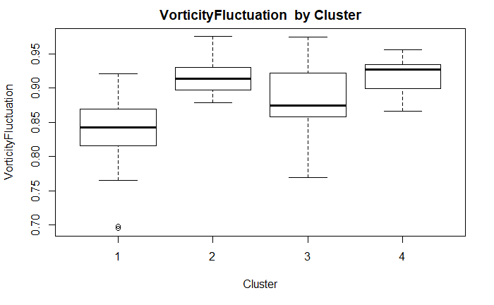
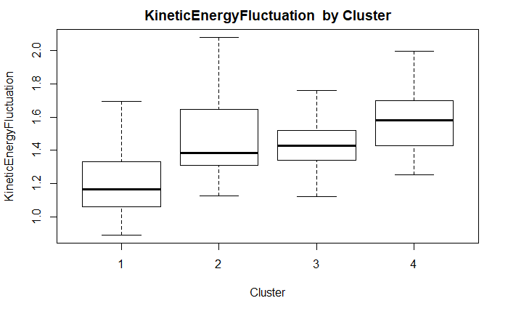
VorticityFluctuation | n | mean | sd | min | median | max
1 | 46 | 0.836737 | 0.046688 | 0.6954 | 0.8422 | 0.9209
2 | 23 | 0.915391 | 0.023267 | 0.8788 | 0.9137 | 0.9757
3 | 13 | 0.879908 | 0.056613 | 0.7694 | 0.8739 | 0.9743
4 | 14 | 0.91785 | 0.027156 | 0.8665 | 0.92655 | 0.9563
KineticEnergyFluctuation | n | mean | sd | min | median | max
1 | 46 | 1.208117 | 0.200947 | 0.8944 | 1.16545 | 1.6946
2 | 23 | 1.467665 | 0.241855 | 1.1265 | 1.383 | 2.0779
3 | 13 | 1.430777 | 0.178781 | 1.1225 | 1.427 | 1.7584
4 | 14 | 1.576093 | 0.190646 | 1.2538 | 1.5792 | 1.9925

Slide 32
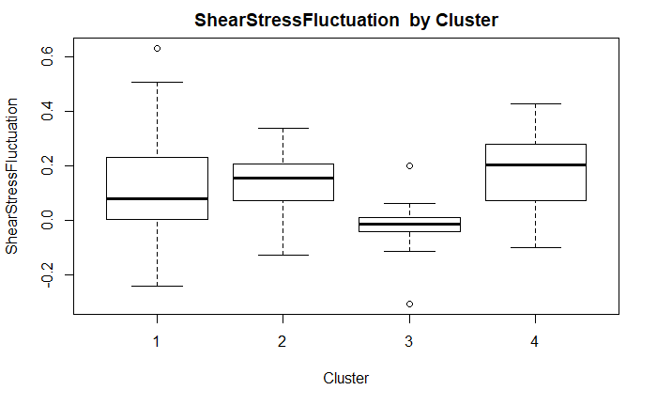
ShearStressFluctuation | n | mean | sd | min | median | max
1 | 46 | 0.116102 | 0.174849 | -0.2394 | 0.0815 | 0.6324
2 | 23 | 0.132735 | 0.117901 | -0.1245 | 0.1552 | 0.338
3 | 13 | -0.019169 | 0.113325 | -0.3042 | -0.0111 | 0.2023
4 | 14 | 0.172514 | 0.147677 | -0.0985 | 0.2032 | 0.4272

Slide 33
Clusters and Cases
Cluster 1
Cluster 2
Cluster 3
Cluster 4
Cases | NYHA | Abnormal EF50
1 | 1 | 0
2 | 1 | 0
3 | 1 | 0
5 | 1 | 0
6 | 1 | 0
7 | 1 | 0
9 | 1 | 0
10 | 1 | 1
12 | 1 | 0
14 | 1 | 0
18 | 1 | 0
⁞ | ⁞ | ⁞
95 | 3 | 1
96 | NA | 1
Cases | NYHA | Abnormal EF50
4 | 1 | 0
8 | 1 | 0
11 | 1 | 0
13 | 1 | 0
16 | 1 | 0
30 | 1 | 1
47 | 1 | 0
48 | 1 | 0
49 | 1 | 0
55 | 1 | 0
57 | 2 | 0
⁞ | ⁞ | ⁞
88 | 1 | 0
89 | 1 | 0
Cases | NYHA | Abnormal EF50
15 | NA | 0
23 | 1 | 0
32 | 3 | 1
33 | 3 | 1
34 | 3 | 1
35 | 3 | 1
36 | 1 | 0
77 | 3 | 1
78 | 3 | 1
79 | 3 | 1
90 | 4 | 1
91 | 3 | 1
92 | 3 | 1
Cases | NYHA | Abnormal EF50
17 | 1 | NA
19 | 1 | 0
25 | 1 | 0
26 | 1 | 0
31 | 1 | 0
42 | 1 | 0
50 | 1 | 0
53 | 1 | 0
54 | 1 | 0
62 | 3 | 1
76 | 2 | 1
80 | 1 | 0
84 | 1 | 0
93 | 1 | 0

Slide 34
END

